Slide 1
Instructions for the Data Analysis Demos
1
You have 3 minutes to present – load your slides into PowerPoint (or whatever program you use), put it into “slide show” mode so the slides are full-screen (without the toolbar, etc.), and be ready to share your screen when your group is called. Practice first! There are five people in your group: hold a short Zoom session to practice sharing in full-screen presentation mode. We can only offer you one opportunity to present so make the most of it.
The next few slides give you all the alternatives for how to present your Data Analysis for swift feedback. Select only the slides that fit your RQ. Before presenting DELETE all slides and text (and instructions) that you do not use (including this slide). You can then enlarge your selection, so it is clearly visible on the slide.
Appointment slots will appear on Canvas soon (calendar) and will take place on Monday during your usual tutorial slots. Sign up early. When space runs out, we cannot issue any further slots. If you do not turn up at the start of your slot you will not be given another opportunity. All the group members should attend but select one person to present. DO NOT SIGN UP unless you can attend. You will not be graded on this presentation but if you do not attend your booked space, your group will have 5 points deducted from the Data Analysis assignment.
At this point we assume you are using your allocated datasets. We are not going to check during the presentation, but your assignment will not be graded if the dataset you use in the analysis has not been allocated to your group.
We look forward to giving you feedback. If your group is not presenting, still attend the tutorial as the feedback will help you too.

Slide 2
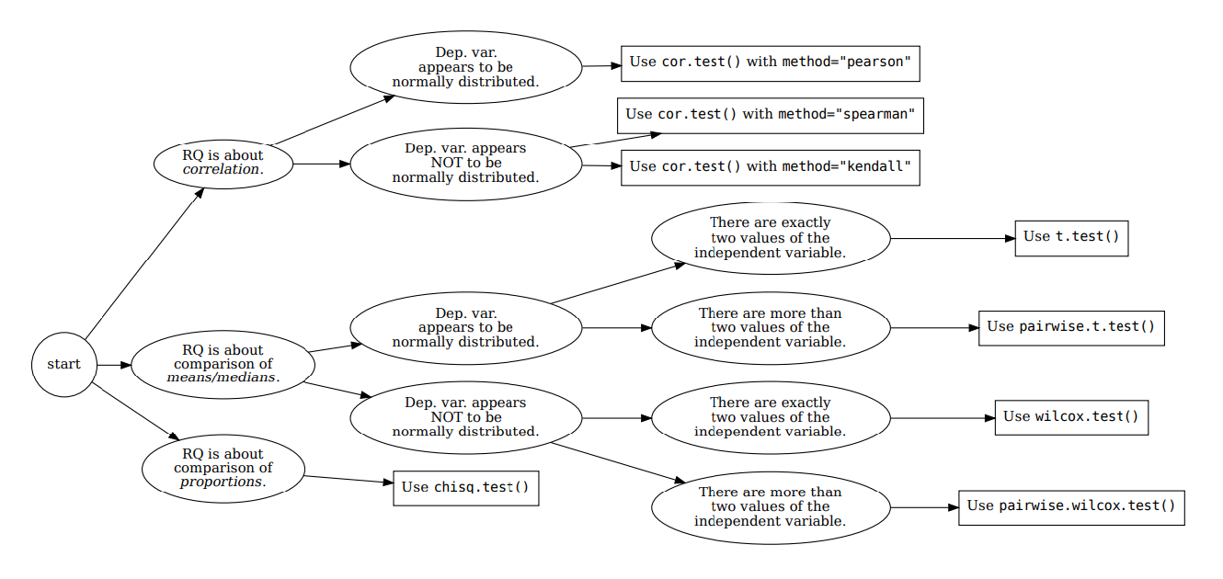







How your RQ + distribution of data (Histogram) leads to a statistical test. Visualization requirements highlighted in yellow.
Histogram & Scatterplots
Histogram and Boxplots
Stacked bar chart (no histogram)
Figure: Decision tree – how Research Questions relate to Visualizations and Statistical Test.

Slide 3

7COM1079-2022 Student Group No: Names of Student Attendees (all group should attend to get feedback):
3
Group Id: Name of Student Presenting:
Data Analysis – Tutorial Presentation for Feedback Date:

Slide 4
7COM1079-2022 Student Group ID:
We are using the dataset (replace this text with your Kaggle K number and csv file name.) to answer our Research question (replace this text with your RQ …… starting, “Is there a …. ” ¹
4
Include a sample of your .csv dataset to include the column names (variables) in your RQ².
List the following: for example
The dataset has 655 rows
The dependent variable³ is Valuation ($B)
The independent variable⁴ is Country
Company | Valuation ($B) | Date Joined | Country
Bytedance | $140 | 4/7/2017 | China
SpaceX | $100.3 | 12/1/2012 | United States
Stripe | $95 | 1/23/2014 | United States
Klarna | $45.6 | 12/12/2011 | Sweden
Epic Games | $42 | 10/26/2018 | United States
Canva | $40 | 1/8/2018 | Australia
Checkout.com | $40 | 5/2/2019 | United Kingdom
Instacart | $39 | 12/30/2014 | United States
Databricks | $38 | 2/5/2019 | United States
Revolut | $33 | 4/26/2018 | United Kingdom
Chime | $25 | 3/5/2019 | United States
¹ Follow one of the three prescribed RQ Templates – If you do not have a correctly formulated RQ, we will stop your presentation here.
² The variable name in your RQ may differ from the column name in cases where the column names are abbreviations.
^{3.4.}Be sure to identify which variable is your dependent variable and which one is your independent variable on this slide
Notes:
4

Slide 5
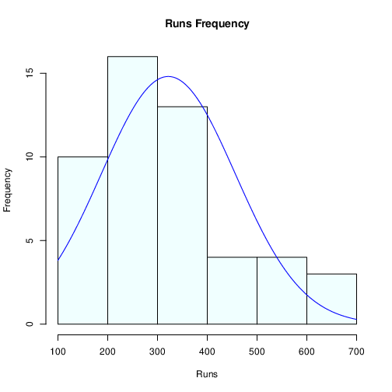
Here is a Histogram showing the frequencies of our dependent variable to include the normal curve overlay.
Our RQ asks about differences in means/ medians
For example:
Choose one:
1. The normal curve overlay follows the contours of the underlying data, so we use the parametric test: t-test.
OR
2. The normal curve overlay does not follow the shape of the underlying data, so we use the non-parametric test that does not assume normality: Wilcoxon also known as the Mann Whitney U Test.
The example here is borderline, in terms of shape, so when in doubt choose the non-parametric equivalent.
5

Slide 6
Here is a Histogram showing the frequencies of our dependent variable to include the normal curve overlay.
Our RQ asks about Correlation
For example:
Choose one:
1. The blue normal curve overlay follows the contours of the underlying data, so for our analysis we will use a parametric test for correlation: Pearson’s r
OR
The normal curve overlay does not follow the shape of the underlying data, so for our analysis we use the non-parametric test for correlation that does not assume normality: Spearman’s Rho or Kendal’s Tau
The example here is borderline, in terms of shape, so when in doubt choose the non-parametric equivalent.
6
Notes:
6

Slide 7
Here is a table (matrix/cross tabulation) showing our dependent variable as rows, and our independent variable as columns. We have at least two values for both variables that are independent of each other (no overlap).
For example:
Our RQ is about differences in proportions
Reason for absenteeism (Sample 16,550)
Age group | Operation | Stress | Physical Illness | Strike | Maternity / paternity | Holiday
16 -25 | 50 | 150 | 25 | 60 | 200 | 6000
26- 35 | 60 | 100 | 40 | 40 | 500 | 6000
36 -45 | 80 | 300 | 60 | 100 | 400 | 6000
46 -55 | 60 | 200 | 80 | 80 | 200 | 6000
56 - 65 | 100 | 250 | 100 | 120 | 100 | 6000
Over 65 | 90 | 80 | 80 | 55 | 0 | 6000
For comparison of proportions analysis, we will use a chi-square test to check for the likelihood that there is a relationship between the two nominal variables (reason for absenteeism and age group in example). This non-parametric test makes no assumptions about the shape of the data (which is nominal, not interval) so we do not include a histogram for this test.
7
Notes:
7

Slide 8
R Script and Results (For ALL types of test) – The Analysis
PRE 7COM1079-2022 Student Group No: ?????
8
Include a snippet of the R code you use to calculate your test statistic.
Give the value of the test statistic.
Tell us the p-value. Is it > or < 0.05?
Is the result significant?
Do you accept or reject the null hypothesis?
What does the result actually mean in the wider context of learning something useful / answering your RQ?
Notes:
8

