Slide 1
Howland Current Source

Slide 2

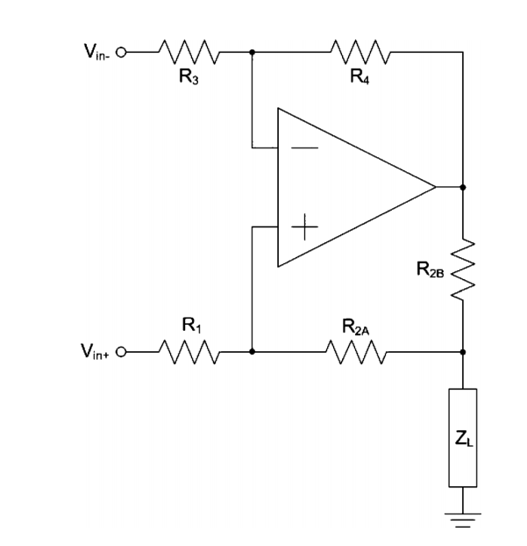
Balanced resistor bridge

Slide 3
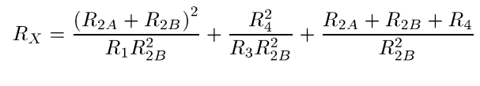
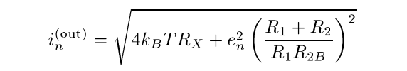
Output-referred current noise density

Slide 4
Noise dependencies (individual sweep)
R1 ↑ , Noise ↓
R2A ↑ , Noise ↑
R2B ↑ , Noise ↓
R3 ↑ , Noise ↓
R4 ↑ , Noise ↑

Slide 5
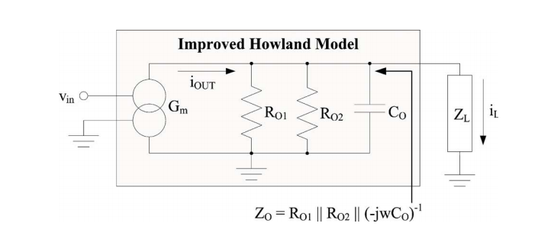
Modelling non-idealities of Howland current source
R_{O1} – resistor bridge mismatch
R_{O2} – Op-amp finite open-loop gain
C_{o} – Op-amp finite bandwidth

Slide 6
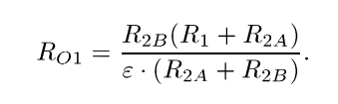
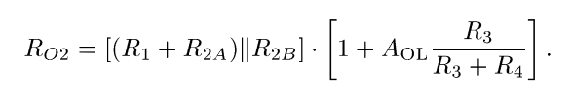
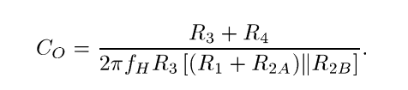
Selecting resistances
X_{Co},R_{O1},R_{O2} >> Z_{L}

Slide 7
Output impedance dependencies

Slide 8
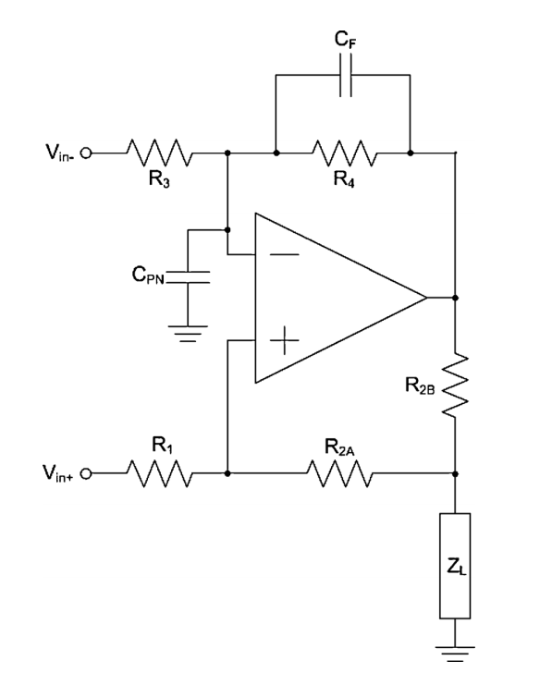
Parasitic capacitance of input terminals
AD797 – 20pF
C_{f} in parallel with R4 for stability compensation

Slide 9
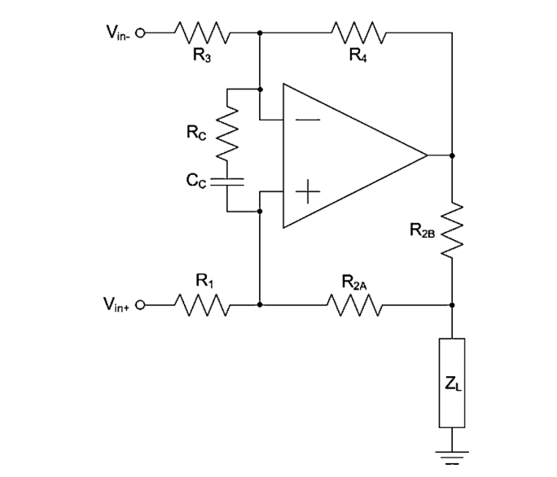
Lead-lag compensation

