Slide 1
MatLab Tone Generator Model

Slide 2
Block diagram
DAC
Attenuator
Filter

Slide 3
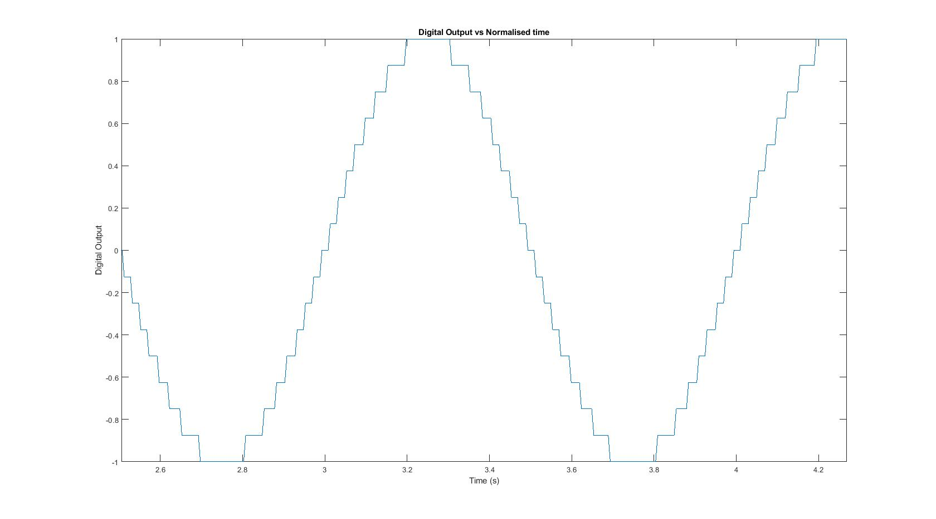
ADC Output

Slide 4
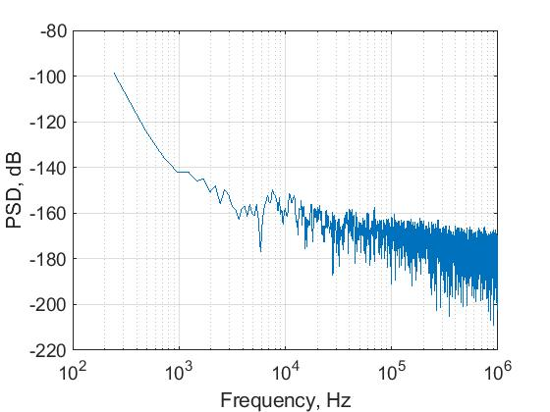
DAC Noise
Corner frequency = 10⁴ Hz
Thermal noise = 10⁻⁹ Hz or
-220dB

Slide 5
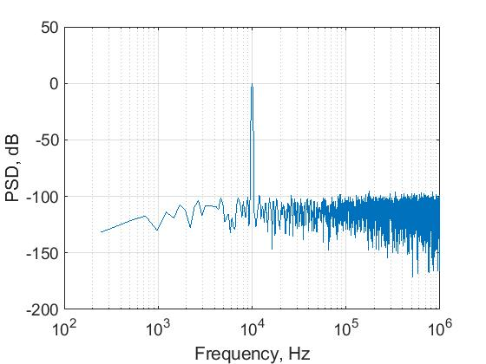
DAC Output
f_{in} = 10⁴ Hz
Sin wave of amplitude 1

Slide 6
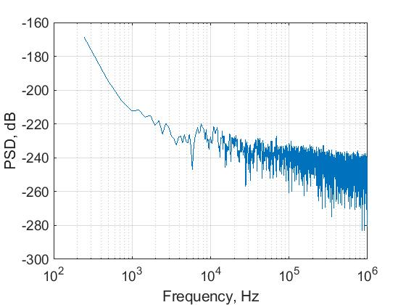
Attenuator Noise
Corner frequency = 10⁵ Hz
Thermal noise = 10⁻¹³ A/sqrt(Hz) or -260dB

Slide 7
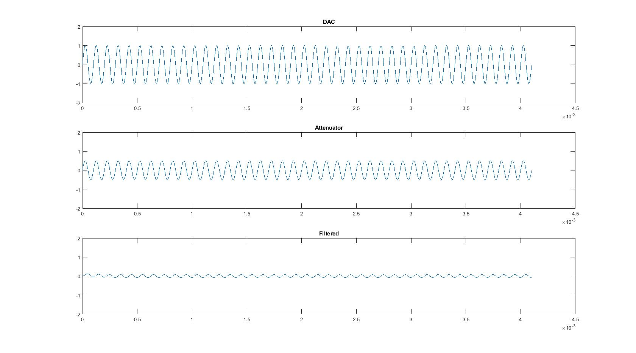
All Outputs

Slide 8
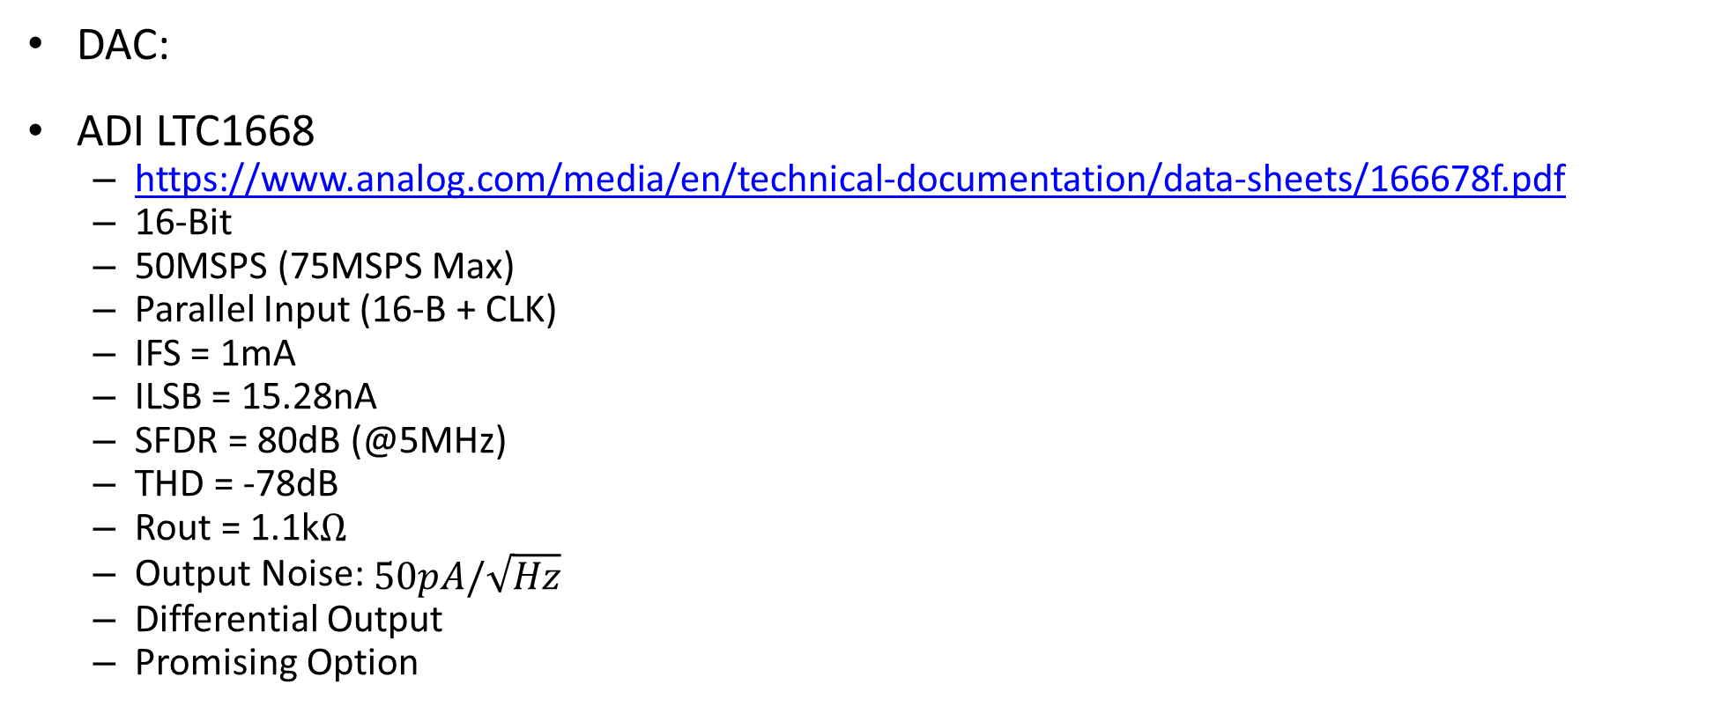
Possible DAC
DAC:
ADI LTC1668
https://www.analog.com/media/en/technical-documentation/data-sheets/166678f.pdf
16-Bit
50MSPS (75MSPS Max)
Parallel Input (16-B + CLK)
IFS = 1mA
ILSB = 15.28nA
SFDR = 80dB (@5MHz)
THD = -78dB
Rout = 1.1k$Ω$
Output Noise: $50pA/\sqrt{Hz}$
Differential Output
Promising Option

Slide 9
Possible Current Conveyor
https://datasheets.maximintegrated.com/en/ds/MAX4112-MAX4120.pdf
Anthony will discuss thoughts on this…

Slide 10
Current Mode Filtering

Slide 11
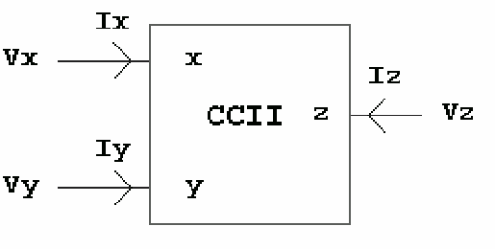
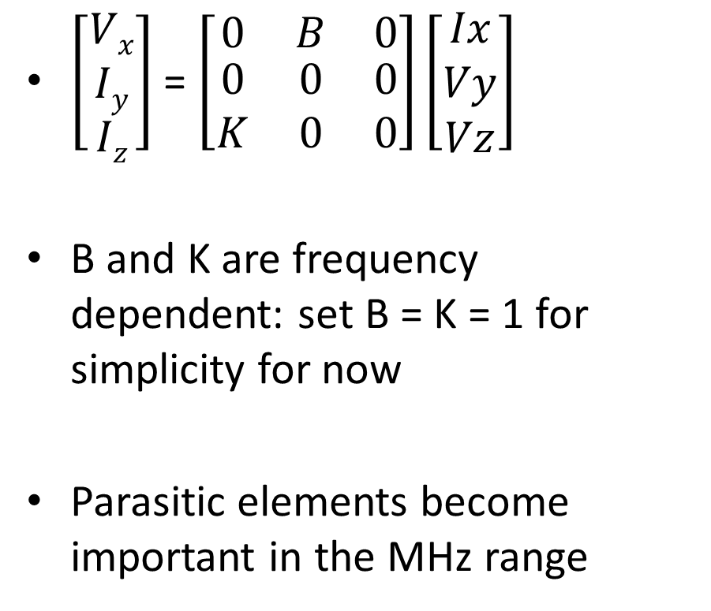
Current conveyors (CCII)
$\left[\begin{aligned}Vx \\ Iy \\ Iz\end{aligned}\right]$ = $\left[\begin{matrix}0 & B & 0 \\ \begin{aligned}0 \\ K\end{aligned} & \begin{aligned}0 \\ 0\end{aligned} & \begin{aligned}0 \\ 0\end{aligned}\end{matrix}\right]\left[\begin{aligned}Ix \\ Vy \\ Vz\end{aligned}\right]$
B and K are frequency dependent: set B = K = 1 for simplicity for now
Parasitic elements become important in the MHz range

Slide 12
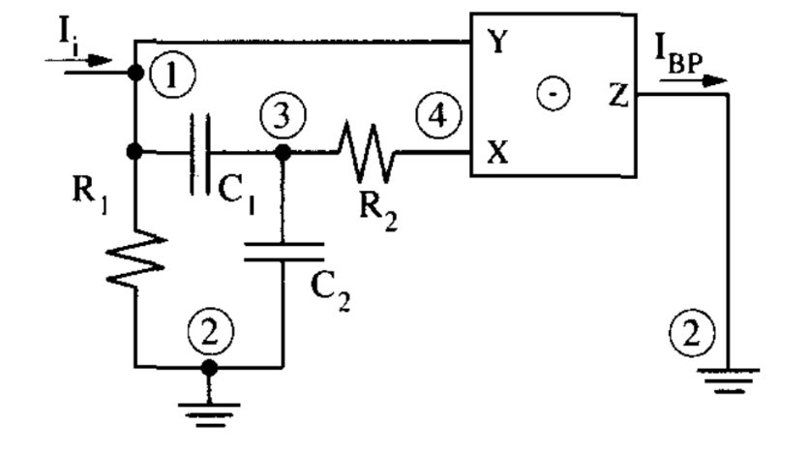

Current-mode bandpass filter using passive components
Assuming I_{y} = 0, K = B = 1
$\frac{Io\left(s\right)}{Iin\left(s\right)}=\frac{\left(−\frac{G2}{C1}\right)s}{s^{2}+\left(\frac{G1}{C2}+\frac{G1}{C1}\right)s+\frac{G1G2}{C1C2}}$
Current conveyor filters: classification and review, Ahmed M. Soliman Microelectronics Journal 1998

Slide 13
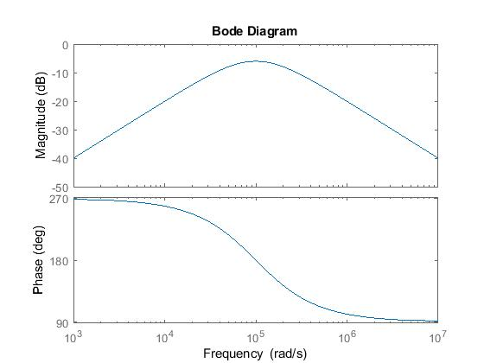
Bandpass Filter Bode Plot

