Slide 1
MEDIKOS
FIND
First-aid kits and Medicinal storages are now smarter than ever

Slide 2
TABLE OF CONTENTS
01
04
About the Project
Have a First LOOK!
02
05
User Research
We have crossed this far!
03
06
Problem Statement
Soon…
The basics that made the idea come to reality
The prototyping phase is on and we are showing you some of the basic model structure
You inspired us to make this. Wonder how? Jump in!
There have been a lot of effort to put up to this and we are showing you the methods
After some digging in to the mark and analysing some points, we came to this conclusion
We would be hoisting out flag soon!

Slide 3
MAIN MOTIVE
MEDIKOS
We just want a simple thing to do. We want to make a device take care of your medical needs. Why wander here and there to find out your medical kit. We have a perfect solution for your all-in-one medical needs, for a day-to-day life consideration. Also, there might be some special surprise!

Slide 4
DOMAINS
DESIGN
PROTOTYPE
UI DEVELOPMENT
Mercury is the closest planet to the Sun
Despite being red, Mars is a cold place, not hot
Neptune is the farthest planet from the Sun

Slide 5
ABOUT THE PROJECT
01.
Medikos – A multidisciplinary project designed to improve the storage and conditions of medical kits at home. Medical kits are important for every house and making them smart is the next bog thing for making the effective storage and transmission of medicines. The project aims to provide an interactive UI. Using the same, the user can select the type of problem they have and hence can get the exact medicine, based on their condition.

Slide 6
USER RESEARCH
02.
About 75% of the people tend to forget their medication
Patients are afraid that if wrong medication is taken then it might lead to adverse effects
Close to 90 million of Americans have inadequate health literacy itself

Slide 7
USER PERSONA
Name: Michael
Age: 61 Years
Sex: Male
Marital Status: Married
Children: 01
Any Heath-Problem: Blood Pressure
Any Medication: Pressure Tablets (Daily)
Frustrations:
- Remembering tablets
- Fear about taking the wrong medication
- Always serious about everything, might lead to pressure problems
Solutions expected:
- Want to get rid of those memorising
- Someone should be there for giving the right medicine

Slide 8
USER PERSONA
Name: Kirsty
Age: 44 Years
Sex: Female
Marital Status: Married
Children: 01
Any Heath-Problem: No
Any Medication: No (As of now)
Frustrations:
- Storing the Medicines
- Contacting doctor
- What to do in case of an emergency?
Solutions expected:
- Keep in touch with specialised doctors
- Sufficient First-aid kit ailments

Slide 9
USER PERSONA
Name: Jake
Age: 21 Years
Sex: Male
Marital Status: Unmarried
Children: 00
Any Heath-Problem: No
Any Medication: No
Frustrations:
- Always Cuts because of outdoor acts
- Constantly busy
- Shortage of time to keep track on health
Solutions expected:
- Need someone to take care of the medicine remembering
- Doctors should be there, right a call away

Slide 10
PROBLEM STATEMENT
Upon subjective analysis, it has been found that most of the user demand the a new collaborative system that might solve the idea of user interaction difficult and provide a new set of intuitive and functional device that:
Memorizes the timings of the medicine
Stores the Medicine
Keep in touch with the doctors
Keep sufficient stock of first-aid kits and other medical needs

Slide 11
OUR GOALS
EXPANSION
FUNCTIONALITY
USABILITY
Cover all your day-to-day medical needs, keeping provision for special cases as well
With a minimalist and swift UI, the interaction becomes less hectic and more intuitive
A day-to-day useful device that would communicate with the patient

Slide 12
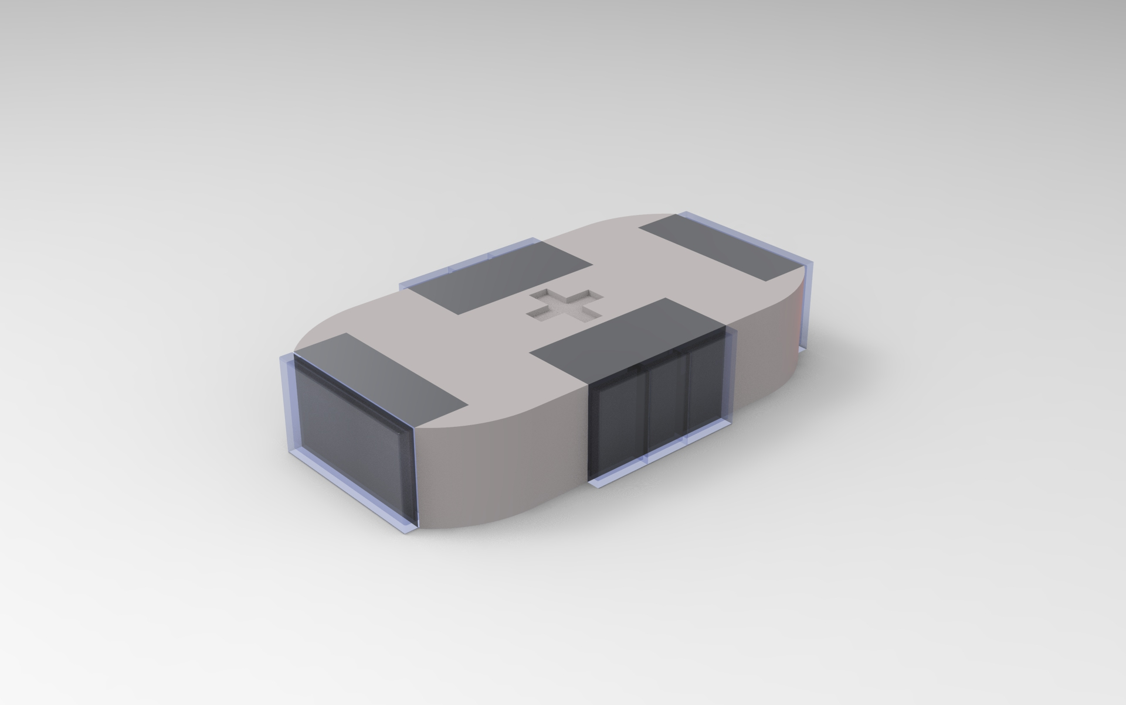
FIRST LOOK
The isometric view showing the various container styles of the device. The device would be able to store 6 different kinds of medicines based upon the choices created, concerning some frequent illnesses. 2 extra containers for the storing some accessories and first-aid kits (subjected to change*)

Slide 13
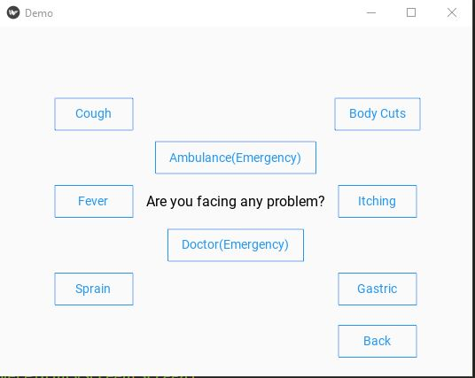
HOW FAR?
Considering the frequent cases of illness found in every households, the following interface has been deduced that would simply act as a method to act in between the user and the device. This method would ensure the correct medicines

Slide 14
HOW FAR?
Next, there would be specific modelling for the device and slots would be made for fitting the interface along with the device. The device modules are almost finalised and the prototyping phase would start just after the modules kept in place…

Slide 15
COMING SOON
06.
The product would be launched soon

Slide 16
THANKS!
Does anyone have any question?
addyouremail@freepik.com
+91 9774225982
tanmaydebnath@outlook.in

