Slide 1
SCOPE
Orders Platform Review
Checkout to fulfilment
DECISION
Pick a message broker
Architecture, performance and vendor choice
OUTCOME
Engineering | Q4 planning
Roadmap for 2 quarters

Slide 2
Agenda
Where we are
Choosing a broker
1
4
KPIs and trend
Comparison and trade-offs
How it works
Pricing options
2
5
Flows and data model
Plans for rollout
Architecture
Roadmap
3
6
Layers and dependencies
Next two quarters

Slide 3
Orders are growing, latency is not
Last 6 months
ORDERS / DAY
P95 LATENCY
ERROR RATE
UPTIME
182k
310 ms
0.42%
99.97%
+24% vs H1
-18%
-0.1 pt
SLO 99.9%
Takeaways
Peak load is 2.3x the daily average
Checkout drives 71% of traffic
Queue depth is the main scaling limit

Slide 4
Service ownership and SLOs
Seven core services
Service | Owner | Language | p95 (ms) | SLO | Status
Checkout | Payments | Java | 240 | 99.95% | Healthy
Catalog | Discovery | Go | 90 | 99.9% | Healthy
Inventory | Supply | Go | 130 | 99.9% | At risk
Pricing | Discovery | Kotlin | 160 | 99.9% | Healthy
Orders | Fulfilment | Java | 310 | 99.95% | At risk
Shipping | Fulfilment | Python | 280 | 99.5% | Healthy
Notifications | Growth | Node | 75 | 99% | Healthy
Latency measured at the gateway over the last 30 days.

Slide 5
Place order: sequence
Happy path through checkout
Client
Gateway
Orders
Payments
Broker
Key points
POST /orders
Payment is synchronous
Fulfilment is async via the broker
Failures roll back before the event
createOrder()
authorize(card)
approved
persist order
OrderPlaced
201 Created
order id
Notes:
Payment is **synchronous**,Fulfilment is **async** via the broker,Failures roll back before the event

Slide 6
Domain model: class diagram
Customer
- id: UUID
- email: String
Order
- id: UUID
- status: Status
- total: Money
+ place()
+ cancel()
OrderLine
«interface»
Payment
- sku: String
- qty: int
+ subtotal(): Money
+ authorize(): Result
CardPayment
WalletPayment
- token: String
- walletId: String
+ authorize(): Result
+ authorize(): Result

Slide 7
Platform architecture
Layers and main dependencies
Clients
Web app
Mobile app
Partner API
Edge
API gateway
auth, rate limits
Services
Orders
Payments
Inventory
Shipping
Data
PostgreSQL
Message broker
Redis

Slide 8
Order lifecycle: state machine
Paid
payment ok
picked
handover
Created
Packed
Shipped
Delivered
timeout
Cancelled
Native shapes: every box and arrow is editable in PowerPoint.

Slide 9
Data model: ER diagram
orders
PK | id | uuid
FK | customer_id | uuid
 | status | text
 | total | numeric
N
1
customers
PK | id | uuid
 | email | text
 | created_at | timestamp
order_lines
PK | id | uuid
FK | order_id | uuid
FK | sku | text
 | qty | int
1
N
N
products
PK | sku | text
 | title | text
 | price | numeric
1

Slide 10
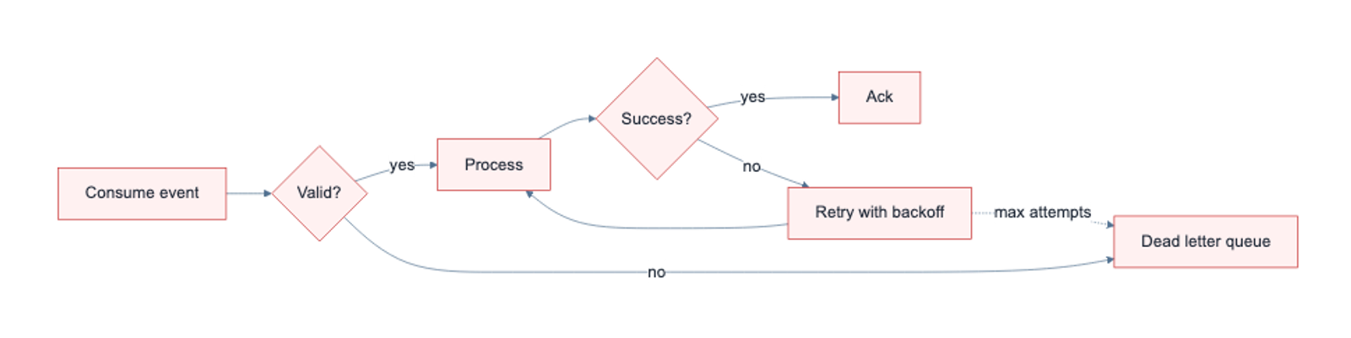
Retry flow (Mermaid)
Rendered with Mermaid for complex layouts

Slide 11
Message broker comparison
Scored against our requirements
 | Kafka | RabbitMQ | SQS + SNS | Pulsar
Capabilities
Ordering guarantees | ● | Per queue | FIFO only | ●
Replay events | ● | – | – | ●
Throughput | Very high | Medium | High | Very high
Operations
Managed offering | ● | ● | ● | Partial
Ops effort | High | Medium | Low | High
Monthly cost (est.) | $2.4k | $1.1k | $0.9k | $2.8k
VERDICT
RabbitMQ fits today's load with the least effort; revisit Kafka if replay becomes a requirement.

Slide 12
RabbitMQ: trade-offs vs Kafka and SQS
Weighted by our requirements
Pros
Scores by criterion
Key facts
Mature, well understood by the team
Flexible routing (topic, fanout, headers)
Managed service on every cloud
Lowest migration effort: about 3 weeks
Sub-10 ms latency at current load
Metric | RabbitMQ | Kafka
Peak msg/s | 50k | 1M+
p99 latency | 8 ms | 25 ms
Ops effort | 0.5 FTE | 1.5 FTE
Monthly cost | $1.1k | $2.4k
Replay | Outbox | Native
Cons
No native event replay
Ceiling near 50k msg/s per node
Clustering needs careful tuning
Fewer stream-processing integrations
WEIGHTED SCORE
MIGRATION
MONTHLY COST
3 weeks
4.0 / 5
$1.1k
Kafka 3.1, SQS 3.8
-54% vs Kafka
DECISION
Adopt RabbitMQ now, with an outbox table to allow replay later.

Slide 13
Rollout options
Per month, estimates
Pilot
RECOMMENDED
Scale
$0.9k
Standard
$2.4k
$1.1k
per month
per month
One region
Orders and Payments only
Business-hours support
per month
Three regions
Event replay
Dedicated SRE
Quarterly game days
Two regions
All core services
24/7 on-call
Weekly capacity review

Slide 14
Roadmap
Next two quarters
Dec
Jan
Feb
Mar
Foundations
Migrate
Cut over
Optimise
Outbox table
Broker staging
Orders events
Dual-write checks
Payments events
Retire old queue
Autoscaling
Replay tooling

Slide 15
Summary
Stay on RabbitMQ now, design for replay later.
Reliability
Cost
Next step
Fix the two at-risk services first.
About $1.1k a month for the standard rollout.
Approve the December foundations work.

