Slide 1
Event Streaming Platforms
QUESTION
Which broker should carry order events?
METHOD
Benchmarks, scorecard, risk review
Tech insight report: landscape, benchmarks and recommendation
ANSWER
RabbitMQ now, Kafka-ready design
Platform Engineering | Nov 2026

Slide 2
EXECUTIVE SUMMARY
Choose the simplest broker that meets 24-month load
RabbitMQ covers 3.1x projected peak load at 46% of Kafka's cost; replay is the only real gap and an outbox closes it.
Load is well inside broker limits
3.1x
1
Projected peak is 16k msg/s in 24 months; a 3-node cluster sustains 50k.
headroom
Latency favours the lighter broker
8 ms
2
p99 of 8 ms versus 25 ms under the same producer profile.
p99
Operational cost is the differentiator
-1 FTE
3
Kafka needs about 1.5 FTE of platform time; RabbitMQ needs 0.5.
ops effort
Replay is the one capability gap
3 wks
4
An outbox table gives replay without changing the broker.
to build
SO WHAT
Approve the December foundations work and revisit Kafka only if sustained load passes 40k msg/s.
Source: internal load tests (Oct 2026), vendor pricing pages, platform on-call logs.

Slide 3
LANDSCAPE
Where the options sit today
Maturity reflects our own assessment
Message brokers
Log streaming
Cloud queues
Glue and tooling
RabbitMQ
ActiveMQ
Kafka
Pulsar
SQS + SNS
Pub/Sub
Debezium
Outbox relay
NATS
Amazon MQ
Redpanda
Kinesis
Service Bus
Schema registry
Routing-first, low latency.
Replay and retention first.
Zero-ops, vendor-tied.
OpenTelemetry
Best fit for routing and request/reply
Sub-10 ms latency, small footprint
Weak at long retention and replay
Partitioned log with days of retention
Highest throughput; consumers replay freely
Needs dedicated ops skills
Nothing to run or patch
Per-message pricing grows with volume
Limited ordering and replay
Makes any broker replayable.
Outbox + relay adds replay to any broker
Schema registry prevents breaking events
Tracing ties events to requests
Maturity:
adopt
trial
assess
hold
Source: team assessment workshop, Oct 2026.

Slide 4
DEEP DIVE
How the outbox pattern adds replay to RabbitMQ
One transaction, two writes, a relay that publishes
Mechanism
Data path
The order service writes the order and an event row in one database transaction. A relay worker reads unsent rows in order and publishes them to the broker, then marks them sent.
Service
Order service
txn
Database
orders
outbox
event rows
poll
Relay
Relay worker
Key points
No dual-write: the event exists only if the order commits
At-least-once delivery; consumers must be idempotent
Replay = reset sent_at and let the relay re-publish
Relay lag is the one metric to alert on
publish
Broker
RabbitMQ
topic exchange
Consumers
Billing
Shipping
Analytics
RELAY LAG P99
THROUGHPUT
DUPLICATE RATE
EXTRA STORAGE
120 ms
14k/s
0.02%
+3 GB/mo
Source: staging soak test, 7 days at 2x production load.

Slide 5
BENCHMARK
Throughput and latency under the same producer profile
Results
Broker | p50 ms | p99 ms | CPU % | Loss
RabbitMQ | 3 | 8 | 62 | 0
Kafka | 9 | 25 | 48 | 0
SQS | 14 | 40 | n/a | 0
Pulsar | 11 | 31 | 51 | 0
Findings
Kafka and Pulsar are 7-8x faster in raw throughput, far above our need
RabbitMQ wins on latency at our load profile
No message loss in any 6-hour run
Method. 3 brokers nodes (8 vCPU, 32 GB), 1 KB messages, 6-hour steady state, producers on separate hosts.
Source: internal load tests, Oct 2026.

Slide 6
EVALUATION
Weighted scorecard
Scores 1-5; weights agreed with product and SRE
Weighted scores (1-5)
Profile
Criterion | Weight | RabbitMQ | Kafka | SQS
Throughput headroom | 15% | 3 | 5 | 4
Latency | 15% | 5 | 3 | 3
Ordering | 8% | 4 | 5 | 3
Replay | 8% | 2 | 5 | 1
Ops effort | 23% | 4 | 2 | 5
Cost | 15% | 4 | 2 | 5
Team skills | 15% | 5 | 2 | 3
Weighted total | 100% | 4.0 | 3.1 | 3.8
RECOMMENDATION
RabbitMQ scores highest overall; SQS is the fallback if we want zero ops.

Slide 7
RISK REVIEW
Risks of adopting RabbitMQ
HIGH RISKS
MEDIUM
LOW
2
2
2
Risk | Likelihood | Impact | Severity | Mitigation | Owner
Event replay needed sooner than planned | Medium | High | High | Ship outbox first; keep Kafka migration runbook | Platform
Cluster partition during peak | Low | High | Medium | Quorum queues, pause-minority, game-day twice a year | SRE
Throughput ceiling reached | Low | Medium | Low | Alert at 60% of 50k; shard by tenant | Platform
Consumers not idempotent | High | Medium | High | Idempotency keys in the shared client library | Orders
Operational knowledge concentrated in two people | Medium | Medium | Medium | Runbooks and rotation of on-call | SRE
Managed offering price change | Low | Low | Low | Annual commitment and exit plan | Finance
SUMMARY
One high-severity risk (replay timing) is covered by the outbox work in December.
Source: risk workshop with Platform, SRE and Orders, Nov 2026.

Slide 8
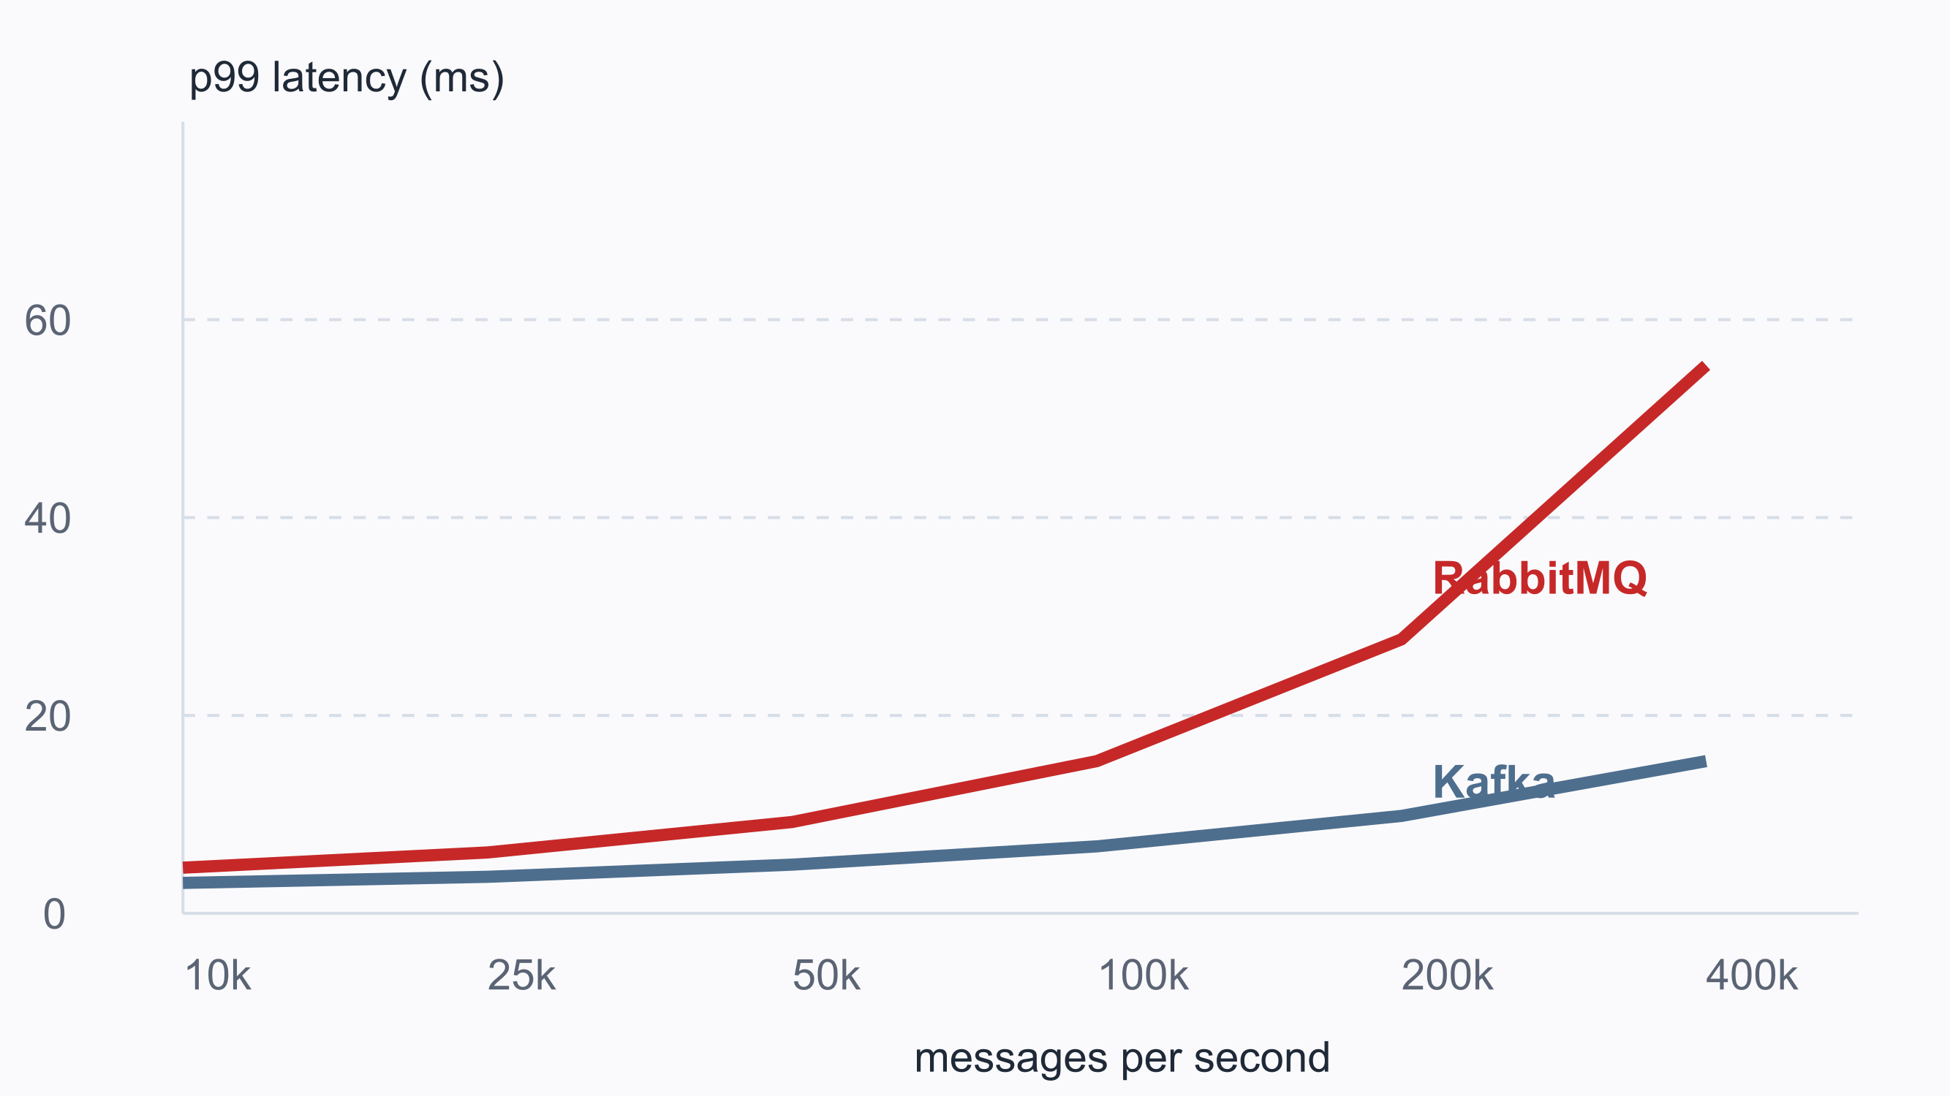
COST
Cost and capacity outlook
Monthly cost by option ($k)
p99 latency vs load
Headline numbers
24-MO TCO
BREAK-EVEN
$38k
40k/s
-54% vs Kafka
Source: vendor price lists; latency from internal load tests.

Slide 9
APPENDIX
Sources and references
[1] Internal load-test report, Platform Engineering, Oct 2026
[5] Apache Pulsar documentation: architecture overview
[6] Transactional outbox pattern, microservices.io
[2] RabbitMQ documentation: quorum queues and clustering guide
[7] Risk workshop notes, Nov 2026
[8] Team skills survey, Sep 2026
[3] Apache Kafka documentation: design and operations
[4] Amazon SQS developer guide and pricing

