Slide 1

Towards Object Recognition and Learning using the BioRC Biomimetic Real-Time Cortical Neurons Focus Area One: Architectures, Models, and Emulation
Alice C. Parker
University of Southern California
June 30, 2016
parker@usc.edu http://ceng.usc.edu/%7Eparker/BioRC_research.html

Slide 2

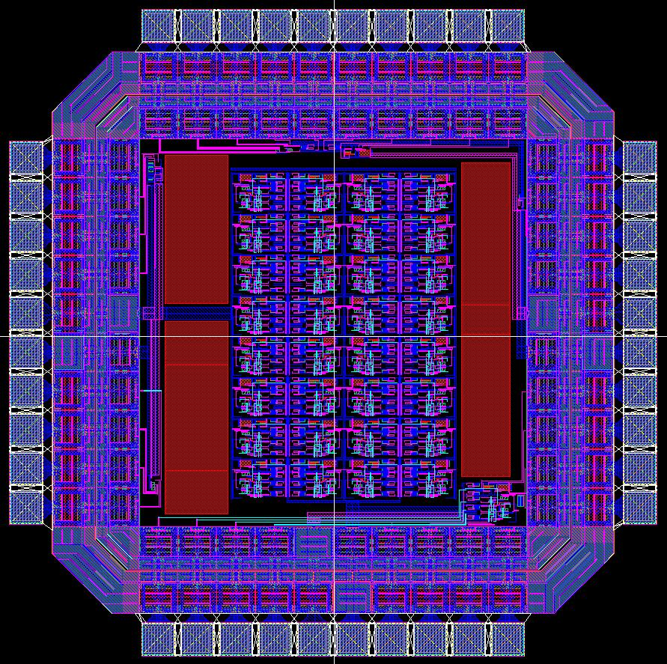
DARPA Autonomous Vehicle Grand Challenge 2003-2005
The Black Pearl
BioRC Biomimetic Real-Time Cortex 2006-
Reliable and Fault-Tolerant Safety-Critical Systems
Notes:
Increase all font sizes, change stochastic to variable

Slide 3
The Starting Premise on the BioRC project was… Memory, learning and Intelligence arise from capturing the complexity of the biological brain Hypothesis: a necessary but probably not sufficient step in realizing intelligence
Intercellular neural signaling
Complexity of computations in individual neurons
Signaling with astrocytes
Complexity

Slide 4
Breaking News – Neurons in the brain are not all the same surprising diversity in the molecules that human brain cells use in transcribing genetic information from DNA to RNA and producing proteins – From Scripps Institute

Slide 5
BioRC Solutions to Complexities
Analog Electronics with control knobs for biological mechanisms
Nanotechnologies
Astrocyte - Neuron Interactions
Large, Noisy Nonlinear Neurons
Structural Plasticity

Slide 6
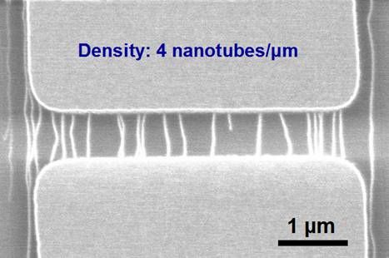
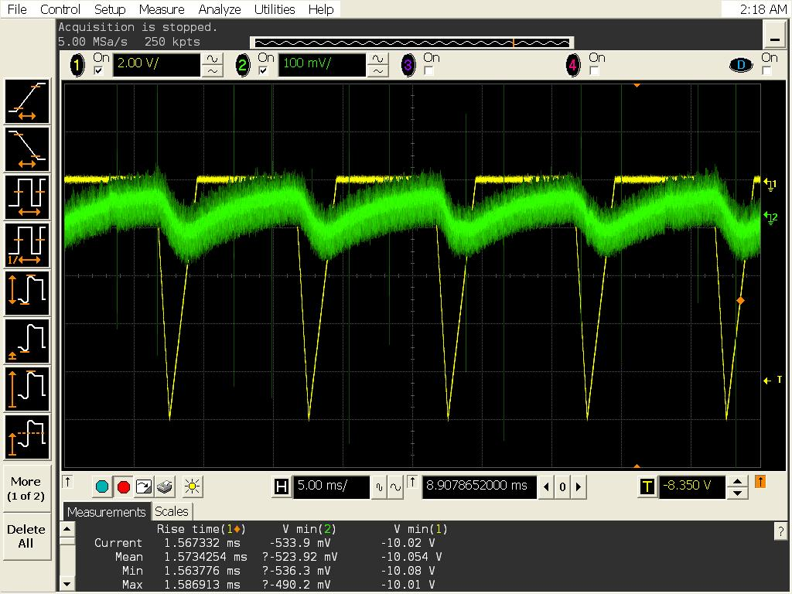
BioRC Solutions to Complexities
First use of nanotechnologies
In neural circuits (in Chongwu Zhou’s Nanolab)
Carbon Nanotube
Transistor
Now considering graphene, Molybdenum disulfide, others
Carbon
Nanotube
Synapse
Experimental
Results

Slide 7
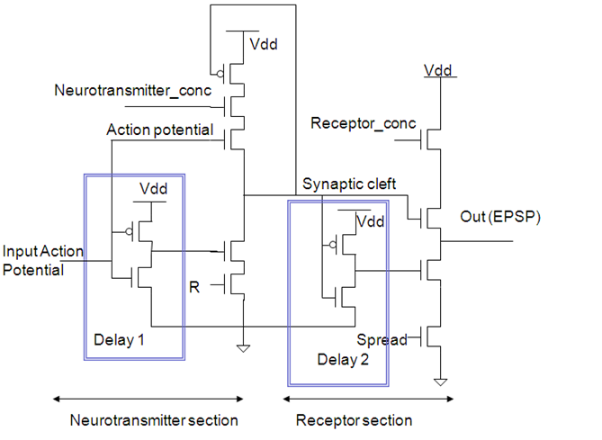
BioRC Solutions to Complexities
Analog Electronics with control knobs for biological mechanisms
Example synapse circuit with control knobs for neurotransmitter
availability, receptor concentration and reuptake rate R

Slide 8
BioRC Solutions to Complexities
Analog Electronics with control knobs for biological mechanisms
Neural Network
External inputs set up initial game
Network is fully connected but synaptic strengths (neurotransmitter concentrations) can be adjusted by a “trainer” circuit using “dopamine”
Trainer circuit contains the rules for the game
In training mode, external inputs force correct answers to strengthen synapses
A neural network that can learn 2X2 Sudoku and Sudoku-like games
A2
A1
A2
B1
B2
A1
B1
D2
B2
C1
C2
D1
D2
D1
C1
C2
Game Format

Slide 9
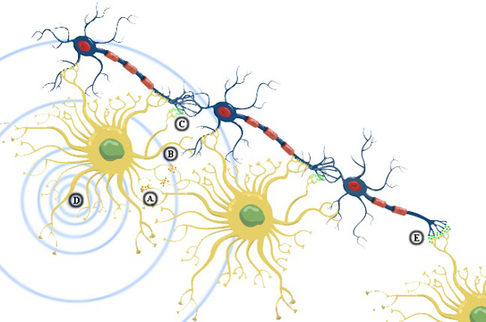
BioRC Solutions to Complexities
Neurons
Astrocytes
Astrocyte - Neuron Interactions –
Astrocytes stimulate, calm, synchronize and repair neurons
There are 10 times as many glial cells as neurons in the brain
Glial cells control blood flow and propagation speed
Glial cells affect processing and memory

Slide 10
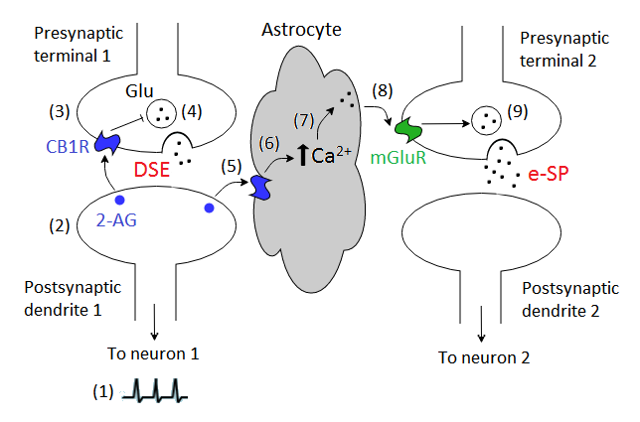
Repair via Retrograde Mechanisms: The Biology
Inspired by mathematical models published by Wade, McDaid and Harkins
The postsynaptic neuron signals the presynaptic neuron to reduce the transmitter release
The astrocyte signals the presynaptic terminals of many nearby neurons to produce more transmitter

Slide 11
Repair via Retrograde Mechanisms: The Experiment
Faulty Synapse

Slide 12
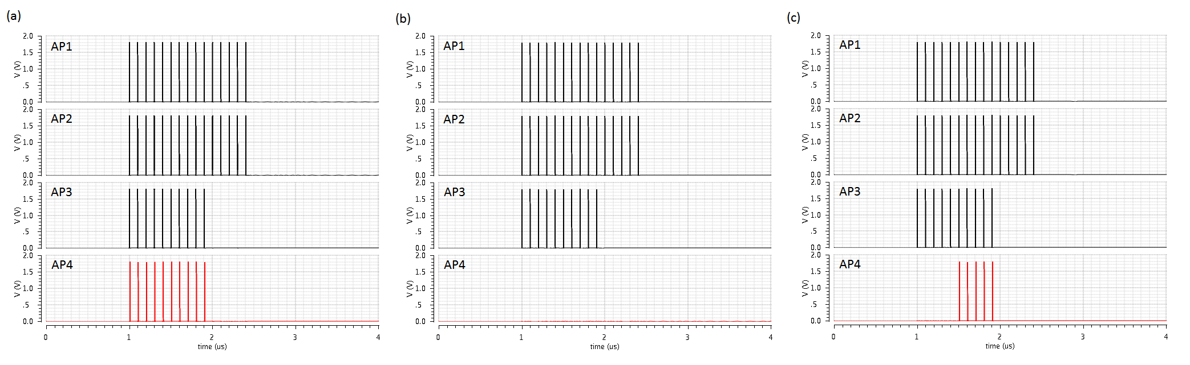
Repair via Retrograde Mechanisms: The Results
N1, N2 and N3 are presynaptic to N4
S9 stops working and
retrograde signaling is used to strengthen
N4’s other synapses
No Faulty Synapse so N4
Fires when expected
S9 on N4 stops working but no
retrograde signaling is used

Slide 13
BioRC Solutions to Complexities
Large, Noisy Nonlinear Neurons
10⁴ synapses in cortical neurons
Assume a simple threshold function for this type of neuron. Although there are N (10⁴ ) inputs, we assume any combination of 300 active inputs can make the neuron spike.
This requires 10⁴ synapse circuits and about 10⁴ 2-input adder circuits, to sum the inputs.
We need one axon hillock to perform the thresholding/spiking function.

Slide 14
BioRC Solutions to Complexities
Moderately-Large Neurons – a hypothetical argument
If we decide instead to model the same exact computation with simpler neurons that only have 300 inputs, there are “N choose M” or “10,000 choose 300” combinations of inputs that make the neural circuit fire at the final output.
Thus, we require N!/(N-M)!M! combinations to be checked, so the first stage of the neural network has N!/(N-M)!M! neurons, each of which has M inputs.
We could estimate the number of neurons in the first stage to ~N^{M}?
Therefore the number of synapses in the first stage of neurons is ~300N^{M}
In the large neuron the total number of synapses was N.

Slide 15
Artificial Brains : The Reality on the BioRC Project
We can build electronic neurons and parts of neurons:
With synaptic plasticity – the connections between neurons can change strengths
With structural plasticity – new connections can form and old ones can disappear
That demonstrate variable behavior (stochastic noise and chaotic)
That contain both excitatory and inhibitory inputs
That mimic retinal neurons with graded potentials
Out of nanotransistors – carbon nanotubes
That communicate with astrocytes (a form of glial cell) for learning and self-repair
With dendritic computations – we can add inputs in a complicated manner, including dendritic spiking
With dendritic plasticity – the additions of inputs can vary
We can build small neural networks, including modeling OCD, MS, Schzophrenic Hallucinations, c. elegans touch-sensitive Network

Slide 16
Ph.D. Students Saeid Barzegarjalali – Learning and Memory Jasmine Berry – Self Awareness in Movements Rebecca Lee – Astrocytes Pezhman Mamdouh – Power reduction in large neurons Kun Yue – nanotechnologies/noise Ph.D. Graduates Yilda Irizarry-Valle, John Joshi, Adi Azar, Ko-Chung Tseng, Chih-Chieh Hsu, Jason Mahvash, Ben Raskob

Slide 17
Thank You

