Slide 1
Assembly and genotyping of a MHC gene fragment
Benjamin Strauch, Moritz Kiekeben

Slide 2
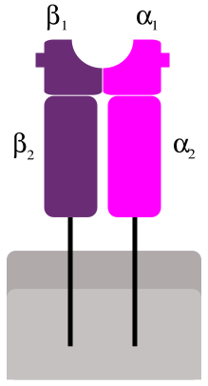
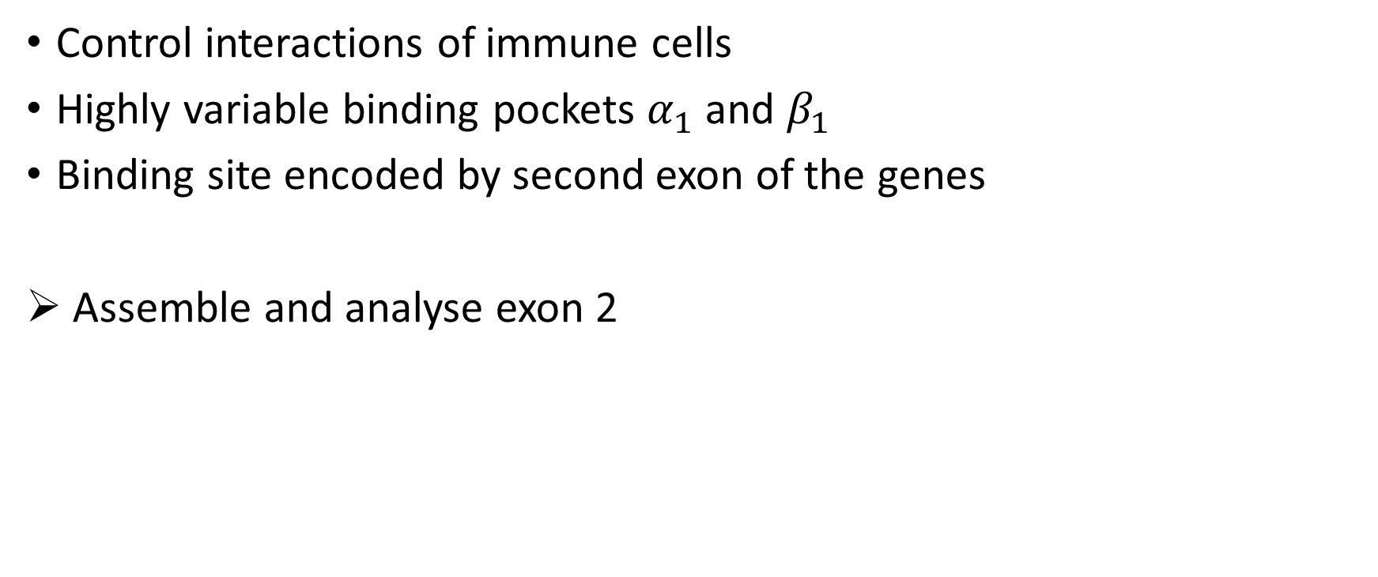
Major histocompatibility complex (MHC)
Control interactions of immune cells
Highly variable binding pockets $α_{1}$ and $β_{1}$
Binding site encoded by second exon of the genes
Assemble and analyse exon 2

Slide 3
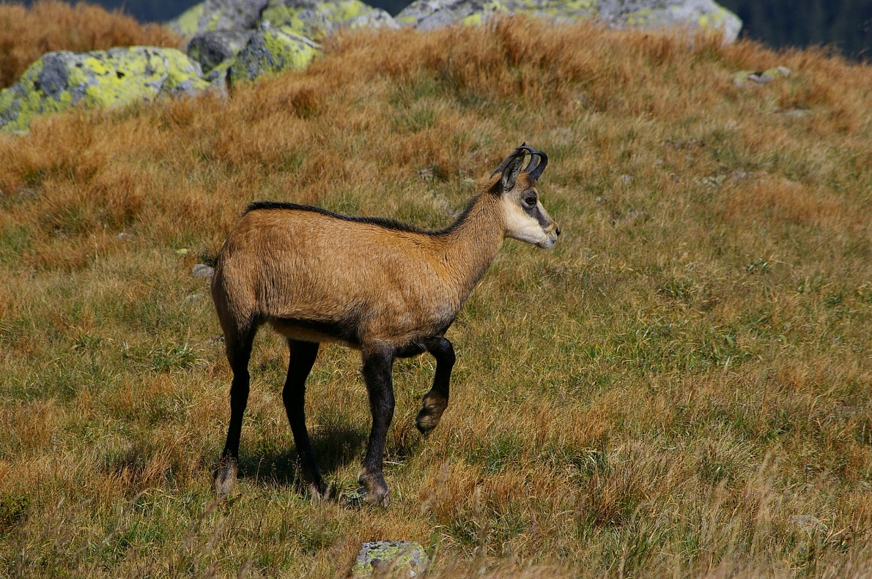
Application of population analysis
Examine sequences of Chamois (an Alpine goat)
Population dynamics determined by sarcoptic mange (ger: Räude)

Slide 4
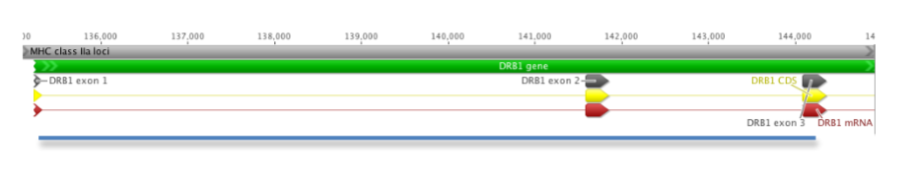
Sequence data
MiSeq sequencing data from the DRB region spanning exon 2
Paired-end read data (300bp) from two chamois individuals
Library was prepared with a Nextera kit (relevant for adapter removal)

Slide 5
Tasks in the analysis pipeline
FASTQC (Verification)
Read trimming (Trimmomatic)
Quality control
Assembly
Characterize alleles
Identify possible paralogs
FASTQC (Verification)
Mapping (Bowtie2)
IGV (Verification)
Create consensus (samtools)
Remapping & Variant calling (GATK)

Slide 6
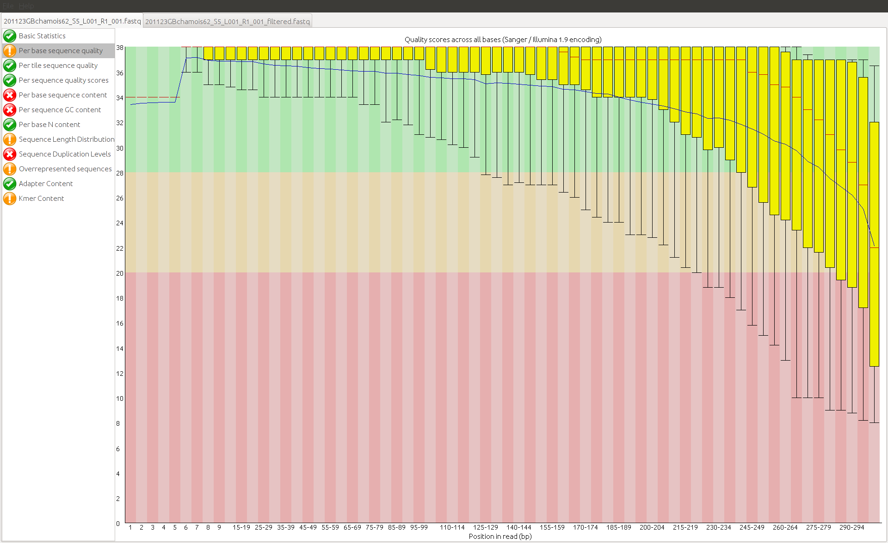
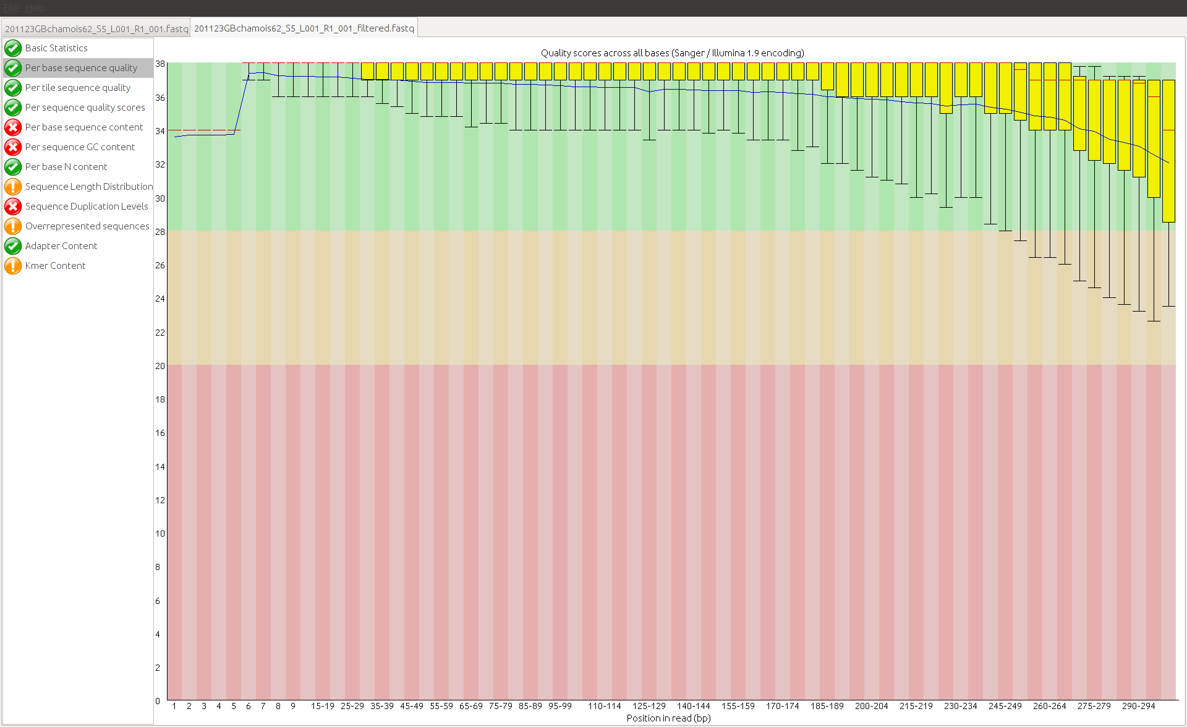
Quality control

Slide 7
Assembly
Reference-based or de novo assembly is possibleCon
Reference-based:
Map reads to related species
Construct consensus from covering reads
De novo:
Detect connections between reads, construct contigs
Reference-guided de novo assembly is possible

Slide 8
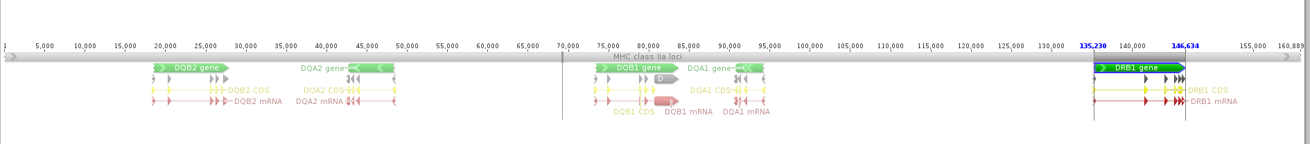
Reference-based assembly
Which reference can be used?
Genomic analysis of Ovis aries (Ovar) MHC class IIa loci, Hermann-Hoesig et al. (2008)
Genetic sequence of multiple genes in the MHC region

Slide 9
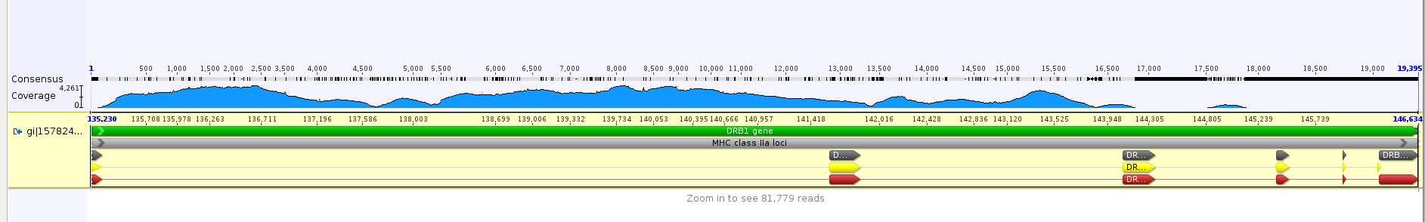
Reference-based assembly
Mapping tools: Bowtie2
Map paired reads to the DRB1 gene
As expected, almost all reads map between exon 1 and exon 3
Notes:
Around 60% mapped

Slide 10
Generating an assembly
Given mapped reads, generate a consensus sequence
Create a pileup from the read mapping using mpileup and bcftools
Between Exon 1 and Exon 3, 96.9% sequence identity with ovis aries

Slide 11
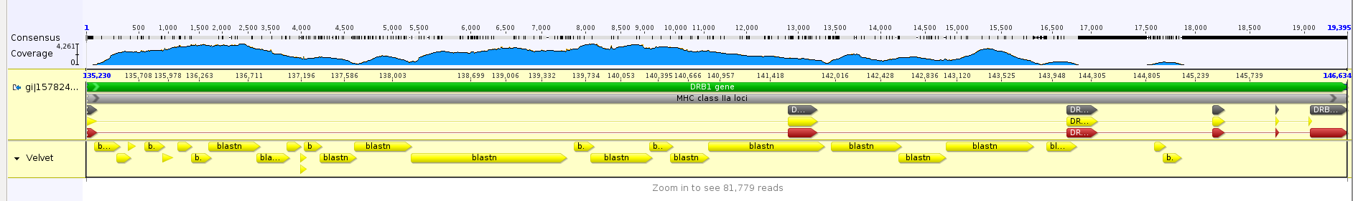
De novo assembly
Assemble without reference: Velvet
Infer sequential structure by detecting overlaps between reads
De novo assembly generally supports the reference-based assembly
Notes:
Around 250 contigs for Velvet

Slide 12
Detecting alleles
Given the consensus region/assembly, detect variants
Try two approaches:
Detect variants in reads when aligned to ovis aries reference
Realign the reads onto the consensus and count 0/1 variants
Variants in the reads will indicate alleles
GATK used for variant calling

Slide 13
Detecting alleles
Multiple variants exist
Few/not significantly more variants in exon 2 detected

Slide 14
Finding paralogs
Try to detect paralogs using the de novo sequencing approach
Expect some contigs to originate from paralogs
Problem: Chimeric contigs, few reads from paralogs
Search contigs in ovis aries, expecting DRB duplication in sheep
Notes:
In paper: No evidence of multiple locus amplification

Slide 15
Discussion
Sequence assembly
Easier with reference-based assembly
Possible with de novo assembly
Allelic definition
Variants indicate existence of heterozygous regions
Variant calling ambigious, differing results depending on software used
Paralog detection
Difficult problem, no clear results
De novo-based approaches seem promising

Slide 16
Outlook

