Slide 1
MHC stuff
yo

Slide 2
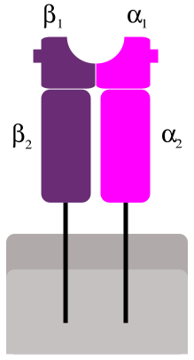
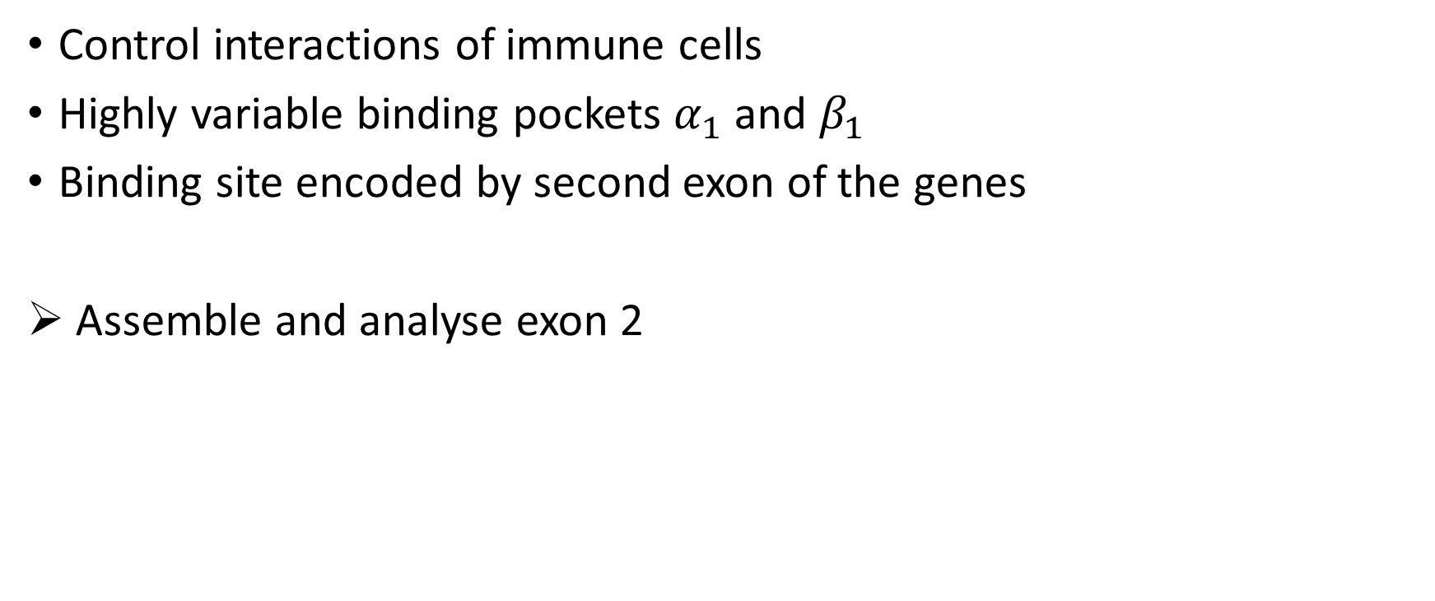
Major histocompatibility complex (MHC)
Control interactions of immune cells
Highly variable binding pockets $α_{1}$ and $β_{1}$
Binding site encoded by second exon of the genes
Assemble and analyse exon 2

Slide 3
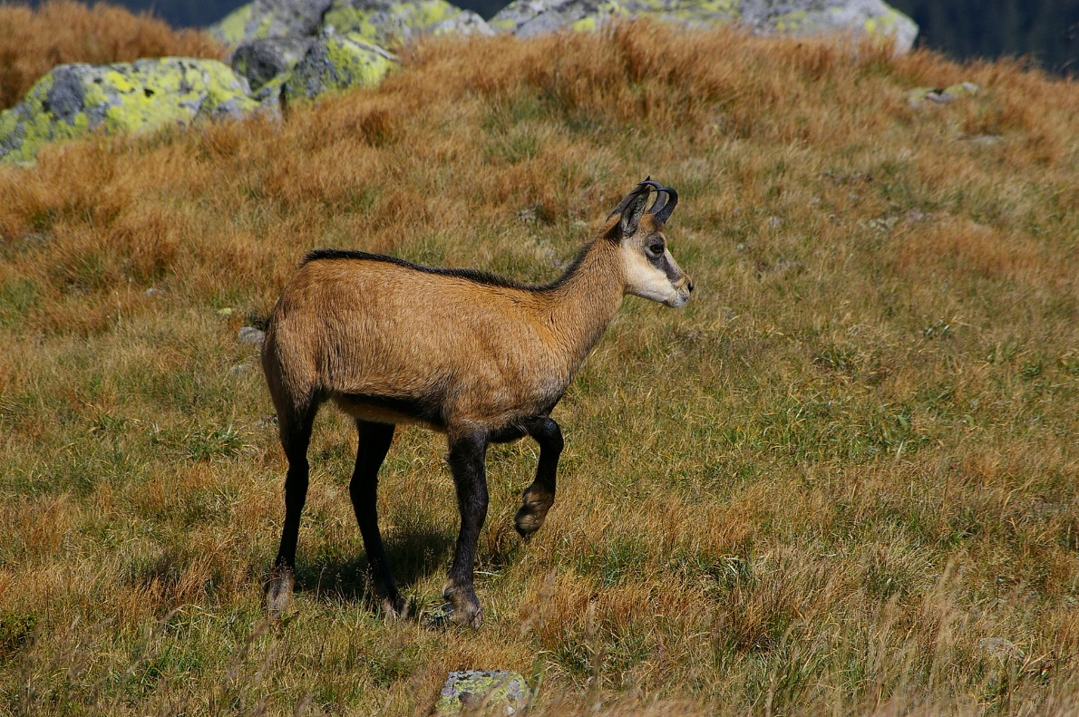
Application of population analysis
Examine sequences of Chamois (an Alpine goat)
Population dynamics determined by sarcoptic mange (ger: Räude)

Slide 4
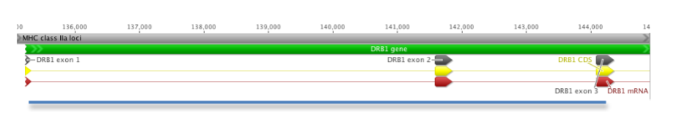
Sequence data
MiSeq sequencing data from the DRB region spanning exon 2
Paired-end read data (300bp) from two chamois individuals
Library was prepared with a Nextera kit (relevant for adapter removal)

Slide 5
Tasks in the analysis pipeline
Quality control
Assembly
Resolve allele definition
Identify possible paralogs

Slide 6
Quality control

Slide 7
Assembly
Reference-based or de novo assembly is possibleCon
Reference-based:
Map reads to related species
Construct consensus from covering reads
De novo:
Detect connections between reads, construct contigs
Reference-guided de novo assembly is possible

Slide 8
Reference-based assembly
Which reference can be used?

