Slide 1
CIS Security Guidelines
Presented by yours truly

Slide 2
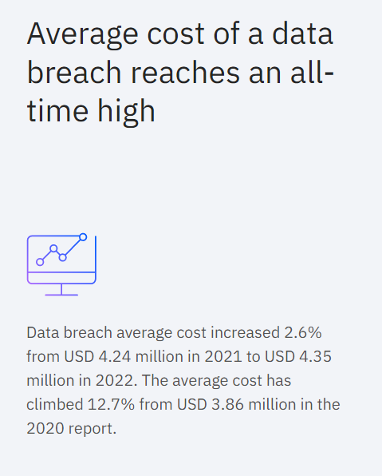
Introduction - Problem Statement
Already widespread use of cloud technologies
Coupled with the increased use and data migration to cloud
Cybersecurity is important
The need to harden system security
The Center for Internet Security (CIS) has devised the standard for cybersecurity – the CIS Benchmarks
Bash Script to check compliance
Source: https://www.ibm.com/security/data-breach

Slide 3

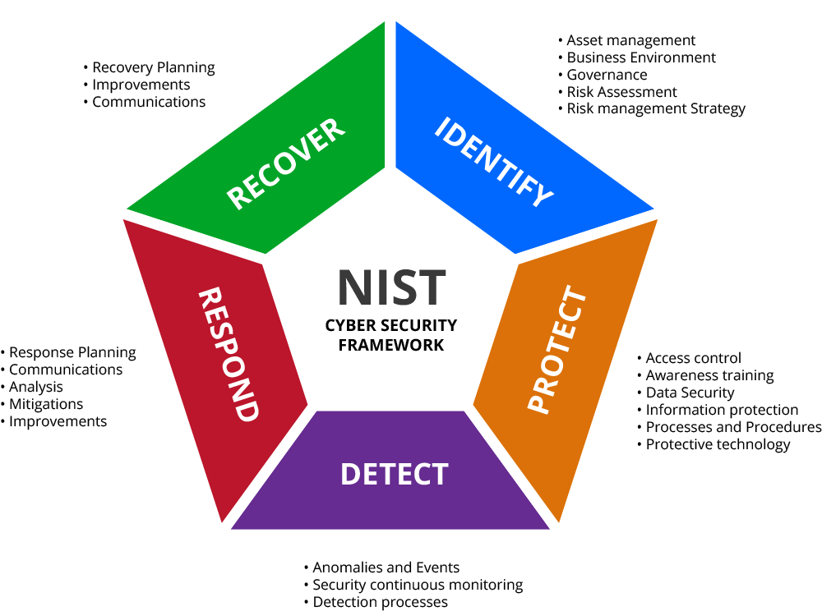


Importance of CIS Benchmarks - Cybersecurity Standards
International
National
Industry

Slide 4
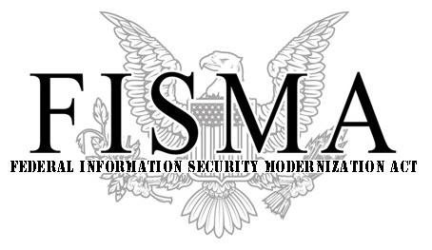

Importance of CIS Benchmarks
CIS Benchmarks are a set of cybersecurity standards for defending IT systems and data against cyberattacks.
Referenced and recognised by compliance standards such as the PCI DSS, Federal Information Security Management Act (FISMA), and more
The "CIS Benchmarks Configuration Certification" is awarded to denote conformance with the CIS Benchmark.
Notes:
CIS is accredited (in a lack thereof of a less chim word, means to be officially recognized or authorized)
by the international standard ISO 27001, which means, CIS Benchmarks are closely mapped 1:1 with ISO 27001 standards.
BUT CIS != ISO certified.

Slide 5
Small sample of the CIS requirements
SSH Rules
Ensure SSH root login is disabled
Ensure SSH PermitEmptyPasswords is disabled
Ensure SSH Protocol is set to 2
Ensure password expiration is 90 days or less
Ensure system accounts are non-login
The bash script shall be executed every 8am and 5pm on a daily basis.
The bash script shall generate the output to a log file or report.
The bash script shall send an email to alert any failure in the compliance check.

Slide 6
Ensure SSH root login is disabled
Root has the highest access rights on the system.
Privilege escalation
Better security

Slide 7
Ensure SSH PermitEmptyPasswords is disabled
Disallows user login without password
Need for authentication
Authentication equals to?
something you know: a password or personal identification number (PIN);
something you have: a token, such as bank card;
something you are: biometrics, such as fingerprints and face recognition.
Improved security

Slide 8
Ensure SSH Protocol is set to 2
SSH v1 was the original protocol and was subject to security issues
SSH v2 is more advanced and secure
SSH v1 suffers from insecurities that do not affect SSH v2
Enhanced security

Slide 9
Ensure password expiration is 90 days or less
Dying concept of password aging
In hypothetical case of data breach, hackers have access to hashed login data
Rainbow table attack to brute force finding passwords
Password expiration ensures that by the time hackers decrypt the hashed password, the password is already different and changed
TLDR: Password expiration to “outrun” the speed of password cracking
Strengthened security

Slide 10
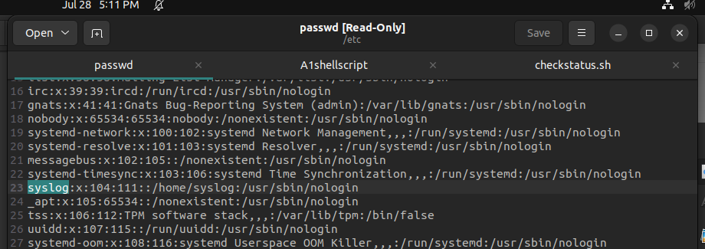
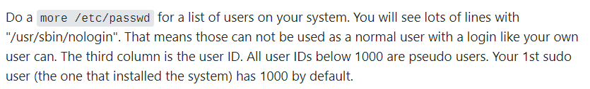
Ensure system accounts are non-login - Part 1
Explanation:
Source: https://askubuntu.com/questions/1109859/why-is-syslog-a-user

Slide 11

Ensure system accounts are non-login - Part 2
Make sure that system accounts are not being used by regular users & are prevented from being used to provide an interactive shell
By default, Ubuntu sets the password field for these accounts to an invalid string, but it is also recommended that the shell field in the password file be set to /sbin/nologin. This prevents the account from potentially being used to run any commands.
Explanation:
Source: https://askubuntu.com/questions/1109859/why-is-syslog-a-user

Slide 12
Conclusion
More secure

Slide 13
Code Demo
Thank you

