Slide 1
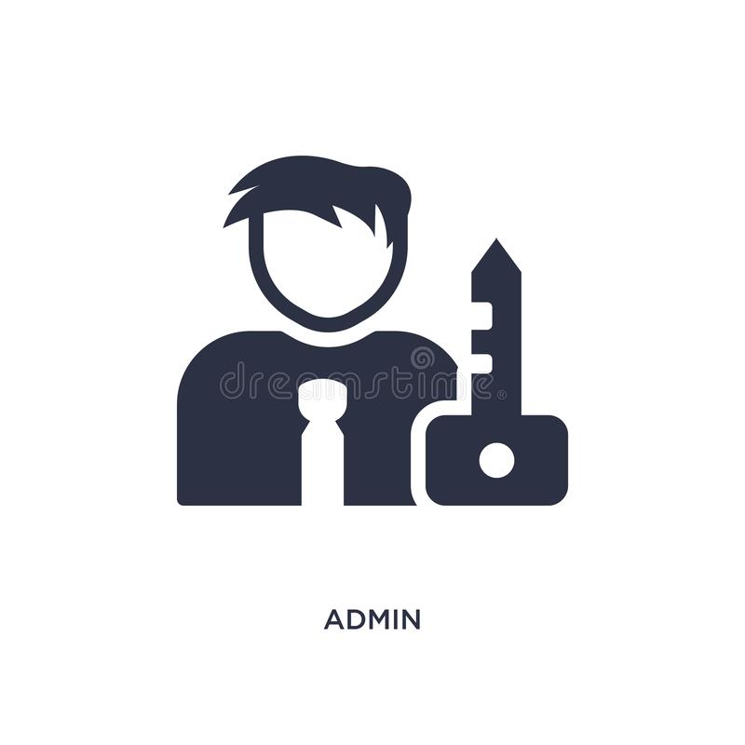


POD
Ingress Admin issues certificates
Sidecar
Client
mTLS
Ingress Controller
mTLS
Ingress
Middle Server
mTLS Egress
Time Server
1
2
3
OSM Controller issues certificates
OSM Controller
Service C Admin issues certificates
Bidirectional mTLS

