Slide 1
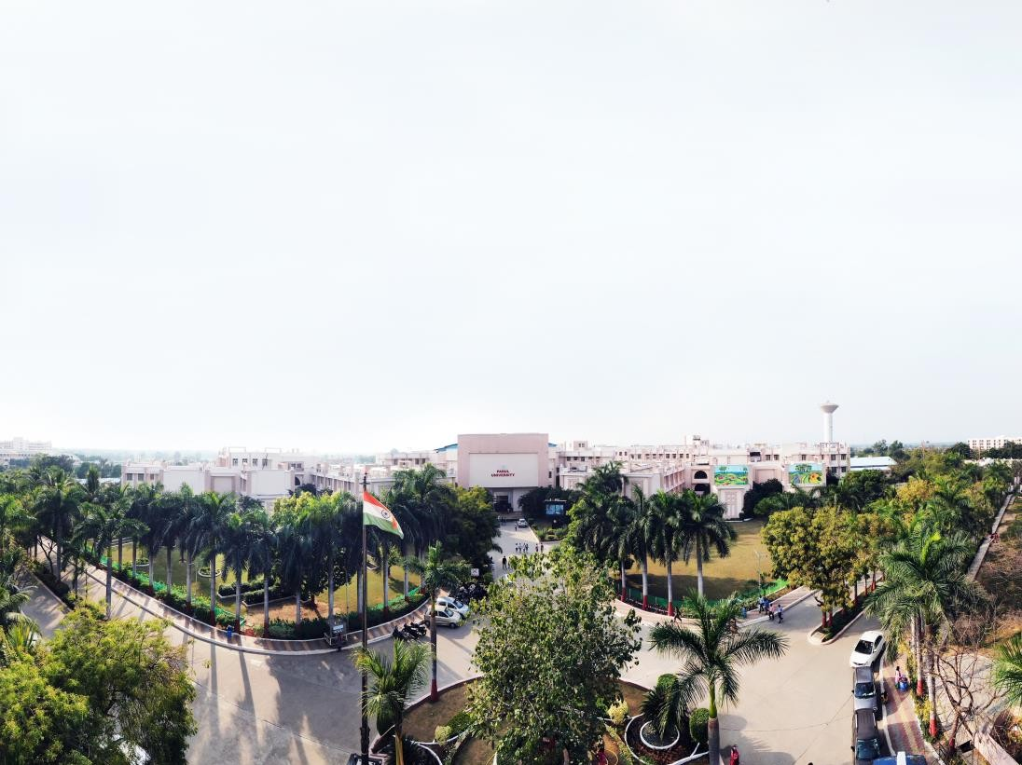


Unit 1 Android Operating System and Development Environment
Kunta Suthar, Assistant Professor
Computer Science and Engineering

Slide 2
Unit - 1
Android Operating System and Development Environment

Slide 3
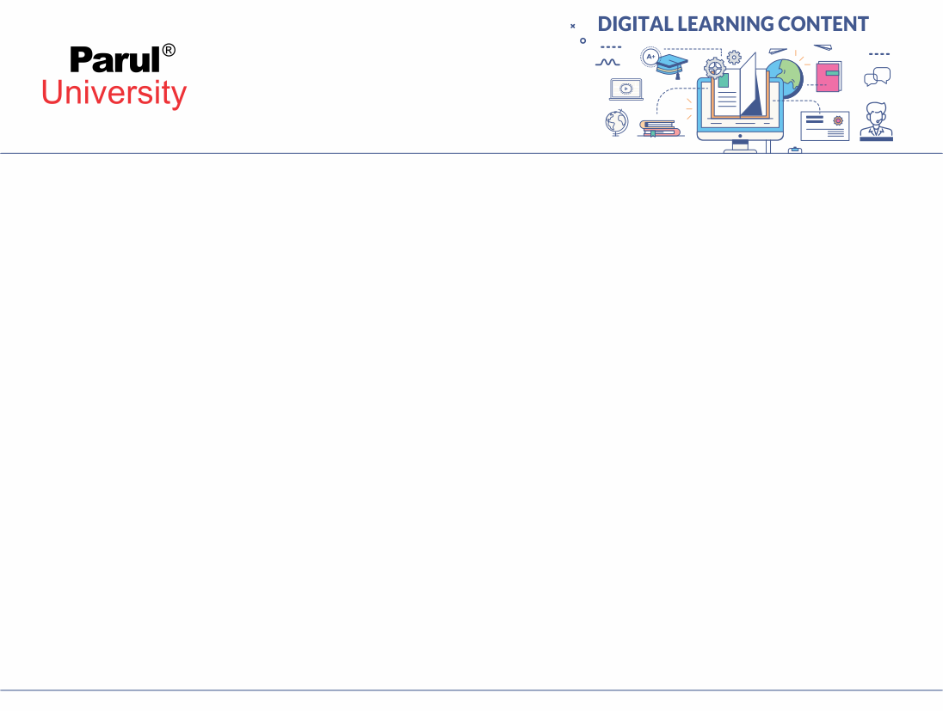

Introduction to Mobile Application Development
Basically, an application is a software which runs on mobile to perform some specific task. And the process of creating that application is known as application development. We make software for smartphones, tablets and digital assistants, most commonly for the Android and iOS operating systems. The software can be preinstalled on the device, downloaded from a mobile app store or accessed through a mobile web browser. The programming and markup languages are used to develop application include Java, Swift, C# and HTML5.

Slide 4
Introduction To Android
Android is a software package and linux based operating system for mobile devices such as tablet computers and smartphones.
It is developed by Google and later the OHA (Open Handset Alliance). Java language is mainly used to write the android code even though other languages can be used.
The goal of android project is to create a successful real-world product that improves the mobile experience for end use

Slide 5
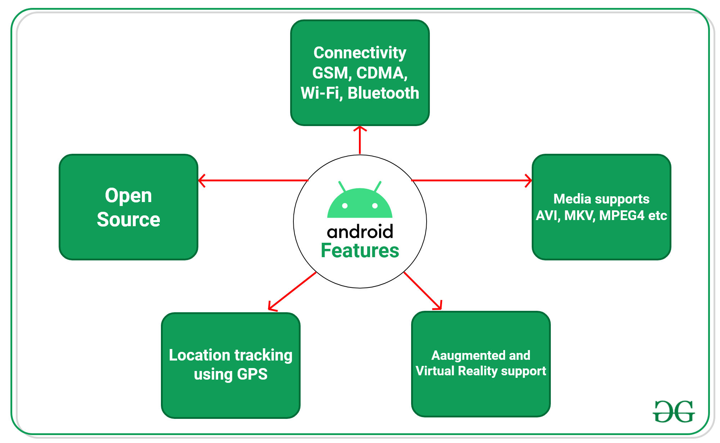
Features of Android

Slide 6
Features of Android
Android Open Source Project so we can customize the OS based on our requirements.
Android supports different types of connectivity for GSM, CDMA, Wi-Fi, Bluetooth, etc. for telephonic conversation or data transfer.
Using wifi technology we can pair with other devices while playing games or using other applications.

Slide 7
Continue..
It contains multiple APIs to support location-tracking services such as GPS.
We can manage all data storage-related activities by using the file manager.
It contains a wide range of media supports like AVI, MKV, FLV, MPEG4, etc. to play or record a variety of audio/video.
It also supports different image formats like JPEG, PNG, GIF, BMP, MP3, etc.

Slide 8
It supports multimedia hardware control to perform playback or recording using a camera and microphone.
Android has an integrated open-source WebKit layout-based web browser to support User Interfaces like HTML5, and CSS3.
Android supports multi-tasking means we can run multiple applications at a time and can switch between them.
It provides support for virtual reality or 2D/3D Graphics.

Slide 9
History of Android:
At first, Android was founded in Android Incorporation in Palo Alto, California, United States by Andy Rubin, in October, 2003.
Key employees of initial startup of Android were Andy Rubin, Rich Miner, Chris White and Nick Sears.
In August 2005, Android was acquired by Google Incorporation.
Earliest Android was intended for camera, later shifted to smart phones due to low demand of camera in market.

Slide 10
Android named on the name of Andy Rubin’s nick name which was given by his colleagues because of his love for robots.
By Google, in 2007 it was officially announced that they are working on the development of Android OS for mobile phones.
Finally, in 2008 HTC introduced and launched first Android based OS phone

Slide 11
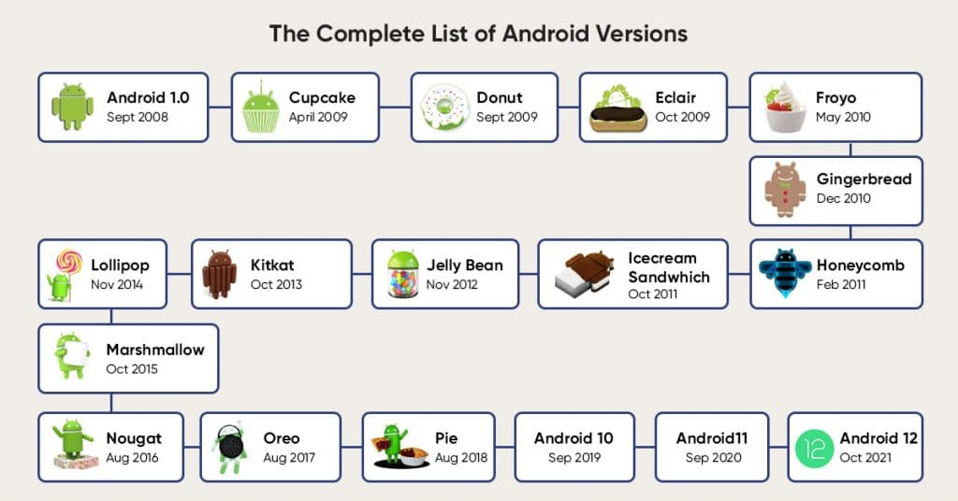
Android Versions

Slide 12
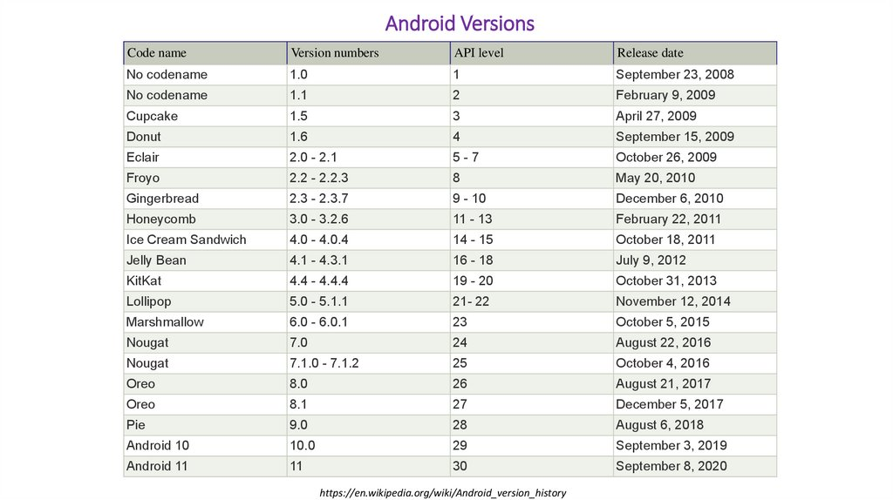
Android versions, name, and API level

Slide 13
Categories of Android applications
There are many android applications in the market.
The top categories are:
Entertainment
Tools
Communication
Productivity
Personalization
Music and Audio
Social
Media and Video
Travel and Local etc

Slide 14
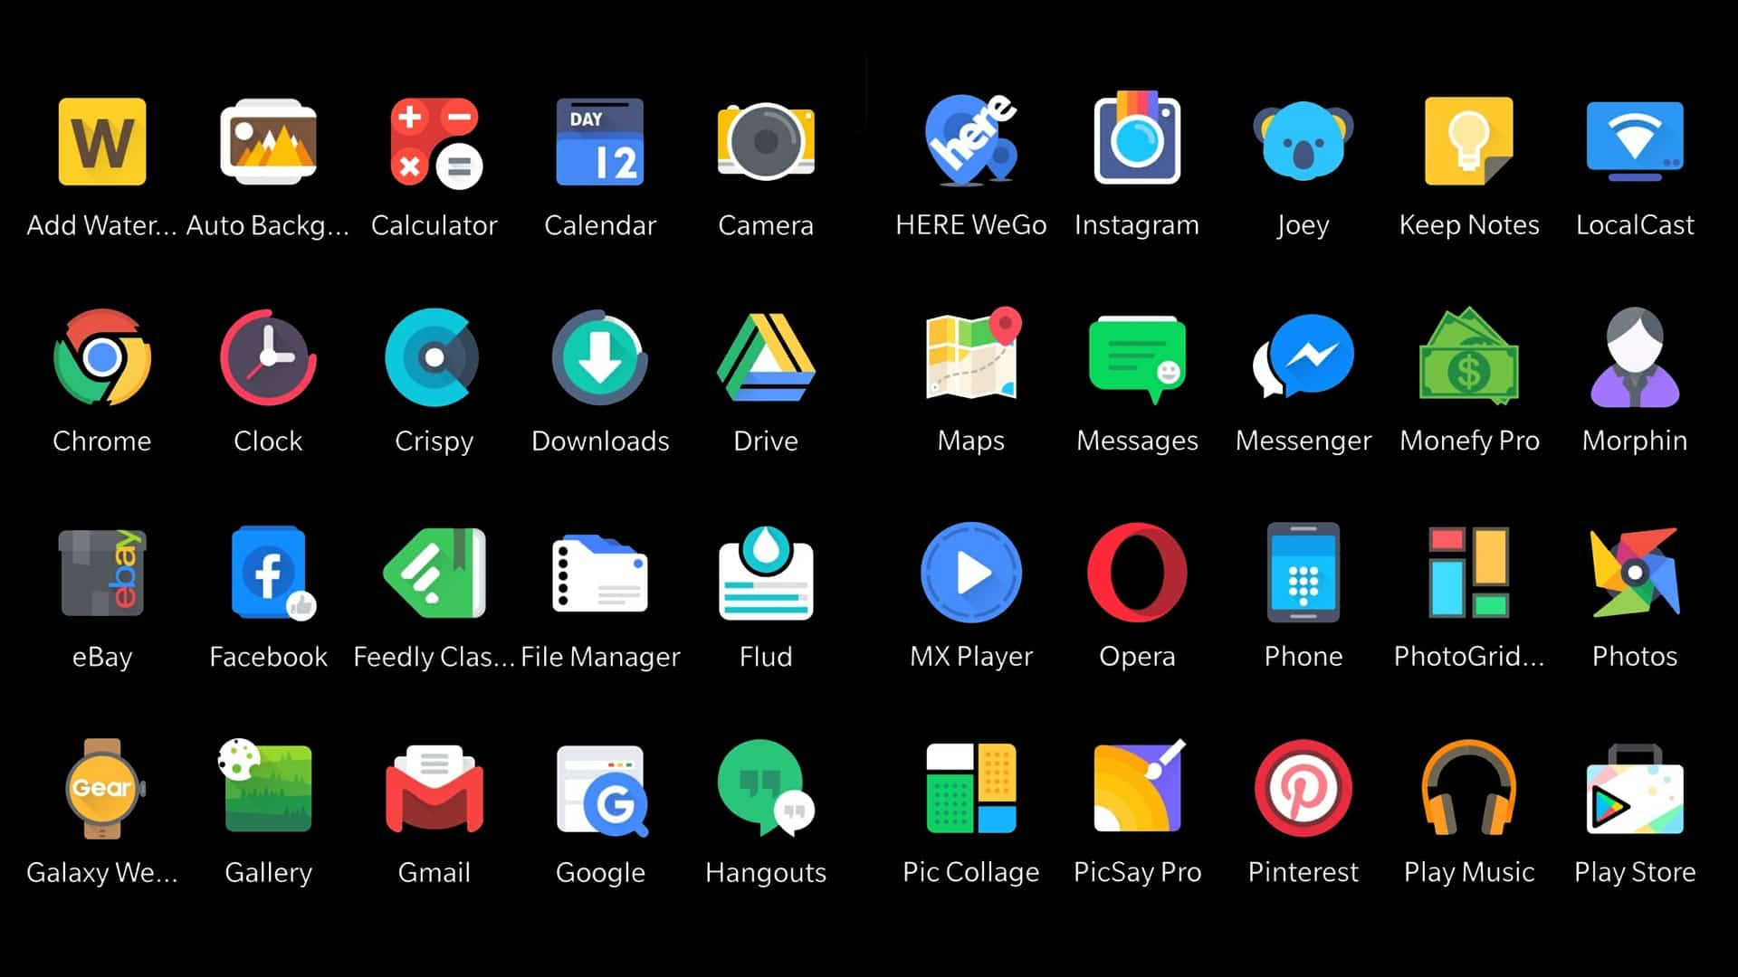

Slide 15
Android Architecture
android architecture or Android software stack is categorized into five parts:
linux kernel
native libraries (middleware),
Android Runtime
Application Framework
Applications

Slide 16
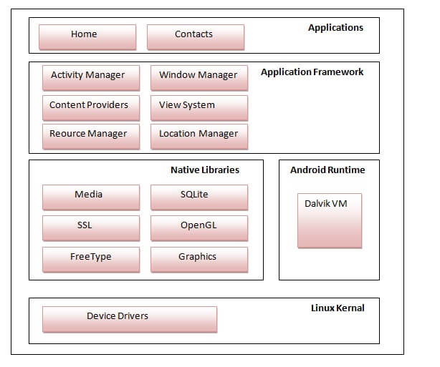
Architecture

Slide 17
. LInux Kernel: It is called as a “Heart of Android Architecture”. It controls all of the drivers that are needed during runtime, including those for displays, cameras, Bluetooth devices, audio devices, memory cards, and more.
An abstraction layer between the hardware of the device and the other elements of the Android architecture will be provided by the Linux Kernel. Memory, power, device management, and other things fall under its purview. Listed down are the features of Kernel:

Slide 18
Continue…
Security: The security between an application and the system is managed by the Linux kernel.
Memory Management: It effectively manages the memory, giving us the flexibility to create our apps.
Process Management: It does a good job of process management, allocating resources to processes as needed.
Network Stack: It manages network communication efficiently..

Slide 19
Driver Model: It guarantees that the program functions correctly on the hardware and that the manufacturers of the devices are accountable for integrating their drivers into the Linux build.

Slide 20
Continue…
Platform Libraries: To enable Android development, the Platform Libraries comprise a number of Java-based and C/C++ essential libraries, including Media, Graphics, Surface Manager, OpenGL, and others. Some of common libraries we use are:
Media library supports to play and record an audio and video formats.
2. Graphics library supports image formats.
3. Surface Manager is responsible of controlling display subsystem access (APIs).

Slide 21
SGL and OpenGL for 2D and 3D computer graphics, there exist cross-language and cross-platform application program interfaces (APIs).
5. SQLite provides support for database.
6. Web-Kit the entire feature set for displaying web content and streamlining page loading is provided by this open source web browser engine

Slide 22
Application Runtime
Application Runtime: This is one of the most important part of Android Architecture. It includes elements such as the Dalvik virtual machine (DVM) and core libraries. It primarily serves as the foundation for the application framework and, with the aid of the core libraries, powers our application. Dalvik Virtual Machine (DVM), like Java Virtual Machine (JVM), is a register-based virtual machine that was created especially for Android and tuned to execute multiple instances of the software on a device in an efficient manner. Low-level memory management and threading are handled by the Linux kernel layer. We can use the conventional Java or Kotlin programming languages to develop Android applications thanks to the core libraries

Slide 23
Continue..
Application Framework: A number of crucial classes are provided by the Application Framework and are needed to construct an Android application. It assists in controlling the user interface with application resources and offers a general abstraction for hardware access. Generally speaking, it offers the services that enable us to develop a certain class and make it useful for the building of applications. It contains a variety of services, such as package manager, view system, activity manager, notification manager, and others, that are useful for developing our application in accordance with the requirements

Slide 24
Applications
Applications: The top layer of the Android architecture is called Applications. Only this layer will have the pre-installed apps (such home, contacts, camera, gallery, etc.) and third-party apps (like games, chat apps, etc.) that were downloaded from the play store. With the aid of the classes and services the application framework offers, it operates inside the Android run time.

Slide 25
Android Studio Folder Structure:
The official IDE (Integrated Development Environment) for creating Android apps, created by the JetBrains community and made available by Google without charge, is called Android Studio. We may use the studio to construct an Android application once the Android Architecture configuration is complete. For every sample application, we must make a new project and learn the folder structure. It looks like:

Slide 26
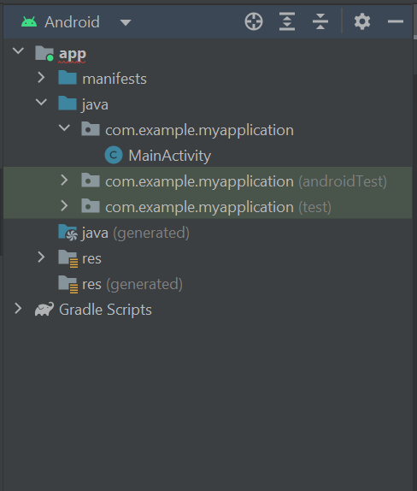

Slide 27
Manifests Folder
Manifests Folder: AndroidManifest.xml is found in the Manifests folder and is used to create our Android application.
This file includes details about our program, including the version for Android, metadata, the Kotlin file's states package, and other application components. It serves as a bridge between our application and the Android OS. Below is the manifests folder structure:

Slide 28
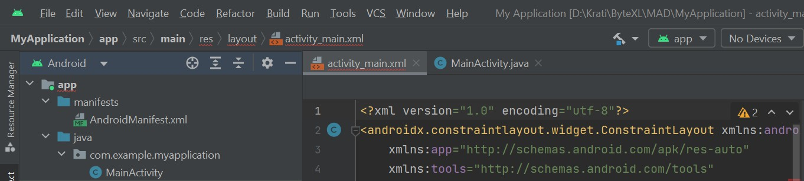

Slide 29
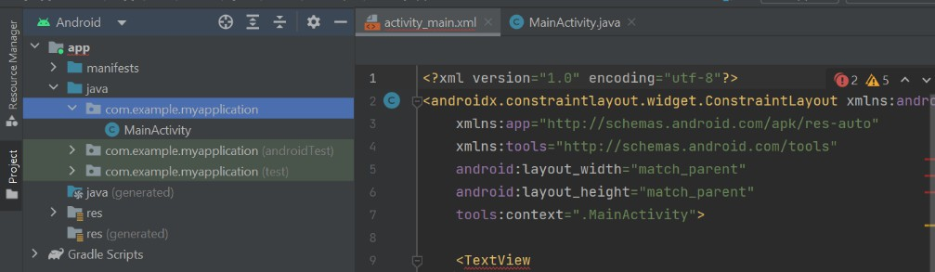
,
Java Folder: All of the Java and Kotlin source code (.java) files that we generate while developing the app are located in the Java folder, along with additional Test files. The class file MainActivity.java will by default generate automatically under the package name "com.example.myapplication" whenever we start a new Java project, as demonstrated below

Slide 30
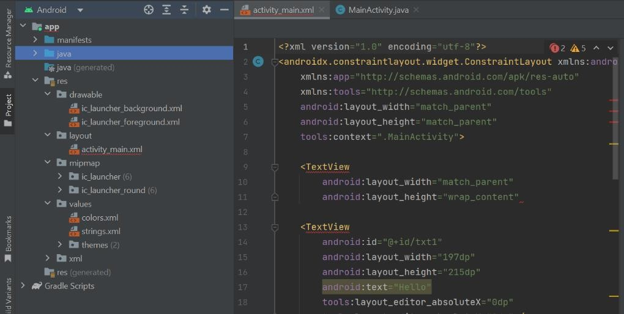
Resource (res) Folder:
Resource (res) Folder:
The resource folder is the most crucial one since it holds all of the non-code resources for our Android application, such as XML layouts, photos, and UI strings.

Slide 31
res (Drawable) Folder: It includes the many image formats that were employed in the application's development.
For the construction of the application, all of the images must be added to a drawable folder. • res (Layout) Folder: All of the XML layout files that we used to specify our application's user interface are contained in the layout folder.
The file activity_main.xml is contained in it. • res (mipmap) Folder: Launcher.xml files are contained in this folder and are used to specify the icons that appear on the home screen.
Depending on the device's size, it has icons with varying densities, such as hdpi, mdpi, and xhdpi. • res (values) Folder: A variety of XML files, including strings, dimensions, colors, and style definitions, are contained in the Values folder. The strings.xml file, which has the resources, is one of the most significant files.

Slide 32
www.paruluniversity.ac.in

