Slide 1
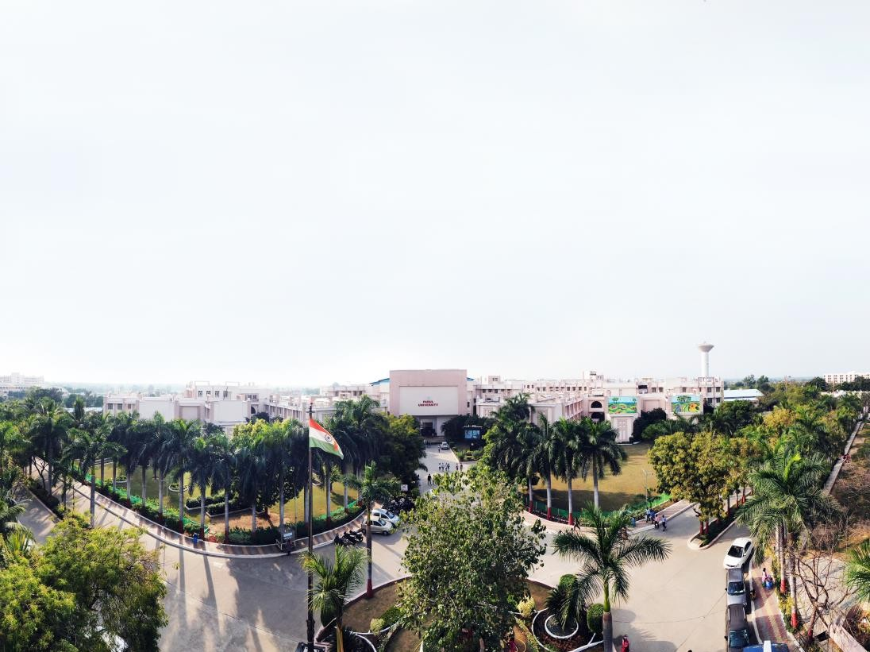


Unit 3
Android User Interface Elements and Layouts
Kunta Suthar, Assistant Professor
Computer Science and Engineering

Slide 2
Unit - 3
Android User Interface Elements and Layouts

Slide 3
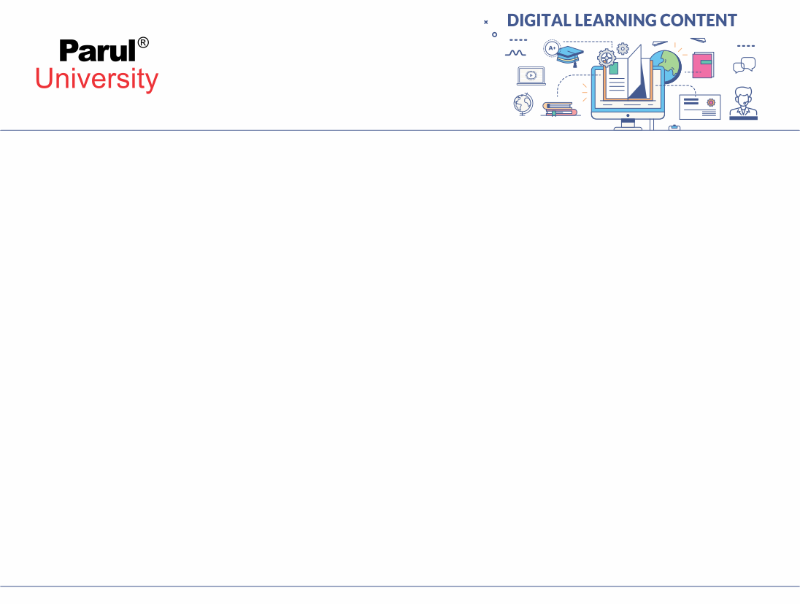

Android UI
Android provides a variety of Pre-built UI components.
Layout objects and UI controls that allow you to build the graphical user interface for your
app.
Android also provides other UI modules for special interfaces such as dialogs, notifications,
and menus.

Slide 4
What is Material Design?
A design system is a combination of rules, standards, and components that can be combined together in order to design any application. Therefore, material design is simply a design system by Google.
Material design was introduced by Google in 2014 and since then it has been a widely adopted design system by many companies. Material design not only helps companies but also is a great resource for individual UI/UX designers.

Slide 5
Layouts
A layout defines the structure for a user interface in your activity.
All elements in the layout are built using a hierarchy of View and ViewGroup objects.
A View usually draws something the user can see and interact with.
Layout(View Group) is an invisible container that defines the layout structure for View and
other Layout(View Group) objects.
It provide a different layout structure, such as LinearLayout or ConstraintLayout.

Slide 6
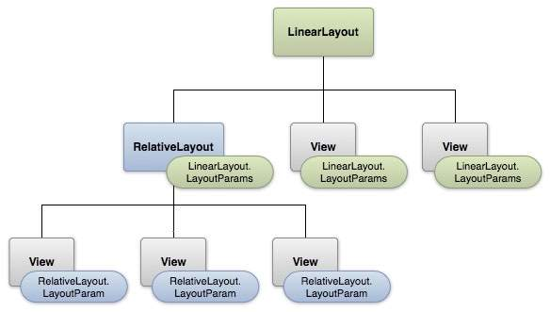

Slide 7
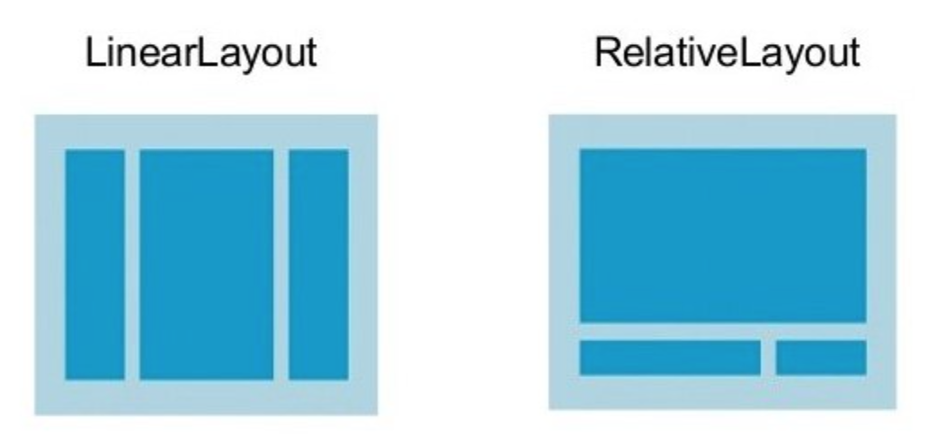
Linear Layout
LinearLayout is a view group that aligns all children in a single direction, vertically or horizontally.
You can specify the layout direction with the android:orientation attribute.
Linear Layout can be created in two direction: Horizontal & Vertical.
LinearLayout also supports assigning a weight to individual children with the android:layout_weight attribute.
This attribute assigns an important value to a view in terms of how much space it should occupy on the screen.
A larger weight value allows it to expand to fill any
remaining space in the parent view.

Slide 8


Relative Layout
RelativeLayout is a view group that displays child views in relative positions.
The position of each view can be specified as relative to sibling elements or in positions relative to the parent
RelativeLayout area.
As it allows us to position the component anywhere, it is considered as most flexible layout.
Relative layout is the most used layout after the Linear Layout in Android.
In Relative Layout, you can use “above, below, left and right” to arrange the component’s
position in relation to other component.

Slide 9
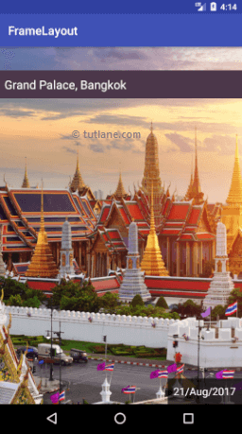

Frame Layout
Frame Layout is designed to block out an area on the screen to display a single item.
It is used to specify the position of Views.
It contains Views on the top of each other to display only single View inside the FrameLayout.
You can, add multiple children to a FrameLayout and control their
position by using gravity attribute.
In this the child views are added in a stack and the most recently
added child will show on the top.

Slide 10
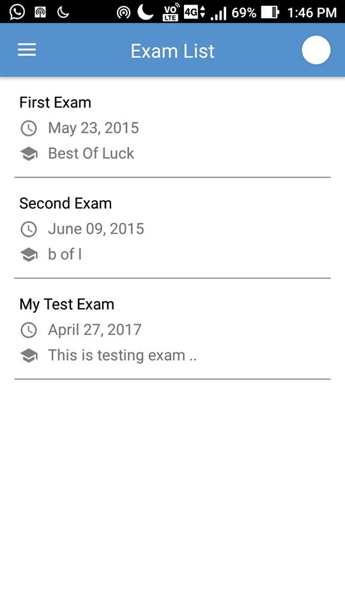
Recycler View
RecyclerView is a ViewGroup added as a successor of the GridView and ListView.
RecyclerView is mostly used to design the user interface with the fine-grain control over the lists and grids of android application.
To implement a basic RecyclerView three sub-parts are needed.
1) The Card Layout : it is an XML layout which will be treated as an item for
the list created by the RecyclerView.
2) The ViewHolder: it is a java class that stores the reference to the card
layout views that modified during the execution of list.
3) The Data Class: it is a custom java class (getter - setter) that acts as a
structure for holding the information for every item of the RecyclerView.

Slide 11
The adapter is main part for RecyclerView for displaying the list.
onCreateViewHolder: which deals with the inflation of the card layout as an item.
onBindViewHolder: which deals with the setting of different data and methods related to clicks on particular items.
getItemCount: which Returns the length of the RecyclerView.

Slide 12
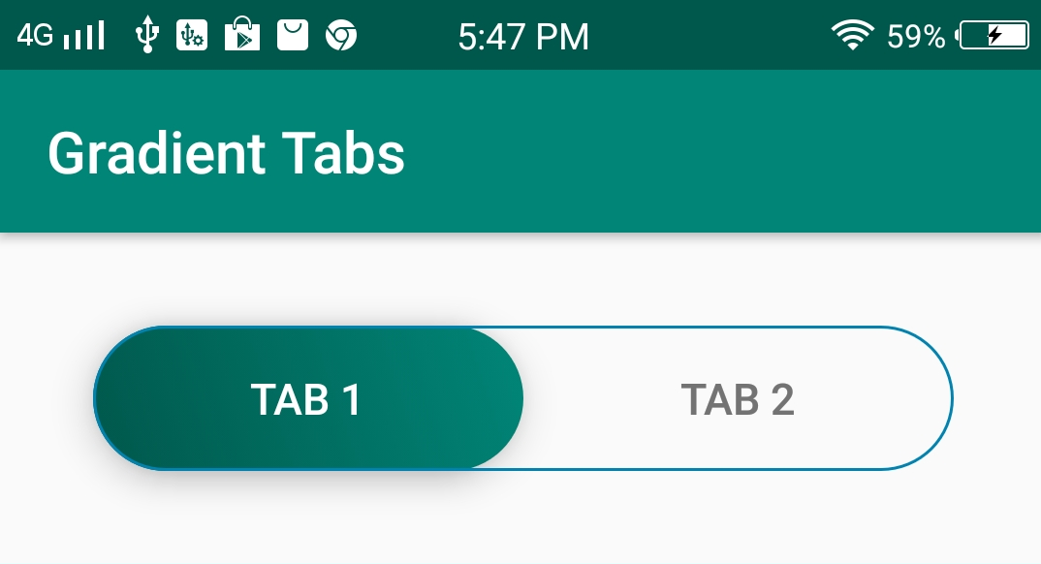
Tab Layout
TabLayout is used to implement horizontal tabs.
Population of the tabs to display is done through TabLayout.Tab instances.
Create tabs via newTab() From there we can change the tab's label or icon via TabLayout.Tab.setText(int).
A TabLayout can be setup with a ViewPager Dynamically create TabItems based on the number of pages, their titles, etc.
Synchronize the selected tab and tab indicator position with page swipes.
There are two types of tabs: Fixed tabs, Scrollable tabs.
1) Fixed tabs display all tabs on one screen, with each tab at a fixed width.
2) Scrollable tabs are displayed without fixed widths. They are scrollable, such that some tabs will remain off-screen until scrolled.

Slide 13
Menus
To provide a familiar and consistent user experience menus are the best.
It define in separate XML file and use that file in our application based on our requirements.
We can use menu APIs to represent user actions and other options in our android application
activities.
The Menus in android applications are :
1) Options Menu
2) Context Menu
3) Popup Menu

Slide 14
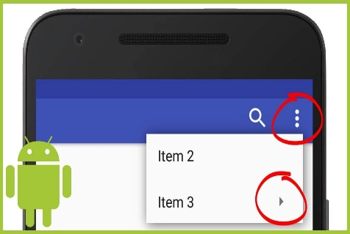
Options Menu
The options menu is the primary collection of menu items for an activity.
Options Menu Generally placed on action bar.
We can declare items for the options menu from either Activity or a Fragment.
Re-order the menu items with the android:orderInCategory attribute from xml file menu item.
To specify the options menu for an activity, override onCreateOptionsMenu().
In this method, you can inflate your menu resource (defined in XML) into the Menu.
You can also add menu items using add() and retrieve items with findItem().
When the user clicks a menu item from the options menu onOptionsItemSelected() method is used to get callback

Slide 15
Context Menu
Android context menu appears when user press long click on the element.
It is also known as floating menu.
It affects the selected content while doing action on it.
It doesn't support item shortcuts and icons

Slide 16
Working with the XML Files
Open res -> Layout -> activity_main.xml and write the following code. In this file add only a TextView to display a simple text.

Slide 17
<?xml version="1.0" encoding="utf-8"?>
<!-- Relative Layout to display all the details -->
<RelativeLayout xmlns:android="http://schemas.android.com/apk/res/android"
xmlns:tools="http://schemas.android.com/tools"
android:id="@+id/relLayout"
android:layout_width="match_parent"
android:layout_height="match_parent"
android:background="#fff"
android:padding="16dp"
tools:context=".MainActivity">
<TextView
android:id="@+id/textView“
android:layout_width="wrap_content"
android:layout_height="wrap_content"
android:layout_centerHorizontal="true"

Slide 18
android:layout_marginTop="20dp"
android:text="Long press me!"
android:textColor="#000"
android:textSize="20sp"
android:textStyle="bold" />
</RelativeLayout>

Slide 19
import android.graphics.Color;
import android.os.Bundle;
import android.view.ContextMenu;
import android.view.MenuItem;
import android.view.View;
import android.widget.RelativeLayout;
import android.widget.TextView;
import androidx.appcompat.app.AppCompatActivity;
public class MainActivity extends AppCompatActivity {
TextView textView;

Slide 20
RelativeLayout relativeLayout;
@Override
protected void onCreate(Bundle savedInstanceState) {
super.onCreate(savedInstanceState);
setContentView(R.layout.activity_main);
// Link those objects with their respective id's that we have given in .XML file
textView = (TextView) findViewById(R.id.textView);
relativeLayout = (RelativeLayout) findViewById(R.id.relLayout);

Slide 21
.
// here you have to register a view for context menu you can register any view
// like listview, image view, textview, button etc
registerForContextMenu(textView);
}
@Override
public void onCreateContextMenu(ContextMenu menu, View v, ContextMenu.ContextMenuInfo menuInfo) {
super.onCreateContextMenu(menu, v, menuInfo);
// you can set menu header with title icon etc
menu.setHeaderTitle("Choose a color");
// add menu items
menu.add(0, v.getId(), 0, "Yellow");
menu.add(0, v.getId(), 0, "Gray");
menu.add(0, v.getId(), 0, "Cyan");
}

Slide 22
// menu item select listener
@Override
public boolean onContextItemSelected(MenuItem item) {
if (item.getTitle() == "Yellow") {
relativeLayout.setBackgroundColor(Color.YELLOW);
} else if (item.getTitle() == "Gray") {
relativeLayout.setBackgroundColor(Color.GRAY);
} else if (item.getTitle() == "Cyan") {
relativeLayout.setBackgroundColor(Color.CYAN);
}
return true;
}
}

Slide 23
UI widgets
There are given a lot of android widgets with simplified examples such as Button, EditText, AutoCompleteTextView, ToggleButton, DatePicker, TimePicker, ProgressBar etc.
Android widgets are easy to learn. The widely used android widgets with examples are given below:
Android Button: Let's learn how to perform event handling on button click.
Android Toast Displays information for the short duration of time.

Slide 24
Continue..
Custom Toast We are able to customize the toast, such as we can display image on the toast
ToggleButtonI t has two states ON/OFF.
CheckBox Let's see the application of simple food ordering.
AlertDialogAlertDialog displays a alert dialog containing the message with OK and Cancel buttons.
SpinnerSpinner displays the multiple options, but only one can be selected at a time.
AutoCompleteTextViewLet's see the simple example of AutoCompleteTextView.
RatingBar RatingBar displays the rating bar.
DatePicker Datepicker displays the datepicker dialog that can be used to pick the date.
TimePicker TimePicker displays the timepicker dialog that can be used to pick the time.
ProgressBar ProgressBar displays progress task.

Slide 25
www.paruluniversity.ac.in

