Slide 1
資料庫匯出 Excel & PDF

Slide 2
Excel Outport

Slide 3
Header
header("Pragma: public");
header("Expires: 0");
header('Cache-Control: must-revalidate, post-check=0, pre-check=0');
header('Content-type: application/vnd.ms-excel');
header('Content-Disposition: inline; filename="applicant.xls";');
header('Content-Transfer-Encoding: binary');

Slide 4
Echo Table
echo "<table>";
echo "<tr>";
echo "<td>NO.</td>";
echo "<td>中文姓名</td>";
echo "<td>英文姓名</td>";
echo "<td>性別</td>";
echo "<td>國籍</td>";
echo "<td>部別</td>";
echo "<td>系所</td>";
echo "</tr>";
Echo “</table>”;

Slide 5
PDF Outport

Slide 6
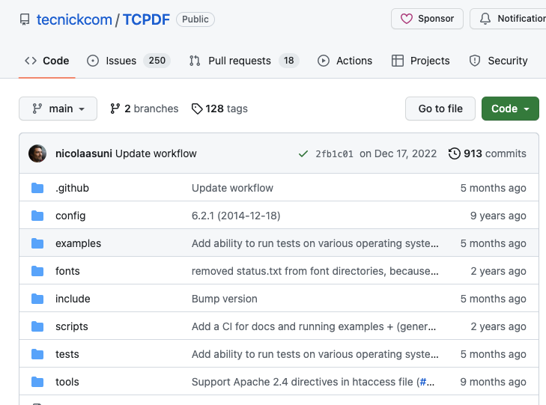
Download tcpdf package

Slide 7
Import package
require_once('tcpdf/tcpdf.php');

Slide 8
Setting
ob_start();
// // create new PDF document
$pdf = new TCPDF(PDF_PAGE_ORIENTATION, PDF_UNIT, PDF_PAGE_FORMAT, true, 'UTF-8', false);
// set font
$pdf->SetFont('msungstdlight', '', 10);
$pdf->setPrintHeader(false);
$pdf->setPrintFooter(false);
$pdf->AddPage();

Slide 9
Content and Output
$html = 'TEST';
// // output the HTML content
$pdf->writeHTML($html);
//file send to file address
$path = "/docs/123info.pdf";
//Close and output PDF document
$pdf->Output(__DIR__ .$path, 'F');
//$pdf->Output($No."-tableinfo.pdf", 'D');
ob_end_flush();

