Slide 1


Slide 2
Course Objectives
This course is designed to
  increase effectiveness of the students as future managers, by introducing them to a framework for understanding organisations and the behaviour of people and groups within them.
  make the students aware of the skills required to deal with the increasing challenges facing organisations.
The goal of this course is to help the students acquire the knowledge and skills that will result in high performance for them and the organisations they would eventually manage.

Slide 3
Course Content
1. INTRODUCTION TO ORGANIZATIONAL BEHAVIOR
2. MANEGEMENT COMMUNICATION.
3. INDIVIDUAL BEHAVIOUR
4. GROUP BEHAVIOUR
5 .DECISION MAKING
6. CONFLICTS AND NEGOTIATION
7. ORGANISATION STRUCTURE
8. ORGANISATION CULTURE
9. ORGANISATIONAL CHANGE AND REGISTANCE TO CHANGE.
10 STRESS MANAGEMENT.

Slide 4
Course Methodology
Teaching.
Case Studies.
Role-plays.
Article Analysis.
Management Games.
Psychometric Tests.

Slide 5
Course Evaluation
In-semester Examination's 20%
Case Studies, Article Analysis, 15%
Presentations & Reports
Assignments 15%
End-semester Examination 30%
Overall Participation in course 10%
Attendance 10%

Slide 6
Book(s)
Stephen Robbins, “Organisational Behaviour”, Pearson Education, 10th Edition, 2005.
K. Ashwathappa, “Organisational Behaviour”, Himalaya Publishing House. 5th Edition, 2004.
Paul Hersey et. al., “Management of Organisational Behaviour – Utilizing human resources”, Prentice-Hall of India Pvt. Ltd., 7th Edition, 1998.

Slide 7
Book(s)
Fred Luthans, “Organisational Behaviour”, Irwin McGraw-Hill, 8th Edition, 1998.
C. B. Mamoria, “Personnel Management”, Himalaya Publishing House, 1998.
John W. Newstrom et. al., “Organisational Behaviour – Human Behaviour at Work”, Tata McGraw-Hill, 9th Edition, 1997.
Stephen Robbins, “Managing Organisational Conflict: A Nontraditional Approach”, Prentice Hall, 1974.

Slide 8
Introduction to Organizational Behaviour

Slide 9
What is OB?
The discipline of Organizational Behavior encompasses three broad areas :
1. The Behavior of People in Organizations
2. Organizational Structure
3. Behavior of organizations

Slide 10
OB interprets people-organization relationships in terms of the whole person, whole group, whole organization, and whole social system. Its purpose is to build better relationships by achieving human objectives, organizational objectives, and social objectives. Therefore it is a system approach.
As you can see from the definition above, organizational behavior encompasses a wide range of topics, such as:
personality, values, ethics
motivation
interpersonal communication
leadership
change management
cross-cultural management

Slide 11
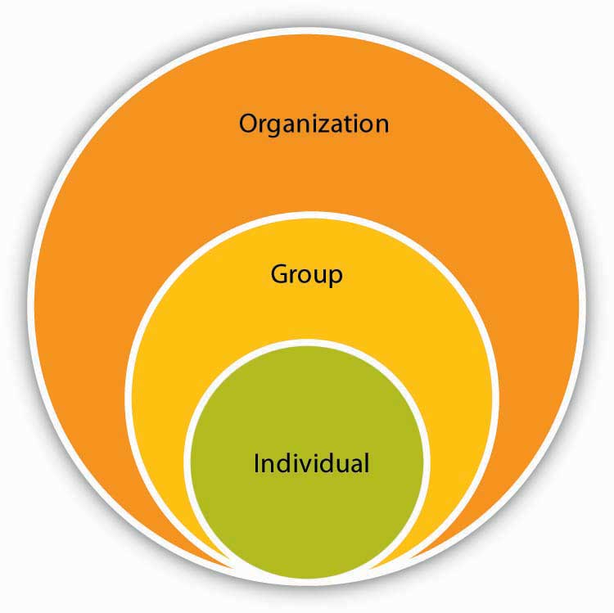

Slide 12
What Is Organizational Behavior
Organization : It is a group of people who are collected to work for a common goal with collective efforts. Organization works through two concepts i.e coordination and delegation among its group members. Delegation is necessary to allocate group members with equal work according to their capability, and coordination is required to achieve organizational goal with precision.
Behavior: It is a verbal or physical response shown by a person as a consequence of the impact of his/her surroundings. Individual Behavior varies in accordance with their mental reactivity to particular circumstances because of their deeply imbibed morals and value system.
Organizational Behavior: Organizational Behavior is the observation of individual and/or group Behavior in response to the other individuals or group as a whole. It studies Behavior of people or group to know their attitude towards particular circumstances

Slide 13
Fundamental Aspects Of Organizational Behavior:
People: This element is the soul of the Organization because people work to achieve the target of Organization and Organization works to fulfill the needs of individual or group of individuals. The word ‘people’ can be anyone who is working inside the Organization, like employees or any external person like supplier, customer, auditor, or any government official.
Structure: It is the body of the Organization which is to be taken care of to bring coordination between different levels of Organization, because Organization does not work aloof and is dependent on people which again work on the concept of division of labor. So, there is always a hierarchy in Organization which if not properly dealt with can mess the system because of nil scrutiny and flow of control.

Slide 14
Technology: Organizations work on technologies to help people in efficiently doing their work. Same technology does not apply to each Organization but different Organizations demand different technologies for their different line of businesses e.g bank needs mediating technology which connects customers and bankers, Manufacturing companies need long linked technology because of their assembly line process, and hospitals.
Environment: Organizations are influenced by the environment in which they work, at a substantial level. Environment is important to Organizations because of the following factors:
Supply and demand comes from this environment.
Human resource, competitors, government agencies, unions, and political parties comes from environment in which Organization is surviving.

Slide 15
Growth of the company is determined by:
The people and the Organizational Culture and Structure

Slide 16
Personal Success Factors
Ability to manage people.
Develop management skills.
Understand Organizational Structure and process.
Politics.

Slide 17
Behavior of People in Organizations
OB draws on psychology, anthropology and sociology to gain insight into the behavior of individuals in organizational settings. Topics studied include:
perception, cognition, learning
personality and motivation
leadership, power, communication
decision making

Slide 18
Importance of Organizational Behavior:
It builds better relationship by achieving people’s, organizational, and social objectives.
It covers a wide array of human resource like behavior, training and development, change management, leadership, teams etc.
It brings coordination which is the essence of management.
It improves goodwill of the organization.
It helps to achieve objectives quickly.
It makes optimum utilization of resources.
It facilitates motivation.
It leads to higher efficiency.
It improves relations in the organization.
It is multidisciplinary, in the sense that applies different techniques, methods, and theories to evaluate the performances.

Slide 19
Thank-You

