Slide 1
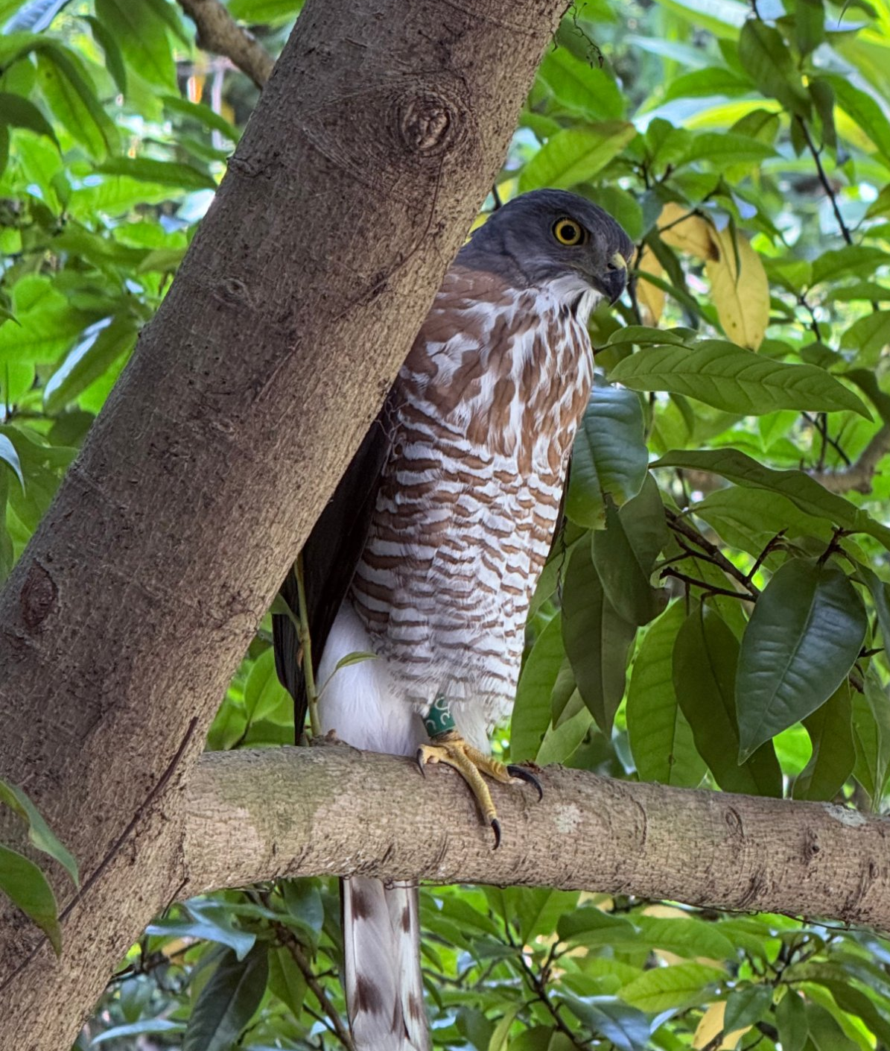

歡迎蒞臨
Green Health Research Center
綠色健康研究中心
College of Bioresources and Agriculture, National Taiwan University
國立臺灣大學生物資源暨農學院
Making the health benefits of nature measurable, designable, and prescribable
讓自然的健康效益 可量測 · 可設計 · 可處方

Slide 2
THE CENTER · 中心組織
Organisation
組織架構
Role 職務 | Name 姓名 | Department 單位
Director 中心主任 | Chun-Yen Chang 張俊彥 特聘教授 | Horticulture and Landscape Architecture 園藝暨景觀學系
Head, Horticultural Therapy 園藝療癒組 | Po-Ju Chang 張伯茹 副教授 | Horticulture and Landscape Architecture 園藝暨景觀學系
Head, Forest Therapy 森林療癒組 | Chia-Pin Yu 余家斌 教授 | Forestry and Resource Conservation 森林環境暨資源學系
Head, Landscape Therapy 景觀療癒組 | Chia-Kuen Cheng 鄭佳昆 副教授 | Horticulture and Landscape Architecture 園藝暨景觀學系
Head, Green Health Tourism 綠色健康旅遊組 | Bau-Show Lin 林寶秀 教授 | Horticulture and Landscape Architecture 園藝暨景觀學系
Head, Green Health Communication 綠色健康傳播組 | Yu-Chan Chiu 邱玉蟬 教授 | Bio-Industry Communication and Development 生物產業傳播暨發展學系
Advisors 顧問 | Te-Ming Yeh · Yu-Sen Chang · Ming-Jer Tsai · Hsiao-Wei Yuan · Chun-Hao Wang | 園藝、森林、生傳
Laboratory leads
實驗室負責人
301
Chun-Yen Chang
張俊彥
302
Bau-Show Lin
林寶秀
303
Hui-Mei Chen · Chia-Kuen Cheng
陳惠美・鄭佳昆
304
Po-Ju Chang
張伯茹
305
Chia-Kuen Cheng
鄭佳昆
Each lead also handles scheduling and external enquiries for that room.
Under the charter the director is nominated by the Dean and appointed by the President; division heads are selected by the director. Professor Hui-Mei Chen, Founding Director.
依設置辦法，中心主任由院長遴選；前任（首任）主任陳惠美特聘教授 Founding Director。
Green Health Research Center · NTU College of Bioresources and Agriculture
2

Slide 3
01
Why Now
為什麼是現在
Three policy currents and one scientific shift converge.
三條政策線與一條學術線交會。
Green Health Research Center · NTU College of Bioresources and Agriculture
3

Slide 4
01 · WHY NOW · 為什麼是現在
Three Policy Currents and One Scientific Shift Converge
三條政策線與一條學術線交會
1
2
3
4
Ageing and Long-term Care 2.0
Rural Regeneration 2.0
Precision Health Talent
A Scientific Shift
高齡化與長照 2.0
農村再生 2.0
精準健康人才培育
研究典範轉移
Non-pharmacological demand is growing fast; the health system needs affordable, scalable options.
非藥物介入需求擴大，醫療體系尋找可負擔、可規模化的方案。
Green-care demonstration schemes mean rural sites need service models grounded in evidence.
綠色照顧示範計畫推動，農村場域需要有實證基礎的服務模型。
Ministry of Education cross-disciplinary programmes link health to agriculture and environment.
教育部跨領域計畫，將健康與農業、環境專業接軌。
From correlation to causal and dose-response evidence — which needs precise measurement and controlled settings.
從相關性走向因果與劑量反應，需要精準量測與可控環境。
The center sits exactly where the four currents cross — the college's field sites, the horticultural and forestry expertise, and the health-technology toolkit.
中心正好座落在這四條線的交點：農學院的場域、園藝與森林的專業、健康科技的工具，缺一不可。
Green Health Research Center · NTU College of Bioresources and Agriculture
4

Slide 5
01 · WHY NOW · 為什麼是現在
Three Missions in the Center's Charter
中心三大任務
1
2
3
Research and Industry Collaboration
Talent Cultivation
International Platform
參與農業療癒與健康環境研究計畫
培育農業療癒與健康環境專長人才
建立農業療癒與健康環境國際平台
Take part in university, inter-university and government research and industry projects on agricultural therapy and healthy environments, and turn the results into social service — the university's social responsibility in practice.
積極參與校內、校際、政府推動之農業療癒與健康環境之學術研究或產學合作相關計畫，並將研究成果轉為社會服務，實踐大學社會責任。
Build curricula and creative teaching that bring students into government programmes and social needs, raising their awareness of policy and their ability to take part in it and deliver.
結合課程設計，運用創意教學帶領學生參與政府相關計畫並支援社會需求，提升學生對政策之關注、參與和執行能力，培養農業療癒與健康環境領域人才。
Act as an integrating hub, widening the network of scholars, professionals and organisations at home and abroad for joint research and shared agendas.
整合資源合作核心，擴大連結農業療癒與健康環境相關領域之學者、專業人士及國內外組織，進行研究合作及議題探討。
The Landscape and Human Health platform is already running, with joint conferences held; its eight member universities are listed in section 06.
已建立 Landscape and Human Health 國際合作研究平台，合作交流並舉辦國際研討會（八校成員名單見第 06 章）。
Green Health Research Center · NTU College of Bioresources and Agriculture
5

Slide 6
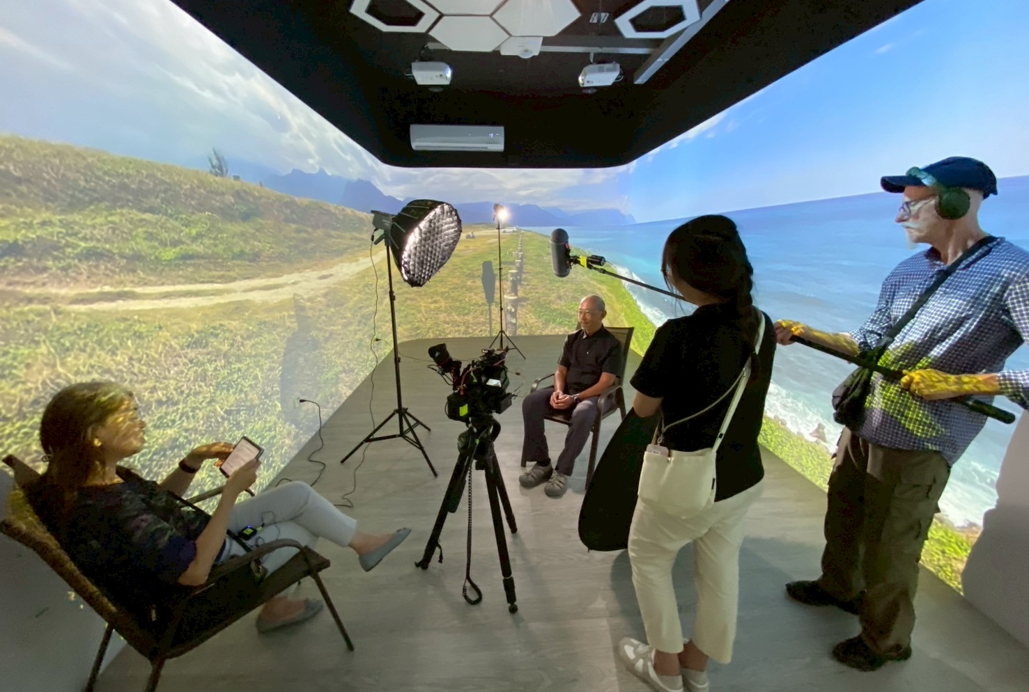
01 · WHY NOW · Charter, Article 2
Seven Mandated Tasks
設置辦法第二條 七項任務
Planning and integration of teaching, curricula, facilities and funding
規劃、整合、執行教學、課程、設備及經費之運用
1
Managing research and teaching facilities as a service
整合研究與教學設備，提供有效管理與服務
2
Hosting lectures, workshops and training programmes
舉辦學術演講、講習會及訓練班
3
Cultivating talent in agricultural therapy and green health
培育農業療癒與綠色健康人才
4
Promoting domestic and international exchange
促進與國內外相關科系及團體之交流
5
Bridging industry and government collaboration
連結業界與政府之合作可能
6
Articles five and six are the formal basis for the international platform and the commissioned research that follow.
第五、六項任務，是後續國際平台與委託研究的正式依據。
Other related research and service matters
其他相關研究與服務事宜
7
Green Health Research Center · NTU College of Bioresources and Agriculture
6

Slide 7
02
Five Laboratories
五間實驗室
Measure · Design · Validate · Prescribe.
量測 · 設計 · 驗證 · 處方。
Green Health Research Center · NTU College of Bioresources and Agriculture
7

Slide 8
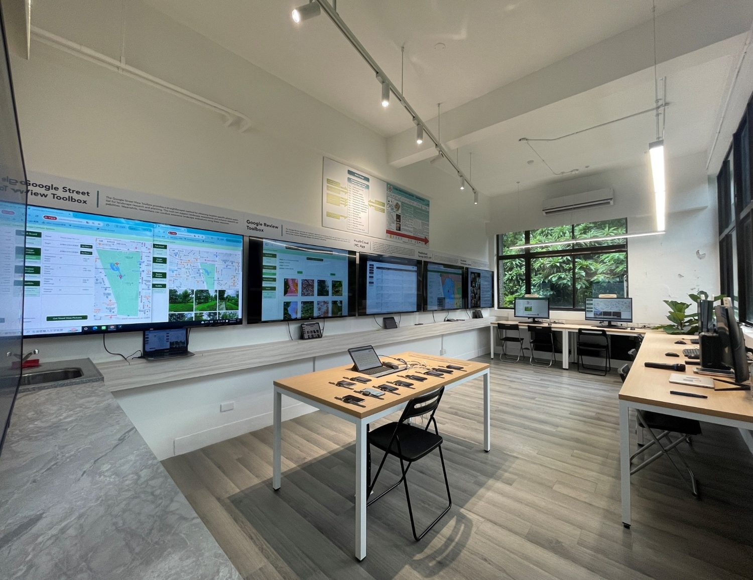
02 · FIVE LABORATORIES · 01 MEASURE · 量測
Lab 301 — Health Landscape Intelligence Lab
301 健康景觀智能室 · 負責人 張俊彥 Lead: Chun-Yen Chang
AI-workstation measurement array
AI 健康景觀智能系統
Landscape image feature extraction
健康影像處理系統
Continuous physiological data capture
長期即時生理資料收集系統
Standardised stimulus library
健康景觀影音資料庫
Therapeutic environment case archive
健康景觀案例資料庫
Qualitative content analysis
文字內容分析系統
Six systems form the data source of the entire center
Every design claim and clinical argument comes back to what is measured here.
所有設計主張與臨床論證，最終都要回到這裡的量測結果。
Green Health Research Center · NTU College of Bioresources and Agriculture
8

Slide 9

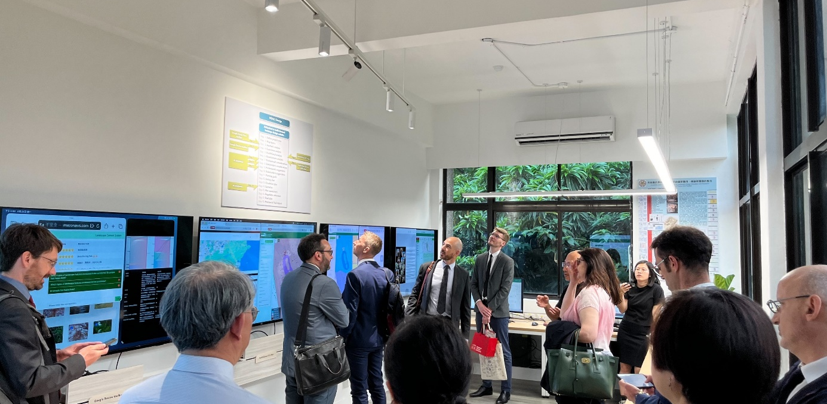
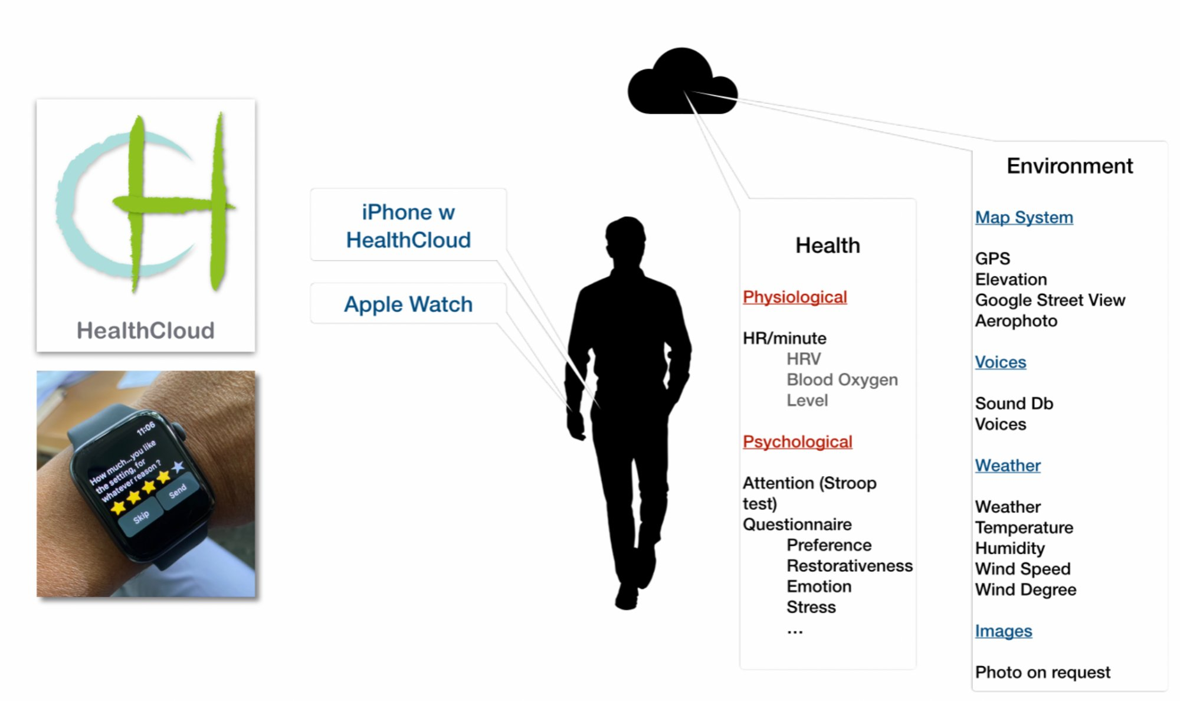
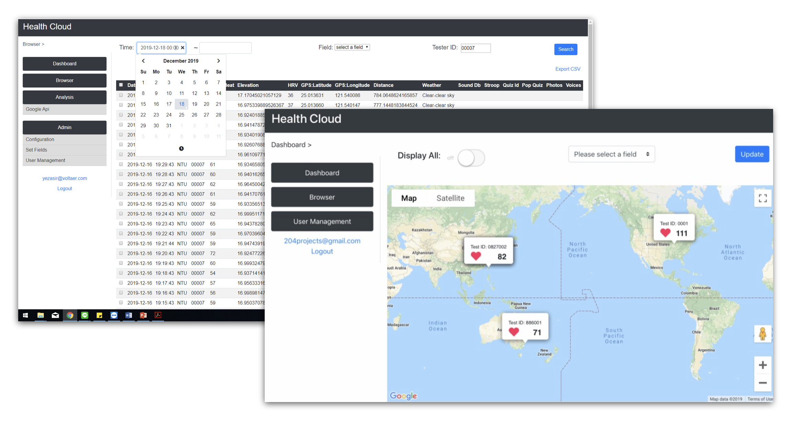
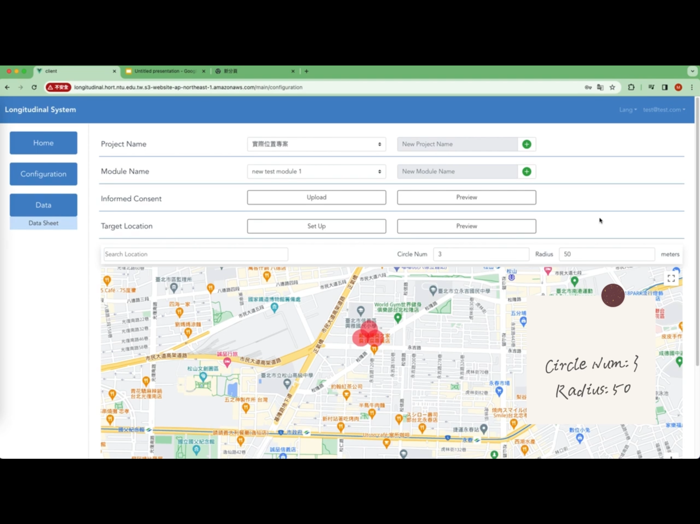
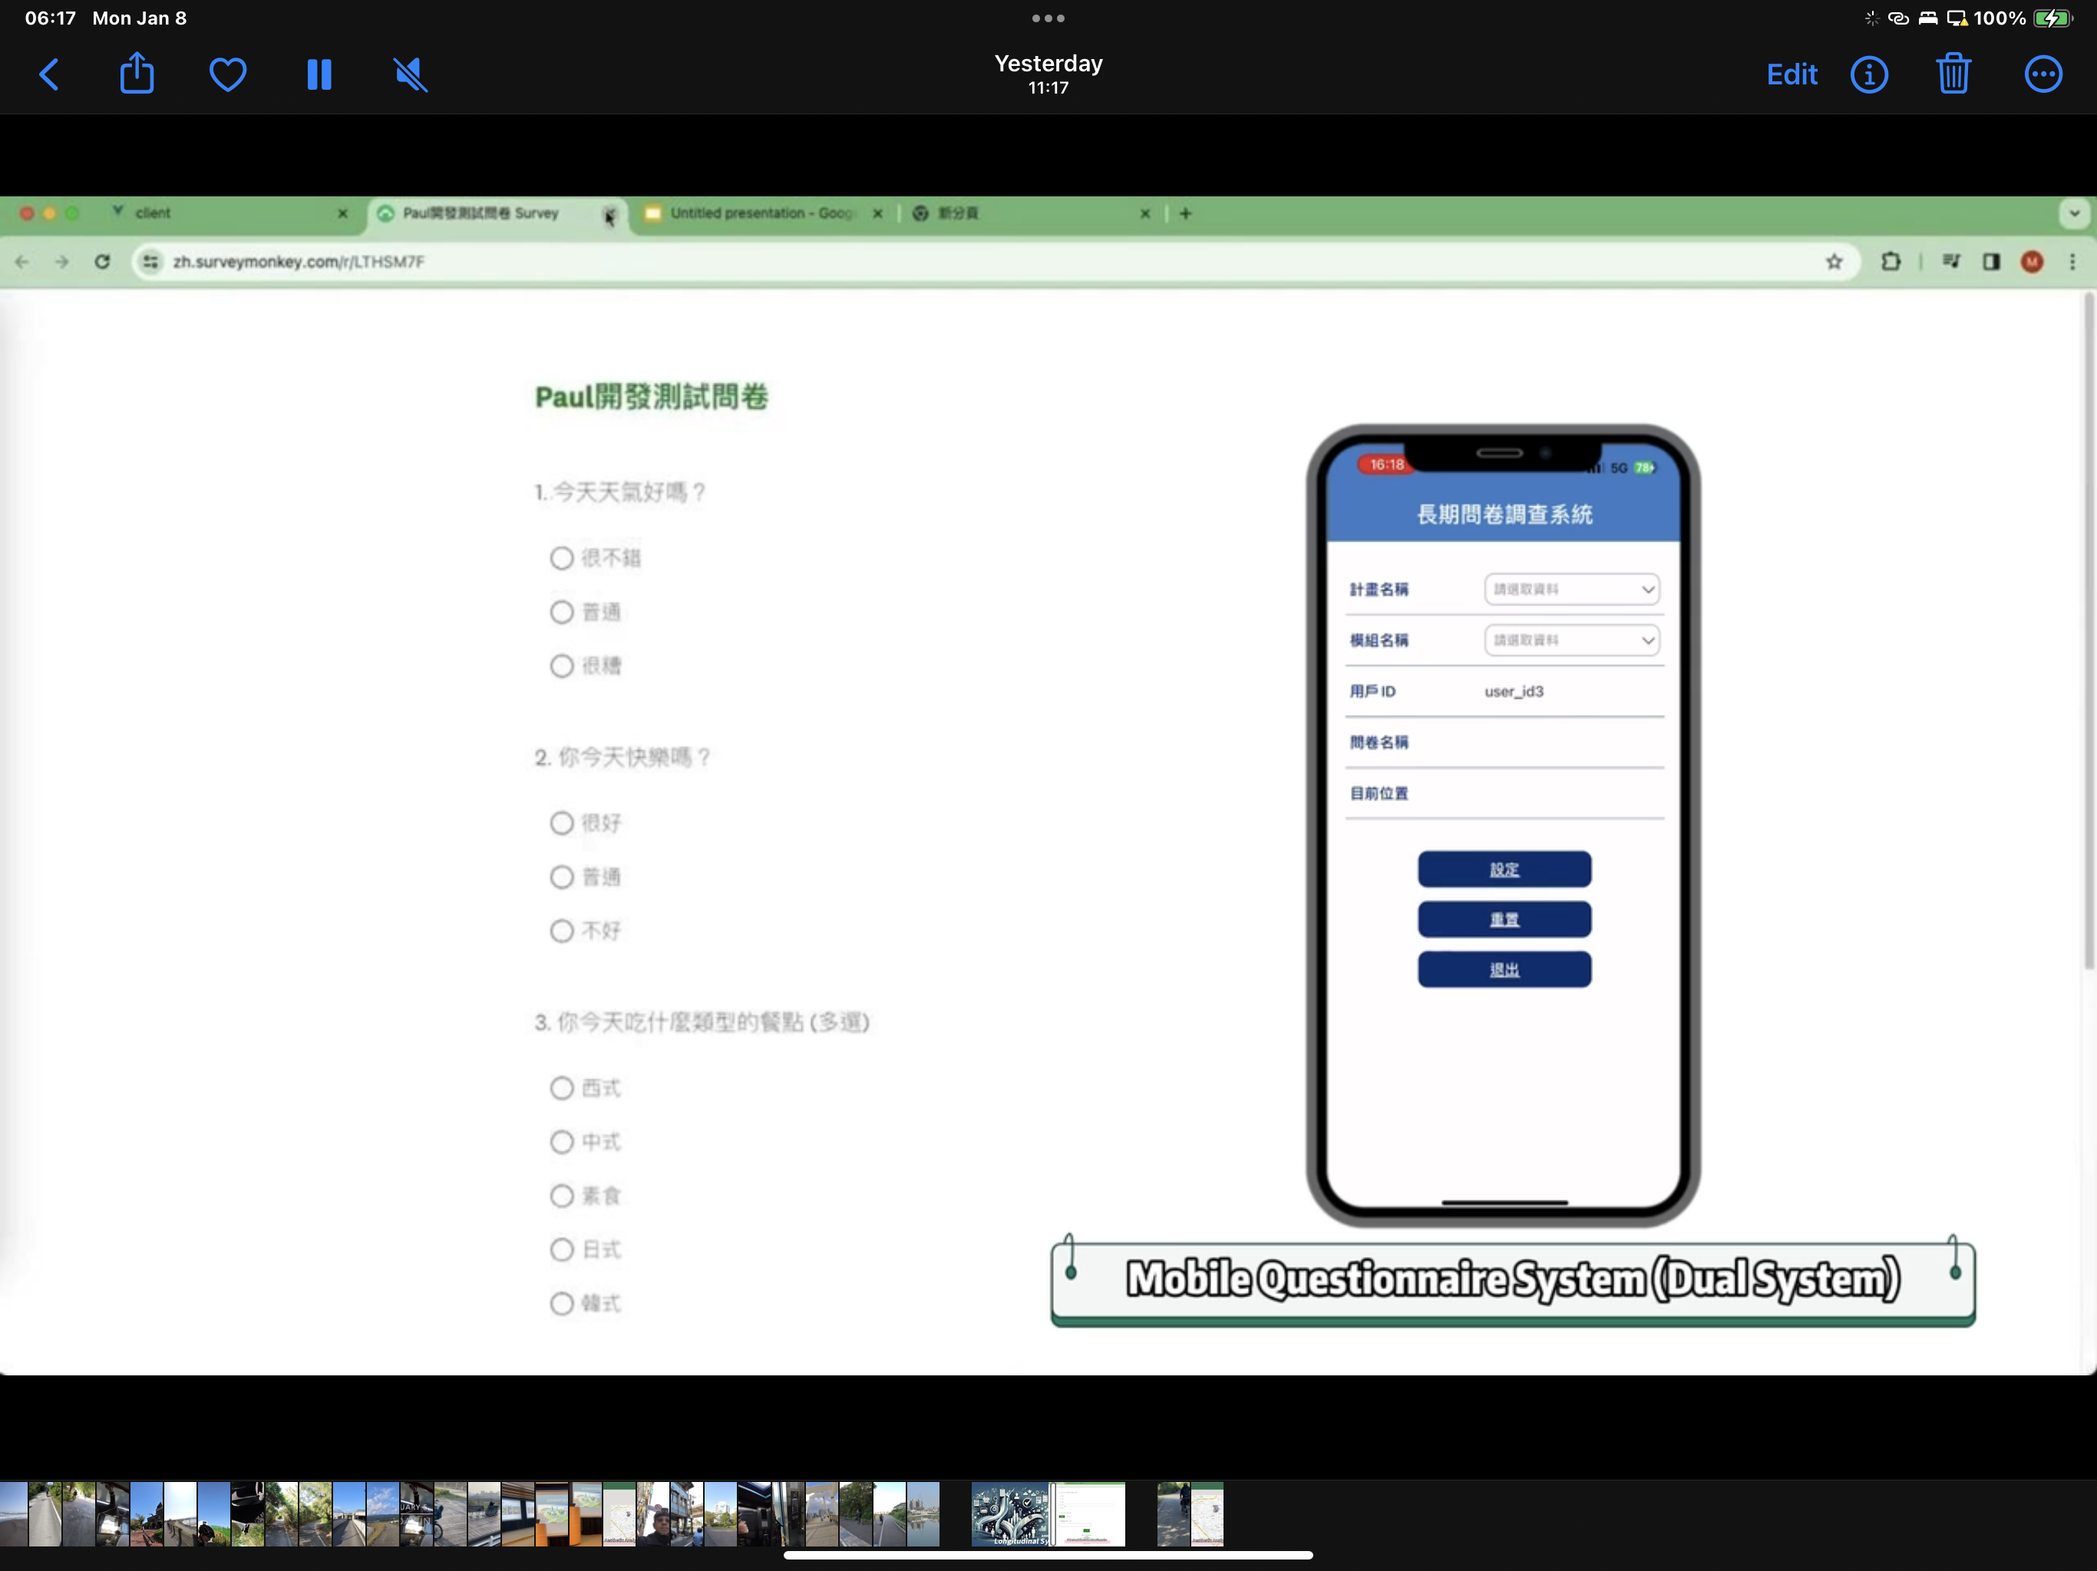
02 · FIVE LABORATORIES · 01 MEASURE · 量測
Lab 301 — Facility and Measurement Interface
301 實驗室環境與健康量測分析介面
Data-analysis workstations
健康數據分析工作站
Intelligence Lab Working Procedure
智能室工作流程
HealthCloud analytics
Health Cloud 健康量測分析
Measurement review
量測結果檢視
Psycho-Physiological dashboard
心生理資料儀表板
Real-Time review entry
即時量表作答
Green Health Research Center · NTU College of Bioresources and Agriculture
9

Slide 10
02 · FIVE LABORATORIES · 01 MEASURE · 方法論
A Landscape-Planning Journey in Seven Stations
景觀規劃打卡之旅 · 七站工具鏈
From reading the land to costing the plan — one growing project file · 從讀地到估價，一份會長大的專案檔
基
›
人
›
檢
›
協
›
斂
›
形
›
整
Site Reading
Psycho-Physiology
Ecological Check
Social Justice
Zoning and Flow
Health Vision
Synthesis
讀地
讀人
生態檢核
社會正義
分區動線
健康願景
綜整
Seven standalone tools, linked by a single project file (heals-chain) that grows at every station — from reading the site to a costed action plan.
七個各自獨立的工具，被一份會逐站長大的專案檔（heals-chain）串起來，從讀懂基地一路走到可估價的行動計畫。
Green Health Research Center · NTU College of Bioresources and Agriculture
10

Slide 11
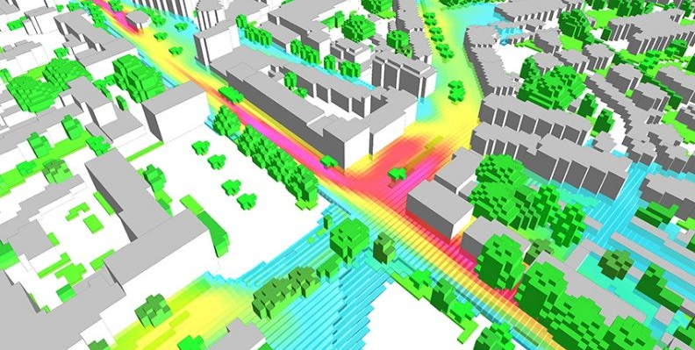
02 · FIVE LABORATORIES · 02 DESIGN · 設計
Lab 302 — Healing Environment Planning Lab
302 療癒環境規劃室 · 負責人 林寶秀 Lead: Bau-Show Lin
ENVI-met microclimate simulation
ENVI-met 微氣候模擬
Built on fluid dynamics and thermodynamics, it simulates the interaction of ground, buildings, planting and air. The digital model covers building tiers, tree canopy, grass, sidewalk, asphalt and water, and is calibrated with WatchDog weather stations and a TR-31B radiant-heat sensor.
基於流體動力學與熱力學，模擬地表、建築、植栽與空氣之交互作用；數位模型涵蓋建築分層、樹冠、草地、人行道、柏油與水體，並以 WatchDog 環境感測站與 TR-31B 熱輻射量測儀校正。
One model yields both human thermal comfort and building cooling load
Health benefit and energy use are solved in the same set of physical equations — the technical basis on which green health and smart energy are integrated, and the interface that couples micro-scale physiology upward to regional models.
同一套模型，同時算出熱舒適度與建築冷卻負荷；健康效益與能源消耗在同一組物理方程式中求解。
Green Health Research Center · NTU College of Bioresources and Agriculture
11

Slide 12
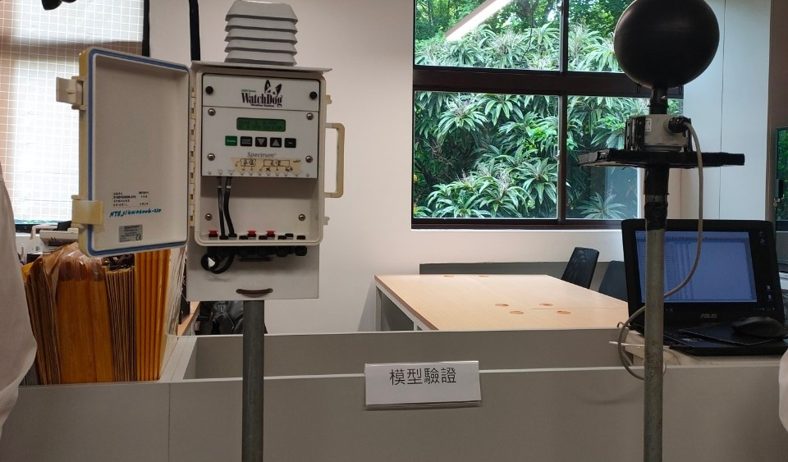
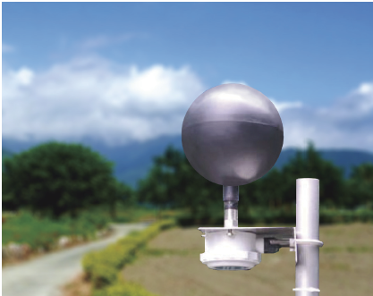
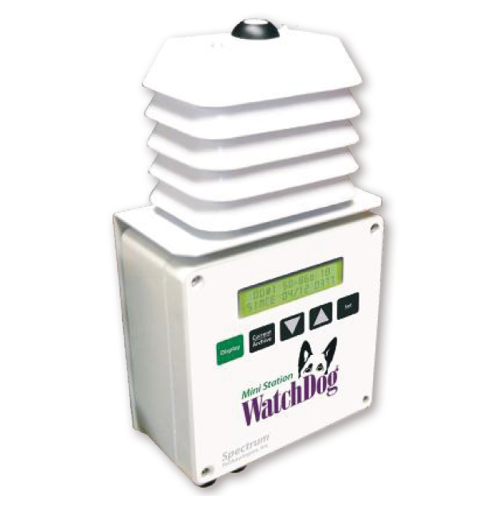
02 · FIVE LABORATORIES · 02 DESIGN · 設計
Lab 302 — Assessment Hardware
療癒環境評估組合系統—硬體設備
Globe thermometer TR-31B
熱輻射（黑球）傳送器 TR-31B
Indoor and outdoor radiant-temperature measurement
室內外環境熱輻射溫度測量
Globe temperature converted to thermal comfort
測量黑球溫度轉換熱舒適度
WatchDog Mini Stations
小型氣象站 WatchDog Mini Stations
Sensing equipment in use at Lab 302
302 規劃室感測設備實景
Real-time indoor and outdoor weather measurement
室內外環境即時氣象測量
Air temperature, humidity, wind speed and direction
測量氣溫、濕度、風速、風向等
On-site sensing calibrates the ENVI-met simulation.
感測資料用於校正 ENVI-met 模擬結果。
Green Health Research Center · NTU College of Bioresources and Agriculture
12

Slide 13
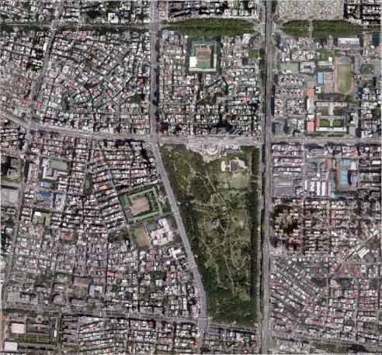
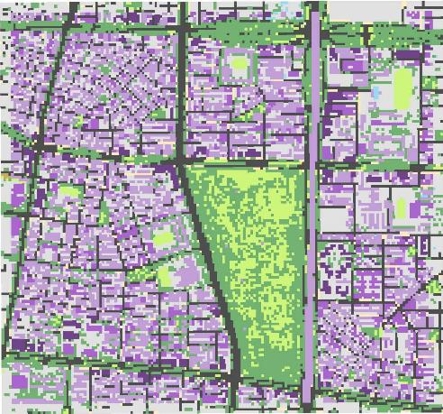
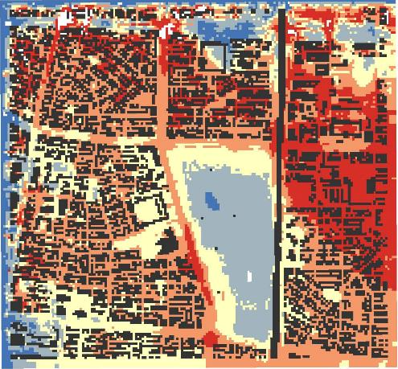
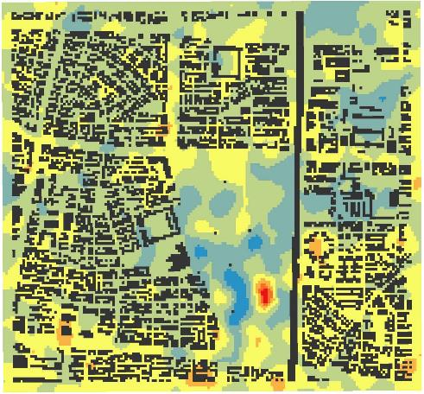
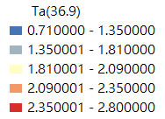
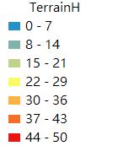
02 · FIVE LABORATORIES · 02 DESIGN · 設計
Lab 302 — Simulation Outputs
療癒環境評估組合系統 · 微氣候模擬成果
Legend
One model yields thermal-environment maps across scenarios and hours, giving planners a like-for-like basis for comparing design options.
同一組模型可輸出不同時段與不同情境的熱環境分布，作為規劃設計方案的比較依據。
Green Health Research Center · NTU College of Bioresources and Agriculture
13

Slide 14
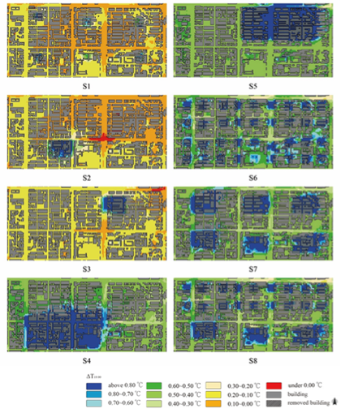
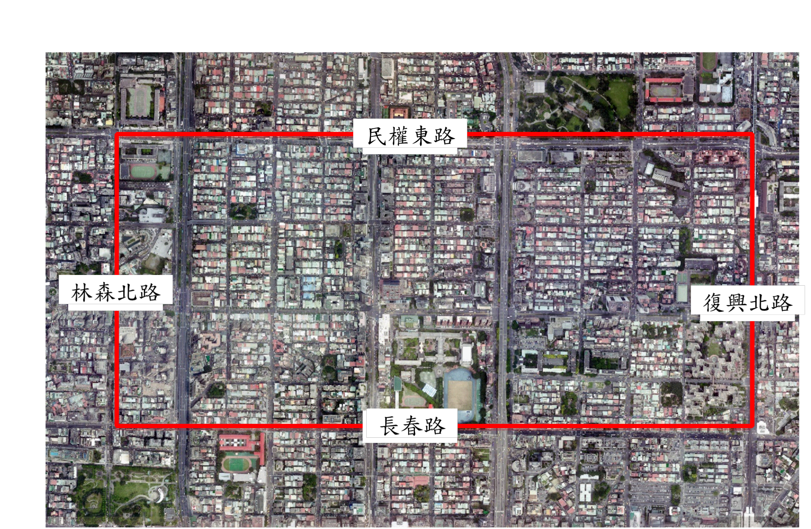
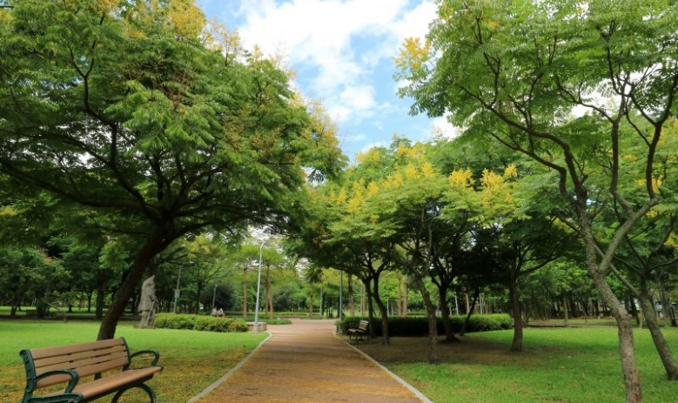
02 · FIVE LABORATORIES · 02 DESIGN · 設計
Lab 302 — Assessing Urban Park Layouts
規劃設計方案評估 · 都市公園佈局方案評估
Two layouts compared
One large park upwind
上風處的大公園
Small parks evenly distributed
平均分散的小公園
Strong district-scale cooling
區域降溫效果佳
Both layouts deliver strong district-scale cooling, on the same microclimate model.
Park layout simulation
公園佈局模擬
Site imagery and model output
基地影像與模擬輸出
Green Health Research Center · NTU College of Bioresources and Agriculture
14

Slide 15
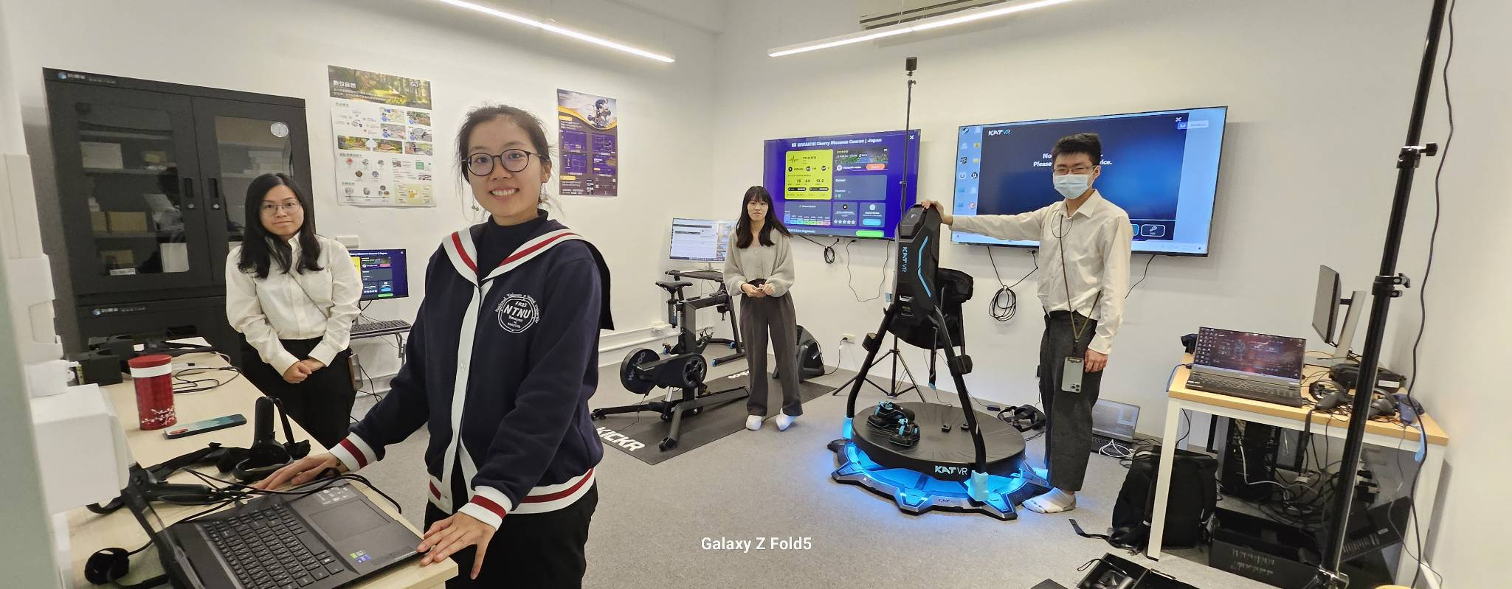
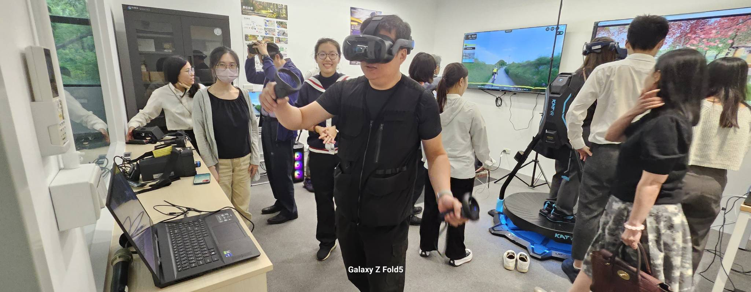
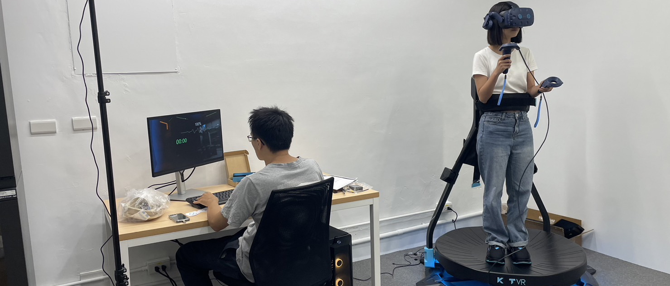
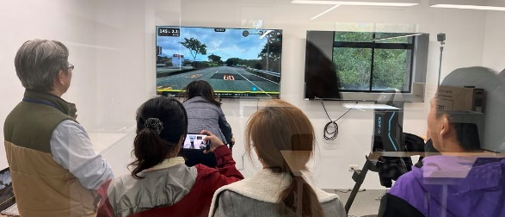
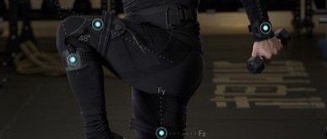
02 · FIVE LABORATORIES · 03 VALIDATE · 驗證
Lab 303 — Facility
303 景觀環境模擬室環境照 · VR 環境模擬
Simulation Lab and VR workstations
模擬室環境與 VR 工作站
Group experiment area, headset stations and control desk
團體實驗區、頭戴裝置站與控制台
Green Health Research Center · NTU College of Bioresources and Agriculture
15

Slide 16
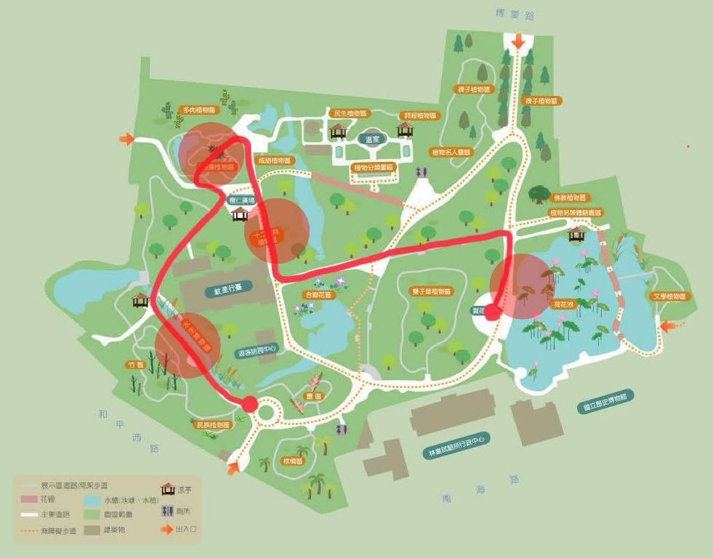
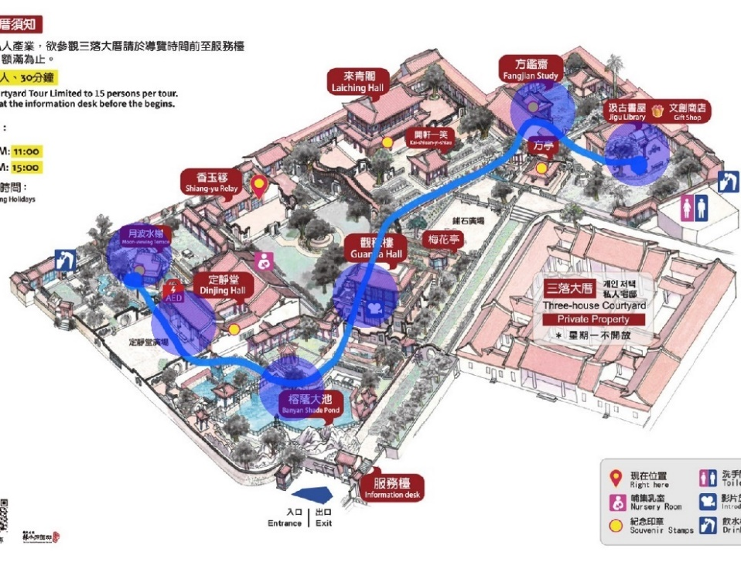
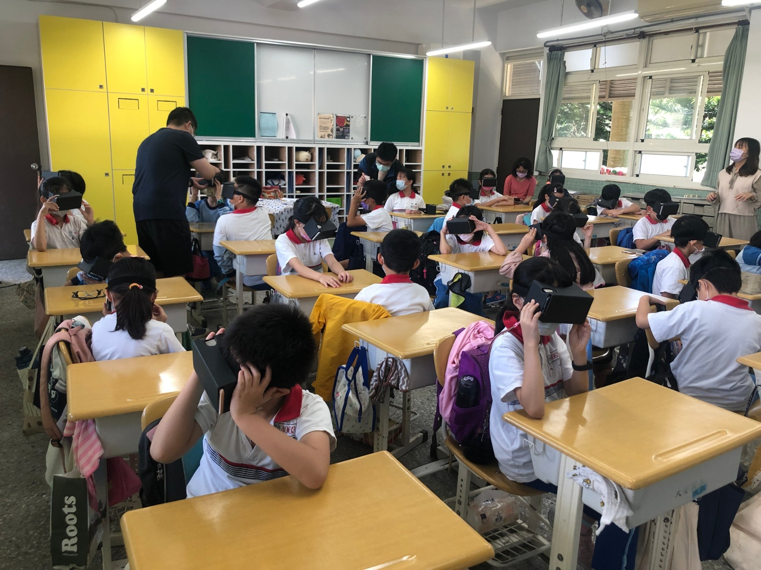
02 · FIVE LABORATORIES · 03 VALIDATE · 驗證
Lab 303 — The 360 VR Content Library
360 VR 影片與環境教育／食農教育教材
Taipei Botanical Garden
臺北植物園 · 360 VR
Lin Family Mansion and Garden
板橋林本源園邸 · 360 VR
Environmental and food-and-farming education
環境教育／食農教育
A library of on-site 360-degree footage, built for environmental and food-and-farming education.
以實地拍攝的 360 度環場影片建立教材庫，供環境教育與食農教育課程使用。
Green Health Research Center · NTU College of Bioresources and Agriculture
16

Slide 17
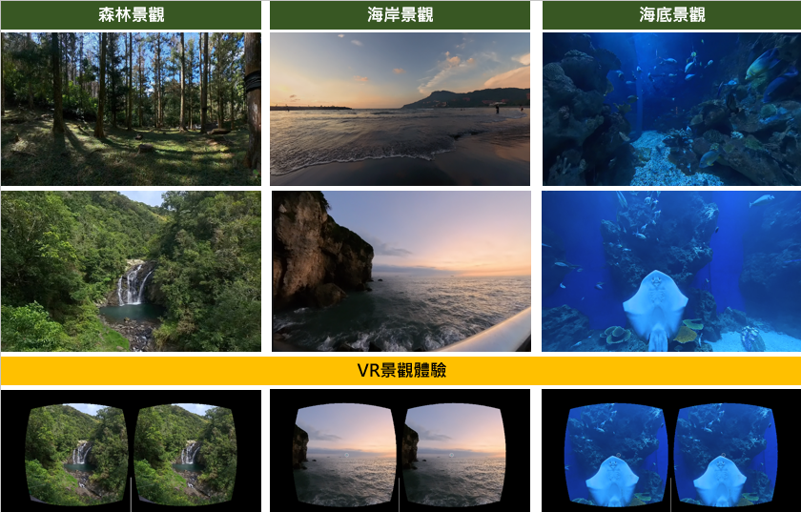
02 · FIVE LABORATORIES · 03 VALIDATE · 驗證
360 VR Cooling Landscapes in Wound-Pain Care
研究開發—360VR 景觀療癒 · VR 清涼景觀在傷口疼痛舒緩照護
Cooling association
清涼景觀
Glaciers and rivers evoke coolness, lowering the burning quality of pain.
冰川、河流的清涼感聯想，降低灼熱痛感
Attentional distraction
動態景觀
Falling water, flying birds and swimming fish draw attention away from pain.
落瀑、鳥飛、魚游轉移注意力，減輕疼痛
Film https://youtu.be/3Mqec0BQWX4
Scenes from the 360 VR wound-care intervention
介入使用之 360 VR 場景
Green Health Research Center · NTU College of Bioresources and Agriculture
17

Slide 18


02 · RESEARCH OUTCOMES · PATIENT CARE · 病患照護
When the Patient Cannot Reach the Forest
當病人無法走進自然
Spiritual care in palliative settings
360VR 觀光 末期病人靈性照護
Thirty locations across Taiwan were filmed on site and classified into physical, social and symbolic environments, forming a stimulus library for spiritual-care intervention in hospice wards.
以臺灣 30 個景點實地取景，依物理環境、社會環境、象徵環境三類分類建置素材庫，用於安寧病房的靈性照護介入。
Virtual chilling landscapes for wound care
360VR 清涼景觀 傷口疼痛舒緩
Two mechanisms run in parallel: waterfalls, rivers and ocean build a cooling association that lowers the burning quality of pain, while falling water, birds and fish draw attention away from it.
兩種機制並行：以瀑布、河流、海洋建立清涼聯想以降低灼熱痛感；以落瀑、飛鳥、游魚的動態景觀分散對疼痛的注意。
Green Health Research Center · NTU College of Bioresources and Agriculture
18

Slide 19
02 · RESEARCH OUTCOMES · FIELD IMPLEMENTATION · 場域落地
Northern Taiwan Rural Green Care Programme
北區農村綠色照顧輔導計畫
7
33
2
counties
rural communities
years
縣市
農村社區
年度
Green care recomposes the land, crops and people a village already has into a care service it can keep running. Our role is not to deliver the service but to build the model, coach local teams, and verify the outcome.
綠色照顧的核心是把農村既有的土地、作物與人力，重組成可持續運作的在地照顧服務；中心的角色不是提供服務，而是建立模型、輔導在地團隊、並驗證成效。
Green Health Research Center · NTU College of Bioresources and Agriculture
19

Slide 20
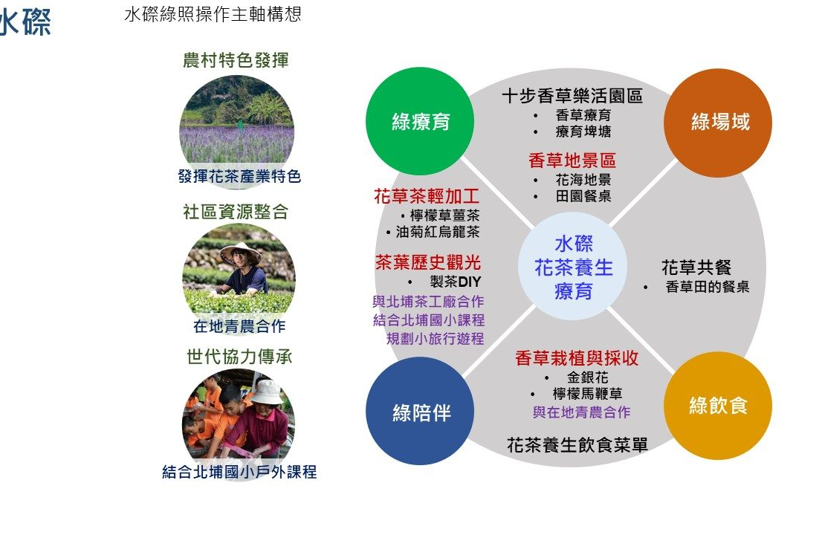
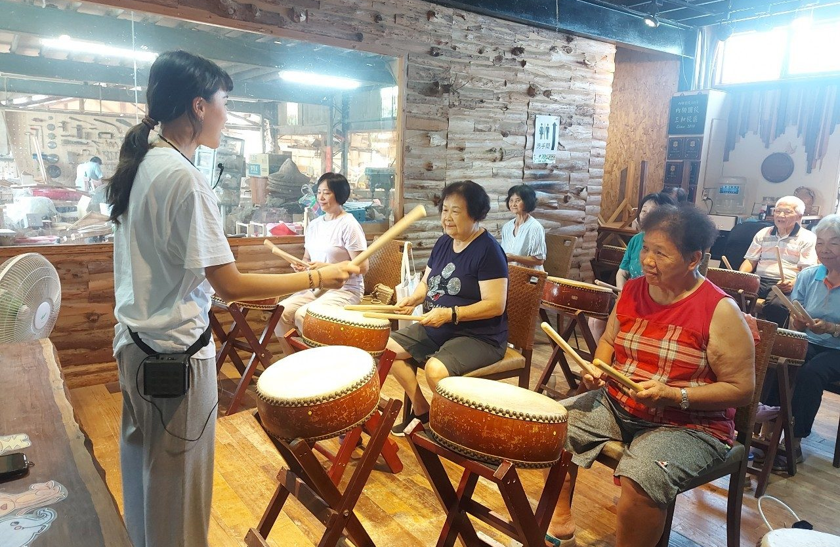
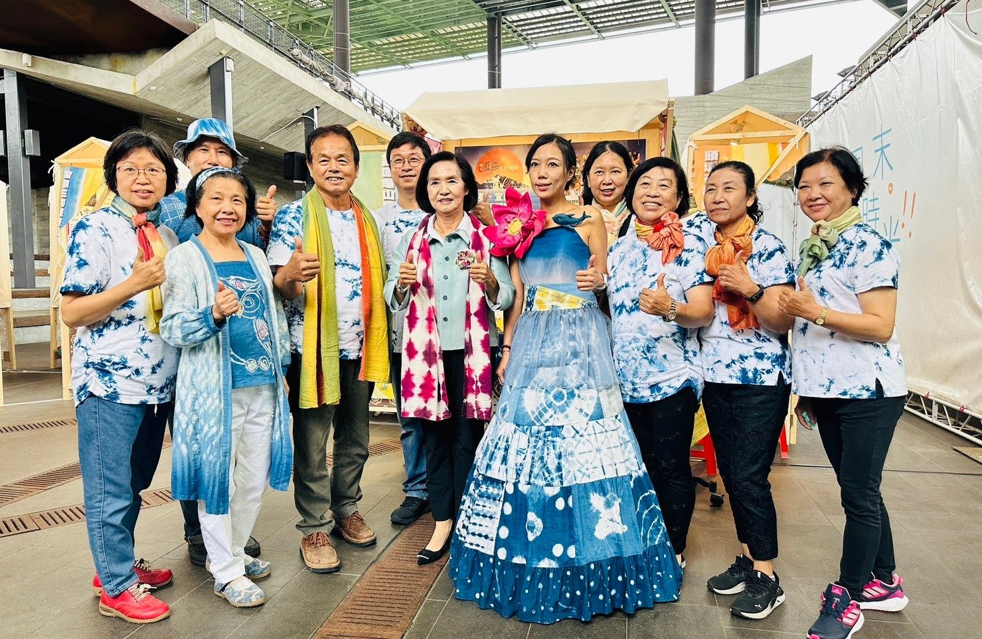
02 · RESEARCH OUTCOMES · FIELD IMPLEMENTATION · 場域落地
Four Community Models
四個代表性社區模型
Hakka Three-Herb Water Village
客家三草水磜
Green site · food · therapy
Built on the village's existing herbal-medicine culture, a three-in-one community industry model.
以客家庄既有的草藥文化為基礎，發展三位一體的社區產業模型。
Neizha Community
內柵社區
Productive ageing
Reverses the assumption that elders are care recipients, upgrading their farming skills into teaching capacity.
翻轉高齡者為被照顧者的預設，將耆老的農事技藝升級為授課能力。
Fucheng Community
福城社區
Indigo craft
A dye workshop at the core, combining indigo craft with plant-dye cuisine into one experience.
以染工坊為核心，發展藍染工藝與植物染餐食的複合體驗。
Letian Community
樂天社區
Intergenerational
International artists invited into the village, pairing home recipes with cross-generation collaboration.
邀請國際藝術家進村，結合家鄉食譜與代間協作的藝術農村。
Four models for four sets of local conditions — chosen against what a village already has, not sold as one package.
四種模型對應四種農村條件，可依社區既有資源選用，而非單一套裝方案。
Green Health Research Center · NTU College of Bioresources and Agriculture
20

Slide 21
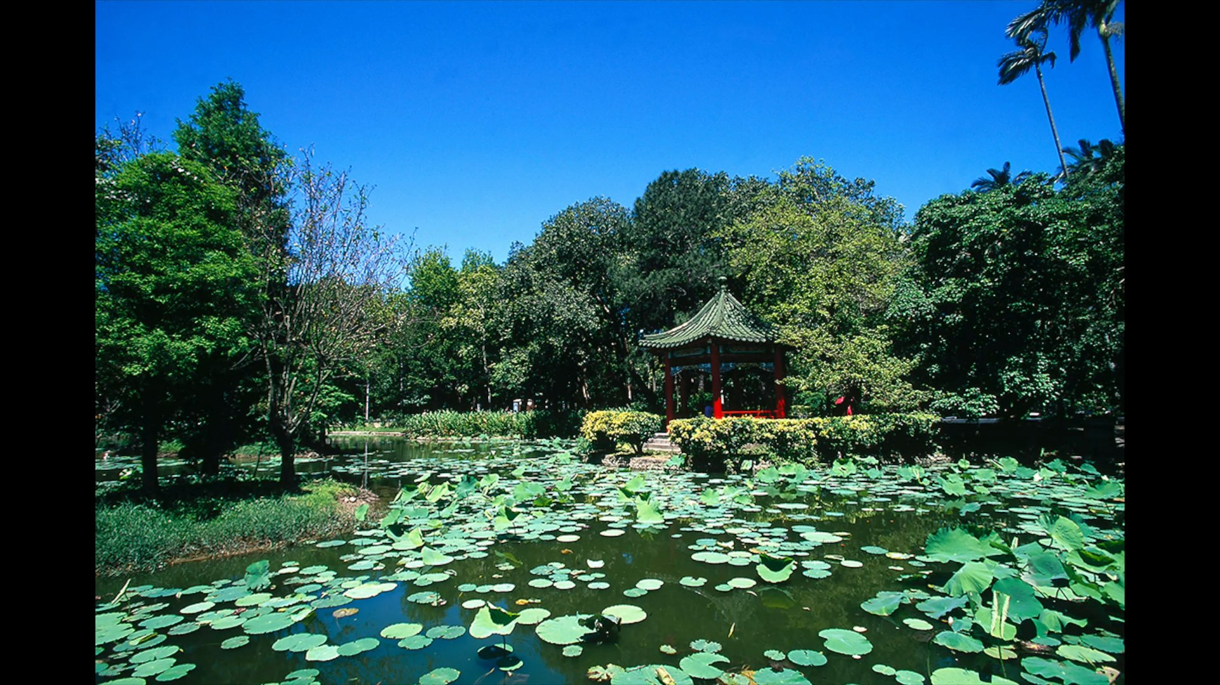
02 · FIVE LABORATORIES · 04 PRESCRIBE · 處方
Lab 304 — Panoramic Cinema Lab
304 全景影院體驗室 · 負責人 張伯茹 Lead: Po-Ju Chang
From single subject to group
從單人到團體
A head-mounted display measures one person at a time, and sample accumulation is the biggest bottleneck in intervention research. A 360-degree theater lets a whole cohort receive the same intervention simultaneously — the key to scaling the work up.
頭戴式裝置一次只能量一個人，樣本累積速度是介入研究最大的瓶頸；360 度全景劇場讓整組受試者同步接受介入，是研究規模化的關鍵設備。
Research 研究
Teaching 教學
Outreach 推廣
Synchronised group interventions and control-group design
團體同步介入實驗與對照組設計
Course demonstrations and cross-department experience classes
課程演示與跨系所體驗課程
Guided visits, exhibitions and international exchange
參訪導覽、展覽與國際交流展示
Funded by the College in 2024; opened 17 February 2025. 2024 年生農學院補助建置，2025 年 2 月 17 日啟用。
Green Health Research Center · NTU College of Bioresources and Agriculture
21

Slide 22
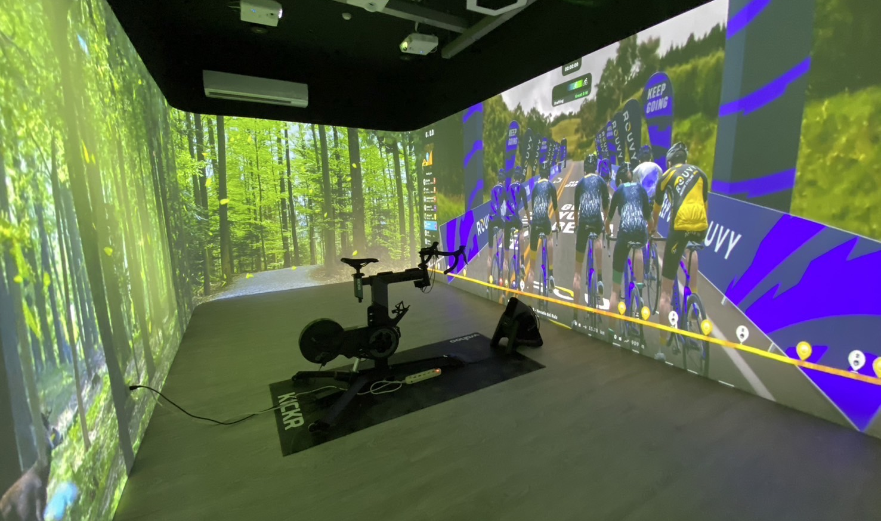
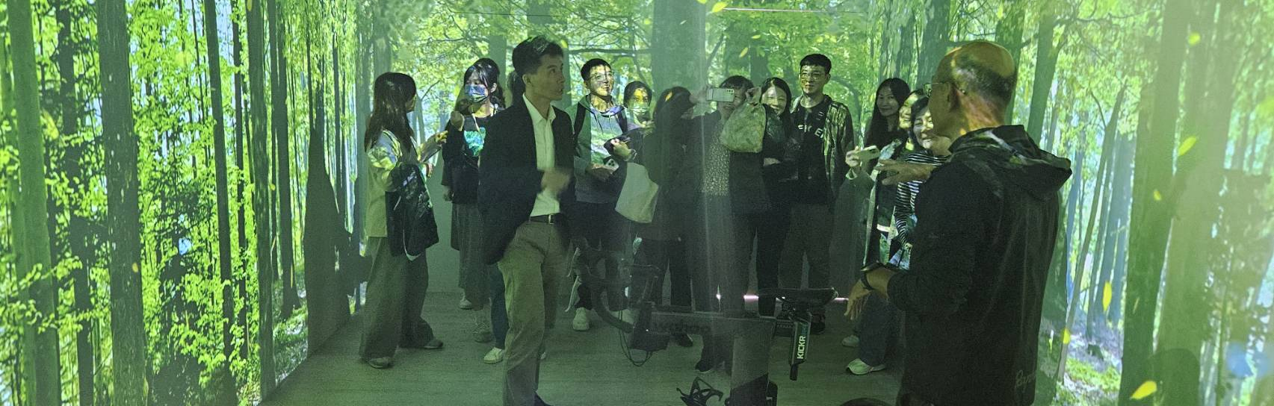
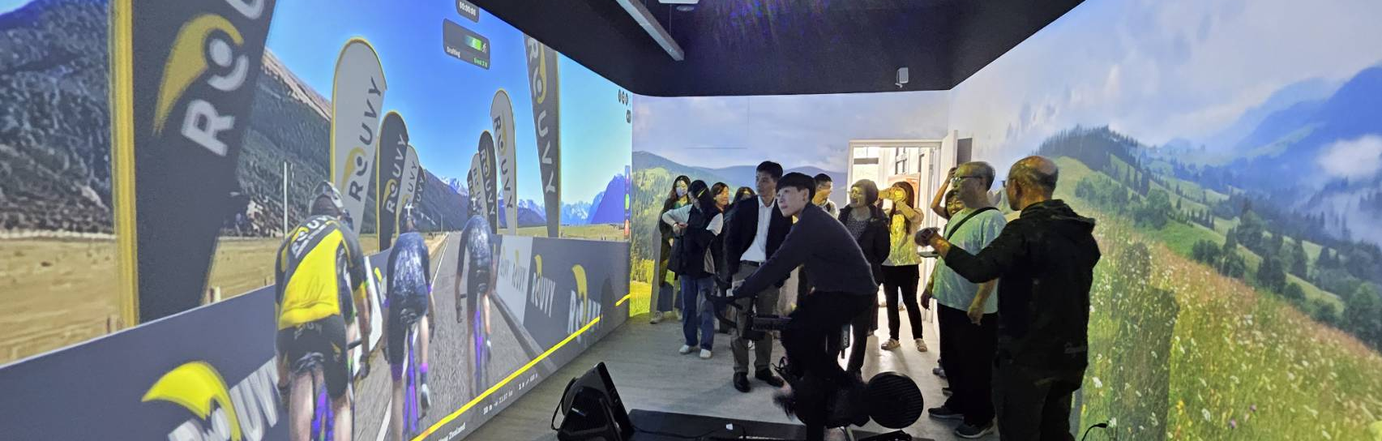

02 · FIVE LABORATORIES · 04 PRESCRIBE · 處方
Lab 304 — Facility
304 全景影院體驗室環境照 · 全景劇院 CAVE VR
Panoramic cinema, CAVE VR
全景劇院 CAVE VR
Group sessions in the cinema lab
團體同步介入場景
Green Health Research Center · NTU College of Bioresources and Agriculture
22

Slide 23
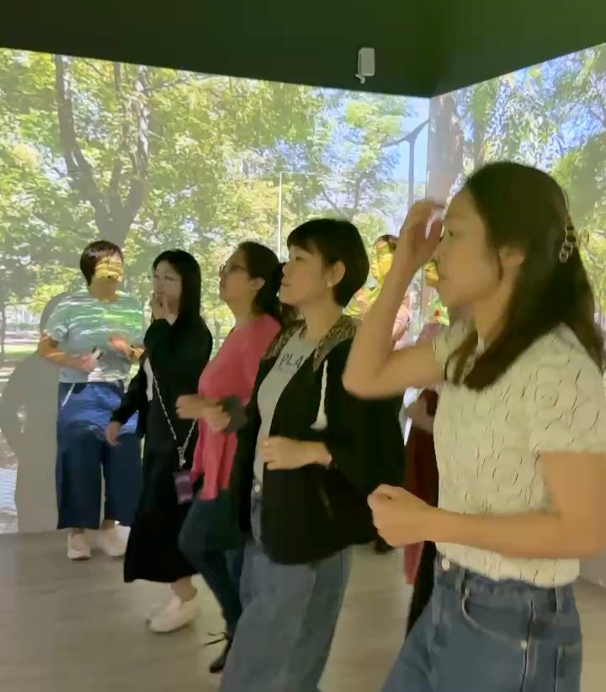
02 · RESEARCH OUTCOMES · FLAGSHIP STUDY · 旗艦案例
Slow Jogging in an Immersive CAVE for Chronic Low Back Pain
VR CAVE 超慢跑對慢性下背痛之效益 · NTU × NTU Hospital
Participants 受試對象
Inclusion 納入條件
Aged 55 and over
55 歲以上
Chronic back discomfort for three months or more
慢性背部不適三個月以上
Capacity 體能要求
Protocol 介入週期
Able to do 20 minutes of light activity
可進行 20 分鐘輕度活動
Four weeks, once a week, about one hour each
四週，每週一次，每次約一小時
A defined clinical population, a scenario-controlled design, a hospital partner and a fixed intervention cycle — of all the center's studies, this comes closest to a green prescription in the strict sense.
有明確的臨床對象、有情境對照設計、有醫院合作、有固定介入週期——這是中心所有研究中，最接近「綠色處方」實質定義的一項。
The closest thing we have to a genuine green prescription.
Green Health Research Center · NTU College of Bioresources and Agriculture
23

Slide 24
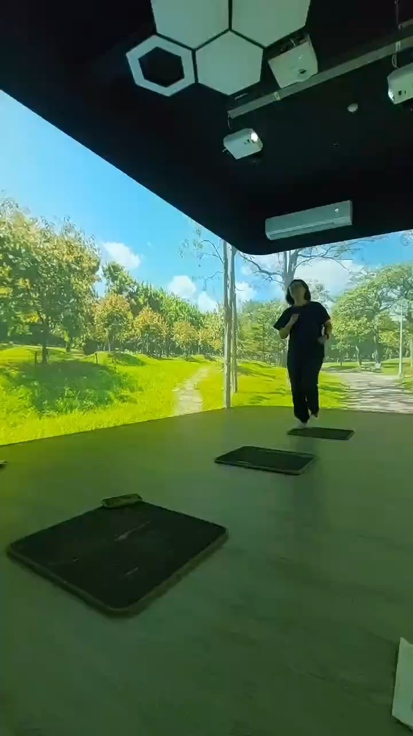
02 · RESEARCH OUTCOMES · FLAGSHIP STUDY · 旗艦案例
Film — Slow Jogging in an Immersive CAVE
VR CAVE 超慢跑對慢性下背痛之效益 研究影片
▶ Film 影片
Clinical intervention with NTU Hospital
臺大醫院跨域合作之臨床介入實況
▶ Video · 影片（另附連結）
Green Health Research Center · NTU College of Bioresources and Agriculture
24

Slide 25
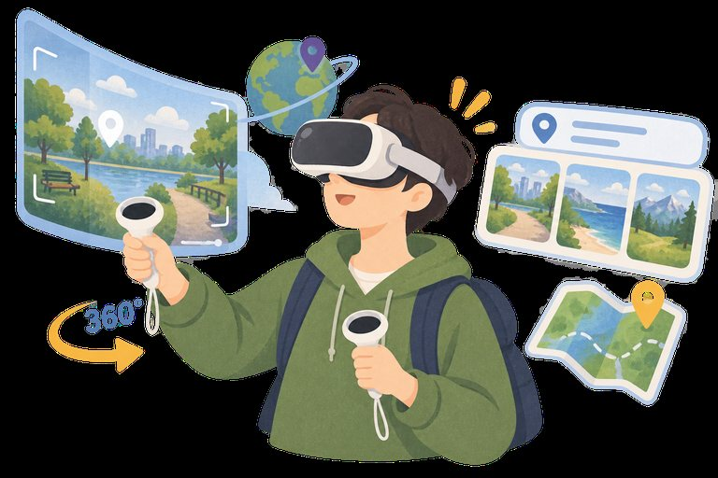

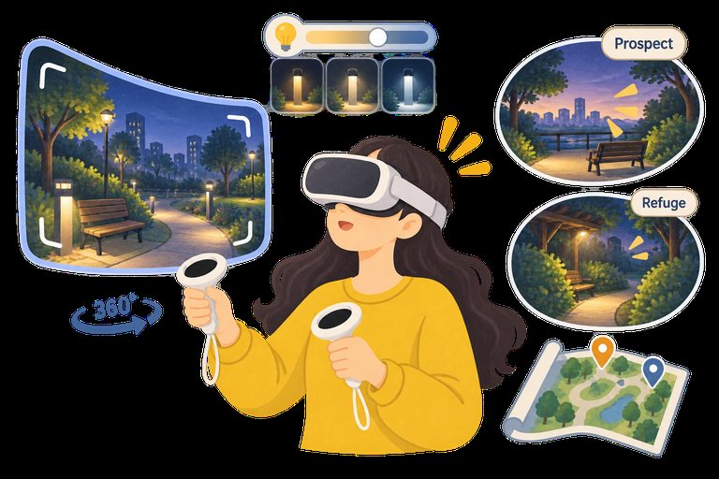
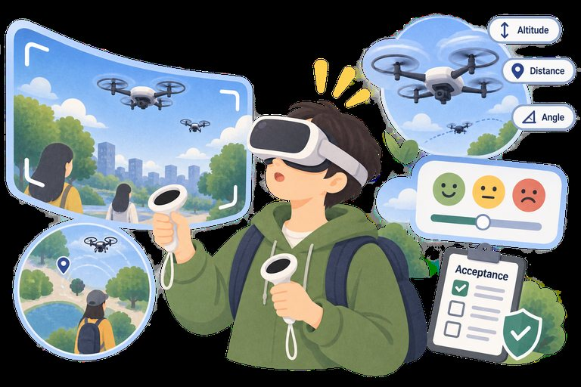
02 · FIVE LABORATORIES · 05 PERCEIVE · 知覺
Lab 305 — Landscape and Place: Selected IVR Studies
景觀與場所 沉浸式虛擬實境研究選輯 2019–2025 · 鄭佳昆 Chia-Kuen Cheng
Travel Behavior — Virtual Tour
Spatial Perception — Crowding
Landscape Lighting
Drone Perception & Acceptance
旅遊行為—虛擬導覽
空間知覺—擁擠感
景觀照明
無人機知覺與接受度
Can an IVR art exhibition substitute for an actual visit?
探討 IVR 展覽能否替代實地造訪。
How distance, crowd size and place context shape perceived crowding and acceptability.
距離、人數與場所脈絡如何影響擁擠感知與可接受度。
How light colour affects emotion and preference, in physical versus virtual settings.
光色在實體與虛擬環境中對情緒與偏好的影響。
How drone height and direction affect safety, privacy and acceptability.
無人機高度與方向對安全感、隱私感與接受度的影響。
Four studies on one methodological platform: immersive VR lets variables be manipulated and psychological responses measured under repeatable, controlled conditions — which is exactly what the Lab 303 equipment is for.
四項研究以沉浸式虛擬實境（IVR）為共同方法平台，在可控且可重複的情境中操作變因、量測心理反應。
Green Health Research Center · NTU College of Bioresources and Agriculture
25

Slide 26
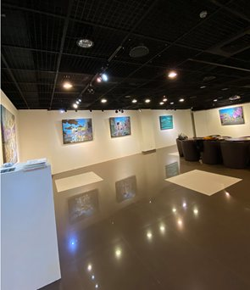
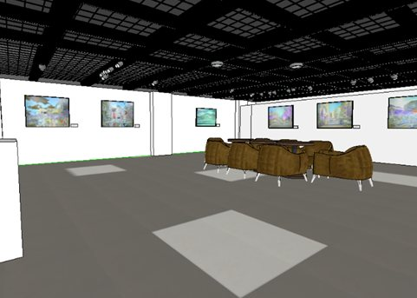
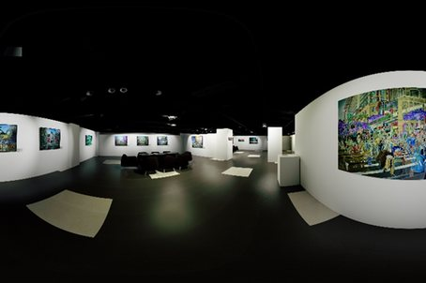
02 · FIVE LABORATORIES · 05 PERCEIVE · 知覺 · IVR STUDY 01
Travel Behavior — Virtual Tour (IVR)
旅遊行為—虛擬導覽 · IVR 能否替代實地造訪
Objectives
Research tool
研究目的
研究工具
Examine how visit motivation and enduring involvement influence perceived similarity between IVR and actual experience
檢視造訪動機與持久涉入如何影響感知相似性
The “City Tempo Oil Painting Exhibition” was modelled in SketchUp and rendered in Enscape. Participants explored it through HTC Vive and moved freely with the controllers.
以 SketchUp 建模、Enscape 渲染重建展場，受試者透過 HTC Vive 自由移動。
Explore the role of perceived similarity in evaluating IVR and actual experiences
探討感知相似性在評價體驗時的角色
Investigate whether IVR can substitute for actual visits and affect future visit intention
檢驗 IVR 能否替代實地造訪並影響造訪意願
Site photo · SketchUp model · Enscape rendering
Motivation
＋
Enduring Involvement
→
Perceived Similarity
→
Intention to Visit
造訪動機
持久涉入
感知相似性
造訪意願
IVR may substitute for actual visits when perceived similarity is high; different motivations and levels of involvement lead to different similarity judgements and visit intentions.
當感知相似性夠高時，IVR 有機會替代實地造訪。 · 陳璿卉（2019）以沉浸式虛擬實境探討活動涉入、感知相似性與造訪意願之關係，國立臺灣大學園藝暨景觀學系碩士論文。
Green Health Research Center · NTU College of Bioresources and Agriculture
26

Slide 27
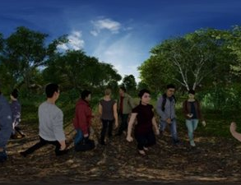
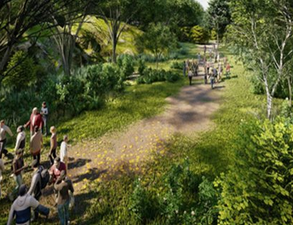
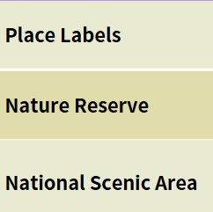
02 · FIVE LABORATORIES · 05 PERCEIVE · 知覺 · IVR STUDY 02
Spatial Perception — Crowding: Study Design
空間知覺—擁擠感 · 研究設計與實驗情境
Objectives
研究目的
Examine how environment, crowd size and distance affect spatial perception
環境、人數與距離如何影響空間知覺
Analyse how distance and crowd size jointly influence perceived crowding
距離與人數如何共同影響擁擠感知
Explore how a dynamic approach affects personal-space pressure
動態接近對個人空間壓力的影響
Urban park
都市公園情境
Forest trail
森林步道情境
Place labels
場所標示操作
Compare perceived crowding against spatial acceptability
擁擠感知與空間可接受度的差異
Participants: 48 · Perceived crowding and acceptability measured
受試者 48 人，量測擁擠感知與可接受度
Exp. 1
Exp. 2
Exp. 3
Location context
Interpersonal distance
Dynamic × context
場所脈絡
人際距離
動靜態 × 場所脈絡
Tests how location context — a nature reserve versus a national scenic area — affects crowding and acceptability.
檢驗場所脈絡如何影響擁擠感知與可接受度。
Tests how interpersonal distance affects crowding and acceptability.
檢驗人際距離如何影響擁擠感知與可接受度。
Tests the combined effects of dynamic/static change and location context.
檢驗動靜態變化與場所脈絡的交互作用。
Pei-Ching Cho (2024), master's thesis 卓沛璟（2024）不同因子對擁擠感知與可接受度的影響，國立臺灣大學園藝暨景觀學系。
Green Health Research Center · NTU College of Bioresources and Agriculture
27

Slide 28
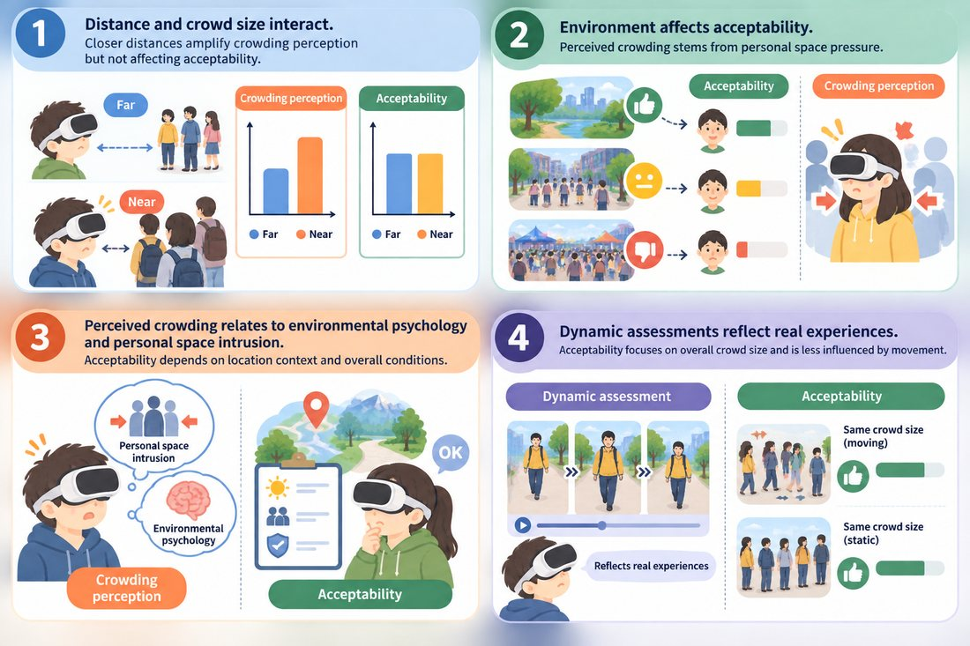
02 · FIVE LABORATORIES · 05 PERCEIVE · 知覺 · IVR STUDY 02
Spatial Perception — Crowding: Findings
空間知覺—擁擠感 · 研究發現
Distance and crowd size interact
距離與人數交互作用
Closer distances amplify perceived crowding but do not directly change acceptability.
1
Environment affects acceptability
環境影響可接受度
Acceptability depends on location context and overall conditions, not distance alone.
2
Crowding stems from personal-space pressure
擁擠感源自個人空間壓力
Perceived crowding relates to environmental psychology and personal-space intrusion.
3
Dynamic assessment reflects real experience
動態評估反映真實體驗
Acceptability focuses on overall crowd size and is less influenced by movement.
4
Summary of the four crowding findings
四項研究發現彙整圖
Pei-Ching Cho (2024) 卓沛璟（2024）碩士論文
Green Health Research Center · NTU College of Bioresources and Agriculture
28

Slide 29

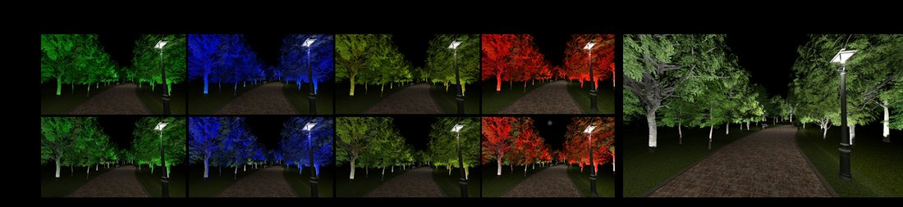
02 · FIVE LABORATORIES · 05 PERCEIVE · 知覺 · IVR STUDY 03
Landscape Lighting — Physical and Virtual
景觀照明 · 實體與虛擬環境中的光色反應
Objectives
研究目的
Compare lighting responses in physical and virtual settings
比較實體與虛擬環境中的照明心理反應
Test the feasibility of VR for coloured-lighting research
評估以 VR 模擬進行光色研究的可行性
How light colour affects emotional response and preference
不同光色如何影響情緒反應與偏好
How colour rendering shapes environmental perception
光色與演色性如何影響環境知覺
Park landscape simulated in IVR, with tree uplighting
以 IVR 模擬戶外公園，並以樹木投射燈建立不同光色情境
Findings 研究發現
Red light — least preferred, more negative affect 紅光最不受偏好
Yellow and white light — more comfortable and stable 黃光與白光較舒適穩定
Mixed white light — most positive and most preferred 混合白光最受偏好
Constructs: light intensity, brightness, visual and locomotor accessibility, prospect, refuge.
Coloured-light scenarios
不同光色情境
Green Health Research Center · NTU College of Bioresources and Agriculture
29

Slide 30

02 · RESEARCH OUTCOMES · COMMISSIONED RESEARCH · 委託研究
Commissioned Research Projects
承攬執行之委託研究計畫
Project 計畫名稱 | Client 委託單位 | Year
Environmental improvement and horticultural-therapy zone design, Taoyuan DARES Taipei branch 科技導入桃園改良場臺北分場環境改善規劃與園藝治療區環境設計研究 | Taoyuan DARES, MOA 農業部桃園區農業改良場 | 2024
Northern Taiwan rural green-care guidance programme 北區農村綠色照顧輔導計畫 | Rural Development and Soil and Water Conservation Agency, MOA 農業部農村發展及水土保持署 | 2024
Northern Taiwan rural green-care guidance programme 北區農村綠色照顧輔導計畫 | Balba Creative Development Consulting (industry–academia) 巴爾巴創意開發管理顧問（產學合作） | 2025
Landscape quality and human-friendliness around urban transport nodes: an AI-based assessment method 探討都市交通節點周邊景觀美質與人本友善性：基於人工智慧的評估法 | CECI Engineering Consultants 台灣世曦工程顧問 | 2025
VR-assisted participatory design for urban renewal 虛擬實境輔助都市更新參與式設計 | Taipei Urban Regeneration Office; Jing-Dian Landscape 臺北市都市更新處、經典景觀工程顧問 | 2024
VR for mower and tiller training (supporting role) VR 於割草機及中耕機教育訓練之應用（協助執行） | Taoyuan DARES via NTU Smart Agriculture Center 桃園場委託臺大智慧農業中心 | 2024
Market validation across sectors
Clients span central ministries, city government and private consultancies — evidence that the center's technical capability has been tested outside academia.
委託來源涵蓋中央部會、地方政府與民間工程顧問公司。
Green Health Research Center · NTU College of Bioresources and Agriculture
30

Slide 31
03
Talent and Education
人才與教育
Curriculum, student ventures, exhibitions and media.
課程教學、學生創業、展覽與媒體推廣。
Green Health Research Center · NTU College of Bioresources and Agriculture
31

Slide 32

03 · TALENT AND EDUCATION · 人才與教育
Student Innovation Awards, Three Cycles Running
學生創新創業 連續三屆獲獎
Silver 銀獎
Digital Nature 數位自然
2022
A VR healing-experience team, later invited to exhibit at Bio Asia-Taiwan and the Senior Health Industry Expo.
VR 療癒體驗團隊，後獲邀參展 Bio Asia-Taiwan 及高齡健康產業博覽會。
Gold 金獎
Mindful Wanderer
2023
A spontaneous-travel service design pairing randomness with mindfulness.
即興出遊服務設計，結合隨機性與正念體驗的旅遊模式。
Gold 金獎
Eco LeARn
2025
An AR nature-education app that turns outdoor environmental education into a game.
自然教育 AR 學習應用程式，將戶外環境教育遊戲化。
All three teams were supervised by center laboratories — research capacity converting reliably into student ventures.
三屆獲獎團隊皆由中心相關實驗室指導，顯示研究能量已能穩定轉化為學生的創業提案。
Green Health Research Center · NTU College of Bioresources and Agriculture
32

Slide 33

03 · TALENT AND EDUCATION · 人才與教育
Exhibitions and Public Outreach
對外展覽與科普推廣
2025 Senior Health Industry Expo
1
2025 高齡健康產業博覽會
2025 Rural Regeneration Showcase
2
2025 農村再生成果展
2025 NTU Future University XR
3
2025 臺大未來大學 XR 展
VR CAVE Art Therapy exhibition
4
VR CAVE 藝術療癒展
Exhibitions and media are the main entry point for visit requests.
展覽與媒體是中心對外能見度的主要來源，也是參訪需求的入口。
Media coverage 媒體報導
2025.07 NTU Alumni Bimonthly feature interview
2025.08.31 Australian director, “Brain Garden” documentary
PTS documentary team 公共電視紀錄片團隊取材
Green Health Research Center · NTU College of Bioresources and Agriculture
33

Slide 34





03 · TALENT AND EDUCATION · 人才與教育 · 展覽
Exhibition — 2025 Rural Regeneration Showcase
展覽—2025 農村再生成果展
Exhibition coverage
展覽相關報導
NTU booth and public sessions at the 2025 Rural Regeneration Showcase
臺大展位與現場體驗活動
Green Health Research Center · NTU College of Bioresources and Agriculture
34

Slide 35








03 · TALENT AND EDUCATION · 人才與教育 · 展覽
Exhibition — 2025 Senior Health Industry Expo
展覽—2025 高齡健康產業博覽會
The center's VR healing experience at the 2025 Senior Health Industry Expo — one of its most visible annual showcases.
中心於高齡健康產業博覽會展出 VR 療癒體驗，為對外能見度最高的年度展會之一。
Green Health Research Center · NTU College of Bioresources and Agriculture
35

Slide 36
04
International Platform
國際平台
Eight universities, two signed partnerships, one joint center.
八校平台、兩項已簽署合作、一座籌設中的聯合中心。
Green Health Research Center · NTU College of Bioresources and Agriculture
36

Slide 37

04 · INTERNATIONAL PLATFORM · 國際平台
Landscape and Human Health — An Eight-University Platform
國際合作研究平台 · 八校成員
Asia 亞洲
Americas 美洲
National Taiwan University
國立臺灣大學
Taiwan
University of Illinois Urbana-Champaign
伊利諾大學
UIUC
University of Hong Kong
香港大學
Hong Kong
Cornell University
康乃爾大學
Cornell
Chiang Mai University
清邁大學
Thailand
Texas A&M University
德州農工大學
Texas A&M
Konkuk University
建國大學
Korea
Michigan State University
密西根州立大學
MSU
Eight universities on one theme — landscape and human health — sustained by joint conferences, student exchange and co-authored research.
八校平台以景觀與人類健康為共同主題，透過研討會、學生互訪與聯合研究維持運作。
Green Health Research Center · NTU College of Bioresources and Agriculture
37

Slide 38

04 · INTERNATIONAL PLATFORM · 國際平台
Signed and Established Partnerships
已簽署與已成形的合作
Joint master's programme with UT Arlington
德州大學阿靈頓分校建築學院來訪，促成景觀學聯合碩士學程。
2024.06.21
MOU signed with Konkuk University
韓國建國大學農業治癒融合研究中心來臺，正式簽署合作備忘錄。
2025.04.21
UT Arlington student delegation visit
德州大學阿靈頓分校學生團來訪，進行實驗室體驗與交流。
2025.05.20
Konkuk has reached reciprocal-visit stage; UT Arlington has advanced to degree-programme level — the most institutionalised line to date.
與建國大學已進入雙向互訪階段；與德州大學阿靈頓分校則推進到學位學程層級。
Reciprocal visit to Konkuk University
中心主任與顧問回訪建國大學，商討研究合作與課程互通。
2025.11.25
Green Health Research Center · NTU College of Bioresources and Agriculture
38

Slide 39
04 · INTERNATIONAL PLATFORM · 國際平台
Academic and Clinical Connections
學術與臨床的國際連結
2024.01.08
2026.02.09
International Conference and Workshop
國際研討會暨工作坊 · Landscape Architecture with AI and Big Data Analysis
Visit by May-Britt Moser
2014 Nobel Laureate in Physiology or Medicine
諾貝爾生理醫學獎得主來訪
William C. Sullivan
University of Illinois Urbana-Champaign
The exchange focused on Alzheimer's disease and the brain's mechanisms of spatial recognition, opening a direct line to the neuroscience community — and pushing the center's research question one layer deeper.
交流主題聚焦阿茲海默症與大腦空間辨識機制，為中心開啟與神經科學社群的直接連結。
Ching-wen Cheng
Arizona State University
Tuula Jyske
University of Helsinki
Chun-Yen Chang
National Taiwan University
Green Health Research Center · NTU College of Bioresources and Agriculture
39

Slide 40

04 · INTERNATIONAL PLATFORM · 國際平台
Where Our Visitors Come From
訪客來自哪裡 · 歷年來訪單位分布
36 institutions from 10 countries · 38 visits · as of 12 October 2026
10 個國家 · 36 個單位 · 38 場 2026 年 10 月 12 日
Green Health Research Center · NTU College of Bioresources and Agriculture
40

Slide 41
05
External Recognition
成果認證
First prize at the 2026 Global Views USR Award.
2026 遠見 USR 大學社會責任獎首獎。
Green Health Research Center · NTU College of Bioresources and Agriculture
41

Slide 42

05 · EXTERNAL RECOGNITION · 成果認證
2026 Global Views USR Award — First Prize
2026 遠見 USR 大學社會責任獎 · 福祉共生組 首獎
Green Health Prescription — Integrating Natural Healing and Smart Technology
綠色健康處方：自然療癒與智慧科技整合的社會實踐 · First Prize, Wellbeing and Symbiosis category
57
222
1
universities entered
entries
first attempt, first prize
所參賽學校
件參賽方案
次參賽即獲首獎
Jointly led by the Departments of Horticulture and Landscape Architecture, and of Forestry — and NTU's first double first prize in a single edition.
由園藝暨景觀學系與森林環境暨資源學系攜手推動，並締造臺大首度於同一屆獲得雙首獎的紀錄。
Green Health Research Center · NTU College of Bioresources and Agriculture
42

Slide 43
05 · EXTERNAL RECOGNITION · 成果認證
The Numbers Behind the Award
得獎方案的量化基礎
39
400
10,000
projects delivered
communities supported
professionals trained
項累計執行計畫
個以上輔導社區
人以上培育人才
Six domains of practice 六大實踐面向
Forest
Horticulture
Green Care
Measurement
Virtual Nature
Diverse Health
森林療癒
園藝療癒
綠色照顧
科技量測
虛擬自然
多元健康
Cumulative figures compiled for the USR award application, including work predating the center.
數字為 USR 獎申請時之累計統計，涵蓋中心成立前相關團隊之長期投入。
Green Health Research Center · NTU College of Bioresources and Agriculture
43

Slide 44
謝謝
Thank you
Green Health Research Center
College of Bioresources and Agriculture, National Taiwan University
國立臺灣大學生物資源暨農學院 綠色健康研究中心
Rooms 301–305, Landscape Building · ntughrc@gmail.com
造園館 3 樓 301 – 305 室
Green Health Research Center · NTU College of Bioresources and Agriculture
44

