Slide 1
Phylogenetic theory and analysis
Stanford Earth Skillshare
November 8, 2019
Please make a free account at https://www.phylo.org/portal2/register.action

Slide 2
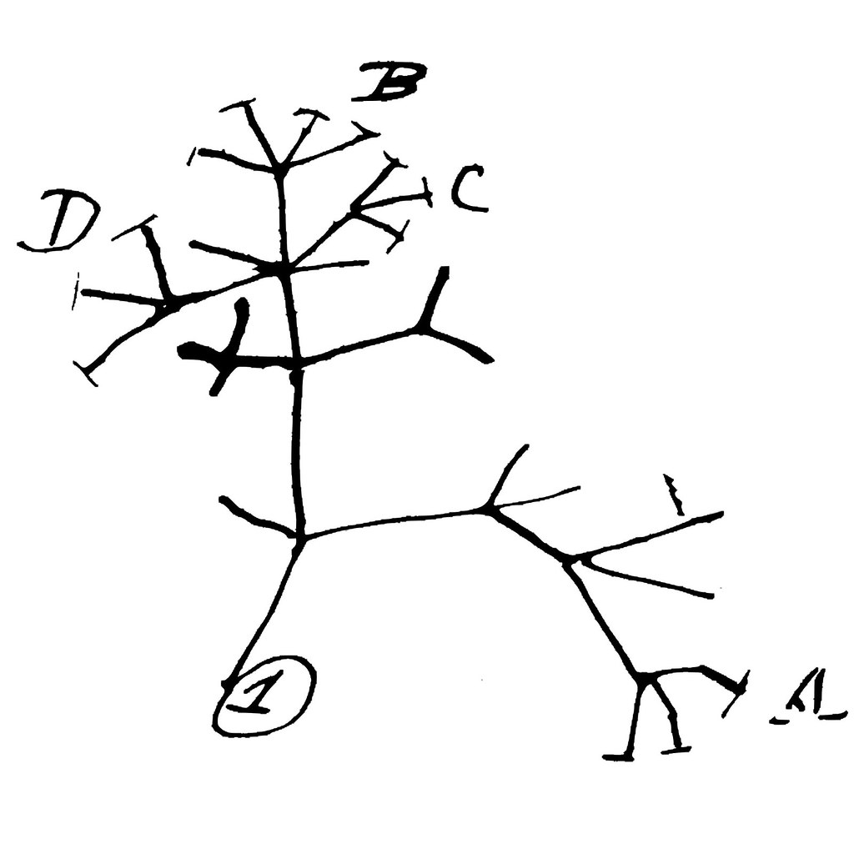
Plan for today!
Introduce ourselves
Make some trees
Theory:
Evolutionary models
Maximum likelihood
Bayesian algorithms
Other methods

Slide 3

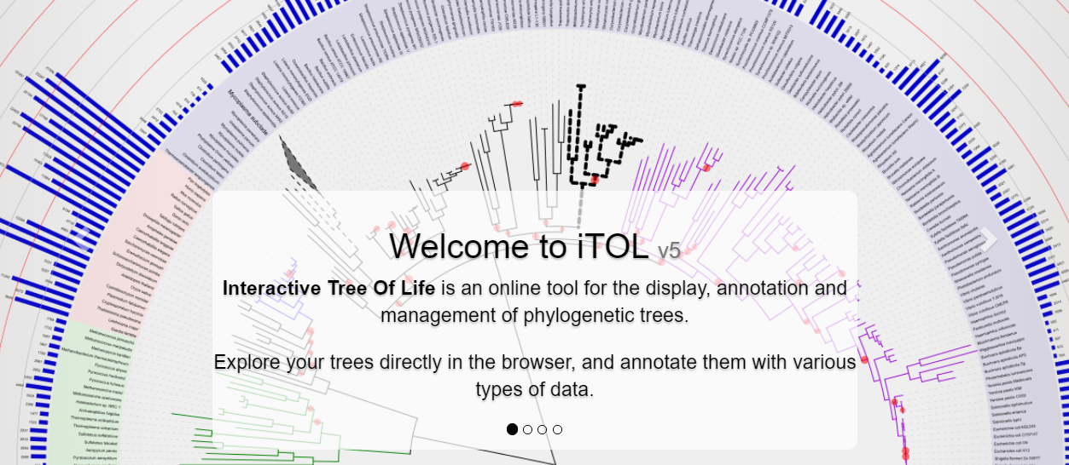
Making some trees

Slide 4
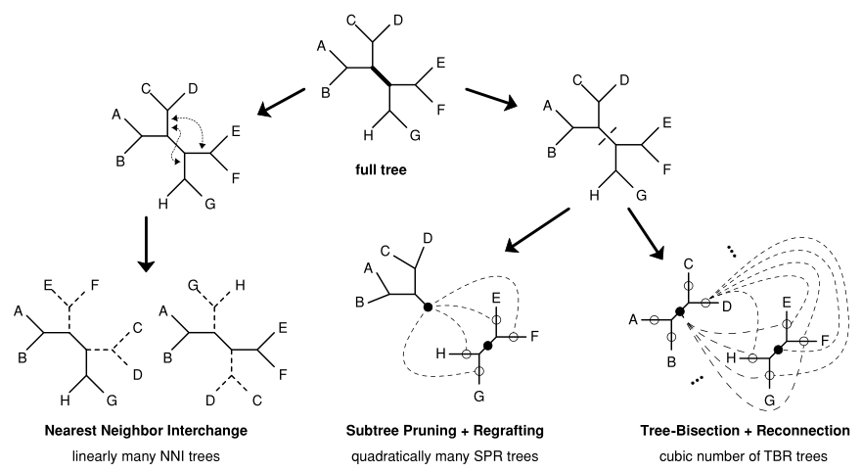

Maximum likelihood
Maximize $P\left(data | tree\right)$
Start with a tree, perturb the tree, calculate likelihood, search, calculate $R= \frac{P(new tree)}{P(old tree)}$, accept new tree if R > 1 (or if R very slightly < 1)
Perturbations until better tree cannot be found
Heiko A. Schmidt and Arndt von Haeseler 2009

Slide 5
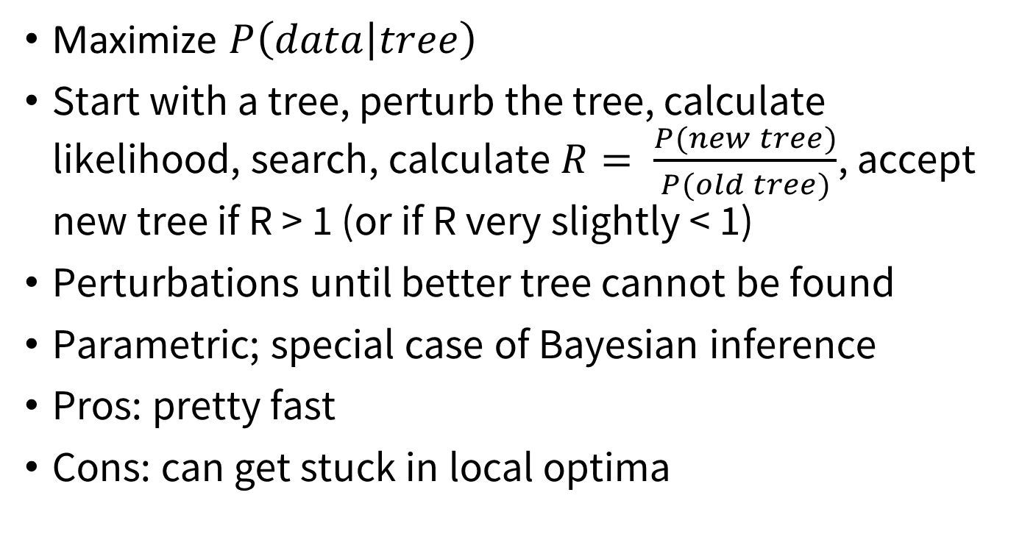
Maximum likelihood
Maximize $P\left(data | tree\right)$
Start with a tree, perturb the tree, calculate likelihood, search, calculate $R= \frac{P(new tree)}{P(old tree)}$, accept new tree if R > 1 (or if R very slightly < 1)
Perturbations until better tree cannot be found
Parametric; special case of Bayesian inference
Pros: pretty fast
Cons: can get stuck in local optima

Slide 6
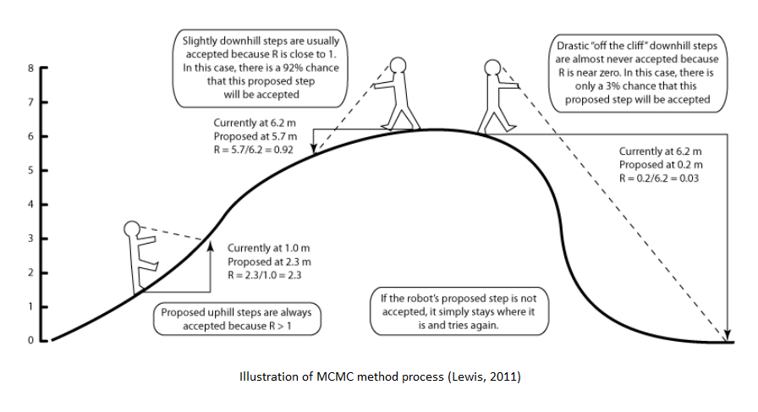
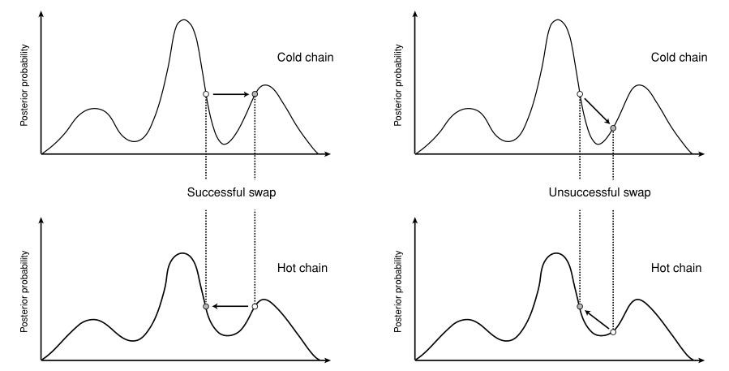

Bayesian method
“posterior”
Likelihood function
“prior”
$P\left(tree | data\right) = \frac{P\left(data | tree\right) ∗ P(tree)}{P(data)}$
Start with a tree, search, calculate $R= \frac{P(new tree)}{P(old tree)}$, accept new tree if R > 1 (for R < 1, accept with probability R)
Run several “chains” of different temperatures
Impossible to calculate
Ronquist, van der Mark, and Huelsenbeck 2009

Slide 7
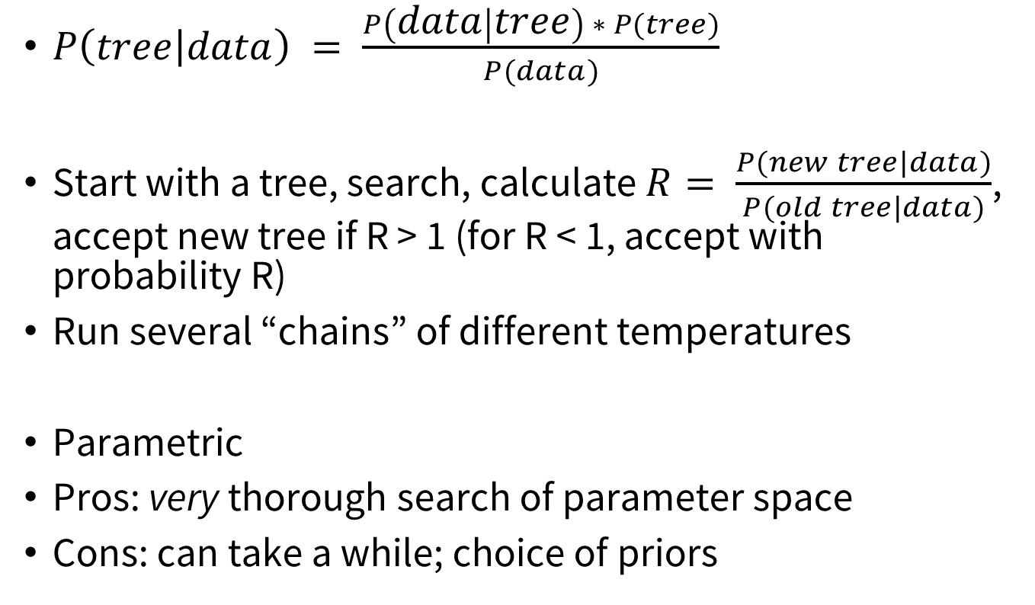
Bayesian method
“posterior”
Likelihood function
“prior”
$P\left(tree | data\right) = \frac{P\left(data | tree\right) ∗ P(tree)}{P(data)}$
Start with a tree, search, calculate $R= \frac{P(new tree|data)}{P(old tree|data)}$, accept new tree if R > 1 (for R < 1, accept with probability R)
Run several “chains” of different temperatures
Parametric
Pros: very thorough search of parameter space
Cons: can take a while; choice of priors
Impossible to calculate

Slide 8
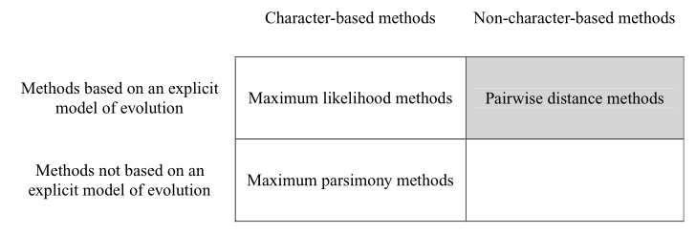
Other methods
Maximum parsimony
Nonparametric
Distance
Fast
Both often used to create starting trees for likelihood-based algorithms
Van de Peer 2009

Slide 9
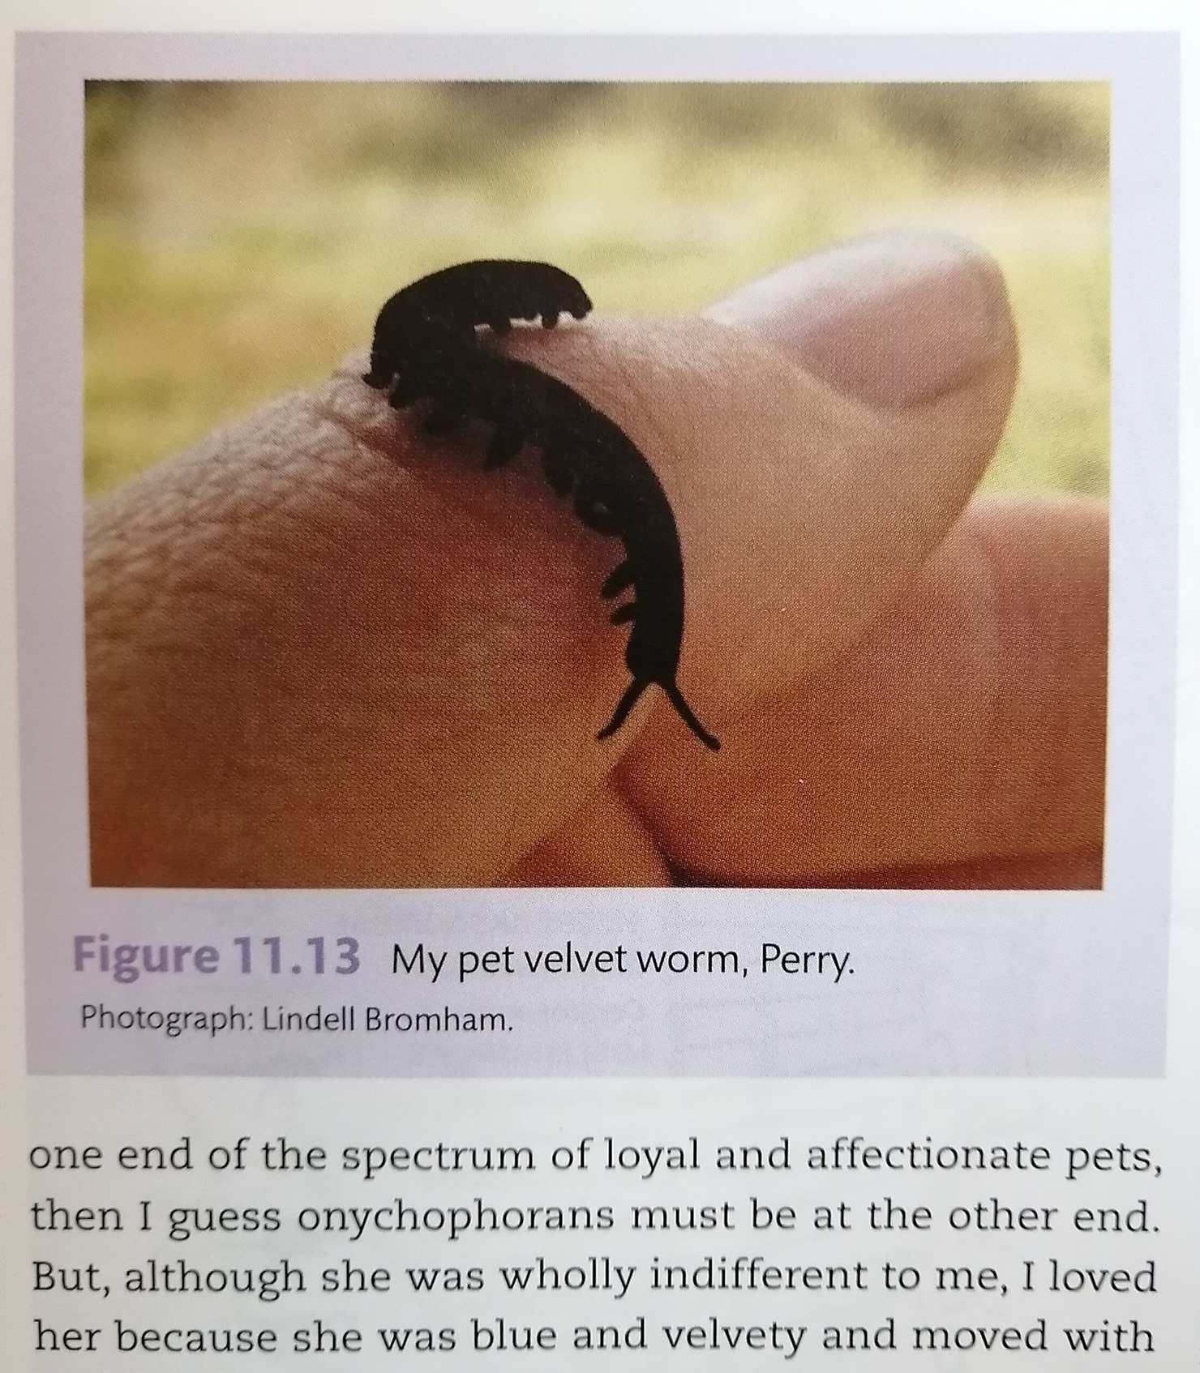
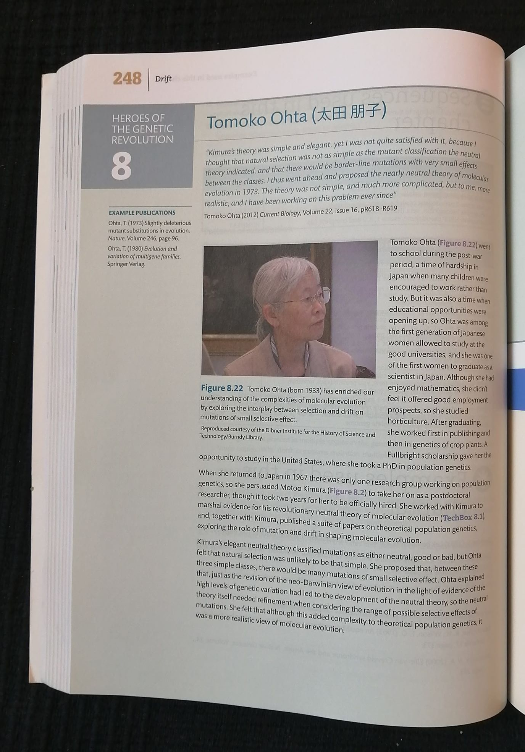
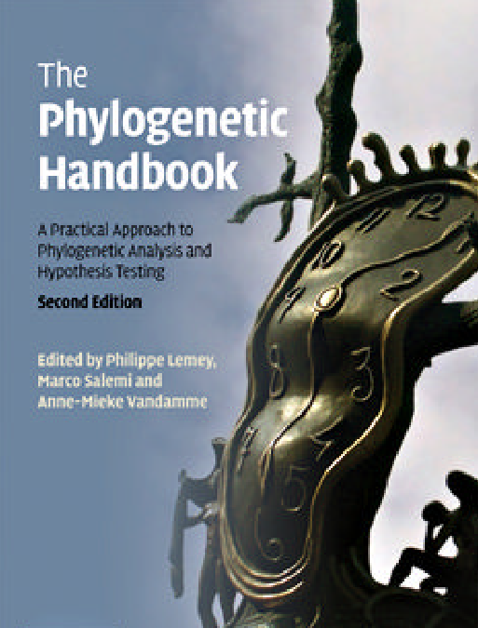
Resources
An Introduction to Molecular Evolution and Phylogenetics by Bromham
The Phylogenetic Handbook: a Practical Approach to Phylogenetic Analysis and Hypothesis Testing Ed. Lemey, Salemi, and Vandamme

Slide 10
Exit ticket
One thing that was unclear or confusing
One thing that was exciting, new, or newly clear

