Slide 1
Git Conflict Resolution

Slide 2
Which give us conflicts
Which commands might give us conflicts? The "mergy" ones, of course:
Git merge
Git rebase
Git am
Git apply
Git stash pop

Slide 3
Conflict resolution tool
The tool of Conflict Resolution:
Git mergetool

Slide 4
What is redis
REmote DIctionary Server
Redis is an open source, advanced key-value store. It is often referred to as a data structure server since keys can contain strings, hashes, lists, sets and sorted sets
One of NoSQL
To deal with high concurrency, big data, etc. SNS

Slide 5
Agenda
What is Redis
Why Redis
How to use
Scenarios & Examples

Slide 6
Comparison--NoSql
Memcache
Key-Value cache works in memory
BerkelyDB
It was a engine of MySQL
now acquired by Oracle
MongoDB
Oriented-Document
Work better in more read/less write system

Slide 7
comparison -- RDMS
Better
Faster
Data structure revise
Distribution
Weaker
Logic expression
Flexible query
Transaction

Slide 8
Feature
Fast
By C and run in memory
Persistence
Could save data to disk in an asynchronous way
Multi languages support
PHP, Java, Perl, Python
Master – Slave Replication
Easy configuration

Slide 9
Agenda
What is Redis
Why Redis
How to use
Scenarios & Examples

Slide 10
Data Structure
String
Lists
Sets
Sorted Sets
Hashes

Slide 11
Data Structure ----String
Map<String, String>
Value is binary safe, could save anything like a jpg
Operations:
set/setnx
Get
Mset/msetnx
Getset
Incr/incrby
Desc/descby
append/
strlen
http://redis.io/commands#string

Slide 12
Data Structure ----Hashes
Map<String, Map<String,String>>
Operations:
hset/hsetnx
hget
hmset/hmsetnx
hincr/hincrby
hdesc/hdescby
Hkeys/hvals
hgetall
http://redis.io/commands#hash

Slide 13
Data Structure ----Lists
Map<String, List<String>>
Operations:
Lpush/rpush
lrange
linsert
Lset/lrem
Lpop/rpop
Lindex
llen
http://redis.io/commands#list

Slide 14
Data Structure ----sets
Map<String, Set<String>>
Operations:
sadd
srem
spop
Sdiff/sdiffstore
Sinter/sinterstore
Sunion/sunionstore
http://redis.io/commands#set

Slide 15
Data Structure ----sorted sets
Map<String, Set<String>>
Operations:
zadd
zrem
Zrank/zrevrank
http://redis.io/commands#sorted_set

Slide 16
Install
Download, extract and compile Redis with:
$ wget http://download.redis.io/releases/redis-3.0.4.tar.gz
$ tar xzf redis-3.0.4.tar.gz
$ cd redis-3.0.4
$ make
Run Redis with:
$ src/redis-server
interact with Redis using the built-in client:
$ src/redis-cli

Slide 17
Transaction
Start with “multi”
End with “exec”
Rollback by “discard”
Optimistic lock by “watch”
Problems:
Only rollback failed ones

Slide 18
Persistence mechanism
Snapshotting
AOF(Append-Only File)

Slide 19
Snapshotting
Default Config
save 900 1 #after 900 sec (15 min) if at least 1 key changed
save 300 10 #after 300 sec (5 min) if at least 10 keys changed
save 60 10000 #after 60 sec if at least 10000 keys changed
Full Backup
Call “save” or “bgsave” to do a backup

Slide 20
AOF
Configuration
appendfsync
always # fsync after every write to the append only log
Everysec # fsync only if 1s passed since the last fsync
No # let the OS flush the data when it wants
Redundancy
Solution: bgrewriteaof
Save the SNAPSHOT by command, then save as aof

Slide 21
Replication
A master can have multiple slaves.
Redis replication is non-blocking on the master side.
by default slaves are read-only
Configurated by “slaveof [IP] [PORT]”

Slide 22
Sub/pub
Subscribers express interest in one or more channels
Publishers send their messages to specific subscribers
Command:
SUBSCRIBE channel1 channel2 …
PUBLISH channel message

Slide 23
Pipeline
Send multiple commands to the server without waiting for the replies at all, and finally read the replies in a single step
Not able in cmd mode.
Can do this in programing.

Slide 24
Other useful cmd
Keys
Dbsize
Rename
Select
Move
Del
Info
Ping
Expire
Ttl

Slide 25
Redis Sentinel
Monitoring.
Sentinel constantly checks if your master and slave instances are working as expected.
Notification.
Sentinel can notify the system administrator, another computer programs, via an API, that something is wrong.
Automatic failover.
If a master is not working as expected, Sentinel can start a failover process where a slave is promoted to master.
Configuration provider.
Sentinel acts as a source of authority for clients service discovery: clients connect to Sentinels in order to ask for the address of the current Redis master responsible for a given service. If a failover occurs, Sentinels will report the new address.

Slide 26
Agenda
What is Redis
Why Redis
How to use
Scenarios & Examples

Slide 27
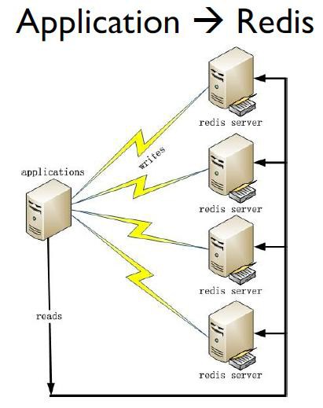
Applications Scenarios

Slide 28
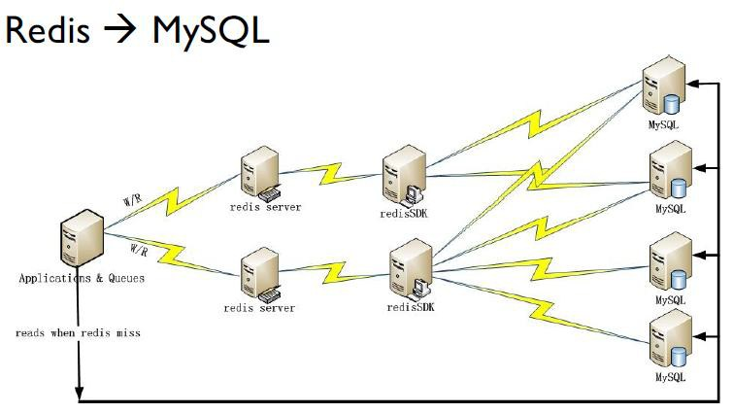
Applications Scenarios

Slide 29
Examples
Top N list
SELECT * FROM foo WHERE ... ORDER BY time DESC LIMIT 10
FUNCTION get_latest_comments(start,num_items):
id_list = redis.lrange("latest.comments",start,start+num_items-1)
IF id_list.length &lt; num_items
id_list = SQL_DB("SELECT ... ORDER BY time LIMIT ...")
END
RETURN id_list
END

