Slide 1
Stop Starting Over
ILC 2026
Three simple prompts that get you better answers from AI
Jason Greer · Peel Business Design

Slide 2
Who has taken AI’s first answer and run with it?
HANDS UP

Slide 3
That’s like asking one person, one time, and calling it research.

Slide 4
Hi, I’m Jason.
I use AI every day. I still get bad answers.

Slide 5
How often do you use AI at work?
HANDS UP
Not yet
Now and then
Every day

Slide 6

Three ways to not settle for the first answer
1
2
3
The Room
The 100 Tries
The Daily Loop
Get more than one point of view.
See what makes it better or worse.
Make tomorrow’s prompt better than today’s.
Scan now: all three prompts, word for word · peelforward.com/ilc

Slide 7



AI is an eager intern.
BEFORE ANYONE OPENS A TOOL
It wants to help. It still needs a boss.
Leave out customer names, personal info and secrets.
Check it before you trust it.
Use the tool your company approves.
Works in ChatGPT, Copilot, Claude or Gemini.

Slide 8
Why did scrap go up?
OUR PRACTICE PLANT · MADE UP FOR TODAY
12
967
4
2
weeks
production runs
presses, 2 shifts
steel suppliers
Each run lists the press, part, steel, operator, start time, scrap and any comment from the floor.

Slide 9
The Room
PROMPT 1 OF 3
Get more than one point of view.

Slide 10
One voice gives you one view.
A room gives you the argument.
1 · The Room

Slide 11
Copy this
PROMPT 1 · THE ROOM
Act as a panel of 4 people: [the boss], [the person who does the work], [the customer] and a skeptic. Each one gives their view on this problem: [your problem]. Then let them respond to each other for 3 rounds. End with what they agree on and what they still disagree on.
Anything in [brackets] is yours to fill in. Have data? Attach it.
1 · The Room

Slide 12
Pick people who would disagree
The boss
The person doing the work
Cares about cost and time.
Knows what really happens.
The customer
The skeptic
Feels the result.
Asks “How do you know?”
1 · The Room

Slide 13
The room argued
OUR PLANT · WHAT THE ROOM SAID
PLANT MANAGER
QUALITY ENGINEER
“My gut says it’s Ridgeline material plus second shift on Press 2.”
“Those four rows are one problem showing up four ways.”
SECOND-SHIFT OPERATOR
SKEPTIC
“We’ve been writing it down since week 2. Nobody followed up.”
“This log can tell us where to look, not what’s broken.”
1 · The Room · The AI played all four · Real lines from one fresh chat

Slide 14
“Put the three of us on Presses 1, 3 or 4 and we scrap the same as day shift.”
THE MOMENT THAT MATTERED
The operator in the room cleared the operators. Then go ask the real one.

Slide 15
The disagreement is where you go look.
THEY AGREED
THEY DISAGREED
It’s one spot, and it’s not one person.
Switch steel now, or keep running it to find the cause?
1 · The Room

Slide 16




Use The Room when people sit on both sides
A hard decision
A plan before you share it
An email that could land wrong
A change people will push back on
1 · The Room

Slide 17
The 100 Tries
PROMPT 2 OF 3
See what makes it better or worse.

Slide 18
One game tells you a story.
A hundred games show you the pattern.
2 · The 100 Tries

Slide 19
Copy this
PROMPT 2 · THE 100 TRIES
Imagine 100 different ways to solve this problem: [your problem]. Sort them into best, average and worst. Then tell me what the best ones have in common and what the worst ones have in common.
2 · The 100 Tries

Slide 20
100 ways to fix a huddle people tune out of
REAL EXAMPLE · NO DATA NEEDED
THE BEST ONES
THE WORST ONES
Close the loop on what people raised.
Treat tuning out as a discipline problem when it’s really a usefulness problem.
Only cover the next 8 hours.
The crew talks as much as the boss.
Add sign-in sheets, quizzes, longer meetings.
One-way: reading, lecturing, announcing.
2 · The 100 Tries · From one fresh chat, summarized

Slide 21
The AI imagines the 100 tries. It doesn’t run them.
ONE HONEST NOTE
Use it to spot patterns, not to trust exact numbers.
Have real data? Give it that instead.
2 · The 100 Tries

Slide 22
Our plant already has 967 real tries
SAME PROMPT, REAL DATA
Here is my data. Sort the runs from best to worst. What do the worst runs have in common? What do the best runs have in common?
What the file looks like: one row per run
Press | Start | Steel | Operator | Scrap | Comment
Press 2 | Jun 22, 6:05 am | Ridgeline 225 | Op 13 | 5 of 438
Press 2 | Jun 22, 2:10 pm | Ridgeline 225 | Op 22 | 46 of 562 | ran slow to hold size
2 · The 100 Tries

Slide 23
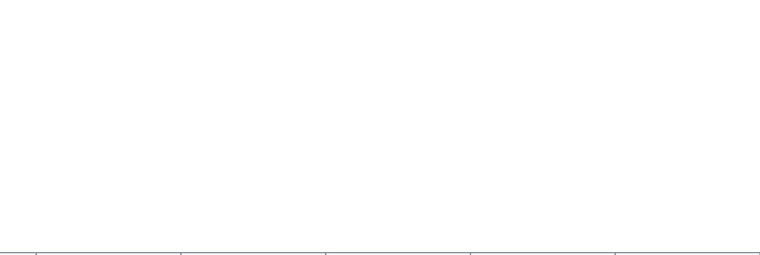


Every run is one dot
OUR PLANT · ONE RUN
One run on Press 1: 13 of 543 parts scrapped
97.6% good
90%
92%
94%
96%
98%
100%
Good parts in each run

Slide 24



Stack them up and a shape appears
OUR PLANT · ALL 967 RUNS
967 runs. One dot each.
The curve: what a normal run looks like when nothing special is going on.
90%
92%
94%
96%
98%
100%
Good parts in each run

Slide 25
THE BEST RUNS
They had almost nothing in common.
Every operator, every part, both steels, both shifts. Mostly ordinary runs that had a good day.
Don’t copy luck.
2 · The 100 Tries

Slide 26
Of the 25 worst runs, how many came from one spot?
YOUR GUESS · HANDS UP
About 5
About 10
About 15
All 25
One spot = Press 2, second shift, Ridgeline steel. About 1 run in 10.
2 · The 100 Tries

Slide 27
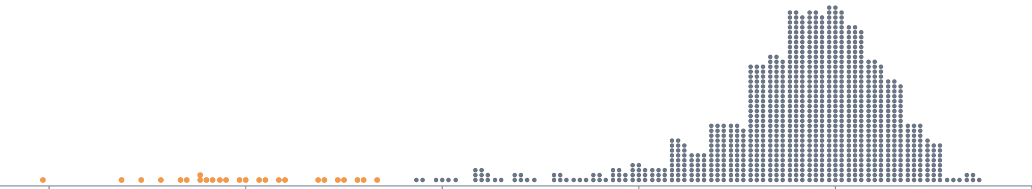
were Press 2, second shift, Ridgeline steel.
THE WORST RUNS
25 of 25
The 25 worst runs
90%
92%
94%
96%
98%
100%
2 · The 100 Tries · I checked this myself in a spreadsheet

Slide 28
Operator 14 has the highest scrap rate in the plant.
THE EASY ANSWER WAS A NAME
Hands up if you’ve seen a report blame a person when the problem was the process.
2 · The 100 Tries

Slide 29
It looked across instead
4.8%
2.3%
Operator 14’s scrap on Press 2
Operator 14’s scrap on the other presses
Same person, normal everywhere else. It’s not one person.
2 · The 100 Tries · Scrap as a percent of parts, 12 weeks · I checked this myself in a spreadsheet

Slide 30
“You can’t be curious and judgmental at the same time.”
“Who scrapped the most?” is a judgmental question.
“What do the worst runs have in common?” is a curious one.

Slide 31
Go look at Press 2.
About 1,700 extra scrapped parts in 12 weeks.

Slide 32
The Daily Loop
PROMPT 3 OF 3
Make tomorrow’s prompt better than today’s.

Slide 33
STOP STARTING OVER
The AI won’t remember what you learned today.
Your prompt will.
Memory features help you. A saved prompt helps your whole team.
3 · The Daily Loop

Slide 34
You already know this loop
PDCA = PLAN, DO, CHECK, ACT
Plan
Do
Check
Act
What will I try?
What exactly do I do today?
How will I know it worked?
What will I change next time?
Shout it out: which step does your team skip most?
3 · The Daily Loop

Slide 35
Copy this
PROMPT 3 · THE DAILY LOOP
Help me with [your problem] using Plan, Do, Check, Act.
Plan: What should I try?
Do: What exactly should I do today?
Check: How will I know if it worked?
Act: What should I change next time?
At the end, write me a better version of this prompt to use tomorrow.
3 · The Daily Loop

Slide 36
It suggested a target before the test
OUR PLANT · WHAT CHECK SAID
7.7%
3.5%
Scrap there now
Suggested target
One good run is a signal. Confirm it with 3 to 5 more.
3 · The Daily Loop · Press 2, second-shift crew, Ridgeline steel, last 3 weeks

Slide 37
“Write me a better version of this prompt to use tomorrow.”
THE TRICK IS THE LAST LINE
You don’t have to be good at AI. The prompt gets a little better every day.

Slide 38
What it added for tomorrow
OUR PLANT · THE PROMPT IT WROTE FOR TOMORROW
STARTS FROM TODAY
CLOSES THE LOOP
“What we already know: …”
“What I tested yesterday: [ran Press 2 evenings on day-shift settings]”
ASKS FOR A TARGET
CHECKS THE DATA
“Set a success number before I start.”
“If anything in the data looks wrong or missing, tell me.”
Tomorrow: new chat, paste it in, attach the new data, fill in the blanks.
3 · The Daily Loop · Lines quoted from the prompt it wrote

Slide 39


Save it like standard work
Put a date on it.
Give it an owner.
Keep it where your team can find it.
Read it before you save it. Trim it when it gets past one screen.
3 · The Daily Loop

Slide 40
Press 2, 2 pm.
SHOUT IT OUT
What do you check first? Who do you ask?

Slide 41



AI is a tool, not a problem solver
Root cause analysis
Go to the gemba
Keep asking why until you reach a cause you can test.
Stand at Press 2 at 2 pm with the crew.
Reason it through
Check the AI
Does your story fit every fact, even the odd ones?
97, 103, 102: same runs, three counts. Tell it how you count.
Gemba: the place where the work actually happens

Slide 42
AI or people?
FIVE STEPS OF ROOT CAUSE ANALYSIS · CALL IT OUT
1
2
3
4
5
Spot it
Narrow where
Go and see
Ask why
Test and confirm
Your people, your charts, or AI
AI is fast here
Only people
People lead, AI suggests
People decide
AI gets you to the gemba faster. It doesn’t make the trip for you.

Slide 43

Which one should I use?
I need other points of view.
The Room
I want to know what makes it better or worse.
The 100 Tries
I’ll be doing this again tomorrow.
The Daily Loop

Slide 44

Try The Room right now
YOUR TURN · 5 MINUTES
Act as a panel of 4 people: [the boss], [the person who does the work], [the customer] and a skeptic. Each one gives their view on this problem: [your problem]. Then let them respond to each other for 3 rounds. End with what they agree on and what they still disagree on.
Need a problem? Handoffs that miss things. New hires quitting in 90 days. Late-order calls.
peelforward.com/ilc
Never used AI? Pair up. No AI allowed? Run it with four people at your table.

Slide 45
THREE THINGS TO TAKE HOME
1
Don’t take the first answer.
2
Look across before you blame.
3
Make tomorrow’s prompt better than today’s.

Slide 46
AI finds where.
You still find why.

Slide 47

Questions?
1. Don’t take the first answer.
2. Look across before you blame.
3. Make tomorrow’s prompt better than today’s.
Jason Greer · Jason@peelbusinessdesign.com
peelforward.com/ilc
The three prompts and the practice plant data

