Slide 1
Elm
Awesomesauce or just yet another language for the Front-end
Magnus Rundberget

Slide 2
Agenda
About Elm
Elm syntax 1-on-1 (repl session)
The Elm Architecture
Making a simple web-app (live coding)
Summary

Slide 3
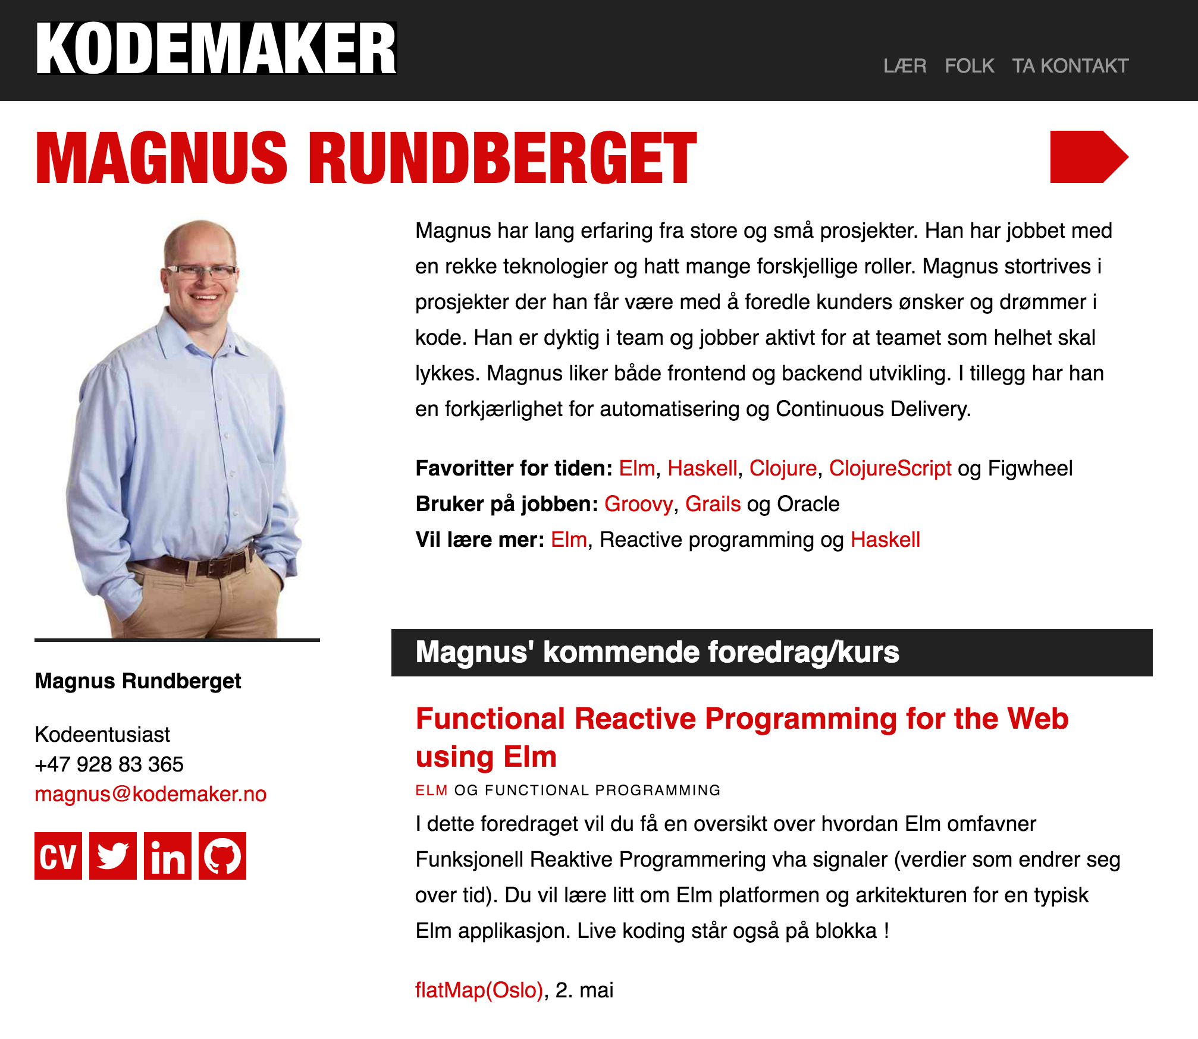
About me

Slide 4
About Elm
Created by Evan Czaplicki (2012)
Functional Statically (strongly) type
Compiles to JavaScript (ES5)
ML family syntax

Slide 5
Key properties / Noble goals
Make Functional Programming (with types) mainstream
Reliable – No runtime exceptions (and no nulls) !
Simple and approachable yet powerful
The compiler as your friend
Designed with love and care ☺

Slide 6
The Elm distribution and ecosystem
elm-make
elm-package
elm-repl
elm-reactor
Community
elm-format
Editor plugins (Vim, Emacs, VSCode, Light Table, Sublime, Atom, IntelliJ)
Packages, node integration and much more

Slide 7
Live coding
Elm 1-on-1

Slide 8
The Elm Architecture
Your Elm App
Elm Runtime
cmds
Msg, Model
update
(Model’, Cmd Msg)
html
Model’
view
Html Msg
subs
Model’
subscriptions
Sub Msg

Slide 9
Live coding
Creating a simple Web app

Slide 10
JavaScript interop
Ports
Customs and border protection
Conversion of JS to Elm types and vice versa
Safe guard against runtime exceptions in your Elm app
MyElmApp
Elm runtime
Subscribe
Send
JS

Slide 11
The current state and future of Elm
Dramatically growing interest
Production use
Steadily improving
Web platform support
Long term ?
Server side Elm
State of the art tooling

Slide 12
Resources
http://elm-lang.org/
http://guide.elm-lang.org/
http://elm-lang.org/try
Book: Elm In Action - MEAP (Manning)
Slack: http://elmlang.herokuapp.com/
Oh and do watch: “Let’s be mainstream! - User focused design in Elm”

Slide 13
Summary
You can make cool stuff with Elm today
Learning Elm is fun
Elm and TEA constrains you, but in a good way
You really owe it to yourself to give it a try !

Slide 14

Q/A
@mrundberget
http://rundis.github.com/blog
magnus@kodemaker.no

