Slide 1


Replacements to our broken voting sytem
Julien Lamarche
President, NCR Chapter
Fair Vote Canada
http://www.fairvote.ca
Juilen.lamarche@gmail.com

Slide 2
Politics 101 Glossary
Legislature vs Executive branch
  Canada : House of Commons vs Government
% of seats /% of votes
Government
Majority (>50% of seats) vs minority (<50% of seats)
First Past the Post
Electoral district

Slide 3
What is an electoral district?
A bounded geographical area who's voters are represented by one or more politician
Canada : 308 electoral districts represented by 308 politician
Norway legislature : 19 ridings, each represented by 4 to 17 politicians

Slide 4
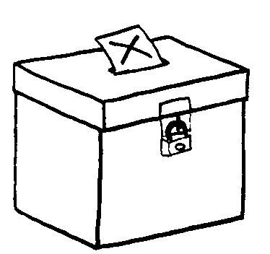
Voting systems
The ballot
Seats per electoral districts
The algorithm
(votes →
winning candidate)

Slide 5
Single member plurality
(First past the post)
The ballot: | One X per vote
Seats per electoral district: | 308 districts of one seat
The algorithm: | The seat is given to the candidate with at least 1 more vote than everyone else.

Slide 6
First Past the Post doesn't serve voters
Lack of representation
Phony majorities
Unstable government
Points lost for cooperating
Exgerates regional differences

Slide 7
FPTP : exagerates regional differences
Canadian federal election 2011
Ontario | % votes | % seats
- Conservative | 44 | 69
- Liberal | 25 | 10
Quebec
- NDP | 43 | 79
- Bloc | 23 | 5

Slide 8
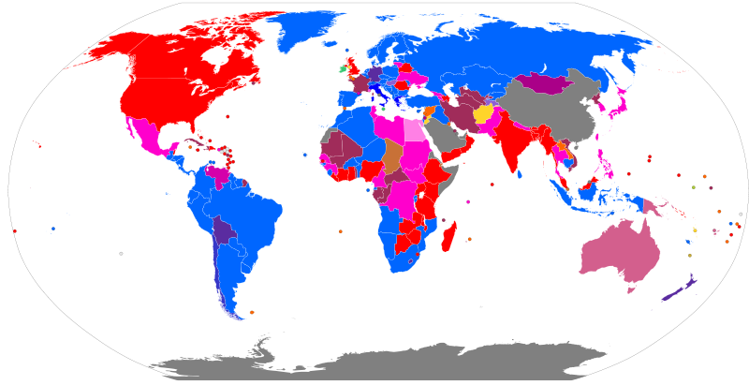
Who uses FPTP?
Legend : http://en.wikipedia.org/wiki/File:Electoral_systems_map.svg

Slide 9
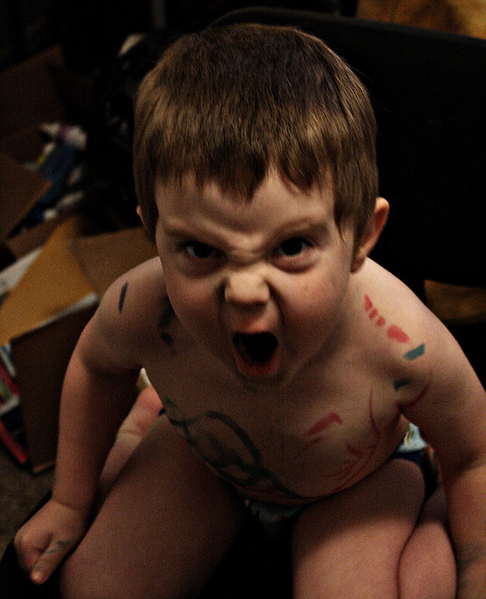

How to fix it?
Proportional representation

Slide 10
Proportional representation
% of seats ≈ % of votes

Slide 11
Many systems
 | The ridings & seat | The ballot | The algorithm
FPTP (SMP) | One seat per geographic riding | 1 « X » | Winner has the most votes, at least one more than everybody else
Mixed Member Proportional (MMP) | Mix of geographic riding and list seats | 2 votes : Candidate and party | List seats used to compensate for lack of proportionality
Single Transferable Ballot | Ridings clustered together | Ranked | Candidates eliminated until all seats are filled.
Alternative Vote |  | Ranked | Candidates eliminated until winner has more than 50%
Semi-Proportional | Mix of geographic riding and list seats | 2 votes : Candidate and party | Lists seats are shared proportionaly but not whole legislature

Slide 12
What are the possible replacements in Canada?
 | Proportional?
Alternative Vote (AV) | X
Single Transferable Vote (STV) | √
Mixed Member Proportional (MMP) | √

Slide 13
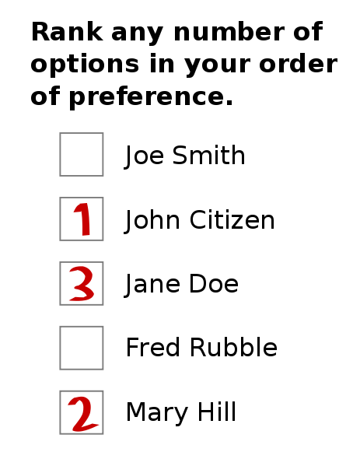
Alternative Vote (AV) :
The ballot
Ranked vote

Slide 14
Alternative Vote
The algorithm
Count #1 choices
Has a candidate reached 50%?
Eliminate last place candidate and distribute his / her votes
Declare that candidate elected
Finished

Slide 15
Altervative vote
(aka Preferential Ballot)
The ballot: | Ranked ballot
Seats per electoral district: | 308 districts of one seat
The algorithm: | The seat is given to the candidate with 50% support, after redistributing votes of the candidate with the smallest support if needed

Slide 16
OECD countries by voting system

Slide 17
Single Transferable Vote (STV)

Slide 18
Single Transferable Vote:
The ballot
Ranked vote

Slide 19
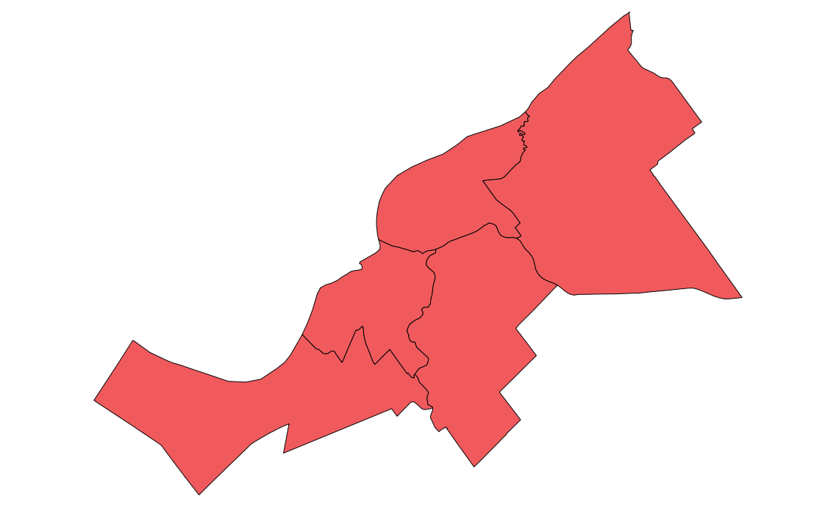
Single Tranferable Vote :
The district & seats
5 ridings of 1 seat each
Ottawa-Orleans
Ottawa-Vanier
Ottawa Centre
Ottawa South
Ottawa West - Nepean

Slide 20

Single Tranferable Vote :
The district & seats
1 riding of 5 seats
Ottawa

Slide 21
Single Transferable Vote
The algorithm
Establish the threshold
Count first choices
Have any candidates reached the threshold?
Eliminate last place candidate and distribute his / her votes
Declare those elected
Enough winners?
Distribute surplus of winners
Finished

Slide 47
Single Transferable Vote
The algorithm :
How many votes do you need to win?
Alternative Vote :
City of Cambridge, MA :

Slide 48
Single Transferable Vote (STV)
The ballot: | Ranked ballot
Seats per electoral district: | Fewer districts of multiple seats
The algorithm: | Votes suplus or from loosing candidate are transfered until there are sufficient candidates to fill every seat

Slide 49
Mixed Member Proportional (MMP)

Slide 50
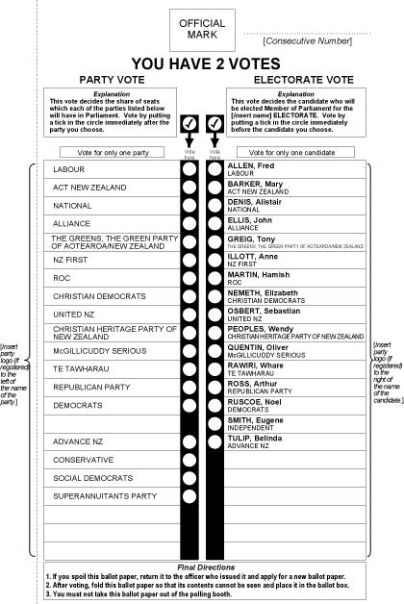
Mixed Member Proportional :
The ballot
Two votes :
  One for local candidate
  One for party

Slide 51
Mixed Member Proportional
The algorithm
Winner of geographic seats are determined first
List seats compensate for lack of proportionality
Some additional algorithm if its open lists
(see Voting Counts:Electoral Reform for Canada, Law Commission of Canada, 2004)

Slide 52
MMP : The algorithm
Fictional legislature of 100 seats
 | Geographic seats | % of vote
Party A | 38 | 40%
Party B | 23 | 31%
Party C | 8 | 19%
Party D | 1 | 6%
Party E | 0 | 4%
Total | 70 | 100%

Slide 53
MMP : The algorithm

Slide 54
MMP : The algorithm

Slide 55
MMP : The algorithm

Slide 56
MMP : The algorithm
Fictional legislature of 100 seats
 | Geographic seats | % of vote | List seats
Party A | 38 | 40% | 2
Party B | 23 | 31% | 8
Party C | 8 | 19% | 11
Party D | 1 | 6% | 5
Party E | 0 | 4% | 4
Total | 70 | 100% | 30

Slide 57
Mixed Member Proportional
The seats & riding
One seat per geographic ridings;
List seats for ridings that span the entirety or parts of the jurisdiction;

Slide 58
Lists seats?

Slide 59
Mixed Member Proportional (MMP)
The ballot: | One vote for a party One vote for a candidate
Seats per electoral district: | 50%-70% are local electoral district Remainder are list seats
The algorithm: | Geographic seats first determined List seats compensate for lack of proportionality

Slide 60
A primer on voting systems
Questions?
Somes images provided by New Zealand government, Wikipedia users
Altes, Rspeer, Mark Ryan, Dariusofthedark, Jhayman & Earl Andrew and flickr users gwendalcentrifugue & darthphilburt.
Julien Lamarche
Juilen.lamarche@gmail.com

Slide 61
Image credits
This work has been released into the
public domain by its author, Earl Andrew
Some rights
Reserved
Image by
Altes
This New Zealand work is in the public domain both in New Zealand and in other countries adhering to international copyright treaties,
Some rights
Reserved
Image by
Rspeer and Mark Ryan
Some rights
Reserved
Image by
Dariusofthedark and Jhayman

Slide 62

Image credits
Flick user darthphilburt
Flick user gwendalcentrifugue

