Slide 1
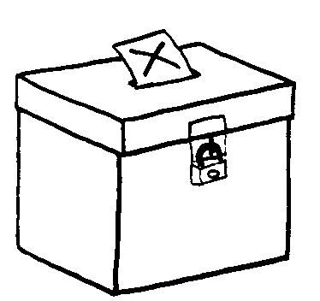
Voting systems
The ballot
Seats per electoral districts
The algorithm
(votes → seats)

Slide 2
Winner Take All

Slide 3
Single member plurality
(First past the post)
The ballot: | One X per vote
Seats per electoral district: | 338 ridings of one seat
The algorithm: | The seat is given to the candidate with at least 1 more vote than everyone else.

Slide 4
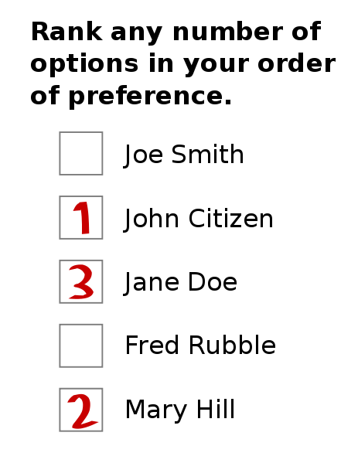
Alternative Vote
The ballot
Also called :
  Preferential voting
  Instant runoff
  « Ranked ballot »

Slide 5
Proportional systems

Slide 6
What is an electoral district?
A bounded geographical area who's voters are represented by one or more legislators
Canada : 338 electoral districts represented by 338 MPs
Australian senate : 6 staes, each represented by 12 elected senators
Norway legislature : 19 counties, each represented by 4 to 17 legislators

Slide 7
List seats

Slide 8
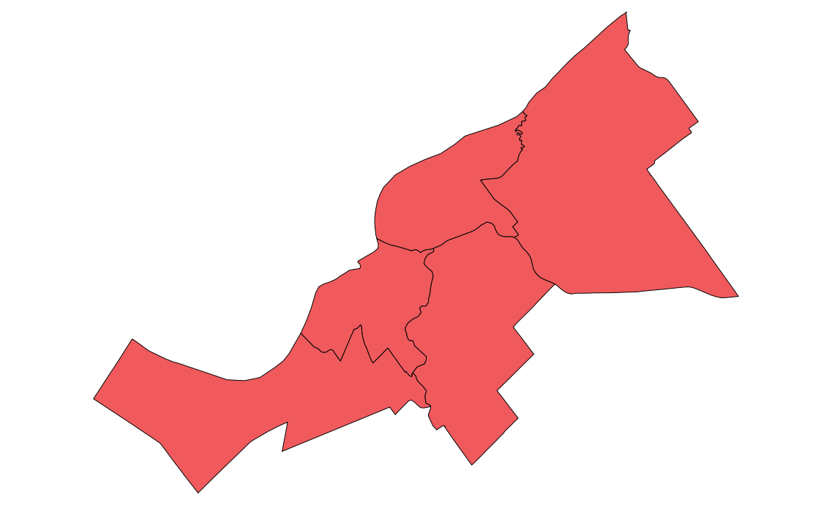
Clusters
5 ridings of 1 seat each

Slide 9

Clusters
1 riding of 5 seats

Slide 10
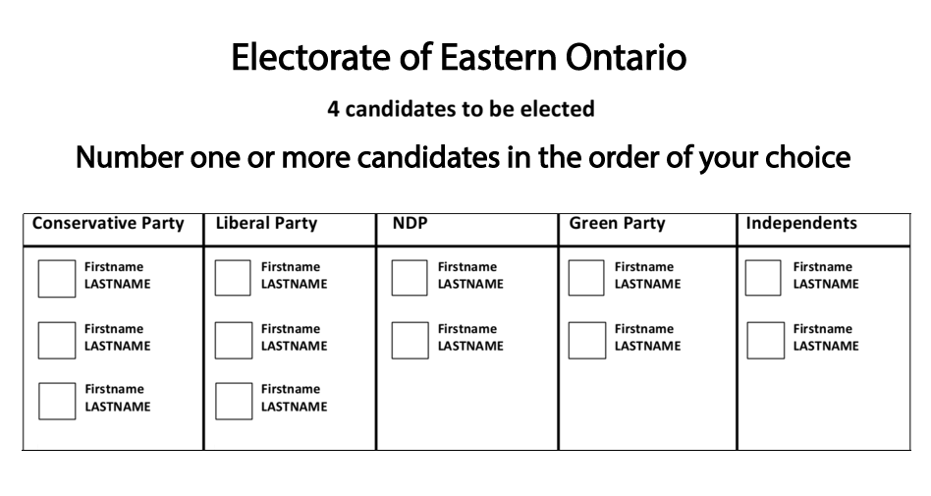
Single Transferable Vote

Slide 11
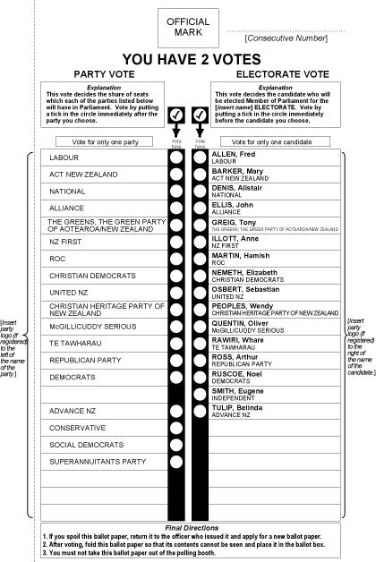
Mixed Member Proportional :
The ballot
Two votes :
  One for local candidate
  One for party

Slide 12
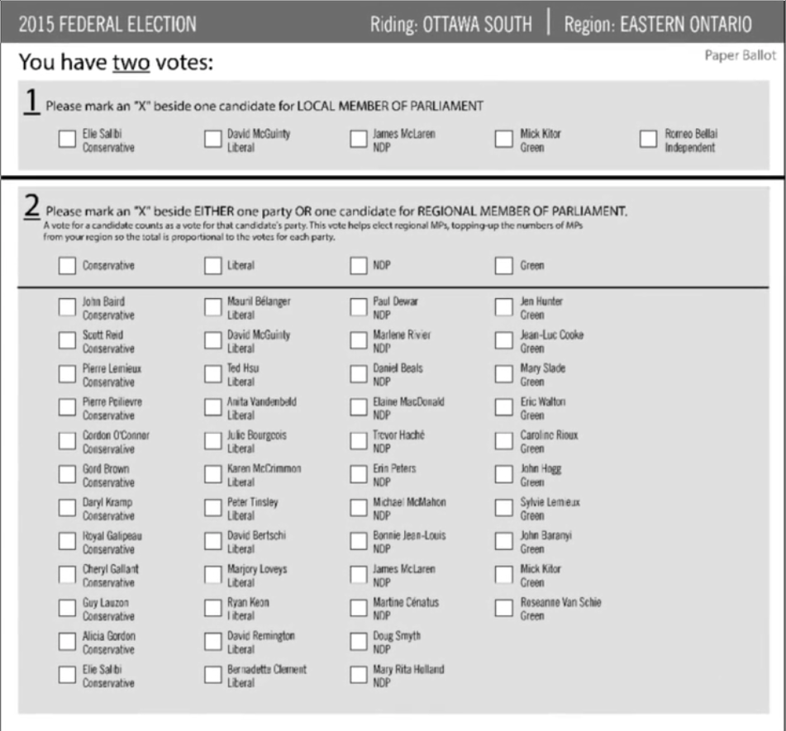
Law Commission 2004 MMP
Ballot

Slide 13
Questions for you
Should legislature have some proportionality or not?
To represent a 1 seat riding, should a local candidate obtain a plurality or 50%?
How should list seats be made? Closed, open, flexible, best loosers?
Do you prefer single seat (smaller ridings) or multi seat (more competition, more choice?)

Slide 14

A primer on voting systems
Julien Lamarche
President, NCR Chapter
Fair Vote Canada
http://www.fairvote.ca
NCR@fairvote.ca

Slide 15
Wrong winner in FPTP
Quebec 1886, 1890, 1900, 1944, 1966 & 1998.
Alberta 1921
New-Brunswick 1974, 2006
Canada 1979
British-Columbia 1996

Slide 16
Distortion of representation (2011)

Slide 17
Distortion of representation (2015)

Slide 18
Distortion of representation (2011)

Slide 19
Distortion of representation (2015)

Slide 20
Distortion of representation (1993)

Slide 21
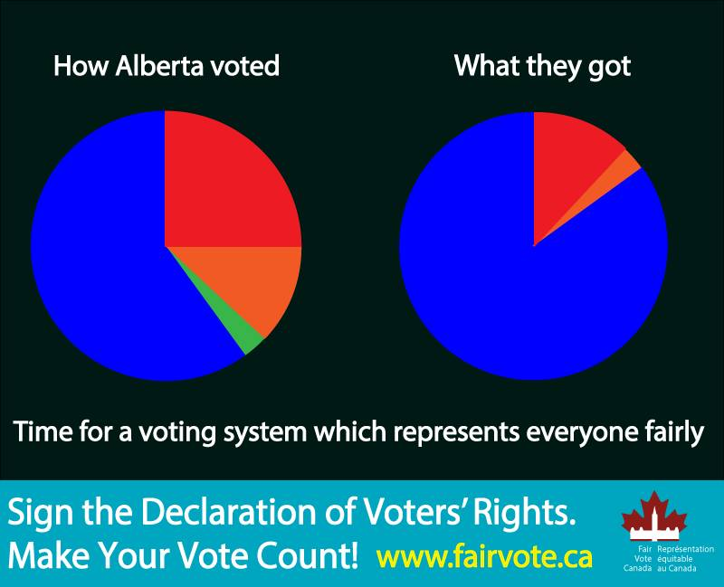

Slide 22
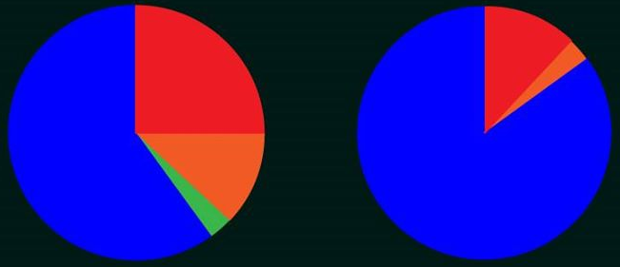
Distorsion : Alberta

Slide 23
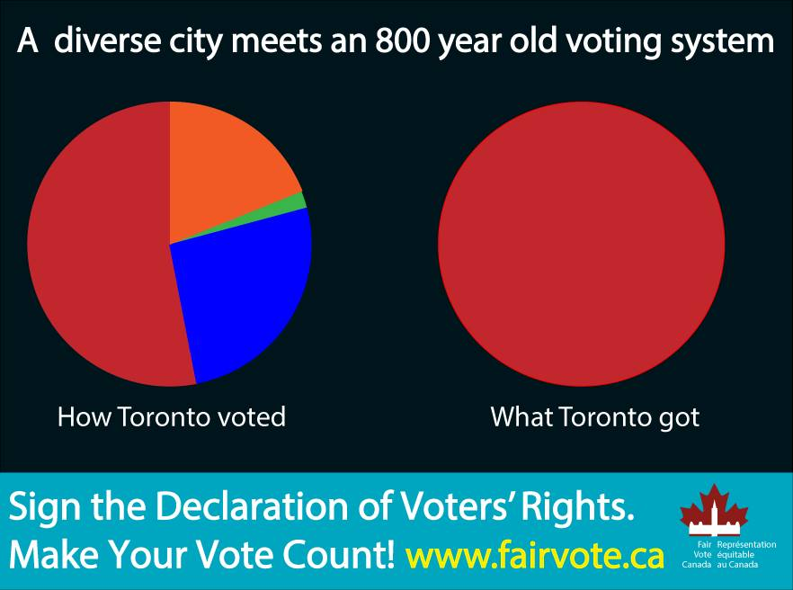

Slide 24
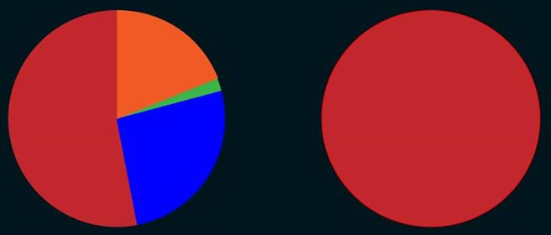
Distorsion : Toronto

Slide 25
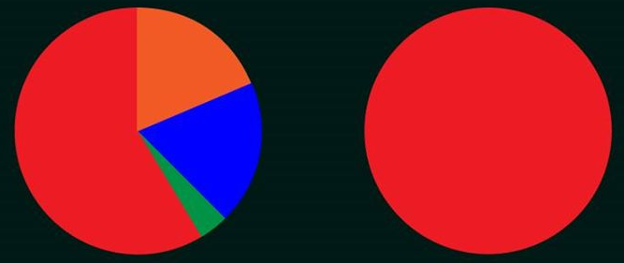
Distorsion : Atlantique

Slide 26
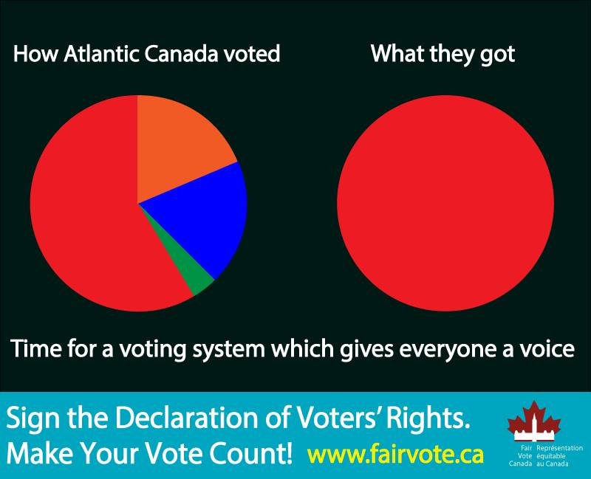

Slide 27
FPTP doesn't serve voters
Under representation of women and ethnic minorities;
Exageration of regional differences
Canadian federal election 2011
Ontario | % votes | % seats
- Conservative | 44 | 69
- Liberal | 25 | 10
Quebec
- NDP | 43 | 79
- Bloc | 23 | 5

Slide 28
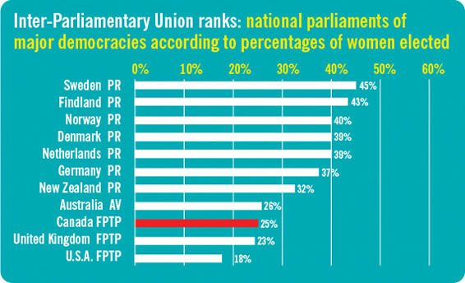
Proportion of women elected in legislatures of OECD* countries
*Organization for Economic Cooperation and Development

Slide 29
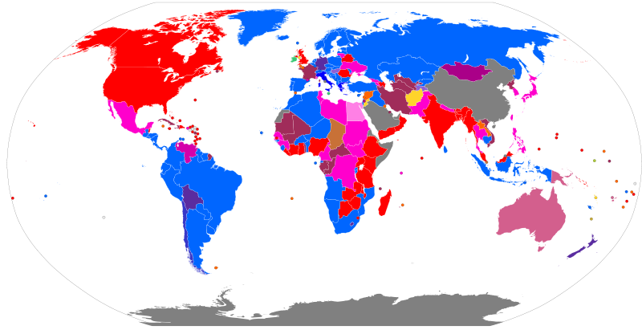
Who uses FPTP?
Legend : http://en.wikipedia.org/wiki/File:Electoral_systems_map.svg

Slide 30
Many systems
 | The ridings & seat | The ballot | The algorithm
FPTP (SMP) | One seat per geographic riding | 1 « X » | Winner has the most votes, at least one more than everybody else
Mixed Member Proportional (MMP) | Mix of geographic riding and list seats | 2 votes : Candidate and party | List seats used to compensate for lack of proportionality
Single Transferable Ballot | Ridings clustered together | Ranked | Candidates eliminated until all seats are filled.
Alternative Vote |  | Ranked | Candidates eliminated until winner has more than 50%
Semi-Proportional | Mix of geographic riding and list seats | 2 votes : Candidate and party | Lists seats are shared proportionaly but not whole legislature

Slide 31
Alors pourquoi la proportionnelle?
Augmentation de la représentation du vote des électeurs
Meilleure représentation de la diversité politique du pays et des provinces
Les pays avec la proportionnelle ont un plus grand nombre de femmes élues à leur législature
Augmente la diversité géographique des partis politques

Slide 32
History of voting reform in the world
1924-1957 : Alberta uses STV (Edmonton & Calgary) & AV (rest of province) to elect MLAs
1993 : New Zealand switches to Mixed Member Proportional (MMP) with 54% support
2011 : UK votes against AV (68% against)
2011 : New Zealand votes to keep MMP with 58% support

Slide 33
Recent history of voting reform in Canada
1984 : Electoral Representation Commission (Québec)
1997 : Federal Majority government with lowest support
2001 : Fair Vote Canada is founded
2002 : Quebec’s Estates-General on the Reform of Democratic Institutions
2004 : Quebec government study (Charest)
2004 : Law Commission of Canada report on ER
2005 : NB Commission on Legislative Democracy
2005 : PEI Plebiscite on voting reform
2005 : BC Citizens Assembly recommends Single Transferable Vote
2005 : In a referendum, BC-STV receives 58% support
2006 : Quebec Citizens Committee Report
2007 : Ontario Citizens Assembly recommends Mixed Member proportional
2007 : Quebec’s Chief Electoral Officer’s Report
2009 : Second referendum on BC-STV

Slide 34
Les systèmes considérés au Canada
Scrutin uninominal à un tour
Représentation proportionnelle mixte
Vote transférable unique
Vote alternatif (vote préférentiel)
P3

Slide 35
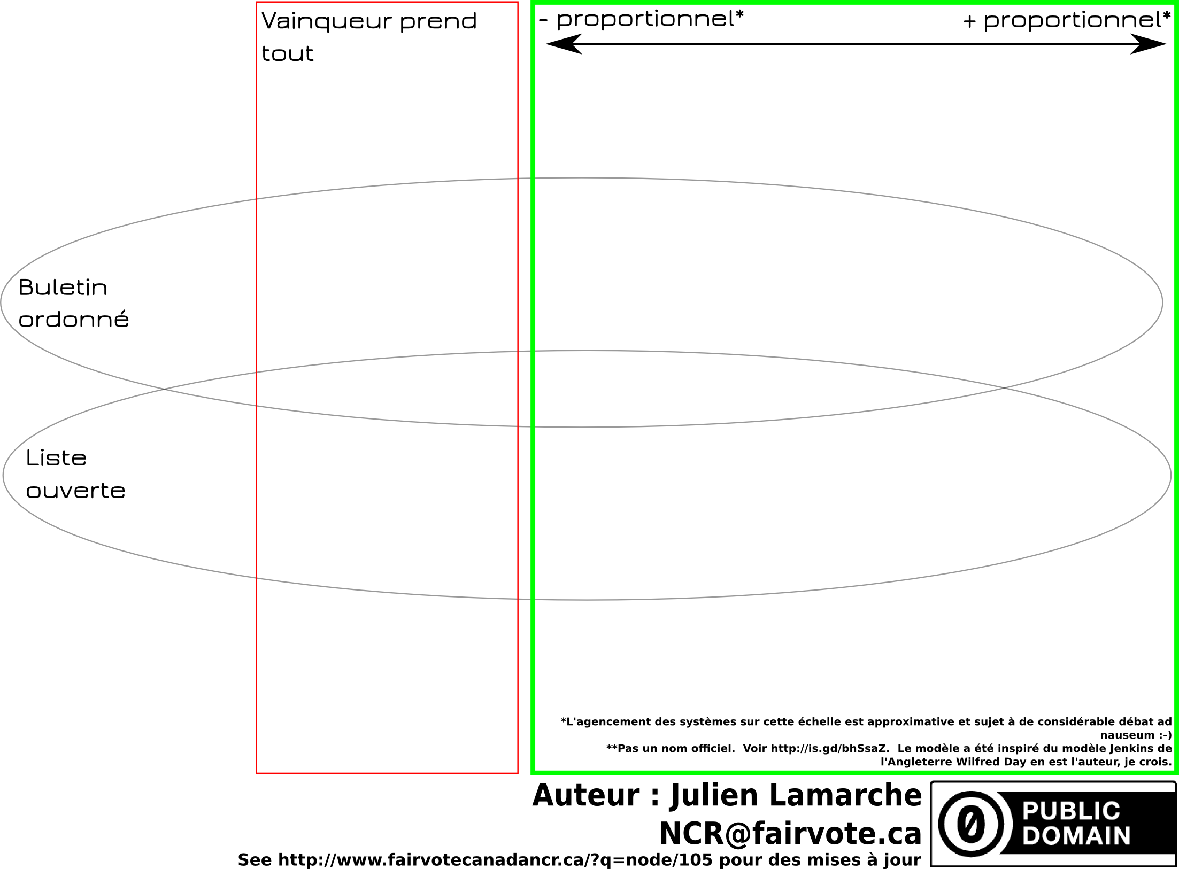

Slide 36
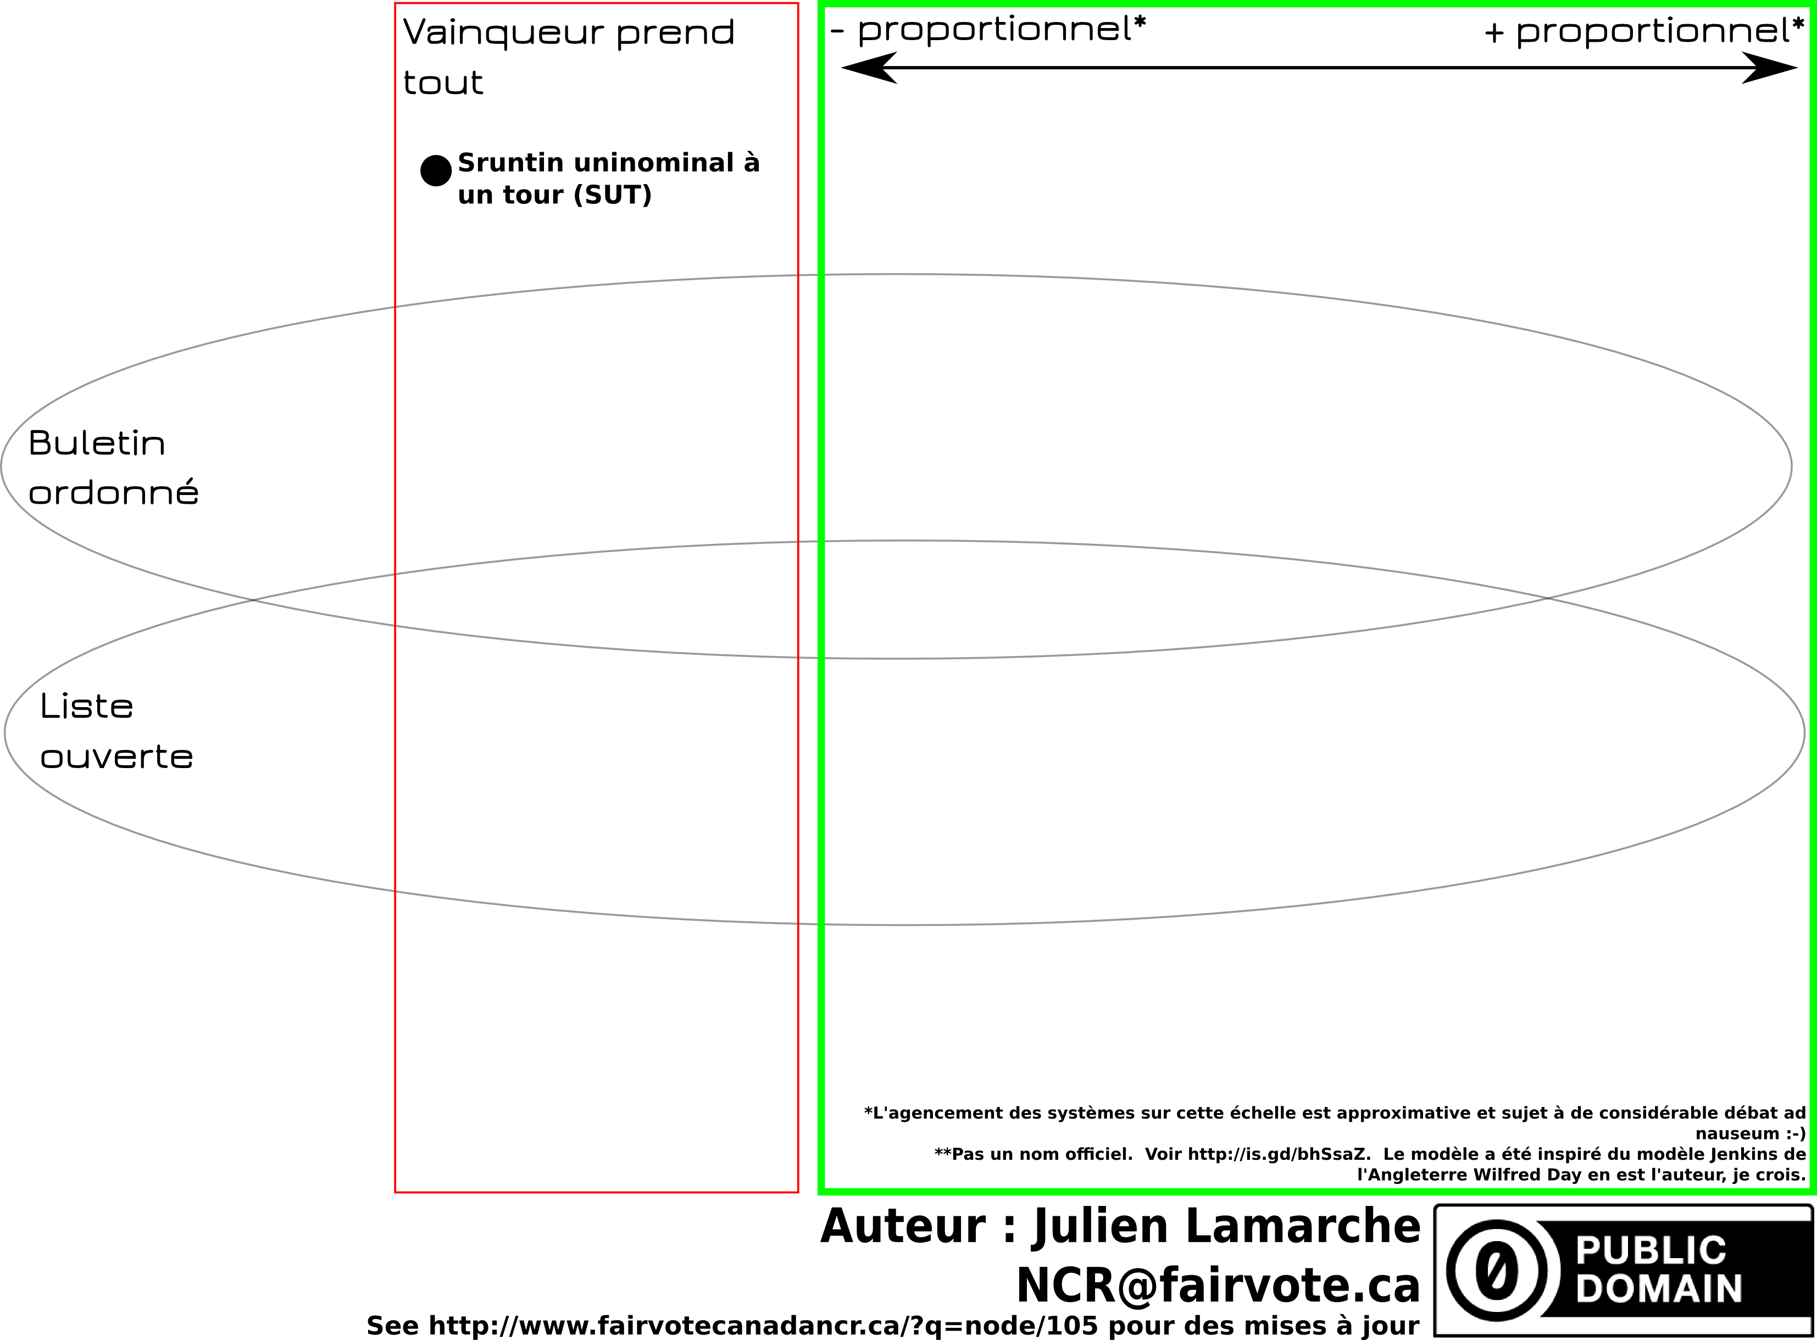

Slide 37
How to get proportionality
Lists
Clusters
Swapping
Pairing

Slide 38
Voting systems considered in Canada
Single Member Plurality (First past the post) (FPTP)

Slide 39
Voting systems considered in Canada
Single Member Plurality (First past the post) (FPTP)
Mixed member proportional (MMP)
Single Transferable Vote (STV)

Slide 40
Voting systems considered in Canada
Single Member Plurality (First past the post) (FPTP)
Mixed member proportional (MMP)
Single Transferable Vote (STV)
Alternative Vote (Preferential Voting) (AV)

Slide 41
Voting systems considered in Canada
Single Member Plurality (First past the post) (FPTP)
Mixed member proportional (MMP)
  Law Commission 2004
  Jenkins-Day
  Dual Member Mixed Proportional
Single Transferable Vote (STV)
Alternative Vote (Preferential Voting) (AV)

Slide 42
Voting systems considered in Canada
Single Member Plurality (First past the post) (FPTP)
Mixed member proportional (MMP)
  Law Commission 2004
  Jenkins-Day
  Dual Member Mixed Proportional
Single Transferable Vote (STV)
Alternative Vote (Preferential Voting) (AV)
P3

Slide 43
Not a voting system
Ranked ballot
Preferential ballot

Slide 44
Clarification
All candidates face voters
All systems keep local or near-local representation

Slide 45
Many systems
 | The ridings & seat | The ballot | The algorithm
FPTP (SMP) | One seat per geographic riding | 1 « X » | Winner has the most votes, at least one more than everybody else
Mixed Member Proportional (MMP) | Mix of geographic riding and list seats | 2 votes : Candidate and party | List seats used to compensate for lack of proportionality
Single Transferable Ballot | Ridings clustered together | Ranked | Candidates eliminated until all seats are filled.
Alternative Vote |  | Ranked | Candidates eliminated until winner has more than 50%
Semi-Proportional | Mix of geographic riding and list seats | 2 votes : Candidate and party | Lists seats are shared proportionaly but not whole legislature

Slide 46
Mixed Member Proportional

Slide 47
Mixed Member Proportional
The algorithm
Winner of geographic seats are determined first
List seats compensate for lack of proportionality

Slide 48
MMP : The algorithm
Fictional legislature of 100 seats
 | Geographic seats | % of vote | List seats
Party A | 38 | 40% | 2
Party B | 23 | 31% | 8
Party C | 8 | 19% | 11
Party D | 1 | 6% | 5
Party E | 0 | 4% | 4
Total | 70 | 100% | 30

Slide 49
Mixed Member Proportional
The seats & riding
One seat per geographic ridings;
List seats for ridings that span the entirety or parts of the jurisdiction;

Slide 50
MMP : The algorithm

Slide 51
MMP : The algorithm

Slide 52
List seats
Closed list
(Ontario MMP 2007)
Open lists
(Voting Counts: Electoral Reform for Canada, Law Commission of Canada, 2004, p. 106)
Best loosers
(Germany)

Slide 53
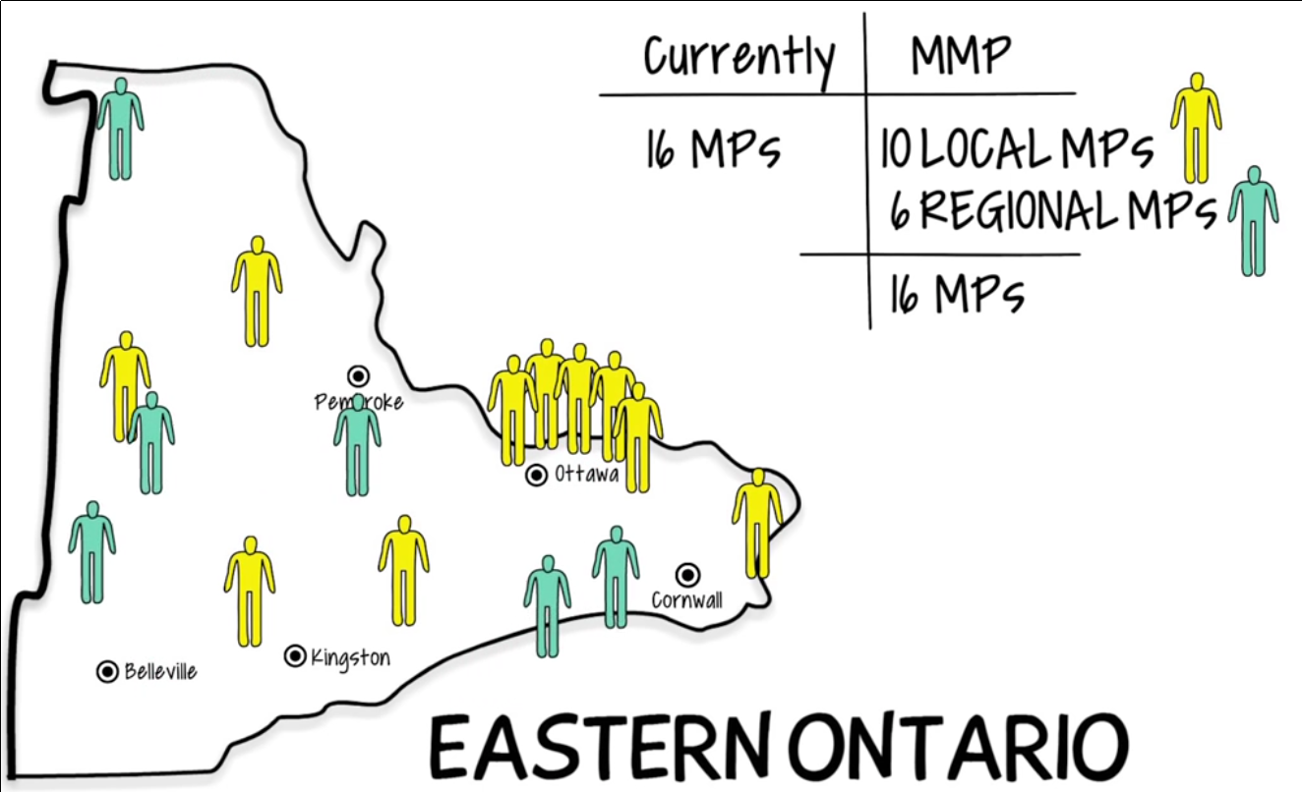
Law Commission 2004 MMP
Eastern Ontario

Slide 54
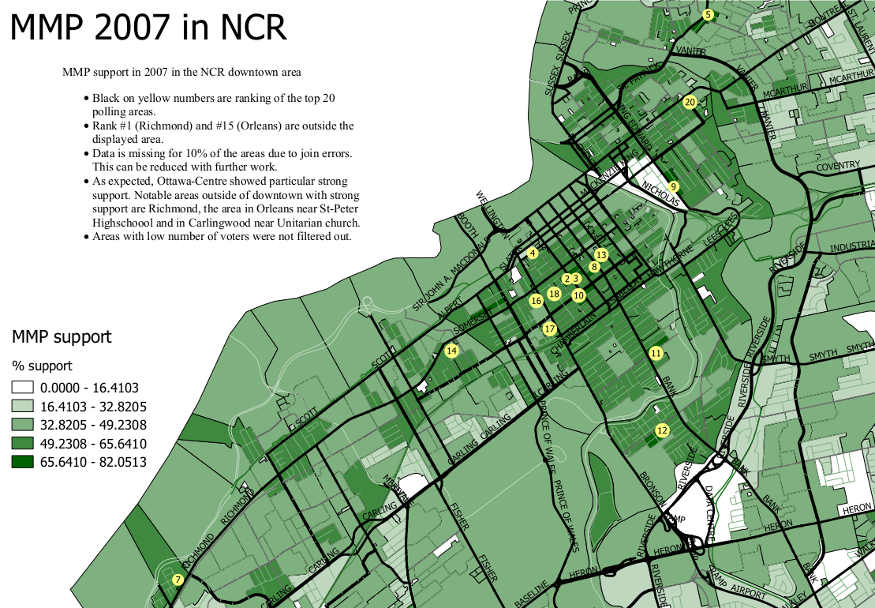

Slide 55
Mixed Member Proportional
The ballot: | One vote for a party One vote for a candidate
Seats per electoral district: | 50%-70% are local electoral district Remainder are list seats
The algorithm: | Geographic seats first determined List seats compensate for lack of proportionality

Slide 56
Dual Member Proportional

Slide 57
The ballot paper would look something like this…
P.E.I. Election 2015
District G, Avonlea-White Sands
Vote by putting a single “X” in the circle beside the option you most support.
X
Parties may nominate up to
2 candidates per district.
Independent candidates may also run.
When a party wins 1 of the 2 seats
for this district, only their first-listed candidate is selected.
CAT PARTY
1. Maud Montgomery
2. Matthew Cuthbert
DOG PARTY
1. Charlie Sloane
2. Anne Shirley
LIZARD PARTY
1. Marilla Cuthbert
2. Gilbert Blythe
RABBIT PARTY
1. Peter Blewett
2. Diana Barry
John Blythe (Independent)

Slide 58
Dual Member Proportional
The ballot: | Single X for a pair of candidates. The X also counts as a party vote.
Seats per electoral district: | 2 seats per district
The algorithm: | First listed candidate with a plurality of votes is selected Determine the number of compensatory seats per party Candidates with the strongest relative support among their party are given the compensatory seats

Slide 59
OECD countries by voting system

Slide 60
Single Transferable Vote

Slide 61
Single Transferable Vote:
The ballot
Ranked vote
No party list

Slide 62
Single Tranferable Vote :
The district & seats
5 ridings of 1 seat each

Slide 63
Single Tranferable Vote :
The district & seats
1 riding of 5 seats

Slide 65
Single Transferable Vote
The threshold
Formula:
Example of 1 seat :
Example of Cambridge Massachussetts :

Slide 66
Single Transferable Vote
The algorithm
Establish the threshold
Count first choices
Have any candidates reached the threshold?
Eliminate last place candidate and distribute his / her votes
Declare those elected
Enough winners?
Distribute surplus of winners
Finished

Slide 91
Single Transferable Vote
The ballot: | A ranked ballot for candidates of different parties, one to many candidates per party
Seats per electoral district: | 2-7 in BC-STV
The algorithm: | Quota determined first Count the one Transfer votes of surplus or loosing candidate Repeat until all seats are filled

Slide 92
Alternative Vote
(not proportional)
Also called Instant Runoff Voting or preferential voting
Like STV, has a ranked ballot
Only one seat per district
Threshold is set to 50%

Slide 93

Vote alternatif
L'algorithme
Établir le seuil
Compte les premiers choix
Est-ce qu'il y a un(e) ou des candidat(e)s qui a plus que 50%
Éliminer le ou la candidat(e) en dernière place et distribuer ses votes
Déclarer élu
Nombre suffisant d'élus?
Distribuer le surplus de votes
Fini

Slide 94
Alternative Vote
Preferential Voting
The ballot: | A ranked ballot for candidates of different parties, one per party
Seats per electoral district: | One seat per district
The algorithm: | Quota determined first Count the number one Transfer votes of loosing candidate Repeat until one candidate has >50%

Slide 95
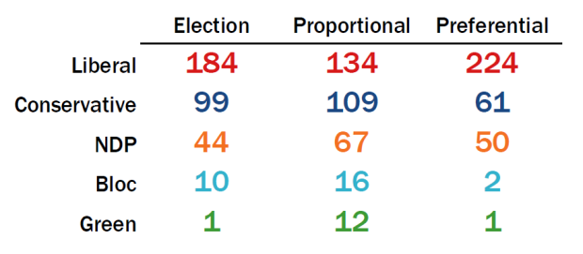
2015 according to Éric Grenier

Slide 96
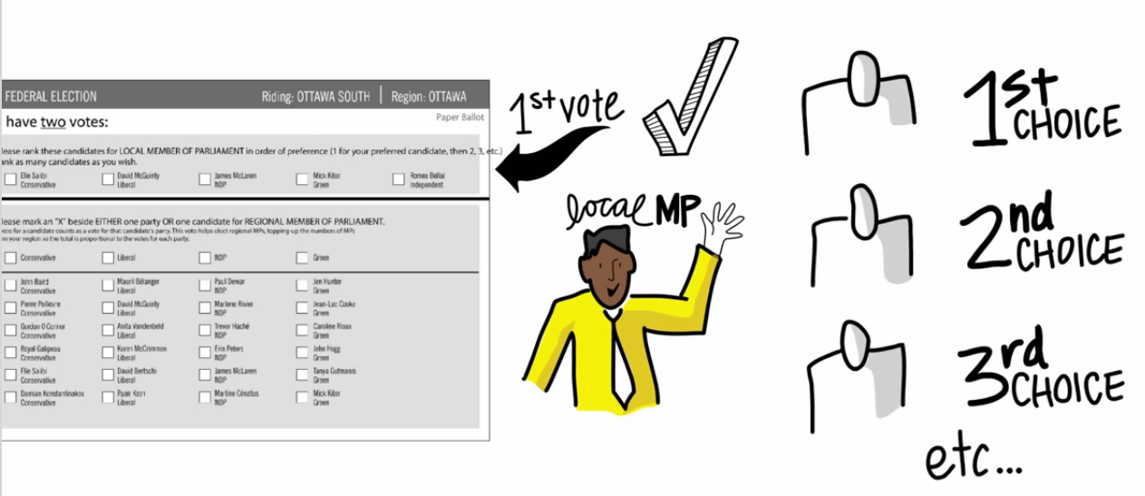
Jenkins-Day MMP

Slide 97
Jenkins-inspired MMP

Slide 98
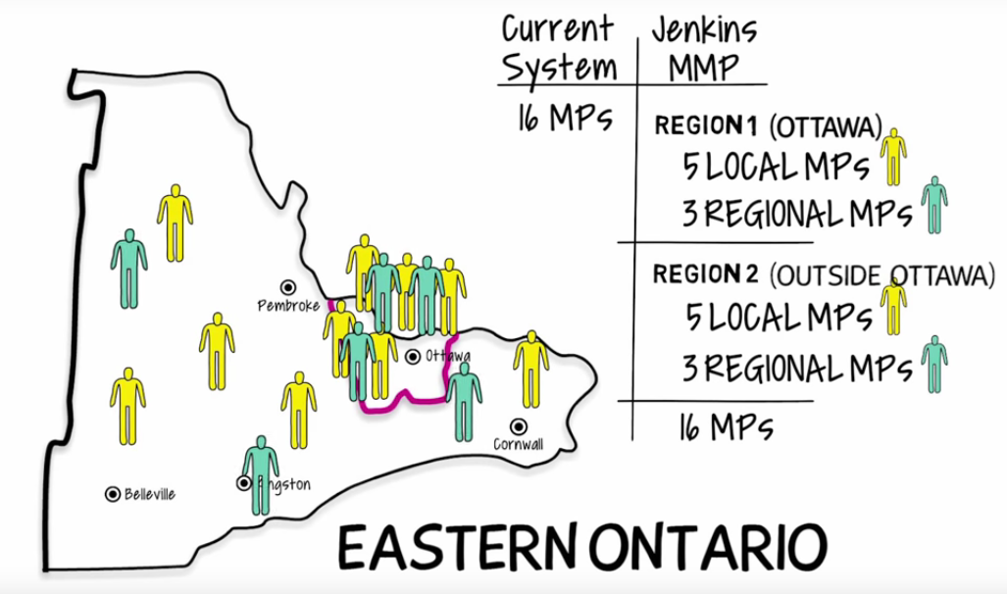
Jenkins-inspired MMP

Slide 99
Jenkins-Day
The ballot: | One vote for a party A ranked ballot for a candidate
Seats per electoral district: | 50%-70% are local electoral district Remainder are list seats
The algorithm: | Geographic seats first determined List seats compensate for lack of proportionality

Slide 100
Jenkins-Day MMP

Slide 101
Jenkins-Day
The ballot: | One vote for a party A ranked ballot for a candidate
Seats per electoral district: | 50%-70% are local electoral district Remainder are list seats
The algorithm: | Geographic seats first determined List seats compensate for lack of proportionality

Slide 102
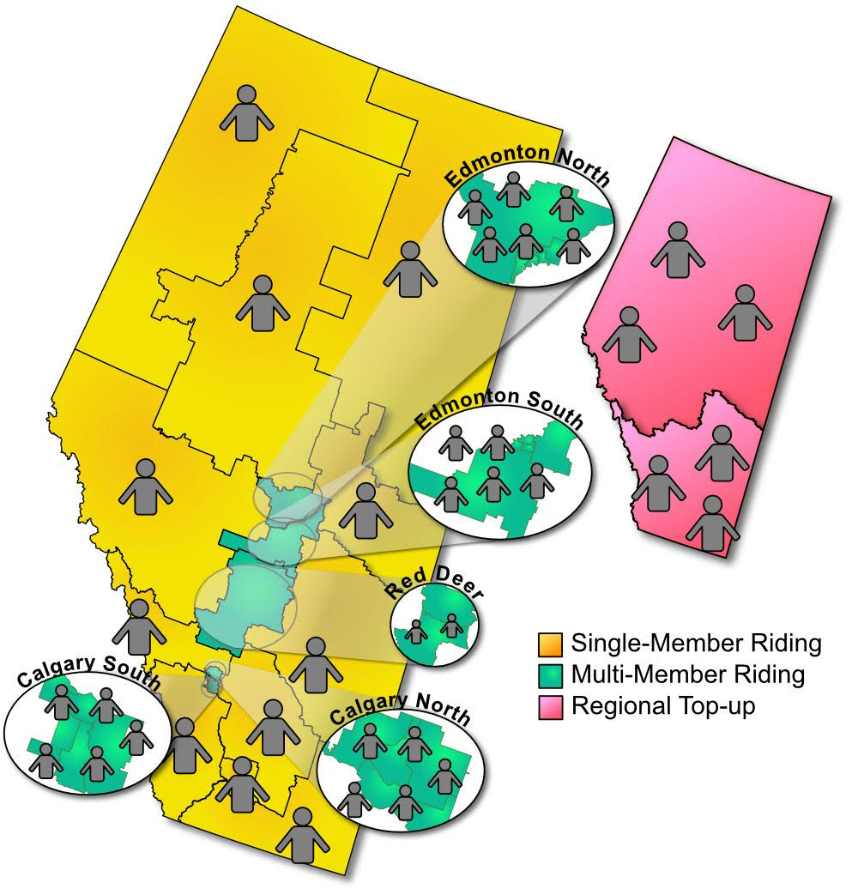
Rural-Urban Proportional

Slide 103
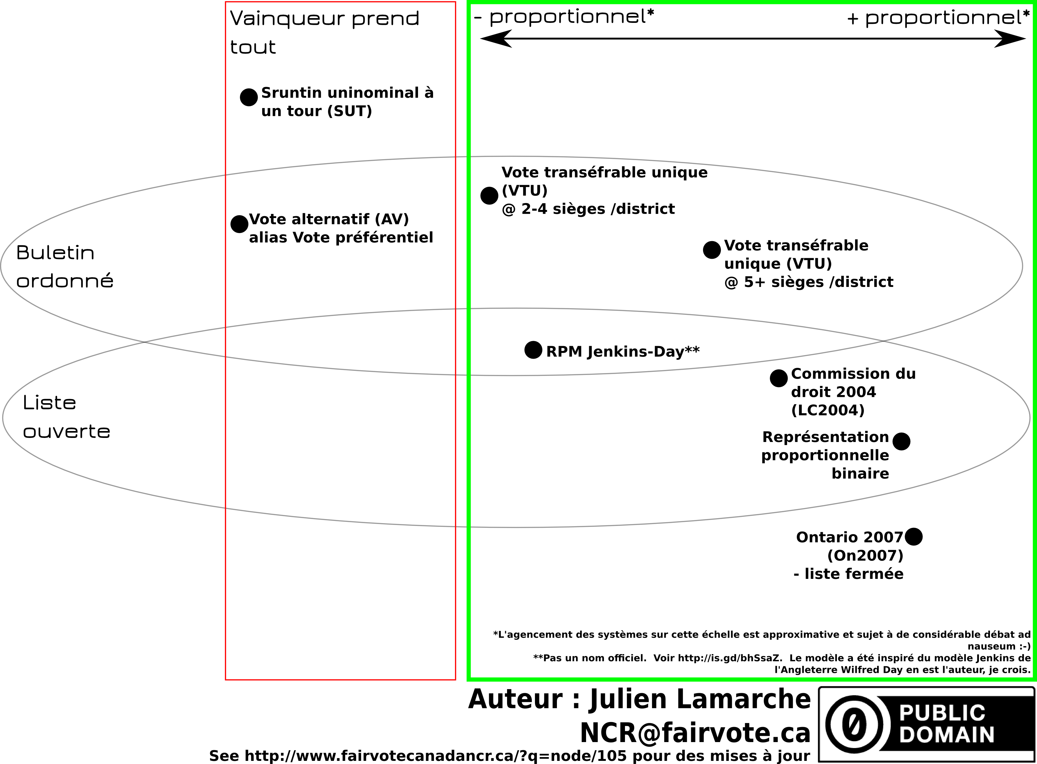

Slide 104
Where to go from here?
Sign Declaration at http://fairvote.ca (supply postal code)
Get your organization to support the PR cause|
(http://www.everyvotercounts.ca/about-us/)
Go to Town Halls: Ottawa-Center, Hull-Aylmer (Thursday October 6th), Pontiac
Write to your MP, ERRE@parl.gc.ca
Get on our volunteers list : NCR@fairvote.ca
Donate : http://www.fairvote.ca/donate/
Write a letter : letters@ottawacitizen.com

Slide 105
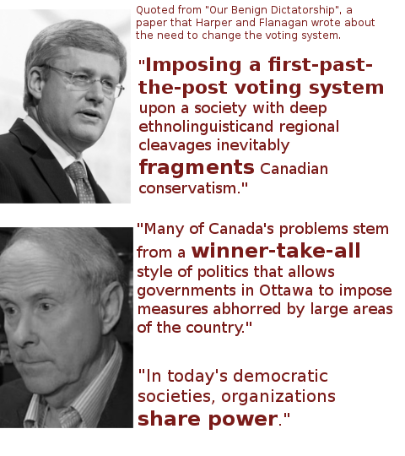
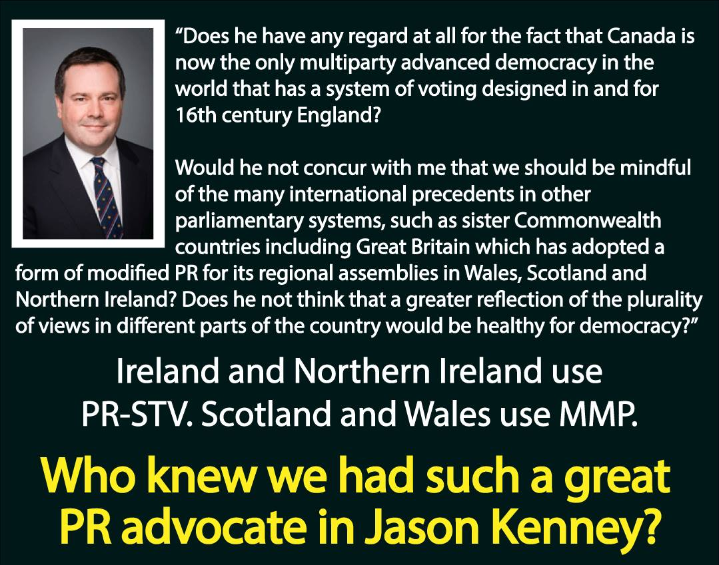
This is Canadian issue

Slide 106
Elavator pitch for PR
« I want your vote & my vote to be equal & effective. That's why I'm advocating for proportinality. »
« I want 39% of the vote to result in 39% of the seats, not 54% of the seats »

Slide 107
Rebutting to referendum advocates
« I agree your voice should matter. I think it should matter every election with an equal vote. That's why I'm a proportionality advocate! »
« I want your vote to be as equal and effective as mine! I want the vote of conservatives in Toronto & Atlantic Canada to elect somebody! Last election they elected no one. »

Slide 108
Explaining without videos

Slide 109
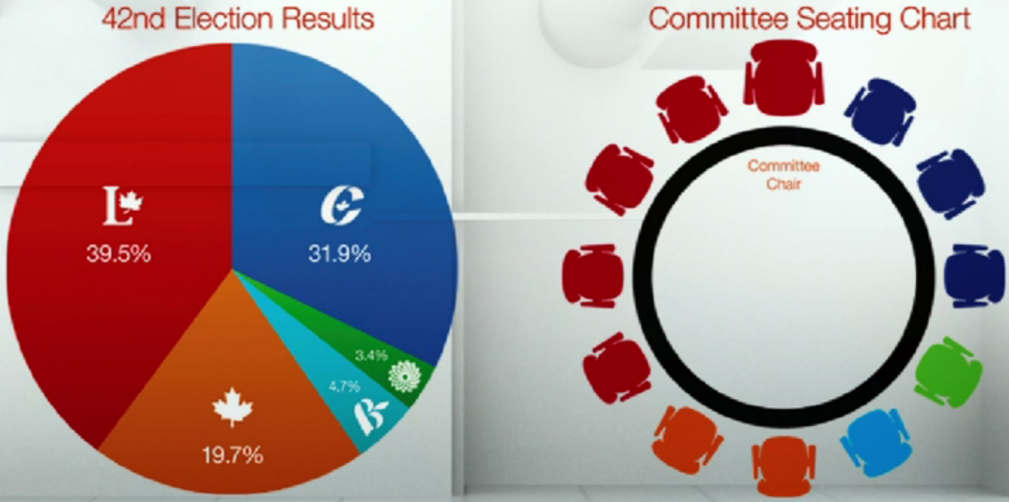
What's next?

Slide 110
Where to go from here?
170 MPs

Slide 111
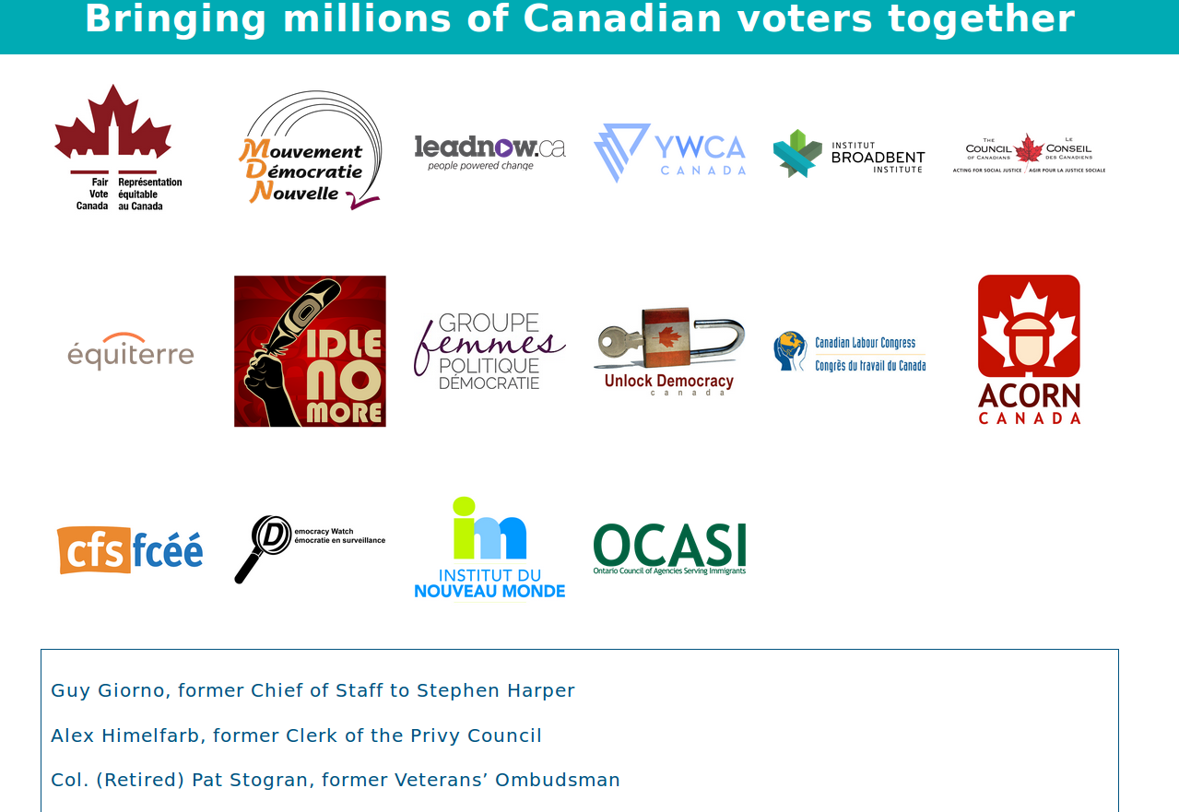
Where to go from here?

Slide 112


Where to go from here?

Slide 113
A primer on voting systems
Questions?
Julien Lamarche
NCR@fairvote.ca
Somes images provided by New Zealand government and Wikipedia users
Altes, Rspeer, Mark Ryan, Dariusofthedark, Jhayman and Earl Andrew.

Slide 114
Toastmasters Clubs
University of Ottawa
CBY 707A
2nd and 4th Tuesday
6:00 pm
613-878-5346
Ottawa Toastmasters
Sandy Hill CC
250 Somerset East
Thursday 6 pm
Odawa Neeskak
Odawa Native Friendship Centre
250 City Centre Avenue 2nd & 4th Thursday
5:15 pm EST
613 835 4076

Slide 115
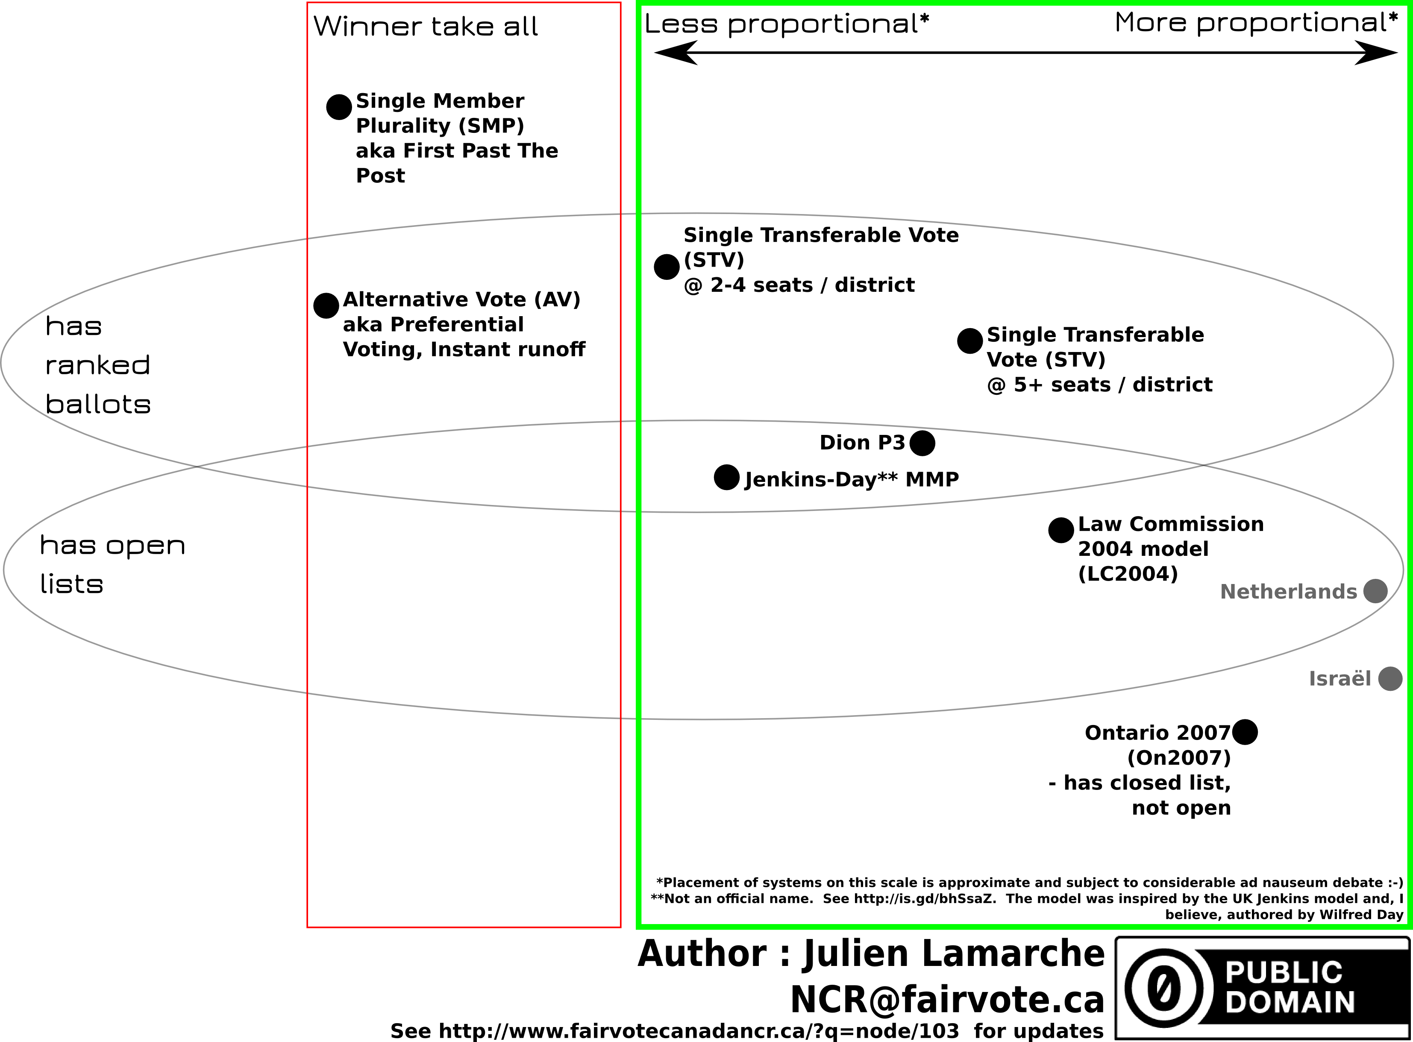

Slide 116
Image credits
This work has been released into the
public domain by its author, Earl Andrew
Some rights
Reserved
Image by
Altes
This New Zealand work is in the public domain both in New Zealand and in other countries adhering to international copyright treaties,
Some rights
Reserved
Image by
Rspeer and Mark Ryan
Some rights
Reserved
Image by
Dariusofthedark and Jhayman

