Slide 1

A primer on voting systems
Julien Lamarche
President, NCR Chapter
Fair Vote Canada
http://www.fairvote.ca
NCR@fairvote.ca

Slide 2
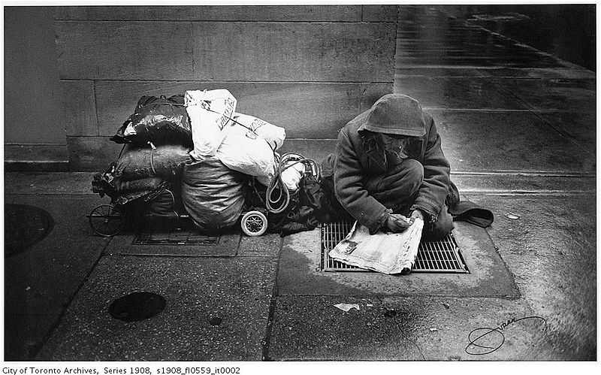
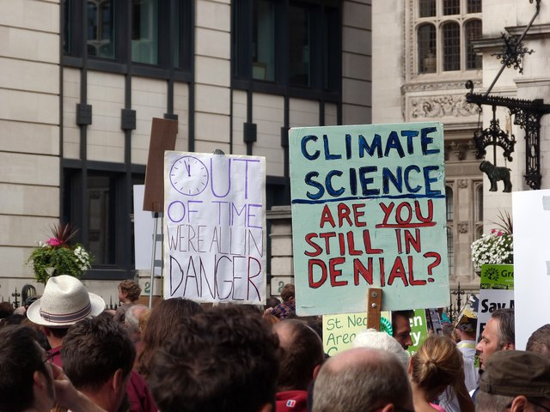
Why proportional representation?
It's the critical issue....
…. to the urgent ones we care about.
Notes:
Proejct management... critical path

Slide 3
What to do next?
Call Will Amos, ask when we will be the next closest consultation in the region
Téléphone : 819-827-5161
William.Amos@parl.gc.ca
Sign the Declaration of voters rights à http://www.fairvote.ca/
Ask your organisation or union to join the « The every voter count » alliance
Ortganise a presentation

Slide 4
Fair Voting
Why FPTP doesn't serve voters
Tools to get proportionality
Different voting systems
Where to go from here?

Slide 5
FPTP doesn't serve voters
Under representation of women and ethnic minorities;
Exageration of regional differences
Canadian federal election 2011
Ontario | % votes | % seats
- Conservative | 44 | 69
- Liberal | 25 | 10
Quebec
- NDP | 43 | 79
- Bloc | 23 | 5

Slide 6
~50%

Slide 7
FPTP doesn't serve voters
Phony majorties
  Ontario (since 1937)
  Canada (since 1984)
  Quebec (since 1985)
How can institutions be accountable?

Slide 8
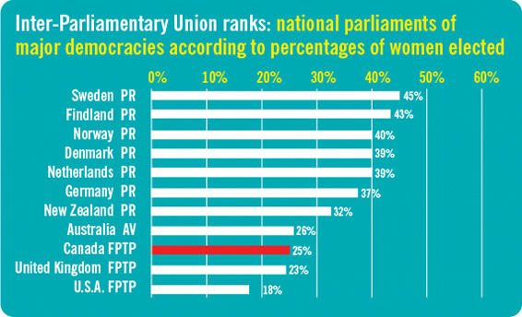
Proportion of women elected in legislatures of OECD* countries
*Organization for Economic Cooperation and Development

Slide 9
Distortion of representation (2011)

Slide 10
Distortion of representation (2015)

Slide 11
Distortion of representation (2011)

Slide 12
Distortion of representation (2015)

Slide 13
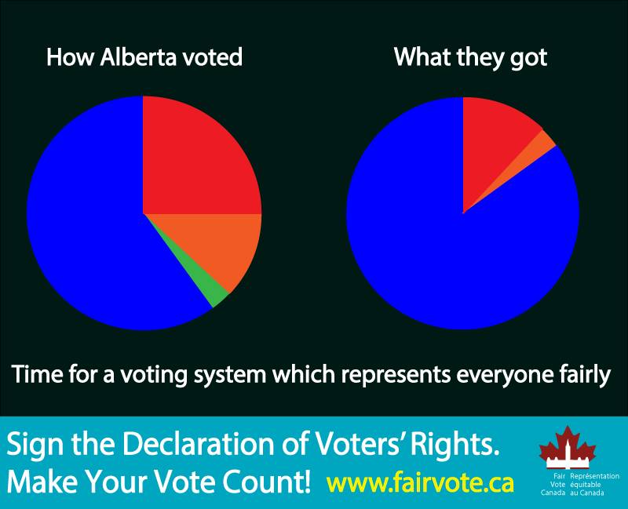

Slide 14
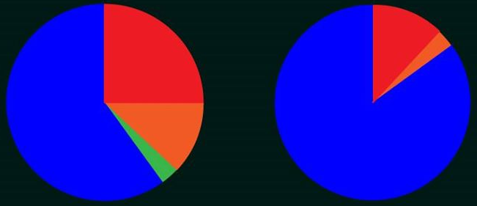
Distorsion : Alberta

Slide 15
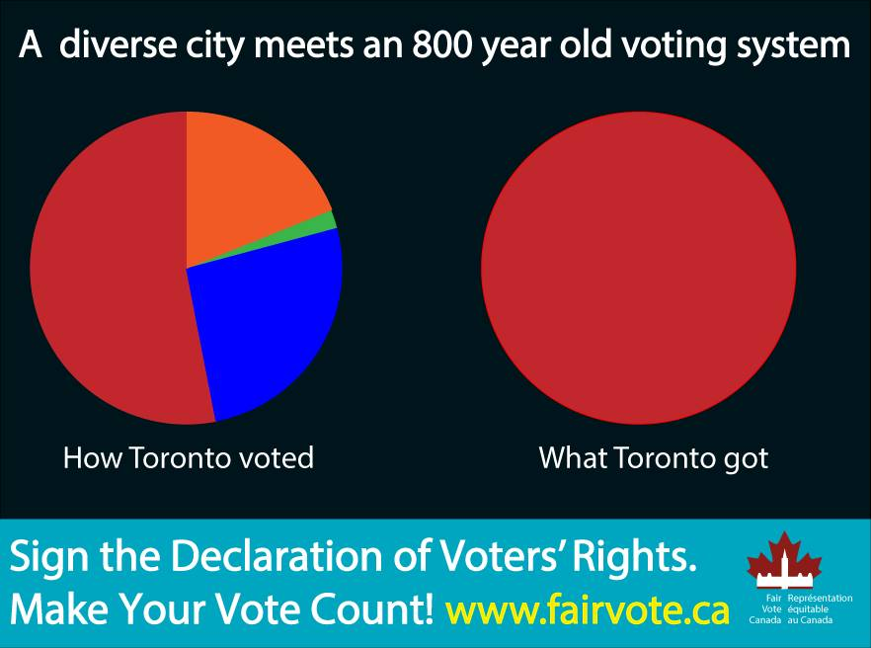

Slide 16
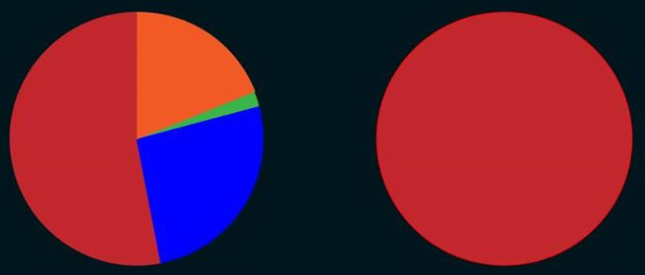
Distorsion : Toronto

Slide 17
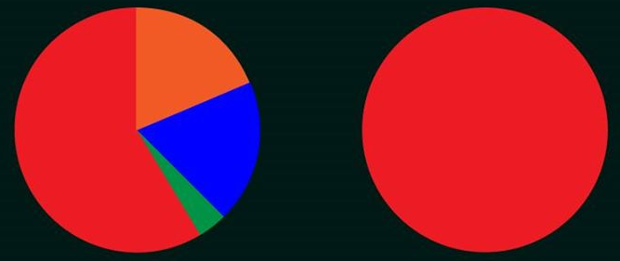
Distorsion : Atlantique

Slide 18
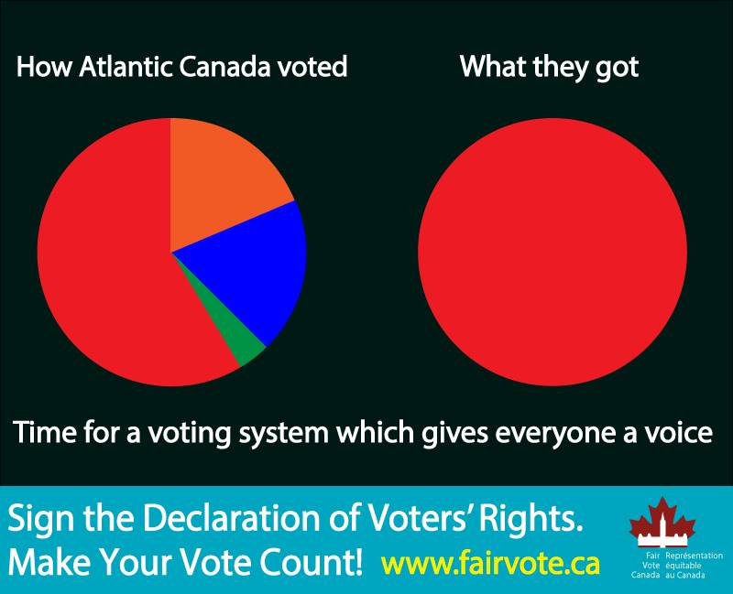

Slide 19
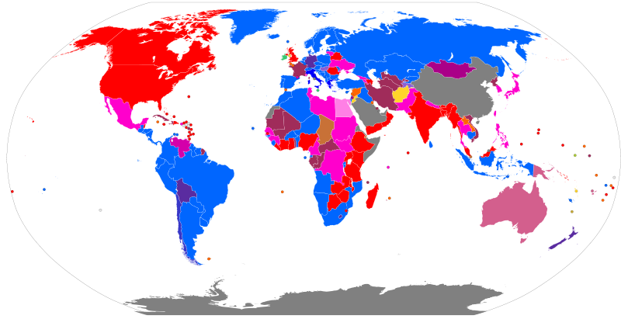
Who uses FPTP?
Legend : http://en.wikipedia.org/wiki/File:Electoral_systems_map.svg

Slide 20
Many systems
 | The ridings & seat | The ballot | The algorithm
FPTP (SMP) | One seat per geographic riding | 1 « X » | Winner has the most votes, at least one more than everybody else
Mixed Member Proportional (MMP) | Mix of geographic riding and list seats | 2 votes : Candidate and party | List seats used to compensate for lack of proportionality
Single Transferable Ballot | Ridings clustered together | Ranked | Candidates eliminated until all seats are filled.
Alternative Vote |  | Ranked | Candidates eliminated until winner has more than 50%
Semi-Proportional | Mix of geographic riding and list seats | 2 votes : Candidate and party | Lists seats are shared proportionaly but not whole legislature

Slide 21
Alors pourquoi la proportionnelle?
Augmentation de la représentation du vote des électeurs
Meilleure représentation de la diversité politique du pays et des provinces
Les pays avec la proportionnelle ont un plus grand nombre de femmes élues à leur législature
Augmente la diversité géographique des partis politques

Slide 22
History of voting reform in the world
1924-1957 : Alberta uses STV (Edmonton & Calgary) & AV (rest of province) to elect MLAs
1993 : New Zealand switches to Mixed Member Proportional (MMP) with 54% support
2011 : UK votes against AV (68% against)
2011 : New Zealand votes to keep MMP with 58% support

Slide 23
Recent history of voting reform in Canada
1984 : Electoral Representation Commission (Québec)
1997 : Federal Majority government with lowest support
2001 : Fair Vote Canada is founded
2002 : Quebec’s Estates-General on the Reform of Democratic Institutions
2004 : Quebec government study (Charest)
2004 : Law Commission of Canada report on ER
2005 : NB Commission on Legislative Democracy
2005 : PEI Plebiscite on voting reform
2005 : BC Citizens Assembly recommends Single Transferable Vote
2005 : In a referendum, BC-STV receives 58% support
2006 : Quebec Citizens Committee Report
2007 : Ontario Citizens Assembly recommends Mixed Member proportional
2007 : Quebec’s Chief Electoral Officer’s Report
2009 : Second referendum on BC-STV

Slide 24
Les systèmes considérés au Canada
Scrutin uninominal à un tour
Représentation proportionnelle mixte
Vote transférable unique
Vote alternatif (vote préférentiel)
P3

Slide 25
What is an electoral district?
A bounded geographical area who's voters are represented by one or more legislators
Canada : 308 electoral districts represented by 308 MPs
Australian senate : 6 staes, each represented by 12 elected senators
Norway legislature : 19 counties, each represented by 4 to 17 legislators

Slide 26
How to get proportionality
Lists
Clusters
Swapping
Pairing

Slide 27
List seats

Slide 28
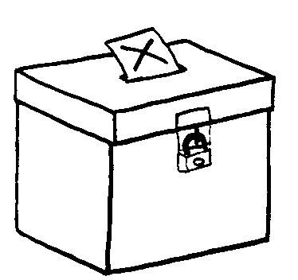
Voting systems
The ballot
Seats per electoral districts
The algorithm
(votes → seats)

Slide 29
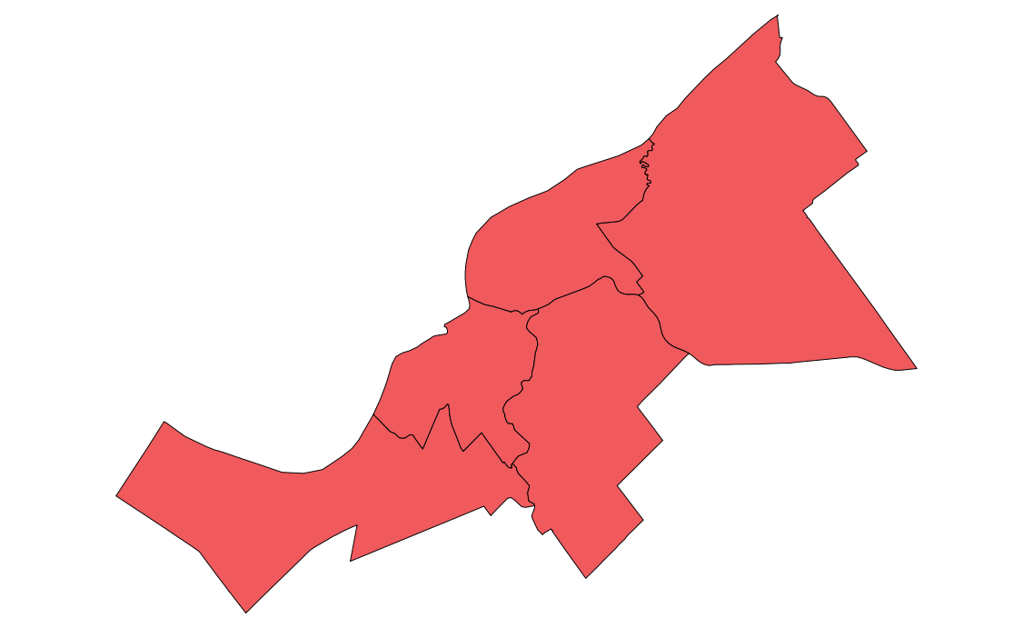
Clusters
5 ridings of 1 seat each

Slide 30

Clusters
1 riding of 5 seats

Slide 31
Pairing
P.E.I. Election 2015
District G, Avonlea-White Sands
X
CAT PARTY
1. Maud Montgomery
2. Matthew Cuthbert
DOG PARTY
1. Charlie Sloane
2. Anne Shirley
LIZARD PARTY
1. Marilla Cuthbert
2. Gilbert Blythe
RABBIT PARTY
1. Peter Blewett
2. Diana Barry
John Blythe (Independent)

Slide 32
Swapping

Slide 33
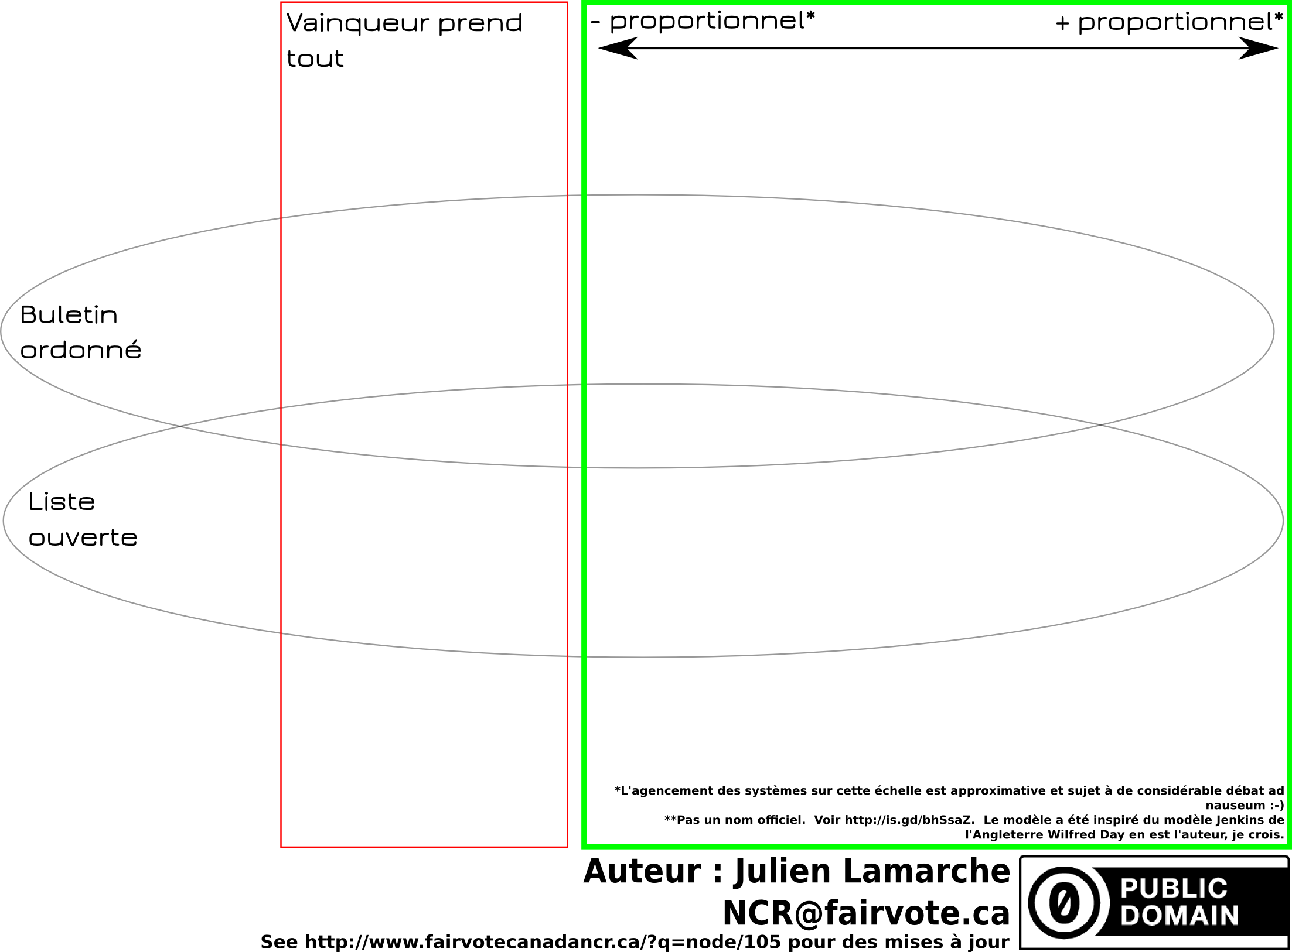

Slide 34
Single member plurality
(First past the post)
The ballot: | One X per vote
Seats per electoral district: | 308 ridings of one seat
The algorithm: | The seat is given to the candidate with at least 1 more vote than everyone else.

Slide 35
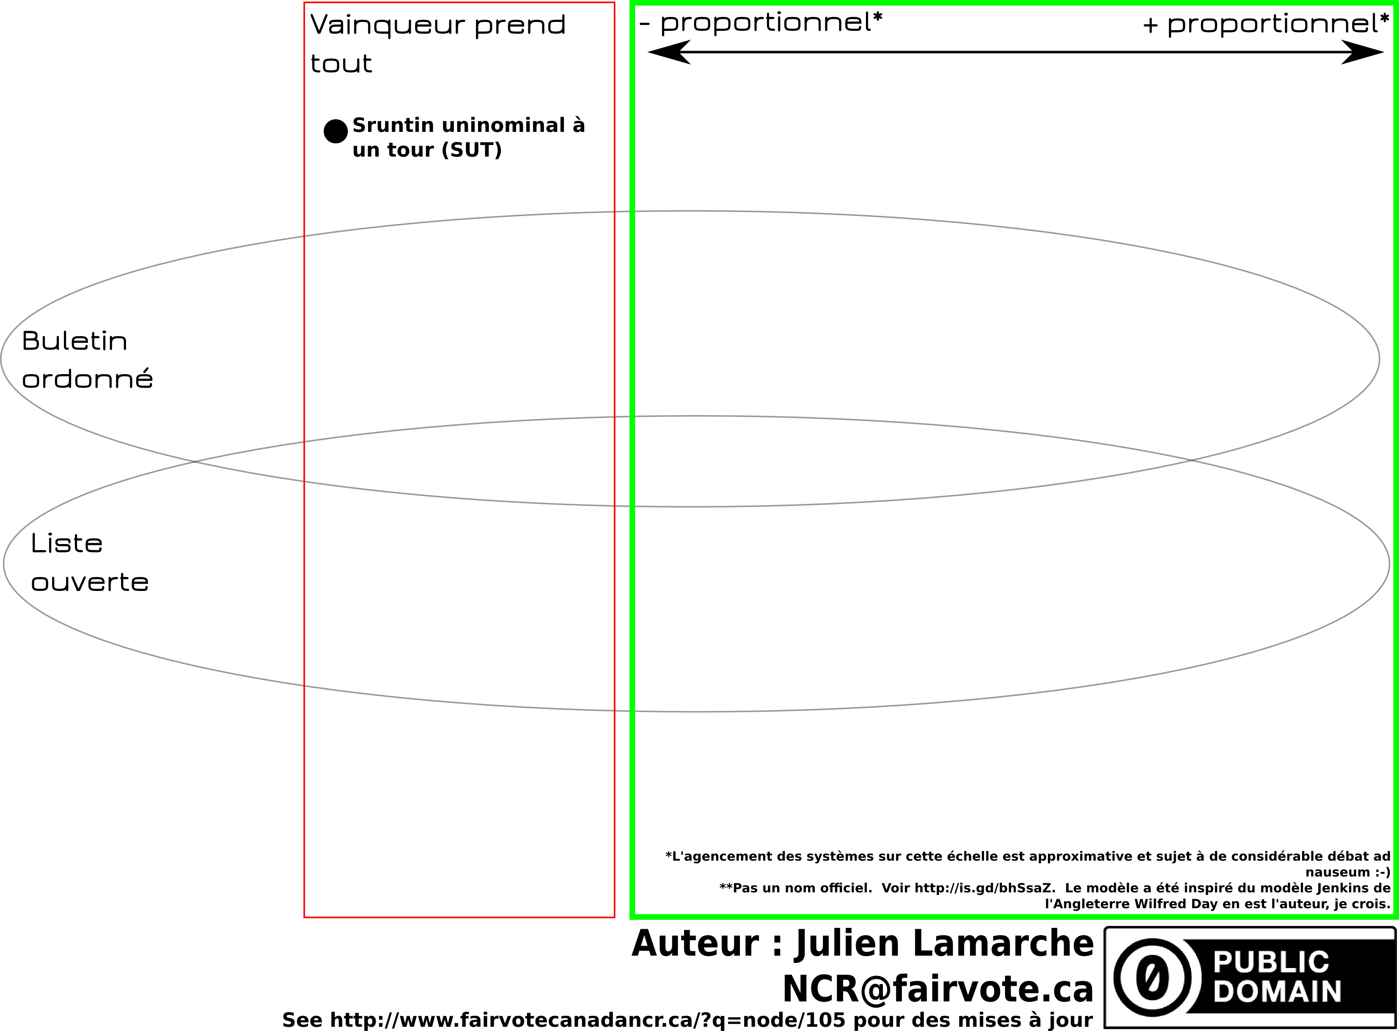

Slide 36
Voting systems considered in Canada
Single Member Plurality (First past the post) (FPTP)

Slide 37
Voting systems considered in Canada
Single Member Plurality (First past the post) (FPTP)
Mixed member proportional (MMP)
Single Transferable Vote (STV)

Slide 38
Voting systems considered in Canada
Single Member Plurality (First past the post) (FPTP)
Mixed member proportional (MMP)
Single Transferable Vote (STV)
Alternative Vote (Preferential Voting) (AV)

Slide 39
Voting systems considered in Canada
Single Member Plurality (First past the post) (FPTP)
Mixed member proportional (MMP)
  Law Commission 2004
  Jenkins-Day
  Dual Member Mixed Proportional
Single Transferable Vote (STV)
Alternative Vote (Preferential Voting) (AV)

Slide 40
Voting systems considered in Canada
Single Member Plurality (First past the post) (FPTP)
Mixed member proportional (MMP)
  Law Commission 2004
  Jenkins-Day
  Dual Member Mixed Proportional
Single Transferable Vote (STV)
Alternative Vote (Preferential Voting) (AV)
P3

Slide 41
Not a voting system
Ranked ballot
Preferential ballot

Slide 42
Clarification
All candidates face voters
All systems keep local or near-local representation

Slide 43
Many systems
 | The ridings & seat | The ballot | The algorithm
FPTP (SMP) | One seat per geographic riding | 1 « X » | Winner has the most votes, at least one more than everybody else
Mixed Member Proportional (MMP) | Mix of geographic riding and list seats | 2 votes : Candidate and party | List seats used to compensate for lack of proportionality
Single Transferable Ballot | Ridings clustered together | Ranked | Candidates eliminated until all seats are filled.
Alternative Vote |  | Ranked | Candidates eliminated until winner has more than 50%
Semi-Proportional | Mix of geographic riding and list seats | 2 votes : Candidate and party | Lists seats are shared proportionaly but not whole legislature

Slide 44
Mixed Member Proportional

Slide 45
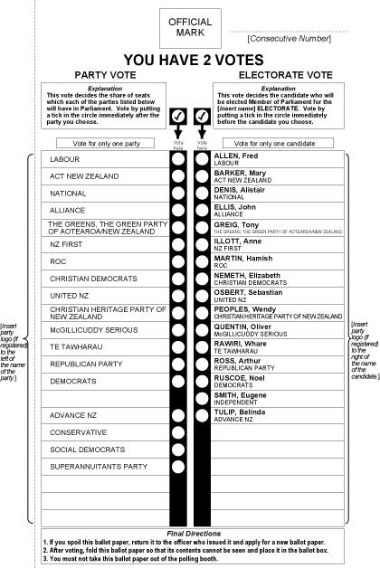
Mixed Member Proportional :
The ballot
Two votes :
  One for local candidate
  One for party

Slide 46
Mixed Member Proportional
The algorithm
Winner of geographic seats are determined first
List seats compensate for lack of proportionality

Slide 47
MMP : The algorithm
Fictional legislature of 100 seats
 | Geographic seats | % of vote | List seats
Party A | 38 | 40% | 2
Party B | 23 | 31% | 8
Party C | 8 | 19% | 11
Party D | 1 | 6% | 5
Party E | 0 | 4% | 4
Total | 70 | 100% | 30

Slide 48
Mixed Member Proportional
The seats & riding
One seat per geographic ridings;
List seats for ridings that span the entirety or parts of the jurisdiction;

Slide 49
MMP : The algorithm

Slide 50
MMP : The algorithm

Slide 51
List seats
Closed list
(Ontario MMP 2007)
Open lists
(Voting Counts: Electoral Reform for Canada, Law Commission of Canada, 2004, p. 106)
Best loosers
(Germany)

Slide 52
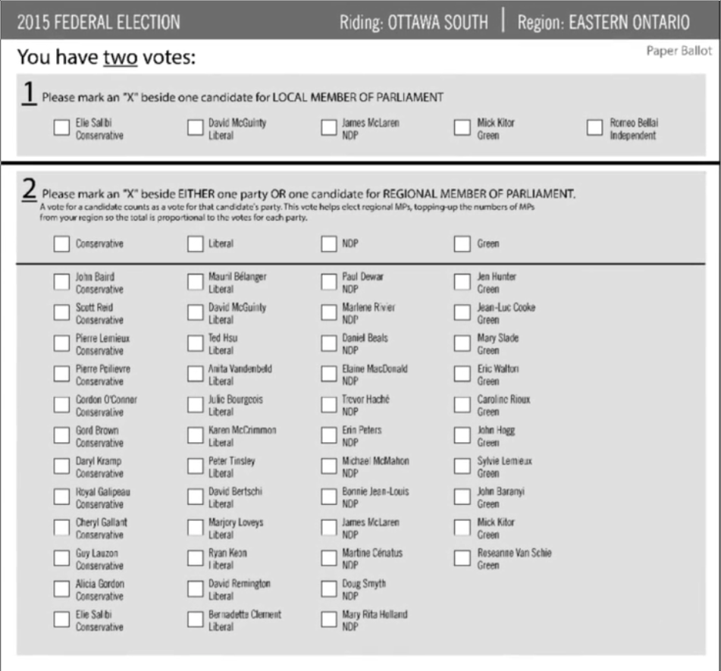
Law Commission 2004 MMP
Ballot

Slide 53
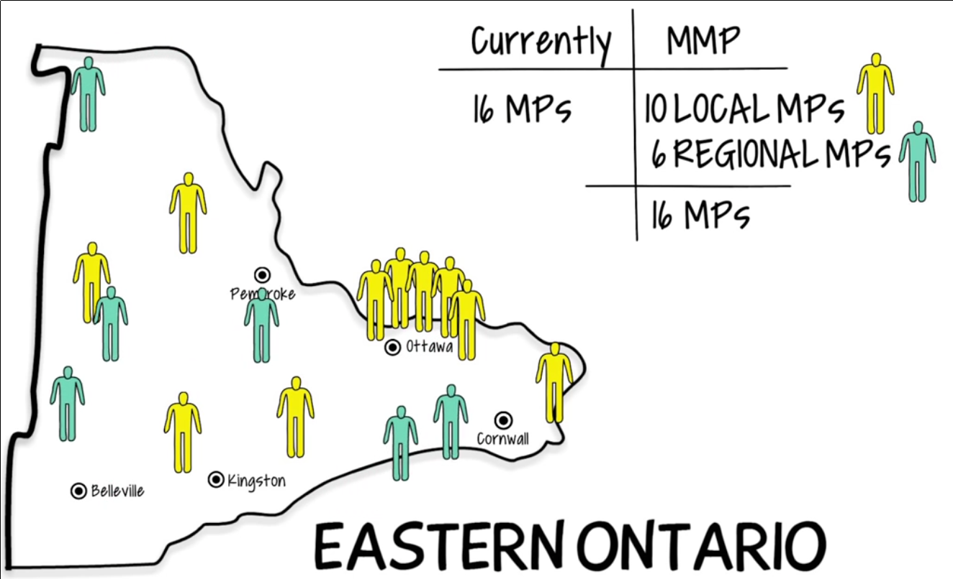
Law Commission 2004 MMP
Eastern Ontario

Slide 54
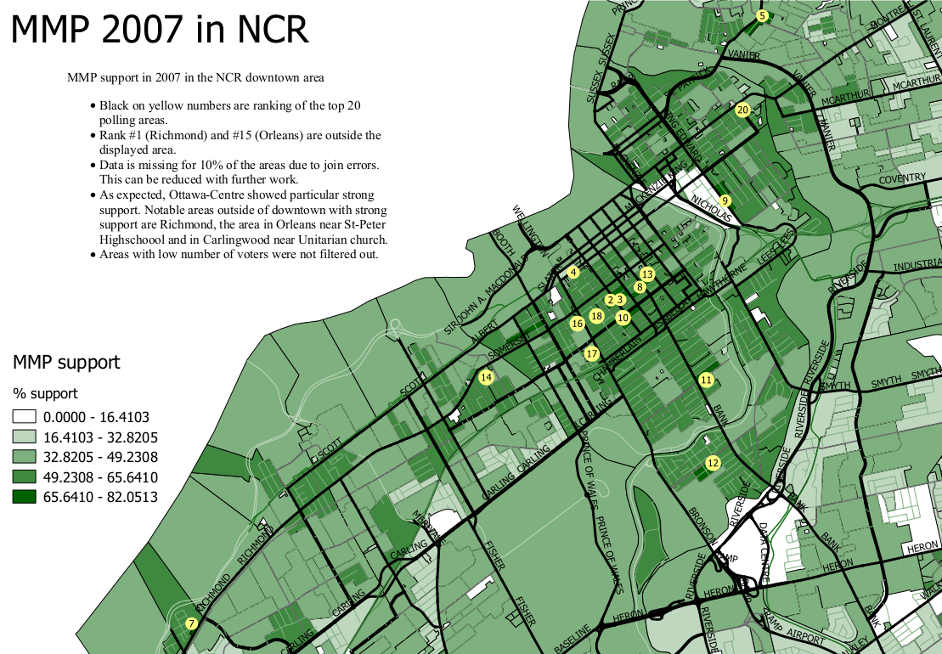

Slide 55
Mixed Member Proportional
The ballot: | One vote for a party One vote for a candidate
Seats per electoral district: | 50%-70% are local electoral district Remainder are list seats
The algorithm: | Geographic seats first determined List seats compensate for lack of proportionality

Slide 56
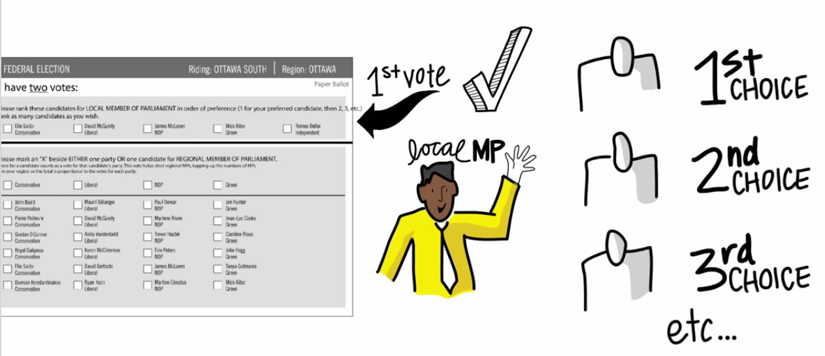
Jenkins-Day MMP

Slide 57
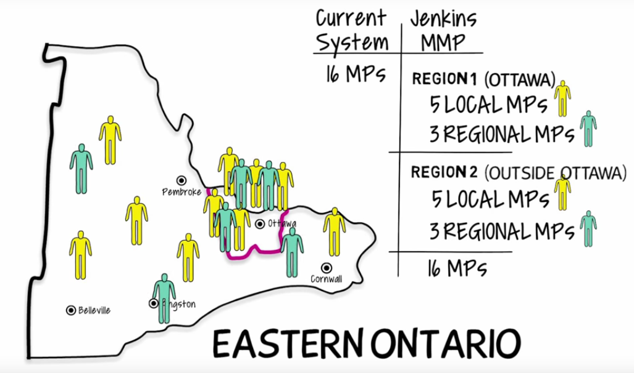
Jenkins-Day MMP

Slide 58
Jenkins-Day
The ballot: | One vote for a party A ranked ballot for a candidate
Seats per electoral district: | 50%-70% are local electoral district Remainder are list seats
The algorithm: | Geographic seats first determined List seats compensate for lack of proportionality

Slide 59
Dual Member Proportional

Slide 60
The ballot paper would look something like this…
P.E.I. Election 2015
District G, Avonlea-White Sands
Vote by putting a single “X” in the circle beside the option you most support.
X
Parties may nominate up to
2 candidates per district.
Independent candidates may also run.
When a party wins 1 of the 2 seats
for this district, only their first-listed candidate is selected.
CAT PARTY
1. Maud Montgomery
2. Matthew Cuthbert
DOG PARTY
1. Charlie Sloane
2. Anne Shirley
LIZARD PARTY
1. Marilla Cuthbert
2. Gilbert Blythe
RABBIT PARTY
1. Peter Blewett
2. Diana Barry
John Blythe (Independent)

Slide 61
Dual Member Proportional
The ballot: | Single X for a pair of candidates. The X also counts as a party vote.
Seats per electoral district: | 2 seats per district
The algorithm: | First listed candidate with a plurality of votes is selected Determine the number of compensatory seats per party Candidates with the strongest relative support among their party are given the compensatory seats

Slide 62
OECD countries by voting system

Slide 63
Single Transferable Vote

Slide 64
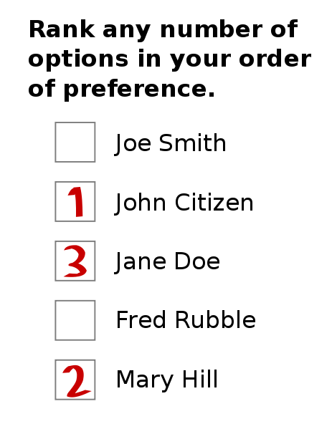
Single Transferable Vote:
The ballot
Ranked vote
No party list

Slide 65
Single Tranferable Vote :
The district & seats
5 ridings of 1 seat each

Slide 66
Single Tranferable Vote :
The district & seats
1 riding of 5 seats

Slide 68
Single Transferable Vote
The algorithm
Establish the threshold
Count first choices
Have any candidates reached the threshold?
Eliminate last place candidate and distribute his / her votes
Declare those elected
Enough winners?
Distribute surplus of winners
Finished

Slide 69
Single Transferable Vote
The algorithm
Formula:
Example of 1 seat :
Example of Cambridge Massachussetts :

Slide 94
Single Transferable Vote
The ballot: | A ranked ballot for candidates of different parties, one to many candidates per party
Seats per electoral district: | 2-7 in BC-STV
The algorithm: | Quota determined first Count the one Transfer votes of surplus or loosing candidate Repeat until all seats are filled

Slide 95
Alternative Vote
(not proportional)
Also called Instant Runoff Voting or preferential voting
Like STV, has a ranked ballot
Only one seat per district
Threshold is set to 50%

Slide 96

Vote alternatif
L'algorithme
Établir le seuil
Compte les premiers choix
Est-ce qu'il y a un(e) ou des candidat(e)s qui a plus que 50%
Éliminer le ou la candidat(e) en dernière place et distribuer ses votes
Déclarer élu
Nombre suffisant d'élus?
Distribuer le surplus de votes
Fini

Slide 97
Alternative Vote
Preferential Voting
The ballot: | A ranked ballot for candidates of different parties, one per party
Seats per electoral district: | One seat per district
The algorithm: | Quota determined first Count the number one Transfer votes of loosing candidate Repeat until one candidate has >50%

Slide 98
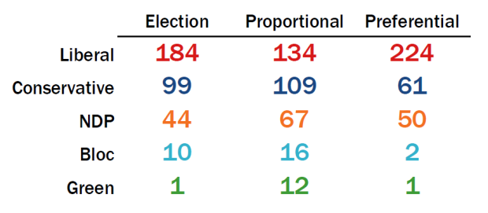
2015 according to Éric Grenier

Slide 99
Jenkins-Day MMP

Slide 100
Jenkins-Day MMP

Slide 101
Jenkins-Day
The ballot: | One vote for a party A ranked ballot for a candidate
Seats per electoral district: | 50%-70% are local electoral district Remainder are list seats
The algorithm: | Geographic seats first determined List seats compensate for lack of proportionality

Slide 102
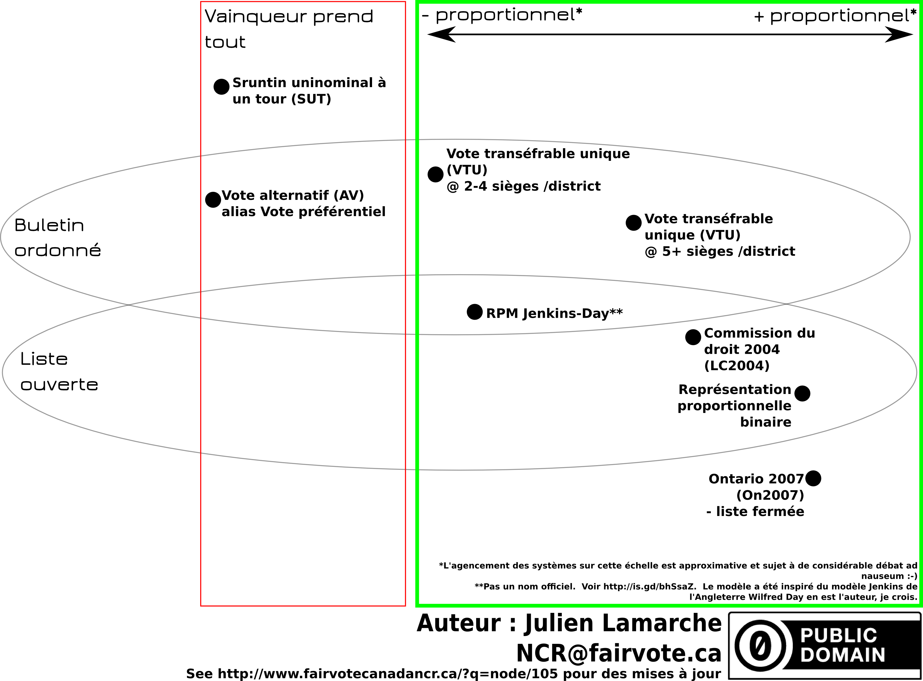

Slide 103
Where to go from here?
Sign Declaration
Update your information with FVC (postal code)
Get candidates to sign the pledge
Get a presentation in your community
Get your organization to support the cause
Get on our volunteers list : NCR@fairvote.ca
Donate : http://www.fairvote.ca/donate/
Write a letter : letters@ottawacitizen.com,
editor@theequity.ca, editor@journalpontiac.com

Slide 104
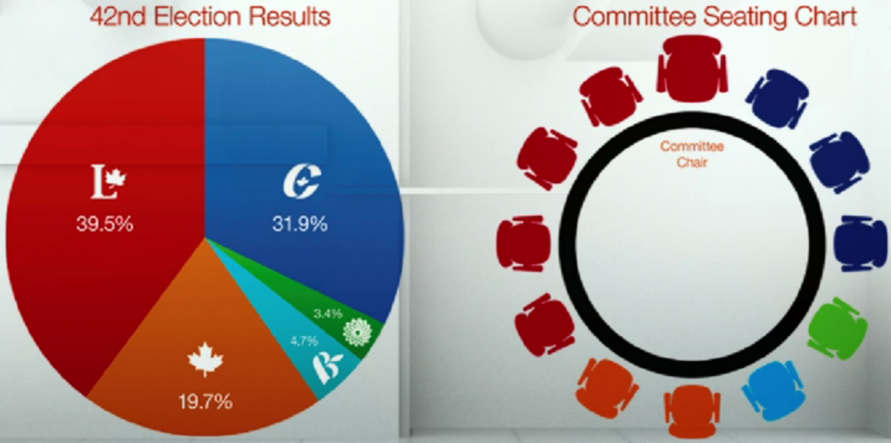
What's next?

Slide 105
Where to go from here?
170 MPs

Slide 106

Where to go from here?

Slide 107
A primer on voting systems
Questions?
Julien Lamarche
NCR@fairvote.ca
Somes images provided by New Zealand government and Wikipedia users
Altes, Rspeer, Mark Ryan, Dariusofthedark, Jhayman and Earl Andrew.

Slide 108
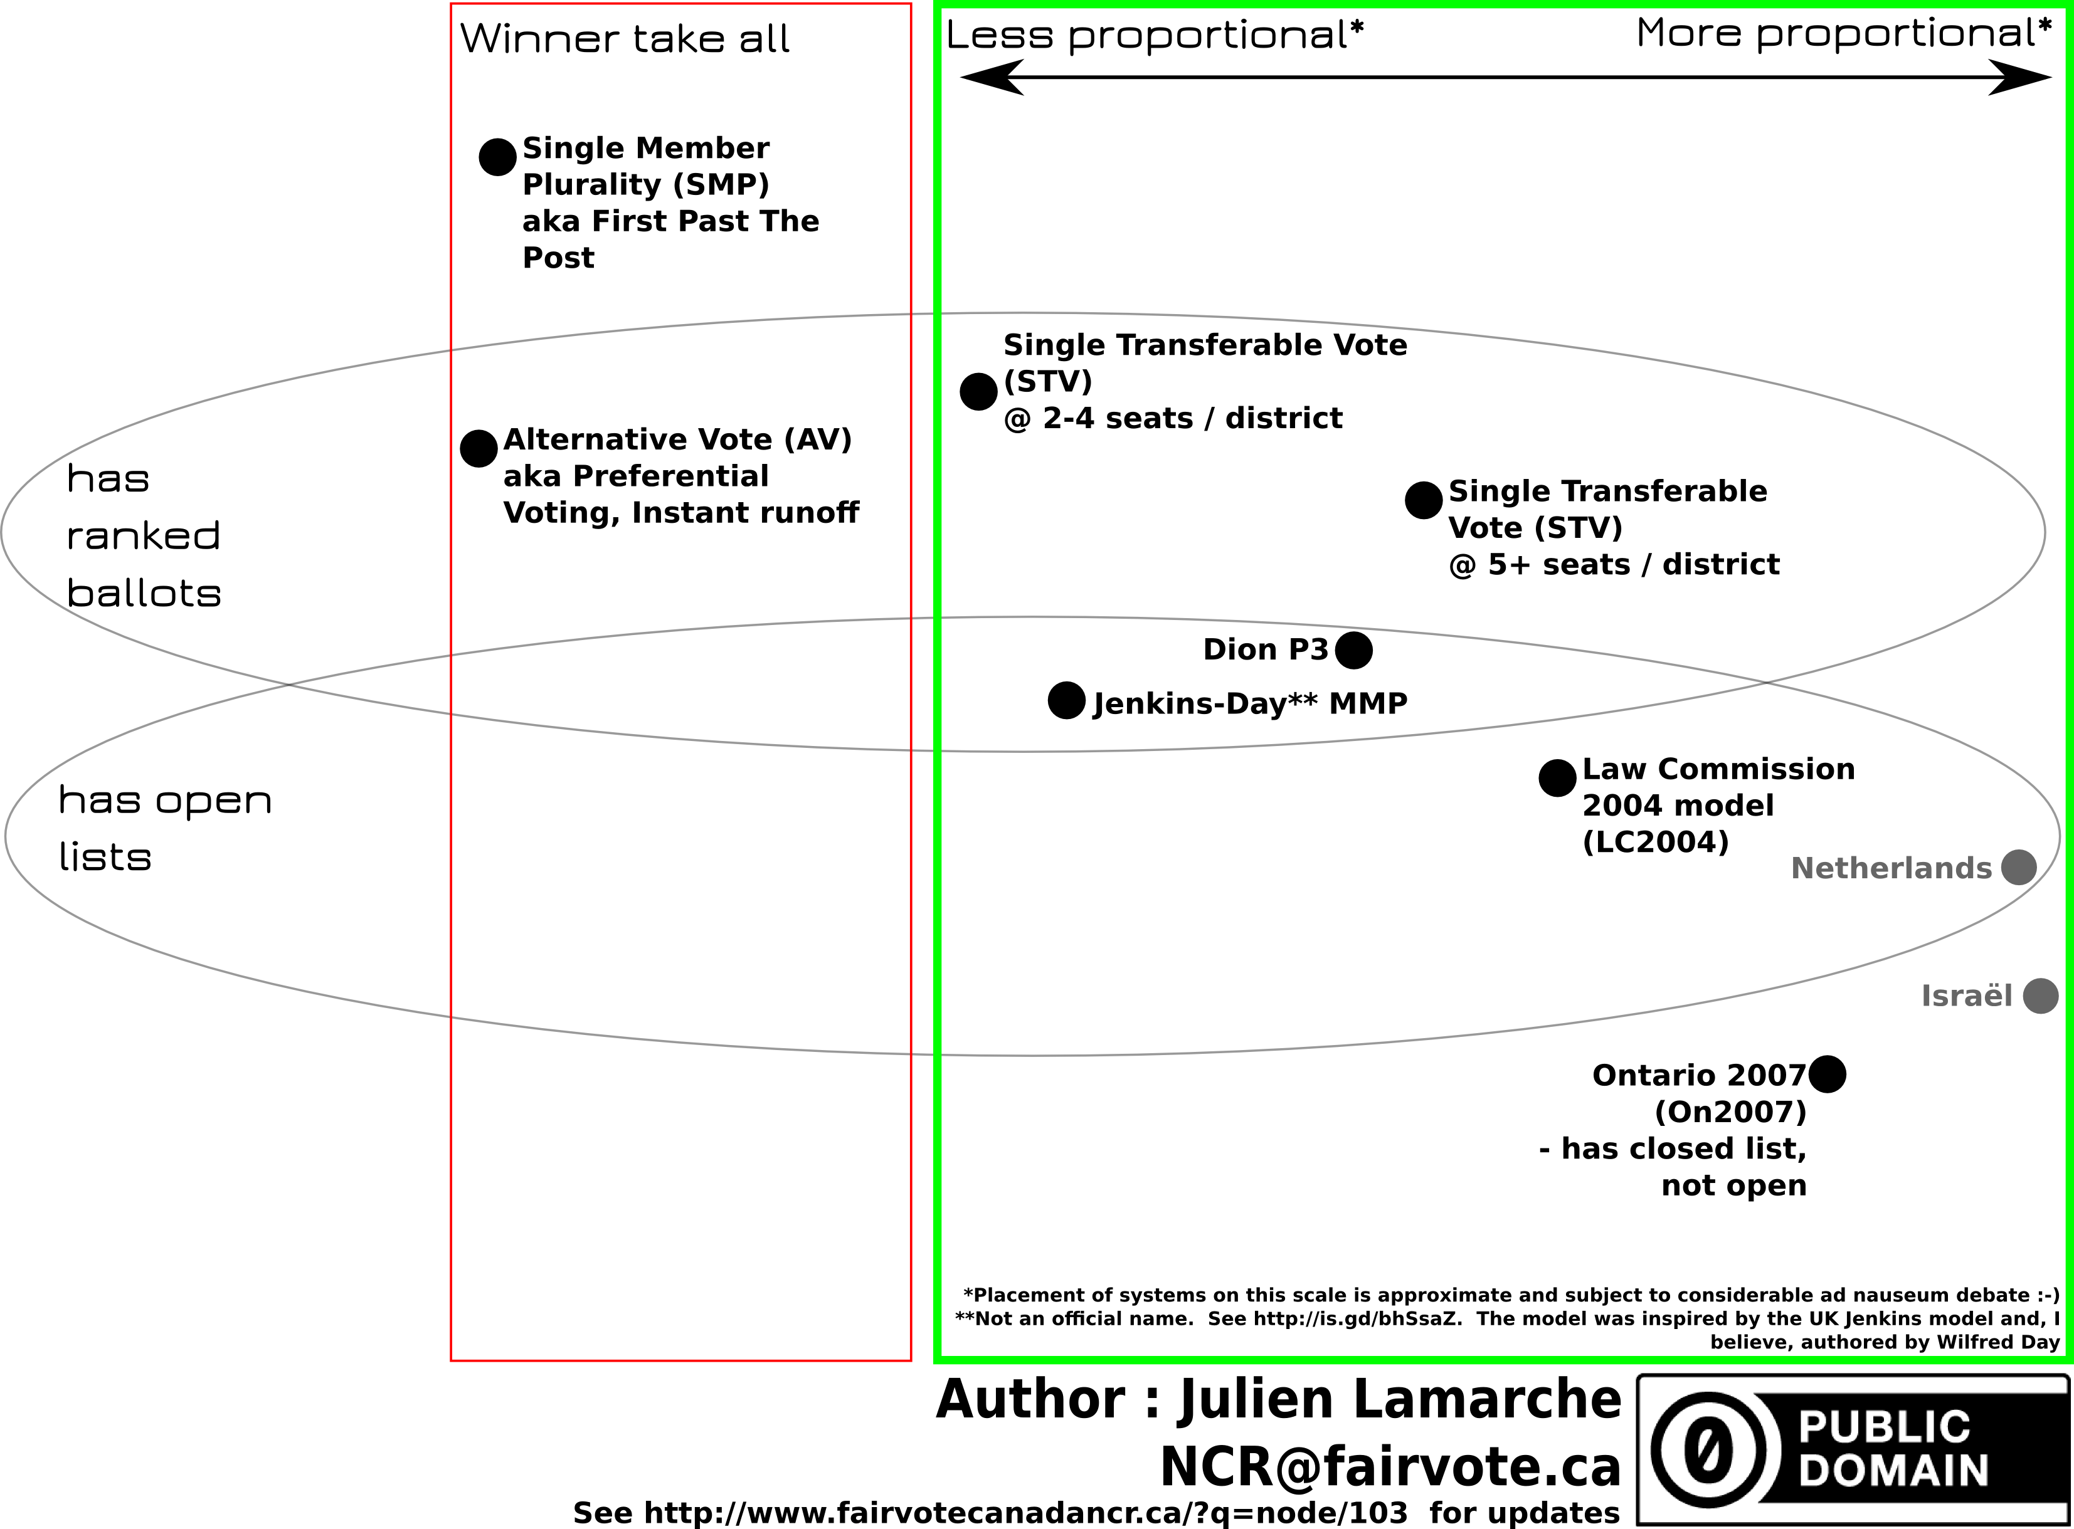

Slide 109
Image credits
This work has been released into the
public domain by its author, Earl Andrew
Some rights
Reserved
Image by
Altes
This New Zealand work is in the public domain both in New Zealand and in other countries adhering to international copyright treaties,
Some rights
Reserved
Image by
Rspeer and Mark Ryan
Some rights
Reserved
Image by
Dariusofthedark and Jhayman

