Slide 1
Social Media
Julien Lamarche
Julien.lamarche@gmail.com

Slide 2
Concepts
URL
Scope
Following
Hashtags
Twidère

Slide 3
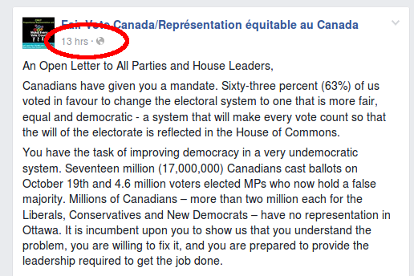
URL
Right click timestamp to get link to this post

Slide 4
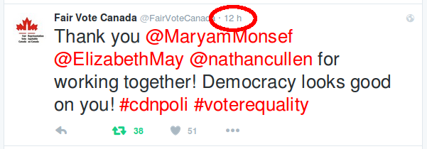
Right clicking on the timestamp and select « copy link » to get link to this post

Slide 5
Scope
If icon next to timestamp is a planet, then visible to everyone, even people without Facebook

Slide 6
Twitter : Following vs hashtags

Slide 7
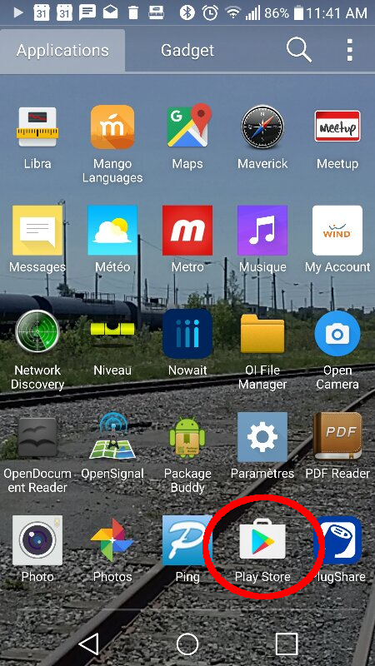

Slide 8
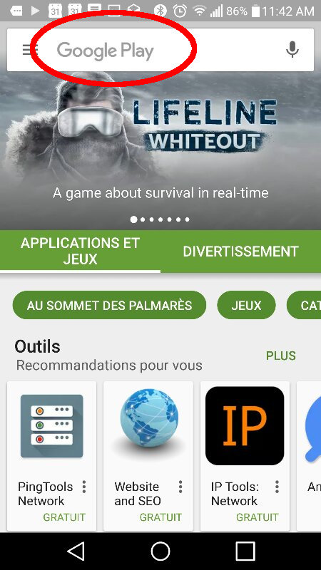

Slide 9
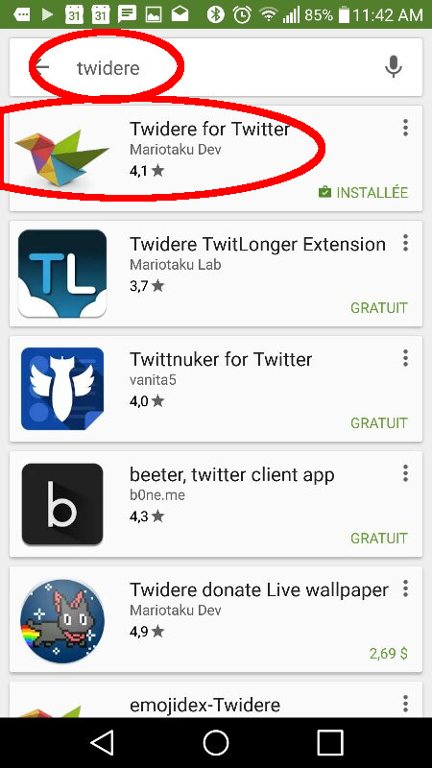

Slide 10
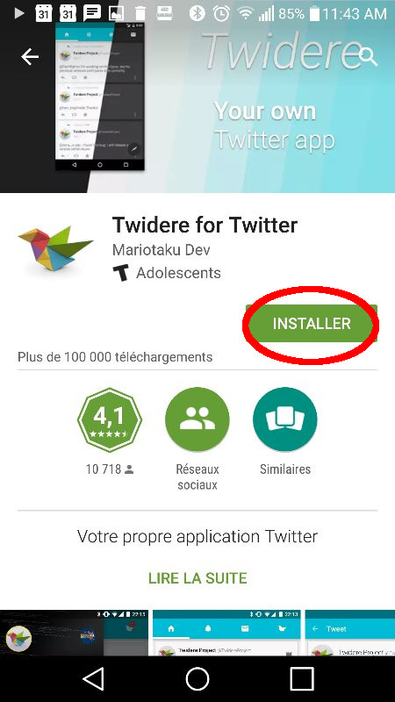

Slide 11
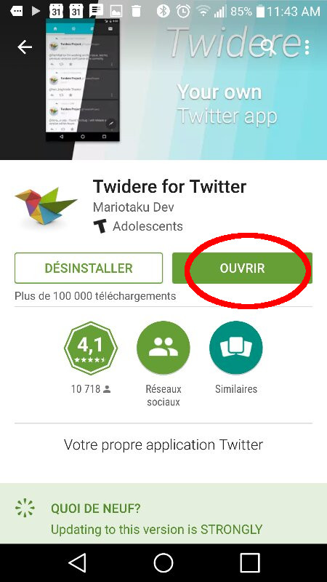

Slide 12
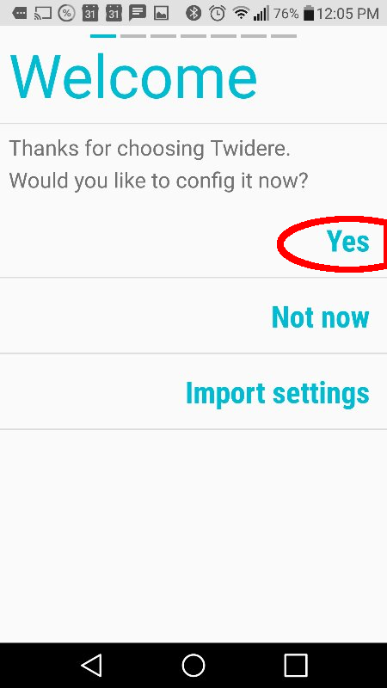
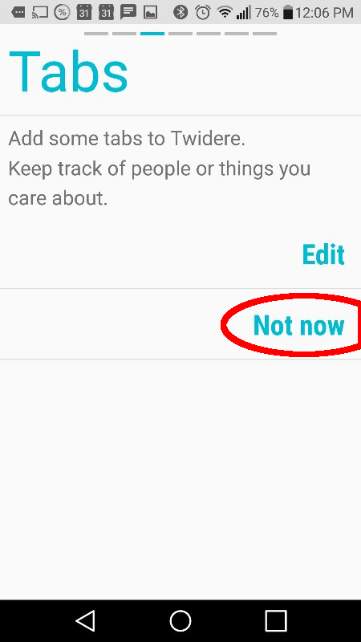

Slide 13
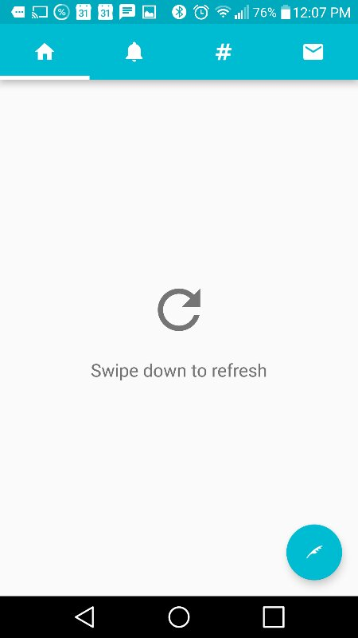

Slide 14
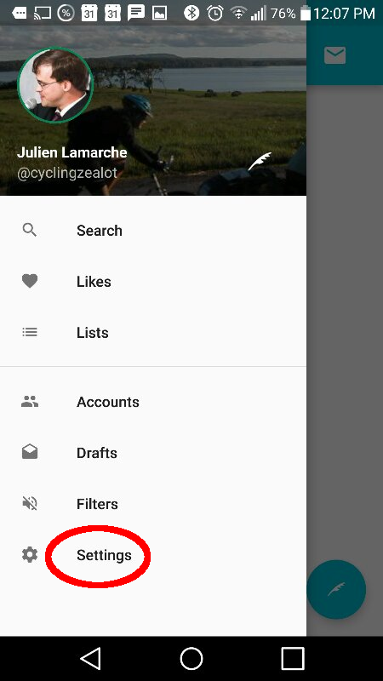

Slide 15
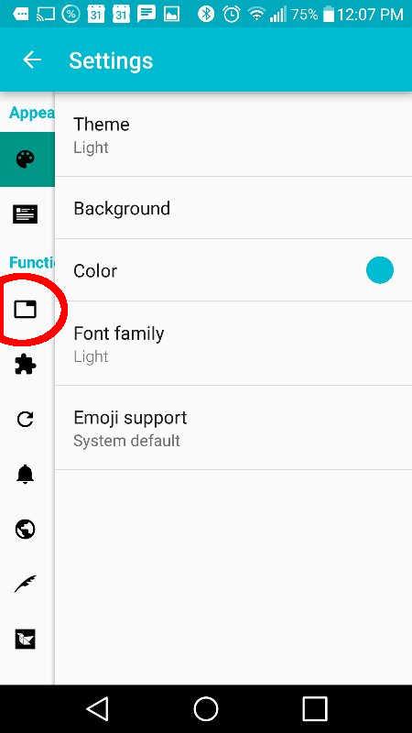

Slide 16
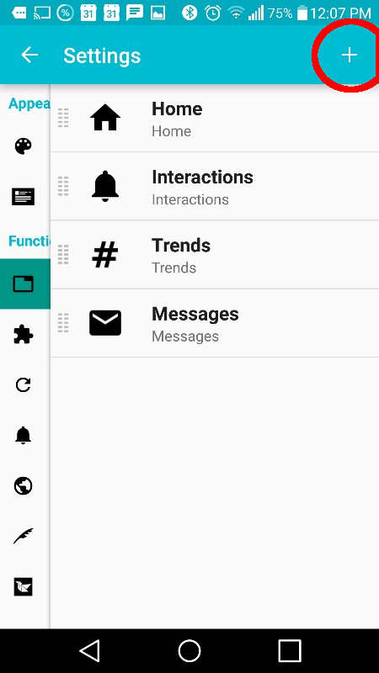

Slide 17
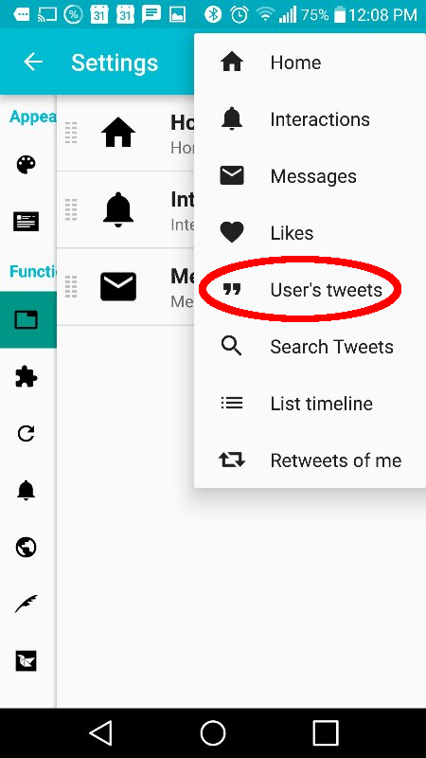

Slide 18
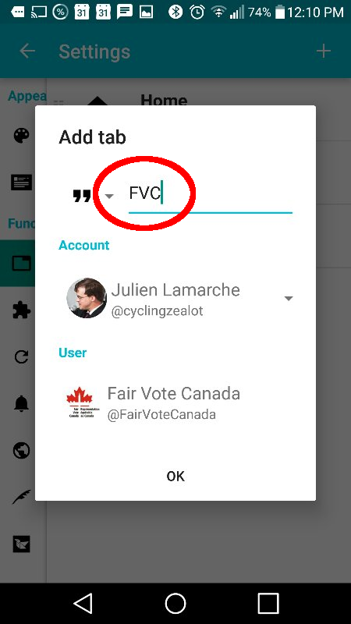

Slide 19
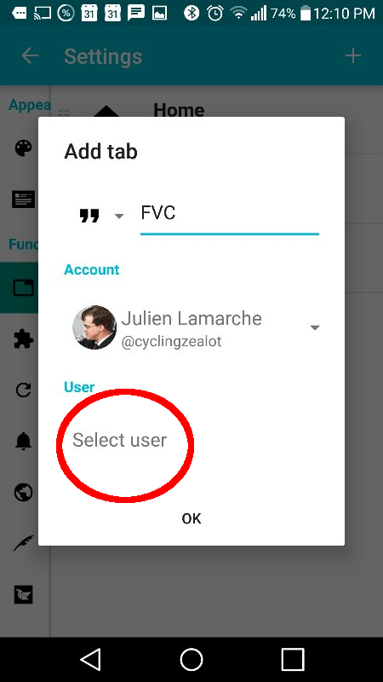

Slide 20
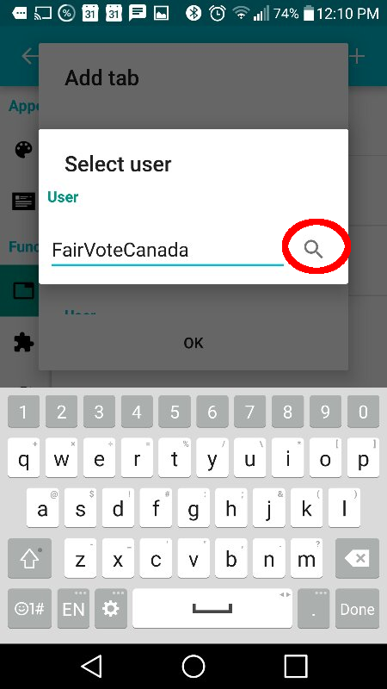

Slide 21
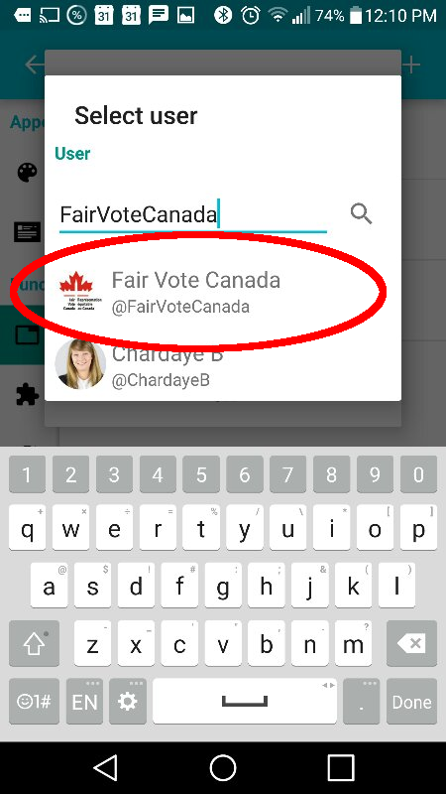

Slide 22
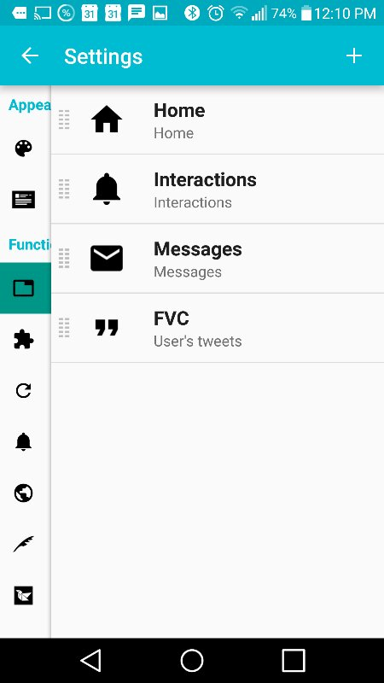

Slide 23
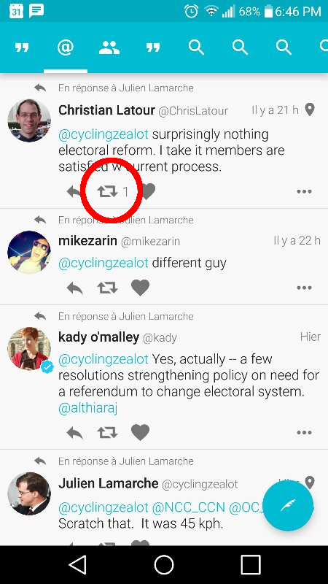

Slide 24
PR rebuttals
« PR is for loosers » | Governance isn't a sport. We are taxpayers too & deserve #voterquality
 | We are not asking for governance, we're just asking for representation
 | Actually, between elections, in PR, you get multiple Mps. So PR is for people not afraid of competition.
« Your local MP represents you » | Yes and under a PR system, I can have multiple Mps with at least one who I voted for
Unacountable | In all proportional systems being proposed, all candidates face voters
Loose local representation | All PR systems being proposed keep an element of local or near-local representation

