Slide 1

A primer on voting systems
Julien Lamarche
President, NCR Chapter
Fair Vote Canada
http://www.fairvote.ca
NCR@fairvote.ca

Slide 2
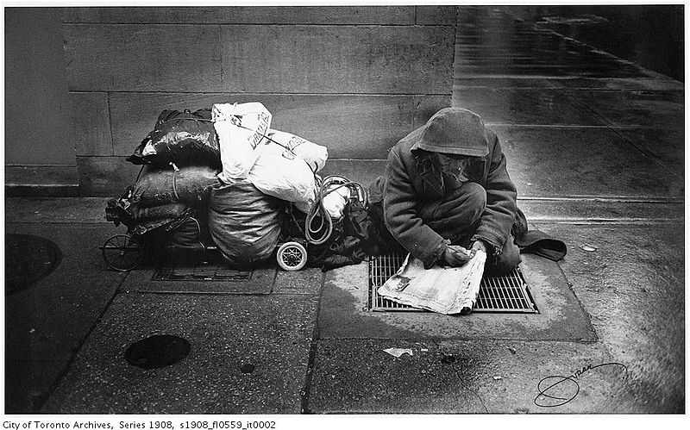
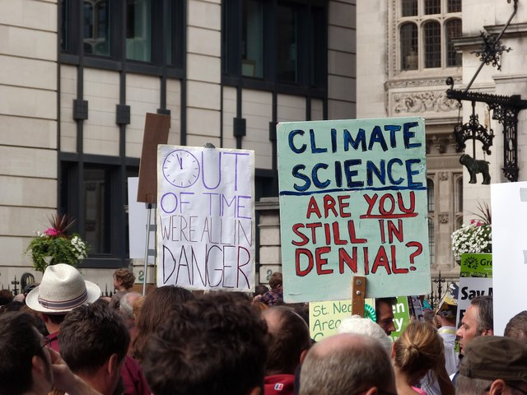
Why proportional representation?
It's the critical issue....
…. to the urgent ones we care about.
Notes:
Proejct management... critical path

Slide 3
Fair Voting
Why FPTP doesn't serve voters
History of the mouvement
Voting system concepts
Different voting systems
Where to go from here?

Slide 4
FPTP doesn't serve voters
Under representation of women and ethnic minorities;
Exageration of regional differences
Canadian federal election 2011
Ontario | % votes | % seats
- Conservative | 44 | 69
- Liberal | 25 | 10
Quebec
- NDP | 43 | 79
- Bloc | 23 | 5

Slide 5
FPTP doesn't serve voters
Phony majorties
  Ontario (since 1937)
  Canada (since 1984)
  Quebec (since 1985)
Half the voters are unrepresented, while others are overrepresented
How can institutions be accountable?

Slide 6
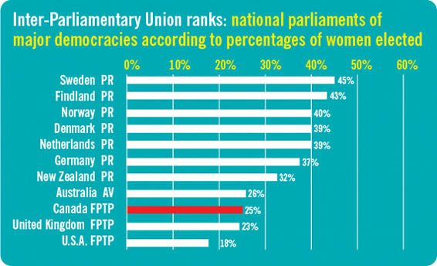
Proportion of women elected in legislatures of OECD* countries
*Organization for Economic Cooperation and Development

Slide 7
Distortion of representation

Slide 8
Distortion of representation

Slide 9
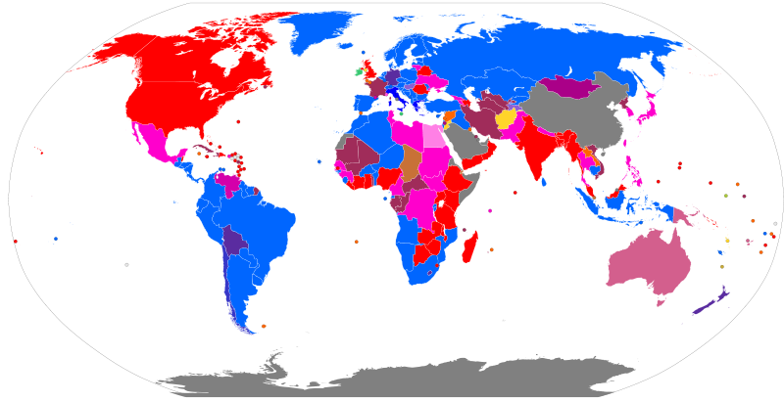
Who uses FPTP?
Legend : http://en.wikipedia.org/wiki/File:Electoral_systems_map.svg

Slide 10
~50%

Slide 11
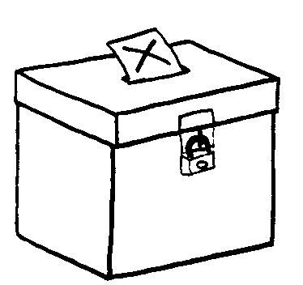
Voting systems
The ballot
Seats per electoral districts
The algorithm
(votes → seats)

Slide 12
Single member plurality
(First past the post)
The ballot: | One X per vote
Seats per electoral district: | 308 ridings of one seat
The algorithm: | The seat is given to the candidate with at least 1 more vote than everyone else.

Slide 13
What is an electoral district?
A bounded geographical area who's voters are represented by one or more legislators
Canada : 308 electoral districts represented by 308 MPs
Australian senate : 6 staes, each represented by 12 elected senators
Norway legislature : 19 counties, each represented by 4 to 17 legislators

Slide 14
History of voting reform in the world
Denmark, Germany,
Early days of Canada
NZ

Slide 15
Recent history of voting reform in Canada
1984 : Electoral Representation Commission (Québec)
1997 : Federal Majority government with lowest support
2001 : Fair Vote Canada is founded
2002 : Quebec’s Estates-General on the Reform of Democratic Institutions
2004 : Quebec government study (Charest)
2004 : Law Commission of Canada report on ER
2005 : NB Commission on Legislative Democracy
2005 : PEI Plebiscite on voting reform
2005 : BC Citizens Assembly recommends Single Transferable Vote
2006 : Quebec Citizens Committee Report
2007 : Ontario Citizens Assembly recommends Mixed Member proportional
2007 : Quebec’s Chief Electoral Officer’s Report
2009 : Second referendum on BC-STV

Slide 16
Voting systems considered in Canada
Single Member Plurality (First past the post) (FPTP)
Mixed member proportional (MMP)
Single Transferable Vote (STV)
Alternative Vote (Preferential Voting) (AV)
================================
Alternative Vote Plus (AV+)
P3

Slide 17
Many systems
 | The ridings & seat | The ballot | The algorithm
FPTP (SMP) | One seat per geographic riding | 1 « X » | Winner has the most votes, at least one more than everybody else
Mixed Member Proportional (MMP) | Mix of geographic riding and list seats | 2 votes : Candidate and party | List seats used to compensate for lack of proportionality
Single Transferable Ballot | Ridings clustered together | Ranked | Candidates eliminated until all seats are filled.
Alternative Vote |  | Ranked | Candidates eliminated until winner has more than 50%
Semi-Proportional | Mix of geographic riding and list seats | 2 votes : Candidate and party | Lists seats are shared proportionaly but not whole legislature

Slide 18
Mixed Member Proportional

Slide 19
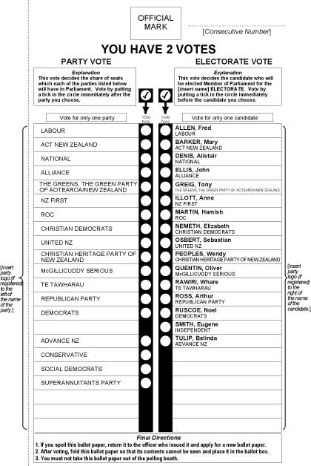
Mixed Member Proportional :
The ballot
Two votes :
  One for local candidate
  One for party

Slide 20
Mixed Member Proportional
The seats & riding
One seat per geographic ridings;
List seats for ridings that span the entirety or parts of the jurisdiction;

Slide 21
Mixed Member Proportional
The algorithm
Winner of geographic seats are determined first
List seats compensate for lack of proportionality

Slide 22
MMP : The algorithm
Fictional legislature of 100 seats
 | Geographic seats | % of vote | List seats
Party A | 38 | 40% | 2
Party B | 23 | 31% | 8
Party C | 8 | 19% | 11
Party D | 1 | 6% | 5
Party E | 0 | 4% | 4
Total | 70 | 100% | 30

Slide 23
MMP : The algorithm

Slide 24
MMP : The algorithm

Slide 25
List seats
Closed list
(Ontario MMP 2007)
Open lists
(Voting Counts: Electoral Reform for Canada, Law Commission of Canada, 2004, p. 106)
Best loosers
(Germany)

Slide 26
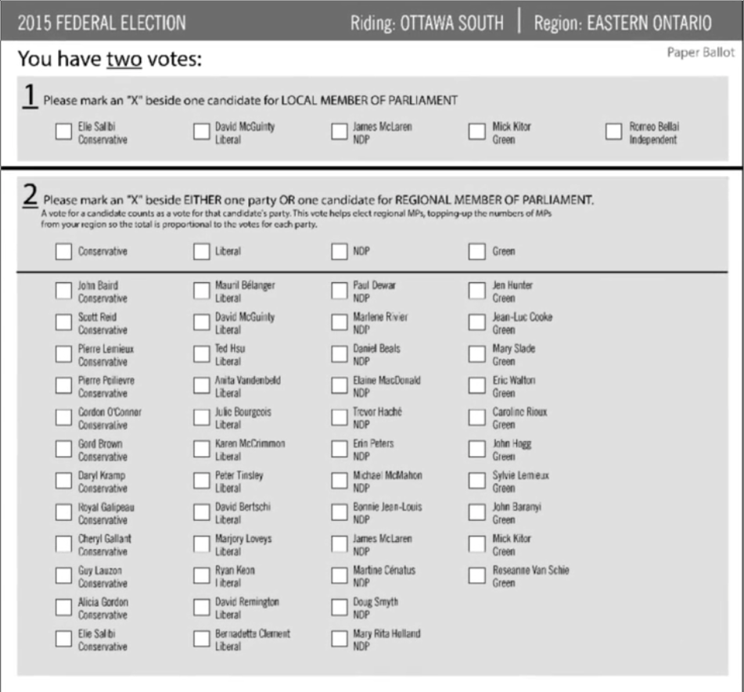
Law Commission 2004 MMP
Ballot

Slide 27
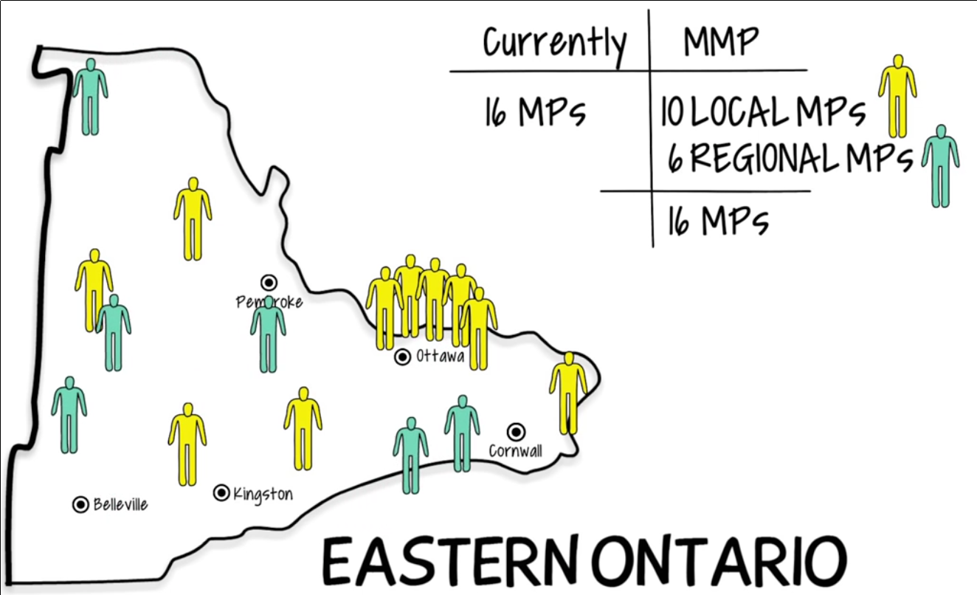
Law Commission 2004 MMP
Eastern Ontario

Slide 28
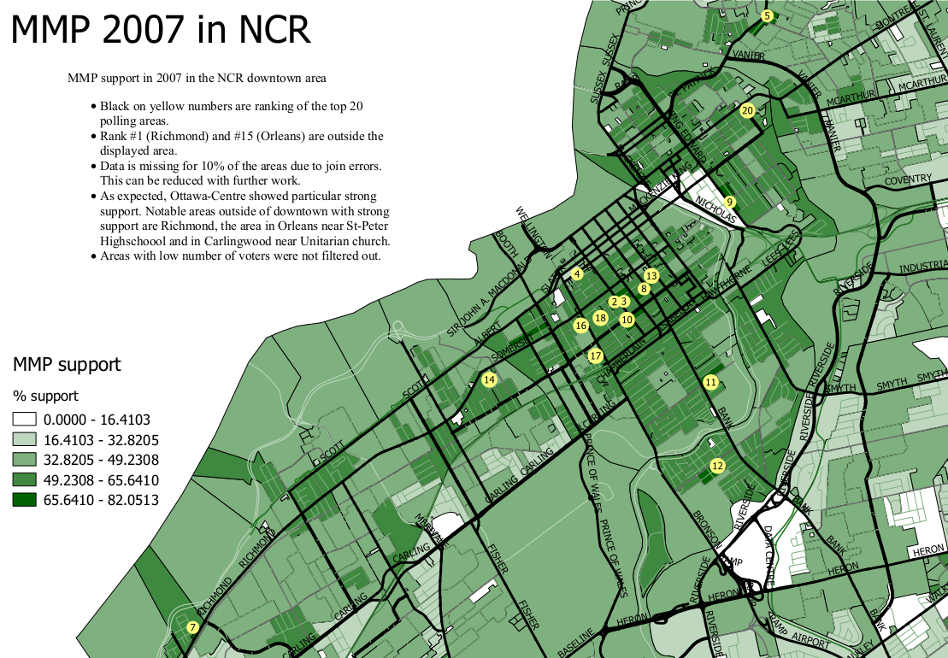

Slide 29
Mixed Member Proportional
The ballot: | One vote for a party One vote for a candidate
Seats per electoral district: | 50%-70% are local electoral district Remainder are list seats
The algorithm: | Geographic seats first determined List seats compensate for lack of proportionality

Slide 30
OECD countries by voting system

Slide 31
Single Transferable Vote

Slide 32
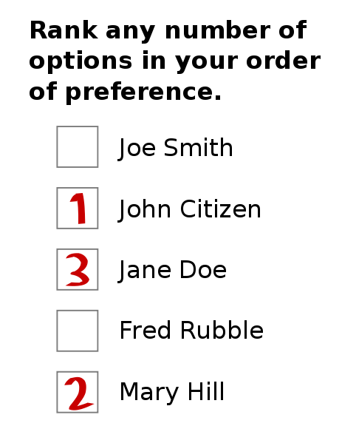
Single Transferable Vote:
The ballot
Ranked vote
No party list

Slide 33
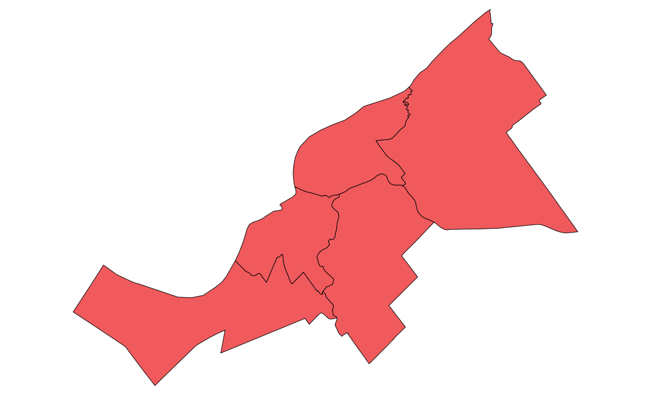
Single Tranferable Vote :
The district & seats
5 ridings of 1 seat each

Slide 34

Single Tranferable Vote :
The district & seats
1 riding of 5 seats

Slide 36
Single Transferable Vote
The algorithm
Establish the threshold
Count first choices
Have any candidates reached the threshold?
Eliminate last place candidate and distribute his / her votes
Declare those elected
Enough winners?
Distribute surplus of winners
Finished

Slide 37
Single Transferable Vote
The algorithm
Formula:
Example of 1 seat :
Example of Cambridge Massachussetts :

Slide 62
Alternative Vote
(not proportional)
Also called Instant Runoff Voting or preferential voting
Like STV, has a ranked ballot
Only one seat per district
Threshold is set to 50%

Slide 63
Where to go from here?
Sign Declaration
Update your information with FVC (postal code)
Get candidates to sign the pledge
Get a presentation in your community
Get your organization to support the cause
Get on our volunteers list : NCR@fairvote.ca
Donate : http://www.fairvote.ca/donate/
Write a letter : letters@ottawacitizen.com,
editor@theequity.ca, editor@journalpontiac.com

Slide 64
Where to go from here?
170 MPs

Slide 65
A primer on voting systems
Questions?
Julien Lamarche
NCR@fairvote.ca
Somes images provided by New Zealand government and Wikipedia users
Altes, Rspeer, Mark Ryan, Dariusofthedark, Jhayman and Earl Andrew.

Slide 66
Image credits
This work has been released into the
public domain by its author, Earl Andrew
Some rights
Reserved
Image by
Altes
This New Zealand work is in the public domain both in New Zealand and in other countries adhering to international copyright treaties,
Some rights
Reserved
Image by
Rspeer and Mark Ryan
Some rights
Reserved
Image by
Dariusofthedark and Jhayman

