Slide 1
Courselist Project
Automated Graduate Student
Information System
Final project for CS 3354

Slide 2
Who is behind Courselist?
Cyclops Group
  …is an open source project foundation focusing on the design of common, abstract, simple, and high quality java software that solves real-life complex problems
  http://www.cyclopsgroup.com
  The Courselist team: Josh Allen, John Christin, Jarvis Cline, Jiaqi Guo, Chris Menken
  Extended documentation and a live demo version are available on the Cyclops Group website.

Slide 3
The Intent of Courselist
Create an easily maintainable system that keeps track of students, teachers, and courses.
Eliminate the need for students and teachers alike to fill out forms, look up courses in catalogs, etc.
Save time, energy, and money
Automation of these tasks means more accurate results

Slide 4
Courselist - Who does what?
System Administrator
  Create, edit, delete, list, and search courses
  Create, edit, delete, list, and search users
  Assign teachers to courses
  Can perform student, teacher, and administrative tasks

Slide 5

Courselist - Who does what?
Teachers
  Drop and add students
  Assign grades to students
  Finish a course (close out registration and assign final grades to students)

Slide 6

Courselist - Who does what?
Students
  Apply to register for courses
  View current courses
  View an unofficial transcript

Slide 7
Basic User Interface
Enter login and password to enter system
Use a tree structure to navigate through pages to perform various tasks
Buttons, drop-down menus, lists that are easy, self-explanatory
Special “System” tab for the administrator to perform certain tasks

Slide 8
User Requirements
Interface
Users
  Students
  Teachers
  Administrators
Systems

Slide 9
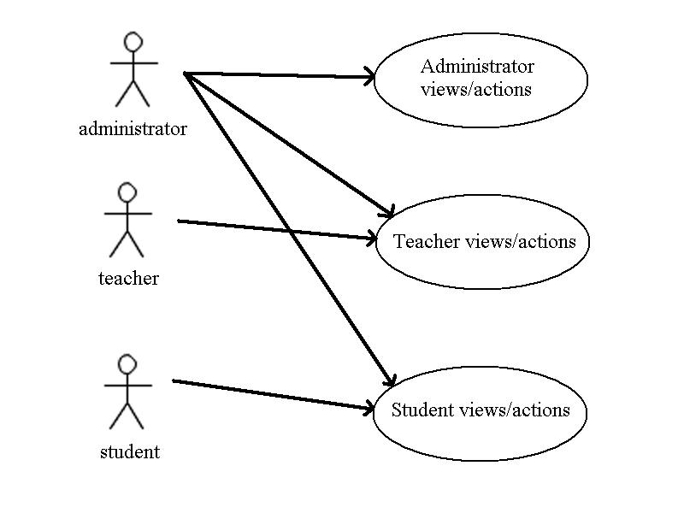
“UML Diagram:” What should users do?

Slide 10
Interface
Navigation:
  The system shall have quick navigation links to allow users to quickly go from page to page.
Help:
  A help page shall be included that provides the user with information on how to use the system.
Log-in:
  The system shall provide a section for the user to log in to his or her account for a length that he or she chooses.
Course Board:
  A list of courses shall be accessible without having to log in. This list shall include information such as: course code, name, teacher name, and requisites.

Slide 11
Users
Students:
  Transcript:
    The CourseList system shall show a list of the courses the student is enrolled in or has completed. This list shall show pertinent information such as; course name, credit received, grade, and current status.
  Add / Drop Courses:
    The student shall have the ability to add or drop courses on his or her schedule. Students shall not be able to add classes that they do not have the pre-requisites or co-requisites for.

Slide 12
Users
Teachers:
  Current Courses:
    The CourseList system shall show a list of the courses the teacher is currently enrolled in. This list shall show information such as; course name, requisites, and the number of students currently enrolled in the course.
  Manage Course:
    Teachers shall be able to manage courses with such abilities as: adding or dropping students, updates grades, and finishing courses.

Slide 13
Users
Administrators:
  Access:
    The Administrator shall have access to all parts of the CourseListing site. This includes all student and teacher options and pages, as well as his or her own unique Administrator powers.
  Course Board:
    The Administrators shall be able to add or remove classes from the course board.

Slide 14
System
Access:
  The system options shall only be accessible by an Administrator.
Manage Users:
  The administrator shall be provided a list of all users and he or she shall have the ability to add, remove, and edit any user. The administrator shall be able to manage information such as: group/role, name, email, password, etc…
Manage Groups and Roles:
  The administrator shall be able to add and remove groups from the system. The administrator shall also be able to assign and edit the roles of these groups.

Slide 15
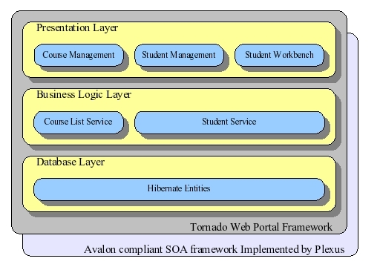
Software architecture
Java web application, a big SERVLET.
3-tier design. Presentation, business logic and database.
SOA container

Slide 16
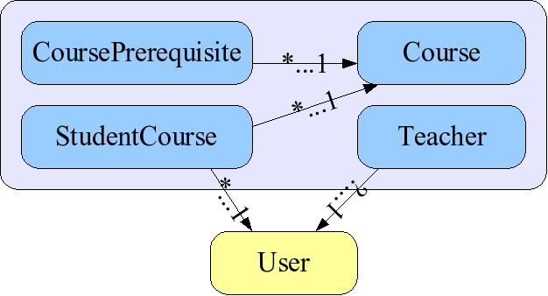
Database(persistence) layer
Four tables
Hibernate as O-R mapping tool
A close look of Course.hbm.xml, CourseBase.java and Course.java.

Slide 17
Business logic layer
Interface defines the functions.
Implementation implements the functions by talking to database layer.
Two services: CourseListService and StudentService.
Specified functions are explained in Javadoc.
Implementations are managed by SOA container

Slide 18
Presentation(GUI) layer
Views and actions.
90% of the development work.
They never talk to database directly.
In course list project, GUI is separated into 3 parts based on user role: course management, teacher workbench and student workbench.
Built on top of Tornado project.

Slide 19
SOA and SOA container
What is SOA? What is service.
Avalon framework came to be one of the SOA standards.
“Inversion of control” pattern.
By the way, Avalon implementation is Plexus container in this project.

Slide 20
Development environment
The project is hosted in sourceforge.net, under project “cyclops-group”. Module name is courselist.
MySQL 4.1 database driven. Although it should be database neutralized theoretically.
Built and managed by Apache Maven.
Tomcat 4.1.x
Tornado project is the infrastructure.

Slide 21
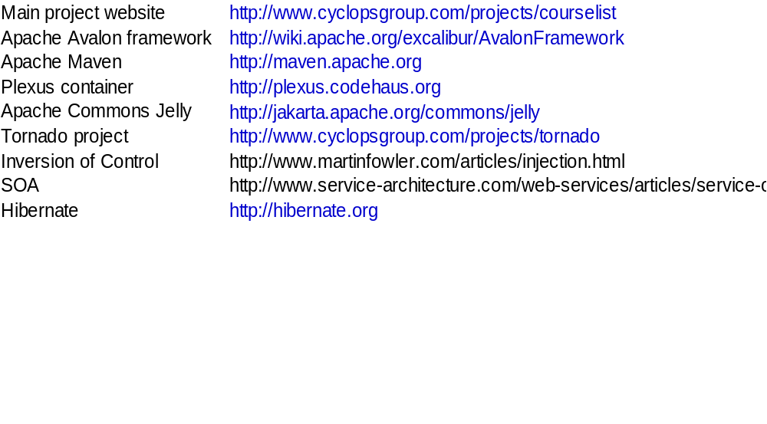
Related links

Slide 22
Testing
Use-case Scenarios

Slide 23
Scenario 1: Administrator creates a new course and assigns a teacher to that course
1)Log in as Administrator
System Navigation menu shows Course Listing, My Information, and Waterview Overview directories.
Main page displays the list of current users that are able to log in to the system as a student, teacher, or administrator.
2)Click on Course Listing icon to add a course to the course board
Course Management, Teacher Workbench, and Student Workbench directories appear under Course Listing.
3)Click on Course Management icon:
Course board, Create Course, and Teacher directories appear under Course Management.
4)Click on Create Course:
The main page will display fields that ask for the course prefix, title,
description, and course number.
5)After filling out the fields, click on create course
Main page will immediately show the updated course board.

Slide 24
Scenario 1 contd..
6) Click on course code of newly created course to assign teacher
The Edit course page will be displayed detailing the entire course
7) Use the drop down box to select the teacher
8) Click on Save changes button
The main page will show the updated course board with the teacher assigned to that specific course.
9) Log out as Administrator.

Slide 25
Scenario 2: John Goodman, a teacher, will assign a student to one of his classes
1)Log in as John Goodman
System Navigation menu will show Home directory and the subdirectories of Course Listing, My Information, and Waterview Overview.
Main page displays the current list of users.
2) Click on Course Listing icon:
Course Management and Teacher Workbench directiories will appear under Course Listing directory.
3) Click on Teacher Workbench icon:
My Course directory will appear
4) Click on My Courses directory
A list of classes that John Goodman is teaching will appear on the main page.

Slide 26
Scenario 2 contd..
5) Click on one of the course codes to add a student to that class
A detailed description of the course will appear on the main page, as well as a section that allows the teacher to add/drop a student from his class.
6) Use drop down menu to assign a student to that class
7) Click on add student button
The new student will be shown on the list of students for that class.
The student will be given a default grade of F.
8) Log out as John Goodman

Slide 27
Scenario 3: Tim Allen, a student, is going to drop one of his classes
1)Log in as Tim Allen
System Navigation menu will display Course Listing, My Information, and Waterview Overview directories under the Home directory.
2) Click on Course Listing subdirectory icon
Course Management and Student Workbench directories will appear under Course Listing directory.
3) Click on Student Workbench icon
My Courses and Transcript directories will appear
4) Click on My Courses
All current courses that Tim is taking is displayed on the main page.
5) Click on one of the check boxes of the class needed to be dropped and click
on “drop selected” button.
The Main Page will refresh and show that Tim is no longer taking that class.
6) Log out as Tim Allen

Slide 28
Scenario 4: Verify that Tim Allen, a student, cannot register for a class that he has not taken the pre-requisite for.
1)Log in as Tim Allen
System Navigation menu will display Course Listing, My Information, and Waterview Overview directories under the Home directory.
2) Click on Course Listing subdirectory icon
Course Management and Student Workbench directories will appear under Course Listing directory.
3) Click on Student Workbench icon
My Courses and Transcript directories appear
4) Click on My courses
A list of courses that Tim Allen is taking appears on the main page
5) Click on Course Management icon
Course board directory appears

Slide 29
Scenario 4 contd…
6) Click on Course board
A list of current courses that are offered is displayed
7) Check box that represents CS 5390 and click apply.
An error message, which states that Tim must take CS 5343 before he can take CS 5390, appears.
8) Log out as Tim Allen

Slide 30
Scenario 5: Administrator adds a new student profile to the system.
1)Log in as Administrator
Home directory appears
2) Choose System Directory Tab
System Administration and Status directory appears under System directory.
Main page shows some information about the System.
3) Click on System Administration icon
Security and Portal Management directory appears
4) Click on Security icon
Manage User, Create User, Manage Groups, and Manage Roles icons appear
5) Click on Create User
Main page contains fields that ask for information about the new user.
6) After filling out the information, click create button
The fields return to default state.

Slide 31
Scenario 5 contd…
7) Click on Manage User icon
A list of current users are displayed
8) Click on the name of the newly created user.
Displays Basic Information, Edit, and Group/Role Tabs
9) Click on Group/Role Tab
Displays the available groups to assign the new user to.
10) Select Student and click on Join Button
Main page will revert back to Basic Information tab.
11) Click on Group/Role Tab
The system recognizes the new user as a student.
12) Log out as Administrator

Slide 32
Courselist Project
End Presentation

