Slide 1
Amazon Cell Phone Reviews
KuanHsun Lu
YiCheng Chen
FengJie Chen

Slide 2
Description
Tasks
Visualize rating of different brands (e.g Apple, Nokia, …etc)
Visualize rating of same brand but different type (e.g Apple 7, Apple 8)
Visualize rating by year
Technology needs
Data preprocessing
Data visualization
Interactive dashboard

Slide 3
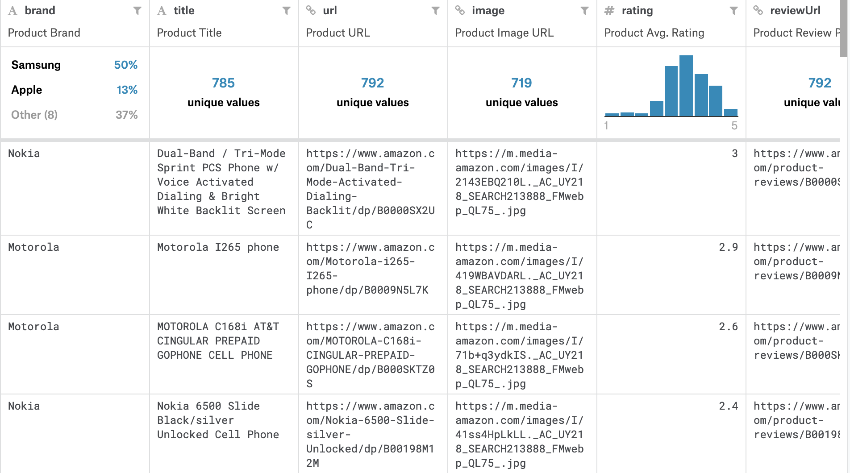
Brief introduction to Dataset
Item.csv
Brand, title, url, image, rating reviewURL, total review, prices

Slide 4
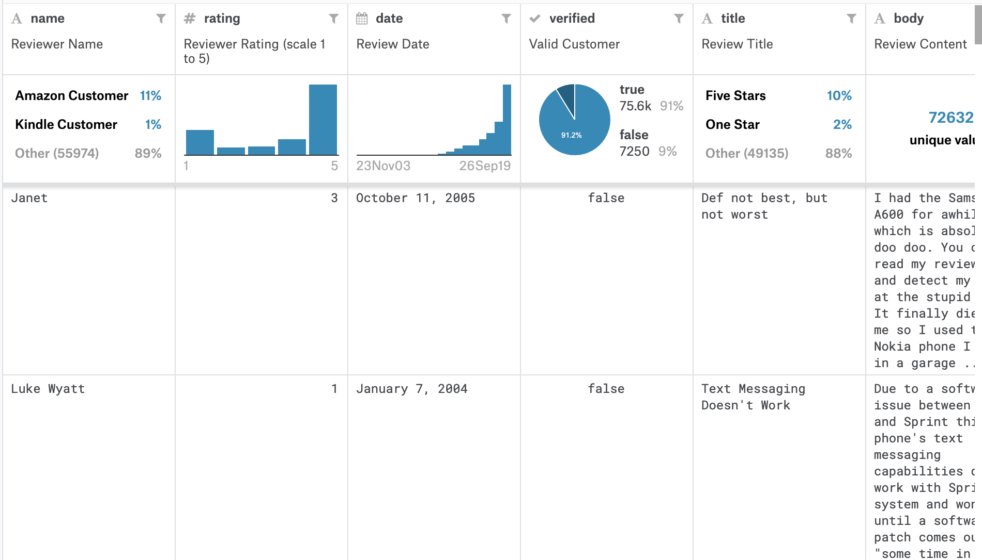
Brief introduction to Dataset
Review.csv
Name, rating, date, review title, body

Slide 5
Use case
Input : A certain brand (e.g Apple)
Output :
Average rating over time
Rating versus different types of cell phone
Pie chart of rating for different types of cell phone
Input : A certain type of cell phone (e.g Apple 7plus)
Output :
Visualize popularity (total reviews), average rating
Display comments with higher votes

Slide 6
Python Libraries
Pandas
Dealing with data processing
Numpy
Handling arrays and matrices calculation
Matplotlib
Visualizing data
Plotly
Plotting interactive graph
Dash
User interface

Slide 7
Libraries comparison
Matplotlib
Often used for static plot
Complicated syntax
Plotly
Friendly to interactive plot
Work with Dash easily
Bokeh
Some graph interactions must be written in JavaScript
Dash
Can write custom React components or find templates on the internet
Simple syntax
Easily integrated with Plotly

