Slide 1
Amazon Cell Phone Reviews
KaunHsun Lu
YiCheng Chen
FengJie Chen

Slide 2
Description
Problem
Analyze different brands of cell phone rating
Analyze same brands but different type of cell phone rating
Analyze cell phone rating by customer based on different year
Rating prediction based on customer reviews
Technology needs
Sentiments analysis
Data preprocessing
Data visualization
Prediction

Slide 3
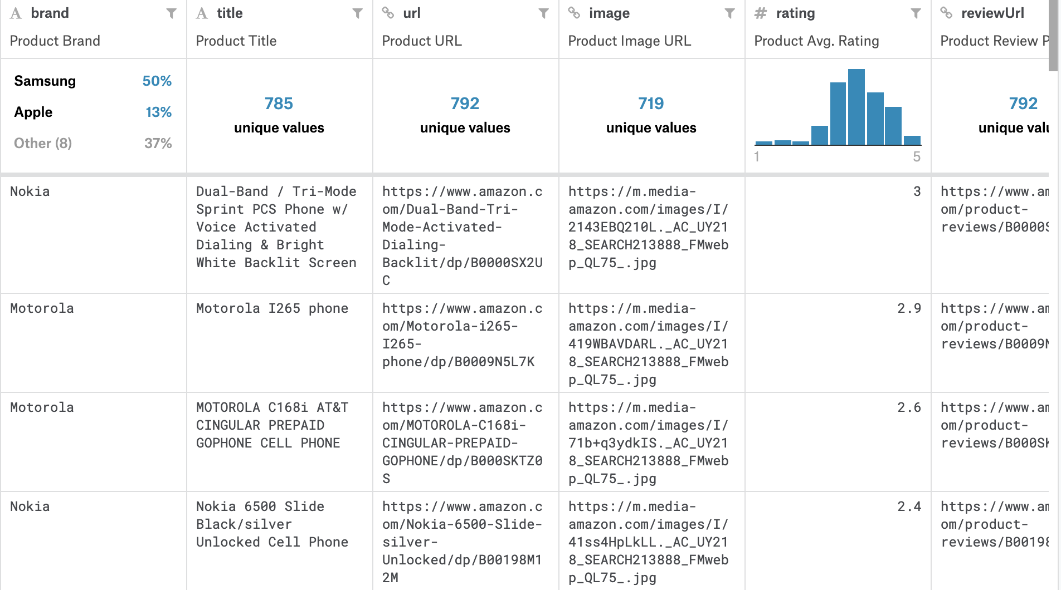
Brief introduction to Dataset
Item.csv
Brand, title, url, image, rating reviewURL, total review, prices

Slide 4
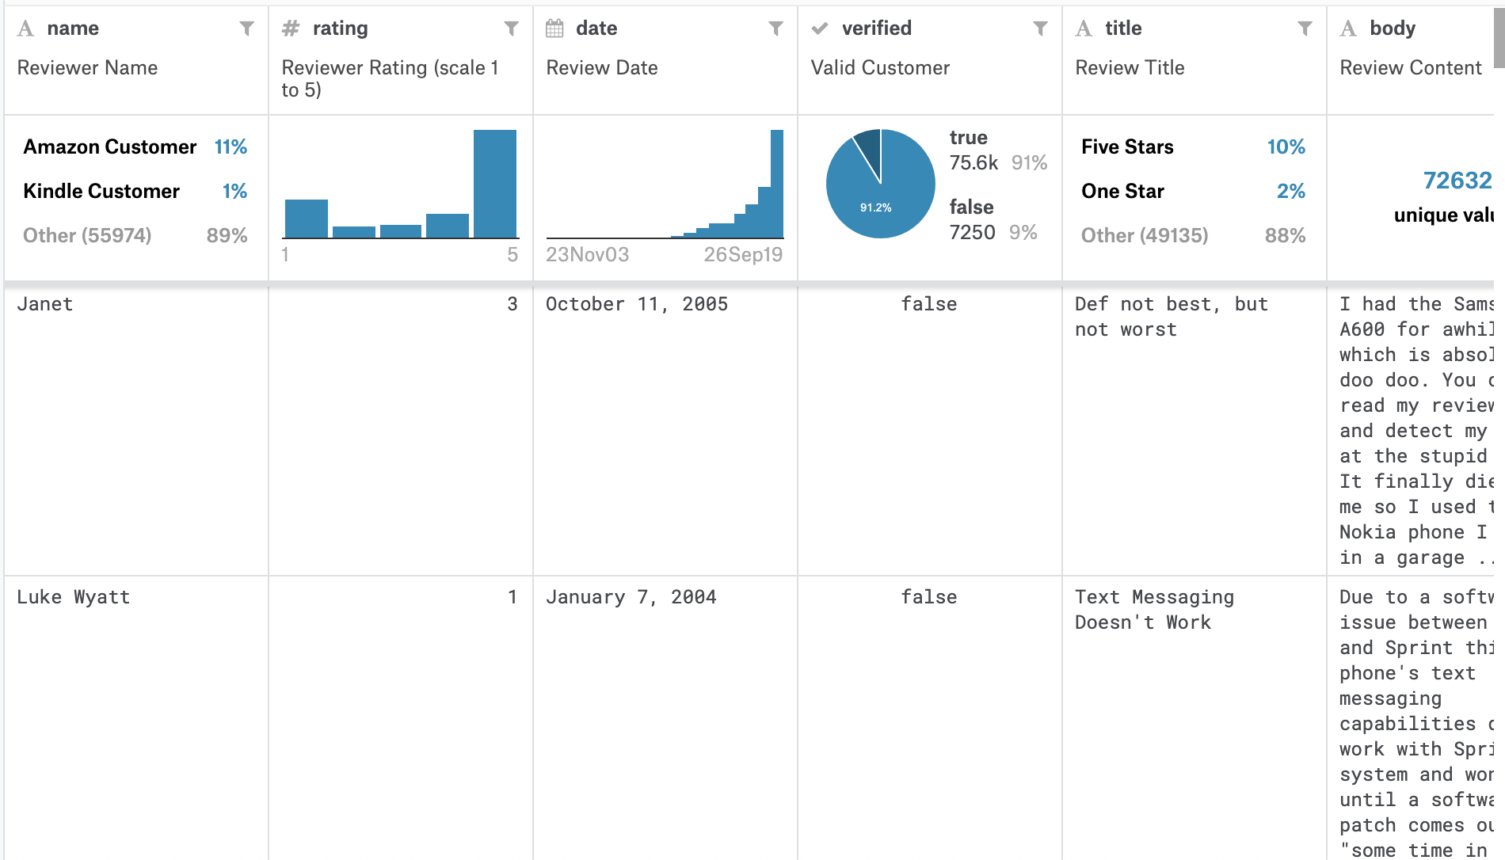
Brief introduction to Dataset
Review.csv
Name, rating, date, review title, body

Slide 5
Use case
Provide information and insight about customer reviews
Provide an easy understanding of data visualization that summarizes the reviews
Provide information for cell phone manufacturing company

Slide 6
Python Libraries
Pandas
Dealing with data processing
Numpy
Handle digit, number problems
Matplotlib
Do data visualization
Keras
Deep learning libraries
NLTK(TextBlob)
Sentiments analysis

