Slide 1
Amazon Cell Phone Reviews
KuanHsun Lu
YiCheng Chen
FengJie Chen

Slide 2
Background
When a customer wants to buy a new cell phone, he or she may wonder which product has good reputation and popularity. Our primary goal is to provide users with a platform where they can refer to. The platform is a web page, which includes the following features:
Visualization of sales volume for cell phones of all brands
Comparisons of ratings for different brands.
Display of most helpful reviews for a selected type.

Slide 3

Data source
Our data comes from Kaggle open dataset, which are collected from Amazon. It consists of two data sets:
items.csv: contains item-level information, main attributes include product id(key), brand, title, rating, totalReviews.
reviews.csv: gathers user-level reviews for cell phones they bought, main attributes include product id(key), rating, review content, helpful votes.
Limitations
It cannot reflect the most recent market trend.
Not sufficient features.

Slide 4
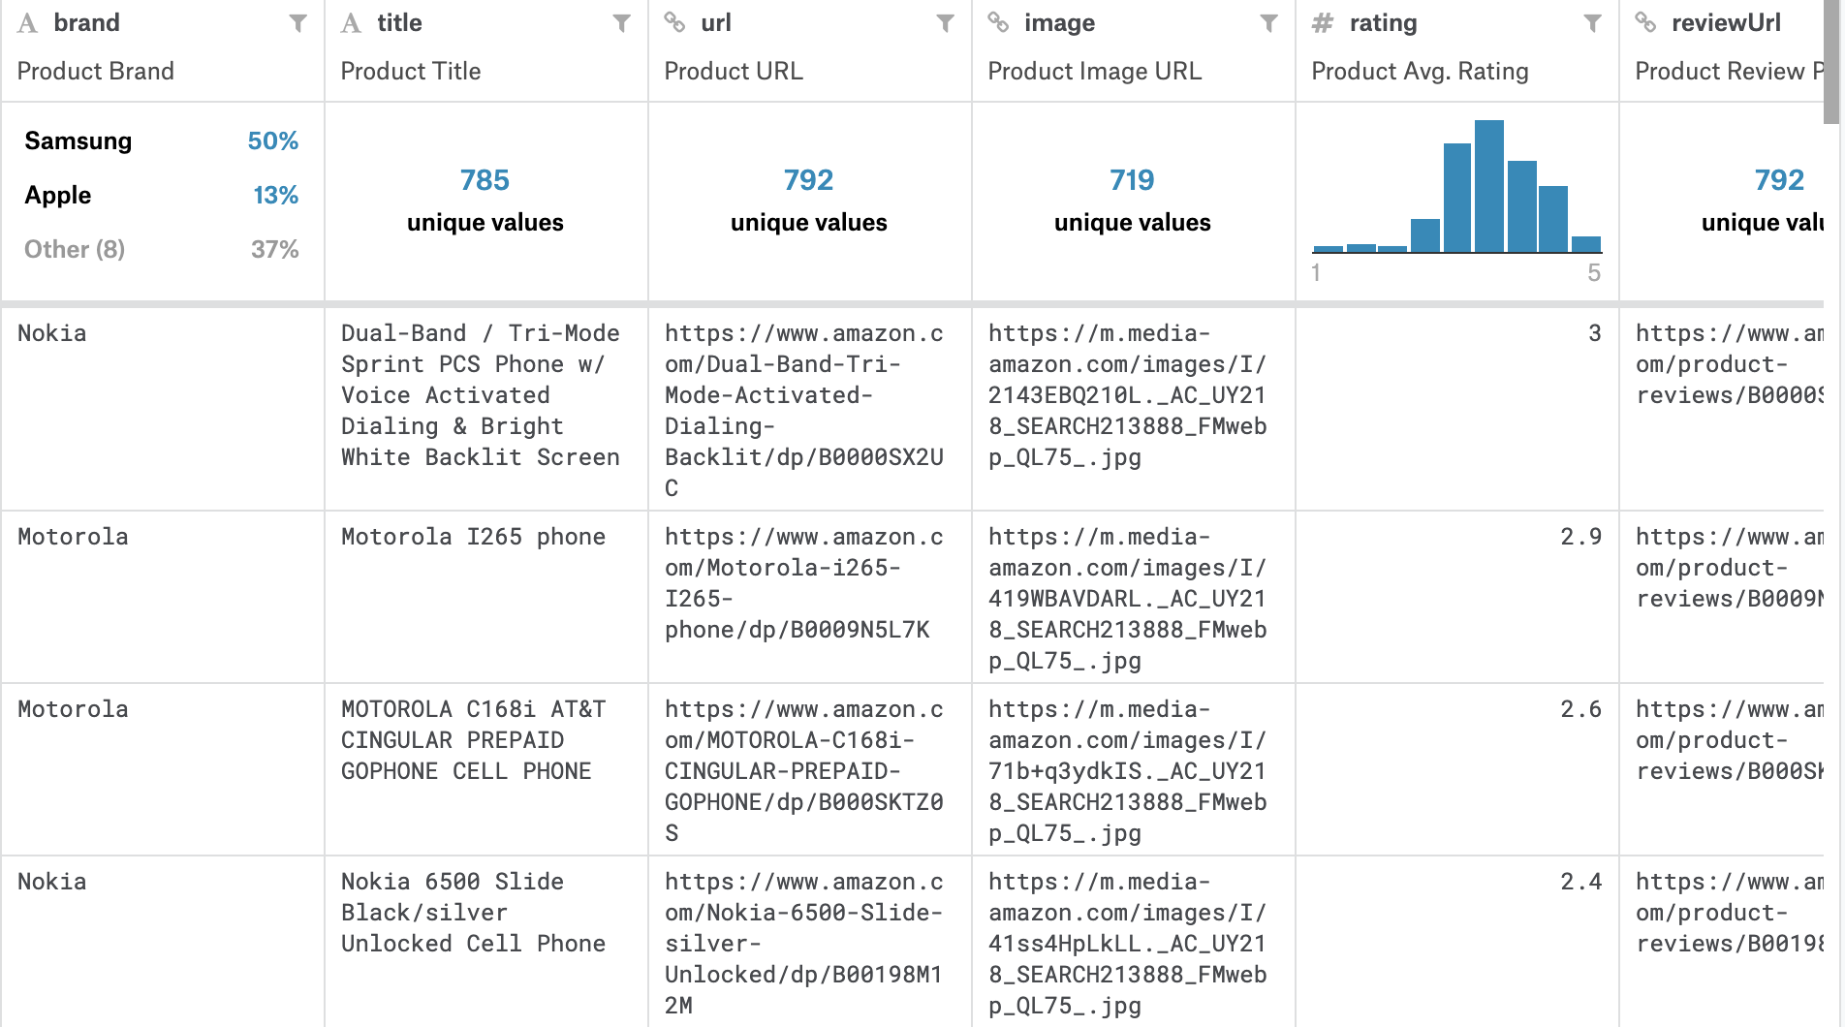
Brief introduction to Dataset
Item.csv
Brand, title, url, image, rating reviewURL, total review, prices

Slide 5
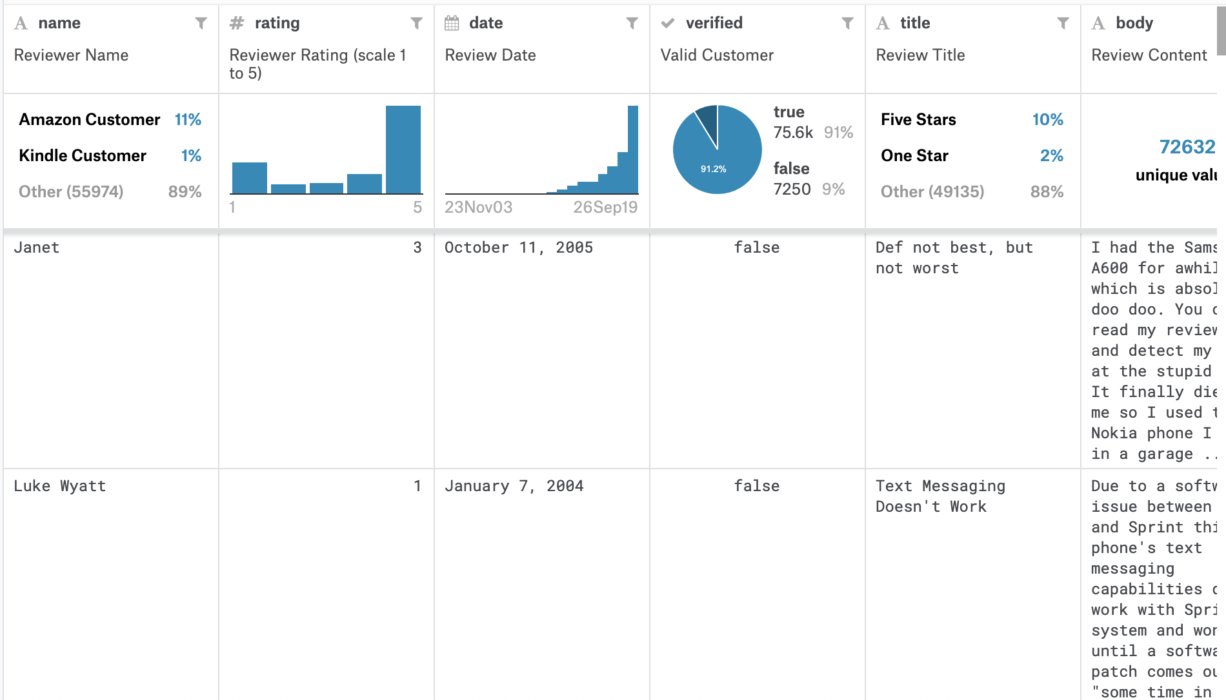
Brief introduction to Dataset
Review.csv
Name, rating, date, review title, body

Slide 6
Use cases - Visualization of sales amount and ratings for all brands
Input
Users can select a brand of cell phone through a dropdown box
Output
Stacked histogram of ratings for all brands
Pie chart of sales amount and rating for a specific brand

Slide 7
Use cases - Retrieve helpful reviews from our data
Input
Users can select a brand through a dropdown box
Output
Show all types of cell phones under the brand in a dropdown box
Input
After users select a brand, they can further select a specific type
Output
Retrieve and display the review with highest votes under this type.

Slide 8
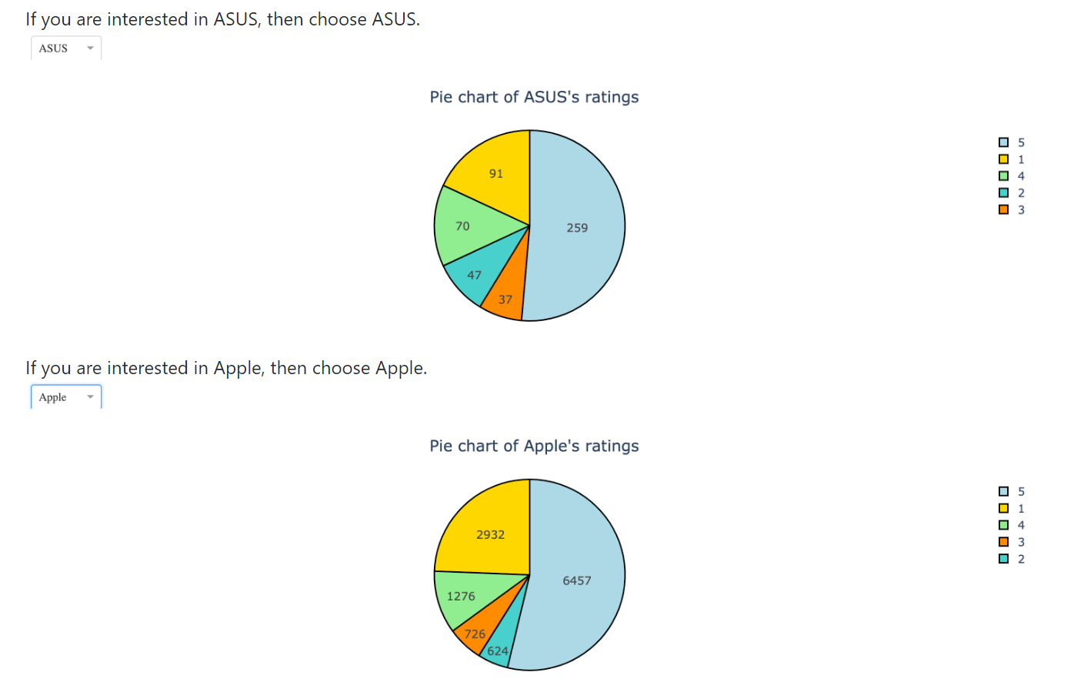
Demo

Slide 9
Design – software components
Data cleaning and merging: contains functions to merge items.csv and reviews.csv based on product id.
Inputs: Two dataframes of raw data
Outputs: A merged and clean dataframe containing both item-level and user-level information.
Visualization manager: extract and gather sales amount, ratings, review, etc. from the merged dataframe.
Inputs: A clean and merged dataframe, and a specific query.
Outputs: Visualization of the query (e.g. histogram, pie chart)
Web manager: build an web interface which manipulates HTML DOM object, enable users to interact with our system.
Inputs: Get the values from the drop down box
Outputs: Plots from visualization manager

Slide 10
Flow chart
Data pre-processing
Data integration
Dataframe
Data query
Sub-dataframe
Visualization manager
User query
Plots, statistics
User interface

Slide 11
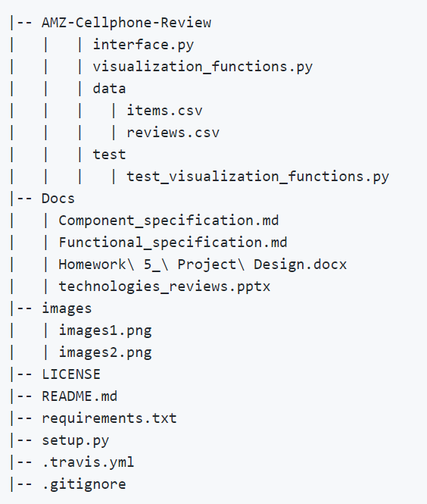
Project Structure

Slide 12
Lessons learned and future work
Components that a software should include
Test module : edge case, unit test, expectation of input and output, continuous integration
Complete documentation
Structure of Python package
Future work
Sentiment analysis for reviews
Regularly update data

