Slide 1
Connected Components Labeling
A Presentation by Craig Bester & Liam Pulles

Slide 2
Outline
Connected Components Labeling is the task of finding and labeling the disjoint parts in a graph.
In computer graphics terms, this becomes the problem of finding distinct regions in a binary image.
This is often used to detect objects; Regions Of Interest in an image.

Slide 3
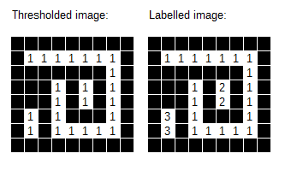
Process Example
We do not label the black pixels – we regard them as being outside of the problem domain.
After the connected components labeling has completed, each element has a label unique to their group.
Image from: https://www.codeproject.com/Articles/825200/An-Implementation-Of-The-Connected-Component-Label

Slide 4
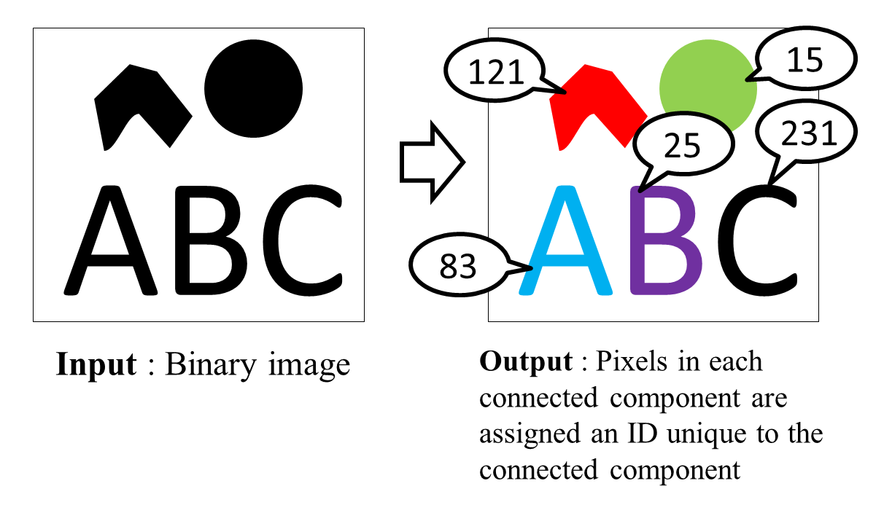
Example continued
To make the distinct regions easier to see, it is often desirable to colorize the output for demonstration purposes.
We will do this in our program.
Image from: http://ito-lab.naist.jp/~n-sibata/cclarticle/index.xhtml

Slide 5
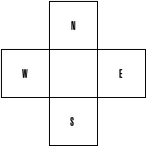
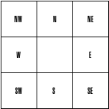
4-connect vs. 8-connect
There are different ways of regarding neighbors.
4-connect: We connect pixels according to their N,E,S,W neighbors.
8-connect: We connect pixels according to their N,NE,E,SE,S,SW,W,NW neighbors.
We use 8-connect for our implementations.

Slide 6

Forward Pass
Because it can be inefficient to check all 8 neighbors at each pixel, if we are going left-to-right and row-to-row, we can use a special mask.
Left: A Forward pass mask for 8-connect.
Right: A Forward pass mask for 4-connect.

Slide 7
Unionfind Overview
The Unionfind algorithm is an efficient way to keep track of which members belong to which sets. We use some variation of Unionfind for all our implementations.
Initially, we assume all members are in their own distinct sets
To put two members in the same set, we “union” them together.

Slide 8
Unionfind Overview
Once we are finished unioning members into sets, we can retrieve their group label by doing a set lookup – a “find”.
The find is not an immediate operation, and requires traversing a set of members to reach a “root” member, which holds the group label.

Slide 9
“Root” Propagation example:
11 wants to find its “root” label.
Here we can see that for (11) to find its own root node (and region label) it needs to traverse to labels[11] = (6), labels[6] = (1), labels[1] = (1). We can see this is a root node as the label equals its index, and we stop.
(11) will now become (1).
Our MPI and Serial implementations implement path compression by setting all the labels of the nodes along the path to the root node- to the root node - after the root is found. This speeds up future finds.
1 | 0 | 3 | 3 | 4
1 | 0 | 3 | 0 | 4
6 | 0 | 3 | 0 | 10
11 | 0 | 0 | 0 | 15
16 | 21 | 22 | 20 | 20

Slide 10
Unionfind example
Input Binary Image
Initial labels
1 | 0 | 0 | 0 | 5
6 | 7 | 0 | 9 | 10
0 | 12 | 13 | 14 | 0
0 | 0 | 0 | 0 | 0
0 | 0 | 0 | 0 | 0

Slide 11
Unionfind example
Union(6,1)
1 | 0 | 0 | 0 | 5
6 | 7 | 0 | 9 | 10
0 | 12 | 13 | 14 | 0
0 | 0 | 0 | 0 | 0
0 | 0 | 0 | 0 | 0
1 | 0 | 0 | 0 | 5
1 | 7 | 0 | 9 | 10
0 | 12 | 13 | 14 | 0
0 | 0 | 0 | 0 | 0
0 | 0 | 0 | 0 | 0
The forward pass mask results in us doing no operations on the top row.
To do a union, we first need to call a find in both (6) and (1). In this case , we see labels[6] = 6 and labels[1] = 1, so they are root nodes at this stage. labels[Max(1,6)] is then set to labels[min(1,6)], in this case labels[6] is set to 1 (This has the effect of pointing the large one to the small one, i.e. the “root”).

Slide 12
Unionfind example
Union(7,1); Union (1,1)
1 | 0 | 0 | 0 | 5
1 | 7 | 0 | 9 | 10
0 | 12 | 13 | 14 | 0
0 | 0 | 0 | 0 | 0
0 | 0 | 0 | 0 | 0
1 | 0 | 0 | 0 | 5
1 | 1 | 0 | 9 | 10
0 | 12 | 13 | 14 | 0
0 | 0 | 0 | 0 | 0
0 | 0 | 0 | 0 | 0
Similarly here, we see labels[7] = 7 and labels[1] = 1, so no traversal. Then labels[7] is set to 1. We will also redundantly compare the top-left corner node with labels[7], though since labels[7] is now 1 there is nothing to do.

Slide 13
Unionfind example
Union(9,5)
1 | 0 | 0 | 0 | 5
1 | 1 | 0 | 9 | 10
0 | 12 | 13 | 14 | 0
0 | 0 | 0 | 0 | 0
0 | 0 | 0 | 0 | 0
1 | 0 | 0 | 0 | 5
1 | 1 | 0 | 5 | 10
0 | 12 | 13 | 14 | 0
0 | 0 | 0 | 0 | 0
0 | 0 | 0 | 0 | 0
Similarly...

Slide 14
Unionfind example
Union(...,...)
1 | 0 | 0 | 0 | 5
1 | 1 | 0 | 5 | 10
0 | 12 | 13 | 14 | 0
0 | 0 | 0 | 0 | 0
0 | 0 | 0 | 0 | 0
1 | 0 | 0 | 0 | 5
1 | 1 | 0 | 5 | 5
0 | 1 | 13 | 14 | 0
0 | 0 | 0 | 0 | 0
0 | 0 | 0 | 0 | 0
We repeat this process for nodes 10 and 12.

Slide 15
Unionfind example
Union(13,1); Union(1,5)
1 | 0 | 0 | 0 | 5
1 | 1 | 0 | 5 | 5
0 | 1 | 13 | 14 | 0
0 | 0 | 0 | 0 | 0
0 | 0 | 0 | 0 | 0
1 | 0 | 0 | 0 | 1
1 | 1 | 0 | 5 | 5
0 | 1 | 1 | 14 | 0
0 | 0 | 0 | 0 | 0
0 | 0 | 0 | 0 | 0
Here, after we have done union(1,13) (which sets labels[13] to 1), we will do union(1,5). Here, take note of the statement “labels[Max(1,5)] set to labels[min(1,5)]” this means labels[5] (in the top right corner) will be set 1, not the 5 (labels[9]) next to labels[13].
We’ve just pointed the 5 root node to the 1 root node.

Slide 16
Unionfind example
Union(14,1); Union(1,5); Union(1,5)
1 | 0 | 0 | 0 | 1
1 | 1 | 0 | 5 | 5
0 | 1 | 1 | 14 | 0
0 | 0 | 0 | 0 | 0
0 | 0 | 0 | 0 | 0
1 | 0 | 0 | 0 | 1
1 | 1 | 0 | 5 | 5
0 | 1 | 1 | 1 | 0
0 | 0 | 0 | 0 | 0
0 | 0 | 0 | 0 | 0
Finally, we set 14. Now we only need do one more pass to retrieve all the labels, by calling find() on each node.

Slide 17
Serial Implementation
In our serial program, we do as follows:
1) We load an image, and binarize it (by thresholding).
2) We create a Unionfind object with as many elements as we have pixels.
3) We follow the process shown previously (using the Unionfind object) for the first pass.
4) We retrieve the labels for each pixel from the Unionfind object (the second pass).
5) We colourise each pixel according to it’s label (thus giving independent regions distinct colors).
6) We output the colored image.

Slide 18
CUDA Implementation
In our CUDA program, we do as follows (excluding the image load, color, save):
1) We copy the binarized image into a CUDA array and bind it to a surface (A surface is essentially a texture with write abilities). We use the surface because of it’s spatial locality speedup property when we do neighbor checking.
2) We initialize one thread for each pixel.
3) [Initial] Each thread does the initial labeling for it’s pixel (setting it’s label to the thread id). Threads whose pixel has value 0 lay dormant for the rest of the process.

Slide 19
CUDA Implementation contd.
4) [Scan] Each thread looks at it’s forward pass neighbors. The thread’s label is then set to the minimum of it and it’s neighbors labels.
The label result of this will vary depending on how quickly individual threads can find the minimum, and set their own label (before other threads check it.
5) [Analysis] Each thread then uses its label as an index to recursively iterate through to its “root” label (region label) using the Unionfind propagation method.

Slide 20
CUDA Implementation contd.
6) Set “result = false”. We enter a while loop, which loops until “result == true”:
  I) [Link] Each thread analyses it’s forward pass neighbors . The thread sets the pixel pointed to by it’s label (not itself, i.e set labels[labels[this_thread]]) to the minimum label of it and its neighbors’ labels.
  II) [Relabel] Each thread then takes the label pointed to by its own current label (labels[labels[this_thread]]), and sets it as its new label (Other threads might have contributed a better minimum to the pointed label, which is why we do (I) ).

Slide 21
CUDA Implementation contd.
  III) Set “result = true”
  IV) [Rescan] Each thread compares the minimum of it’s forward pass neighbors. If the minimum of these neighbors’ labels is not equal to the thread’s own label, then set “result = false” (note result is global).
  The result of this is that result=true will only be satisfied if all the threads have neighbors with the same label - in which case we’ll be done.
7) Finally, we can copy back the image from the GPU and attain our result.

Slide 22
CUDA Implementation notes
Although thread contention is likely to occur when checking and setting neighbors, thread interleaving will hopefully hide this latency from us.
We also implemented a version which makes use of global memory (which is slightly faster).
We did not make use of shared memory, as memory accesses are not block-local (threads can directly set their “root” nodes , potentially far away.)
We also did not make use of constant memory, as all of the data changes quite rapidly, the data is potentially too big, and the amount of data we process varies in size greatly.

Slide 23
MPI Implementation
In our MPI program, we do as follows (excluding the load, color, save):
1) After loading, we split the binarized image into ~p/n sized chunks (where p is the number of processes and n is the number of pixels). Actually, we find the offsets that describe these chunks (this is done by the master process).
2) We distribute these chunks using the offsets with MPI_Scatterv().
3) Each process now performs the two passes of Unionfind on it’s chunk, finding and labeling the regions in them.
4) The chunks are sent back to the master process with MPI_Gatherv().
5) The master process now joins the regions together along the region boundaries (fulfilling the first pass) and then relabels the whole image (the second pass). And we are done.

Slide 24
MPI Implementation notes
Although it is possible to perform the merging of the regions in parallel using a binary tree like method, it would entail additional communication costs. We believe that the relatively small sizes of the regions mean that the startup cost of communicating them again would eat up any advantage of doing the merge in parallel.
You will note that we do more than two passes on the image, however:
I) The first two passes are done in parallel (for the chunks).
II) The first pass of the final merge only requires the boundary rows of the chunks. There are p – 1 of these rows, which is down from n.

Slide 25
Implementation Comparison

