Slide 1
SUSTAINABILITY ISN'T IDEOLOGY
IT'S PHYSICS
That’s not politics. Just cause and effect.

Slide 2

EARTH IS A
CLOSED SYSTEM
Energy enters from the sun. Matter stays.
Energy in
Matter stays.

Slide 3
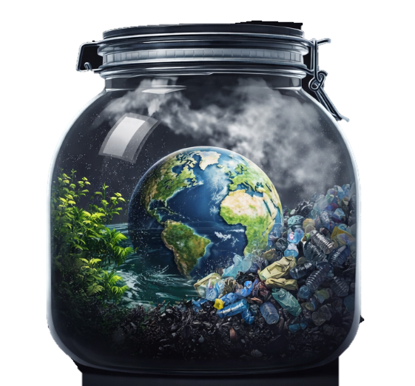
THERE IS NO EXIT &
NO RESET BUTTON
So outputs accumulate

Slide 4
STOCK VS FLOW
The problem isn't emissions.
It's accumulation.

Slide 5
MORE EMISSIONS
=
MORE RISK
Environmental disruption
Economic
volatility
Social
instability
Further amplified by feedback loops

Slide 6
FEEDBACK LOOP
When outputs become inputs.
A changes B B changes A Repeat
There are two kinds: Some stabilize. Some amplify.

Slide 7
STABILIZING FEEDBACK
The system pushes back & self corrects
More heat
More evaporation
More clouds
More reflection
Cooler with fewer clouds

Slide 8
AMPLIFYING FEEDBACK
The system accelerates, without brakes.
Less ice
Less reflection
More heat absorbed
More melted ice
More heat

Slide 9

TIPPING POINTS
Systems hold, until they don’t.
That transition isn't reversible on human timescales.

Slide 10
HUMAN ACTIVITY
DRIVES AFFECTS
THESE SYSTEMS
But not equally.

Slide 11
71% OF INDUSTRIAL
EMISSIONS COME FROM ~ 100 COMPANIES
Not Jim's tire shop. Not Svenja's sewing company.
~ 100 COMPANIES

Slide 12
THE PHYSICS ISN'T
THE DEBATE
Who's responsible?
Who pays?
Does the system built to fix it work?

Slide 13
NEXT VIDEO
From "don't dump chemicals in the river" to a $30B compliance industry.

