Slide 1
DES Cracking Through Brute Force
By:
Dayananda Sarasvati A
Chiranjeevi Raghavendra Yerrajodu

Slide 2
Time taken by algorithm to crack DES whose key range.

Slide 3
Cipher Text for given sample text
Case 1:
Plain Text:1000010111101000000100110101010000001111000010101011010000000101
Key: 0000000000000000000000000000000000000000000010000000000000000000
Cipher: 0001111011111111100001110101100010101110110001110000011111111001
Case 2:
Plain Text:1000010111101000000100110101010000001111000010101011010000000101
Key:0000000000000000000000000000000000000000000100000000000000000000
Cipher: 1011111011111110110010001110101100011001000111010010110111001001
Case 3:
Plain Text:1000010111101000000100110101010000001111000010101011010000000101
Key:0000000000000000000000000000000000000000001000000000000000000000
Cipher: 1101101000110111110011111001111110010000110000000110110111010101

Slide 4
Instructions:
Steps:
Copy the privatekey ( ISARedhat.pem)file into the linux machine from where we want to run code
Change permission of private key file to 400.
Login into 52.24.65.123 host using Ubuntu as username and private key file.
Then run ./des_script.sh shell script
Shell script will login into other linux machines and run clients.
Output will loaded into server.log in 52.24.65.123 machine

Slide 5
Login:
User : Ubuntu
Host : 52.24.65.123
Pem file : ISARedhat.pem

Slide 6
Files for verification of plain and cipher.
We have used 7 machines to crack des, and divided key space in power of 2 to get equal distribution of key among machines.
Program will take Plain and Cipher text from a file and do two time verification whether found key is correct or not.
/home/Ubuntu/ciphertext1.txt
/home/Ubuntu/ciphertext2.txt
/home/Ubuntu/plaintext1.txt
/home/Ubuntu/plaintext2.txt

Slide 7
Files
Key Range file : keysrange for 32.txt
Private key for Amazon machines : ISARedhat.ppk (for putty)
Private key for Amazon machines : ISARedhat.pem (for ssh)
Server code : server1.cpp (52.24.65.123)
Client Code : Clientcout_1.cpp( all machines)

Slide 8
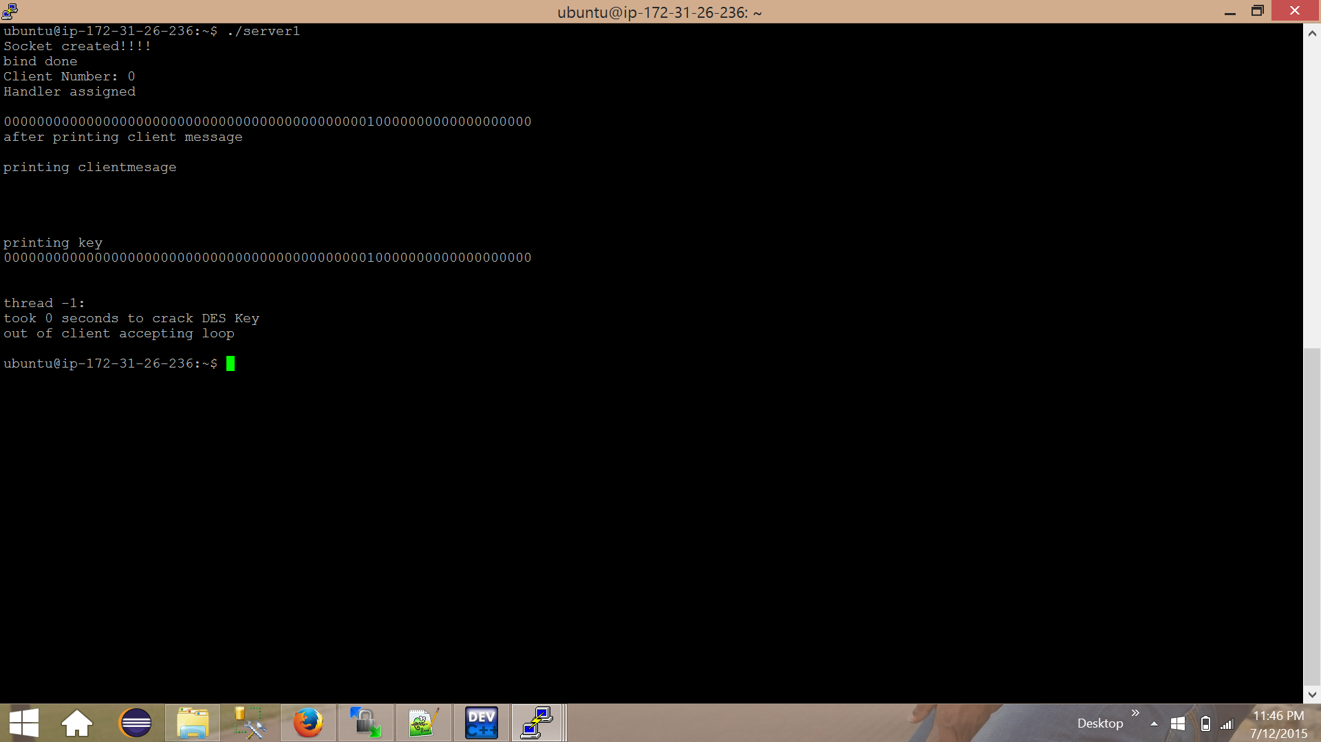
Screenshots: key 1

Slide 9

Screenshots: key 2

Slide 10
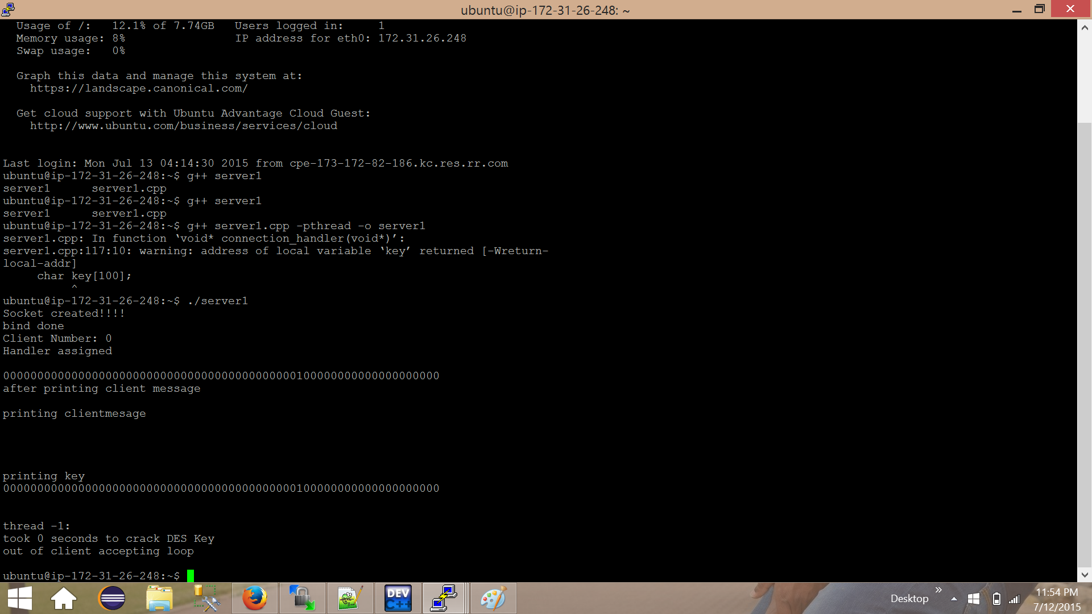
Screenshots: key3

