Slide 1
Public and private clouds as infrastructures for sharing data and computing services for VPH researchers
Jan Meizner
ACC CYFRONET AGH
Kraków, Poland

Slide 2
Outline
What the Cloud is?
Type of cloud services
Cloud services based on ownership
Sample public services and middlewares for private deployments
Cloud Federations
Hybrid cloud example based on VPH-Share
Sample Cloud Federation based on EGI
Cloud security aspects

Slide 3
What the Cloud is?
For service providers:
flexible, manageable resources
virtualization for efficient resource sharing (usually)
Isolation
For everybody else:
infinite resources (at least illusion)
availability, reliability and easy access
Good business model (for commercial services)

Slide 4
What the Cloud is?
For service providers:
Problems
Failures – hardware, network, etc.
Security risks – bugs, attics
For everybody else:
Problems
Trust – do we trust providers (and others)
Legal
We’re trying to solve them … and hope to succeed!

Slide 5
Why Cloud?
Allows to manage in-house resources efficiently through virtualization => different workloads using different separated software could share the same physical resources
Possible automatic scale-up and scale-down when needed
Different service levels for each user – from IaaS for IT specialists to SaaS for domain users
Ability to offload load peeks to public cloud (cloud bursting)
Elastic billing model (for public services) => low entry point for the users

Slide 6
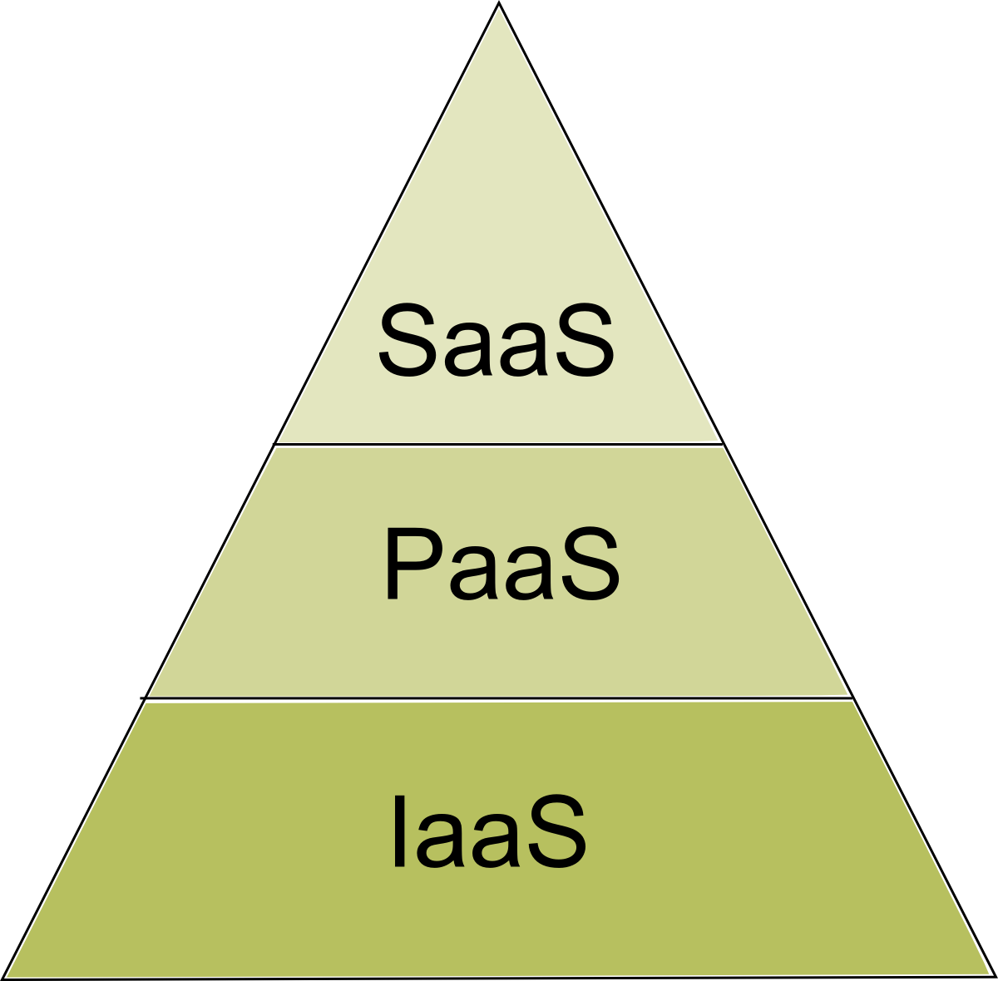
Type of cloud services
We could divide cloud services as:
IaaS
PaaS
SaaS
Additionally we could enumerate additional specific one such as DBaaS

Slide 7
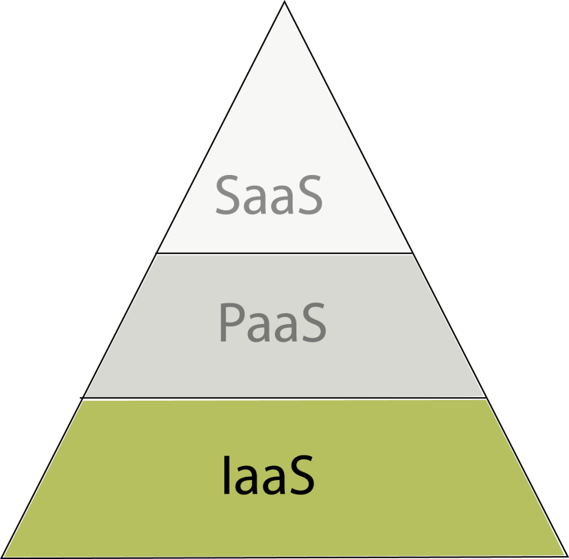
Infrastructure as a Service
The most basic type of service giving largest freedom for user at cost of complexity
User must be (or employ) fully qualified system administrator for chosen OS
Gives access to raw VMs
Possibility to install any type of software supported by the OS
Large OS pool including Linux and Windows

Slide 8
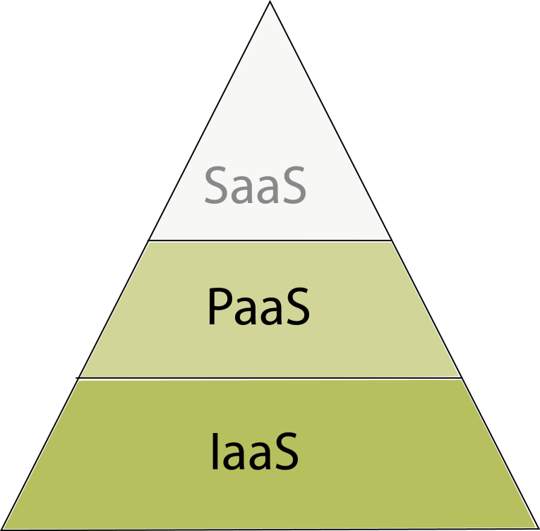
Platform as s Service
Less flexible then IaaS yet simpler
Doesn’t require deep OS knowledge
Allows to deploy arbitrary applications as long as they’re supported by the platform
Large number of supported solutions like:
Ruby
Java
Python
.NET, etc.

Slide 9
Software as a Service
Usually fixed-function (with some customizations possible)
Do not require any technical knowledge
Designed to provide defended functionality like any stand-alone application
Applicable to various solutions ranging from everyday life (e.g. mail program, calendar) through business solutions (e.g. documents creation) to advanced scientific packages

Slide 10
Cloud services based on ownership
We could also divide clouds based on ownership:
Private cloud – completely in-house, provided to own internal users
Community cloud – also in-house, possible federated cross-institutional, provided to defined group of people (such as scientists)
Public clouds – services open to anybody usually offered for a defined fee

Slide 11
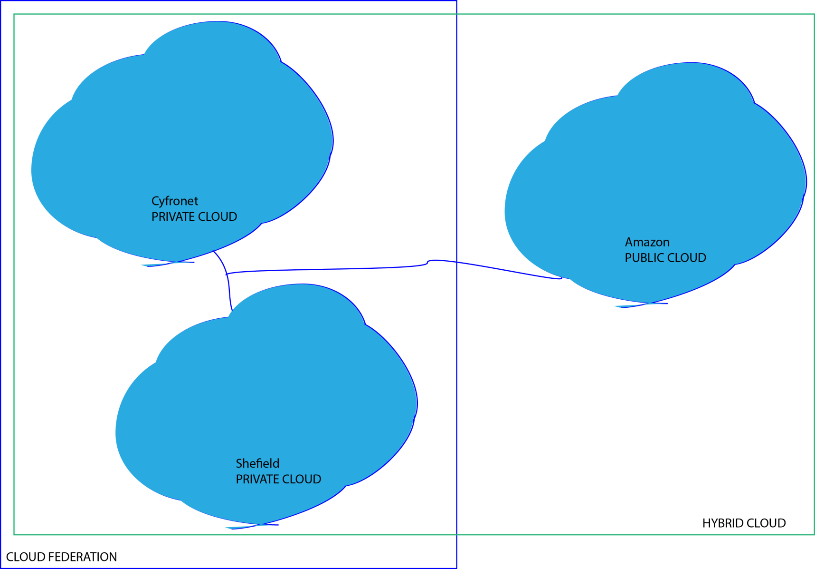
Cloud Federation and Hybrid Solutions

Slide 12
Cloud Middlewares
There are multiple middlewares/stacks that allows providing of cloud services. They could be:
For internal use / undisclosed – e.g. used by Amazon for AWS
Proprietary yet available for a price – e.g. VMWare vCloud
OpenSource – e.g. OpenStack, OpenNebula, Eucalyptus or Nimbus

Slide 13
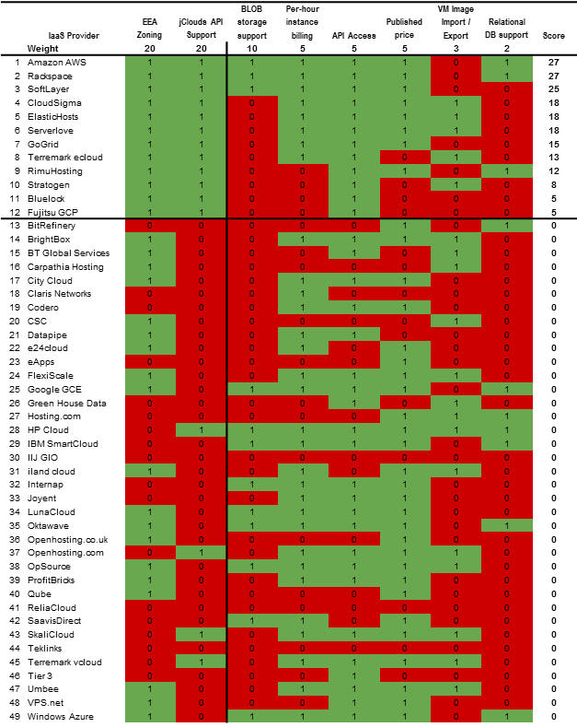
Public Services
Amazon AWS
Rackspace
SoftLayer
CloudSigma
ElasticHost
Serverlove
GoGrid
Etc.

Slide 14
Cloud Federation
Formed by a group of cooperating Cloud providers
Providers are independent
Cloud middleware don’t have to be enforced
Requires interoperability mechanisms
Users may choose most suitable offer
Depending on integration level federation could be classified as “loose” or “tight”

Slide 15
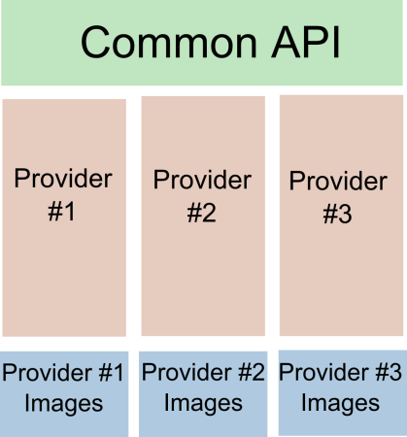
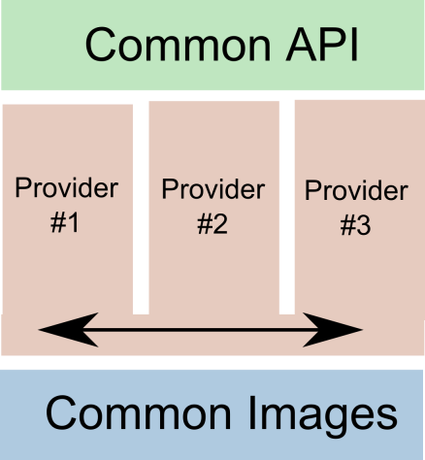
Cloud Federations
Loose Federation
Tight Federation
No central image repository or synchronization
Possible different middlewares and hypervisors
Just API level compatibility
Simpler yet less powerful
VM cannot be migrated
Centralized repository or on-line synchronization
Homogenous middleware and hypervisor or conversion service in place
Full stack compatibility needed
Allows to run arbitrary image on arbitrary provider

Slide 16
Hybrid cloud based on VPH-Share

Slide 17
Hybrid cloud based on VPH-Share
Atmosphere manages access to different private and public clouds and provides common high-level API
Private cloud installation in Krakow @Cyfronet:
Open Stack (Folsom) – Keystone, Glance, Nova, Swift
1 HEAD node + 12 VM nodes (HP ProLiant BL2x220c G5)
OS – Ubuntu 12.04 LTS
Other private clouds soon (Sheffield, Vienna)
Public cloud services – current tests using Amazon EC2 and S3 – other possible in the future

Slide 18
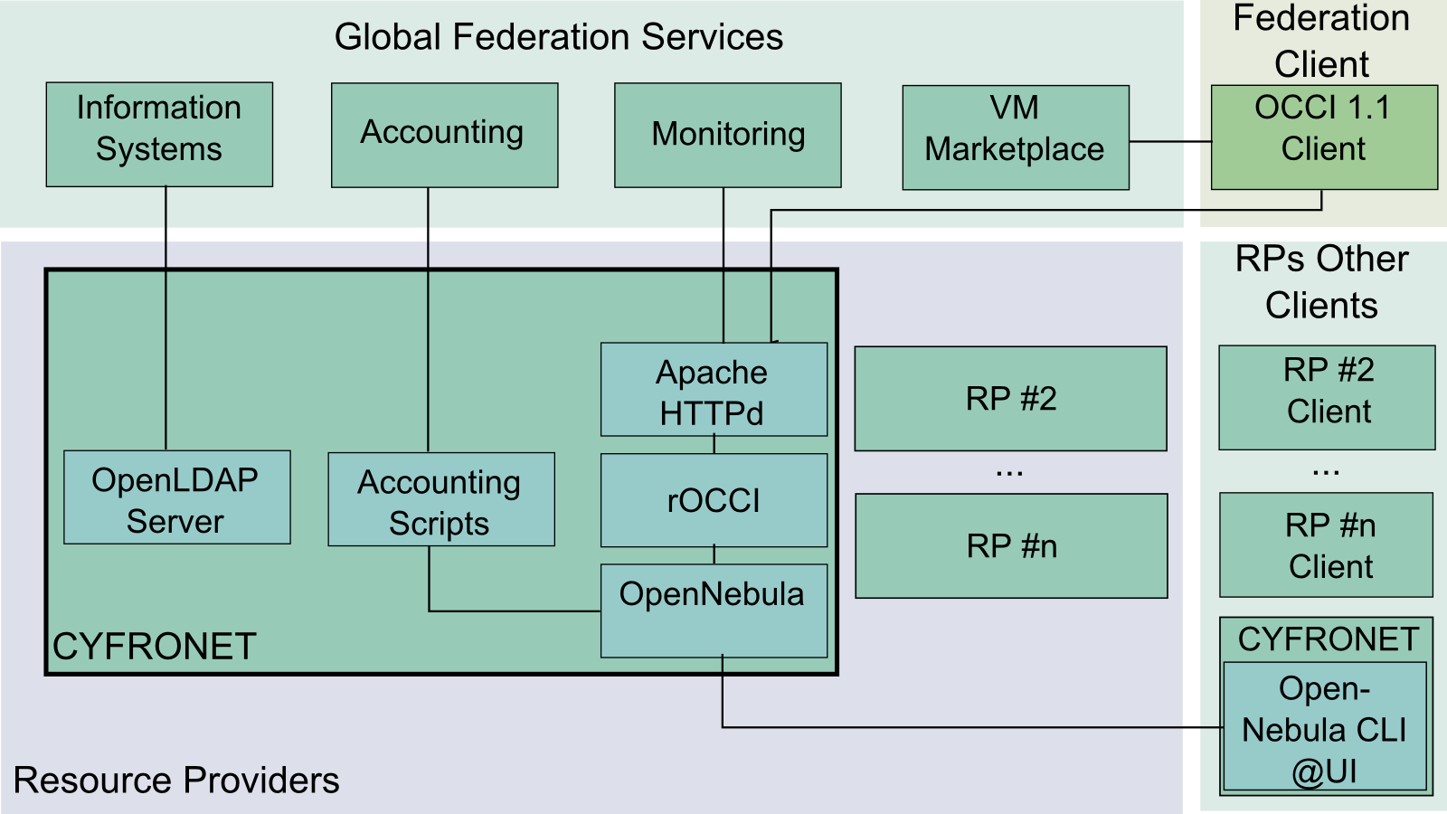
Sample Cloud Federation based on EGI

Slide 19
Sample Cloud Federation based on EGI
Each Resource Provider needs to fulfill a set of requirements:
Provide at least OCCI 1.1 API
No middleware is enforced if the mentioned API is supported
Provide integration mechanism with Information Systems (BDII), Accounting and Monitoring
Secure the endpoint with X.509
Provide a set of OS images (stored locally)
Publish metadata describing images to central repository – EGI VM Marketplace
Other (non-federated) endpoints may also be exposed.

Slide 20
Cloud security aspects
Cloud security is essential
We need to analyze secure:
access to the platform
access to VMs
access to services
Stored data handling
Computed data handling
Communication (VPNs, VPC etc)

Slide 21
Secure access to the platform(s)
Needed for management of the public and private services underneath
Handled by the VPH-Share platform itself
Currently user/password (OpenStack) and public/secret key paradigms (Amazon)
Other might be added if needed (such as X.509 certificates used in the EGI FedCloud)

Slide 22
Secure access to VMs
Needed to access VM as user/administrator (NOT service deployed there)
Currently -> SSH key pair injection mechanism in place
Used in development mode

Slide 23
Access to the services
Handled by Security Proxy provided by ATOS
Authentication based on Biomed Town
Policy based authorization
SecProxy – installed between user and it’s service

Slide 24
Stored data handling
Critical for some workflows
Some data needs to be stored in private cloud
Less confidential data might be stored in public cloud with following provisions:
Trust for the provider (should we?)
End-to-end encryption (decryption key stays in protected/private zone)
Data dispersal (portion of data, dispersed between nodes so it’s non-trivial/impossible to recover whole message)

Slide 25
Processed data handling
Also critical for some workflows
End-to-end encryption not possible as data needs to be decrypted for processing (usually)
Possible mitigations:
No permanent storage of unencrypted data
Data encryption through secure service located in private zone (on the fly)
Dedicated hardware solution – e.g. newly supplied by Amazon – AWS CloudHSM

Slide 26
Providers’ assurances
E.g. Amazon claims to be certified:
SOC 1/SSAE 16/ISAE 3402,
SOC2,
FISMA,
DIACAP,
FedRAMP,
PCI DSS Level 1,
ISO 27001
ITAR (US government zone)
FIPS 140-2 (US government zone)

Slide 27
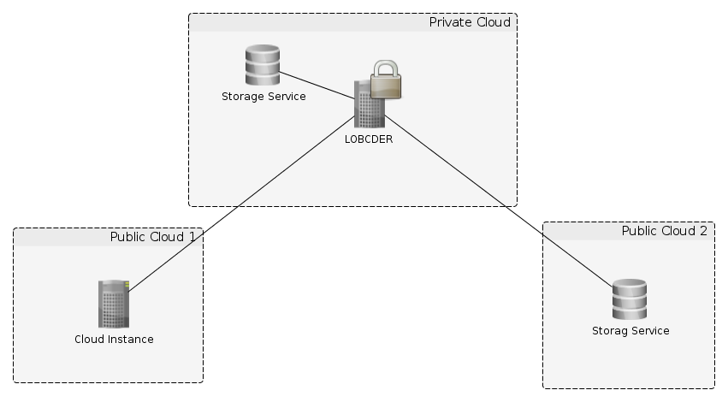
Solution #1: LOBCDER based
LOBCDER is responsible for encrypting the data. The symmetric key entered during startup and stored in memory.
LOBCDER in trusted zone

Slide 28
Solution #1: LOBCDER based
seamless access to the data using DAV client / davfs2 as well as the portal.
LOBCDER will also control access to the data so the only authorized entities could get decrypted data.

Slide 29
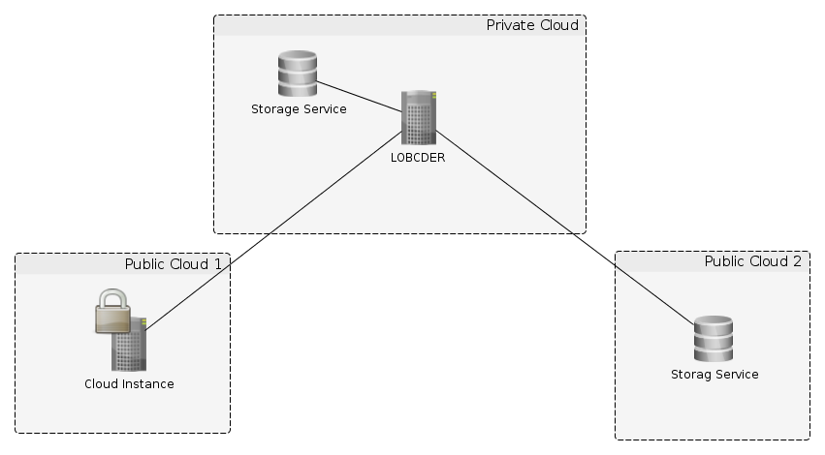
Solution #2: End-to-end
VPH project could assist by suggesting usage of some standard tools (such as OpenSSL [8])
LOBCDER would allow turning its encryption off (so data encrypted in “end to end” fashion wouldn’t be needlessly re-encrypted by LOBCDER)

Slide 30
Solution #2: End-to-end
only the data provider knows the key so no one else could decrypt the data.
obvious drawback - standard VPH tools (such as the portal) wouldn’t be able to assist the user in a decryption process

Slide 31
Secured Communication
Application level security – e.g. HTTPS
Custom VPN to the specific VM (e.g. OpenVPN, IPSec)
Site-to-site VPN – e.g. IPSec VPN offered as part of Amazon VPC, custom solution between project partners
Dedicated isolated L1/L2 link (e.g. dark fiber, CWDM/DWDM or QinQ between federation members, public services such as “AWS Direct Connect” offered by Amazon

Slide 32
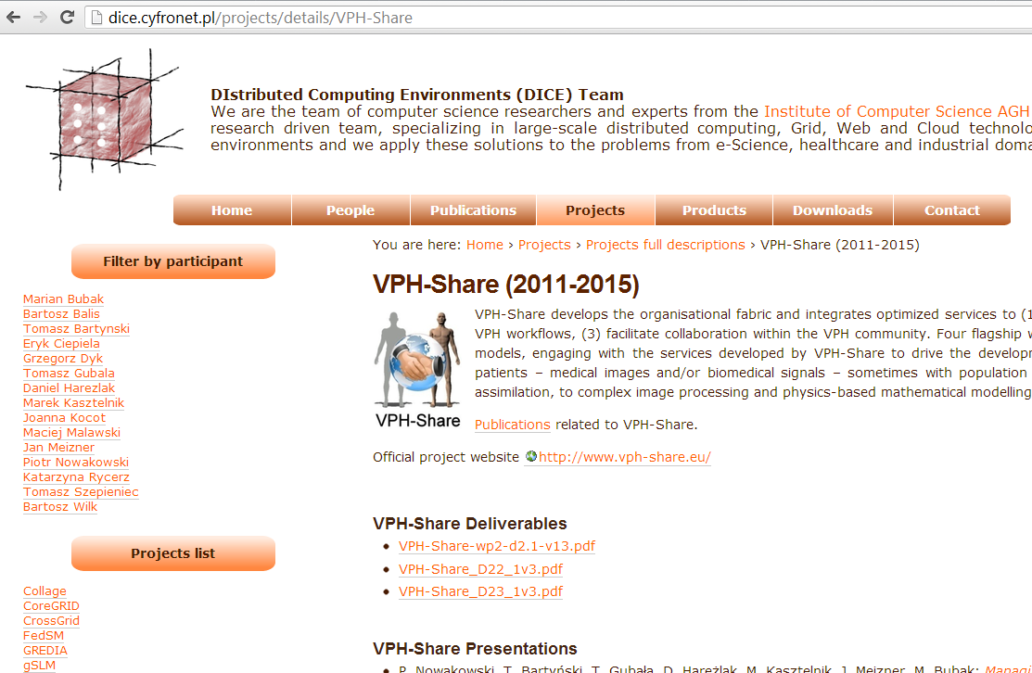
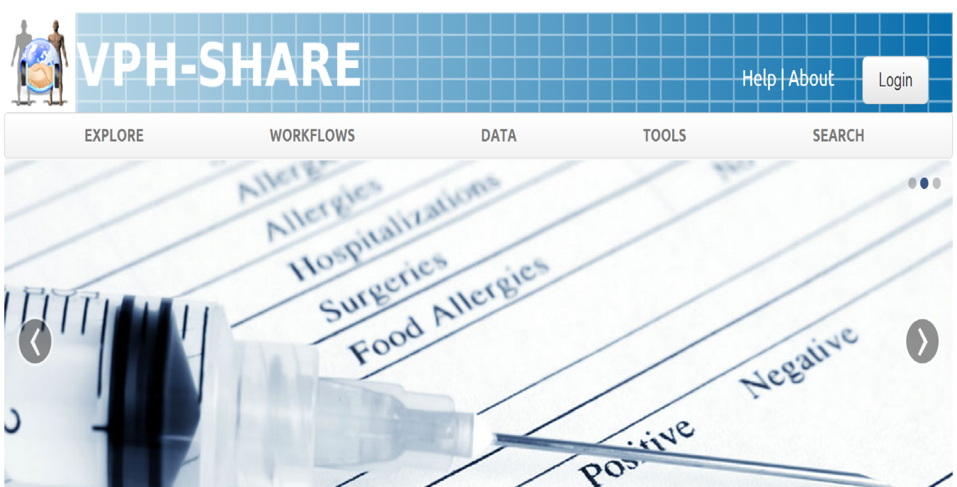
For more information…
dice.cyfronet.pl – the DIstributed Computing Environments (DICE) team at CYFRONET (i.e. „those guys who develop the VPH-Share cloud platform”).
Contains documentation, publications, links to manuals, videos etc.
Also describes some of our other ideas and development projects.
jump.vph-share.eu – the newest release of the VPH-Share Master Interface.
Your one-stop entry to all VPH-Share functionality.
You can log in with your BioMedTown account (available to all members of the VPH NoE)

