Slide 1







Federating cloud resources for building and execution of VPH applications
Marian Bubak
Department of Computer Science and Cyfronet AGH Krakow, PL
and
VPH-Share Project team
dice.cyfronet.pl/projects/VPH-Share
www.vph-share.eu

Slide 2
Co-authors
AGH Krakow – Cyfronet: Piotr Nowakowski, Maciej Malawski, Marek Kasztelnik, Daniel Harezlak, Jan Meizner, Tomasz Bartynski, Tomasz Gubala, Bartosz Wilk, Wlodzimierz Funika
University of Amsterdam: Spiros Koulouzis, Dmitry Vasunin, Reggie Cushing, Adam Belloum
UCL London: David Chang, Stefan Zasada, Peter Coveney
ATOS Research: Dario Ruiz Lopez, Rodrigo Diaz Rodriguez
University of Sheffield: Susheel Varma

Slide 3
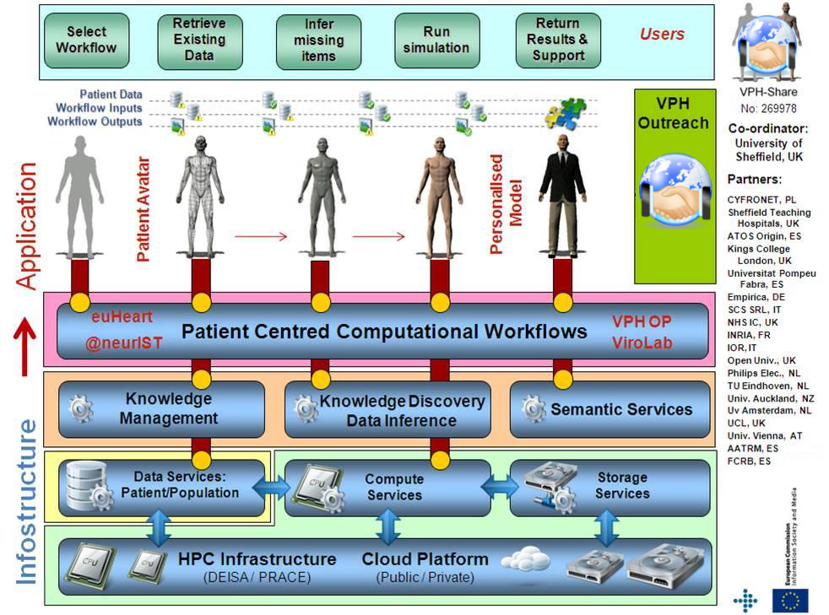
Infostructure for Virtual Physiological Human
2

Slide 4
A (very) short glossary
Raw OS
!
Virtual Machine: A self-contained operating system image, registered in the Cloud framework and capable of being managed by VPH-Share mechanisms.
OS
!
Atomic service: A VPH-Share application (or a component thereof) installed on a Virtual Machine and registered with the cloud management tools for deployment.
VPH-Share app.
(or component)
External APIs
Cloud host
!
Atomic service instance: A running instance of an atomic service, hosted in the Cloud and capable of being directly interfaced, e.g. by the workflow management tools or VPH-Share GUIs.
OS
VPH-Share app.
(or component)
External APIs

Slide 5

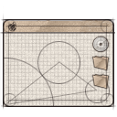


Basic functionality of cloud platform
Install any scientific
application in the cloud
Access available
applications and data
in a secure manner
End user
Developer
Application
Managed application
Cloud infrastructure
for e-science
Manage cloud
computing and storage
resources
Administrator
Install/configure each application service (which we call an Atomic Service) once – then use them multiple times in different workflows;
Direct access to raw virtual machines is provided for developers, with multitudes of operating systems to choose from (IaaS solution);
Install whatever you want (root access to Cloud Virtual Machines);
The cloud platform takes over management and instantiation of Atomic Services;
Many instances of Atomic Services can be spawned simultaneously;
Large-scale computations can be delegated from the PC to the cloud/HPC via a dedicated interface;
Smart deployment: computations can be executed close to data (or the other way round).

Slide 6
VPH-Share federated cloud

Slide 7





Resource allocation management
Management of the VPH-Share cloud features is done via the Cloud Facade which provides a set of APIs for the Master Interface and any external application with the proper security credentials.
Developer
Admin
Scientist
VPH-Share Core Services Host
VPH-Share Master Int.
Cloud Facade
(secure RESTful API )
Atmosphere Management Service (AMS)
Cloud Manager
Cloud stack plugins (JClouds)
Atmosphere Internal Registry (AIR)
Development Mode
Generic Invoker
Workflow management
OpenStack/Nova Computational Cloud Site
Other CS
External application
Head Node
Worker Node
Worker Node
Worker Node
Worker Node
Cloud Facade client
Amazon EC2
Customized applications may directly interface the Cloud Facade via its RESTful APIs
Worker Node
Worker Node
Worker Node
Worker Node
Image store (Glance)

Slide 8



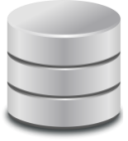
HPC execution environment
Provides virtualized access to high performance execution environments
Seamlessly provides access to high performance computing to workflows that require more computational power than clouds can provide
Deploys and extends the Application Hosting Environment – provides a set of web services to start and control applications on HPC resources
Invoke the Web Service API of AHE to delegate computation to the grid
Application Hosting Environment
Auxiliary component of the cloud platform, responsible for managing access to traditional (grid-based) high performance computing environments. Provides a Web Service interface for clients.
Application
Present security token (obtained from authentication service)
-- or --
AHE Web Services
(RESTlets)
User access
layer
GridFTP
WebDAV
Tomcat container
Workflow environment
Job Submission Service (OGSA BES / Globus GRAM)
Resource client
layer
QCG Computing
RealityGrid SWS
-- or --
Delegate credentials, instantiate computing tasks, poll for execution status and retrieve results on behalf of the client
End user
Grid resources running Local Resource Manager
(PBS, SGE, Loadleveler etc.)

Slide 9

Data access for large binary objects
Ticket validation service
Master Interface component
LOBCDER host
(149.156.10.143)
Auth
service
WebDAV servlet
Core component host
(vph.cyfronet.pl)
Data Manager
Portlet
(VPH-Share
Master Interface component)
REST-interface
LOBCDER service backend
GUI-based access
Resource factory
Storage
driver
Storage
driver
(SWIFT)
Atomic Service Instance
(10.100.x.x)
Service payload (VPH-Share application component)
Encryption keys
Resource catalogue
Mounted on local FS
(e.g. via davfs2)
SWIFT
storage
backend
Generic WebDAV client
External host
VPH-Share federated data storage module (LOBCDER) enables data sharing in the context of VPH-Share applications
The module is capable of interfacing various types of storage resources and supports SWIFT cloud storage as well as Amazon S3
LOBCDER exposes a WebDAV interface and can be accessed by any DAV-compliant client. It can also be mounted as a component of the local client filesystem using any DAV-to-FS driver (such as davfs2)

Slide 10
Data reliability and integrity
Provides a mechanism which keeps track of binary data stored in cloud infrastructure
Monitors data availability
Advises the cloud platform when instantiating atomic services
LOBCDER
DRI Service
Metadata extensions for DRI
A standalone application service, capable of autonomous operation. It periodically verifies access to any datasets submitted for validation and is capable of issuing alerts to dataset owners and system administrators in case of irregularities.
Binary
data
registry
Validation policy
Register files
Get metadata
Migrate LOBs
Get usage stats
(etc.)
Configurable validation runtime
(registry-driven)
Runtime layer
End-user features
(browsing, querying,
direct access to data,
checksumming)
Extensible
resource
client layer
Amazon S3
OpenStack Swift
Cumulus
VPH Master Int.
Store and marshal data
Data management portlet (with DRI management extensions)
Distributed Cloud storage

Slide 11
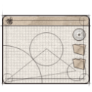



Security framework
Provides a policy-driven access system for the security framework.
Provides a solution for an open-source based access control system based on fine-grained authorization policies.
Implements Policy Enforcement, Policy Decision and Policy Management
Ensures privacy and confidentiality of eHealthcare data
Capable of expressing eHealth requirements and constraints in security policies (compliance)
Tailored to the requirements of public clouds
VPH clients
(or any authorized user capable of presenting a valid security token)
Application
Workflow management service
Developer
End user
Administrator
VPH Security Framework
Public internet
VPH Security Framework
VPH Atomic Service Instances

Slide 12




Architecture of the cloud platform
Admin
Developer
Scientist
Cloud Platform
Atomic Service Instances
Deployed by AMS (T2.1) on available resources as required by WF mgmt (T6.5) or generic AS invoker (T6.3)
VPH-Share Master UI
AM
Service
VPH-Share Tool / App.
AS mgmt. interface
Generic AS invoker
T2.1
Raw OS (Linux variant)
Workflow description and execution
VM templates
AS images
101101
011010
111011
LOB Federated storage access
101101
011010
111011
Security mgmt. interface
101101
011010
111011
Web Service cmd. wrapper
Computation
UI extensions
DRI
Service
Available cloud
infrastructure
T6.3, 6.5
Managed
datasets
Web Service security agent
Data mgmt. interface
T2.5
Atmosphere persistence layer (internal registry)
Generic VNC server
Generic data retrieval
Data mgmt.
UI extensions
Security
framework
LOB federated
storage access
T6.4
T2.6
T2.4
Custom AS client
Remote access to
Atomic Svc. UIs
Cloud stack
clients
HPC resource
client/backend
Physical
resources
T6.1
T2.2
T2.3

Slide 13
Platform modules and technologies
Component/Module | Technologies
Cloud Resource Allocation Management | Ruby on Rails application with REST interfaces; RoR4 ORM framework deployed upon a PostgreSQL database; cloud integration provided by the Fog gem (library)
Cloud Execution Environment | Hybrid OpenStack environment (Folsom release); compute sites at CYF and UNIVIE; support for Amazon EC2 integration; Ganglia monitoring framework (Nagios probes under development)
High Performance Execution Environment | Application Hosting Environment with Web Service (REST/SOAP) interfaces; GUI deployed as a VPH-Share Atomic Service
Data Access for Large Binary Objects | Standalone application preinstalled on VPH-Share Virtual Machines; connectors for OpenStack ObjectStore and Amazon S3; GridFTP for file transfer
Data Reliability and Integrity | Standalone application wrapped as a VPH-Share Atomic Service, with Web Service (REST) interfaces; uses T2.4 tools for access to binary data and metadata storage
Security Framework | Uniform security mechanism for SOAP/REST services; Master Interface SSO enabling shell access to virtual machines,

Slide 14

Example: sensitivity analysis application
Problem: Cardiovascular sensitivity study: 164 input parameters (e.g. vessel diameter and length)
First analysis: 1,494,000 Monte Carlo runs (expected execution time on a PC: 14,525 hours)
Second Analysis: 5,000 runs per model parameter for each patient dataset; requires another 830,000 Monte Carlo runs per patient dataset for a total of four additional patient datasets – this results in 32,280 hours of calculation time on one personal computer.
Total: 50,000 hours of calculation time on a single PC.
Solution: Scale the application with cloud resources.
Scientist
Launcher script
VPH-Share implementation:
Scalable workflow deployed entirely using VPH-Share tools and services.
Consists of a RabbitMQ server and a number of clients processing computational tasks in parallel, each registered as an Atomic Service.
The server and client Atomic Services are launched by a script which communicates directly withe the Cloud Facade API.
Small-scale runs successfully competed, large-scale run in progress.
Secure API
Server AS
Atmosphere
RabbitMQ
Cloud Facade
DataFluo
Atmosphere Management
Service
(Launches server and automatically scales workers)
DataFluo Listener
Worker AS
Worker AS
RabbitMQ
RabbitMQ

Slide 15
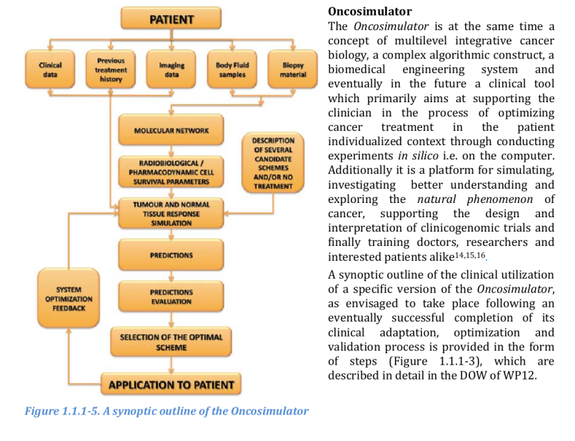
Example: p-medicine OncoSimulator

Slide 16
Deployment of OncoSimulator in the cloud
P-Medicine users
VPH-Share Computational Cloud Platform
Cloud
Facade
Atmosphere Management Service (AMS)
P-Medicine Portal
AIR registry
OncoSimulator Submission Form
Launch Atomic Services
OncoSimulator ASI
Visualization window
Cloud
HN
Cloud WN
OncoSimulator ASI
Mount LOBCDER and select results for storage in P-Medicine Data Cloud
VITRALL Visualization Service
Store output
P-Medicine Data Cloud
LOBCDER Storage Federation
Storage resources
Storage resources
Deployment of the OncoSimulator Tool on VPH-Share resources:
Uses a custom Atomic Service as the computational backend.
Features integration of data storage resources
OncoSimulator AS also registered in VPH-Share metadata store

Slide 17
Summary: key features of the cloud platform
Provides a layer of abstraction over cloud-based virtual machines, enabling the platform to automatically select the best hardware resources upon which to deploy application services
Automatic load balancing which enables applications to scale up (allocating more hardware resources)
Automated migration of virtual machine images (templates) across compute sites – e.g. redeployment of OpenStack applications in the Amazon EC2 public cloud
In-depth monitoring of individual applications and of the platform itself to enable performance optimizations

Slide 18
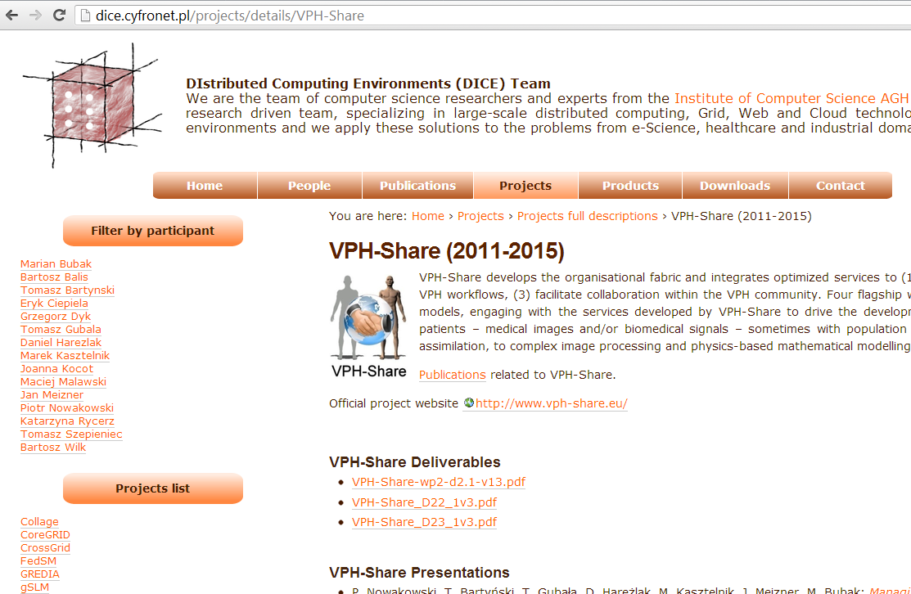
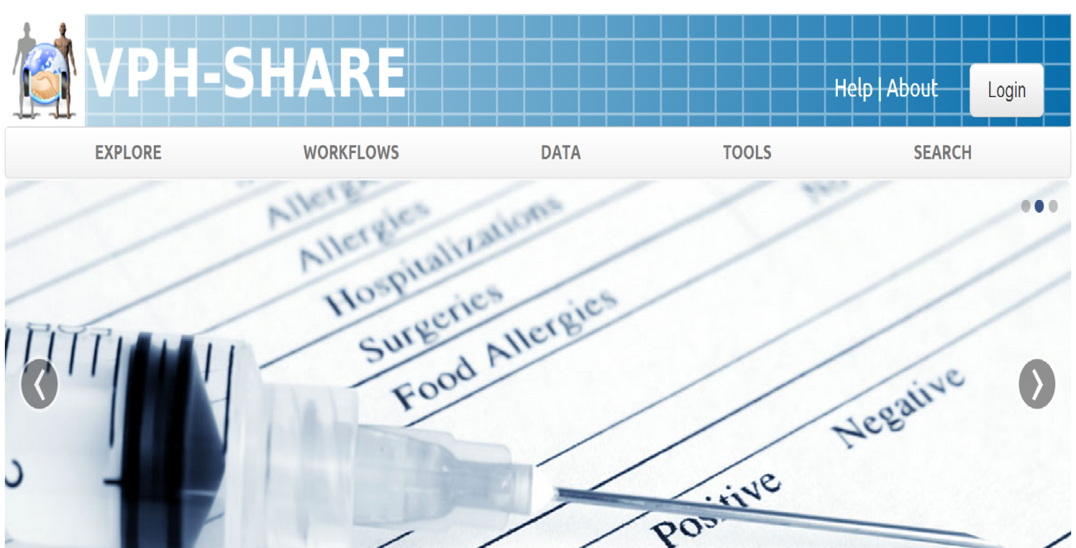
For more information…
dice.cyfronet.pl
documentation, publications, links to manuals, videos, etc.
www.vph-share.eu
Your one-stop entry to all VPH-Share functionality.
You can log in with your BioMedTown account (available to all members of the VPH NoE)

