Slide 1
Towards a framework for creation, deployment and reliable operation of distributed, time-critical applications
Marian Bubak and Marek Kasztelnik
bubak@agh.edu.pl, m.kasztelnik@cyfronet.pl
Department of Computer Science and Cyfronet
AGH University of Science and Technology Krakow, Poland
dice.cyfronet.pl

Slide 2
DICE team - http://dice.cyfronet.pl
Investigation of methods for building complex scientific collaborative applications
Elaboration of environments and tools for e-Science
Integration of large-scale distributed computing infrastructures
Knowledge-based approach to services, components, and their semantic composition
CrossGrid | 2002-2005 | Interactive compute- and data-intensive applications
K-Wf Grid | 2004-2007 | Knowledge-based composition of grid workflow applications
CoreGRID | 2004-2008 | Problem solving environments, programming models for grid applications
GREDIA | 2006-2009 | Grid platform for media and banking applications
ViroLab | 2006-2009 | Script based composition of applications, GridSpace virtual laboratory
PL-Grid; + | 2009-2015 | Advanced virtual laboratory, DataNet – metadata models
gSLM | 2009-2012 | Service level management for grid and clouds
UrbanFlood | 2009-2012 | Common Information Space for Early Warning Systems
MAPPER | 2010-2013 | Computational strategies, software and services for distributed multiscale simulations
VPH-Share | 2011-2015 | Federating cloud resources for VPH compute- and data intensive applications
Collage | 2011-? | Executable Papers; 1st award of Elsevier Competition at ICCS2011
ISMOP | 2013-2016 | Management of cloud resources, workflows, big data storage and access, analysis tools
PaaSage | 2013-2016 | Optimization of workflow applications on cloud resources

Slide 3

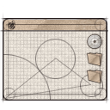


Functionality of cloud platform for VPH
Install any scientific
application in the cloud
Access available
applications and data
in a secure manner
End user
Developer
Application
Managed application
Cloud infrastructure
for e-science
Manage cloud
computing and storage
resources
Administrator
Install/configure each application service (which we call an Atomic Service) once – then use them multiple times in different workflows;
Direct access to raw virtual machines is provided for developers, with multitudes of operating systems to choose from (IaaS solution);
Install whatever you want (root access to Cloud Virtual Machines);
The cloud platform takes over management and instantiation of Atomic Services;
Many instances of Atomic Services can be spawned simultaneously;
Large-scale computations can be delegated from the PC to the cloud/HPC via a dedicated interface;
Smart deployment: computations can be executed close to data (or the other way round).

Slide 4
VPH-Share federated cloud

Slide 5
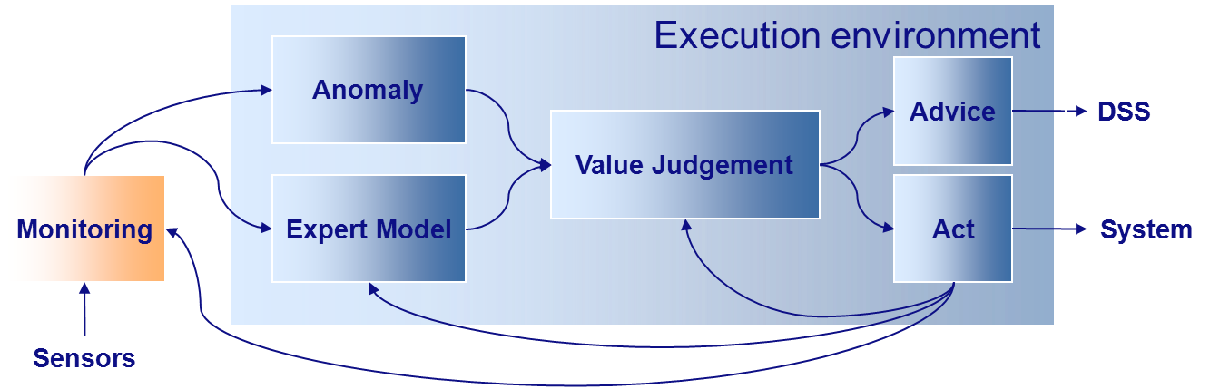
EWS and CIS framework
An Early Warning System (EWS) is any system which implements a four-step protocol
Monitoring
Analysis
Judgement
Advice / action
The Common Information Space (CIS) is a service-oriented software framework facilitating development, deployment and execution of distributed time-critical systems (Early Warning Systems) which rely on a series scientific computations

Slide 6
CIS for Flood Early Warning System
Monitoring: dikes are monitored in real time using wireless sensors
Analysis: data from the sensors is analyzed in order to detect anomalies or compute dike breach risk
Judgement: analysis results are assessed to decide whether an emergency situation has occurred
Action: if assessment indicates an emergency, the system either recommends or automatically takes actions

Slide 7
From Flood EWS to SimCity EWS (1/2)
Monitoring: dikes are monitored in real time using wireless sensors cars from taxi company are monitored using wireless/GSM sensors
Analysis: data from the sensors is analyzed in order to detect anomalies or compute dike breach risk to detect traffic jams
Judgement:results of analysis are assessed to decide whether an emergency situation has occurred, e.g. traffic jams
Action: if assessment indicates an emergency, the system either recommends or automatically takes actions, e.g. reconfigure traffic lights

Slide 8
From Flood EWS to SimCity EWS (2/2)
Monitoring: dikes are monitored in real time using wireless sensors twitter/facebook/… is monitored in real time
Analysis: data from the sensors is analyzed in order to detect anomalies or compute dike breach risk to discover information about drugs/danger activities
Judgement: results of analysis are assessed to decide whether an emergency situation has occurred, e.g. someone is selling drugs/preparing terrorist attack
Action: if assessment indicates an emergency, the system either recommends or automatically takes actions, e.g. sent information into police department

Slide 9
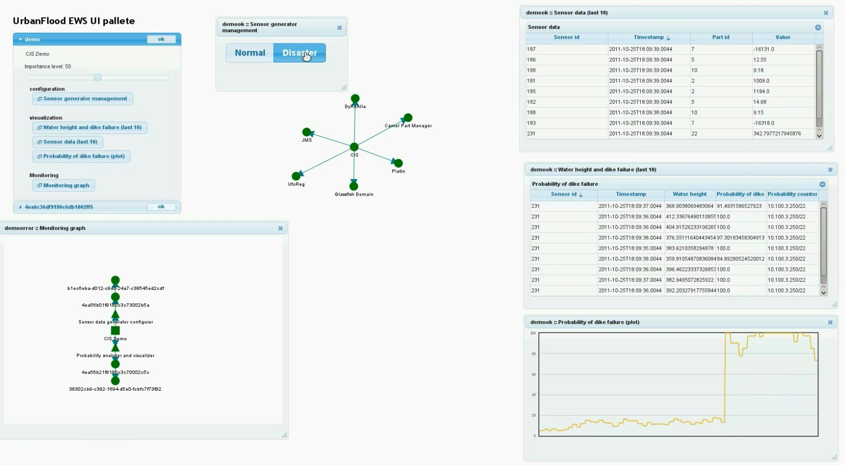
CIS for Flood EWS in Operation - Demo
EWS creation, execution, dedicated UIs, autoscalling, autohealing

Slide 10
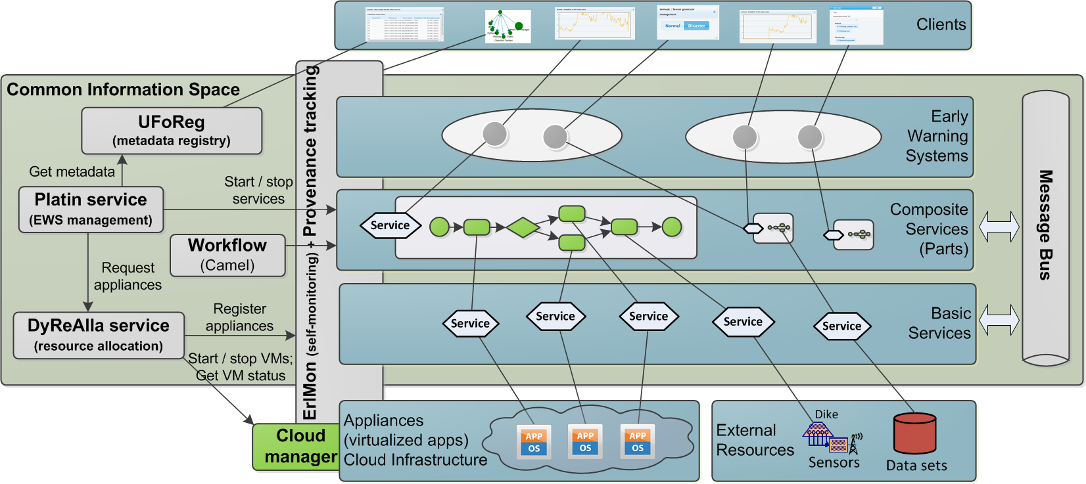
CIS usage in UrbanFlood EWS
Domain resources exposed as Basic Services
Data, sensors, apps wrapped as appliances and deployed onto clouds, …
Composite Services (Parts)
Building blocks for EWSs
Orchestrate domain resources towards complex application scenarios (e.g. area flood simulation)
Early Warning System
A number of Parts deployed, connected, and configured for a specific setting (e.g. a dike section)

Slide 11
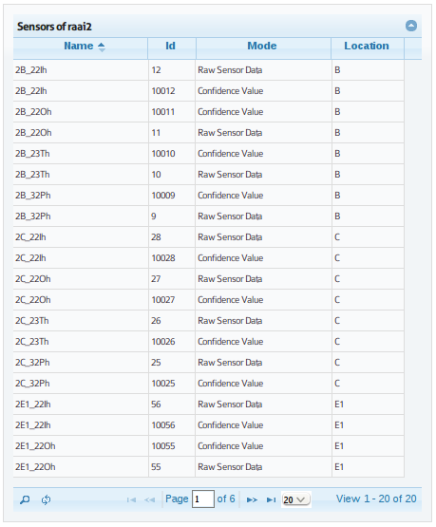
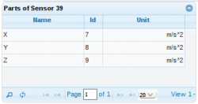
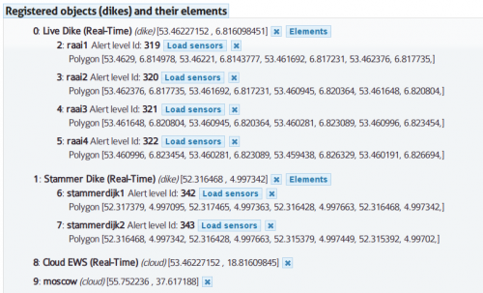
Sensor Data storage in UrbanFlood
Based on sint (Semantic integration tool) technology
MongoDB as a backend
Currently we are evaluating Hadoop like solutions

Slide 12
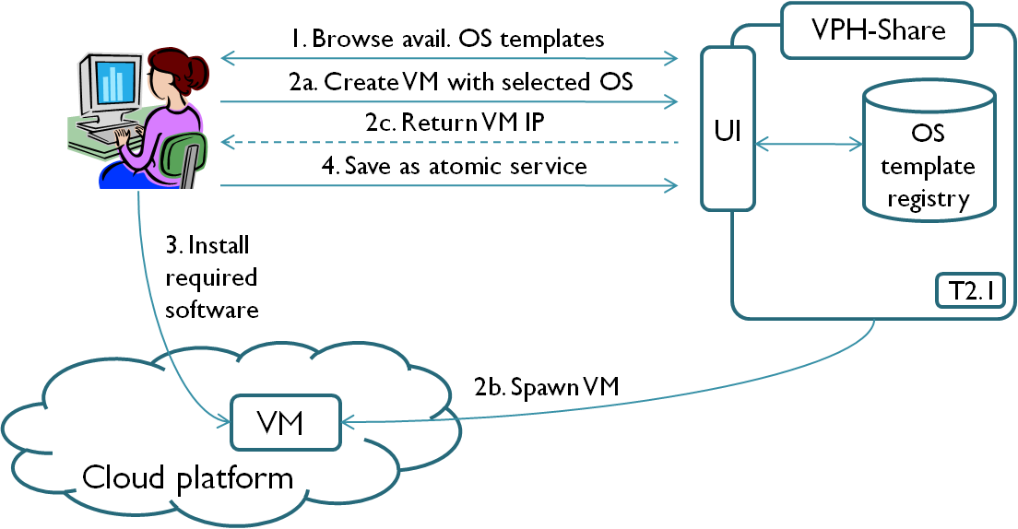
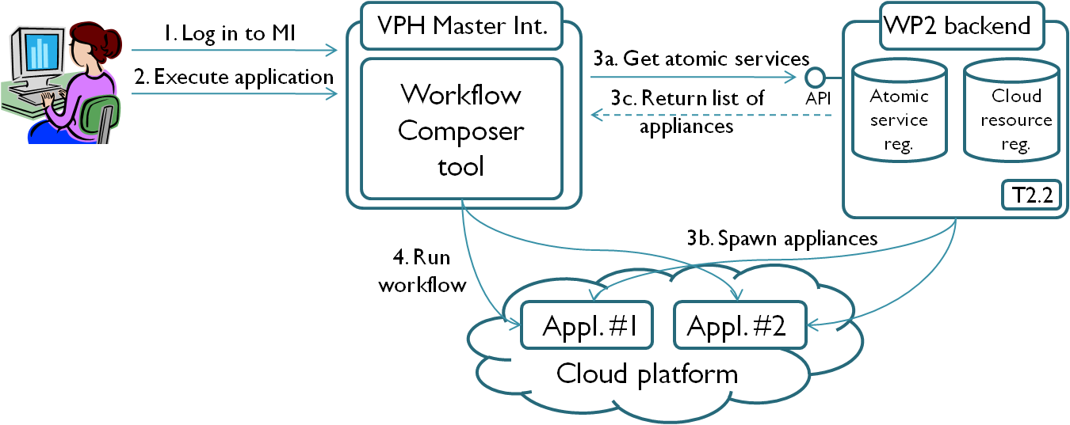
Cloud platform for VPH applications
Creation of a new
virtualized application
Deployment of a complex
application

Slide 13
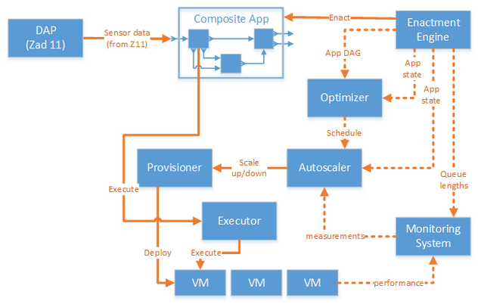
CIS concept in ISMOP (flood embankment)

Slide 14
Summary: possible application of presented concepts (and tools)
Creation of applications (VM instantiation, redirections, initial configurations, load balancing)
Orchestration of applications
Federation of cloud sites
Dynamic cloud resource allocation
Autoscaling
Autohealing
Billing

Slide 15
More information at
http://dice.cyfronet.pl/

Slide 16
Backup slides

Slide 17
Autoscaling (1)
VM
VM
HTTP traffic
Load balancer
Monitoring
VM
VM
Response time
Machine status, load
Start/stop/configure VM
CIS – autoscaling, autohealing

Slide 18
Autoscaling (2)
VM
VM
Messages
Queue
Monitoring
VM
VM
Queue lenght
Machine status, load
Start/stop/configure VM
CIS – autoscaling, autohealing

Slide 19
Autoscaling (3)
Storm
application
Bolt
Bolt
Bolt
Monitoring
Spout
Bolt
Spout
Machine status, load,
storm specific
monitoring data
Start/stop/configure VM
CIS – autoscaling, autohealing

Slide 20
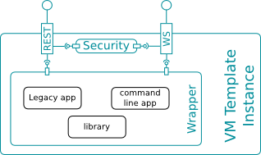
Basic service (generic architecture)

Slide 21
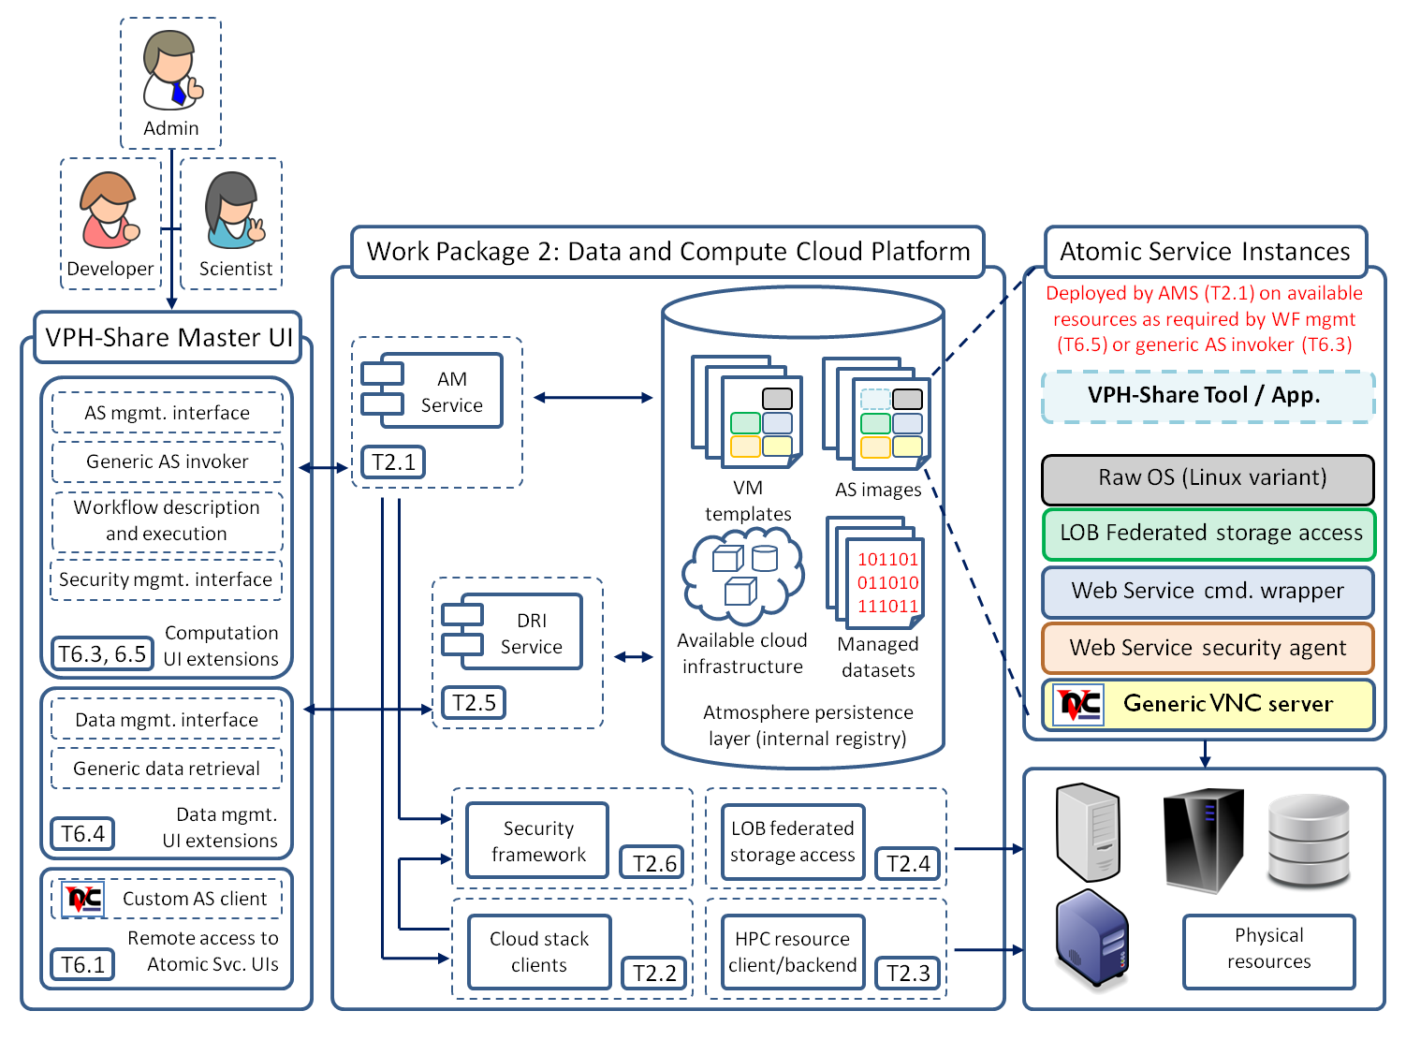
VPH-Share

Slide 22
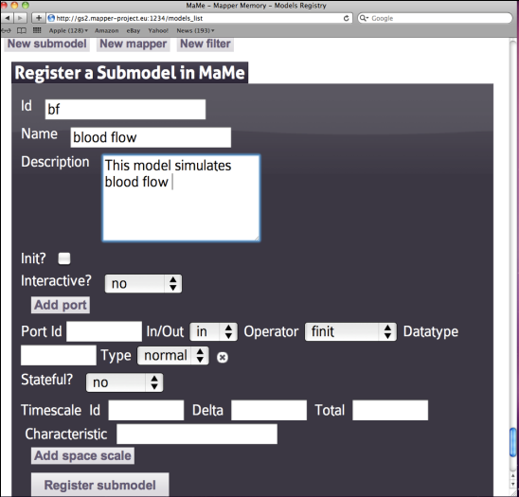
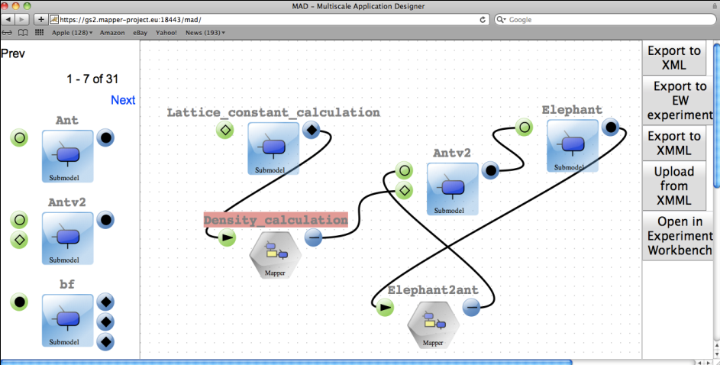
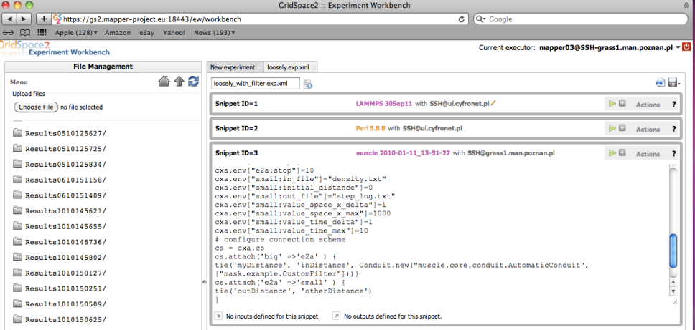
MAPPER
Registration of MML metadata: submodules and scales
Application composition:
from MML to executable experiment
Execution of experiment using interoperability layer
on e-infrastructure
Result and provenance
Management

Slide 23
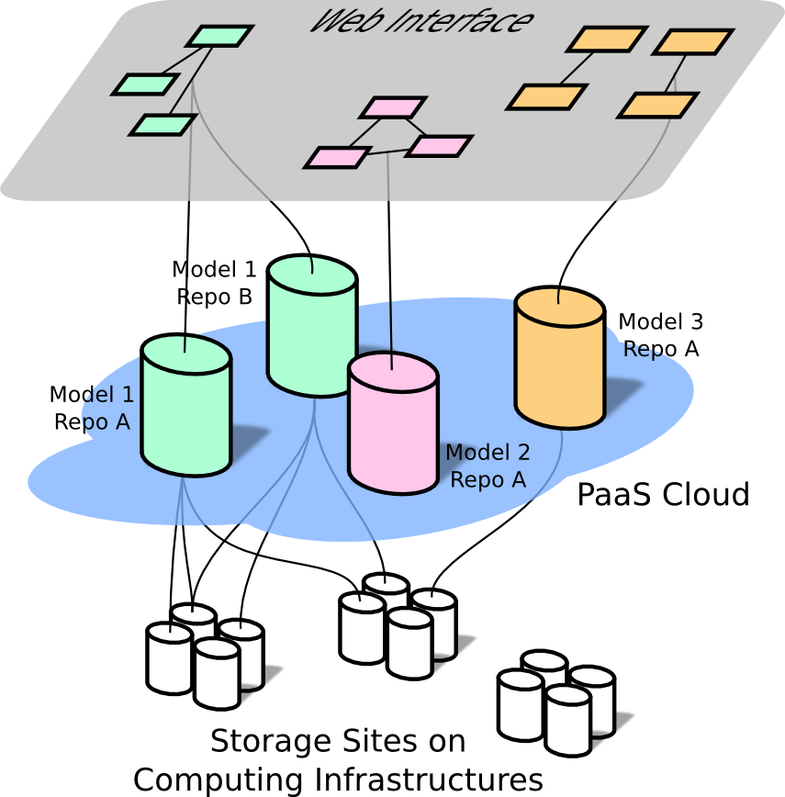
DataNet
Web Interface is used by users to create, extend and discover metadata models
Model repositories are deployed in the PaaS Cloud layer for scalable and reliable access from computing nodes through REST interfaces
Data items from Storage Sites are linked from the model repositories

Slide 24
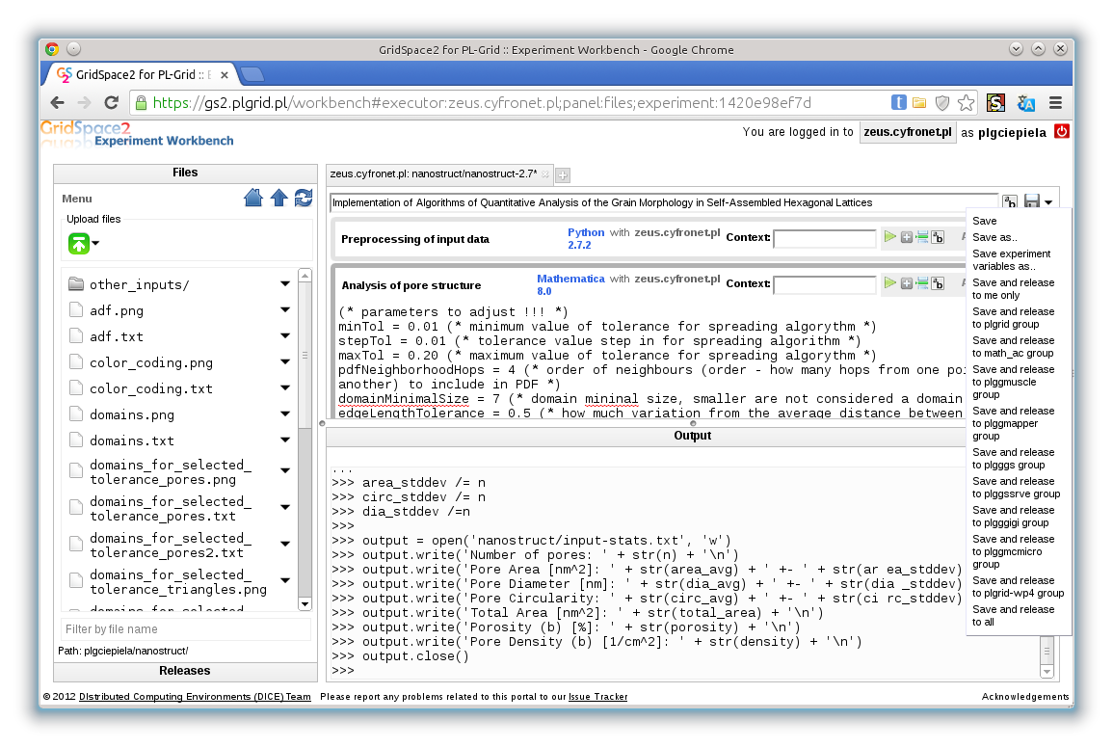
GridSpace

Slide 25
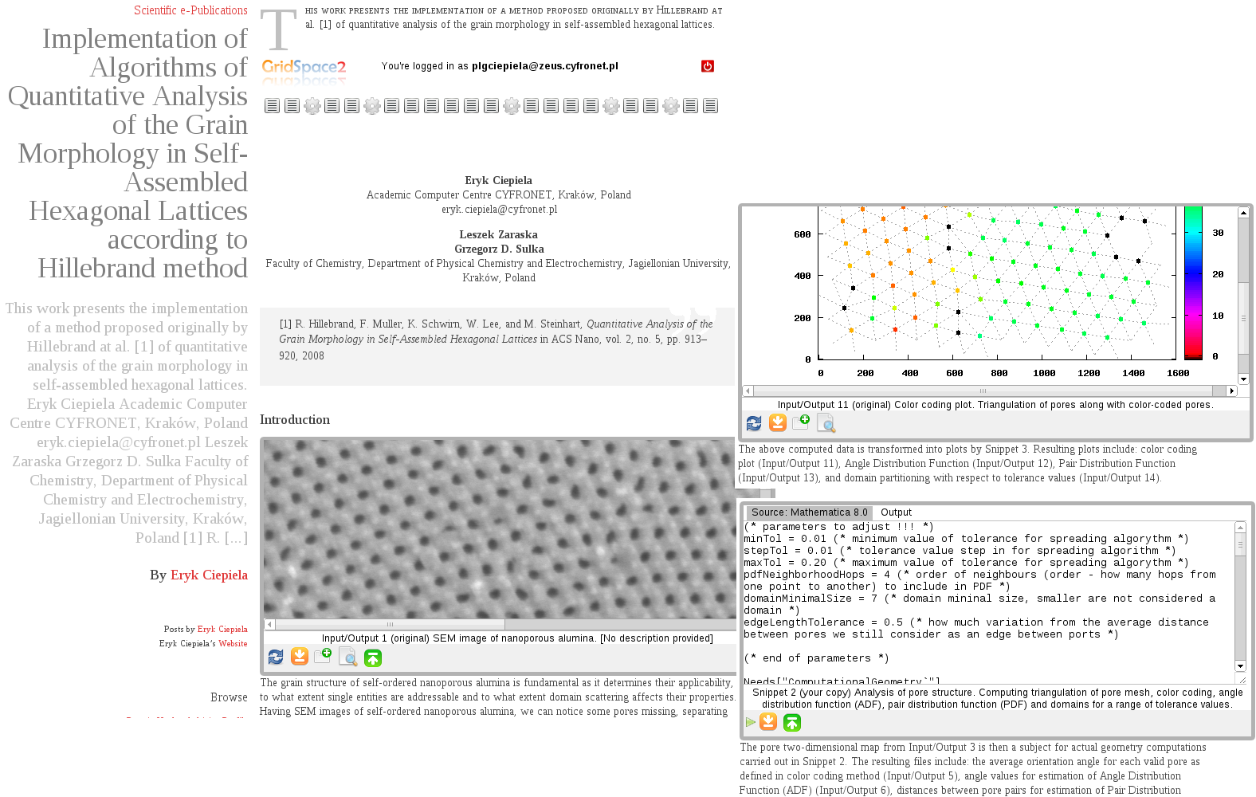
Collage

