Slide 1







Cloud Platform for VPH Applications
Marian Bubak
Department of Computer Science and Cyfronet, AGH Krakow, PL
Informatics Institute, University of Amsterdam, NL
and
WP2 Team of VPH-Share Project
dice.cyfronet.pl/projects/VPH-Share
www.vph-share.eu
VPH-Share (No 269978)

Slide 2
Coauthors
Piotr Nowakowski, Maciej Malawski, Marek Kasztelnik, Daniel Harezlak, Jan Meizner, Tomasz Bartynski, Tomasz Gubala, Bartosz Wilk, Wlodzimierz Funika
Spiros Koulouzis, Dmitry Vasunin, Reggie Cushing, Adam Belloum
Stefan Zasada
Dario Ruiz Lopez, Rodrigo Diaz Rodriguez

Slide 3
Outline
Motivation
Architecture
Overview of platform modules
Use cases
Current functionality
Scientific objectives
Technologies applied
Summary and further development

Slide 4
Cloud computing
What the Cloud computing is?
„Unlimited” access into computing power and data storage
Virtualization technology (enables to run many isolated operating systems on one physical machine)
Lifecycle management (deploy/start/stop/restart)
Scalability
Pay per use charging model
What the Cloud computing isn’t?
Magic platform to scale your application from your PC automaticaly
Secure place where sensitive data can be stored (that is why we need security and data anonimization…)

Slide 5



Motivation: 3 groups of users
The goal of of the platform is to manage cloud/HPC resources in support of VPH-Share applications by:
Providing a mechanism for application developers to install their applications/tools/services on the available resources
Providing a mechanism for end users (domain scientists) to execute workflows and/or standalone applications on the available resources with minimum fuss
Providing a mechanism for end users (domain scientists) to securely manage their binary data in a hybrid cloud environment
Providing administrative tools facilitating configuration and monitoring of the platform
End user support
Easy access to applications and binary data
Application
Generic service
Cloud Platform Interface
Manage hardware resources
Heuristically deploy services
Ensure access to applications
Keep track of binary data
Enforce common security
Developer support
Tools for deploying applications and registering datasets
Application
Application
Data
Data
Data
Admin support
Management of VPH-Share hardware resources
Hybrid cloud environment (public and private resources)

Slide 6
A very short glossary
Raw OS
!
Virtual Machine: A self-contained operating system image, registered in the Cloud framework and capable of being managed by VPH-Share mechanisms.
OS
!
Atomic service: A VPH-Share application (or a component thereof) installed on a Virtual Machine and registered with the cloud management tools for deployment.
VPH-Share app.
(or component)
External APIs
Cloud host
!
Atomic service instance: A running instance of an atomic service, hosted in the Cloud and capable of being directly interfaced, e.g. by the workflow management tools or VPH-Share GUIs.
OS
VPH-Share app.
(or component)
External APIs

Slide 7
Cloud platform offer
Scale your applications in the Cloud („unlimited” computer power/reliable storage)
Use resources in the cost-effective way
Install/configure (Atomic Service) once use multiple times in different workflows
Many instances of Atomic Services can be instantiated automatically
Heavy computation can be delegated from the PC into the cloud/HPC
Smart deployment: computation will be executed close to the data or the other way round
Multitudes of operating systems to choose from
Install whatever you want (root access to the machine)

Slide 8






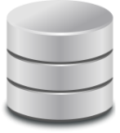


Architecture of cloud platform
Admin
Modules available in advanced prototype
Developer
Scientist
Work Package 2: Data and Compute Cloud Platform
Atomic Service Instances
Deployed by AMS (T2.1) on available resources as required by WF mgmt (T6.5) or generic AS invoker (T6.3)
VPH-Share Master UI
AM
Service
VPH-Share Tool / App.
AS mgmt. interface
Generic AS invoker
T2.1
Raw OS (Linux variant)
Workflow description and execution
VM templates
AS images
101101
011010
111011
LOB Federated storage access
101101
011010
111011
Security mgmt. interface
101101
011010
111011
Web Service cmd. wrapper
Computation
UI extensions
DRI
Service
Available cloud
infrastructure
T6.3, 6.5
Managed
datasets
Web Service security agent
Data mgmt. interface
T2.5
Atmosphere persistence layer (internal registry)
Generic VNC server
Generic data retrieval
Data mgmt.
UI extensions
Security
framework
LOB federated
storage access
T6.4
T2.6
T2.4
Custom AS client
Remote access to
Atomic Svc. UIs
Cloud stack
clients
HPC resource
client/backend
Physical
resources
T6.1
T2.2
T2.3

Slide 9


Resource allocation management
Management of the VPH-Share cloud features is done via the Cloud Facade which provides a set of APIs for the Master Interface and any external application with the proper security credentials.
Developer
Admin
Scientist
VPH-Share Core Services Host
VPH-Share Master Int.
Cloud Facade
(secure RESTful API )
Atmosphere Management Service (AMS)
Cloud Manager
Cloud stack plugins (JClouds)
Atmosphere Internal Registry (AIR)
Development Mode
Generic Invoker
Workflow management
OpenStack/Nova Computational Cloud Site
Other CS
External application
Head Node
Worker Node
Worker Node
Worker Node
Worker Node
Cloud Facade client
Amazon EC2
Customized applications may directly interface the Cloud Facade via its RESTful APIs
Worker Node
Worker Node
Worker Node
Worker Node
Image store (Glance)

Slide 10
Cloud execution environment
Private cloud sites deployed at CYFRONET, USFD and UNIVIE
A survey of public IaaS cloud providers has been performed
Performance and cost evaluation of EC2, RackSpace and SoftLayer
A grant from Amazon has been obtained and @neuFuse services are deployed on Amazon resources

Slide 11
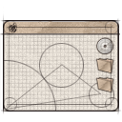


HPC execution environment
Provides virtualized access to high performance execution environments
Seamlessly provides access to high performance computing to workflows that require more computational power than clouds can provide
Deploys and extends the Application Hosting Environment – provides a set of web services to start and control applications on HPC resources
Invoke the Web Service API of AHE to delegate computation to the grid
Application Hosting Environment
Auxiliary component of the cloud platform, responsible for managing access to traditional (grid-based) high performance computing environments. Provides a Web Service interface for clients.
Application
Present security token (obtained from authentication service)
-- or --
AHE Web Services
(RESTlets)
User access
layer
GridFTP
WebDAV
Tomcat container
Workflow environment
Job Submission Service (OGSA BES / Globus GRAM)
Resource client
layer
QCG Computing
RealityGrid SWS
-- or --
Delegate credentials, instantiate computing tasks, poll for execution status and retrieve results on behalf of the client
End user
Grid resources running Local Resource Manager
(PBS, SGE, Loadleveler etc.)

Slide 12

Data access for large binary objects
Ticket validation service
Master Interface component
LOBCDER host
(149.156.10.143)
Auth
service
WebDAV servlet
Core component host
(vph.cyfronet.pl)
Data Manager
Portlet
(VPH-Share
Master Interface component)
REST-interface
LOBCDER service backend
GUI-based access
Resource factory
Storage
driver
Storage
driver
(SWIFT)
Atomic Service Instance
(10.100.x.x)
Service payload (VPH-Share application component)
Encryption keys
Resource catalogue
Mounted on local FS
(e.g. via davfs2)
SWIFT
storage
backend
Generic WebDAV client
External host
VPH-Share federated data storage module (LOBCDER) enables data sharing in the context of VPH-Share applications
The module is capable of interfacing various types of storage resources and supports SWIFT cloud storage (support for Amazon S3 is under development)
LOBCDER exposes a WebDAV interface and can be accessed by any DAV-compliant client. It can also be mounted as a component of the local client filesystem using any DAV-to-FS driver (such as davfs2).

Slide 13
Approach to data federation
Need for loosely-coupled flexible distributed easy to use architecture
Build on top of existing solutions
To aggregate a pool of resources in a client-centric
A standardized protocol that can be also mounted
Provide a file system abstraction
A common management layer that loosely couples independent storage resources
As a result, distributed applications have a global shared view of the whole available storage space
Applications can be developed locally and deployed on the cloud platform without changing the data access parameters
Use storage space efficiently with the copy-on-write strategy
Replication of data can be based on efficiency cost measures
Reduce the risk of vendor lock-in in clouds since no large amount of data are on a single provider

Slide 14
LOBCDER transparency
LOBCDER locates files and transport data providing:
Access transparency: clients are unaware that files are distributed and may access them in the same way as local files are accessed
Location transparency: a consistent namespace encompasses remote files The name of a file does not give its location
Concurrency transparency: all clients have the same view of the state of the file system
Heterogeneity: provided across different hardware operating system platforms
Replication transparency: replicate files across multiple servers and clients are unaware of it
Migration transparency: files are move around without the client's knowledge
LOBCDER loosely couples a variety of storage technologies such as Openstack-Swift , iRODS , GridFTP

Slide 15
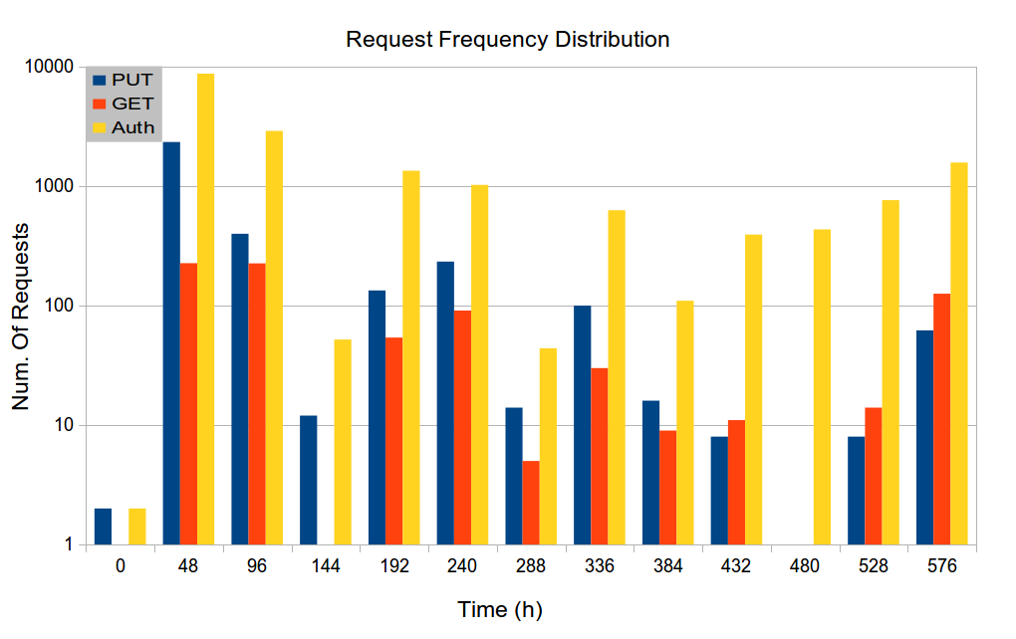
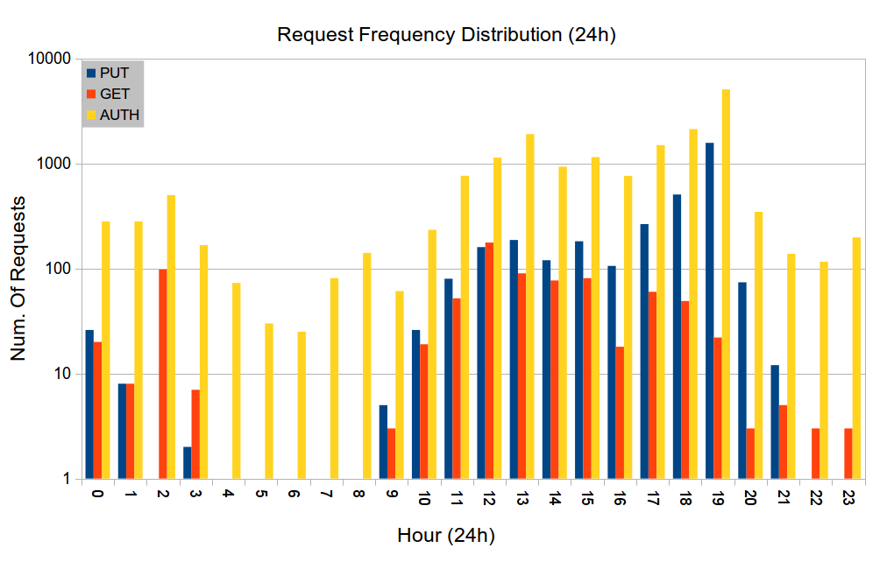
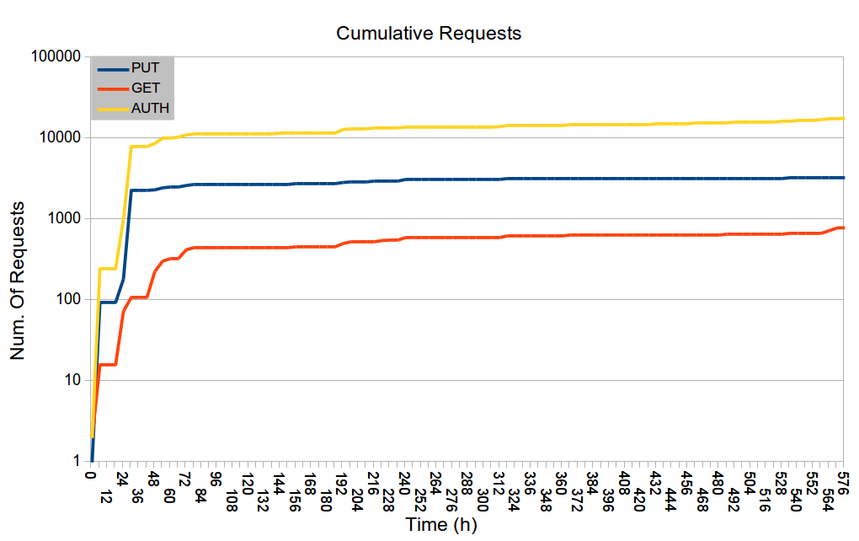
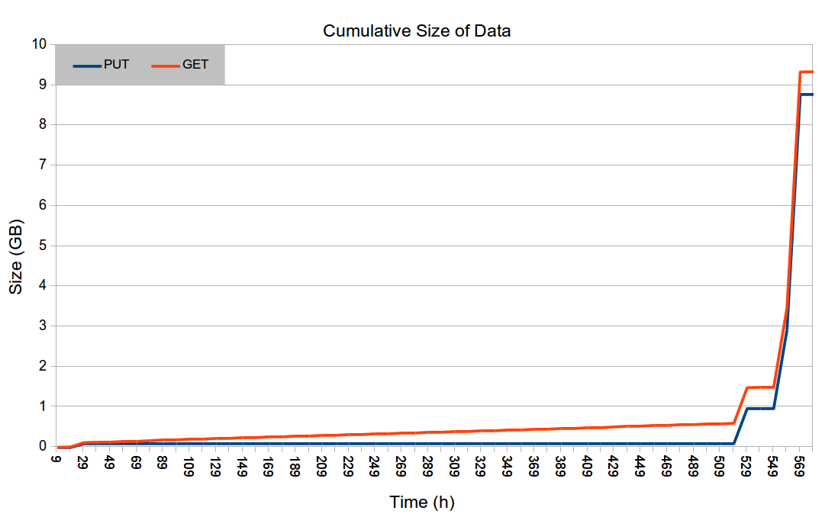
Usage statistics for LOBCDER

Slide 16
Data storage security
Problem:
How to ensure secure storage of confidential data in public clouds where it could be efficiently processed by application services and controlled by administrators (including guaranteed erasure on demand)?
Current status:
The SWIFT data storage resources on which LOBCDER is based are managed internally by Consortium members and belong to their private cloud infrastructures. Under these conditions access to sensitive data is tightly controlled and security risks remain minimal.
A thorough analysis of data instancing on cloud resources and possibilities for malicious access and clean-up processes after instance closing has been conducted.
Proposed solutions (detailed in State of the Art document published by CYF in April 2013):
Data sharding: procurement of multiple storage resources and ensuring that each resource only receives a nonrepresentative subset of each dataset
On-the-fly encryption, either built into the platform or enforced on the application/AS level
Volatile-memory storage infrastructure (i.e. storage of confidential data in service RAM only, with sufficient replication to guard against potential failures)

Slide 17
Data reliability and integrity
Provides a mechanism which keeps track of binary data stored in cloud infrastructure
Monitors data availability
Advises the cloud platform when instantiating atomic services
LOBCDER
DRI Service
Metadata extensions for DRI
A standalone application service, capable of autonomous operation. It periodically verifies access to any datasets submitted for validation and is capable of issuing alerts to dataset owners and system administrators in case of irregularities.
Binary
data
registry
Validation policy
Register files
Get metadata
Migrate LOBs
Get usage stats
(etc.)
Configurable validation runtime
(registry-driven)
Runtime layer
End-user features
(browsing, querying,
direct access to data,
checksumming)
Extensible
resource
client layer
Amazon S3
OpenStack Swift
Cumulus
VPH Master Int.
Store and marshal data
Data management portlet (with DRI management extensions)
Distributed Cloud storage

Slide 18
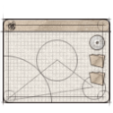



Security framework
Provides a policy-driven access system for the security framework.
Provides a solution for an open-source based access control system based on fine-grained authorization policies.
Implements Policy Enforcement, Policy Decision and Policy Management
Ensures privacy and confidentiality of eHealthcare data
Capable of expressing eHealth requirements and constraints in security policies (compliance)
Tailored to the requirements of public clouds
VPH clients
(or any authorized user capable of presenting a valid security token)
Application
Workflow management service
Developer
End user
Administrator
VPH Security Framework
Public internet
VPH Security Framework
VPH Atomic Service Instances

Slide 19
Security and atomic services
The application API is only exposed to localhost clients
Calls to Atomic Services are intercepted by the Security Proxy
Each call carries a user token (passed in the request header)
The user token is digitally signed to prevent forgery. This signature is validated by the Security Proxy
The Security Proxy decides whether to allow or disallow the request on the basis of its internal security policy
Cleared requests are forwarded to the local service instance
VPH-Share Atomic Service Instance
Actual application API (localhost access only)
2. Intercept
request
Security
Proxy
Service payload
(VPH-Share
application component)
1. Incoming
request
Public AS API
(SOAP/REST)
5. Relay original request (if cleared)
3’, 4’ Report error
Security
Policy
Exposed externally by
local web server
(apache2/tomcat)
6. Intercept service response
7. Relay
response
User token
3. Decrypt and validate the digital signature with the VPH-Share public key.
5. Otherwise, relay the original request to the service payload. Include the user token for potential use by the service itself.
a6b72bfb5f2466512ab2700cd27ed5f84f991422rdiaz!developer!rdiaz,Rodrigo Diaz,rodrigo.diaz@atosresearch.eu,,SPAIN,08018
4. If the digital signature checks out, consult the security policy to determine whether the user should be granted access on the basis of his/her assigned roles.
6-7. The service response is relayed to the original client. This mechanism is entirely transparent from the point of view of the person/application invoking the Atomic Service.
3’, 4’. If the digital signature is invalid or if the security policy prevents access given the user’s existing roles, the Security Proxy throws a HTTP/401 (Unauthorized) exception to the client.
digital signature
unique username
assigned role(s)
additional info

Slide 20

Sensitivity analysis application
Problem: Cardiovascular sensitivity study: 164 input parameters (e.g. vessel diameter and length)
First analysis: 1,494,000 Monte Carlo runs (expected execution time on a PC: 14,525 hours)
Second Analysis: 5,000 runs per model parameter for each patient dataset; requires another 830,000 Monte Carlo runs per patient dataset for a total of four additional patient datasets – this results in 32,280 hours of calculation time on one personal computer.
Total: 50,000 hours of calculation time on a single PC.
Solution: Scale the application with cloud resources.
Scientist
Launcher script
VPH-Share implementation:
Scalable workflow deployed entirely using VPH-Share tools and services.
Consists of a RabbitMQ server and a number of clients processing computational tasks in parallel, each registered as an Atomic Service.
The server and client Atomic Services are launched by a script which communicates directly withe the Cloud Facade API.
Small-scale runs successfully competed, large-scale run in progress.
Secure API
Server AS
Atmosphere
RabbitMQ
Cloud Facade
DataFluo
Atmosphere Management
Service
(Launches server and automatically scales workers)
DataFluo Listener
Worker AS
Worker AS
RabbitMQ
RabbitMQ

Slide 21
p-medicine OncoSimulator
P-Medicine users
VPH-Share Computational Cloud Platform
Cloud
Facade
Atmosphere Management Service (AMS)
P-Medicine Portal
AIR registry
OncoSimulator Submission Form
Launch Atomic Services
OncoSimulator ASI
Visualization window
Cloud
HN
Cloud WN
OncoSimulator ASI
Mount LOBCDER and select results for storage in P-Medicine Data Cloud
VITRALL Visualization Service
Store output
P-Medicine Data Cloud
LOBCDER Storage Federation
Storage resources
Storage resources
Deployment of the OncoSimulator Tool on VPH-Share resources:
Uses a custom Atomic Service as the computational backend.
Features integration of data storage resources
OncoSimulator AS also registered in VPH-Share metadata store

Slide 22
Collaboration with p-medicine
Application deployment
The P-Medicine OncoSimulator application has been deployed as a VPH-Share Atomic Service and can be instantiated on our existing cloud resources.
OncoSimulator applications have been integrated with the VPH-Share semantic registry and can be searched for using this registry.
Security and sensitive data
First approach to a gateway service for translating requests from one service to another: security token translation service to enable Share - P-Medicine interoperability.
BioMedTown accounts provided for p-medicine users to allow them to access shared services (as sharing data in the p-medicine data warehouse requires signing and adhering to contracts governing data protection and data security).
File storage
A LOBCDER extension for the p-medicine data storage infrastructure is in the planning phase
Due to the fact that authentication in VPH-Share is based on the security token and there are no such tokens in use within p-medicine we have extended the LOBCDER authentication model to validate user credentials not only at a remote site, but also against a local credentials DB. This allows non-VPH users to obtain authorized access to the data stored in LOBCDER.

Slide 23
Scientific objectives (1/2)
Investigating the applicability of cloud computing model for complex scientific applications
Optimization of resource allocation for scientific applications on hybrid cloud platforms
Resource management for services on a heterogeneous hybrid cloud platform to meet demands of scientific applications
Performance evaluation of hybrid cloud solutions for VPH applications
Researching means of supporting urgent computing scenarios in cloud platforms, where users need to be able to access certain services immediately upon request
Creating a billing and accounting model for hybrid cloud services by merging the requirements of public and private clouds
Research into the use of evolutionary algorithms for automatic discovery of patterns in cloud resources provisioning
Investigation of behavior-inspired optimization methods for data storage services
Research in domain of operational standards towards provisioning of highly sustainable federated hybrid cloud e-Infrastructures for support of various scientific communities

Slide 24
Scientific objectives (2/2)
Research on procedural and technical aspects of ensuring efficient yet secure data storage, transfer and processing featuring use of private and public storage cloud environments, taking into account full lifecycle from data generation to permanent data removal
Research on Software Product Lines and Feature Modeling principles in application to Atomic Service component dependency management, composition and deployment
Research on tools for Atomic Services provisioning in cloud infrastructure
Design of domain-specific, consistent information representation model for VPHShare platform, its components and its operating procedures
Design and development of a persistence solution to keep vital information safe and efficiently delivered to various elements of VPHShare platform
Design and implementation of entity identification and naming scheme to serve as common platform of understanding between various, heterogeneous elements of VPHShare platform
Defining and delivering unified API for managing scientific applications using virtual machines deployed into heterogeneous cloud
Hiding cloud complexity from the user through simplified API

Slide 25
Selected publications
P. Nowakowski, T. Bartynski, T. Gubala, D. Harezlak, M. Kasztelnik, M. Malawski, J. Meizner, M. Bubak: Cloud Platform for Medical Applications, eScience 2012
S. Koulouzis, R. Cushing, A. Belloum and M. Bubak: Cloud Federation for Sharing Scientific Data, eScience 2012
P. Nowakowski, T. Bartyński, T. Gubała, D. Harężlak, M. Kasztelnik, J. Meizner, M. Bubak: Managing Cloud Resources for Medical Applications, Cracow Grid Workshop 2012, Kraków, Poland, 22 October 2012
M. Bubak, M. Kasztelnik, M. Malawski, J. Meizner, P. Nowakowski, and S. Varma: Evaluation of Cloud Providers for VPH Applications, CCGrid 2013 (2013)
M. Malawski, K. Figiela, J. Nabrzyski: Cost Minimization for Computational Applications on Hybrid Cloud Infrastructures, FGCS 2013
D. Chang, S. Zasada, A. Haidar, P. Coveney: AHE and ACD: A Gateway into the Grid Infrastructure for VPH-Share, VPH 2012 Conference, London
S. Zasada, D. Chang, A. Haidar, P. Coveney: Flexible Composition and Execution of Large Scale Applications on Distributed e-Infrastructures, Journal of Computational Science (in print).
M.Sc. Thesis:
Bartosz Wilk: Installation of Complex e-Science Applications on Heterogeneous Cloud Infrastructures, AGH University of Science and Technology, Kraków, Poland (August 2012), PTI award

Slide 26
Software engineering methods
Scrum methodology used to organize team work
Redmine (http://www.redmine.org ) as flexible project management
Redmine backlog (http://www.redminebacklogs.net ) - redmine plugin for agile teams
Continous delivery based on Jenkins (http://jenkins-ci.org )
Code stored in private GitLab (http://gitlab.org ) repository
Short release period time:
Fixed 1 month period for delivering new feature rich Atmosphere version
Bug fix version released as fast as possible
Versioning based on semantic versioning (http://semver.org )
Tests, tests, test…
TestNG
Junit

Slide 27
Technologies in platform modules
Component/Module | Technologies used
Cloud Resource Allocation Management | Java application with Web Service (REST) interfaces, OSGi bundle hosted in a Karaf container, Camel integration framework
Cloud Execution Environment | Java application with Web Service (REST) interfaces, OSGi bundle hosted in a Karaf container, Nagios monitoring framework, OpenStack and Amazon EC2 cloud platforms
High Performance Execution Environment | Application Hosting Environment with Web Service (REST/SOAP) interfaces
Data Access for Large Binary Objects | Standalone application preinstalled on VPH-Share Virtual Machines; connectors for OpenStack ObjectStore and Amazon S3; GridFTP for file transfer
Data Reliability and Integrity | Standalone application wrapped as a VPH-Share Atomic Service, with Web Service (REST) interfaces; uses T2.4 tools for access to binary data and metadata storage
Security Framework | Uniform security mechanism for SOAP/REST services; Master Interface SSO enabling shell access to virtual machines,

Slide 28
Schedule of platform development
Y0.5
Y1
Y1.5
Y2
Y2.5
Y3
Y3.5
Y4
Design phase
First impl.
phase
Second implementation
phase
Third implementation
phase
Integration/deployment
of app workflows
D2.1/2.2
SOTA + Design
D2.3
First prototype
D2.4/2.5
Adv. prototype
+ resource spec.
D2.6
First deployment
+ service bundle
candidate release
D2.7
Final evaluation
and release
Further iterative improvements of platform functionality
detailed plan for each module
based on emerging users' requirements
focusing on robustness and optimization of existing components (service instantiation and storage, I/O, smarter deployment policies, multi-site operation, integration of additional cloud resources and stacks)
support for application development and performance testing
ongoing integration with VPH-Share components; Cloud Platform API extensions enabling development of advanced external clients
further collaboration with p-medicine

Slide 29
Summary: basic features of platform
Install any scientific
application in the cloud
Access available
applications and data
in a secure manner
End user
Developer
Application
Managed application
Cloud infrastructure
for e-science
Manage cloud
computing and storage
resources
Administrator
Install/configure each application service (which we call an Atomic Service) once – then use them multiple times in different workflows;
Direct access to raw virtual machines is provided for developers, with multitudes of operating systems to choose from (IaaS solution);
Install whatever you want (root access to Cloud Virtual Machines);
The cloud platform takes over management and instantiation of Atomic Services;
Many instances of Atomic Services can be spawned simultaneously;
Large-scale computations can be delegated from the PC to the cloud/HPC via a dedicated interface;
Smart deployment: computations can be executed close to data (or the other way round).

Slide 30
More information at
dice.cyfronet.pl/projects/VPH-Share
www.vph-share.eu
jump.vph-share.eu

