Slide 1
Development, Execution and Sharing of VPH Applications in the Cloud with the Atmosphere Platform
Piotr Nowakowski, Tomasz Bartyński, Marian Bubak, Tomasz Gubała, Daniel Harężlak, Marek Kasztelnik, Maciej Malawski
ACC CYFRONET AGH
Virtual Physiological Human Conference 2014
Trondheim, 9-12 September 2014

Slide 2
Scientific objectives
Investigating the applicability of cloud computing model for complex scientific applications
Optimization of resource allocation for scientific applications on clouds
Resource management for services on heterogeneous resources
Researching means of supporting urgent computing scenarios on distributed infrastructures
Elaborating billing and accounting models for cloud computing
Research into the procedural and technical aspects of efficient yet secure data storage, transfer and processing
Research into component dependency management, composition and deployment

Slide 3




A (very) brief introduction
The challenge
Where we are
There’s a better way!
I need to compute
something.
Office PC
Computational cloud
Scientist
Scientist
MySpine (cloud service)
Requires: MS Windows
Scientist
MySpine (client application)
Requires: MS Windows
Developer
Developer
Computations are an inherent part of modern e-science, particularly within the life sciences domain. As the available IT tools grow ever more sophisticated, domain scientists require help from scientific programmers and other IT specialists to be able to perform their research.
When faced with a computational task, the first reaction is to either install the necessary software by oneself or call in help from the IT department. Either way, such traditional setups carry serious drawbacks:
Computational clouds enable us to avoid these problems entirely. A cloud-based service can perform all the functions of a locally running application, with the following benefits:
The hardware is provided by the cloud operator (and can be vastly more powerful than any local resources you have access to!)
A cloud application is available from anywhere
Once deployed, the application can be accessed by many users at the click of a button
You need to provision your own hardware (typically an office PC)
A locally running application is only accessible from one place (typically your office)
Applications and data cannot be easily transferred to other computers

Slide 4

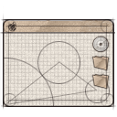


Basic functionality of the cloud platform
Install any scientific
application in the cloud
Access available
applications and data
in a secure manner
End user
Developer
Application
Managed application
Cloud infrastructure
for e-science
Manage cloud
computing and storage
resources
Administrator
Install/configure each application service (which we call an Atomic Service) once – then use them multiple times in different workflows;
Direct access to raw virtual machines is provided for developers, with multitudes of operating systems to choose from (IaaS solution);
Install whatever you want (root access to cloud Virtual Machines);
The cloud platform takes over management and instantiation of Atomic Services;
Many instances of Atomic Services can be spawned simultaneously;
Large-scale computations can be delegated from the PC to the cloud/HPC via a dedicated interface.

Slide 5


VPH-Share Computational Cloud: developers’ view
4. The new service is automatically registered in VPH-Share and can be shared with platform users (including other developers, who may wish to continue development work on the application).
VPH-Share Computational Cloud
MySpine v22 (cloud service)
GIMIAS (cloud service)
OpenLab v1 (cloud service)
OpenLab v1 (cloud service)
ViroLab DRS (cloud service)
MS Windows (OS template)
3. Once the developer is satisfied with the application, he/she may instruct the VPH-Share cloud platform to package and upload it as a new service to the cloud.
Developer
Ubuntu Linux (OS template)
The developer, selects and instantiates a service. This can be an existing application (e.g. MySpine) or a „raw” OS image (e.g. MS Windows Server)
Service instance
2. The VPH-Share cloud platform creates a virtual machine which hosts an instance of the selected template and provides the required quantity of hardware resources.
Service instance
2’. The developer may securely log into the machine and install any software of his/her choosing – in this case, we’re installing the OpenLabyrinth virtual patient management application.
Ubuntu Linux (OS template)
Hardware: 4 cores, 8 GB RAM, 30 GB HDD
OpenLab v1 (development)
Hardware: 4 cores, 8 GB RAM, 30 GB HDD
Notes:
Slide Objectives:
Speaking Points:

Slide 6
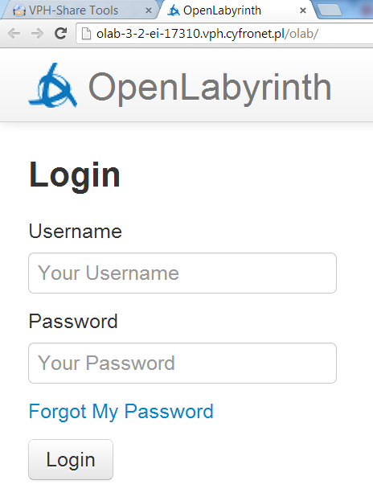


VPH-Share Computational Cloud: end users’ view
VPH-Share Computational Cloud
MySpine v22 (cloud service)
GIMIAS (cloud service)
ViroLab DRS (cloud service)
OpenLab v1 (cloud service)
Scientist
3. The user is free to interact with the service. Once the instance is no longer needed, it can be shut down in order to conserve computational resources.
The scientist browses the available services and requests access to a given service. Only published services (not OS templates) are visible to non-developers.
2. The service’s owner (typically its developer) approves the sharing request, following which the scientist may spawn instances of the service in the cloud infrastructure
Service instance
OpenLab v1 (cloud service)
Authorized users:
Developer
2’. The cloud platform creates an instance of the service with the appropriate hardware allocation (as set by the developer) and provides the user with access information.
OpenLab v1 (cloud service)
Hardware: as required by the application
Notes:
Slide Objectives:
Speaking Points:

Slide 7








Hybrid cloud environment
VPH-Share Master Interface host
portal.vph-share.eu
96 CPU cores
Head Node
Worker Node
Worker Node
Worker Node
Worker Node
184 GB
RAM
Cloud Management Portlets
Provide GUI elements which enable service developers and end users to interact with the Atmosphere platform and create/deploy services on the available cloud resources
4 TB
storage
Image store
Worker Node
Worker Node
Worker Node
Worker Node
private IP space
VPH-Share cloud site at ACC CYFRONET AGH
Secure RESTful API
(Cloud Facade)
WP2 Core Services Host
vph.cyfronet.pl
128 CPU cores
Atmosphere Core
Head Node
Worker node w/large resource pool
(„fat node”)
256 GB
RAM
Authentication and authorization logic
Communication with underlying computational clouds
Launching and monitoring service instances
Creating new service templates
Billing and accounting
Logging and administrative services
4 TB
storage
Image store
Worker node w/large resource pool
(„fat node”)
private IP space
VPH-Share cloud site at UNIVIE
Atmosphere Registry (AIR)
Massive (functionally limitless) hardware resource pool
API
host
Worker Node
user accounts
Image store
Worker Node
public IP space
available cloud sites
services and templates
Amazon Elastic Compute Cloud (EC2) – European availability zone

Slide 8
Service propagation in a hybrid cloud environment
VPH-Share cloud site at ACC CYFRONET AGH
Template repository (GLANCE)
1. Developer creates a new service
on one of the available cloud sites
Service templates (qcow2 format)
OpenLab v1 (cloud service)
Developer
2. Upon request, the service template may be automatically propagated to other federated sites so that it can be instantiated and accessed there
Atmosphere
Template
converter
The Atmosphere platform handles propagation and registration of templates in an automatic fashion.
3. The template image can be directly copied to OpenStack sites which use the qcow2 image format
4. In order to deploy the template in a public cloud, the template must first undergo (automated) conversion
VPH-Share cloud site at UNIVIE
Amazon Elastic Compute Cloud (EC2) – EU availability zone
Template repository (GLANCE)
Template repository
Service templates (qcow2 format)
Service templates (AMI format)
The VPH-Share computational cloud is a hybrid environment composed of multiple cloud sites – „private” sites maintained by Project partners as well as the public (commercial) resources purchased from Amazon EC2.
In order to enable instantiation of services on arbitrary cloud sites, the Atmosphere platform implements template propagation. New services can be uploaded (upon developer’s request) to selected cloud sites. This feature creates a truly federated cloud with scale-out capability for applications which require more computational power than a single site can provide.
Additionally, services which manage sensitive data may be restricted to certain (private) sites so that such data is processed in a controlled environment, in accordance with legal restrictions.

Slide 9
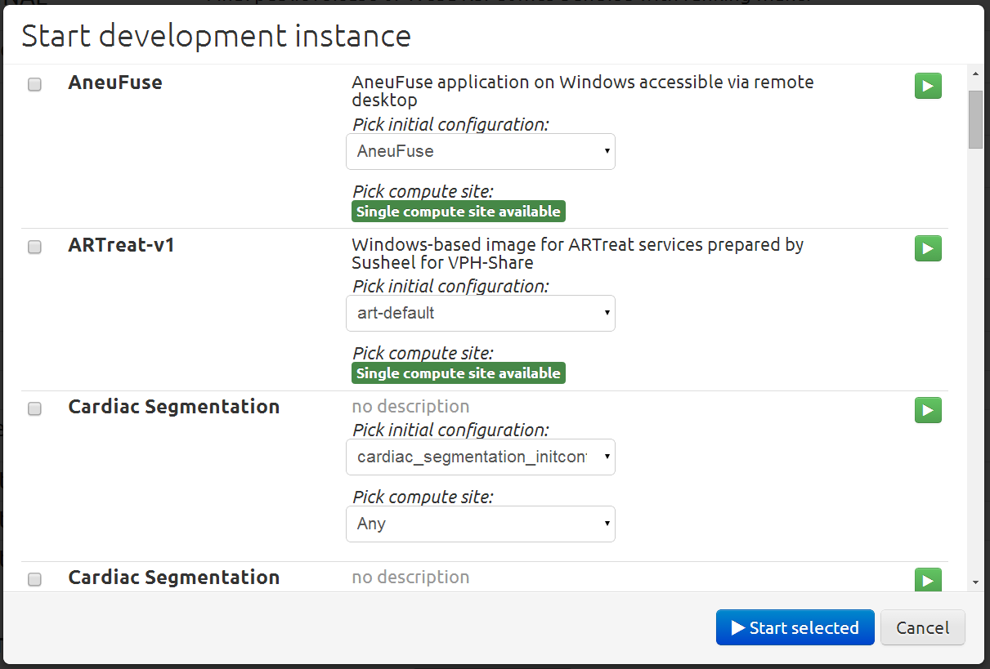
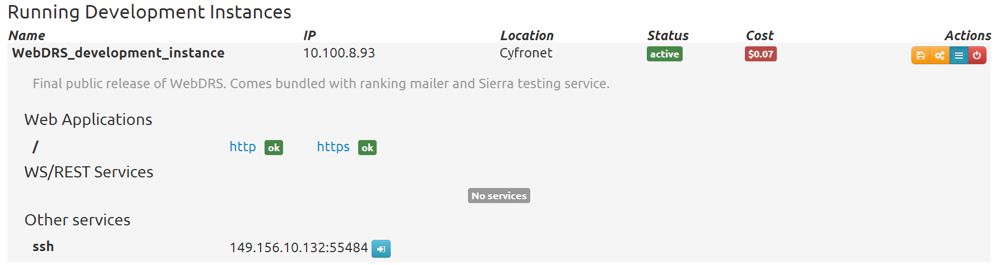



Cloud platform interfaces
End user
A full range of user-friendly GUIs is provided to enable service creation, instantiation and access. A comprehensive online user guide is also available.
The GUIs work by invoking a secure RESTful API which is exposed by the Atmosphere host. We refer to this API as the Cloud Facade.
Atmosphere
Ruby on Rails controller layer
(core Atmosphere logic)
Any operation which can be performed using the GUI may also be invoked programmatically by tools acting on behalf of the platform user – this includes standalone applications and workflow management environments (which VPH-Share also provides).
Application
-- or --
Atmosphere Registry (AIR)
Cloud
sites
Workflow environment
All operations on cloud hardware are abstracted by the Atmosphere platform which exposes a unified RESTful API (with a suitable set of developer’s documentation available).
For end users, the API is concealed by a layer of platform GUIs embedded in the VPH-Share portal and providing a user-friendly work environment - for domain scientists and service developers alike.
The API can also be directly invoked by external services as long as they possess the required security credentials (Atmosphere relies on the well-known OpenID authentication standard with the VPH site at www.biomedtown.org acting as its identity provider).

Slide 10


Domain-based service proxy
Private cloud site (OST/CYF)
Atmosphere core
Redirus controller
Worker Node
Head Node
1. Atmosphere instructs the proxy host to set up a redirection
https://web-7936.vph.cyfronet.pl/app/
AS Instance: Google Refine
Local IP: 10.100.8.34
Exposes external interface on port 3333
Exposes HTTP endpoint with path app/ through the interface listed above
2. A downstream link is opened to the Worker Node hosting the service instance
HTTP proxy host
149.156.10.135
Worker Node
User
3. The domain-based proxy creates a dedicated domain on the fly, and can do so using secure (HTTPS) channels:
Redirus
worker
Redirus worker
(proxy webhost)
Worker Node
Private intranet (10.100.8.0/22)
Public Internet (149.156.10.132/28)
The HTTP proxy is a component of the cloud platform which enables external access to HTTP-based service instances deployed in a private cloud site. This includes (in particular) web applications which expose graphical interfaces to end users, but also SOAP/RESTful services which perform computations as part of larger application workflows. The proxy resolves the IP address crunch in a graceful manner, ensuring that each HTTP endpoint is matched to a unique domain (created on the fly by a dedicated Atmosphere component). This change enables seamless deployment of web applications and services which reference themselves through HTTP/HTTPS hyperlinks.
Notes:
Slide Objectives:
Highlight and showcase effort not shown in Clinical Demos (above are just suggestions)
Speaking Points:

Slide 11

Shared and scalable services – smart utilization of hardware resources
Published services become visible to non-developers and can be instantiated using the Generic Invoker.
Developers are free to spawn „snapshot” images of their cloud services (e.g. for backup purposes) without exposing them to external users.
Atmosphere Cloud Platform
Cloud Service
Developer
Published
Scientist
A Shared service is backended by a single virtual machine which „mimics” multiple instances from the users’ point of view.
Shared services greatly conserve hardware resources and can be instantiated quickly.
Atmosphere
Cloud Service
Shared VM
Scientist
Scientist
Shared
Cloud WN
Scientist
Scientist
When a Scalable service is overloaded with requests Atmosphere can spawn additional instances in the cloud to handle the additional load.
The process is transparent from the user’s perspective.
Atmosphere
Separate VM
Cloud Service
Cloud WN
Scalable
Separate VM
Scientist
Cloud WN

Slide 12

Cloud billing logic
Atmosphere Internal Registry
Atmosphere core
Billing service
Determines who can run what and on which sites;
Periodically bills all running instances;
Can shut down/suspend instances when out of funds.
User 1
User 2
Fund1
Instance #1
Running at: CYF
Launched by: User 1
Paid for by: Fund 1
Requirements: med
Hourly cost: $0.0114
Instance #2
Running at: CYF
Launched by: User 2
Paid for by: Fund 1
Requirements: low
Hourly cost: free
User 3
Fund 2
Instance #3
Running at: AWS
Launched by: User 3
Paid for by: Fund 2
Requirements: hi
Hourly cost: $0.2660
Instance #4
Running at: AWS
Launched by: User 3
Paid for by: Fund 2
Requirements: v. hi
Hourly cost: $0.5320
Billing log
Each user may be assigned to one or more Funds.
Each fund contains a set quantity of monetary resources and can be drawn upon when launching instances.
Registers all billing actions for post-mortem analysis and debugging.
The cloud billing service is a dedicated module built into Atmosphere which monitors financial expenditures associated with the use of cloud resources. Each service instance must be assigned to a Fund which is periodically charged for continued operation of that service. Hourly charges depend on the quantity of hardware resources (CPU, memory etc.) required by the service. Atmosphere interfaces with the underlying billing APIs exposed by popular cloud providers; however system administrators may assign arbitrary hourly rates to each service flavor.
Notes:
Slide Objectives:
Highlight and showcase effort not shown in Clinical Demos (above are just suggestions)
Speaking Points:

Slide 13
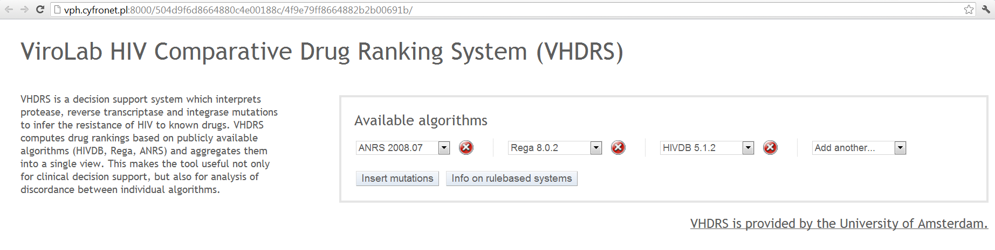
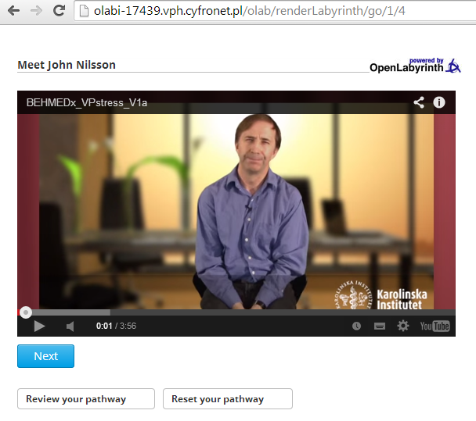
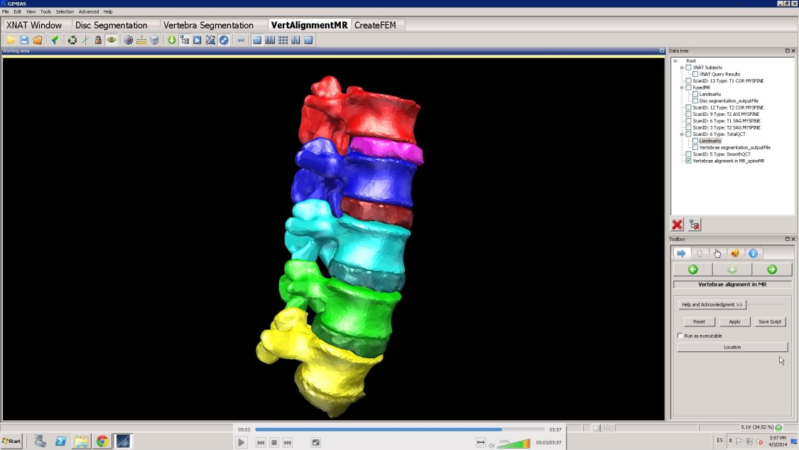
VPH-Share application services
Not just a proof-of-concept deployment: a real production infrastructure with real-world applications and services.
Over 150 service templates currently registered, with approximately 50 instances launched on a daily basis across three computational cloud sites.
A ticketing system is in place and technical support is available on a regular basis both to service developers and end users.
Online user manuals and platform API documentation is available.

Slide 14

A more complex case study – the DataFluo Application
Problem: Cardiovascular sensitivity study: 164 input parameters (e.g. vessel diameter and length)
First analysis: 1,494,000 Monte Carlo runs (expected execution time on a PC: 14,525 hours)
Second Analysis: 5,000 runs per model parameter for each patient dataset; requires another 830,000 Monte Carlo runs per patient dataset for a total of four additional patient datasets – this results in 32,280 hours of calculation time on one personal computer.
Total: 50,000 hours of calculation time on a single PC.
Solution: Scale the application with cloud resources.
Scientist
Launcher script
VPH-Share implementation:
Scalable workflow deployed entirely using VPH-Share tools and services.
Consists of a RabbitMQ server and a number of clients processing computational tasks in parallel, each registered as a service.
The server and client services are launched by a script which communicates directly withe the Cloud Facade API.
Secure API
Server AS
Atmosphere
RabbitMQ
Cloud Facade
DataFluo
Atmosphere Management
Service
(Launches server and automatically scales workers)
DataFluo Listener
Worker AS
Worker AS
RabbitMQ
RabbitMQ

Slide 15
Summary: challenges and solutions
The Atmosphere framework provides a way to port scientific applications to the cloud
A layer of abstraction is created over cloud-based virtual machines, enabling the platform to automatically select the best hardware resources upon which to deploy application services
Automatic load balancing allows applications to scale up as needed
VPH-Share also provides access to cloud hardware upon which scientific applications can be deployed
A whole range of applications – from Linux-based SOAP/REST services all the way to rich graphical clients running under MS Windows have been successfully ported, proving the usefulness and versatility of our solution
The platform is fully integrated with the wider VPH ecosystem, including its authentication/authorization, sharing and data management mechanisms
A billing model has been implemented in order to ensure long-term sustainability of the Project architecture
We provide ongoing technical support and advice to application developers and end users
Notes:
Slide Objectives:
Speaking Points:

Slide 16







Cloud Platform
Cloud based home for data collection and processing
Cloud and Grid Computing
Virtual Machines
Database Services
Scalable Storage
VPH-SHARE
A single platform for the development
of scientific workflows
www.vph-share.eu
Scientific Applications
Sophisticated image processing pipeline
Clinical or Industrial Workflows
Library of Applications
Command-line Tools
Whole or Part Workflows Available
Visit Us!
Booth in the conference hall
Hands-on session on 12th September at 12:30
Pan-European Collaborative Environment
Share VPH data tools and services
Rich Library of Anonymised Medical Images
Free text, Guided and Semantic Search
Request Access to Data
Find Experts

Research Results
Risk Analysis, e.g. Shape Analysis for Aneurysms
Retrieve Results
Run Simulations
Generate New Knowledge
Clinical Applications
Multipurpose platform for multiple medical specialisms
Complex Analysis Simplified Through User Portal
Wealth of Cross Domain Resources
Easy to Develop New Workflows
₊
₊
₊
₊
₊
VPH-Share
19 International Partners
Coordinated by Sheffield University
www.vph-share.eu
€10 Million Funding

Slide 17
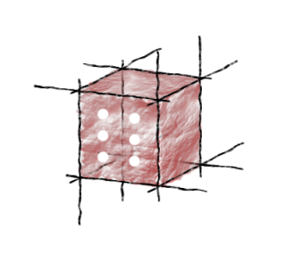
For further information…
A more detailed introduction to the Atmosphere cloud platform (including user manuals) can be found at https://vph.cyfronet.pl/tutorial
You’re also welcome to visit our DIstributed Computing Environments (DICE) team homepage at http://dice.cyfronet.pl

