Slide 1
Support for Taverna Workflows in VPH-Share Cloud Platform
Marek Kasztelnik¹, Marian Bubak^{2,1}, Maciej Malawski^{2,1}, Piotr Nowakowski¹, Ernesto Coto³, Juan Arenas³
¹ACC CYFRONET AGH
²AGH University of Science and Technology
³CISTIB, INSIGNEO, University of Sheffield
Virtual Physiological Human Conference 2014
Trondheim, 9-12 September 2014
Presentation available at:
http://dice.cyfronet.pl/projects/details/VPH-Share

Slide 2
Facts
Modern science uses computations…
Computations are wrapped and accessible as services
Workflow systems (like Taverna) are used to create and execute scientific workflows
a lot
That’s great, but…

Slide 3
There are drawbacks
I only have it installed on my laptop
My laptop is not enough
I need to pay for resources…
The service I used yesterday has just disappeared
Is there hope?
even if they are not used

Slide 4
Cloud to the rescue
The service can be turned ON and OFF and I can do it myself ☺
If I need another service for my friend – not a problem let’s start a new service instance
Spending under control – I’m paying only when the service is ON
It is great but…

Slide 5
What it looks like
Log into e.g. Amazon, RackSpace
Launch required services with the correct flavor
Locate service endpoints
Register service endponts in Taverna
SUCCESS: I can start my workflow
Oops; I forgot to turn off unused services, my bill is huge ☹
What is a flavor? Why do I need to care?

Slide 6
I just want to start my workflow and I don’t care about the rest
The cloud is not enough
We need Atmosphere

Slide 7
Atmosphere – what is it?
Context-aware environment for managing scientific applications hosted in the cloud
Create context, add information about required services and Atmosphere will take care of the rest:
Optimizer will decide which cloud site should be used and how many resources should be allocated to a given service
Redirus will take care of endpoint mapping and load balancing
Billing will check whether the defined budged has not been exceeded
If needed, the service image will be migrated to a new cloud site and started there (cloud bursting)
And when you don’t need your services anymore, simply delete the context
But wait… it is supposed to be easy!

Slide 8
You can forget about previous slide…
…because…
We have a Taverna plugin which will do it for you
☺

Slide 9
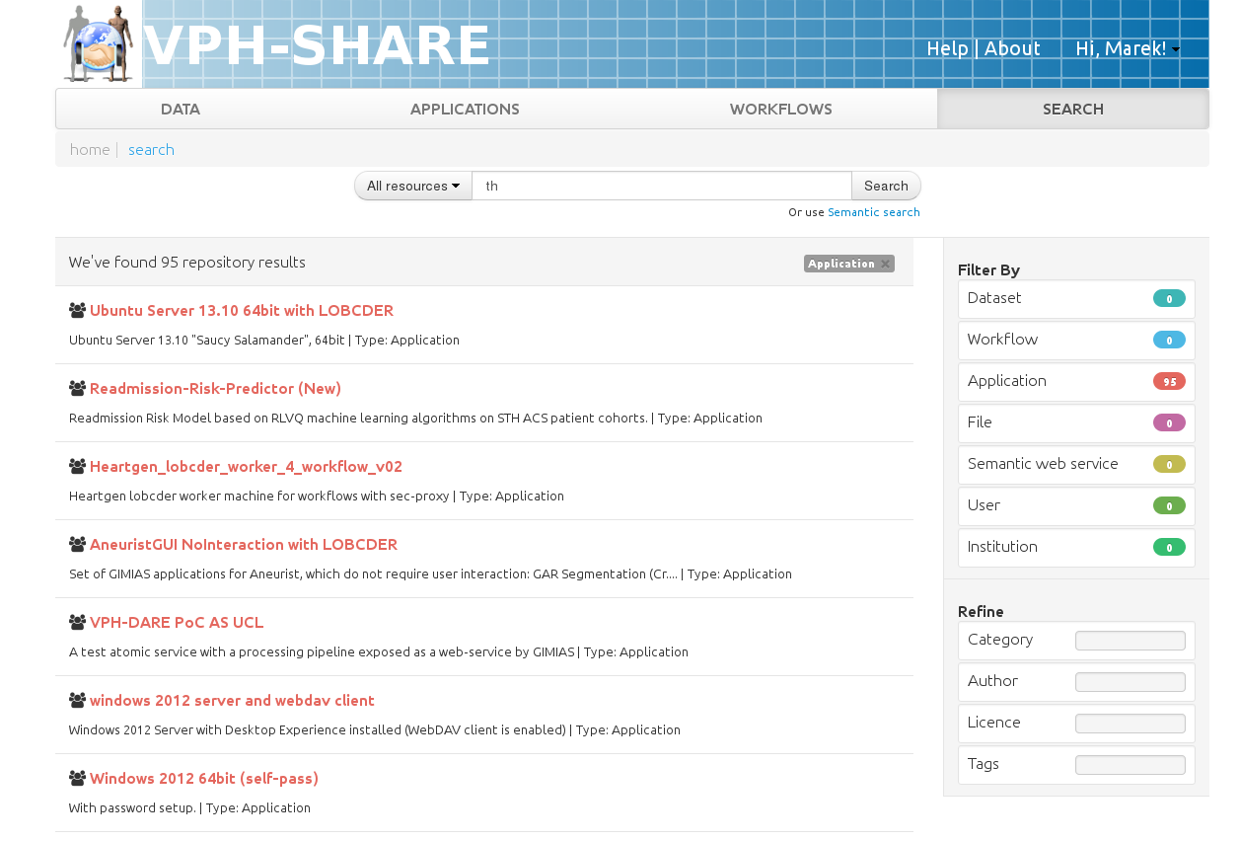


Let’s create a new workflow
I want to create a new workflow. What kind of services can I use?
Great! Now I can create my workflow as I always do
Scientist
Phase 1: Discover services
Phase 2: Create workflow
Taverna workbench
or Taverna online

Slide 10
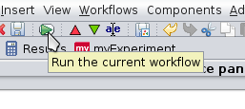
And run it (phase 3)
Uff.. workflow is ready. It is time to run it.
Scientist
That’s it, there is NO phase 4
☺

Slide 11

How is it possible?
Analyze workflow. Discover required resources.
Register required resources
Optimize resources. As a result, a deployment plan is prepared.
Start
workflow
Atmosphere
Workflow finished
Invoke services
Start required virtual machines. Virtual machines can be started in a private cloud site with private IP addresses
Register redirections, load balancing policies
Cloud
Redirus
GIMIAS
MySpine v22
ViroLab

Slide 12
Atmosphere can do more
Integration of heterogeneous compute sites
Currently in VPH Share we have:
Amazon (58 VMTs, 10 VMs)
OpenStack at Cyfronet (214 VMTs, 21 VMs)
OpenStack at the University of Vienna (218 VMTs, 5 VMs)
Advanced optimization strategies
Redirection management
Billing triggers
Automatic virtual machine template migration between compute sites

Slide 13
Existing workflows
@neurIST (allows to test the aneurist morhoplogical analysis)
N4 bias Correction (N4 to correct the MR bias field of and image)
VPHOP (The workflow starts from the patient data hosted on PhysiomeSpace, applies the patient-specific loading conditions, and performs the FE simulation over 10 years)
Heartgen (executes the heartgen service on a cohort of binary masks)
Many more!

Slide 14
Conclusions
We expose what’s good and conceal the underlying complexity:
Services are started on demand
You only pay for the resources you actually use
Thanks to the Taverna plugin there is no need to focus on boring and error-prone cloud tasks
You can use it for free ☺
https://portal.vph-share.eu

Slide 15







Cloud Platform
Cloud based home for data collection and processing
Cloud and Grid Computing
Virtual Machines
Database Services
Scalable Storage
VPH-SHARE
A single platform for the development
of scientific workflows
www.vph-share.eu
Scientific Applications
Sophisticated image processing pipeline
Clinical or Industrial Workflows
Library of Applications
Command-line Tools
Whole or Part Workflows Available
Visit Us!
Booth in the conference hall
Hands-on session on 12th September at 12:30
Pan-European Collaborative Environment
Share VPH data tools and services
Rich Library of Anonymised Medical Images
Free text, Guided and Semantic Search
Request Access to Data
Find Experts

Research Results
Risk Analysis, e.g. Shape Analysis for Aneurysms
Retrieve Results
Run Simulations
Generate New Knowledge
Clinical Applications
Multipurpose platform for multiple medical specialisms
Complex Analysis Simplified Through User Portal
Wealth of Cross Domain Resources
Easy to Develop New Workflows
₊
₊
₊
₊
₊
VPH-Share
19 International Partners
Coordinated by Sheffield University
www.vph-share.eu
€10 Million Funding

Slide 16
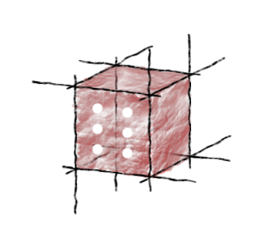
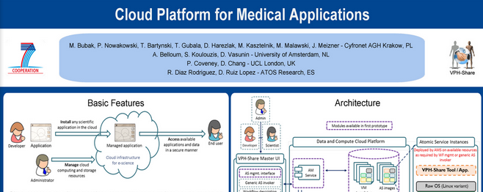
Want more?
A more detailed introduction to the Atmosphere cloud platform (including user manuals) can be found at https://vph.cyfronet.pl/tutorial
You’re also welcome to visit our DIstributed Computing Environments (DICE) team homepage at http://dice.cyfronet.pl
Take a flyer

