Slide 1







Security in the Cloud Platform for VPH Applications
Marian Bubak
Department of Computer Science and Cyfronet, AGH Krakow, PL
Informatics Institute, University of Amsterdam, NL
and
WP2 Team of VPH-Share Project
dice.cyfronet.pl/projects/VPH-Share
www.vph-share.eu
VPH-Share (No 269978)

Slide 2
Coauthors
AGH Krakow: Piotr Nowakowski, Maciej Malawski, Marek Kasztelnik, Daniel Harezlak, Jan Meizner, Tomasz Bartynski, Tomasz Gubala, Bartosz Wilk, Wlodzimierz Funika
UvA Amsterdam: Spiros Koulouzis, Dmitry Vasunin, Reggie Cushing, Adam Belloum
UCL London: Stefan Zasada, Peter Coveney
ATOS: Dario Ruiz Lopez, Rodrigo Diaz Rodriguez

Slide 3
Outline
Motivation
Overview of cloud platform
Security issues for VPH applications
VPH-Share security framework
Data security
Data integrity and availability

Slide 4
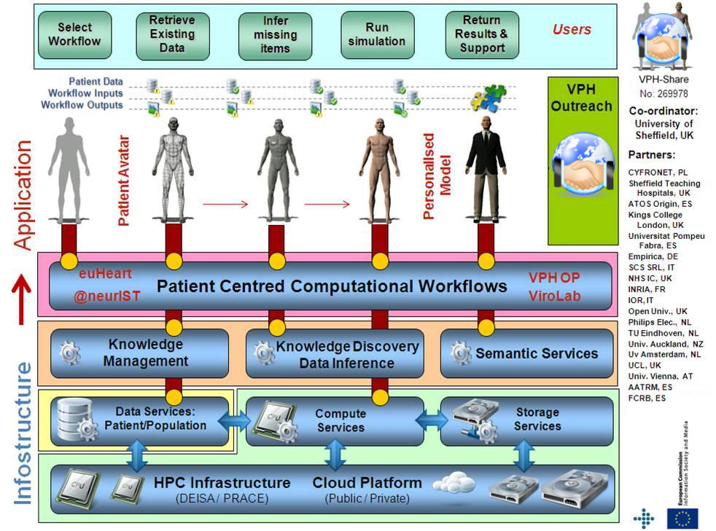
Infostructure for Virtual Physiological Human
2

Slide 5
A (very) short glossary
Raw OS
!
Virtual Machine: A self-contained operating system image, registered in the Cloud framework and capable of being managed by VPH-Share mechanisms.
OS
!
Atomic service: A VPH-Share application (or a component thereof) installed on a Virtual Machine and registered with the cloud management tools for deployment.
VPH-Share app.
(or component)
External APIs
Cloud host
!
Atomic service instance: A running instance of an atomic service, hosted in the Cloud and capable of being directly interfaced, e.g. by the workflow management tools or VPH-Share GUIs.
OS
VPH-Share app.
(or component)
External APIs

Slide 6

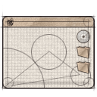


Basic functionality of cloud platform
Install any scientific
application in the cloud
Access available
applications and data
in a secure manner
End user
Developer
Application
Managed application
Cloud infrastructure
for e-science
Manage cloud
computing and storage
resources
Administrator
Install/configure each application service (which we call an Atomic Service) once – then use them multiple times in different workflows;
Direct access to raw virtual machines is provided for developers, with multitudes of operating systems to choose from (IaaS solution);
Install whatever you want (root access to Cloud Virtual Machines);
The cloud platform takes over management and instantiation of Atomic Services;
Many instances of Atomic Services can be spawned simultaneously;
Large-scale computations can be delegated from the PC to the cloud/HPC via a dedicated interface;
Smart deployment: computations can be executed close to data (or the other way round).

Slide 7
VPH-Share federated cloud

Slide 8





VPH application deployment
The platform provides a set of APIs for the VPH-Share Master Interface and other applications, enabling Atomic Services to be developed.
User manual is available at http://vph.cyfronet.pl/wiki
Developer
Admin
Scientist
VPH-Share Core Services Host
VPH-Share Master Int.
Cloud Facade
(secure RESTful API )
Atmosphere Management Service (AMS)
Cloud Manager
Cloud stack plugins (JClouds)
Atmosphere Internal Registry (AIR)
Development Mode
Generic Invoker
Workflow management
OpenStack/Nova Computational Cloud Site
Other CS
External application
Head Node
Worker Node
Worker Node
Worker Node
Worker Node
Cloud Facade client
Amazon EC2
Customized applications may directly interface the Cloud Facade via its RESTful APIs
Worker Node
Worker Node
Worker Node
Worker Node
Image store (Glance)

Slide 9
Cloud types and security risks
Private
Infrastructure ownership impacts data security
A private system can be made quite secure without complex mechanisms
If the system is to be used in community environments it might be more difficult to secure
As the VPH Platform is designed for deployment in public clouds, special care needs to be taken (such environments could be considered potentially hostile)
Isolated infrastructure
Trusted users
Full control over middleware
Community
Less isolated then private one
Users external yet still trusted
Some control over middleware
Public
Exposed to the Internet
Open to all users
No control over middleware

Slide 10
Security in VPH-Share
Information security = preservation of confidentiality, integrity and availability of information (ISO/IEC 27001)
Security framework should provide secure
access to the platform
access to VMs
access to services
stored data handling
computed data handling
communication (VPNs, firewalls etc)

Slide 11
Secure access to platform
Needed for management of the public and private services underneath
Handled by the VPH-Share platform itself
Currently tenant/user/password (OpenStack) and public/secret key paradigms (Amazon)
Other might be added if needed (such as X.509 certificates used in the EGI FedCloud)

Slide 12
Secure access to VMs
Needed to access VM as user/administrator (NOT the service deployed there)
Currently -> SSH key pair injection mechanism in place
Used in development mode

Slide 13
Access to the services
Handled by a custom Security Proxy
Authentication based on BiomedTown which implements the OpenID paradigm
Policy-based authorization
SecProxy – installed between the user and the service

Slide 14
Stored data handling
Critical for many VPH applications
Some data needs to be stored in private clouds
Less confidential data might be stored in public cloud with following provisions:
Trust for the provider (should we?)
End-to-end encryption (decryption key stays in protected/private zone)
Data dispersal (portions of data dispersed between nodes so it becomes nontrivial/impossible to recover the entire message)

Slide 15
Processed data handling
End-to-end encryption not possible as data needs to be decrypted for processing (usually)
Possible mitigation strategies:
No permanent storage of unencrypted data
Data encryption through secure services located in the private zone (on the fly)
Dedicated hardware solution – e.g. AWS CloudHSM, recently supplied by Amazon

Slide 16
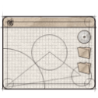




Security framework
Provides a policy-driven access system for the security framework.
Provides a solution for an open-source based access control system based on fine-grained authorization policies.
Implements Policy Enforcement, Policy Decision and Policy Management
Ensures privacy and confidentiality of eHealthcare data
Capable of expressing eHealth requirements and constraints in security policies (compliance)
Tailored to the requirements of public clouds
VPH clients
(or any authorized user capable of presenting a valid security token)
Application
Workflow management service
Developer
End user
Administrator
VPH Security Framework
Public internet
VPH Security Framework
VPH Atomic Service Instances

Slide 17
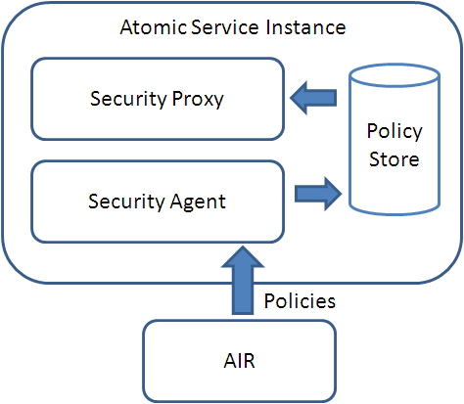
Security Policies
Allowing developers to decide whether to grant access to a VPH-Share applications or not
Policy definition can be established during app registration but can also be modified later through the GUI
All policies are stored in the Atmosphere Internal Registry via the Cloud Facade
Appropriate policies are deployed through the Security Agent and stored locally

Slide 18
VPH-Share Master Interface: integrated security
The OpenID architecture enables the Master Interace to delegate authentication to any public identity provider (e.g. BiomedTown).
Following authentication the MI obtains a secure user token containing the current user’s roles. This token is then used to authorize access to Atomic Service Instances, in accordance with their security policies.
Developer
Admin
Scientist
1. User selects „Log in with BiomedTown”
VPH-Share Master Int.
BiomedTown Identity Provider
Authentication widget
2. Open login window and delegate credentials
Authentication service
Login feature
Users and
roles
3. Validate credentials and spawn session cookie containing user token (created by the Master Interface)
Portlet
VPH-Share Atomic Service Instance
Portlet
4. When invoking AS, pass user token along with request header
Security
Proxy
Portlet
Service payload
(VPH-Share
application component)
6’. Relay request
if authorized
Portlet
Security
Policy
6’. Report error (HTTP/401)
if not authorized
5. Parse user token, retrieve roles and allow/deny access to the ASI according to the security policy

Slide 19
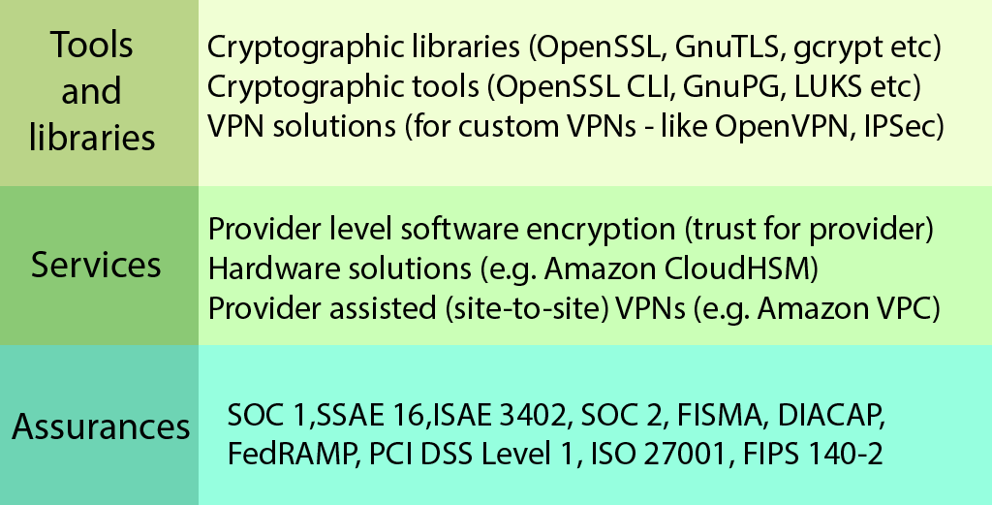
Procedural assurances for data storage
Providers commonly offer some assurances related to procedures and certifications
We cannot rely just on those as the project data might be highly sensitive
Providers could assist us by offering some security related services
There are also some external tools and libraries available
Notes:
Assurances – self assesment or third-party certification.
Services:
CloudHSM (HSM = Hardware Security Module) -> allows to store cryptographic material (keys) in a way not accessible even for Amazon’s administrators
VPC (Virtual Private Cloud) -> allows interconnecting private and public cloud using encrypted Virtual Private Network (VPN)
Tools:
OpenSSL/GnuTLS/gcrypt/GnuPG – encryption + signing (generic) ; LUKS – encrypted file systems; OpenVPN/IPSec – secured communication (VPN)

Slide 20
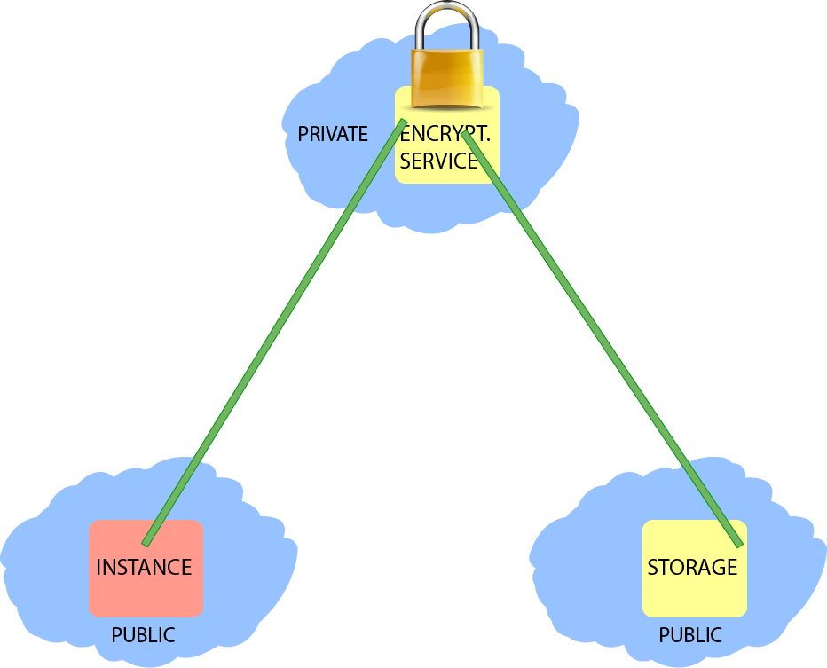
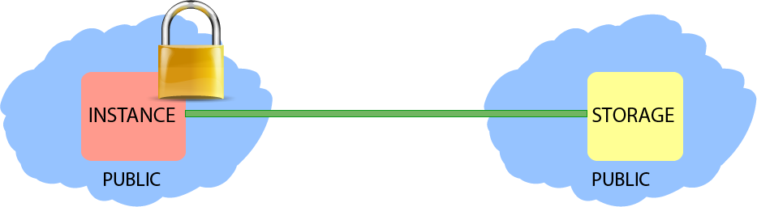
Secure data storage solutions
End-to-end encryption (decryption key stays in protected/private zone)
Trusted organization manages keys and en/decryption process
Easy for end users
Would require LOBCDER extensions
User responsible for en/decryption
No external trusted parties needed
More complex – user requires special knowledge regarding specific tools
We may provide advice on how which technologies are well suited for the task
Could be used immediately by VPH users

Slide 21
Data reliability and integrity
Provides a mechanism which keeps track of binary data stored in cloud infrastructure
Monitors data availability
Advises the cloud platform when instantiating atomic services
LOBCDER
DRI Service
Metadata extensions for DRI
A standalone application service, capable of autonomous operation. It periodically verifies access to any datasets submitted for validation and is capable of issuing alerts to dataset owners and system administrators in case of irregularities.
Binary
data
registry
Validation policy
Register files
Get metadata
Migrate LOBs
Get usage stats
(etc.)
Configurable validation runtime
(registry-driven)
Runtime layer
End-user features
(browsing, querying,
direct access to data,
checksumming)
Extensible
resource
client layer
Amazon S3
OpenStack Swift
Cumulus
VPH Master Int.
Store and marshal data
Data management portlet (with DRI management extensions)
Distributed Cloud storage

Slide 22
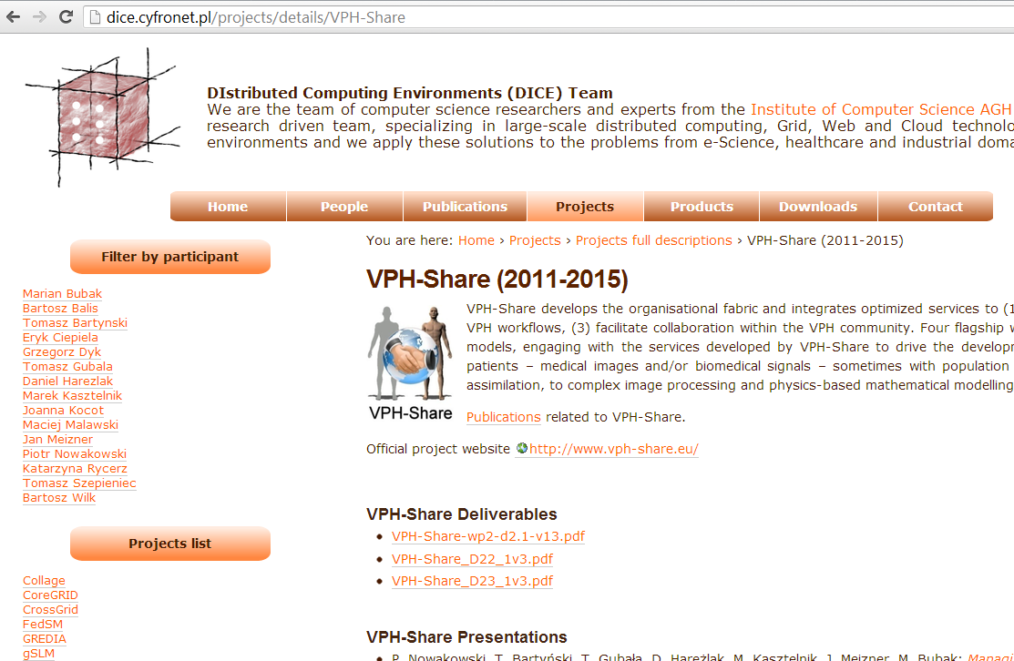
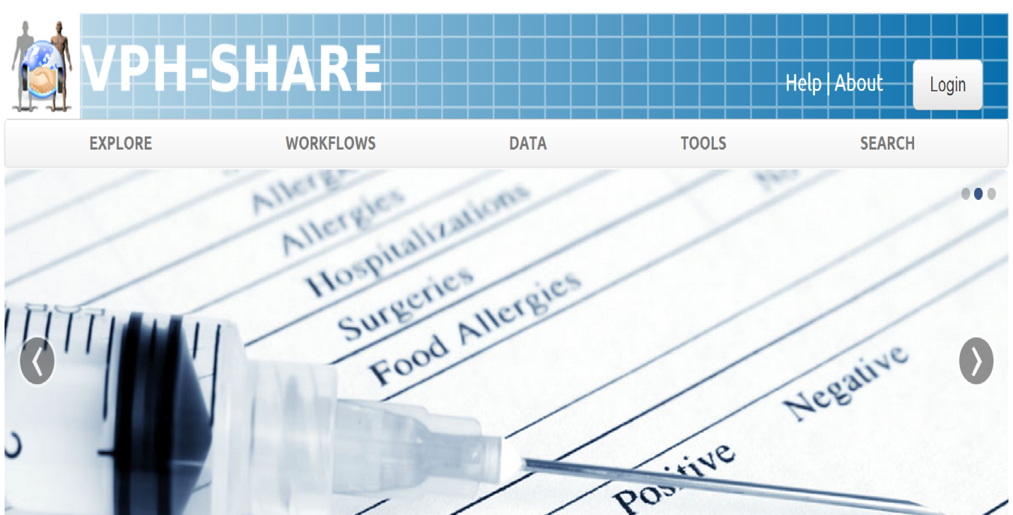
For more information…
dice.cyfronet.pl – the DIstributed Computing Environments (DICE) team at CYFRONET (i.e. „those guys who develop the VPH-Share cloud platform”).
Contains documentation, publications, links to manuals, videos etc.
Also describes some of our other ideas and development projects.
www.vph-share.eu – the newest release of the VPH-Share Master Interface.
Your one-stop entry to all VPH-Share functionality.
You can log in with your BioMedTown account (available to all members of the VPH NoE)

