Slide 1
Cloud-centric Development of Scientific Applications for the VPH Community
Piotr Nowakowski
ACC CYFRONET AGH
Kraków, Poland

Slide 2



A cloud platform for three user groups
The goal of of the platform is to manage cloud/HPC resources in support of VPH-Share applications by:
Providing a mechanism for application developers to install their applications/tools/services on the available resources
Providing a mechanism for end users (domain scientists) to execute workflows and/or standalone applications on the available resources with minimum fuss
Providing a mechanism for end users (domain scientists) to securely manage their binary data in a hybrid cloud environment
Providing administrative tools facilitating configuration and monitoring of the platform
End user support
Easy access to applications and binary data
Application
Generic service
Cloud Platform Interface
Manage hardware resources
Heuristically deploy services
Ensure access to applications
Keep track of binary data
Enforce common security
Developer support
Tools for deploying applications and registering datasets
Application
Application
Data
Data
Data
Admin support
Management of VPH-Share hardware resources
Hybrid cloud environment (public and private resources)

Slide 3
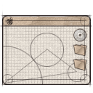
Basic features of the cloud platform
Install any scientific
application in the cloud
Access available
applications and data
in a secure manner
End user
Developer
Application
Managed application
Cloud infrastructure
for e-science
Manage cloud
computing and storage
resources
Administrator
Install/configure each application service (which we call an Atomic Service) once – then use them multiple times in different workflows;
Direct access to raw virtual machines is provided for developers, with multitudes of operating systems to choose from (IaaS solution);
Install whatever you want (root access to Cloud Virtual Machines);
The cloud platform takes over management and instantiation of Atomic Services;
Many instances of Atomic Services can be spawned simultaneously;
Large-scale computations can be delegated from the PC to the cloud/HPC via a dedicated interface;
Smart deployment: computations can be executed close to data (or the other way round).

Slide 4
A (very) short glossary
Raw OS
!
Virtual Machine: A self-contained operating system image, registered in the Cloud framework and capable of being managed by VPH-Share mechanisms.
OS
!
Atomic service: A VPH-Share application (or a component thereof) installed on a Virtual Machine and registered with the cloud management tools for deployment.
VPH-Share app.
(or component)
External APIs
Cloud host
!
Atomic service instance: A running instance of an atomic service, hosted in the Cloud and capable of being directly interfaced, e.g. by the workflow management tools or VPH-Share GUIs.
OS
VPH-Share app.
(or component)
External APIs

Slide 5





The VPH-Share Cloud Platform: a Generic Solution for VPH Application Deployment
The platform provides a set of APIs for the VPH-Share Master Interface and other applications, enabling Atomic Services to be developed.
A detailed user manual is available at http://vph.cyfronet.pl/wiki
Developer
Admin
Scientist
VPH-Share Core Services Host
VPH-Share Master Int.
Cloud Facade
(secure RESTful API )
Atmosphere Management Service (AMS)
Cloud Manager
Cloud stack plugins (JClouds)
Atmosphere Internal Registry (AIR)
Development Mode
Generic Invoker
Workflow management
OpenStack/Nova Computational Cloud Site
Other CS
External application
Head Node
Worker Node
Worker Node
Worker Node
Worker Node
Cloud Facade client
Amazon EC2
Customized applications may directly interface the Cloud Facade via its RESTful APIs
Worker Node
Worker Node
Worker Node
Worker Node
Image store (Glance)

Slide 6


Atmosphere: a generic Cloud platform resource manager
receives requests from clients stating that a set of Atomic Services is required to process/produce certain data;
queries the Component Registry to determine the relevant AS and data characteristics;
collects infostructure metrics,
analyzes available data and prepares an optimal deployment plan.
Atmosphere
AIR
Core component of the VPH-Share cloud platform, responsible for managing cloud resources and deploying Atomic Services accordingly.
Also called the Atmosphere Internal Registry; stores all data on cloud resources, Atomic Services and their instances.
1. Application (or any other authorized entity) requests access to an Atomic Service
2. Poll AIR for data regarding this AS and the available computing resources
Application
-- or --
3. Heuristically determine whether to recycle an existing instance or spawn a new one. Also determine which computing resources to use when instantiating additional instances (based on cost information and performance metrics obtained from monitoring data)
Workflow environment
[Asynchronous process] Collect monitoring data and analyze health of the cloud infrastructure to ensure optimal deployment of application services
-- or --
4. Call cloud middleware services to enforce the deployment plan
Computing infrastructure
(hybrid public/private cloud)
End user
Cloud middleware
Selection of low-level middleware libraries to manage specific types of cloud sites
5. Deploy Atomic Service Instances as directed by Atmosphere

Slide 7
The VPH-Share Master Interface: integrated security
The OpenID architecture enables the Master Interace to delegate authentication to any public identity provider (e.g. BiomedTown).
Following authentication the MI obtains a secure user token containing the current user’s roles. This token is then used to authorize access to Atomic Service Instances, in accordance with their security policies.
Developer
Admin
Scientist
1. User selects „Log in with BiomedTown”
VPH-Share Master Int.
BiomedTown Identity Provider
Authentication widget
2. Open login window and delegate credentials
Authentication service
Login feature
Users and
roles
3. Validate credentials and spawn session cookie containing user token (created by the Master Interface)
Portlet
VPH-Share Atomic Service Instance
Portlet
4. When invoking AS, pass user token along with request header
Security
Proxy
Portlet
Service payload
(VPH-Share
application component)
6’. Relay request
if authorized
Portlet
Security
Policy
6’. Report error (HTTP/401)
if not authorized
5. Parse user token, retrieve roles and allow/deny access to the ASI according to the security policy

Slide 8


Security key management
1. Open SSH client software and generate a pair of security keys
SSH key generator
Atmosphere provides a mechanism for developers to manage and access their Atomic Services in a secure manner.
Prior to starting development work on an Atomic Service the developer opens their favorite SSH client software and generates a pair of RSA security keys.
The public key is uploaded into Atmosphere using the Key Manager extension in the Cloud Manager interface. The developer keeps the private key in a safe place and does not share it with anyone.
Public key authentication is supported by all popular SSH clients and enables the user to obtain shell access to their development-mode Atomic Service Instances without relying on „magic” accounts or pre-shared root credentials.
Atmosphere takes care of managing public keys. Any number of keys may be registered by a single developer.
Developer
Public key
Private key
2. Upload your public key to Atmosphere using the Key Manager
VPH-Share Master Int.
Cloud Manager
Development Mode
Key Manager
3. Key Manager asks Cloud Facade to store key
Cloud Facade (API)
Core Component Host
(149.156.10.143)
4. Cloud Facade stores key in AIR
Atmosphere Internal Registry
Keystore

Slide 9
Instantiating an Atomic Service Template (1/2)
The Cloud Manager portlet enables developers to create, deploy, save and instantiate Atomic Service Instances on cloud resources.
Developer
OpenStack WN
(10.100.x.x)
VPH-Share Master Int.
Atomic
Service
Instance
7.
WN hypervisor (KVM)
7. Boot VM
Cloud Manager
Mounted network storage
Development Mode
Start Atomic Service
Virtual HDD
Per-WN storage
1. Start AS
8. Inject security key (development mode)
6. Upload VM image
to WN storage
Cloud Facade (API)
Core Component Host
(149.156.10.143)
2. Request instantiation of Atomic Service
Nova Head Node
(149.156.10.132)
4. Call Nova to instantiate selected VM
Atmosphere AMS
Glance image store
OpenStack
(API)
Atmosphere Internal Registry
3. Get AS VM details
5. Stage AS image on WN
AS Images
Comp. model
8. Retrieve security key
MongoDB
Keystore
Nova management interface

Slide 10
Instantiating an Atomic Service Template (2/2)
Atmosphere takes care of interpreting user requests and managing the underlying cloud platform.
The platform now honors resource allocation requests.
Developer
IP Wrangler host
(149.156.10.132)
OpenStack WN
(10.100.x.x)
VPH-Share Master Int.
DNAT
Atomic
Service
Instance
Cloud Manager
Development Mode
Port mapping
table
WN hypervisor
ASI details
Virtual HDD
9. Report VM is booting
16. Poll
for ASI status
and update view
10. Report VM is running
14. Configure DNAT to enable port forwarding
Cloud Facade (API)
Core Component Host
(149.156.10.143)
17. Retrieve ASI status, port mappings and access credentials
Nova Head Node
(149.156.10.132)
Atmosphere AMS
OpenStack
(API)
11. Poll Nova for VM status
Nova management interface
Atmosphere Internal Registry
12. Delegate query and relay reply
Comp. model
13. Register ASI as booting/running
MongoDB
Keystore
15. Register port mappings for this ASI

Slide 11
Obtaining access to Atomic Service Instance in development mode
OpenStack WN (10.100.x.x) KVM hypervisor
IP Wrangler host
(149.156.10.131)
Atomic Service Instance
(Virtual Machine)
Standard IP stack (accessible via public IP)
IP Wrangler
Local shell
2. Initiate interaction.
Use private key to authenticate self
3. Relay
4. Call ASI
SSH host
Developer
Port mapping
table
Virtual
HDD
Public key
1. Look up ASI details (including IP Wrangler IP, port mappings and access credentials, if needed)
5. Perform authentication
VPH-Share Master Int.
Note: Atomic Service Instances typically do not have public IPs
The role of the IP Wrangler is to facilitate user interaction on arbitrary ports (e.g. SSH, VNC etc.) with VMs deployed on a computing cluster (such as is the case at CYFRONET)
Accessing Atomic Service Instances in development mode requires the user to present his/her private key
The preinjected public key enables the SSH server residing on the ASI to perform user authentication
Cloud Manager
Development Mode
ASI metadata

Slide 12






Managing Atomic Service Redirections and Endpoints
The IP Wrangler – a generic client interface to private cloud resources
Ensures configurable, secure access to Atomic Service Instances
Solves the public IP address crunch (insufficient public IP to cover the entire cloud site)
Two types of redirections: TCP (generic port forwarding via DNAT) and HTTP (access through standard HTTP ports with Nginx; disambiguates services by path name)
Compatible with arbitrary external applications and services
Admin
Developer
Scientist
SSH client
VNC client
Browser
Application
Atmosphere/IP Wrangler
Public Internet
TCP (DNAT)
HTTP (Nginx)
:14171
:16021
:11506
:18090
:8443/<WFID>/app/
:8000/<WFID>/svc/
:22
:22
:22
:5900
:443/app/
:80/svc/
149.156.10.132
149.156.10.143
Private cloud
SSH (:22)
10.100.8.1
VNC (:5900)
SSH (:22)
10.100.8.2
webapp (:443/app/)
SSH (:22)
10.100.8.3
SOAP (:80/svc/)
AS Instance #1
AS Instance #2
AS Instance #3
Cloud WN
Cloud WN
Cloud WN

Slide 13
Behind the scenes: Saving the Instance as a new Atomic Service
Developers are able to save existing instances as new Atomic Services.
Once saved, an Atomic Service can be instantiated by clients.
Developer
OpenStack WN
(10.100.x.x)
VPH-Share Master Int.
Atomic
Service
Instance
5.
WN hypervisor (KVM)
5. Image selected VM (incl. user space)
Cloud Manager
Mounted network storage
Development Mode
Save Atomic Service
Assigned
local storage
Per-WN storage
AS metadata
1. Create AS from ASI
specifying service name, requirements and flags
6. Upload VM image
to Glance
Cloud Facade (API)
Core Component Host
(149.156.10.143)
2. Request storage of Atomic Service
Nova Head Node
(149.156.10.131)
Atmosphere AMS
3. Call Nova to persist ASI
4. Store VM image in Glance
Glance image store
3’. Register AS
as being saved.
OpenStack
(API)
Atmosphere Internal Registry
7. Report success
AS Images
Comp. model
8. Register AS as available.
MongoDB
Keystore
Nova management interface

Slide 14

Atomic Service Flags
Published services become visible to non-developers and can be instantiated using the Generic Invoker.
Developers are free to spawn „snapshot” images of their Atomic Services (e.g. for backup purposes) without exposing them to external users.
Atmosphere Cloud Platform
Atomic Service
Developer
Published
Scientist
A Shared service is backended by a single virtual machine which „mimics” multiple instances from the users’ point of view.
Shared services greatly conserve hardware resources and can be instantiated quickly.
Atmosphere
Atomic Service
Shared VM
Scientist
Scientist
Shared
Cloud WN
Scientist
Scientist
When a Scalable service is overloaded with requests, Atmosphere will spawn additional instances in the cloud to handle the additional load.
The process is transparent from the user’s perspective.
Atmosphere
Separate VM
Atomic Service
Cloud WN
Scalable
Separate VM
Scientist
Cloud WN

Slide 15
Application deployments – the DataFluo workflow
Problem: Cardiovascular sensitivity study: 164 input parameters (e.g. vessel diameter and length)
First analysis: 1,494,000 Monte Carlo runs (expected execution time on a PC: 14,525 hours)
Second Analysis: 5,000 runs per model parameter for each patient dataset; requires another 830,000 Monte Carlo runs per patient dataset for a total of four additional patient datasets – this results in 32,280 hours of calculation time on one personal computer.
Total: 50,000 hours of calculation time on a single PC.
Solution: Scale the application with cloud resources.
Scientist
Launcher script
VPH-Share implementation:
Scalable workflow deployed entirely using VPH-Share tools and services.
Consists of a RabbitMQ server and a number of clients processing computational tasks in parallel, each registered as an Atomic Service.
The server and client Atomic Services are launched by a script which communicates directly withe the Cloud Facade API.
Small-scale runs successfully competed, large-scale run in progress.
Secure API
Server AS
Atmosphere
RabbitMQ
Cloud Facade
DataFluo
Atmosphere Management
Service
(Launches server and automatically scales workers)
DataFluo Listener
Worker AS
Worker AS
RabbitMQ
RabbitMQ

Slide 16
Application deployments – the OncoSimulator application
P-Medicine users
VPH-Share Computational Cloud Platform
Cloud
Facade
Atmosphere Management Service (AMS)
P-Medicine Portal
AIR registry
OncoSimulator Submission Form
Launch Atomic Services
OncoSimulator ASI
Visualization window
Cloud
HN
Cloud WN
OncoSimulator ASI
Mount LOBCDER and select results for storage in P-Medicine Data Cloud
VITRALL Visualization Service
Store output
P-Medicine Data Cloud
LOBCDER Storage Federation
Storage resources
Storage resources
Deployment of the OncoSimulator Tool on VPH-Share resources – a joint effort of P-Medicine and VPH-Share.
Uses a custom Atomic Service as the computational backend.
Features integration of data storage resources
OncoSimulator AS also registered in VPH-Share metadata store (not shown)

Slide 17
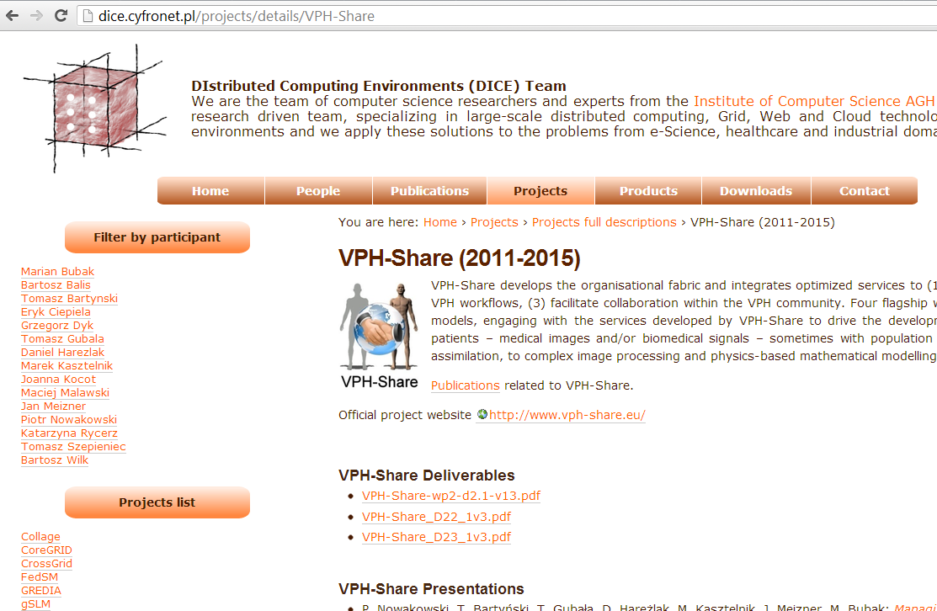
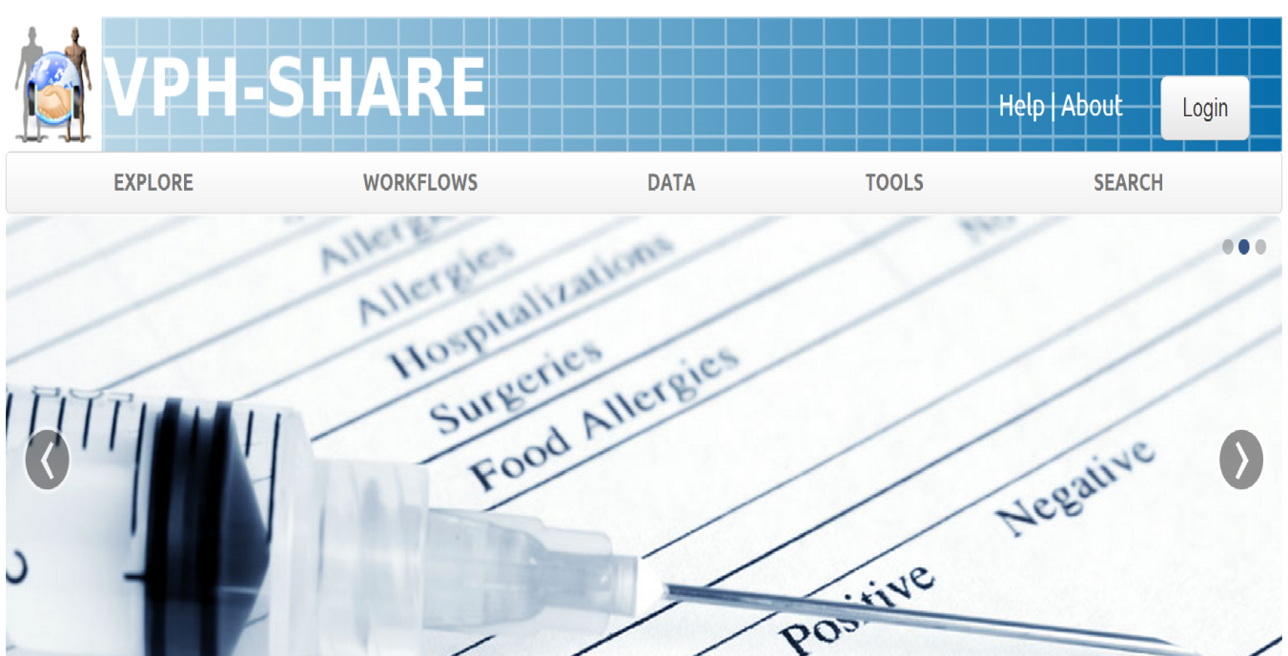
For more information…
dice.cyfronet.pl – the DIstributed Computing Environments (DICE) team at CYFRONET (i.e. „those guys who develop the VPH-Share cloud platform”).
Contains documentation, publications, links to manuals, videos etc.
Also describes some of our other ideas and development projects.
jump.vph-share.eu – the newest release of the VPH-Share Master Interface.
Your one-stop entry to all VPH-Share functionality.
You can log in with your BioMedTown account (available to all members of the VPH NoE)

