Slide 1
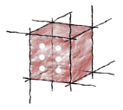
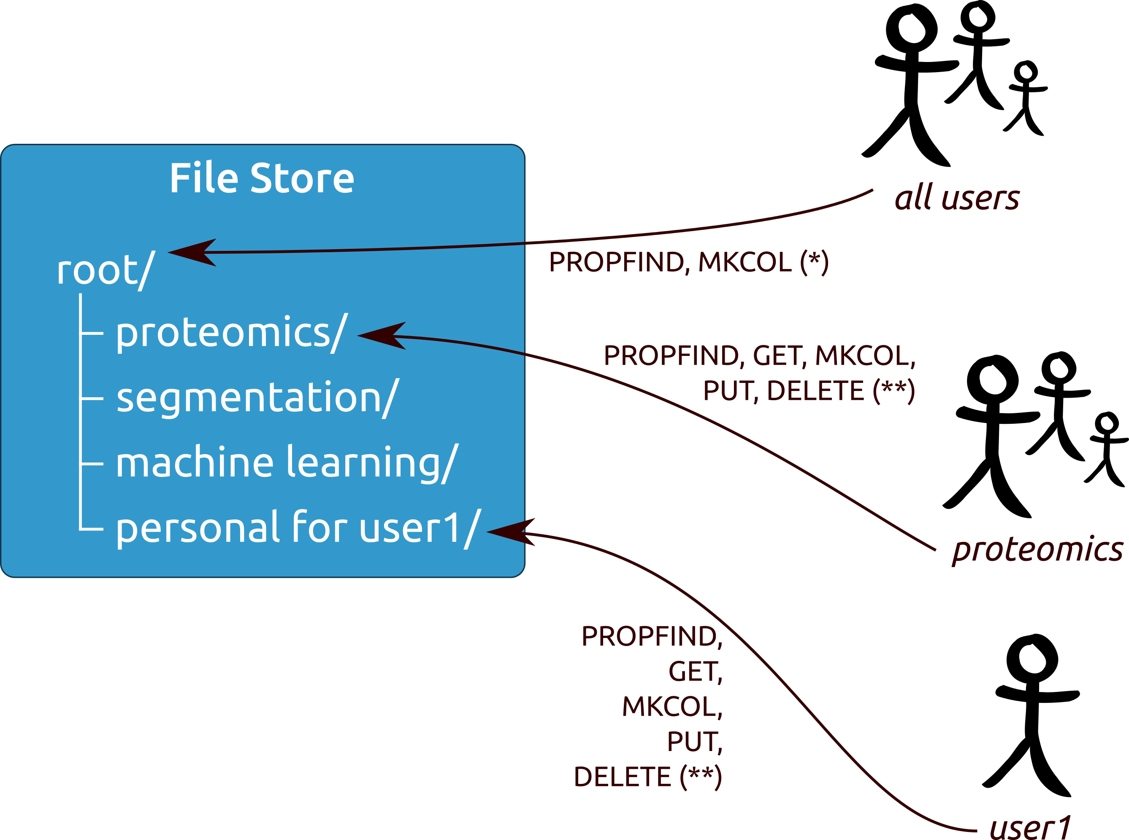





Model Execution Environment
for Investigation of Heart Valve Diseases
Marian Bubak^{1,2}, Tomasz Bartyński², Tomasz Gubała², Daniel Harężlak², Marek Kasztelnik²,
Maciej Malawski¹, Jan Meizner², Piotr Nowakowski²
¹AGH University of Science and Technology, Department of Computer Science, Kraków, Poland
² Academic Computer Centre Cyfronet AGH, Kraków, Poland
bubak@agh.edu.pl; http://dice.cyfronet.pl
Investigations leading to practical implementations of personalized medicine are challenging. The main goal of the EurValve project is to combine a set of complex modeling tools to deliver a workflow which will enable evaluation of medical prospects and outlook for individual patients presented with cardiovascular symptoms suggesting valvular heart disease. This research should result in a decision support system (DSS) which can be applied in clinical practice. This research activity requires a dedicated problem solving environment which we refer to as the Model Execution Environment (MEE).
1. Objectives
To develop and provide the necessary infrastructure to
Collect, represent, annotate and publish data
Store and grant secure access to all necessary data
Execute the models in the most appropriate computational infrastructure
Support real-time multiscale visualization
Process encrypted data in public clouds
To deploy and operate the infrastructure, ensuring
Quality of deployed software components
Quality of service, including such aspects as availability, responsiveness and cost efficiency
2. Simulation Pipeline
The envisioned data flow consists of steps involving image segmentation, proteomics analysis and literature mining to construct system models which, in turn, enable building reduced order models as the knowledge base for the DSS.
4. Security
Policy Decision Point (PDP) available as a service
GUI for configuring resource permissions
JWT tokens used
Policy Enforcement Point implemented as an Nginx module
Fine-grained data security (policies based on access methods)
3. Architecture of MEE
5. File Store
WebDAV standard compliant
Accepts JWT token delegation
Access fully customizable by data owners
Provides a web-based file browser
6. Summary
Detailed requirements formulated and state-of-the-art in the area of valvular diseases analyzed
Detailed design recommendations relating to model-based research environments established
Prototypes of the Model Execution Environment, with supporting File Store and Integrated Security components facilitating simulations with the aim to develop decision support systems for heart diseases
Various access methods (GUI, CLI, scripting) via secure REST APIs
Built on top of the robust Atmosphere platform
Uses a selection of middleware services to submit computation
HPC, private and public cloud resources with advanced visualization
References
M. Kasztelnik, E. Coto, M. Bubak, M. Malawski, P. Nowakowski, J. Arenas, A. Saglimbeni, D. Testi, and A. F. Frangi, Support for Taverna Workflows in the VPH-Share Cloud Platform, to be published in Computer Methods and Programs in Biomedicine
Web resources: http://www.eurvalve.eu (Project website), https://valve.cyfronet.pl (EurValve Portal), https://files.valve.cyfronet.pl (EurValve File Store)
Acknowledgements. This work is partly supported by the EU project EurValve Personalised Decision Support for Heart Valve Disease H2020 PHC-30-2015 689617 and by the PLGrid infrastructure

