Slide 1

Data Management System for Investigation of Heart Valve Diseases
Marian Bubak^{1,2}, Daniel Harężlak², Steven Wood³,Tomasz Bartyński², Tomasz Gubala², Marek Kasztelnik², Maciej Malawski¹, Jan Meizner², Piotr Nowakowski²
¹Department of Computer Science, AGH Krakow, Poland
²ACC Cyfronet AGH, Krakow, Poland
http://dice.cyfronet.pl/
³Scientific Computing, Department of Medical Physics, Sheffield Teaching Hospitals, UK

Slide 2
Outline
Motivation: Virtual Physiological Human, personalized medicine
Objectives of the EurValve project
Model Execution Environment
Requirements for medical data management
File Store
Flow of medical data
Integrated security
Typical scenarios
Summary

Slide 3
Motivation
Investigations leading to practical implementations of personalized medicine are challenging
The main goal of the EurValve project is to combine a set of complex modeling tools to deliver a workflow which will enable evaluation of medical prospects and outlook for individual patients presented with cardiovascular symptoms suggesting valvular heart disease
This research should result in a decision support system (DSS) which can be applied in clinical practice
This research activity requires a dedicated problem solving environment which we refer to as the Model Execution Environment (MEE)

Slide 4
Model Execution Environment Objectives
Collect, represent, annotate and publish core homogeneous data
Store and give secure access to the participating clinical centers and to development partners to the necessary data
Execute the models in the most appropriate computational environment (private workstation, private cloud, public cloud) according to needs
Support real-time multiscale visualization
To develop an integrated security system supporting
Authentication and authorisation
Data encryption for secure processing in public clouds

Slide 5
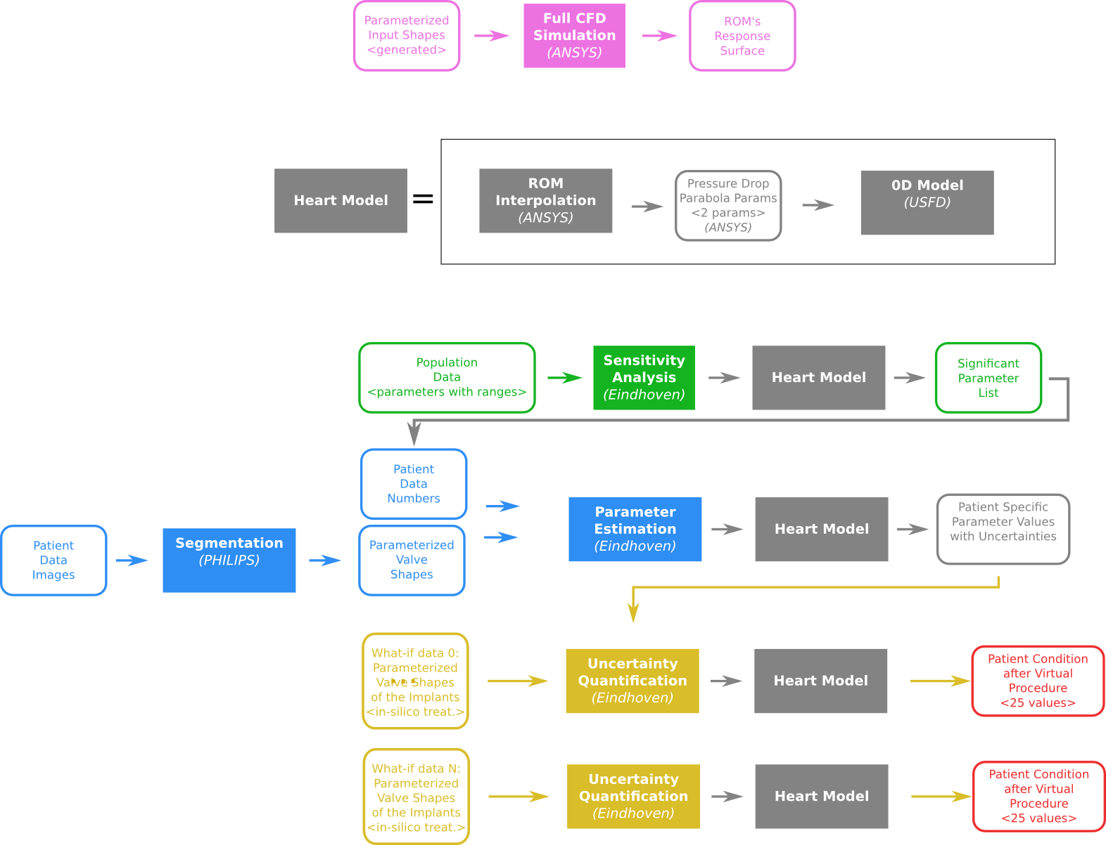
Data and action flow
Data and action flow consists of:
full CFD simulations
sensitivity analysis to acquire significant parameters
parameter estimation based on patient data
uncertainty quantification of various procedures
The flow except of CFD simulations and sensitivity analysis is part of a clinical patient treatment

Slide 6
From Research Environment to DSS
Research Computing Infrastructure
Development of models for DSS
Clinical Computing Environment
Real-time Multiscale Visualization
Model Execution Environment
Data Collection and Publication Suite
DSS Execution Environment
ROM
0-D Model
Patient Data
ROM
3-D Model
Model A
Images
Population data
Security System
Model B
Infrastructure Operations
Data Source 1
Data Source 2
HPC Cluster
Cloud
Workstation
Provide final models for DSS

Slide 7
Model Execution Environment

Slide 8
Model Execution Environment Prototype
Components
EurValve Portal – discover collected files for patient clinical case, submit blood flow computation into Prometheus supercomputer, monitor computation execution, discover results, the EurValve Portal is integrated with File Store, Rimrock, PLData, Security
EurValve File Store – each computation receives and delivers files there
Rimrock – to submit jobs into Prometheus supercomputer
PLData – to access files stored on the Prometheus disks
EurValve Security
Typical use case
Create new Patient clinical case
Automatically discovers files connected with the Patient Case id
Run blood flow computation on Prometheus supercomputer
Monitor computation execution
Discover produced results and update clinical case progress
Computation result files are automatically retrieved after the simulation is finished
Notes:
8

Slide 9
Medical data
2 groups of medical data
retrospective (Clinical Examination, Patient Tables, Medication etc.)
prospective (from the medical trials)
3 types of medical data
Files / BLOBs - large chunks of data (e.g. images) that do not need to be searchable and are to be stored in File Store
DB Records - are relatively small tabular records (measurements, patient records) which must be searchable and are to be stored in the Database
Mixed Data - data composed of BLOB and Metadata - e.g. DICOMs - needs to be decomposed by storing BLOB data in the File Store and Metadata + BLOB reference (URI) in the DB
Basic operations on medical deta
Data aggregation from available medical sources done with the Data Publication Suite (DPS) for the retrospective data and the ArQ tool from STH for the prospective data
Data de-indentification and, optionally, separation/classification of BLOB and DB data done with the DPS and ArQ
Data storing into the FileStore or DB

Slide 10
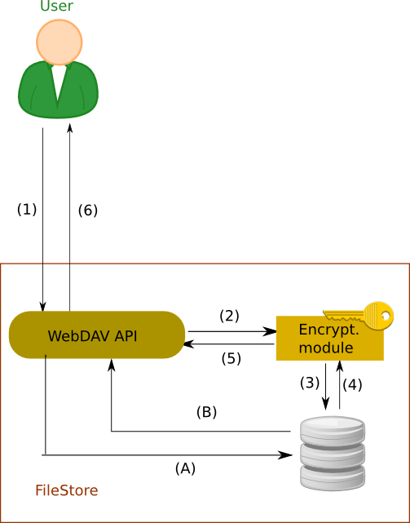
Flow of medical data
Secure locally hosted service
(1)
REST
Data is going to be handled based on the confidentiality level:
Step 1 (all levels) – data is sent via encrypted channel to the service
Step 2-3 (high) – data encrypted and stored on disk
Step 4-5 (high) – data decrypted and retrieved
Step A-B (lo) – data stored directly to disk
Step 6 (all) – data sent back to the user
(6)
SQL
Database access

Slide 11
Requirements for medical data management systems
Support for both binary files and structured data
Standard interfaces allowing to browse and access data in a way convenient for user (support a variety of operating systems, web browsers, tools and client-side software libraries and remote file system protocols)
Secure and efficient data transfer to and from computational infrastructure
Enable delegation of credentials to services working on behalf of a user
Support complex data access policies
Enable sharing and group access to selected data sets
Data security:
sensitive patient information must be encrypted before it is persisted
prevent from reading data even if one has access to hardware or has intercepted communication
Specified level of security for a specific piece of data

Slide 12
Basic features of the File Store
Deployment of a file repository compliant with the WebDav protocol, including search capabilities (RFC 5323)
File Store component (browser) enabling web-based file browsing, downloads, uploads is a part of the EurValve portal
File Browser may be reused on dedicated portal views where a user may browse only a specified sub-folder and perform restricted set of operations
Securing the file repository with the EurValve's security compatible mechanism
Remote file system can be mounted on local computer using one of the WebDav clients on Windows, MacOs and Linux systems
File Store is integrated with EurValve’s security solution; directory permissions can be granted to a user or to a group of users

Slide 13
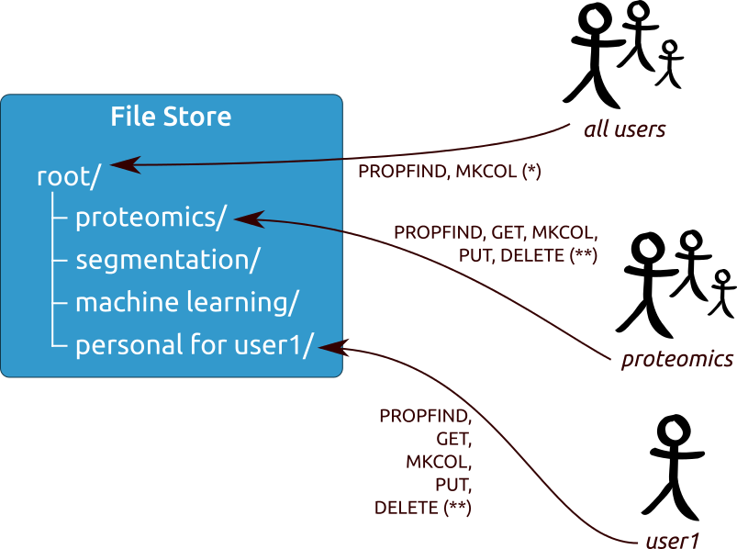
File Store - multi policy approach
Access policies are attached to different nodes according to user sharing policies. Private spaces can be created for individual users and groups.

Slide 14
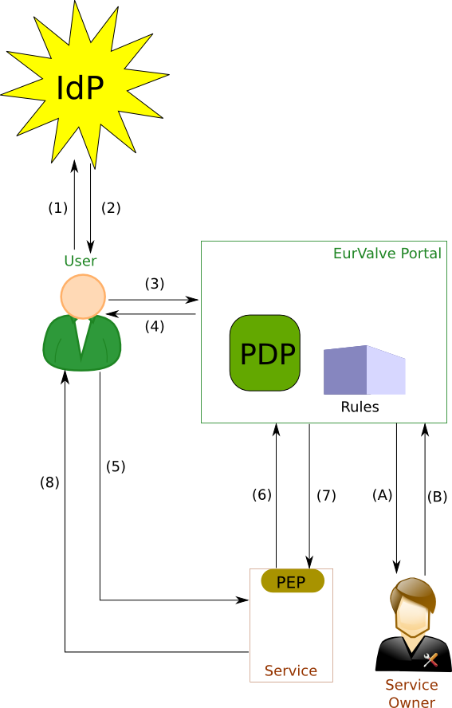
Integrated Security Framework
Step 1-2 (optional): Users authenticate themselves with the selected identity provider (hosted by the project or external trusted one) and obtain a secure token which can then be used to authenticate requests in DSS and RCE.
Step 3-4: User requests JWT token from the Portal, based on IdP or local authentication.
Step 5 – User request to the service (token attached)
Step 6-7 – Service PEP validates token and permissions against the PDP (authorization).
Step 8 – service replies with data or error (access denied)
Optional interaction by the service owner:
Step A-B – Service Owner may interact with the PDP via the Portal GUI or API to modify rules/policies.
IdP - Identity Provider
PDP - Policy Decision Point
PRP - Policy Retrieval Point
PEP - Policy Enforcement Point

Slide 15
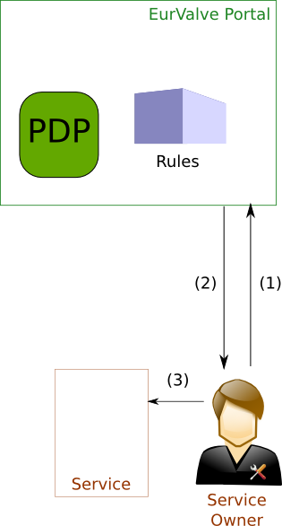
New Service Registration
To secure the service its owner needs to register it first in the Portal/PDP.
Step 1-2: Service Owner logs into the Portal and create Service and set of Global Policies and gets Service Token
Step 3: Service Owner configures it’s Service PEP to interact with the PDP (incl. setting the service token).
Standard PEP for Web-based Services is provided by our Team. Custom PEP may be developed using provided API.
The Service may use its token to:
Query the PDP for user access
Modify Local Policies for fine grain access to the Service

Slide 16
File Store typical use case – fine-grained permission management at the level of WebDAV HTTP methods
Components
UI to facilitate user login and data store access
Authentication mechanisms
PDP, PEP – policy decision/enforcement point to grant/revoke access to resources on the basis of resource owners’ policies
Scenario
User 1 logs into the UI, accesses the File Store component and creates a directory
User 1 uploads a file to the newly created directory
User 2 logs in and attempts to retrieve the file – however, directory access is denied due to lack of sufficient permissions.
User 1 grants User 2 read-only access for the newly created directory
User 2 is now able to access the directory and retrieve its contents. He is, however, unable to upload new files due to the lack of „write” permissions.
User 1 extends User 2’s permission set with „write” access
User 2 is now able to create new files and subdirectories in the target directory

Slide 17
Database typical use case – Database queries using graphical UI and HTTPS REST calls
Components
UI to facilitate user login and data store access
Authentication mechanisms
PDP, PEP – policy decision/enforcement point to grant/revoke access to resources on the basis of resource owners’ policies
Scenario
User 1 logs into the UI, selects a dataset and lands on the query page
User designs a query using the graphical interface
Users executes the query
Services check the access rights through the PDP and either runs the query or denies access
User is presented with the query results for inspection or download

Slide 18
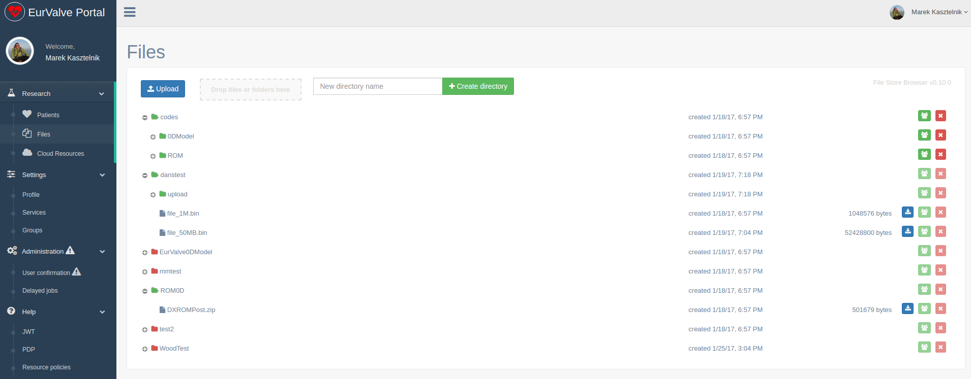
File Store Browser (1/2)
User is able to browse files in a web browser
Basic integration with EurValve security in place
Basic file sharing and permission management mechanism in place

Slide 19
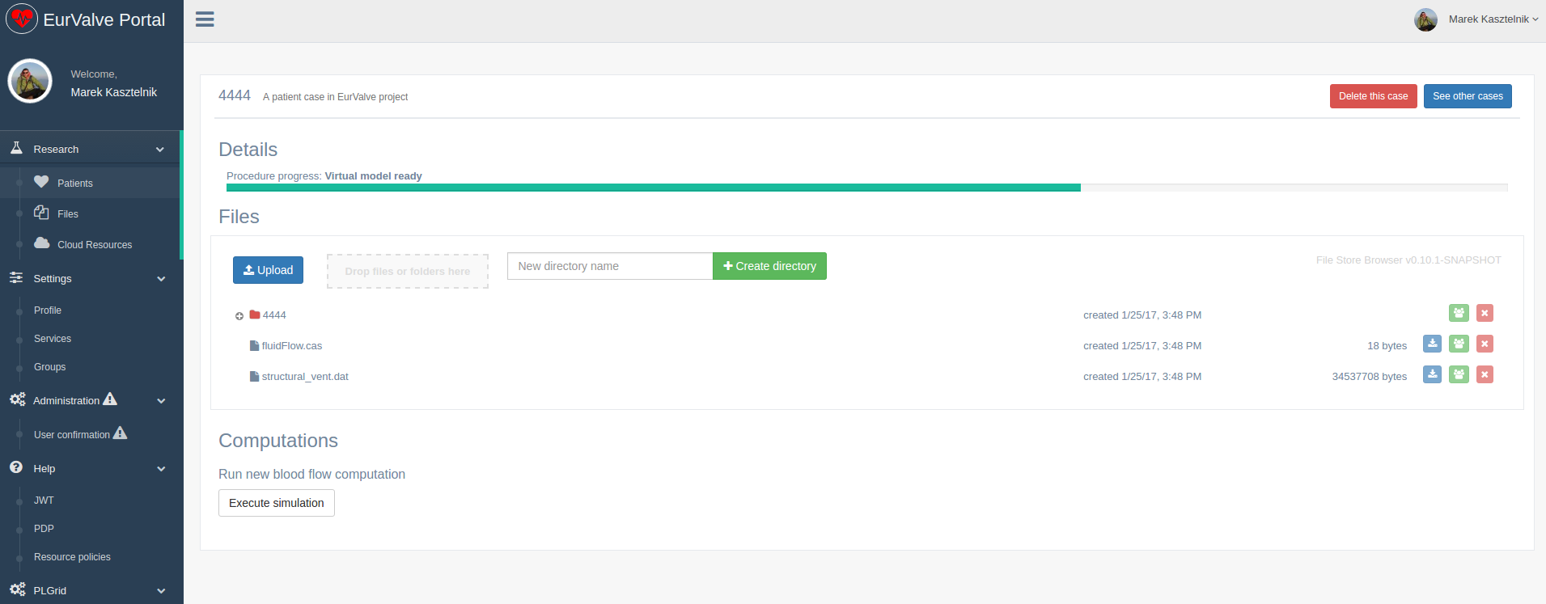
File Store Browser (2/2)
File Browser can be injected into any web page
File browsing can be limited to a selected directory

Slide 20
File Store Performance (1/2)
Available network bandwidth between the File Store and the testing node (tool: iperf)
442.9 MiB/s
Underlying storage write/read speed
Tool: bonnie++ (16 GiB test file with 8 KiB blocks)
Write: 541.9 MiB/s
Read: 36.9 MiB/s
Tool: dd (16 GiB test file with 16 KiB blocks)
Write: 629.5 MiB/s
Read: 37.3 MiB/s

Slide 21
File Store Performance (2/2)
Number of read/write threads: 10
Profiling tool used: Apache JMeter
Transfer of 128000 files each 4 KiB (500 MiB total)
Write (PUT): 0.37 MiB/s
Read (GET): 0.39 MiB/s
Transfer of 1030 files each 2 MiB (2 GiB total)
Write (PUT): 53.6 MiB/s
Read (GET): 9.01 MiB/s
Transfer of 10 files each 1 GiB (10 GiB total)
Write (PUT): 93.46 MiB/s
Read (GET): 13.4 MiB/s

Slide 22
File Store Performance - Summary
Stable request processing by a single node
Each upload/download request processed in similar time
No transfer errors
Network and storage bandwidth utilization
Still room for improvement (approx. 20% of the bandwidth used for large files)
Multi-node setup possible

Slide 23
Summary
Detailed requirements formulated and state-of-the-art in the area of valvular diseases analyzed
Detailed design recommendations relating to model-based research environments established
Prototypes of the Model Execution Environment, with supporting File Store and Integrated Security components facilitating simulations with the aim to develop decision support systems for heart diseases

Slide 24

EurValve H2020 Project 689617 http://www.eurvalve.eu http://dice.cyfronet.pl

