Slide 1
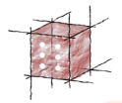
Towards Model Execution Environment for Investigation of Heart Valve Diseases
Marian Bubak
Tomasz Bartynski, Tomasz Gubala, Daniel Harezlak, Marek Kasztelnik, Maciej Malawski, Jan Meizner, Piotr Nowakowski
Department of Computer Science AGH
ACC Cyfronet AGH
Krakow, PL
http://dice.cyfronet.pl/

Slide 2
Outline
Motivation – personalized medicine; Virtual Physiological Human
Objectives
Data and computing flow
Model Execution Environment
File store
Integrated security
Visualization module
Summary
http://www.vph-institute.org/

Slide 3
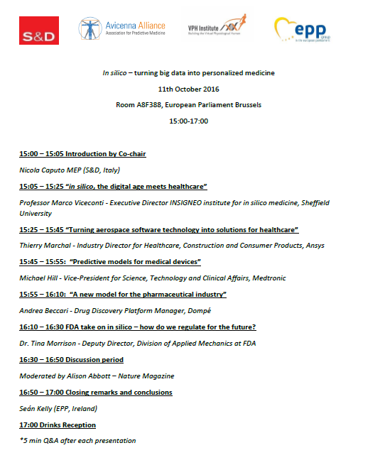

Slide 4














Atmosphere Cloud Platform
VPH-Share Master Interface host
portal.vph-share.eu
96 CPU cores
Head Node
Worker Node
Worker Node
Worker Node
Worker Node
184 GB
RAM
Cloud Management Portlets
Provide GUI elements which enable service developers and end users to interact with the Atmosphere platform and create/deploy services on the available cloud resources
4 TB
storage
Image store
Worker Node
Worker Node
Worker Node
Worker Node
private IP space
VPH-Share cloud site at ACC CYFRONET AGH
Secure RESTful API
(Cloud Facade)
WP2 Core Services Host
vph.cyfronet.pl
128 CPU cores
Atmosphere Core
Head Node
Worker node w/large resource pool
(„fat node”)
256 GB
RAM
Authentication and authorization logic
Communication with underlying computational clouds
Launching and monitoring service instances
Creating new service templates
Billing and accounting
Logging and administrative services
4 TB
storage
Image store
Worker node w/large resource pool
(„fat node”)
private IP space
VPH-Share cloud site at UNIVIE
Atmosphere Registry (AIR)
Massive (functionally limitless) hardware resource pool
API
host
Worker Node
user accounts
Image store
Worker Node
public IP space
available cloud sites
services and templates
Amazon Elastic Compute Cloud (EC2) – European availability zone

Slide 5
Motivation
Investigations leading to practical implementations of personalized medicine are challenging
The main goal of the EurValve project is to combine a set of complex modeling tools to deliver a workflow which will enable evaluation of medical prospects and outlook for individual patients presented with cardiovascular symptoms suggesting valvular heart disease
This research should result in a decision support system (DSS) which can be applied in clinical practice
This research activity requires a dedicated problem solving environment which we refer to as the Model Execution Environment (MEE)

Slide 6
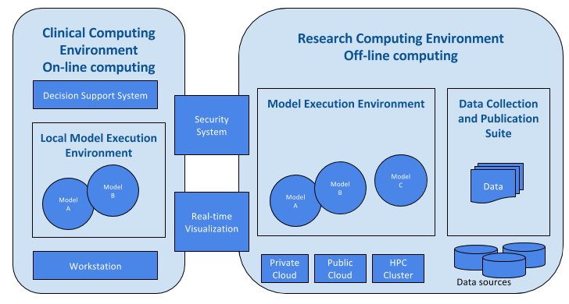
DSS and Research Environment

Slide 7
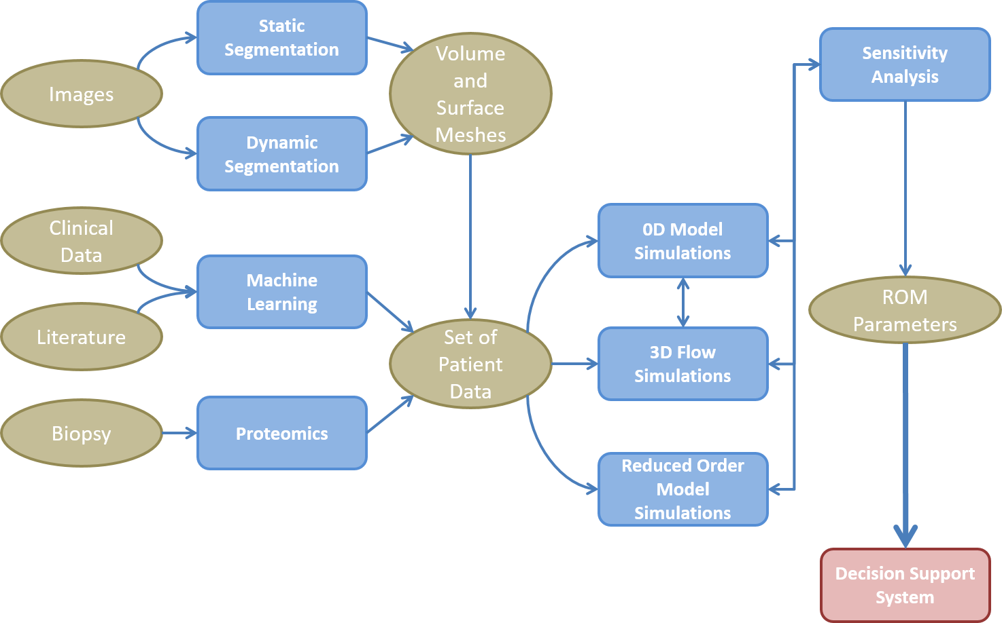
Data and action flow
Data and action flow consists of steps involving image segmentation, proteomics analysis and literature mining to construct system models which, in turn, enable building reduced order models as the knowledge base for the DSS.

Slide 8
Objectives
To develop and provide the necessary infrastructure to:
Collect, represent, annotate and publish core homogeneous data
Store and give secure access to the participating clinical centres and to the development partners to the necessary data
Execute the models in the most appropriate computational environment (private workstation, private cloud, public cloud) according to needs
Support real-time multiscale visualisation.
To develop an integrated security system supporting:
Authentication and authorisation
Data encryption for secure processing in public clouds
To deploy and operate the developed infrastructure, ensuring:
Quality of software components deployed and installed
Quality of service, including such aspects as availability, responsiveness and cost efficiency

Slide 9
Examples of user requirements
Execution environment delivers access to commercial numerical computing environments such as Matlab and AnsysCFD solvers (it will be used to deliver 0D system model and ROM creation of 4D CFD)
Execution environment delivers access to significant computer power and storage (ROM creation requires a lot of computer power and storage, >1000 CPU, many TB of HDD)
Some of the computations will be executed outside the research environment (e.g. Segmentation will be run locally with node-locked license)
Data is transferred from data warehouse to compute environment
Sensitivity analyses are visualized while the computation takes place
The environment should support interactive and batch processing
Interaction with selected services should be automated by scripting or Web UI interfaces

Slide 10
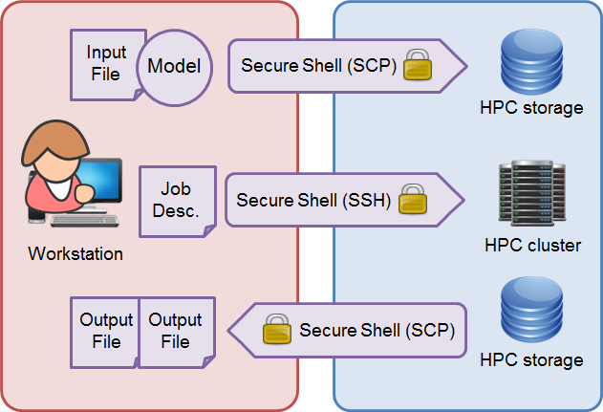
Basic mode of access to HPC
A user, utilizing a series of secure shell connections, transfers files (e.g., simulation input files, heart valve 3D model) to the HPC cluster's file system, submits a computational job execution (for instance, a fluid dynamics simulation) and retrieves job execution output (e.g., the visualization of the performed blood flow simulation through the uploaded heart model).

Slide 11
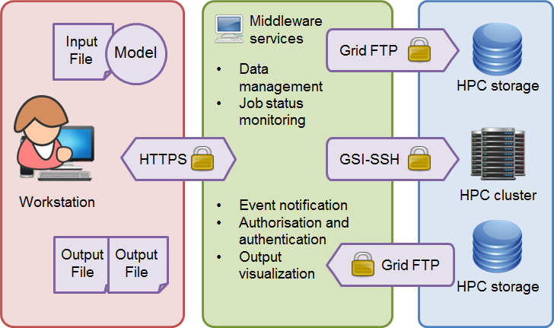
Middleware based access to HPC
The user delegates one's credentials to middleware services, which in turn manage user's input and output data, create and submit the computational job description, actively monitor job execution on the remote computational cluster, and notify the user of completion status. Sometimes such services are also able to visualize simulation execution outputs to the user.

Slide 12
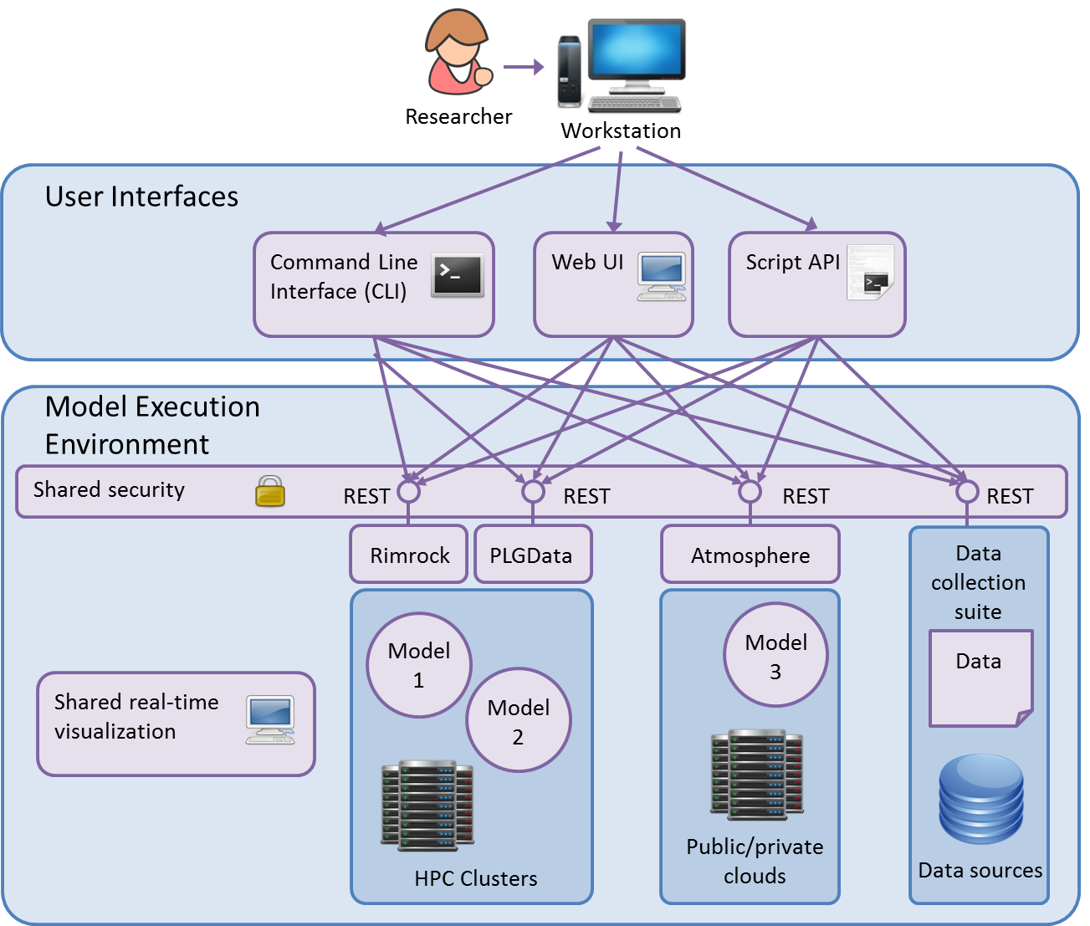
Vision: Model Execution Environment

Slide 13
Alpha version of MEE – 3 services
EurValve File Store - https://files.valve.cyfronet.pl
EurValve Portal - https://valve.cyfronet.pl
Security subsystem

Slide 14
EurValve File Store
Deployment of a file repository compliant with the WebDav protocol, including search capabilities (RFC 5323)
Modification and integration of the FileStore component (developed within VPH-Share) allowing for web-based file browsing/downloads/uploads as part of the newly created EurValve portal
Securing the file repository with a EurValve's security compatible mechanism

Slide 15
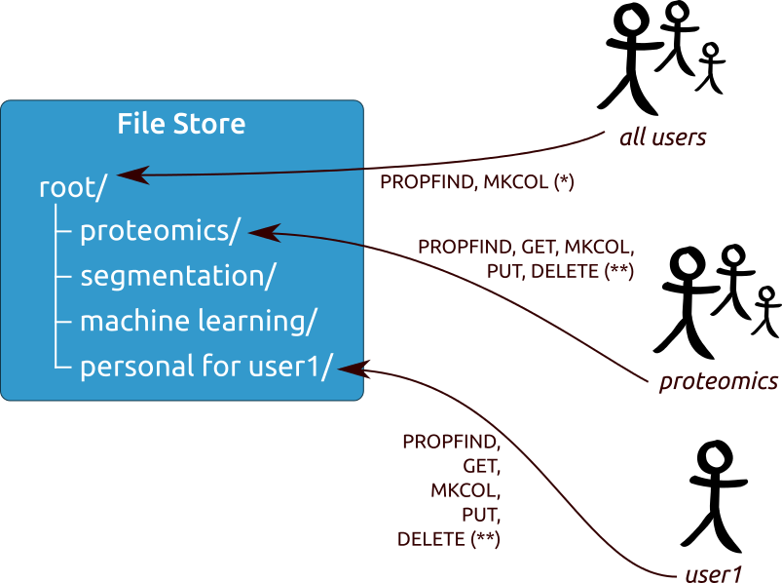
File Store - multi policy approach
Access policies are attached to different nodes according to user sharing actions. Private spaces can be created for individual users and groups.

Slide 16
Model Execution Environment Prototype
Components
Valve portal – discover collected files for patient clinical case, submit blood flow computation into Prometheus supercomputer, monitor computation execution, discover results
Rimrock – tool for submitting jobs into Prometheus supercomputer
PLData – web based file browser for Prometheus files
Prometheus supercomputer
Typical use case
Create new Patient clinical case
Discover files connected with the Patient
Run blood flow computation on Prometheus supercomputer
Monitor computation execution
Discover produced results and update clinical case progress

Slide 17
Integrated Security and Data Protection
Main Portal
Step 1-2: Users authenticate themselves with the selected identity provider (hosted by the project or external trusted one) and obtain a secure token which can then be used to authenticate requests in DSS and RCE.
Step 3-4: Authorization to use computational services is granted in accordance with policies stored in PDP. Optionally user may request service access from resource manager.
Security System
PDP
PRP
IdP
AuthZ
Rules
Data
Rules
PRP
4a
4b
PEP
2
PEP
DSS in Clinical Environment
On-line computing
(a)
Research Computing Environment
Off-line computing
(b)
1a
1b
3a
3b
Model Execution Environment
Data Warehouse
Local Model Execution Environment
User
File Storage
Clinical Data
IdP - Identity Provider
PDP - Policy Decision Point
PRP - Policy Retrieval Point
PEP - Policy Enforcement
Point
Workstation
Private Cloud
Public Cloud
HPC Cluster

Slide 18
PDP, PEP – typical use case
Components
PDP – policy decision point implemented as Valve Portal REST interface
UI to configure permissions for concrete resource. Permission can be given for concrete user or for the group of users
PEP – policy enforcement point implemented as Nginx module
Use case
A request without JWT (JSON web token) is made to a service secured by PEP – the unauthorized response code is returned (401)
A request accompanied by a valid JWT is made, resulting in an access denied (403) exception
Another user registers a service and authorizes other users to access it
The procedure performed in step 2 is repeated – this time permission is granted (200) and secured content is returned to the user

Slide 19
File Store typical use case
Components
UI to facilitate user login and data store access
Authentication mechanisms
PDP, PEP – policy decision/enforcement point to grant/revoke access to resources on the basis of resource owners’ decisions
Scenario
User 1 logs into the UI, accessess the File Store component and creates a directory
User 1 uploads a file to the newly created directory
User 2 logs in and attempts to retrieve the file – however, directory access is denied due to lack of sufficient permissions.
User 1 grants User 2 read-only access for the newly created directory
User 2 is now able to enter the directory and retrieve its content. He is, however, unable to upload new files due to the lack of „write” permissions.
User 1 extends User 2’s permission set with „write” access.
User 2 is now able to create new files and subdirectories in the target directory.

Slide 20
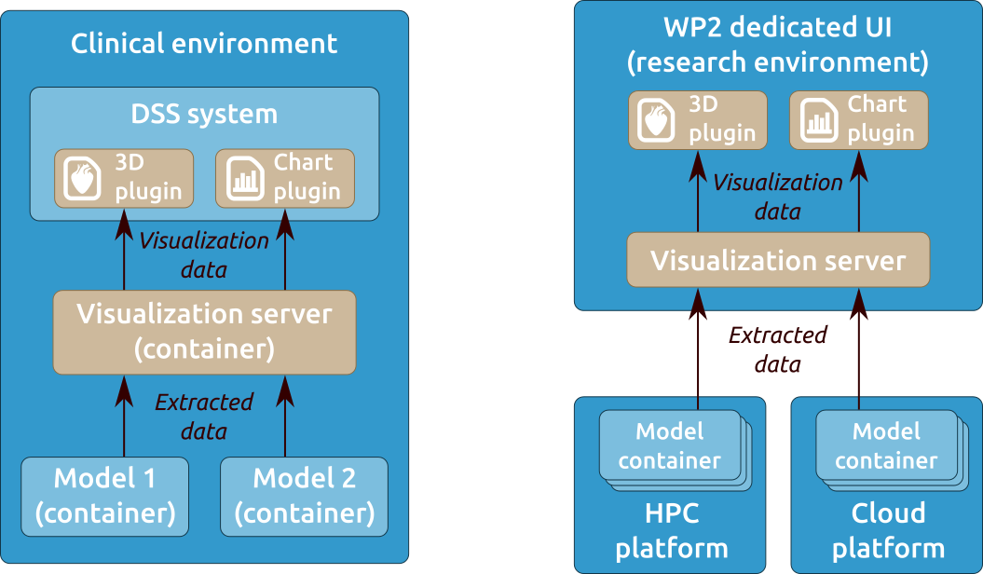
Real-time Multiscale Visualization
Deployment to local and remote Model Execution Environments
Using container technology for packaging
Integration with HPC, local and research computing infrastructure
Visualization components available as embeddable web browser views

Slide 21
MEE services at Cyfronet (alpha versions)
EurValve Portal
URL: https://valve.cyfronet.pl
Registration at: https://valve.cyfronet.pl/users/sign_up
EurValve File Store
URL (docs): https://files.valve.cyfronet.pl
WebDAV endpoint (portal account required): https://files.valve.cyfronet.pl/webdav

Slide 22
Summary
Detailed requirements formulated and state-of-the-art in the area of valvular diseases analyzed
Detailed design recommendations relating to model-based research environments established
Prototypes of the Model Execution Environment, with supporting File Store and Integrated Security components facilitating simulations with the aim to develop decision support systems for heart diseases

Slide 23
Towards Complete Model Execution Environment

Slide 24
H2020 Project 689617: EurValve http://www.eurvalve.eu http://dice.cyfronet.pl

