Slide 2
Final Review
27th March 2019

Slide 3
Platform evaluation
Marian Bubak, Marek Kasztelnik
ACC Cyfronet AGH

Slide 4
Model Execution Environment
MEE integrates the capabilities of the research branch of EurValve and is used to compute models for the clinical environment (i.e. for DSS)
MEE can be accessed from a dedicated GUI (the EurValve Portal), through a RESTful API or through a comman-line interface, depending on the researcher’s preferences.
Computational tasks can be run on HPC resources or in a cloud environment as appropriate.
A uniform security layer is provided.
API – Application Programming Interface
REST – Representational state transfer
Rimrock – service used to submit jobs to HPC cluster
Atmosphere – provides access to cloud resources
GIT – distributed revision control system

Slide 5
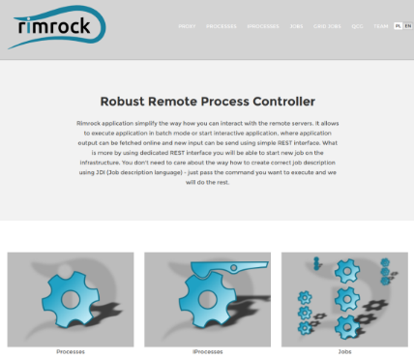
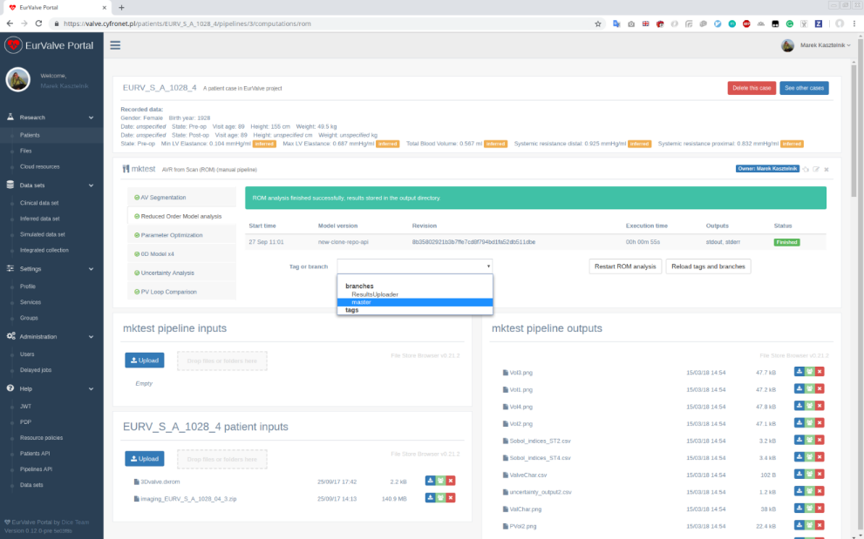
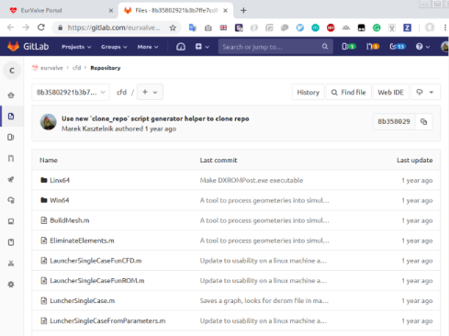
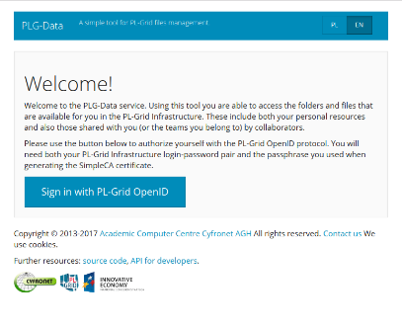
Functionality of MEE platform
Integrated with PLGrid infrastructure (automatic proxy generation)
Enables submitting jobs to the Prometheus HPC cluster
Enables file upload and download to/from Prometheus storage
Connected with GitLab repositories for model versioning and provenance
Tabular data
Run
Select model version
Browse inputs
and outputs

Slide 6
Platform usage statistics
Model Execution Environment
2 environments (production https://valve.cyfronet.pl and development https://valve-dev.cyfronet.pl)
25 releases (13 feature-rich, 12 bugfix releases)
357 feature and bug issues solved, 413 merge requests merged
Uptime: 99.92%
File Store
2 environments (production https://files.valve.cyfronet.pl and development https://files.valve-dev.cyfronet.pl)
36 releases (22 feature-rich, 14 bugfix releases)
129 feature and bug issues solved, 126 merge requests merged
Uptime: 98.87%

Slide 7
Resource usage
The Prometheus cluster was used to develop ROM and perform patient simulations. We applied for 5 computation grants and consumed 305,000 CPU hours:
Grant name | Start date | End date | Requested CPU hours | Consumed CPU hours
EurValve 1 | 12.01.2016 | 12.01.2017 | 25000 | 22869
EurValve 2 | 17.02.2016 | 17.02.2017 | 500000 | 38018
EurValve 3 | 22.02.2017 | 22.02.2018 | 150000 | 94279
EurValve 4 | 05.03.2018 | 05.03.2019 | 150000 | 150000
EurValve 5 | 01.02.2019 | 30.06.2019 | 150000 | XXXXX
Patient data and simulation results are stored in 72,953 files which use 265GB of disk storage.
Tabular Data Store
Clinical data items 357 records with 305 data items each
Simulated results 1457 records with 78 data items each

Slide 8
Software engineering goals
To ensure good development practices throughout the Project
To define a clear set of release procedures
To set up infrastructure monitoring
To promote model versioning for simulations

Slide 9
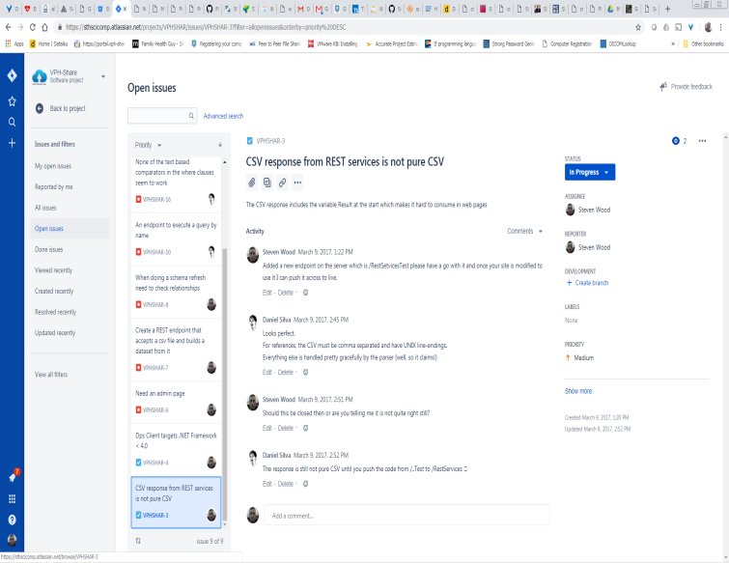
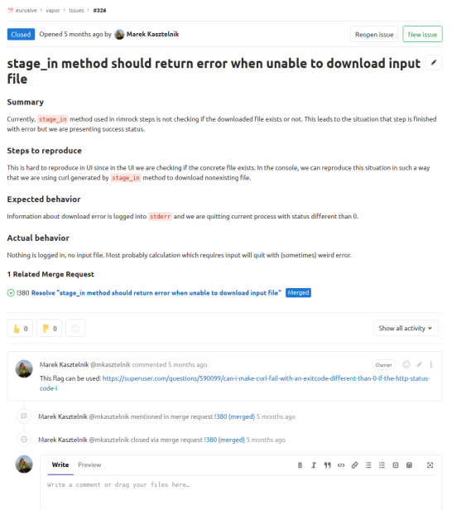
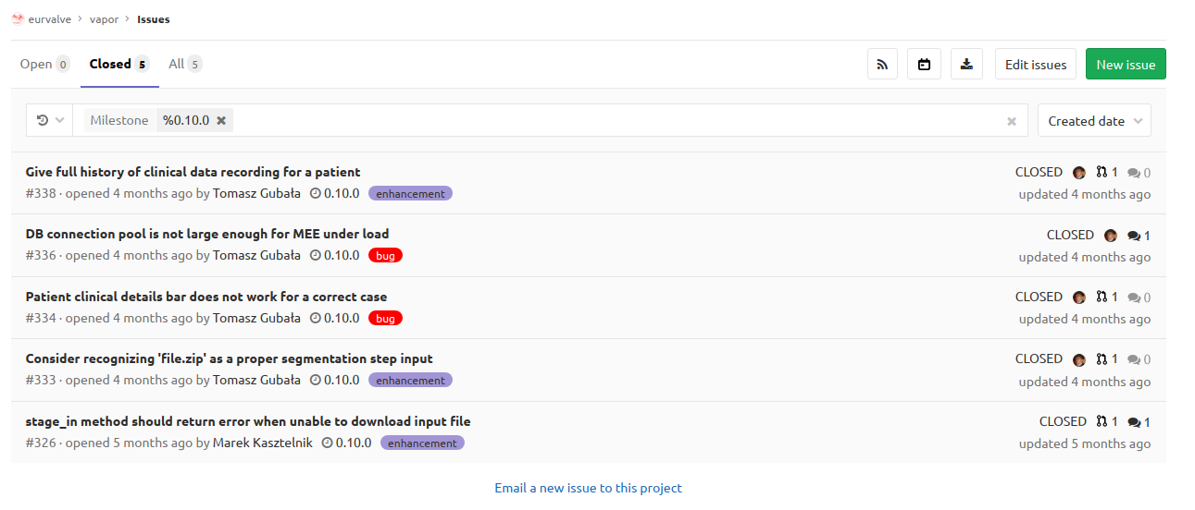
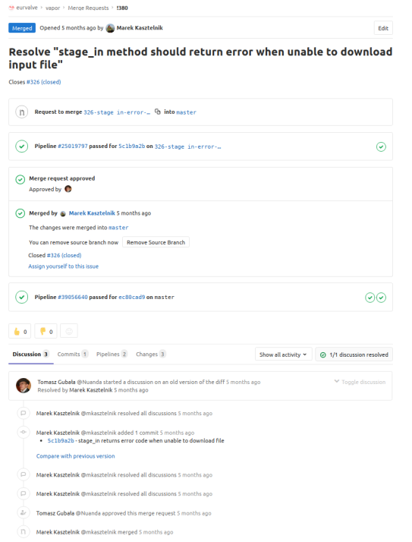
Development methodology
Identification of ideas/issues – We begin by describing problems or suggested features using the GitLab/Jira issue tracking systems.
Planning – Following each development cycle we hold a planning session to decide what to do next. As a result, issues are grouped into milestones.
Development – Development focuses on addressing issues scheduled for the current milestone. Finished features are submitted for review by the rest of the team, in the form of a Merge Request.

Slide 10
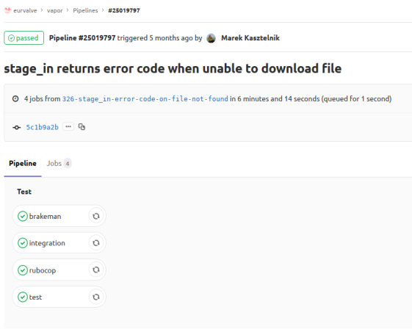
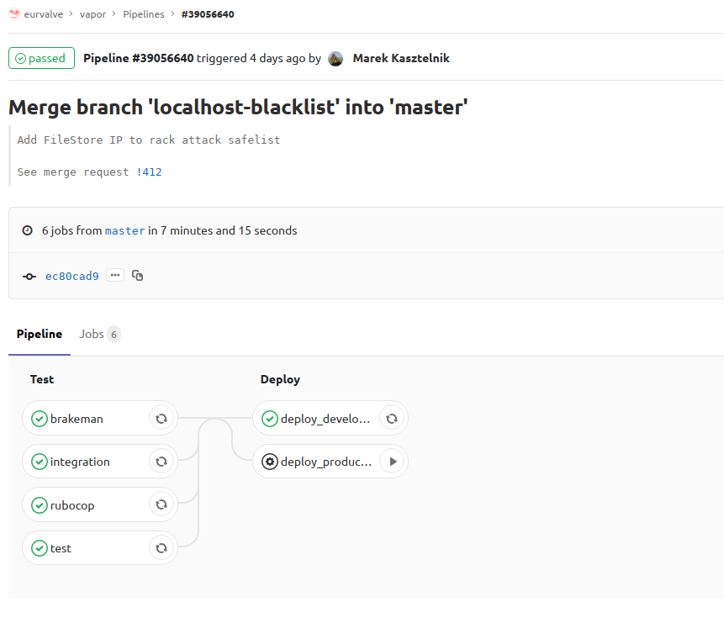
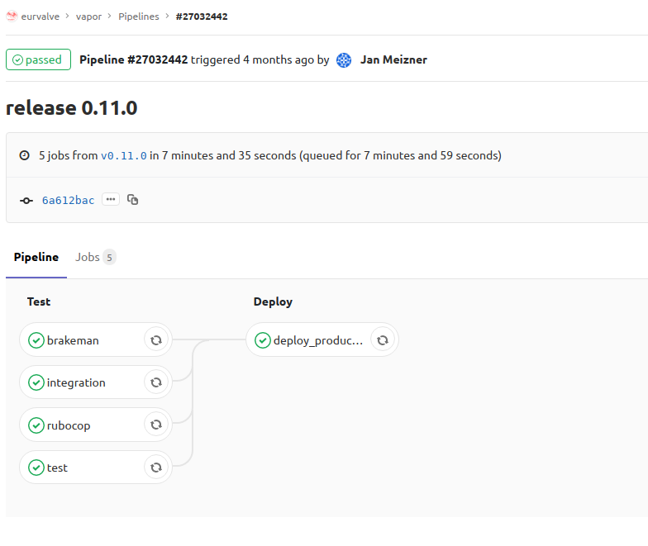
Development methodology (2/2)
Review – The merge request is reviewed by the rest of the team. During the review code is improved until the team decided that it is “ready to be merged”. Each change triggers an automatic testing pipeline.
Merge and deployment of a development MEE instance – After code is merged, an automatic build pipeline is triggered. Once all tests pass successfully, a new MEE version is built and deployed to the development environment (https://valve-dev.cyfronet.pl).
Release – Once all issues from the milestone have been resolved, a new release is created. The release assumes the form of a Git tag, pushed to a remote Git repository (https://youtu.be/dh8-zGaQ5xo).
Deployment of a production MEE instance – After the new tag appears in the repository, an automatic pipeline is triggered which verifies the new MEE version. Once all tests have passed, the new version is built and deployed to the production environment (https://valve.cyfronet.pl) .

Slide 11
Implemented tests
Unit tests – the most lightweight tests, used to validate specific features in isolation (MEE development uses rspec unit tests)
Feature tests – tests which “impersonate the user” while all integration with external systems is mocked. For the web applications, we set up a headless browser and simulate user clicks (MEE uses rspec feature tests and Capybara)
Integration tests – similar to feature tests, but involve testing integration with external systems (e.g. MEE integration tests invoke the File Store to obtain the structure of a selected directory or fetch a specific file)
Static code analysis – tests which perform static code analysis and find potential formatting problems, propose code optimization, warn about deprecations, etc. (MEE uses rubocop for static code analysis)
Security audit – a set of tools which checks versions of dependencies and uses static code analysis to find potential security vulnerabilities (MEE uses brakeman for security vulnerabilities scans).

Slide 12
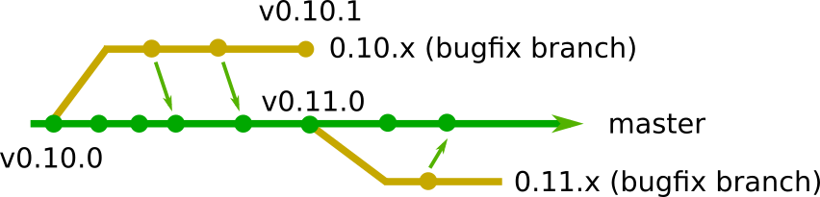
Bugfix releases
If a problem is found in the current release:
a bugfix branch is created from the corresponding tag (e.g. 0.11.x branch from v0.11.0 tag)
fixes are pushed to the bugfix branch and backported to the master branch
all bugfix releases are performed using the bugfix branch
the bugfix branch lives until a new feature-rich release is available (e.g. the 0.11.x bugfix branch is deleted following release v0.12.0)

Slide 13
MEE 0.13.0 – release procedure demo
Switch to recorded release demo
https://youtu.be/dh8-zGaQ5xo
Script:
See current MEE version
Set release version in changelog and version files
Create v0.13.0 Git tag
Push tag to remote repository
See testing and “push to production” pipeline
See new MEE version and begin new development cycle

Slide 14
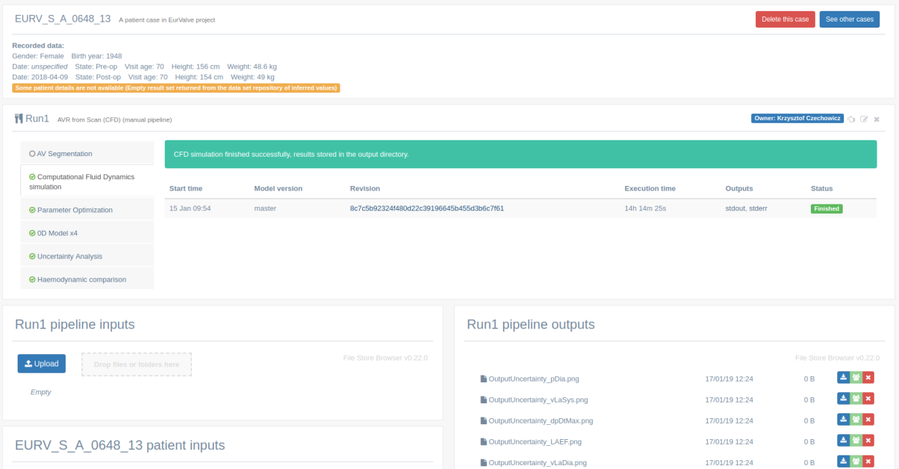
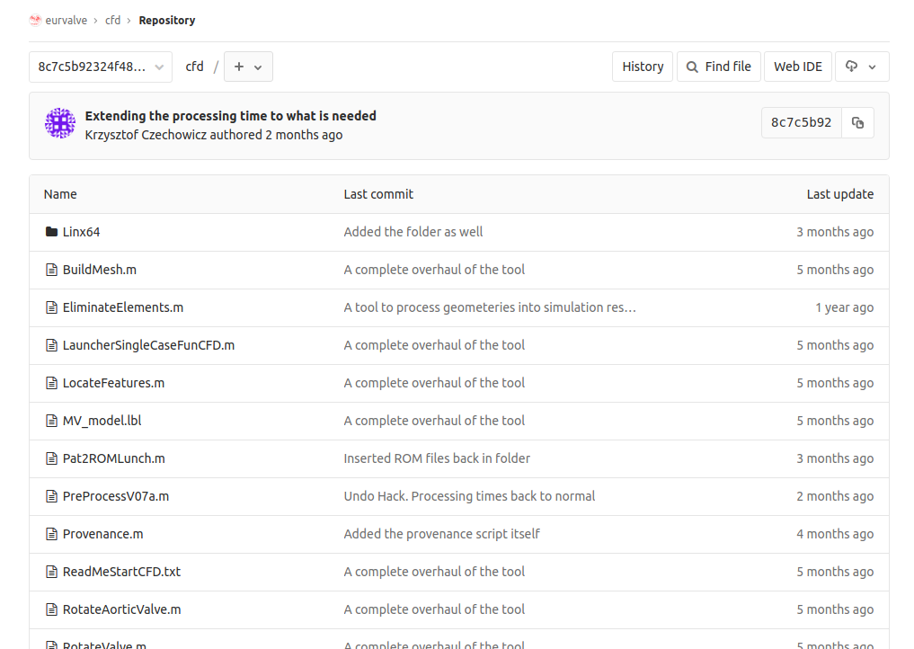
Model versioning
All models started in MEE need to be versioned using a Git repository. This approach brings the following advantages:
We are able to start different model versions and compare the results;
We are able to trace each change in the code to a specific user (Git history – a way to implement code provenance);
We are able to experiment with the model by creating dedicated Git branches which can be executed on the Prometheus supercomputer.

Slide 15
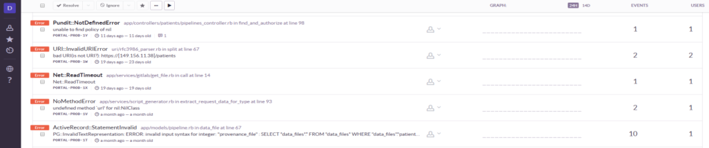
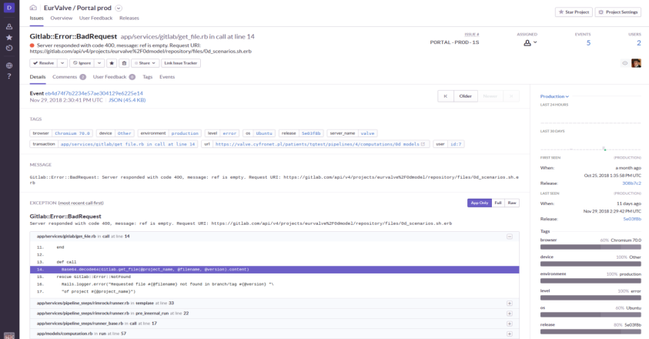
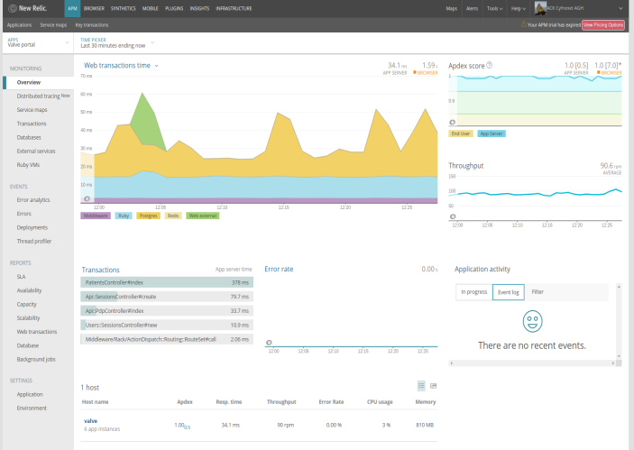
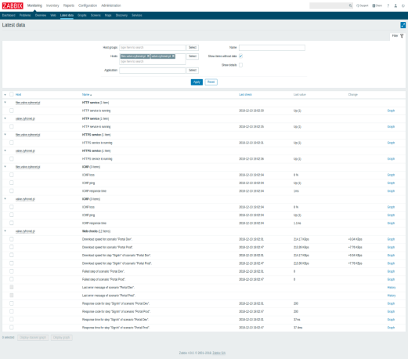
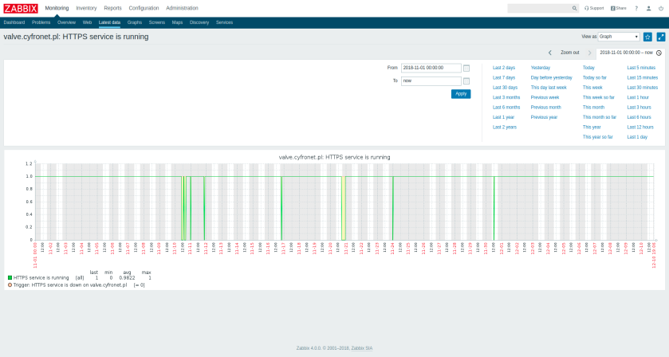
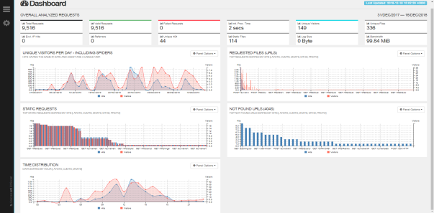
Monitoring
Both the development and production EurValve builds are subject to monitoring using:
Sentry – responsible for collecting and aggregating information about EurValve portal errors
NewRelic – used to track portal performance and availability by alerting system operators to any infrastructural downtime (due to e.g. app/OS crashes, electrical failures, network failures etc.)
Zabbix – used to monitor service uptime (complementary to NewRelic), collecting resource utilization data, evaluating the risk of service crash due to lack of resources (before it actually occurs) as well as presenting collected data in the form of graphs.
GoAccess – used to analyze web logs which enables administrators to understand system access profiles

Slide 16
Summary
All components developed in the scope of EurValve have a well established development methodology
Code is checked for potential bugs (unit/feature/integration tests, static code analysis, security scans)
An established release procedure is operational
Deployed components are monitored to discover availability and errors/issues
Models are versioned, model execution for the patient is recorded (with the MEE pipelining system)

Slide 17













More at http://dice.cyfronet.pl http://www.eurvalve.eu EurValve H2020 Project 689617

