Slide 1
EurValve First Period Review
WP2 Model Execution Environment
Cyfronet
Marian Bubak

Slide 2
WP2 Summary
WP Purpose
WP2 elaborates and operates a flexible, easy to use environment for the development, deployment and execution of large scale simulations, required for learning process development and for sensitivity analyses (a ‘Model Execution Environment’).
Main Events
WP2 is expected to complete its specification phase by Project Month 6 and begin gathering data by Project Month 9. The candidate release of WP2 tools is expected by Project Month 30.
Main Events in this period
An advanced prototype of the Model Execution Environment (v 0.7.0) has been completed and is ready to process patient pipelines, as demonstrated during the review meeting.
Completed Objectives
Users of the MEE are able to browse data, run patient pipelines and visualize results at each step of the process. A security system is in place and a selection of data processing tools is available.
The MEE has been integrated with the high performance computing infrastructure at ACC Cyfronet AGH, enabling tasks to be run on the Prometheus supercomputer.
Challenges and Solutions
The main goal, i.e. being able to run a simulation for an input data set, has been completed, and the MEE provides full-fledged functionality in this regard.
Additional data manipulation tools and presentation options are being integrated.

Slide 3
From Research Environment to DSS
Research Computing Infrastructure
Development of models for DSS
Clinical Computing Environment
Real-time Multiscale Visualization
Model Execution Environment
Data Collection and Publication Suite
DSS Execution Environment
ROM
0-D Model
Patient Data
ROM
3-D Model
Model A
Images
Population data
Security System
Model B
Infrastructure Operations
Data Source 1
Data Source 2
HPC Cluster
Cloud
Workstation
Provide elaborated models and data for DSS

Slide 4
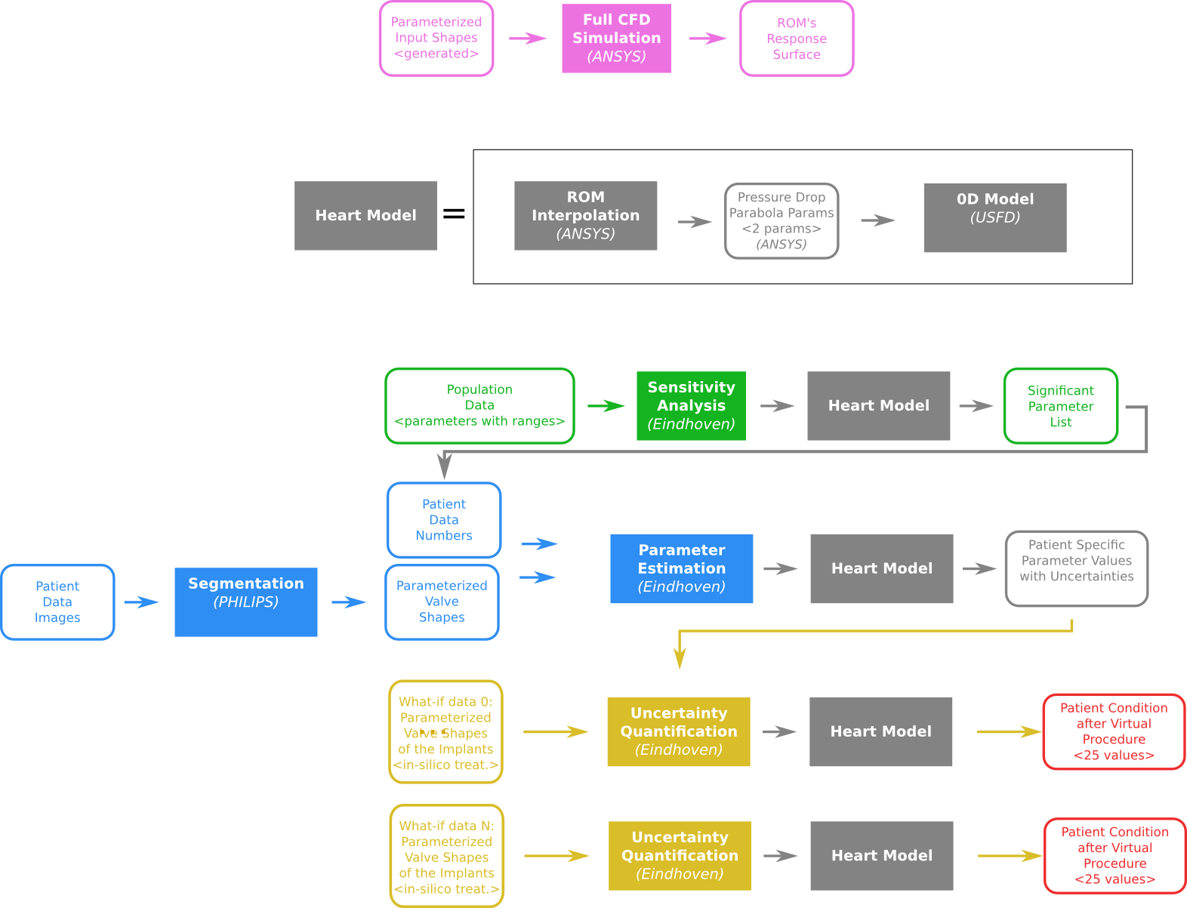
Pipelines for ROM and sensitivity analysis
Data and action flow consists of:
full CFD simulations
sensitivity analysis to acquire significant parameters
parameter estimation based on patient data
uncertainty quantification of various procedures
The flow of CFD simulations and sensitivity analysis is part of clinical patient treatment

Slide 5
Medical data in MEE
Data classification based on source
retrospective (Clinical Examination, Patient Tables, Medication etc.)
prospective (data generated in the course of medical trials)
Types of data and unique handling requirements
Files / BLOBs (Binary Large Object) – large chunks (MB-GB range) of data (e.g. images) that do not need to be searchable and are to be stored in the File Store
DB (Database) records – relatively small (B-KB) tabular records (measurements, patient records) which must be quickly searchable and are to be stored in a database
Mixed Data – data composed of BLOBs and Metadata – e.g. DICOMs – needs to be decomposed by storing BLOB data in the File Store and Metadata + BLOB reference (URI) in the DB
Basic operations on medical data
Data aggregation from available medical sources done with the Data Publication Suite (DPS) for the retrospective data and the ArQ tool from STH for the prospective data
Data de-identification and, optionally, separation/classification of BLOB and DB data done with the DPS and ArQ
Data storage in File Store or DB

Slide 6
WP2: Partner roles
Partner | PM | Role Description
Cyfronet | 47 | Leading WP2, development of the Model Execution Environment, responsibility for integration with the data warehouse, and support to WP5 in its deployment within WP5
USFD | 5 | Ensuring the operation of the modelling analysis tools of WP3 with the infrastructure
DHZB | 21 | Work with STHFT on the introduction and support of the clinical data system
UR1-LTSI | 1 | Ensuring the operation of the case-based reasoning through the infrastructure
STHFT | 24 | Design and deployment of the data warehouse and the interface to the clinical systems

Slide 7
WP2: Task summary
Task | CYF | USFD | DHZB | UR1 | STHFT | Description
T2.1 | 2 | 2 | 15 | 0 | 16 | Construction of data warehouse and provision of data collection and publication suite Data hosting facilities, data collection
T2.2 | 15 | 1 | 1 | 1 | 2 | Model Execution Environment Execution environment, interface to data warehouse and to modelling tools. Private workstation, private and public clouds, HPC
T2.3 | 10 | 1 | 2 | 0 | 2 | Integrated security and data encryption Authentication, authorisation, data protection provided in collaboration with Task 2.1
T2.4 | 10 | 0 | 1 | 0 | 2 | Real-time multiscale visualisation Tools for real-time multiscale visualisation within a Web browser
T2.5 | 10 | 1 | 2 | 0 | 2 | Platform quality assurance Assuring quality of service of the platform, including availability, responsiveness and support

Slide 8
WP2 T2.1 Construction of Data Warehouse and Provision of Data Collection and Publication Suite
 | T2.1 Construction of Data Warehouse and Provision of Data Collection and Publication Suite
Achievement | Access to structural data (databases) and binary data (imaging/processing results) is provided and integrated with the Model Execution Environment.
Context | Data access is essential for any processing to take place in the context of EurValve. Accordingly, a robust solution must be in place before simulation pipelines can be executed.
Location | This task is led by STHFT and DHZB, assisted by other partners – notably Cyfronet, which is responsible for the File Store subsystem.
Dependencies | This task depends on access to medical data as provided by ArQ and TrialConnect, and it feeds into the data processing features developed in the context of WP2. It also requires dedicated storage resources for binary data.
Importance | This task is of fundamental importance for the data processing and presentation layers of the MEE software stack.
Demonstration | Querying medical datasets and visualizing simulation results stored in the EurValve Data Store is supported by the current version of the MEE. Both components can also feed data into computational tasks and store results.
Plans | Additional visualization and querying options are being developed

Slide 9
Basic features of the structured data store
Exists as a collection of independent databases, one for each dataset required in the project, Clinical, Inferred, Computed etc.
Datasets can be updated and queried individually by different groups of users.
High-level “virtual” datasets can be configured so queries can be transparently federated across the underlying sources.
Web based graphical query tools have been developed for data exploration.
Web services deployed for low level data access.
Command line tools developed for easy use in HPC environments.
Higher level data aggregation services are now being delivered for example “stacked queries” which insert inferred values into empty fields in the clinical records before simulation.

Slide 10
Basic features of the File Store
Deployment of a file repository compliant with the WebDav protocol, including search capabilities (RFC 5323)
File Store component (browser) enabling web-based file browsing, downloads and uploads through the EurValve portal
File Browser may be reused in dedicated portal views where the user can browse a specified sub-folder and perform a restricted set of operations
Remote file system can be mounted on a local computer using an off-the-shelf WebDav client under Windows, MacOs or Linux
File Store is integrated with the EurValve security solution; directory permissions can be granted to a user or to a group of users. All data is encrypted with a strong encryption mechanism (AES256).

Slide 11
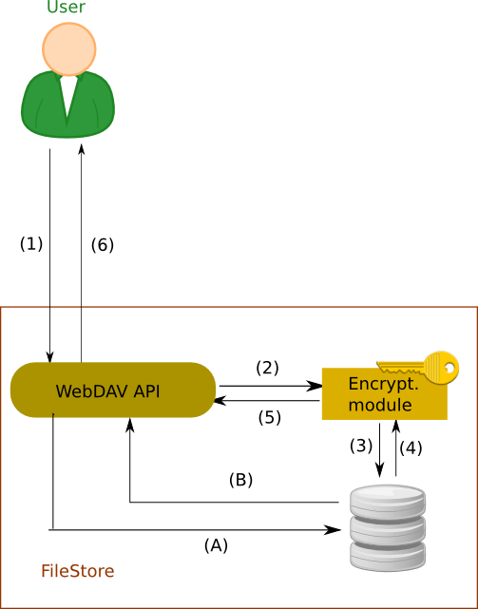
Flow of Medical Data
Secure locally hosted service
BLOB Data handled based on the confidentiality level:
Step 1 (all levels) – data is sent via encrypted channel to the service
Step 2-3 (high) – data encrypted and stored on disk
Step 4-5 (high) – data decrypted and retrieved
Step A-B (lo) – data stored directly to disk
Step 6 (all) – data sent back to the user
DB Records:
Step 1b – data is saved via an encrypted channel to the DB service in a secured location
Step 2b – data is retrieved from the service via an encrypted channel
At present, all EurValve data is encrypted; however steps A and B could also proceed in an unencrypted mode (if required for performance reasons).
API – Application Programming Interface
BLOB – Binary Large Object
REST – REpresentational State Transfer
(1b)
REST
(2b)
SQL
Database access

Slide 12
WP2 T2.2 Model Execution Environment
 | T2.2 Model Execution Environment
Achievement | A fully functional release of the Model Execution Environment is available and actively used to support medical data processing in the context of various simulation pipelines.
Context | The MEE is where EurValve computational research takes place. Its goal is to produce datasets suitable for the EurValve Decision Support Systems, and to provide researchers with tools to access and process data.
Location | This task is led by Cyfronet.
Dependencies | MEE depends on access to data storage and computing infrastructures (including HPC and Cloud resources), and it also integrates data processing algorithms produced in WP3.
Importance | This task facilitates all long-term (i.e. non-runtime) data processing which takes place in EurValve.
Demonstration | All features of the MEE suite are in place, including authentication/authorization, policy management, access to data, access to computations and visualization of results.
Plans | The MEE is currently being extended with additional types of processing pipelines. Validation of results against retrospective patient data is in development.

Slide 13
Functionality of Model Execution Environment
Reproducibility, versioning, documentation of the pipeline
Automation of the simulation pipeline with human in the loop for:
new models, new versions of models,
new users
Data preservation
Basic provenance features
Helpful visualization of simulation flow and obtained results
Generation of some components of publications
Portability

Slide 14
Model Execution Environment - structure
The MEE can be interfaced from a dedicated GUI (the EurValve Portal), through a RESTful API or through a comman-line interface, depending on the researcher’s preferences.
Computational tasks can be run on HPC resources or in a cloud environment, as appropriate.
A uniform security layer is provided.
API – Application Programming Interface
REST – Representational state transfer
Rimrock – service used to submit jobs to HPC cluster
Atmosphere – provides access to cloud resources
git – a distributed revision control system

Slide 15
Notable features of the MEE
Pipeline execution management: organizes set of models into a single sequential execution pipeline with files as the main data exchange channel
Model development organization through structuralization
Retention of execution and development history
Computation execution diff: an adequate tool for model developers to compare two different model executions, revealing any changes along with their impact on results
Dedicated comparison software for specific types of results
Easier problem detection and manual validation
Mounting File Store under Windows and Linux
No extra dependencies needed under Windows
EurValve portal account required
Access to EurValve file resources with native Windows and Linux clients
Mounting EurValve file resources to be used by other services

Slide 16
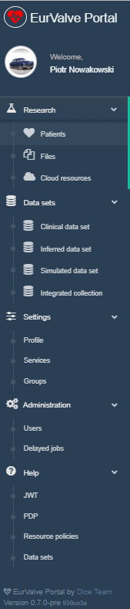
Implementation of MEE
Model Execution Environment:
Patient case pipeline integrated with File Store and Prometheus supercomputer
File Store for data management
Cloud resources based on Atmosphere cloud platform
Data sets
Structural access to patient databases
Query interfaces for real, simulated and inferred data
Security configuration
Service management – for every service dedicated set of policy rules can be defined
User Groups – can be used to define security constraints
REST API
Creating a new user session – as a result, new JWT (JSON Web Token) tokens are generated for credential delegation
PDP – Policy Decision Point: check if user has access to concrete resource
Resource policies – add/remove/edit service security policies
Notes:
16

Slide 17
WP2 T2.3 Integrated security and data encryption
 | T2.3 Integrated security and data encryption
Achievement | A comprehensive security solution is in place, protecting all features of the Model Execution Environment and EurValve data repositories.
Context | All access to EurValve data requires proper authentication and authorization, and the MEE must implement mechanisms by which access policies can be defined and managed.
Location | This task is led by Cyfronet with contributions from STHFT.
Dependencies | No internal dependencies exist, although given the fact that EurValve computations are run on the Prometheus supercomputer at ACC Cyfronet AGH, the EurValve security solution must be (and has been) integrated with existing security mechanisms governing access to Prometheus.
Importance | The importance of secure access to data – particularly medical data – is self-evident.
Demonstration | Authentication, authorization, policy management and integration with HPC security components at Cyfronet are all available for demonstration.
Plans | More fine-grained security policies for the EurValve File Store are contemplated, along with access trace mechanisms.

Slide 18
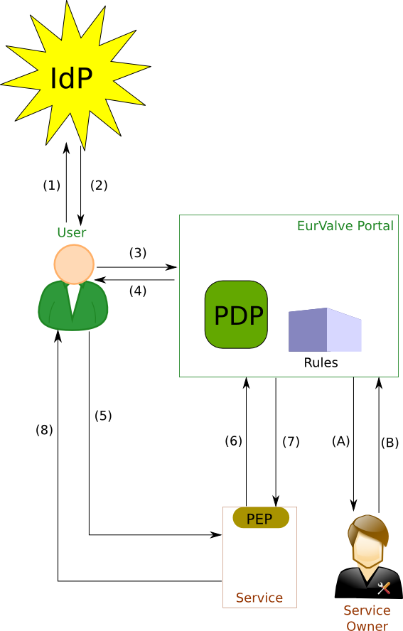
Integrated Security Framework and its use
Step 1-2 (optional): Users authenticate themselves with the selected identity provider (hosted by the project or an external trusted IdP) and obtain a secure token which can then be used to authenticate requests in MEE
Step 3-4: User requests JWT token from the Portal, based on IdP or local authentication
Step 5 – User sends a request to a service (token attached)
Step 6-7 – Service PEP validates token and permissions against the PDP (authorization)
Step 8 – service replies with data or error (access denied)
Optional interaction by the Service Owner:
Step A-B – Service Owner may modify policies for the PDP via:
the Portal GUI: global and local policies can be defined
API (e.g. from within a Service): local policies only
IdP – Identity Provider
PDP – Policy Decision Point
JWT – JSON Web Token
PEP – Policy Enforcement Point

Slide 19
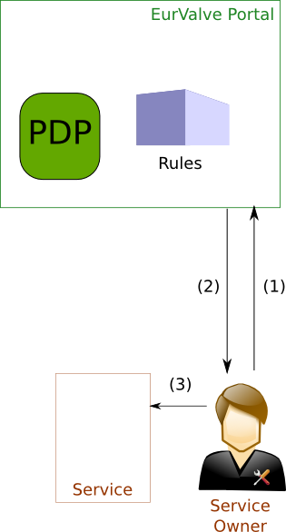
Registration of a new service
To secure a service its owner first needs to register it in the Portal/PDP
Step 1-2: Service Owner logs into the Portal, creates the Service and a set of Global Policies, and obtains a Service Token
Step 3: Service Owner configures the Service PEP to interact with the PDP (incl. setting the service token).
A standard PEP for Web-based Services is provided by the Cyfronet team.
Custom PEPs may be developed using the provided API.
The Service may use its token to:
query the PDP for user access
modify Local Policies for fine-grained access to the Service

Slide 20
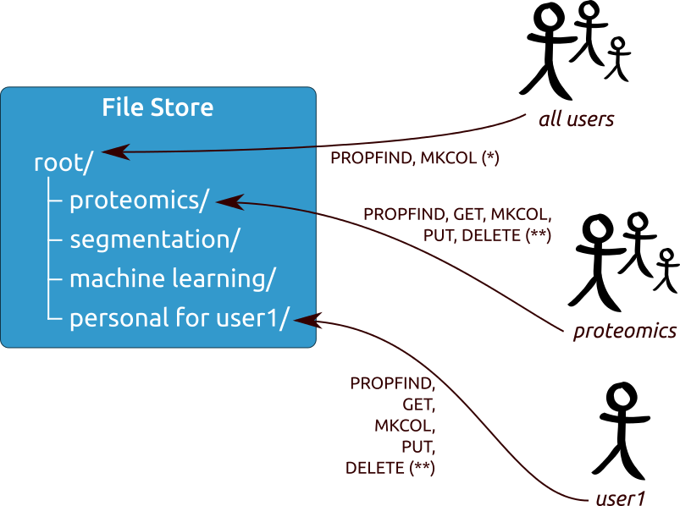
File Store - multi policy approach
Access policies are attached to different nodes according to user sharing policies. Private spaces can be created for individual users and groups.

Slide 21
WP2 T2.4 Real-time multiscale visualization
 | T2.4 Real-time multiscale visualization
Achievement | A Web-based visualization feature has been built into the MEE, enabling the output of simulation pipelines to be directly visualized and compared.
Context | This is an add-on feature which augments simulation pipelines provided by the MEE.
Location | This task is led by Cyfronet with contributions from STHFT.
Dependencies | Visualization tools depend on integration with data storage components (particularly the EurValve File Store) and on integration with EurValve security mechanisms.
Importance | Being able to directly visualize the output of simulations is a useful feature for platform users.
Demonstration | Visualization plugins for various types of data elements are available for use.
Plans | More visualization options for popular medical imaging formats, as required by MEE users.

Slide 22
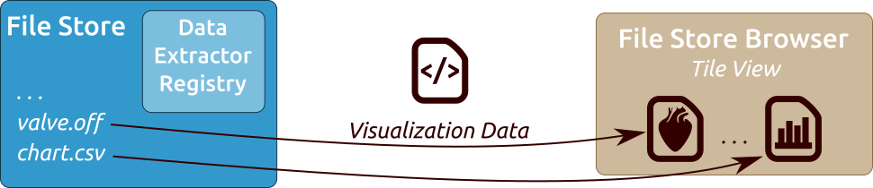
Visualization module
The File Store component has been extended with a Data Extractor Registry with code defining how to extract relevant visualization data from a given file
Data Extractors can be associated with given file extensions, particular folders and viewers
The web-based File Store Browser uses registered extractors to fetch visualization data and initialize dedicated viewers if given file formats have been associated with any data extractors
Any new data written to the File Store updates the viewers immediately

Slide 23
WP2 T2.5 Platform quality assurance
 | T2.5 Platform quality assurance
Achievement | A software development and release timeline has been agreed upon, along with a list of tools and mechanisms applicable in the software development process.
Context | As WP2 produces a large quantity of software, the goal of this task is to ensure that such software is developed in a manner consistent with best practices in software development.
Location | This task is led by Cyfronet with contributions from STHFT.
Dependencies | This task does not, by itself, depend on other tasks or work packages of EurValve.
Importance | Proper validation, unit/integration testing and code reviews are important in any major software development project, and EurValve is no exception.
Demonstration | While not part of the clinical demo, we are ready to demonstrate the tools we used in the software development process (upon request).
Plans | We intend to clearly establish channels by which the MEE can be extended with additional features, and provide guidelines for developers of such features (e.g. additional pipeline steps).

Slide 24




CASE tools in use
Gitlab
RuboCop
Popular GIT project repository (can be deployed locally)
Provides change tracking, ticketing and collaborative development tools
Supports automatic testing and validation of submitted code
Code quality review tool
Detect style violations and suggests improvements
Supports modern versions of Ruby and JRuby
Integrated with Gitlab; dispatches notifications by e-mail
Gitlab CI
Brakeman
Continuous Integration tool supported by Gitlab
Can automatically run software build specs in various configurations
Can quickly detect and pinpoint integration problems
Rails security scanner
Statically analyses Ruby on Rails code to discover security issues
Checks app config for consistency with RoR best practices
Easy to set up, can be run at any stage of development
Notes:
Slide Objectives:
Speaking Points:

Slide 25
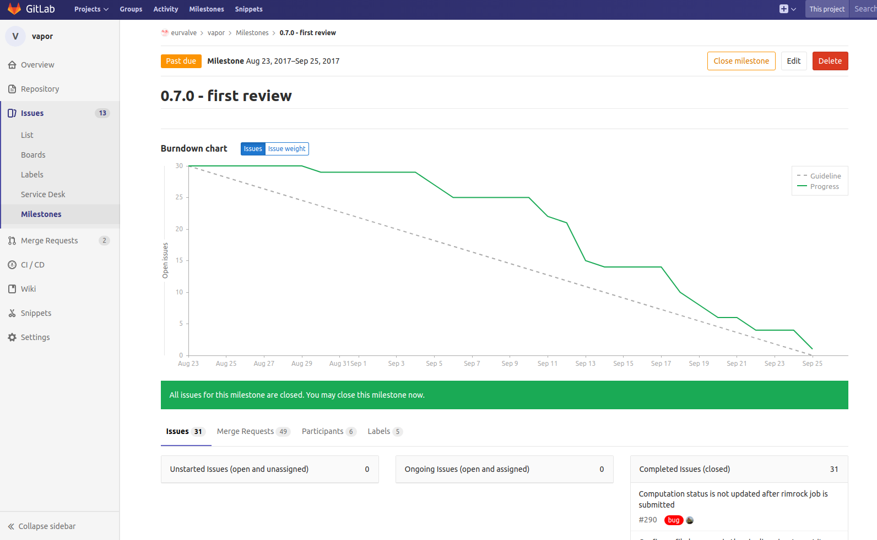
Software release process
A new version of the Model Execution Environemnt is released every 2-3 months (we are currently using version 0.7.0).
We use Gitlab as the project code repository.
Issues are tracked and pull requests processed by the Cyfronet team.
A code review is performed for each pull request, and a number of automatic CASE tools are in place to ensure consistency and quality of submitted code.
Notes:
25

Slide 26
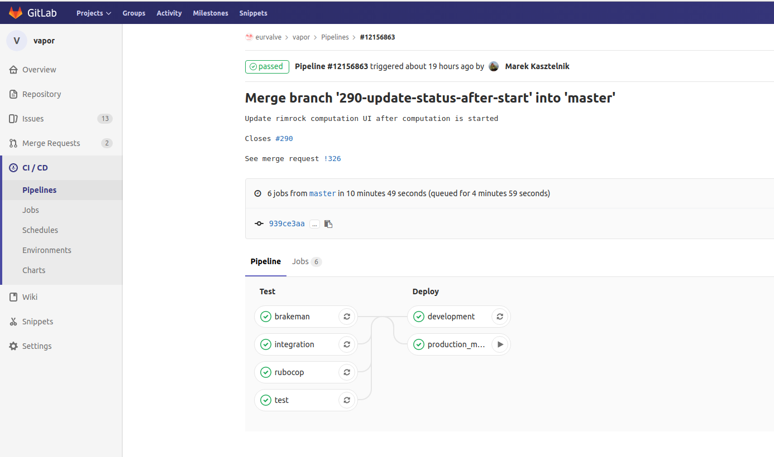
Issue tracking and pull requests
New code is merged only after passing through a formal review process.
Unit tests and static code analyzers are run automatically.
https://gitlab.com/eurvalve/vapor is the MEE project url on Gitlab.
Feature requests and bug reports may be submitted by all registered users.
Notes:
26

Slide 27
MEE extensibility – support for additional computational modules
Additional modules can be implemented:
As applications deployed on the Prometheus supercomputer
As external services communicating with the platform via its REST interfaces
As virtual machines deployable directly in the Cyfronet cloud via the Atmosphere extension of the MEE
Encapsulating pipeline steps as HPC tasks:
Scripts are run on the Prometheus supercomputer via the Rimrock extension
Files uploaded to the FileStore (e.g. using MEE GUIs) can be accessed on Prometheus nodes via curl, leveraging the WebDAV interface provided by FileStore
Any result files can also be uploaded directly to FileStore from the Prometheus computational nodes
External tools can be used to monitor job completion status e.g. by periodically scanning FileStore content
Notes:
27

Slide 28
Model Execution Environment – usage
The following slides will present:
Features provided by existing MEE components
Accessing the MEE via its RESTful API
Security management interfaces built into the MEE
Access to cloud-based resources and application components
Notes:
28

Slide 29
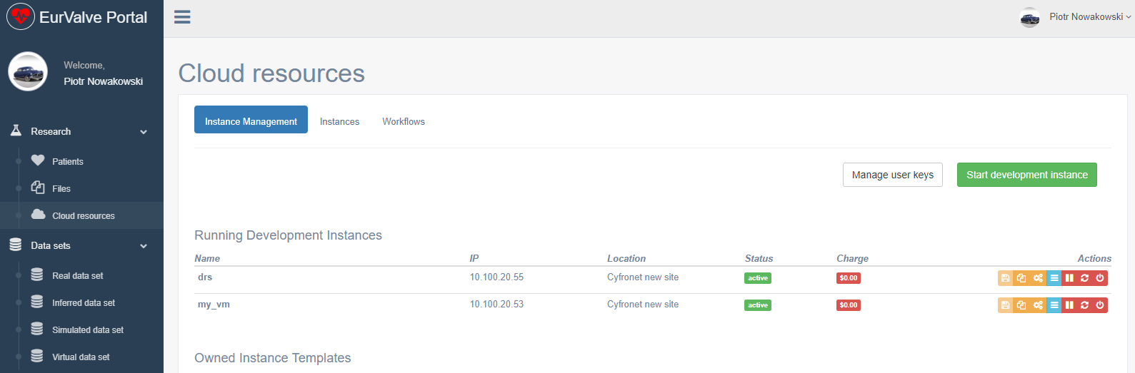
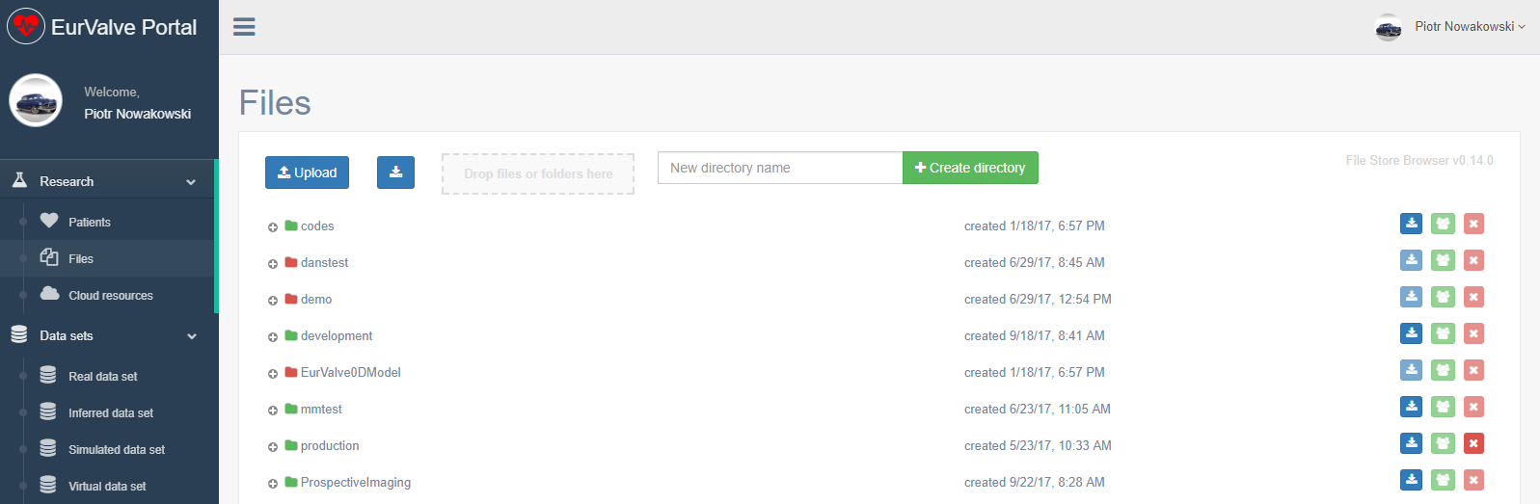
Generic MEE tools
Cloud resources
Based on Atmosphere cloud platform
Can start/stop/suspend virtual machine on cloud infrastructure
Can save running existing machine as template
(Future) can share templates with other users
File Store
Basic file storage for the project
Ability to create new directories and upload/download files
Can share directories with other users or groups of users
Can be mounted locally using WebDav clients
The File Browser GUI can also be embedded in other views
Notes:
29

Slide 30
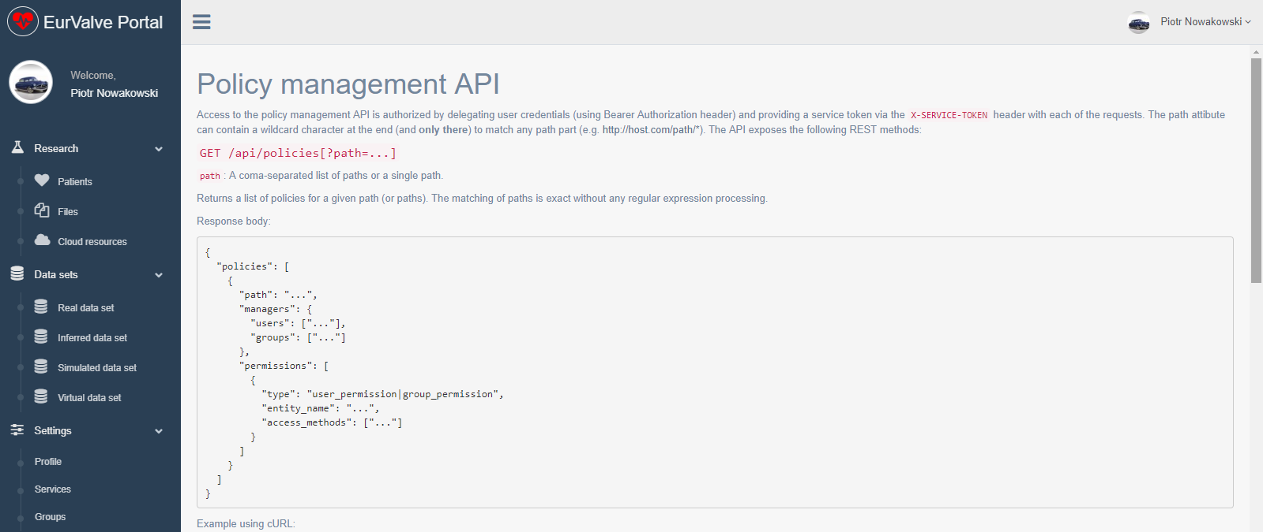
MEE functionality via REST API
Generate user JWT Token
User (or other service) can retrieve new JWT token by passing username and password
JWT token can be used for user credential delegations by external EurValve services
PDP API
Check if user has right to access a specific resource
Resource policy management
Create/edit/delete local policies by external EurValve service on user behalf
Currently integrated with File Store
Initial ArQ integration tests underway
Notes:
30

Slide 31
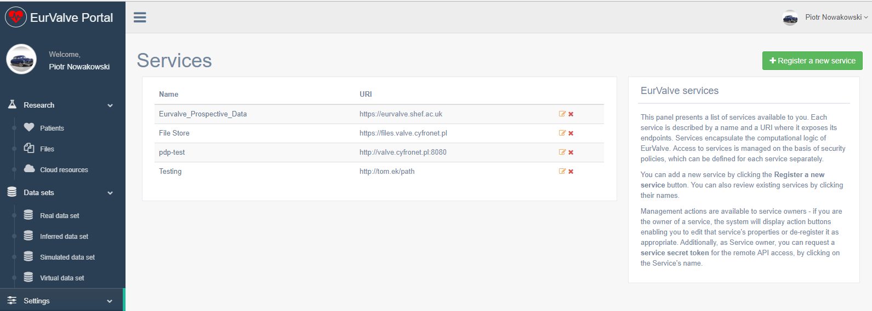
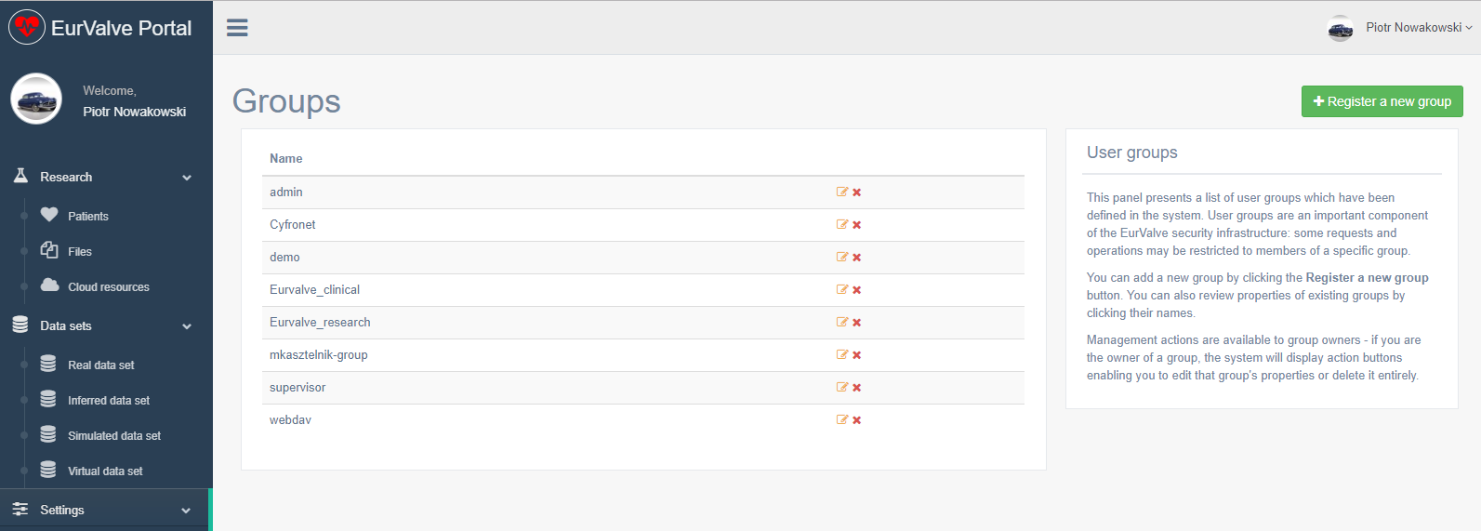
MEE security management UIs
Services
Basic security unit where dedicated security constraints can be defined
Two types of security policies:
Global – can be defined only by service owner
Local – can be created by the service on the user’s behalf
Groups
Group users
Dedicated portal groups:
Admin
Supervisor – users who can approve other users in the portal
Generic groups:
Everyone can create a group
Groups can be used to define security constraints
Notes:
31

Slide 32
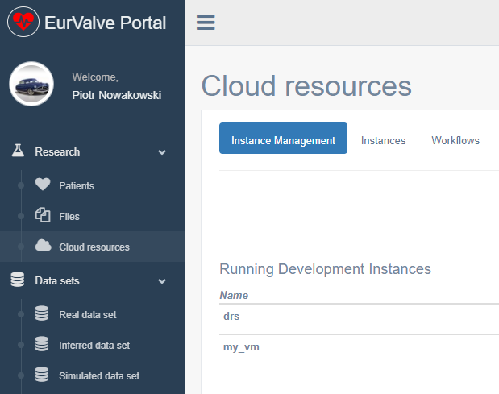







MEE - cloud access via Atmosphere
Secure RESTful API
(Cloud Facade)
Atmosphere host
Atmosphere Core
Communication with underlying computational clouds
Launching and monitoring service instances
Billing and accounting
Logging and administrative services
Atmosphere Registry (AIR)
user accounts
available cloud sites
services and templates
Access to cloud resources
The Atmosphere extension provides access to cloud resources in the EurValve MEE
Applications can be developed as virtual machines, saved as templates and instantiated in the cloud
The extension is available directly in the MEE GUI and through a dedicated API
Atmosphere is integrated with EurValve authentication and authorization mechanisms
Notes:
32

Slide 33
The Patient Case Pipeline
Segmentation – to start this calculation, a zip archive with a dedicated structure needs to be created and transferred into the OwnCloud input directory. Next, the output directory needs to be monitored for computation output.
Reduced Order Model analysis – based on the results of the segmentation step, a ROM simulation is executed and its results uploaded to the File Store.
Parameter Optimization – a technical step which prepares suitable parameters for the 0D model sequence
0D model sequence – runs four versions of the 0D model analysis for various input datasets
Uncertainty Quantification – Matlab script which can include the 0D Heart Model. It will be executed on the Prometheus supercomputer, where input files will be transferred automatically from the File Store. Results are transferred back from Prometheus to the File Store.
Output visualization – produces actionable visualization of the 0D model output data based on File Store contents.
Patient Case Pipeline high-level building blocks:
File-driven computation (such as Segmentation) – use case: upload file to remote input directory, monitor remote output directory for results
Scripts started on Prometheus supercomputer – use case: transfer script and input files from File Store to the cluster, run job, monitor job status, once the job has completed – transfer results from the cluster to File Store (examples: 0D Heart Model, Uncertainty Quantification, CFD simulation)
Notes:
33

Slide 34
WP2 deliverables
Deliverable | Month | Title
D2.1 | 3 | Data requirements (STH)
D2.2 | 4 | Infrastructure design recommendations (Cyfronet)
D2.3 | 8 | Data workshop (DHZB)
D2.4 | 15 | Infrastructure beta release (Cyfronet)
D2.5 | 30 | Infrastructure candidate release (Cyfronet)

Slide 35
Publications and presentations
Piotr Nowakowski, Marian Bubak, Tomasz Bartyński, Daniel Harężlak, Marek Kasztelnik, Maciej Malawski, Jan Meizner: VPH applications in the cloud with the Atmosphere platform – lessons learned, Virtual Physiological Human 2016 Conference, 26-28 September 2016, Amsterdam, NL
M. Bubak, T. Bartynski, T. Gubala, D. Harezlak, M. Kasztelnik, M. Malawski, J. Meizner, P. Nowakowski: Towards Model Execution Environment for Investigation of Heart Valve Diseases, CGW Workshop 2016, 24-26 October 2016, Krakow, Poland
Marian Bubak, Daniel Harężlak, Steven Wood, Tomasz Bartyński, Tomasz Gubala, Marek Kasztelnik, Maciej Malawski, Jan Meizner, Piotr Nowakowski: Data Management System for Investigation of Heart Valve Diseases, Workshop on Cloud Services for Synchronisation and Sharing, Amsterdam 29.01-2.02.2017, https://cs3.surfsara.nl/
M. Kasztelnik, E. Coto, M. Bubak, M. Malawski, P. Nowakowski, J. Arenas, A. Saglimbeni, D. Testi, A.F. Frangi: Support for Taverna Workflows in the VPH-Share Cloud Platform, Computer Methods and Programs in Biomedicine, 146, July 2017, 37–46
P. Nowakowski, M. Bubak, T. Bartyński, T. Gubała, D. Harężlak, M. Kasztelnik, M. Malawski, J. Meizner: Cloud computing infrastructure for the VPH community, Journal of Computational Science, Available online 21 June 2017
For more information – see the DICE website at http://dice.cyfronet.pl or our Github profile at http://dice-cyfronet.github.io/

Slide 36
MEE services at Cyfronet
EurValve Project Website at Cyfronet AGH
URL: http://dice.cyfronet.pl/projects/details/EurValve
EurValve Portal
URL: https://valve.cyfronet.pl
Registration at: https://valve.cyfronet.pl/users/sign_up
EurValve File Store
URL (docs): https://files.valve.cyfronet.pl
WebDAV endpoint (portal account required): https://files.valve.cyfronet.pl/webdav

Slide 37
Recorded demos of MEE
Logging in to EurValve and PLGrid systems – https://youtu.be/4I907aAOCvU
File Store Browser – https://youtu.be/-6fXG0am6iE
Distributed Cloud File Store – https://youtu.be/FTF-QaI5ZZQ
Services, security, restricted access – https://youtu.be/-6fXG0am6iE
Cloud Resource Access – https://youtu.be/A4wkxFCRLak
Patient case
https://youtu.be/SIwpxdoQYWw (patient case)
https://youtu.be/j0Nu-E-0elE (pipeline diff)
Integration of computational services – https://youtu.be/SIwpxdoQYWw

Slide 38
Plans for the second phase
Further improvement of the MEE based on user feedback
Implementation of computation quality validation against retrospective patient data in order to compare pipeline results with retrospective patient data measured in vivo following intervention
Extension of the patient case scenario by:
integrating additional sources of user data (e.g. enabling additional user parameters used by models to be retrieved from the Data Store)
adding additional computational facilities delivered by project partners
Implementation of additional automation features for existing pipelines, enabling fine-grained control over the configuration and execution of individual pipeline steps in the context of specific patient data.
Development of advanced accounting mechanisms:
logging events, such as data access or attempts to do so, with appropriate metadata
analysis of events to detect anomalies (such as suspected access from new IP/location, device etc.) to potentially alert administrators, data owners, users etc. about suspicious activities.

