Slide 1



Towards the Center of Excellence for Personalized Diagnostics and Medical Therapy
Marian Bubak
Academic Computer Cyfronet, Laboratory for Informatics in Medicine
Department of Computer Science,
AGH University of Science and Technology
Kraków, Poland
http://dice.cyfronet.pl/; bubak@agh.edu.pl

Slide 2
Our research interests
Trends
Enhanced scientific discovery is becoming collaborative and analysis-focused; in-silico experiments are becoming more and more complex
Available compute and data resources are distributed and heterogeneous
Modelling of complex collaborative scientific applications
domain-oriented semantic descriptions of modules, patterns and data to automate composition of applications
Studying the dynamics of distributed resources
investigating temporal characteristics, dynamics, and performance variations to run applications with the desired quality of service
Modelling and designing a software layer to access and orchestrate distributed resources
mechanisms for aggregating multi-format/multi-source data into a single coherent schema
semantic integration of compute/data resources
Data-aware mechanisms for resource orchestration
enabling reusability based on provenance data

Slide 3
DICE Team skillset
Interactive compute- and data-intensive applications, knowledge-based workflow composition, programming models | CrossGrid, K-Wf Grid, CoreGRID | 2002-2008
Script-based composition of applications, GridSpace Virtual Laboratory | ViroLab, GREDIA | 2006-2009
Federating cloud resources for VPH compute- and data-intensive applications, DataNet – metadata models | VPH-Share, PL-Grid | 2009-2015
Common Information Space for Early Warning Systems, big data storage and access, analysis tools | UrbanIFlood, ISMOP | 2009-2016
Computational strategies, software and services for distributed multiscale simulations | MAPPER | 2010-2013
Executable Papers; 1st prize in Elsevier competition at ICCS2011 (Elsevier follow-up project) | Collage | 2011-2013
Optimization of workflow applications on cloud resources | PaaSage | 2013-2016
Computing solutions for exascale challenges | PROCESS | 2017-2020
Environment for large-scale simulations in medicine | EurValve PRIMAGE | 2016-2019 2018-2022
Business plan of a Centre of Excellence for New Methods in Computational Diagnostics and Personalised Therapy (Teaming Phase 1) | CECM | 2017-2018

Slide 4
Mission of CECM Project
CECM EU H2020 „Teaming for Excellence” project has developed a Business Plan to establish in Kraków a European Centre of Excellence for computational medicine.
The CECM Consortium is going to build a world-class centre of excellence, attractive to foreign partners, with a significant impact at both regional and national scales, providing benefits for the pan-European society.
It is a consortium of leading European science and innovation institutions in all domains of the new CoE.
ACC Cyfronet AGH has a long record of efficient support for scientists in the computational life science EU and PL research projects.
Małopolska and Kraków are well positioned for a key role in the computational medicine.

Slide 5
CECM / SANO Partners
Leading European science and innovation institutions:
University of Sheffield and Insigneo Institute – experts in translation of in silico modelling and simulations to clinics
Forschungszentrum Jülich – experts in modern HPC and data techniques, applied for science and industry
Fraunhofer ISI – experts in systemic multi-domain solutions and innovation in healthcare
They will work together with Partners from Poland:
ACC Cyfronet AGH – experts in simulation and provisioning computing infrastructure for science
Klaster LifeScience Kraków – Poland’s top cluster of industry, academia and hospitals for the life science domain
NCBiR - the Polish National Centre for Research and Development (project coordinator)

Slide 6
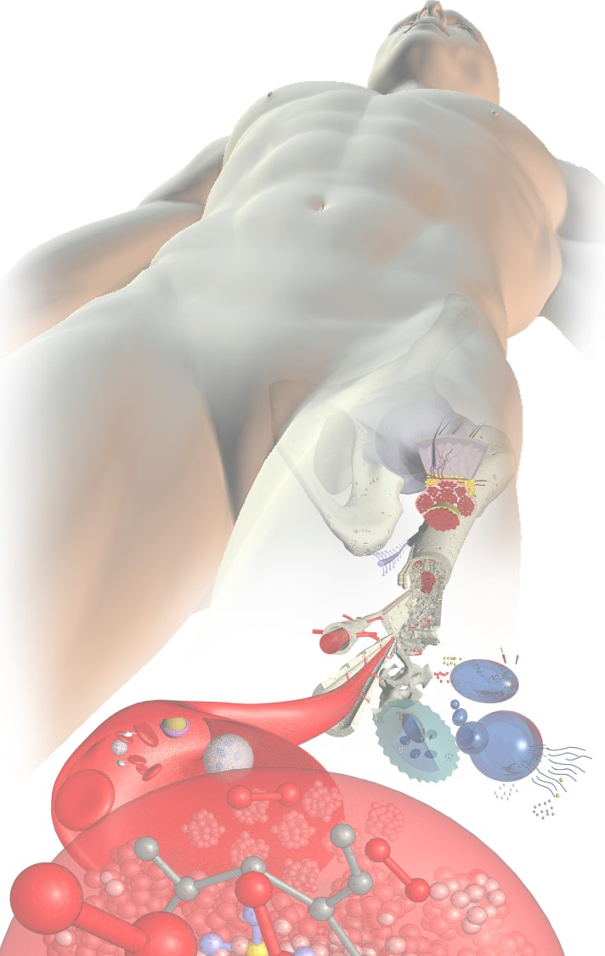

SANO: Challenge and Solution
The Challenge
The Solution
Complexity
In Silico Medicine
Ageing ⇨ Co-morbidities
Specialists’ Capacity
Population-specific
Imprecise Diagnosis
Suboptimal Treatment
Fragmented Care
Complexity by composition
Unlimited Capacity
Subject-specific
Precise Diagnosis
Ranked Treatments
Integrated Care

Slide 7
Main Objectives of CoE
Development of new computation-based solutions for diagnostics and therapy in daily healthcare.
Strong advancement of algorithms, models and technologies involved in personalised medicine, including design of holistic, replicable, generic framework for simulation-based Decision Support Systems creation. Systematic involvement of regional biomed businesses, specialising in technologies and services for personalised medicine, in high-profile research projects and clinical adoption of their outcome.
Education initiatives to train knowledge workers with the skills in data analytics, simulation, and HPC/Big Data, to respond to the growing demand for skilled workforce in bio-engineering and medical devices.

Slide 8
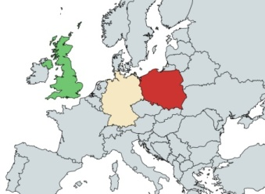
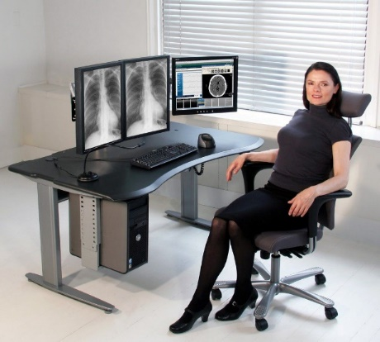
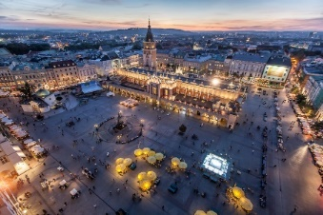


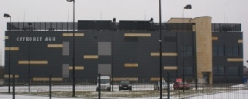

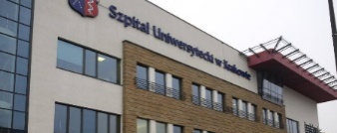


Leadership in Clinical Decision Support
A strategic cooperation between Poland & UK
Strongly supported by expertise from Germany
Building the Polish Decision-Support Industry
Championing global healthcare in the 21st Century
Geographically located in Kraków
Serving the world
Kick-started with EU and Polish Funding, supporting core activities and research
Dual-centred, with access to Clinic and HPC
Ensuring complete scientific coverage
Self-sustaining
after the first 7 years
Staffed by experts in Computational Medicine
Handpicked for their skills, fields, compatibility

Slide 9


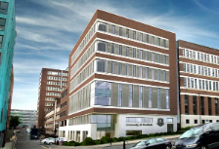
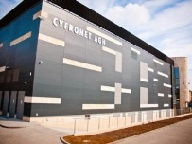

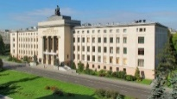
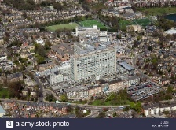

The Synergy
Insigneo (Est 2012)
140 researchers, 50 clinicians
Cyfronet (Est 1973)
Polish leader in HPC
University of Sheffield
29,000 students
AGH Univ Scie & Tech
36,000 students
ST Hospital Trust
Sheffield’s Teaching Hospitals
University Hospital
Kraków’s Teaching Hospital
Insigneo: largest In Silico Medicine (ISM) research institute in Europe
Researchers develop dozens of ISM prototypes
Lacks the capability to convert them into industrial-quality solutions with appropriate level of service
Brexit will make this even harder
Cyfronet mission is to deliver industrial-quality solutions with appropriate level of service
DICE team has seeded a level of expertise in ISM unusual in most HPC centres, but lacks portfolio
Kraków partners offer the skills, infrastructures, and development policies to sustain unlimited growth

Slide 10














The Consortium, the Partnership
Core
Venture capital and seed funds
Consortium
Tech/Clinical
Funding
€ Public
€ Private
HPC skill
Healthcare Innovation
Hardware
The
Centre
An independent research foundation
In silico expertise
Comp Medicine skills
Modelling research
HPC Lab and hardware
Clinical Data
Human resources
Computer science research
Technology
Human resources
Science
LifeSci/Med research
Advice
Clinical Data
Medical Labs
Infrastr’
Human resources
Data and Trials
Industry
Talents
Fund/Exp’t
Data

Slide 11
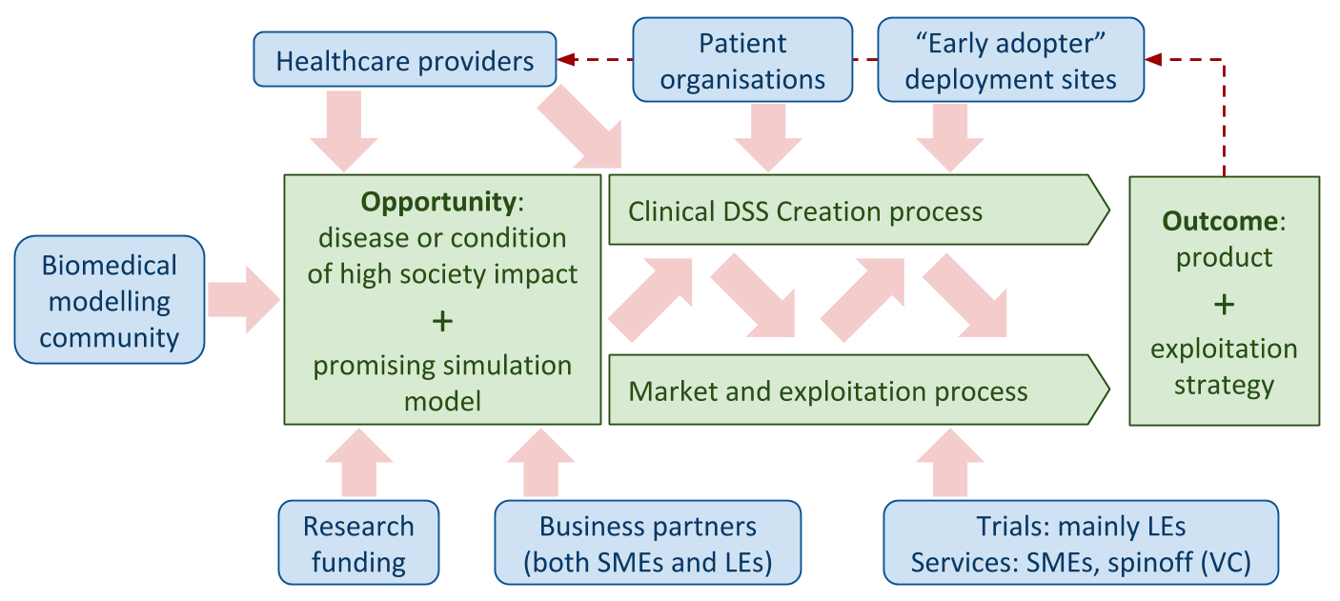
Towards a successful, sustainable CoE
Collaboration:
Modellers + Healthcare Professionals → identify in silico opportunities
Innovation: New in silico solutions for
diagnostics and therapy in daily healthcare
State-of-the-art: Advancement of algorithms, models and technologies
Exploitation: Regional biomed businesses
Education: knowledge transfer in health data analytics, modelling, HPC Foster: young Entrepreneurs → technical/commercial/financial skills

Slide 12








Human Resource
International committees and management : excellence in talent acquisition
Int. Scientific Committee : Chaired by Marco Viceconti
13 members (UK, IT, DE, NL, US, PL)
Selects top candidates
Foundation Council
5 reps of Teaming partners (UK, DE, PL)
Concludes employment contracts
Search Committee: 6 members (UK, DE, PL)
Access to quality candidates
Centre’s Management : Led by Scientific Affairs Director Marian Bubak
The Network
Top international candidates for the Directorship, and Laboratory Leaders
Healthcare Informatics
Key Performance Indicators
KPI-1 Research groups
KPI-4 R&D personnel
KPI-5 New scientists
KPI-6 Foreign scientists
KPI-7 Publications
Recruitment of Life Science and IT research and management staff
Track record (2017): 8 international CSOs/lab leaders recruited
Data
Science
Modelling and Simulation
(5)
(55)
(33)
(15)
(60)
The
Centre
Algorithmic decision science
In silico techniques
Computer Science and HPC
Access to local and international Candidates for Middle and Junior Researcher positions

Slide 13




Summary
Participation of the Cyfronet AGH in EU Health projects and collaboration with the Sheffield University has resulted in a unique opportunity to build a world-class centre of excellence, attractive to foreign partners and capable of achieving significant impact on both regional and national scales, with lasting benefits for the pan-European society.
http://dice.cyfronet.pl
bubak@agh.edu.pl

