Slide 1

Model Execution Environment Current status of the WP2 Infrastructure Platform
Marian Bubak¹,
Daniel Harężlak¹, Marek Kasztelnik¹ , Piotr Nowakowski¹, Steven Wood²,
and
Tomasz Bartyński¹, Tomasz Gubala¹, Maciej Malawski¹, Jan Meizner¹,
¹ACC Cyfronet AGH, Krakow, Poland
http://dice.cyfronet.pl/
²Scientific Computing, Department of Medical Physics, Sheffield Teaching Hospitals, UK

Slide 2
Outline
Typical action and flow
Model Execution Environment
objectives, vision, and structure
Current implementation
Examples of MEE usage
Overview of new features of MEE
Plan of demo
Recommendations for MEE users
Summary

Slide 3
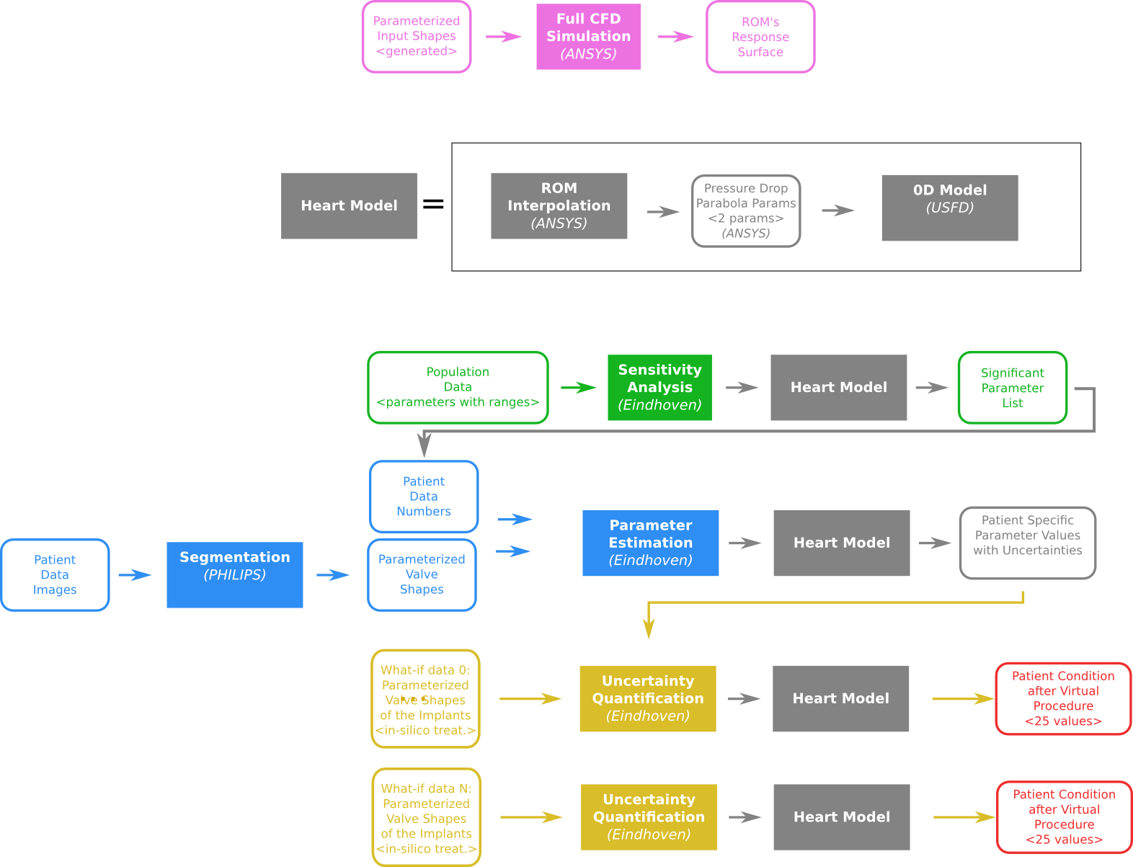
Pipelines for ROM and sensitivity analysis
Data and action flow consists of:
full CFD simulations
sensitivity analysis to acquire significant parameters
parameter estimation based on patient data
uncertainty quantification of various procedures
The flow of CFD simulations and sensitivity analysis is part of clinical patient treatment

Slide 4
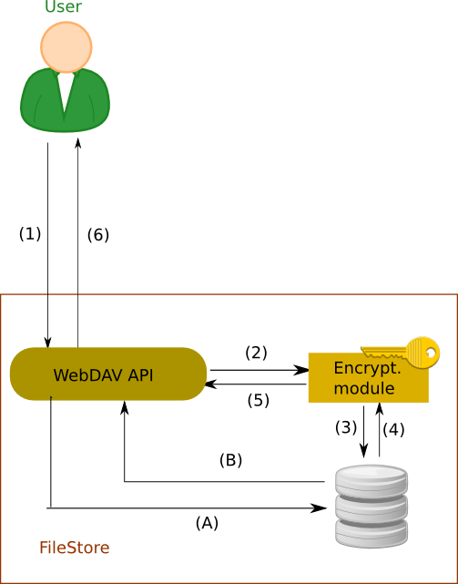
Flow of medical data
Secure locally hosted service
BLOB Data handled based on the confidentiality level:
Step 1 (all levels) – data is sent via encrypted channel to the service
Step 2-3 (high) – data encrypted and stored on disk
Step 4-5 (high) – data decrypted and retrieved
Step A-B (lo) – data stored directly to disk
Step 6 (all) – data sent back to the user
DB Records:
Step 1b – data are stored via the encrypted channel to the DB service in secured location
Step 2b – data are retrieved from the service via encrypted channel
(1b)
REST
(2b)
SQL
Database access

Slide 5
Model Execution Environment objectives
Collect, represent, annotate and publish core homogeneous data
Store and securely provision the necessary data to the participating clinical centers and development partners
Execute the models in the most appropriate computational environment (private workstation, private cloud, public cloud) according to needs
Support real-time multiscale visualization
To develop an integrated security system supporting
authentication and authorisation
data encryption for secure processing

Slide 6
Model Execution Environment structure
API – Application Programming Interface
REST – Representational state transfer
Rimrock – servis used to submit jobs to HOC cluster
Atmosphere – provides access to cloud resources
git – a distributed revision control system

Slide 7
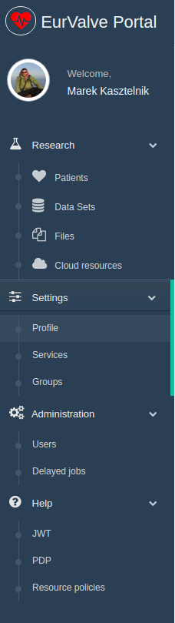
MEE implementation
Model Execution Environment:
Patient case pipeline integrated with File Store and Prometheus supercomputer
File Store for data management
Cloud resources based on Atmosphere cloud platform
Security configuration
Service management – for every service dedicated set of policy rules can be defined
User Groups – can be used to define security constraints
REST API
Creating a new user session – as a result, new JWT (JSON Web Token) tokens are generated for credential delegation
PDP – Policy Decision Point: check if user has access to concrete resource
Resource policies – add/remove/edit service security policies
Notes:
7

Slide 8
Example of MEE usage
Components
EurValve Portal – discover collected files for patient clinical case, submit blood flow or 0D Heart model computation to Prometheus supercomputer, monitor computation execution and download results. the EurValve Portal is integrated with File Store, Rimrock and Security components
EurValve File Store – each computation receives and delivers files to the File Store
Rimrock – submits jobs to the Prometheus supercomputer
EurValve Security - input data and results accessible only to EurValve group members.
Typical use case
Create new Patient clinical case
Automatically discover files connected with the Patient Case ID
2. Run 0D Heart Model (with ROM) on Prometheus supercomputer
Alternatively, run the blood flow CFD simulation (prepared by Martijn)
3. Monitor computation execution
4. Discover produced results and update clinical case progress
Computation result files are automatically accessible within the Portal once the computation has concluded.
Notes:
8

Slide 9
New functionality of MEE (1/4)
Pipeline execution management
Goal: organize set of models into a single sequential execution pipeline with files as the main data exchange channel
Supported ideas:
Model development organization through structuralization
Retention of execution and development history
Result provenance tracking and recording
Notes:
9

Slide 10
New functionality of MEE (2/4)
Computation execution diff
Goal: an adequate tool for model developers to compare two different model executions, revealing any changes along with their impact on results.
Supported ideas:
Modelling quality improvement tracking
Dedicated comparison software for specific types of results
Easier problem detection and manual validation
Notes:
10

Slide 11
New functionality of MEE (3/4)
New functionality of the File Store
Mounting File Store under Windows and Linux
No extra dependencies needed under Windows
EurValve portal account required
Potential use cases
Access to EurValve file resources with native Windows and Linux clients
Mounting EurValve file resources to be used by other services
Planned implementation tasks
Extend EurValve portal policy management API with policy move and copy operations
Integrate File Store with the extended portal’s policy API

Slide 12
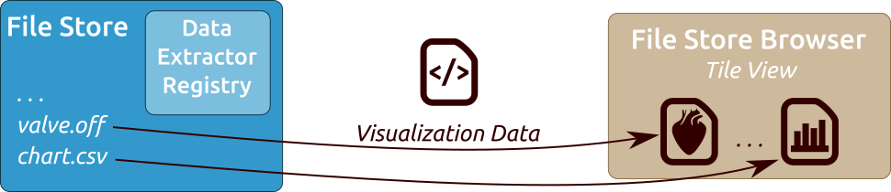
New functionality of MEE (4/4)
Visualization Module
The File Store component is extended with a Data Extractor Registry with codes defining how to extract relevant visualization data from a given file
Data Extractors can be associated with given file extensions, particular folders and viewers
The web-based File Store Browser uses registered extractors to fetch visualization data and initialize dedicated viewers if given file formats have been associated with any data extractors
Any new data written to the File Store updates the viewers immediately

Slide 13
The Patient Case Pipeline
Segmentation provided by Philips - to start this calculation a zip archive with dedicated structure need to be created and transferred into OwnCloud input directory. Next, the output directory needs to be monitored for computation output. Current status: initial execution tests passed
Uncertainty Quantification provided by Eindhoven – Matlab script which can include the 0D Heart Model. It will be executed on the Prometheus supercomputer, where input files will be transferred automatically from File Store. Results are transferred back from Prometheus to File Store. Current status: we are able to manually start Uncertainty Quantification Matlab scripts as Prometheus jobs
Patient Case Pipeline high level building blocks:
File-driven computation (such as Segmentation) – use case: upload file to remote input directory, monitor remote output directory for results
Scripts started on Prometheus supercomputer – use case: transfer script and input files from File Store to the cluster, run job, monitor job status, once the job has completed – transfer results from the cluster to File Store (examples: 0D Heart Model, Uncertainty Quantification, CFD simulation)
Notes:
13

Slide 14
Possible future functionality of MEE
Computation quality validation against retrospective patient data
Goal: comparing pipeline results with retrospective patient data measured in vivo after intervention
Supported ideas:
Model pipeline output quality validation
Error assessment and quantification
Specialized comparison for given computation results
Notes:
14

Slide 15
The scenario of the MEE Demo
Introduction, MB 3 min
Login to the EurValve and PLGrid systems, PN 5 min
Access to clinical (tabular) data, SW 10 min
File Store Browser: review and manipulation of files, security aspects, sharing directories (groups), DH 10 min
Services, security, restricted access, DH 2 min
Atmosphere: access and management of cloud resources, PM 5 min
Patient case: creation, segmentation, simulation of blood flow, sensitivity, visualization, MK 10 min
PN - Piotr Nowakowski, SW - Steven Wood, DH - Daniel Harezlak, MK - Marek Kasztelnik

Slide 16
Recommendations for MEE module developers (1/4)
Additional modules can be implemented:
As scripts intended for execution on the Prometheus supercomputer
As external services communicating with the platform via its REST interfaces
As virtual machines deployable directly in the CYFRONET cloud via the Atmosphere extension of the MEE
Notes:
16

Slide 17
Recommendations for MEE module developers (2/4)
Developing extensions as HPC scripts:
Scripts are run on the Prometheus supercomputer via the Rimrock extension
Files uploaded to the FileStore (e.g. using MEE GUIs) can be accessed on Prometheus nodes via curl, leveraging the WebDAV interface provided by FileStore
Any result files can also be uploaded directly to FileStore from the Prometheus computational nodes
External tools can be used to monitor job completion status e.g. by periodically scanning FileStore content
Notes:
17

Slide 18
Recommendations for MEE module developers (3/4)
Developing extensions as external services:
This requires computational services to be hosted externally, communicating with the MEE platform via its APIs
Files can be retrieved and uploaded to FileStore via RESTful (WebDAV) commands
The client must supply a valid JWT user token along with each request (see previous section for a description of authentication and authorization procedures)
Notes:
18

Slide 19
Recommendations for MEE module developers (4/4)
Developing extensions as cloud services:
The MEE provides access to cloud resources, enabling developers to spawn virtual machines and develop computational services which are then hosted in the CYF cloud
This feature is enabled by the VPH-Share Atmosphere extension which is now integrated with the MEE, including its security mechanisms
Go to https://vph.cyfronet.pl/tutorial/doku.php for an in-depth overview of the features of the cloud platform
Notes:
19

Slide 20
Publications and presentations
Piotr Nowakowski, Marian Bubak, Tomasz Bartyński, Daniel Harężlak, Marek Kasztelnik, Maciej Malawski, Jan Meizner: VPH applications in the cloud with the Atmosphere platform – lessons learned, Virtual Physiological Human 2016 Conference, 26-28 September 2016, Amsterdam, NL
M. Bubak, T. Bartynski, T. Gubala, D. Harezlak, M. Kasztelnik, M. Malawski, J. Meizner, P. Nowakowski: Towards Model Execution Environment for Investigation of Heart Valve Diseases, CGW Workshop 2016, 24-26 October 2016, Krakow, Poland
Marian Bubak, Daniel Harężlak, Steven Wood, Tomasz Bartyński, Tomasz Gubala, Marek Kasztelnik, Maciej Malawski, Jan Meizner, Piotr Nowakowski: Data Management System for Investigation of Heart Valve Diseases, Workshop on Cloud Services for Synchronisation and Sharing, Amsterdam 29.01-2.02.2017, https://cs3.surfsara.nl/
M. Kasztelnik, E. Coto, M. Bubak, M. Malawski, P. Nowakowski, J. Arenas, A. Saglimbeni, D. Testi, A.F. Frangi: Support for Taverna Workflows in the VPH-Share Cloud Platform, Computer Methods and Programs in Biomedicine, 146, July 2017, 37–46
P. Nowakowski, M. Bubak, T. Bartyński, T. Gubała, D. Harężlak, M. Kasztelnik, M. Malawski, J. Meizner: Cloud computing infrastructure for the VPH community, Journal of Computational Science, Available online 21 June 2017

Slide 21
MEE services at Cyfronet
EurValve Project Website at Cyfronet AGH
URL: http://dice.cyfronet.pl/projects/details/EurValve
EurValve Portal
URL: https://valve.cyfronet.pl
Registration at: https://valve.cyfronet.pl/users/sign_up
EurValve File Store
URL (docs): https://files.valve.cyfronet.pl
WebDAV endpoint (portal account required): https://files.valve.cyfronet.pl/webdav

Slide 22

EurValve H2020 Project 689617 http://www.eurvalve.eu http://dice.cyfronet.pl

