Slide 1

Beta Release of the Infrastructure Platform Current status, towards D2.4 and review
Marian Bubak¹, Daniel Harężlak¹, Steven Wood²,Tomasz Bartyński¹, Tomasz Gubala¹, Marek Kasztelnik¹, Maciej Malawski¹, Jan Meizner¹, Piotr Nowakowski¹
¹ACC Cyfronet AGH, Krakow, Poland
http://dice.cyfronet.pl/
²Scientific Computing, Department of Medical Physics, Sheffield Teaching Hospitals, UK

Slide 2
Fourfold purpose of this presentation
Presentation of the work progress in WP2
Presentation of the current status of the Model Execution Environment and show how it may be used by the EurValve partners
Presentation of possible contribution to the review demos
Outline of the deliverable D2.4 which should present:
The first version of the infrastructure platform will be implemented, deployed and made operational.
Functionality, although limited, will support the selected pilot components and models of the DSS.
The infrastructure will be supported by operation and development teams that will ensure availability and gather feedback from the deployed DSS components.

Slide 3
Outline
Motivation and objectives
Typical data and action flow
Updated vision of the Model Execution Environment
Overview of current implementation of MEE
Examples of MEE usage
Integrated security framework
Medical data in MEE: flow, requirements
File Store: functionality, examples of usage
Recommendations for MEE users
User feedback and resulting improvements of MEE
Usage of Cyfronet AGH resources
Plans for MEE extensions
Summary

Slide 4
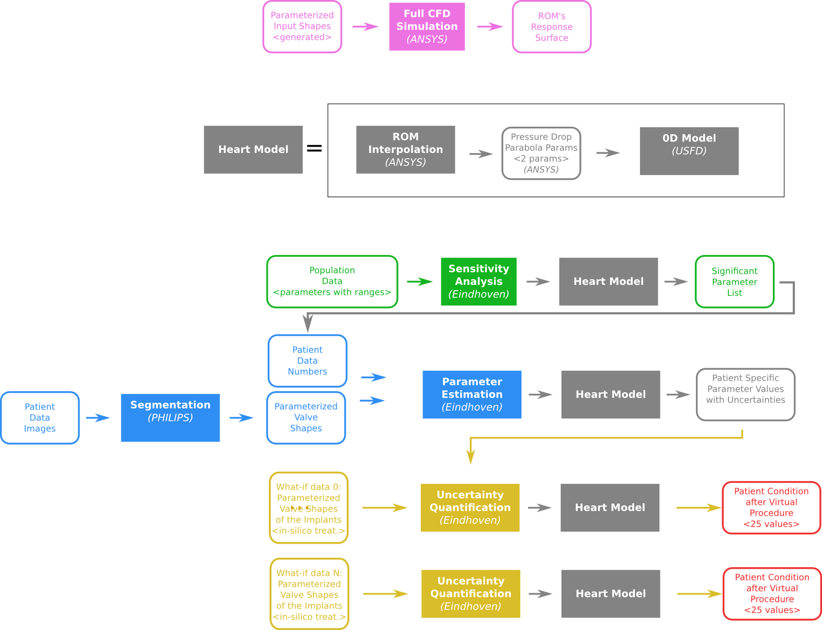
Pipelines for ROM and sensitivity analysis
Data and action flow consists of:
full CFD simulations
sensitivity analysis to acquire significant parameters
parameter estimation based on patient data
uncertainty quantification of various procedures
The flow of CFD simulations and sensitivity analysis is part of clinical patient treatment

Slide 5
Data and action flow – ROM
0D uses the ROM to calculate the pressure drop across the valve (similar to the extraction of results from the 3D model)
The software passes geometrical parameters to the ROM interpolation tool along with 5 values of flow. The ROM interpolation calculates the pressure drops at those 5 flows for each geometry and the results then passed back to the modelling software and used to characterize the valve and extract two valve coefficients that describe the relationship between pressure and flow.
To calculate the pressure drop the ROM interpolation tool needs to create a response surface which creates the relationship between the geometrical parameters and flow and the pressure drop. To create the response surface the ROM builder has to run full 3D simulations multiple times with different the input parameters. The result of each simulation is the single value of pressure drop. The number of runs needed to characterize the response surface is dependent on the number of input parameters in a non-linear way. This process needs to be run on an HPC once for the final generation of the model.

Slide 6
Data and action flow – sensitivity analysis
Each sensitivity analysis run requires approx. 120 MB of RAM
Input for the 0D model is a 30 element vector, output is a 25 element vector
Output of the agPCE model are 3 plain-text files
Uncertainty.txt - 3 columns: output variable name, estimated value, uncertainty (think mean +- standard deviation)
Sensitivity.txt - 25*30 matrix, a Sobol sensitivity index of each input for each output
Quality.txt - 3 columns, output variable name, R^2 (model/meta-model agreement score) and Q^2 (leave-one-out error, i.e. an error measurement that determines the 'robustness' of the metamodel).

Slide 7
Data and action flow – segmentation, learning, etc.
WP2 team is waiting for specific requirements
from appropriate partners

Slide 8
From Research Environment to DSS
Research Computing Infrastructure
Development of models for DSS
Clinical Computing Environment
Real-time Multiscale Visualization
Model Execution Environment
Data Collection and Publication Suite
DSS Execution Environment
ROM
0-D Model
Patient Data
ROM
3-D Model
Model A
Images
Population data
Security System
Model B
Infrastructure Operations
Data Source 1
Data Source 2
HPC Cluster
Cloud
Workstation
Provide elaborated models and data for DSS

Slide 9
Model Execution Environment objectives
Collect, represent, annotate and publish core homogeneous data
Store and securely provision the necessary data to the participating clinical centers and development partners
Execute the models in the most appropriate computational environment (private workstation, private cloud, public cloud) according to needs
Support real-time multiscale visualization
To develop an integrated security system supporting
authentication and authorisation
data encryption for secure processing

Slide 10
Model Execution Environment extended functionality
Reproducibility, versioning, documentation of the pipeline, a kind of continuous integration environment
Automation of the simulation pipeline with human in the loop for
new input data,
new models, new versions of models,
a new user
Data preservation
Simplified provenance
Helpful visualization of simulation flow and obtained results
Generation of some components of publications
Portability

Slide 11
Model Execution Environment structure
API – Application Programming Interface
REST – Representational state transfer
Rimrock – servis used to submit jobs to HOC cluster
Atmosphere – provides access to cloud resources
git – a distributed revision control system

Slide 12
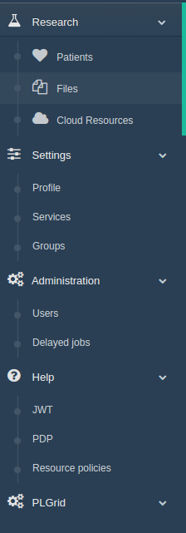
MEE implementation - current prototype
Model Execution Environment:
Patient case pipeline integrated with File Store and Prometheus supercomputer
File Store for data management
Cloud resources based on Atmosphere cloud platform
Security configuration
Service management – for every service dedicated set of policy rules can be defined
User Groups – can be used to define security constraints
REST API
Creating a new user session – as a result, new JWT (JSON Web Token) tokens are generated for credential delegation
PDP – Policy Decision Point: check if user has access to concrete resource
Resource policies – add/remove/edit service security policies
Notes:
12

Slide 13
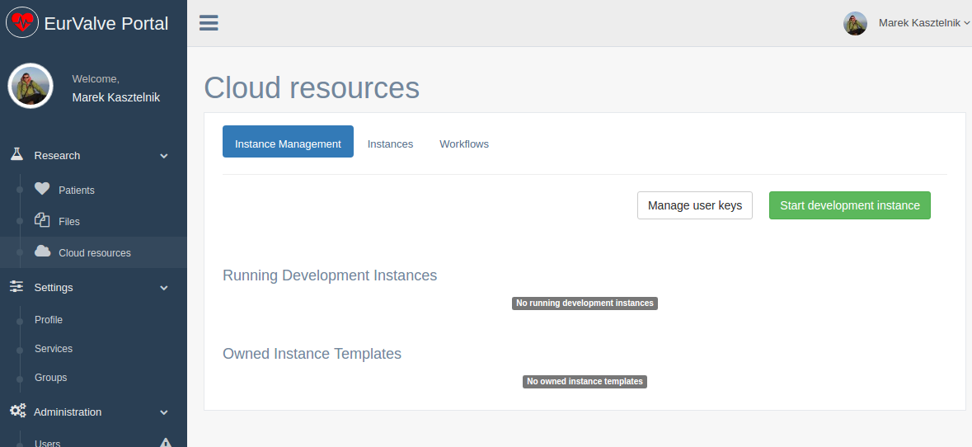
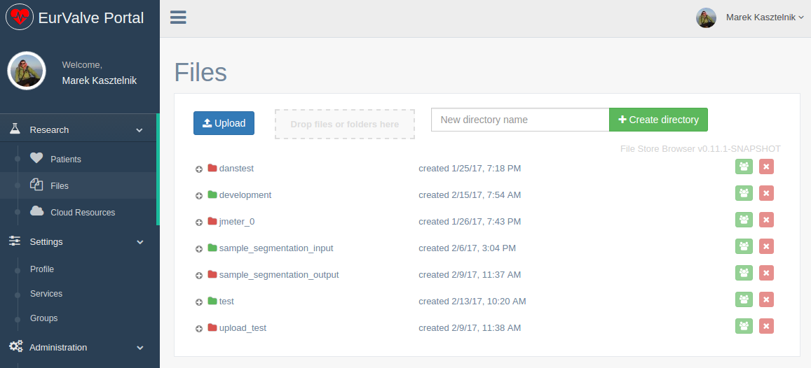
Generic tools of MEE
Cloud resources
Based on Atmosphere cloud platform
Can start/stop/suspend virtual machine on cloud infrastructure
Can save running existing machine as template
(Future) can share templates with other users
File Store
Basic file storage for the project
Ability to create new directories and upload/download files
Can share directories with other users or groups of users
Can be mounted locally using WebDav clients
The File Browser GUI can also be embedded in other views
Notes:
13

Slide 14
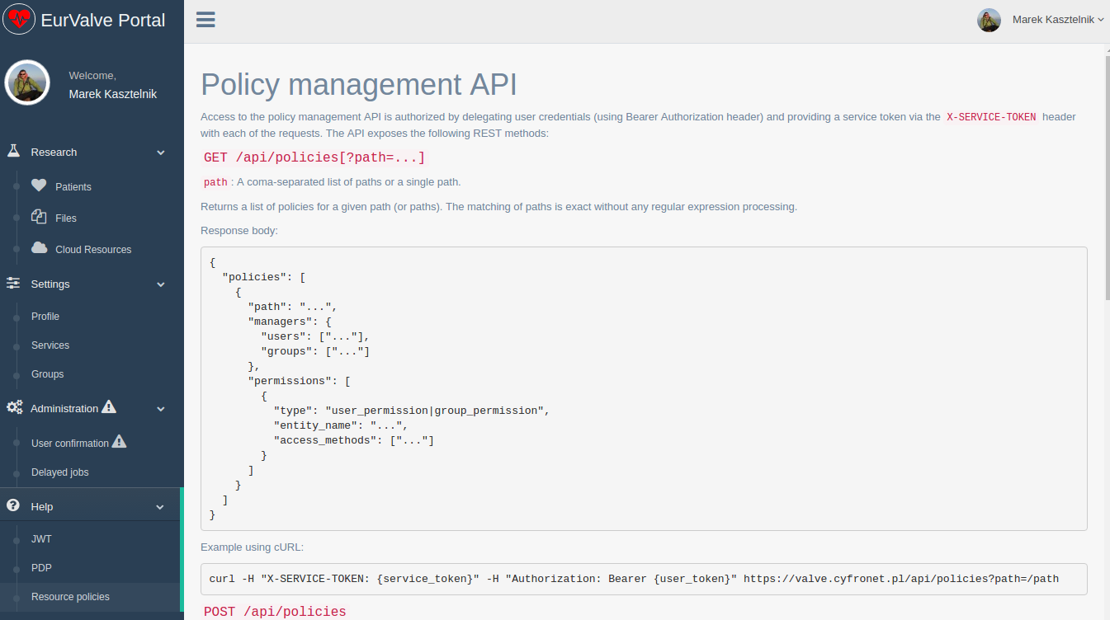
MEE functionality via REST API
Generate user JWT Token
User (or other service) can generate new JWT token by passing username and password
JWT token can be used for user credential delegations by external EurValve services
PDP API
Check if user has right to access a specific resource
Resource policy management
Create/edit/delete local policies by external EurValve service on user behalf
Currently integrated with File Store
Initial ArQ integration tests underway
Notes:
14

Slide 15
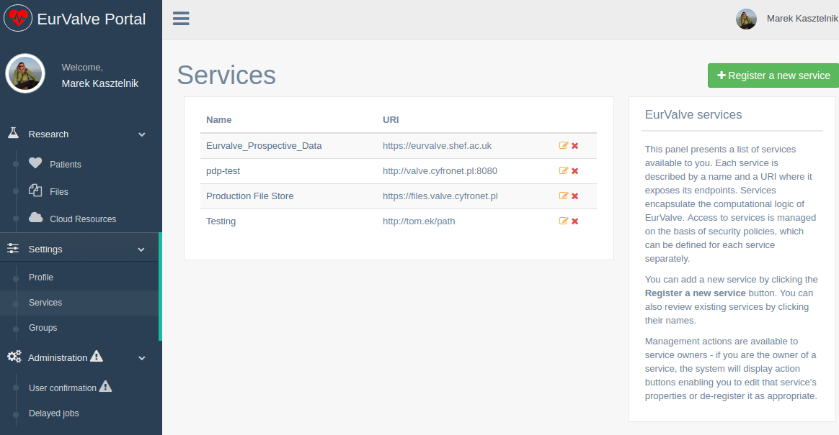
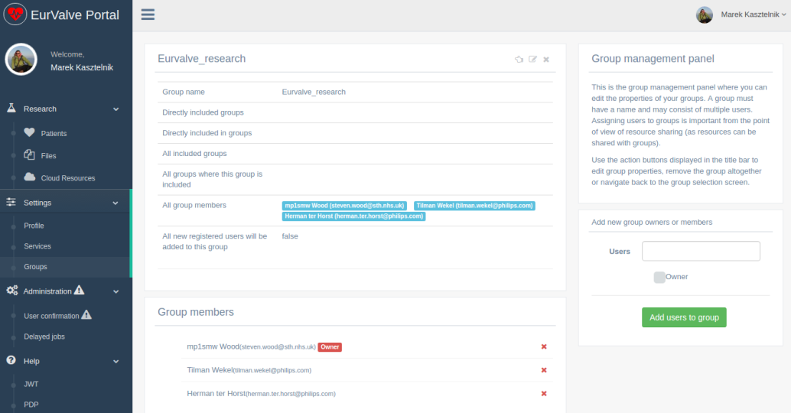
MEE security management UIs
Services
Basic security unit where dedicated security constraints can be defined
Two types of security policies:
Global – can be defined only by service owner
Local – can be created by the service on the user’s behalf
Groups
Group users
Dedicated portal groups:
Admin
Supervisor – users who can approve other users in the portal
Generic groups:
Everyone can create a group
Groups can be used to define security constraints
Notes:
15

Slide 16
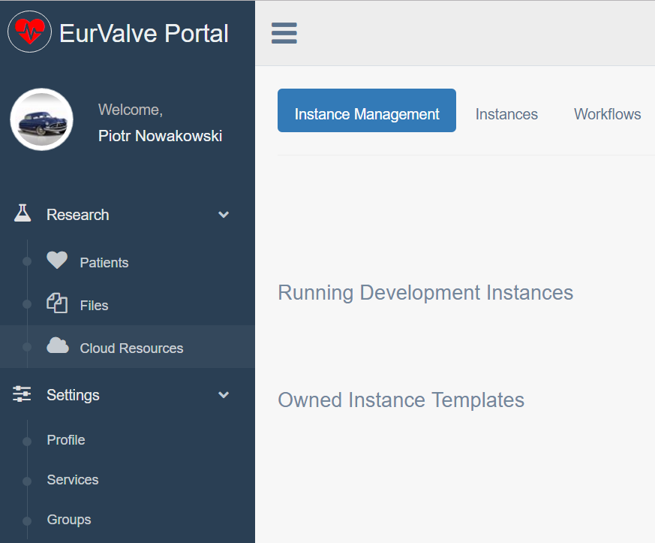







MEE - cloud access via Atmosphere
Secure RESTful API
(Cloud Facade)
Atmosphere host
Atmosphere Core
Communication with underlying computational clouds
Launching and monitoring service instances
Billing and accounting
Logging and administrative services
Atmosphere Registry (AIR)
user accounts
available cloud sites
services and templates
Access to cloud resources
The Atmosphere extension provides access to cloud resources in the EurValve MEE
Applications can be developed as virtual machines, saved as templates and instantiated in the cloud
The extension is available directly in the MEE GUI and through a dedicated API
Atmosphere is integrated with EurValve authentication and authorization mechanisms
Notes:
16

Slide 17
Example of MEE usage (1/2)
Components
EurValve Portal – discover collected files for patient clinical case, submit blood flow or 0D Heart model computation to Prometheus supercomputer, monitor computation execution and download results. the EurValve Portal is integrated with File Store, Rimrock and Security components
EurValve File Store – each computation receives and delivers files to the File Store
Rimrock – submits jobs to the Prometheus supercomputer
EurValve Security - input data and results accessible only to EurValve group members.
Typical use case
Create new Patient clinical case
Automatically discover files connected with the Patient Case ID
2. Run 0D Heart Model (with ROM) on Prometheus supercomputer
Alternatively, run the blood flow CFD simulation (prepared by Martijn)
3. Monitor computation execution
4. Discover produced results and update clinical case progress
Computation result files are automatically accessible within the Portal once the computation has concluded.
Notes:
17

Slide 18
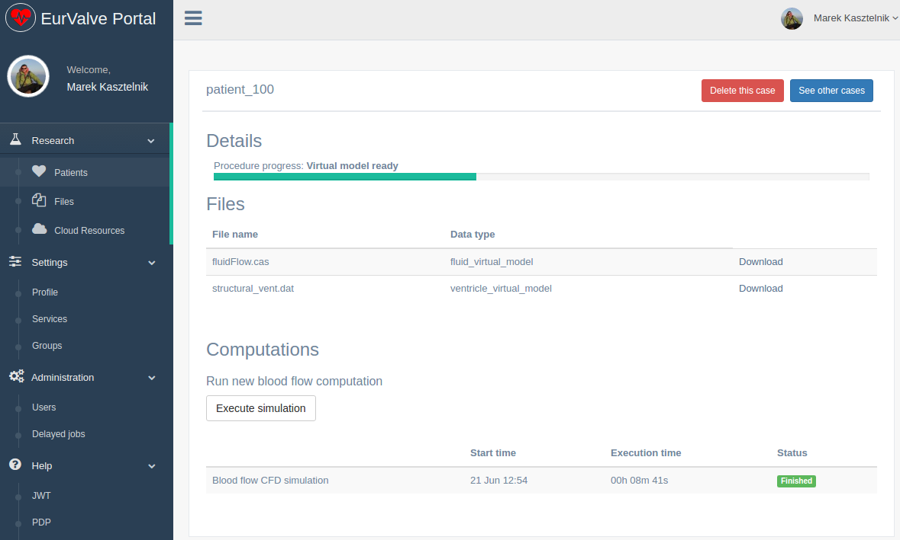
Example of MEE usage (2/2)

Slide 19
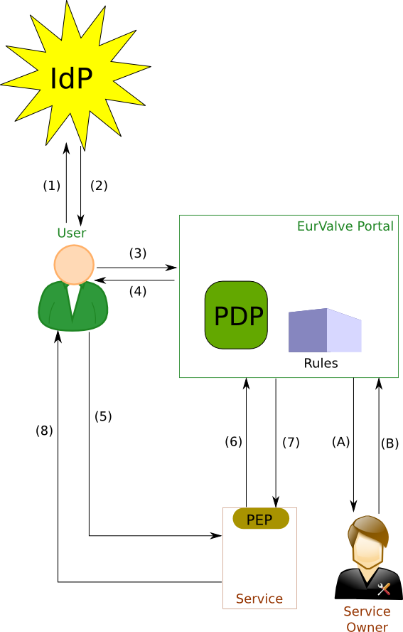
Integrated Security Framework
Step 1-2 (optional): Users authenticate themselves with the selected identity provider (hosted by the project or an external trusted IdP) and obtain a secure token which can then be used to authenticate requests in both MEE and DSS
Step 3-4: User requests JWT token from the Portal, based on IdP or local authentication
Step 5 – User sends a request to a service (token attached)
Step 6-7 – Service PEP validates token and permissions against the PDP (authorization).
Step 8 – service replies with data or error (access denied)
Optional interaction by the service owner:
Step A-B – Service Owner may modify policies for the PDP via:
the Portal GUI: global and local
API (e.g. from the Service): local only
IdP - Identity Provider
PDP - Policy Decision Point
JWT – JSON Web Token
PEP - Policy Enforcement Point

Slide 20
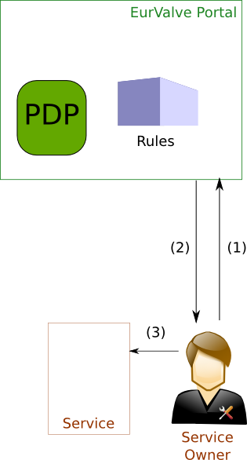
Registration of a new service
To secure a service its owner first needs to register it in the Portal/PDP.
Step 1-2: Service Owner logs into the Portal, creates the Service and a set of Global Policies, and obtains a Service Token
Step 3: Service Owner configures the Service PEP to interact with the PDP (incl. setting the service token).
A standard PEP for Web-based Services is provided by the DICE team.
Custom PEPs may be developed using the provided API.
The Service may use its token to:
query the PDP for user access
modify Local Policies for fine-grained access to the Service

Slide 21
Encryption performance (1/2)
The benchmark evaluates the overhead of AES (Advanced Ecryption Standard) encryption for the File Store based on various settings
Results will be used to find a compromise between speed and security for a given confidentiality level
Benchmark scenario
Generate multiple input files with different sizes
Use customized prototype module to encrypt files and measure the overhead (no encryption, AES with 128, 192 and 256 bits keys)
Use the same module for decryption – also measure overhead
Compare decrypted data vs. input (validate the proces)

Slide 22
Encryption performance (2/2)
Benchmark environment:
CPU: Intel Core i7 2.3 GHz (4 cores)
RAM: 16GB DDR3
OS: Mac OS X 10.9
Java: 1.8.0_121
Input: 10 blocks of data 100 MB each (in memory, to avoid network overhead)
Average speed for AES128
Encryption: 98.11 MB/s
Decryption: 91.02 MB/s
Average speed for AES192
Encryption: 89.57 MB/s
Decryption: 84.25 MB/s
Average speed for AES256
Encryption: 87.94 MB/s
Decryption: 78.56 MB/s

Slide 23
Medical data in MEE
Data classification based on a source
retrospective (Clinical Examination, Patient Tables, Medication etc.)
prospective (data generated in the course of medical trials)
Types of data and unique handling requirements
Files / BLOBs (Binary Large Object) – large chunks (MB-GB range) of data (e.g. images) that do not need to be searchable and are to be stored in the File Store
DB (Database) Records – relatively small (B-KB) tabular records (measurements, patient records) which must be quickly searchable and are to be stored in the Database
Mixed Data – data composed of BLOBs and Metadata - e.g. DICOMs – needs to be decomposed by storing BLOB data in the File Store and Metadata + BLOB reference (URI) in the DB
Basic operations on medical data
Data aggregation from available medical sources done with the Data Publication Suite (DPS) for the retrospective data and the ArQ tool from STH for the prospective data
Data de-identification and, optionally, separation/classification of BLOB and DB data done with the DPS and ArQ
Data storing into the FileStore or DB

Slide 24
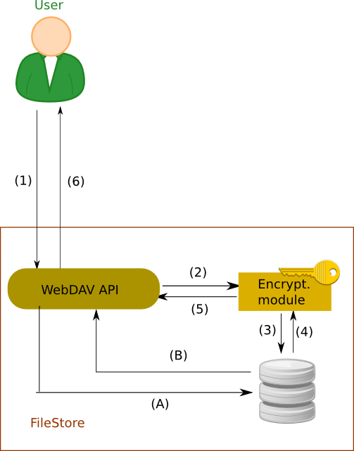
Flow of medical data
Secure locally hosted service
BLOB Data handled based on the confidentiality level:
Step 1 (all levels) – data is sent via encrypted channel to the service
Step 2-3 (high) – data encrypted and stored on disk
Step 4-5 (high) – data decrypted and retrieved
Step A-B (lo) – data stored directly to disk
Step 6 (all) – data sent back to the user
DB Records:
Step 1b – data are stored via the encrypted channel to the DB service in secured location
Step 2b – data are retrieved from the service via encrypted channel
(1b)
REST
(2b)
SQL
Database access

Slide 25
Requirements for medical data management systems
Support for both binary files and structured data
Standard interfaces allowing to browse and access data in a way convenient for the user (support a variety of operating systems, web browsers, tools and client-side software libraries and remote file system protocols)
Secure and efficient data transfer to and from computational infrastructure
Enable delegation of credentials to services working on behalf of the user
Support complex data access policies
Enable sharing and group access to selected data sets
Data security:
sensitive patient information must be encrypted before it is persisted
prevent from reading data even if one has access to hardware or has intercepted communication
Specified level of security for a specific piece of data

Slide 26
Basic features of the File Store
Deployment of a file repository compliant with the WebDav protocol, including search capabilities (RFC 5323)
File Store component (browser) enabling web-based file browsing, downloads and uploads through the EurValve portal
File Browser may be reused in dedicated portal views where the user can browse a specified sub-folder and perform a restricted set of operations
Securing the file repository with a EurValve-compatible security mechanism
Remote file system can be mounted on a local computer using an off-the-shelf WebDav client under Windows, MacOs or Linux
File Store is integrated with the EurValve security solution; directory permissions can be granted to a user or to a group of users

Slide 27
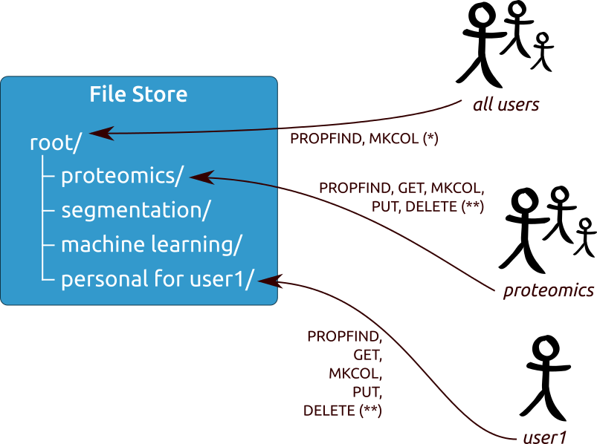
File Store - multi policy approach
Access policies are attached to different nodes according to user sharing policies. Private spaces can be created for individual users and groups.

Slide 28
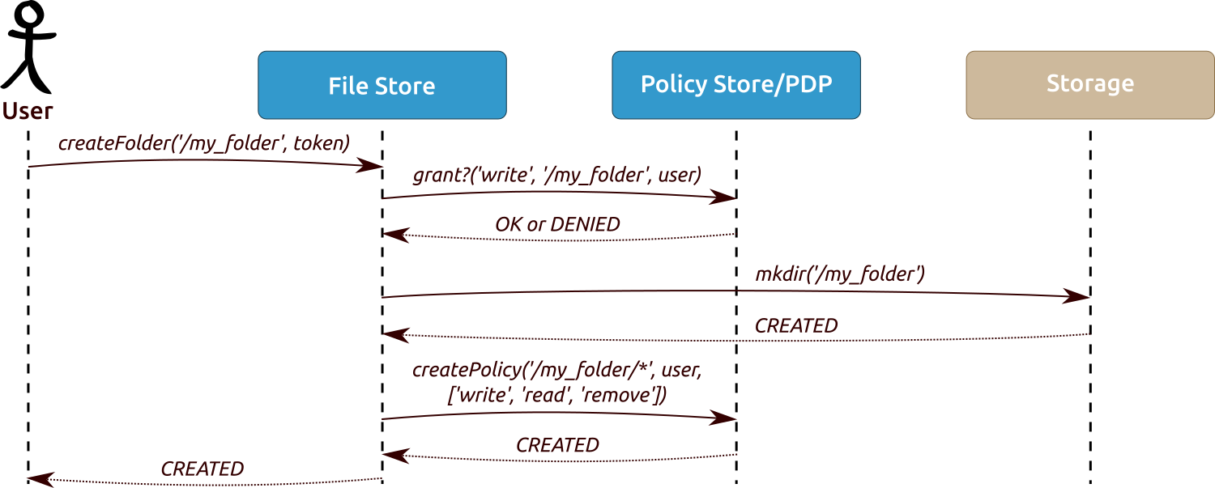
Communication between the File Store and the Policy Store/PDP
By default File Store can create top-level private folders
Each File Store request is evaluated by a PDP on the basis of the requested action, resource path and user identifier
Storage operations are performed only as allowed by the PDP
When creating top-level folders a new policy is created, which grants write, read and remove permissions only to the user invoking the operation

Slide 29
File Store typical use case – fine-grained permission management at the level of WebDAV HTTP methods
Components
UI to facilitate user login and data store access
Authentication mechanisms
PDP, PEP – policy decision/enforcement point to grant/revoke access to resources on the basis of resource owners’ policies
Scenario
User 1 logs into the UI, accesses the File Store component and creates a directory
User 1 uploads a file to the newly created directory
User 2 logs in and attempts to retrieve the file – however, directory access is denied due to lack of sufficient permissions
User 1 grants User 2 read-only access for the newly created directory
User 2 is now able to access the directory and retrieve its contents. He is, however, unable to upload new files due to the lack of write permissions.
User 1 extends User 2’s permission set with write access
User 2 is now able to create new files and subdirectories in the target directory

Slide 30
Database typical use case – Database queries using graphical UI and HTTPS REST calls
Components
UI to facilitate user login and data store access
Authentication mechanisms
PDP, PEP – policy decision/enforcement point to grant/revoke access to resources on the basis of resource owners’ policies
Scenario
User 1 logs into the UI, selects a dataset and lands on the query page
User designs a query using the graphical interface
Users executes the query
Services check the access rights through the PDP and either runs the query or denies access
User is presented with the query results for inspection or download

Slide 31
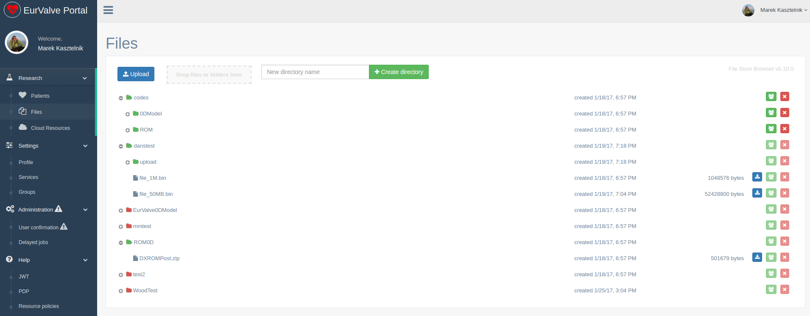
File Store Browser (1/2)
User is able to browse files in a web browser
File Store is integrated with the EurValve security
File sharing and permission management mechanism are implemented

Slide 32
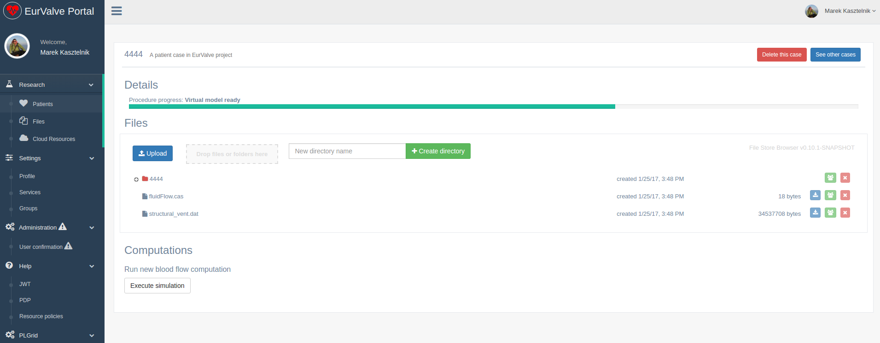
File Store Browser (2/2)
File Browser can be injected into any web page
File browsing can be limited to a selected directory

Slide 33
File Store performance (1/2)
Available network bandwidth between the File Store and the testing node (tool: iperf)
442.9 MB/s
Underlying storage write/read speed
Tool: bonnie++ (16 GB test file with 8 KB blocks)
Write: 541.9 MB/s
Read: 36.9 MB/s
Tool: dd (16 GB test file with 16 KB blocks)
Write: 629.5 MB/s
Read: 37.3 MB/s

Slide 34
File Store performance (2/2)
Number of read/write threads: 10
Profiling tool used: Apache JMeter
Transfer of 128000 files each 4 KB (500 MB total)
Write (PUT): 0.37 MB/s
Read (GET): 0.39 MB/s
Transfer of 1030 files each 2 MB (2 GB total)
Write (PUT): 53.6 MB/s
Read (GET): 9.01 MB/s
Transfer of 10 files each 1 GB (10 GB total)
Write (PUT): 93.46 MB/s
Read (GET): 13.4 MB/s

Slide 35
File Store performance - summary
Stable request processing by a single node
Each upload/download request processed in similar time
No transfer errors
Network and storage bandwidth utilization
Still room for improvement (approx. 20% of bandwidth used for large files)
Multi-node setup possible

Slide 36
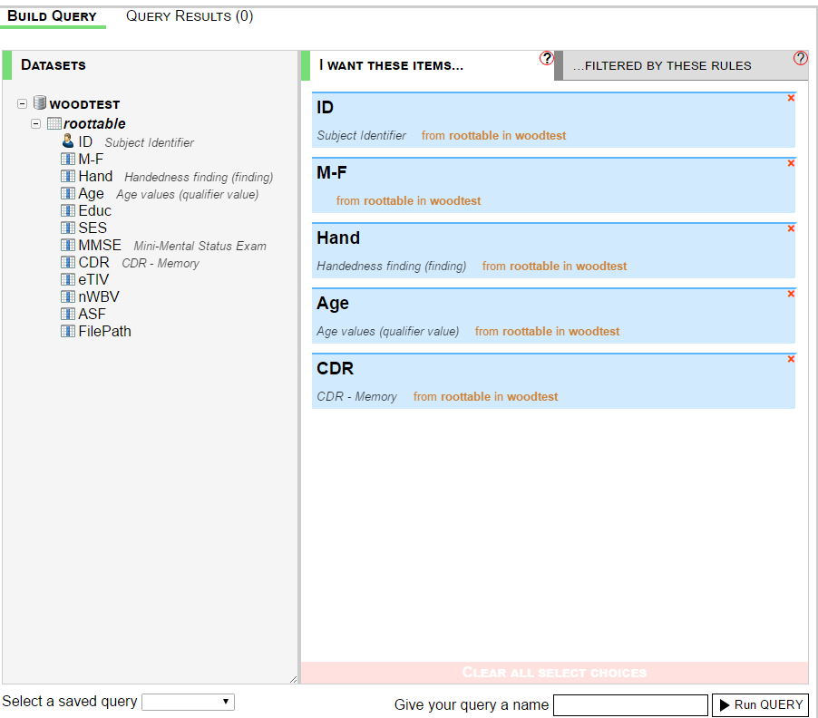
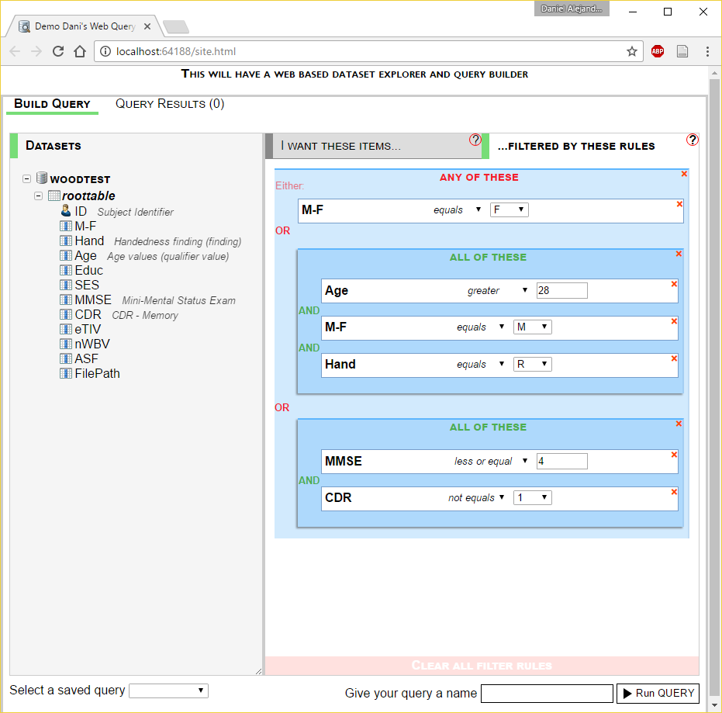
Clinical data query view

Slide 37
Clinical data progress
Integration of the query service in the final stages of security testing
All services now completely stand alone from VPH-DARE
All core data collection systems live
Data extraction from Imaging systems still in progress with vendor
Hopefully all services will be live and available by April

Slide 38
Recommendations for MEE module developers (1/4)
Additional modules can be implemented:
as scripts intended for execution on the Prometheus supercomputer
as external services communicating with the platform via its REST interfaces
as virtual machines deployable directly in the CYFRONET cloud via the Atmosphere extension of the MEE
Notes:
38

Slide 39
Recommendations for MEE module developers (2/4)
Developing extensions as HPC scripts:
Scripts are run on the Prometheus supercomputer via the Rimrock extension
Files uploaded to the FileStore (e.g. using MEE GUIs) can be accessed on Prometheus nodes via curl, leveraging the WebDAV interface provided by FileStore
Any result files can also be uploaded directly to FileStore from the Prometheus computational nodes
External tools can be used to monitor job completion status e.g. by periodically scanning FileStore content
Notes:
39

Slide 40
Recommendations for MEE module developers (3/4)
Developing extensions as external services:
This requires computational services to be hosted externally, communicating with the MEE platform via its APIs
Files can be retrieved and uploaded to FileStore via RESTful (WebDAV) commands
The client must supply a valid JWT user token along with each request (see previous section for a description of authentication and authorization procedures)
Notes:
40

Slide 41
Recommendations for MEE module developers (4/4)
Developing extensions as cloud services:
The MEE provides access to cloud resources, enabling developers to spawn virtual machines and develop computational services which are then hosted in the CYF cloud
This feature is enabled by the VPH-Share Atmosphere extension which is now integrated with the MEE, including its security mechanisms
Go to https://vph.cyfronet.pl/tutorial/doku.php for an in-depth overview of the features of the cloud platform
Notes:
41

Slide 42
User feedback and support actions
User feedback and requests | Actions
Insufficient performance of File Store due to costly generation of JSONWebToken | Enhanced configuration of HTTP servers + caching mechanism in File Store which resulted in 5x speedup
Matlab and Fluent on HPC infrastructure | Ensured that required tools are available on Prometheus cluster with valid licences
Use Philips deployment of owncloud to prototype integration of segmentation service with EurValve pipeline | MEE integrated with specified instance of owncloud service
Ambiguities related to use of provided services (File Store, portal, security) | Providing documentation and examples, supporting users via emails and teleconferences
Difficulties in registering and accessing HPC infrastructure | Guiding users via registration process and supporting deployment and execution of user-provided applications

Slide 43
Segmentation service integration
Portal @ Cyfronet
Owncloud
@ Philips
Segmentation srv
@ Philips
/
Patient
Case
Pipeline
input
webdav
webdav
Segmentation
output
Input
Zipped file following naming convention: 0_unique.zip where 0 is the job type.
Uploaded by Patient Case Pipeline to input directory in owncloud server.
Downloaded by Segmentation Service.
Output
Zipped file with name corresponding to input file.
Uploaded by Segmentation Service to output directory in owncloud server.
Downloaded by Patient Case Pipeline.

Slide 44
Usage of Cyfronet resources
External users registered in the portal: 6
a.j.narracott@sheffield.ac.uk
tilman.wekel@philips.com
k.czechowicz@sheffield.ac.uk
steven.wood@sth.nhs.uk
r.meiburg@tue.nl
herman.ter.horst@philips.com
Computation grant utilization on Prometheus: 7.6%
37 821 wall time hours out of 500 000 used
Grant expired on 17 February 2017
We should report back to PLGrid office all EurValve publications which acknowledge PLGrid Infrastructure support – this will help secure further computational grants

Slide 45
New functionality of the File Store
Mounting File Store under Windows and Linux
No extra dependencies needed under Windows
EurValve portal account required
Potential use cases
Access to EurValve file resources with native Windows and Linux clients
Mounting EurValve file resources to be used by other services
Planned implementation tasks
Extend EurValve portal policy management API with policy move and copy operations
Integrate File Store with the extended portal’s policy API

Slide 46
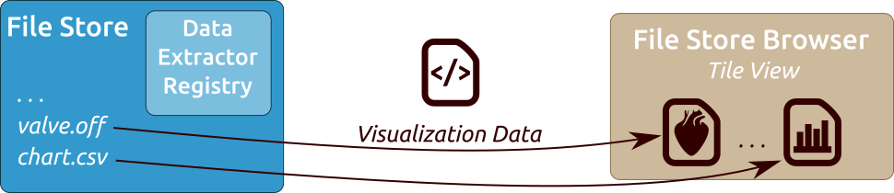
Visualization Module development
The File Store component will be extended with a Data Extractor Registry with codes defining how to extract relevant visualization data from a given file
Data Extractors can be associated with given file extensions, particular folders and viewers
The web-based File Store Browser uses registered extractors to fetch visualization data and initialize dedicated viewers if given file formats have been associated with any data extractors
Any new data written to the File Store updates the viewers immediately

Slide 47
Additional steps planned to be integrated with the Patient Case Pipeline
Segmentation provided by Philips - to start this calculation a zip archive with dedicated structure need to be created and transferred into OwnCloud input directory. Next, the output directory needs to be monitored for computation output. Current status: initial execution tests passed
Uncertainty Quantification provided by Eindhoven – Matlab script which can include the 0D Heart Model. It will be executed on the Prometheus supercomputer, where input files will be transferred automatically from File Store. Results are transferred back from Prometheus to File Store. Current status: we are able to manually start Uncertainty Quantification Matlab scripts as Prometheus jobs
Patient Case Pipeline high level building blocks:
File-driven computation (such as Segmentation) – use case: upload file to remote input directory, monitor remote output directory for results
Scripts started on Prometheus supercomputer – use case: transfer script and input files from File Store to the cluster, run job, monitor job status, once the job has completed – transfer results from the cluster to File Store (examples: 0D Heart Model, Uncertainty Quantification, CFD simulation)
Notes:
47

Slide 48
Future functionality of MEE (1/3)
Pipeline execution management
Goal: organize set of models into a single sequential execution pipeline with files as the main data exchange channel
Supported ideas:
Model development organization through structuralization
Retention of execution and development history
Result provenance tracking and recording
Notes:
48

Slide 49
Future functionality of MEE (2/3)
Computation execution diff
Goal: an adequate tool for model developers to compare two different model executions, revealing any changes along with their impact on results.
Supported ideas:
Modelling quality improvement tracking
Dedicated comparison software for specific types of results
Easier problem detection and manual validation
Notes:
49

Slide 50
Future functionality of MEE (3/3)
Computation quality validation against retrospective patient data
Goal: comparing pipeline results with retrospective patient data measured in vivo after intervention
Supported ideas:
Model pipeline output quality validation
Error assessment and quantification
Specialized comparison for given computation results
Notes:
50

Slide 51
Presentations and publications
Piotr Nowakowski, Marian Bubak, Tomasz Bartyński, Daniel Harężlak, Marek Kasztelnik, Maciej Malawski, Jan Meizner: VPH applications in the cloud with the Atmosphere platform – lessons learned, Virtual Physiological Human 2016 Conference, 26-28 September 2016, Amsterdam, NL
M. Bubak, T. Bartynski, T. Gubala, D. Harezlak, M. Kasztelnik, M. Malawski, J. Meizner, P. Nowakowski: Towards Model Execution Environment for Investigation of Heart Valve Diseases, CGW Workshop 2016, 24-26 October 2016, Krakow, Poland
Marian Bubak, Daniel Harężlak, Steven Wood, Tomasz Bartyński, Tomasz Gubala, Marek Kasztelnik, Maciej Malawski, Jan Meizner, Piotr Nowakowski: Data Management System for Investigation of Heart Valve Diseases, Workshop on Cloud Services for Synchronisation and Sharing, Amsterdam 29.01-2.02.2017, https://cs3.surfsara.nl/

Slide 52
Summary
Detailed requirements formulated and state-of-the-art in the area of valvular diseases analyzed
Detailed design recommendations related to model-based research environments established
Prototype of the Model Execution Environment with supporting File Store and Integrated Security components facilitating simulations with the aim to develop decision support systems for heart diseases
Users’ feedback is being gathered and resulting modifications are being implemented
A set of 5 uses case ready for demonstration

Slide 53
MEE services at Cyfronet (beta versions)
EurValve Project Website at Cyfronet AGH
URL: http://dice.cyfronet.pl/projects/details/EurValve
EurValve Portal
URL: https://valve.cyfronet.pl
Registration at: https://valve.cyfronet.pl/users/sign_up
EurValve File Store
URL (docs): https://files.valve.cyfronet.pl
WebDAV endpoint (portal account required): https://files.valve.cyfronet.pl/webdav

Slide 54

EurValve H2020 Project 689617 http://www.eurvalve.eu http://dice.cyfronet.pl

