Slide 1


From the grid medical consortium, through virtual labs and bioinformatic environments, to the center of excellence for personalized diagnostics and medical therapy
Marian Bubak
Academic Computer Centre Cyfronet, Department of Computer Science,
AGH University of Science and Technology, Krakow, PL
http://dice.cyfronet.pl/; bubak@agh.edu.pl

Slide 2
Area of Research
Investigation of methods for complex scientific collaborative applications
Elaboration of environments and tools for eScience
Integration of large-scale distributed computing infrastructures
Knowledge-based approach to services, components, and their composition

Slide 3
Grid Environment for Interactive
Applications
Expanding the Grid for a new category of applications in medicine, environmental control, and physics, running interactively, and extending the Grid infrastructure across eleven European countries.
Efficient development of these kinds of applications on the Grid required new tools for verification of source code, performance prediction, evaluation and on-line analysis.
The Grid was equipped with new components for monitoring of application performance, efficient distributed data access, specific resource management, as well as portals and mobile personalised user interfaces.
5FP EU Project – CrossGrid, 2002-2005
http://cordis.europa.eu/pub/ist/docs/grids/crossgrid_achievement.pdf

Slide 4
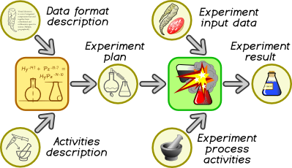
ViroLab Virtual Laboratory
Design of a laboratory for virologists, epidemiologists and clinicians investigating the HIV virus and the possibilities of treating HIV-positive patients
Based on notion of in-silico experiments built and refined by cooperating teams of programmers, scientists and clinicians
Employed full concept-prototype-refinement-production circle for virology tools
Set of dedicated yet interoperable tools bind together programmers and scientists for a single task
Support for system-level science with concept of result reuse between different experiments
6FP EU Project – ViroLab, 2006-2009 http://www.virolab.org/

Slide 5
VPH-Share EU 7FP Project
VPH-Share project has developed the organisational fabric (the infostructure) and integrated the optimised services to expose and share data and knowledge, jointly develop multiscale models for the composition of new VPH workflows, facilitate collaborations within the VPH community
VPH-Share provides the essential services, as well as the computational infrastructure, for the sharing of clinical and research data and tools, facilitating the construction and operation of new VPH workflows, and collaborations between the members of the VPH community.
http://www.vph-share.eu ; http://dice.cyfronet.pl

Slide 6
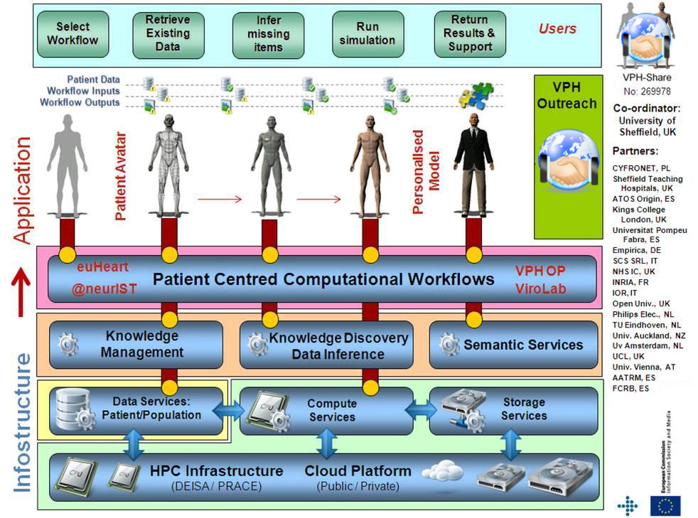
Infostructure for VPH

Slide 7
VPH-Share federated cloud

Slide 8
The EurValve EU H2020 Project
Valvular heart disease currently affects 2.5% of the population; it is overwhelmingly a disease of the elderly.
EurValve will implement, test and validate a modelling based decision support system (DSS) for aortic and mitral valve diseases that allows simulating, comparing and understanding the effects and risks of different treatment strategies.
The DSS will improve knowledge of disease mechanisms by applying a holistic assessment of cardiovascular function that includes haemodynamic data at all cardiovascular compartments (ventricle, valve, vessels) and multiscale components that couple organ with cell function.
http://www.eurvalve.eu ; http://dice.cyfronet.pl

Slide 9
From Research Environment to DSS
Research Computing Infrastructure
Development of models for DSS
Clinical Computing Environment
Real-time Multiscale Visualization
Model Execution Environment
Data Collection and Publication Suite
DSS Execution Environment
ROM
0-D Model
Patient Data
ROM
3-D Model
Model A
Images
Population data
Security System
Model B
Infrastructure Operations
Data Source 1
Data Source 2
HPC Cluster
Cloud
Workstation
Provide elaborated models and data for DSS

Slide 10
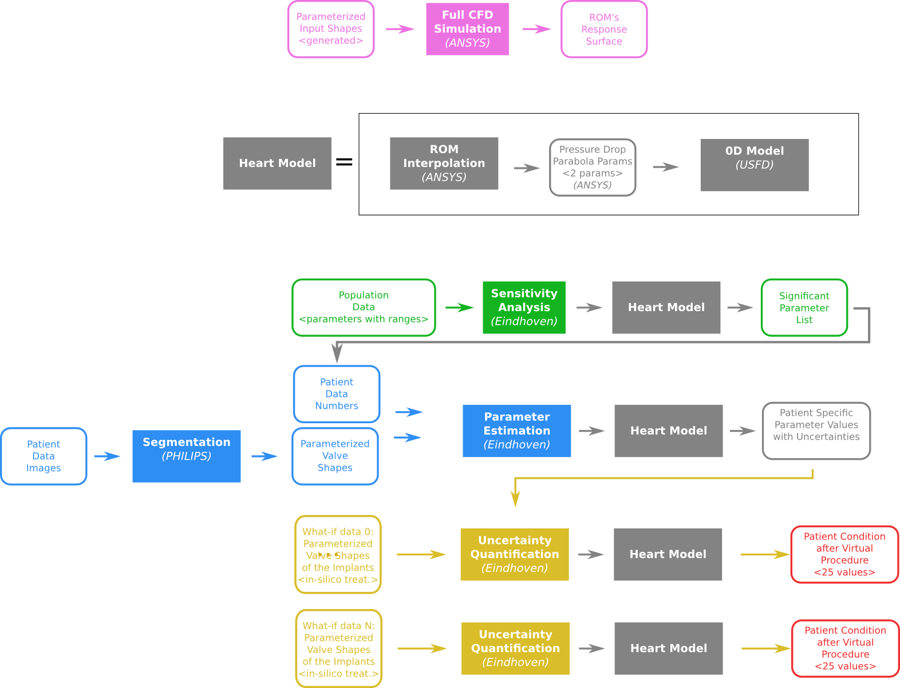
ROM and sensitivity analysis
Data and action flow consists of:
full CFD simulations
sensitivity analysis to acquire significant parameters
parameter estimation based on patient data
uncertainty quantification of various procedures
The flow of CFD simulations and sensitivity analysis is part of clinical patient treatment

Slide 11
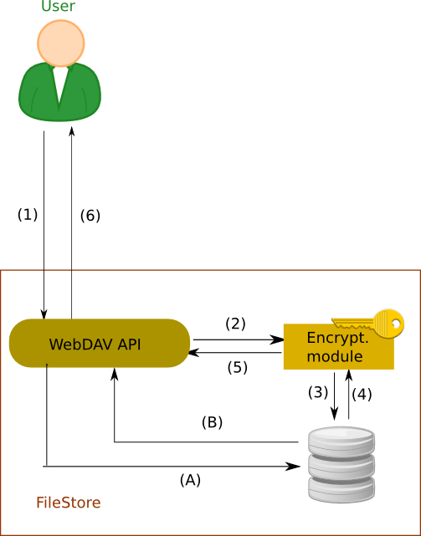
Flow of medical data
Secure locally hosted service
BLOB Data handled based on the confidentiality level:
Step 1 (all levels) – data is sent via encrypted channel to the service
Step 2-3 (high) – data encrypted and stored on disk
Step 4-5 (high) – data decrypted and retrieved
Step A-B (lo) – data stored directly to disk
Step 6 (all) – data sent back to the user
DB Records:
Step 1b – data are stored via the encrypted channel to the DB service in secured location
Step 2b – data are retrieved from the service via encrypted channel
(1b)
REST
(2b)
SQL
Database access

Slide 12
Model Execution Environment
API – Application Programming Interface
REST – Representational state transfer
Rimrock – servis used to submit jobs to HOC cluster
Atmosphere – provides access to cloud resources
git – a distributed revision control system

Slide 13

DICE Team skillset
Interactive compute- and data-intensive applications, knowledge-based workflow composition, programming models | CrossGrid, K-Wf Grid, CoreGRID | 2002-2008
Script-based composition of applications, GridSpace Virtual Laboratory | ViroLab, GREDIA | 2006-2009
Federating cloud resources for VPH compute- and data-intensive applications, DataNet – metadata models | VPH-Share, PL-Grid | 2009-2015
Common Information Space for Early Warning Systems, big data storage and access, analysis tools | UrbanIFlood, ISMOP | 2009-2016
Computational strategies, software and services for distributed multiscale simulations | MAPPER | 2010-2013
Executable Papers; 1st prize in Elsevier competition at ICCS2011 (Elsevier follow-up project) | Collage | 2011-2013
Optimization of workflow applications on cloud resources | PaaSage | 2013-2016
Infrastructure for large-scale simulations in medicine | EurValve | 2016-2019
Providing computing solutions for exascale challenges | PROCESS | 2017-2020
http://dice.cyfronet.pl/ ; http://dice-cyfronet.github.io/#history

Slide 14






Centre for New Methods in Computational Diagnostics and Personalised Therapy

Slide 15
Mission of CECM Project
CECM EU H2020 „Teaming for Excellence” project develops a Business Plan to establish in Krakow a European Centre of Excellence for computational medicine.
The CECM Consortium is going to build a world-class centre of excellence, attractive to foreign partners, with a significant impact at both regional and national scales, providing benefits for the pan-European society.
It is a consortium of leading European science and innovation institutions in all domains of the new CoE.
ACC Cyfronet AGH has a long record of efficient support for scientists in the computational life science EU and PL research projects.
Małopolska and Kraków are well positioned for a key role in the computational medicine.

Slide 16
CECM Partners
Leading European science and innovation institutions:
University of Sheffield and Insigneo Institute – experts in translation of in silico modelling and simulations to clinics
Forschungszentrum Jülich – experts in modern HPC and data techniques, applied for science and industry
Fraunhofer ISI – experts in systemic multi-domain solutions and innovation in healthcare
They will work together with Partners from Poland:
ACC Cyfronet AGH – experts in simulation and provisioning computing infrastructure for science
Klaster LifeScience Kraków – Poland’s top cluster of industry, academia and hospitals for the life science domain
NCBiR - the Polish National Centre for Research and Development (project coordinator)

Slide 17
Regional Position
Poland / Kraków are well positioned for a key role in computational medicine:
Kraków educates large numbers of medical and IT professionals
There is a high concentration of research hospitals in and around the city
The entrepreneurial community has entered a phase of rapid growth.
ACC Cyfronet AGH, the project leader:
Has a long record of efficient support for PL/EU computational scientists
Already hires personnel experienced in computational life science domain
Provides considerable set of hardware and software resources
Proved the capacity to act as a leader for large scientific projects.
.

Slide 18
Objectives of the New CoE
A: Development of new computation-based solutions for diagnostics and therapy in daily healthcare.
B: Systematic involvement of regional biomed businesses, specialising in technologies and services for personalised medicine, in high-profile research projects and clinical adoption of their outcome.
C: Development of education initiatives to train knowledge workers with the skills in data analytics, simulation, and HPC/Big Data, to respond to the growing demand for skilled workforce in medical devices and bio-engineering.
D: Strong advancement of algorithms, models and technologies involved in personalised medicine, including design of holistic, replicable, generic framework for simulation-based Decision Support Systems (DSS) creation.

Slide 19
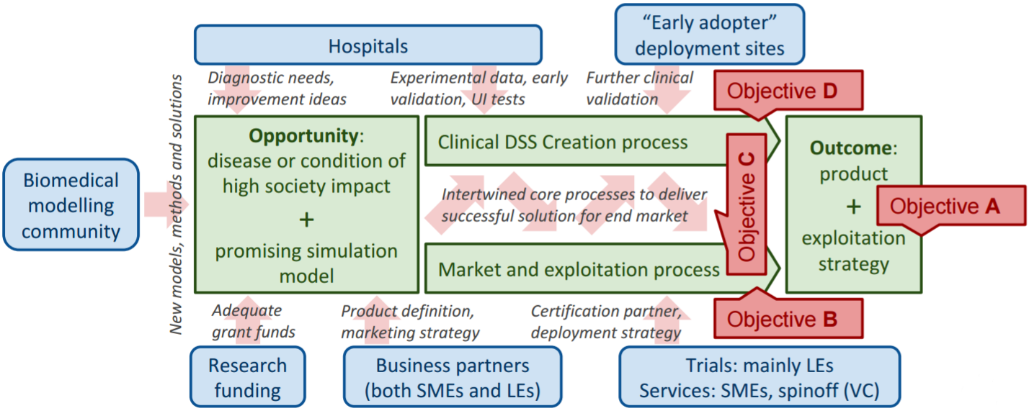
CoE Value Chain
Centre’s Customers come from two distant sides of the value chain
The aim is a replicable, refined workflow, rather than a single system
Bridging the gap will locate the Centre as a crucial actor of the process
Re-iteration as an inherent excellence-building mechanism

Slide 20
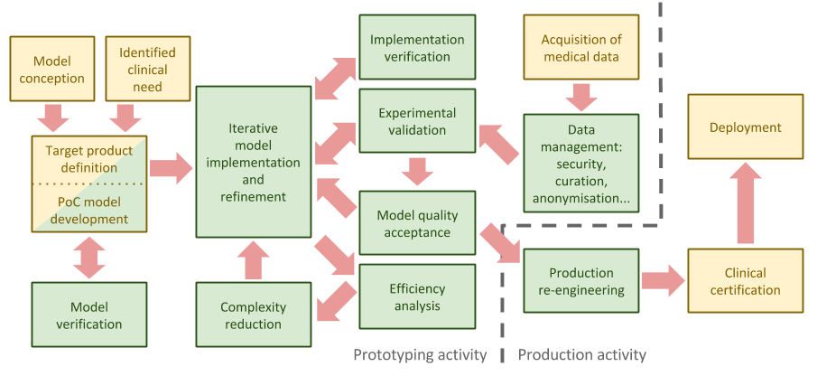
CoE Methodology

Slide 21
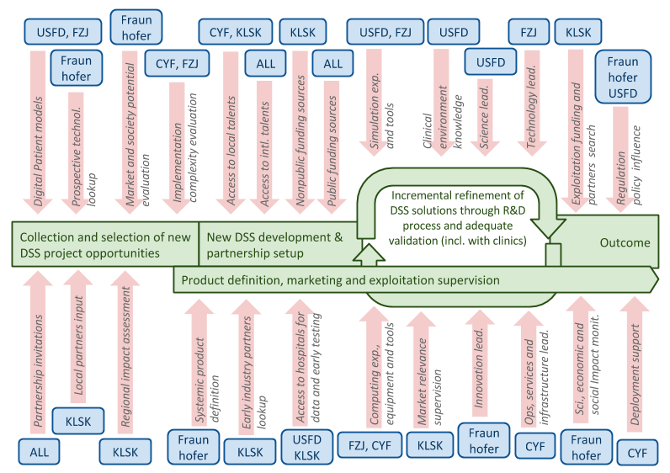
CECM Partnership

Slide 22
Sources of Funding
Centre activity | Model and sources of funding
Opportunities and potential assessment | Initially by the Teaming Phase 2 EC Grant and Polish matching program, later by both public and industrial revenue streams.
DSS creation R&D | Research grants (both EU and PL) acquired for development of specific medical methods. Late-TRL projects will be covered by cooperation with industry.
Promotion, dissemination and impact maximisation | Individual projects’ dissemination and exploitation budgets. Limited Teaming Phase 2 funding is expected for some activities (e.g. managing technology transfer databases, organising showcases and workshops etc.).
Support: HPC, IT, HR, accounting, legal and similar. | Polish and regional structural funds (hardware, offices, etc.) and individual projects’ overhead (personnel). Our precise alignment with the national and regional Smart Specialisation is an important enabling factor .
Overall management and governing structure | Individual project management will be covered from the project’s management budgets. Management of the Teaming Phase 2 Project will be covered from the Teaming budget. IP management will be funded from revenue.

Slide 23
Call for Collaborators
Industrial
large & small enterprises present in the clinical DSS value chain
in all stages, from product conception to certification and deployment
Clinical
pilot studies with retrospective and prospective patient data
common projects on the most demanding clinical cases
Scientific
simulation aiming at assisting personalised therapy
computation- and data-based diagnostic tool

Slide 24
Summary
The CECM will exploit these advantages to build a world-class centre of excellence, attractive to foreign partners, and having a significant impact at both regional and national scales, with lasting benefits for pan-European society.
http://dice.cyfronet.pl/projects/details/CECM
bubak@agh.edu.pl

