Slide 1
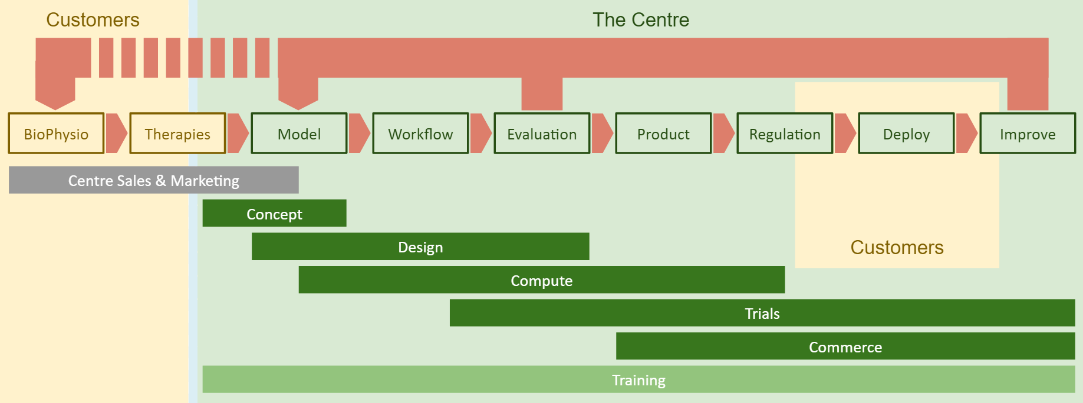









Towards a Centre for New Methods
in Computational Diagnostics and Personalised Therapy
This EU H2020 „Teaming for Excellence” project develops a Business Case to establish in Poland a European centre of excellence for computational medicine.
Objectives
Development of new computation-based solutions for diagnostics and therapy in daily healthcare.
Systematic involvement of regional biomed businesses, specialising in technologies and services for personalised medicine, in high-profile research projects and clinical adoption of their outcome.
Development of education initiatives to train knowledge workers with the skills in data analytics, simulation, and HPC/Big Data, to respond to the growing demand for skilled workforce in medical devices and bio-engineering.
Strong advancement of algorithms, models and technologies involved in personalised medicine, including design of holistic, replicable, generic framework for simulation-based Decision Support Systems (DSS) creation.
Methodology
International Environment
This is a multi-discipline challenge, which we plan to address with a unique mixture of competences and resources from leading European science and innovation institutions, representing all necessary domains:
University of Sheffield and Insigneo Institute – experts in translation of in silico modelling and simulations to clinics
Forschungszentrum Jülich – experts in modern HPC and data techniques, applied for science and industry
Fraunhofer ISI – experts in systemic multi-domain solutions and innovation in healthcare.
They will work together with Partners from Poland:
Cyfronet – local experts in simulation and provisioning computing infrastructure for science
Klaster LifeScience Kraków – Poland’s top cluster of industry, academia and hospitals for the life science domain.
National and Regional Environment
Poland, and in particular Kraków, are well positioned to play a key role in computational medicine:
Kraków educates large numbers of medical and IT professionals, and routinely engages in interdisciplinary research with Europe’s world-leading in silico research community.
There is a high concentration of research hospitals in and around the city.
The entrepreneurial community has recently entered a phase of rapid growth, and this includes life science companies.
The project is coordinated by Polish National Centre for Research and Development, and Małopolska (Kraków) region authorities and policymakers are strongly involved in, to achieve adequate alignment of the Centre’s goal with national and regional specialisations and development strategies.
The CECM will exploit these advantages to establish a world-class CoE, attractive to partners, with a significant impact at regional and national scales, with lasting benefits for pan-European society.
Contact: Marian Bubak, Academic Computer Centre Cyfronet, AGH University of Science and Technology, Kraków, Poland
bubak@agh.edu.pl, http://dice.cyfronet.pl/
Acknowledgements. This work is partly supported by the EU project CECM Centre for New Methods in Computational Diagnostics and Personalised Therapy H2020 WIDESPREAD TEAMING PHASE 1 (contract number 763734).

